Slide 1
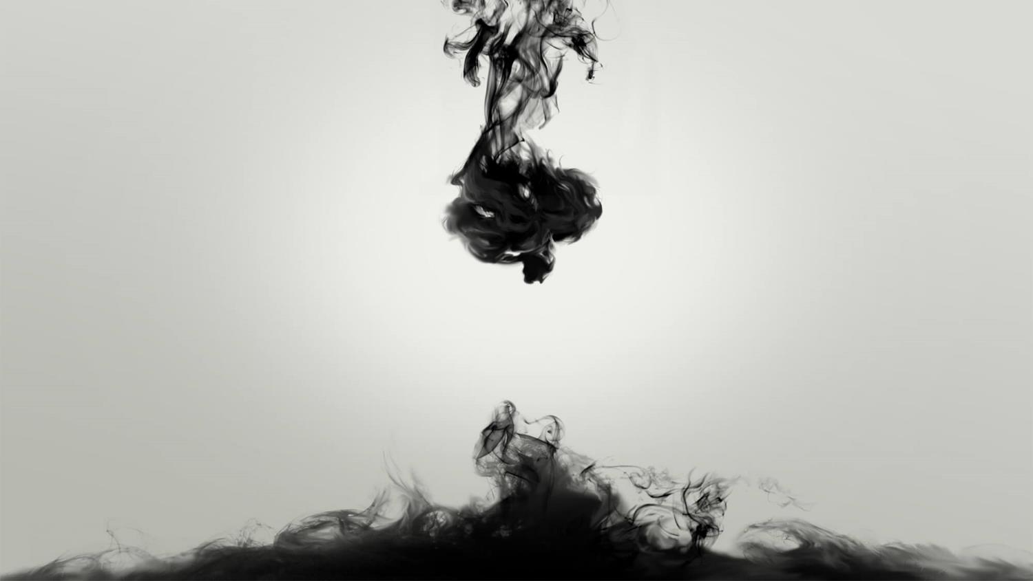
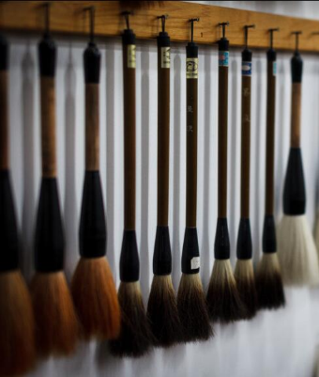
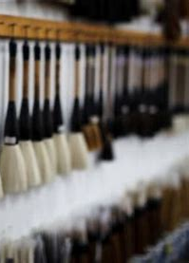

Chinese Writing: Ancient Writing and Painting Tool, Writing Brush
Li Xintian & Xie Jiayu
English Translation

Slide 2
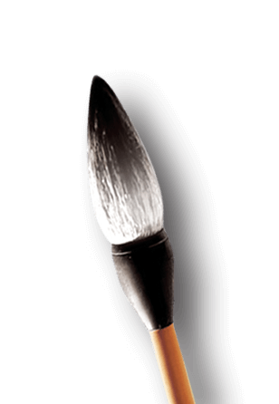
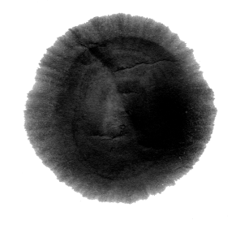
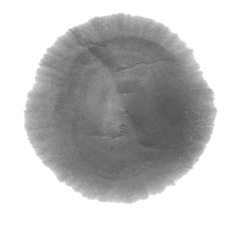

CONTENTS
1 History of Writing Brush
2 Materials for Making Writing Brush (Interactive Part)
3 Varieties of Writing Brush

Slide 3
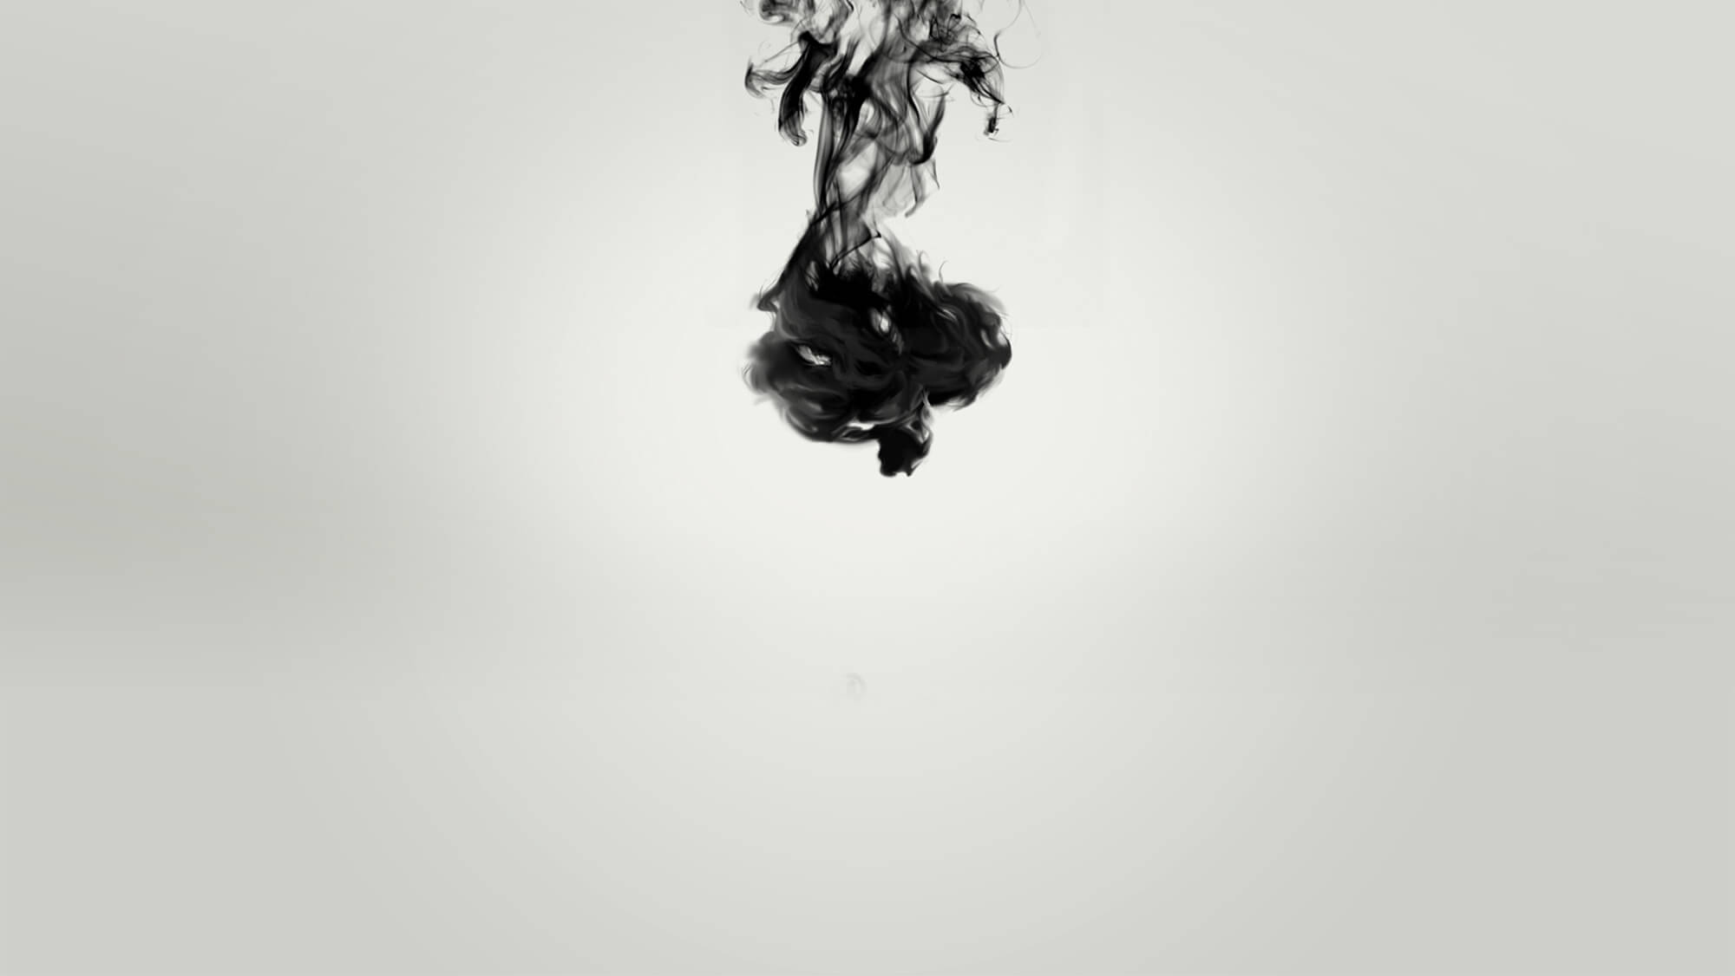
【一】History of Writing Brush

Slide 4
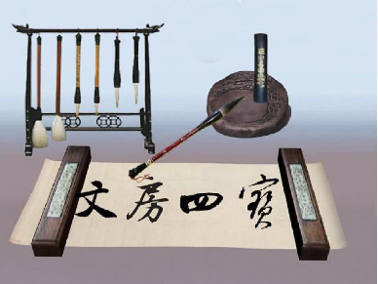
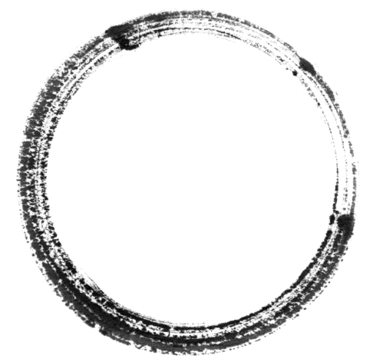


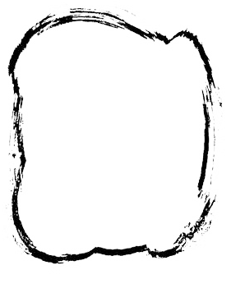
History of Writing Brush
ink stick, paper, ink slab
Brief Introduction
The Neolithic Age(10000~ 4000 years up to now)
A writing and painting tool
One of the four treasures of the study

Slide 5
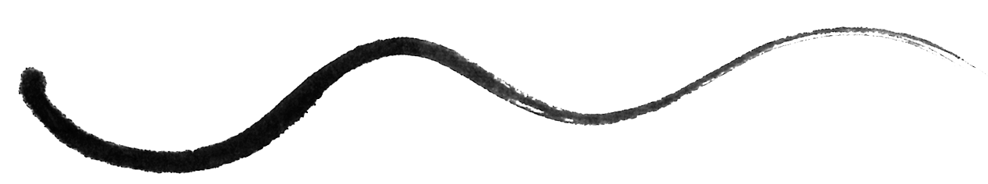
History of Writing Brush
The Wei, the Jin and the Southern and Northern Dynasties, 220A.D.-589A.D.
Shorter on the holder and more elastic on tip
A craze for luxury among the rich and powerful
The Qin and the Han Dynasties, 221B.C.-220A.D.
Nationwide practice.
Started to pursue decoration
The Warring States Period, 475 B.C.-221B.C.
“the writing brush from the Warring States Period”(“战国笔”)
The Ming and the Qing Dynasties, 1368A.D.-1911A.D.
Gorgeous style and artistic flavor
The Song and the Yuan Dynasties, 960A.D.-1369A.D.
The Hu style brush(“湖笔”)
The Sui and the Tang Dynasties, 581A.D.-907A.D.
The Xuan style Writing Brush (“宣笔”)

Slide 6
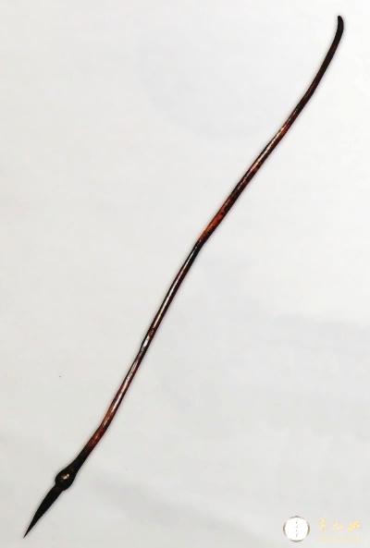
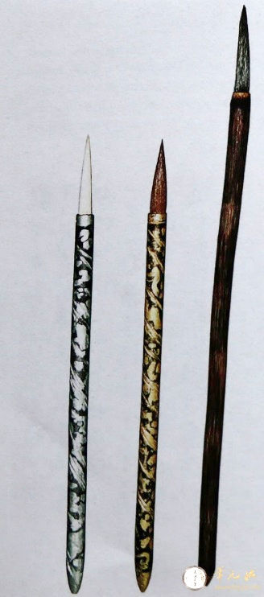
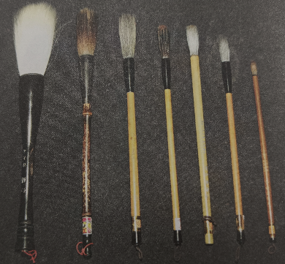
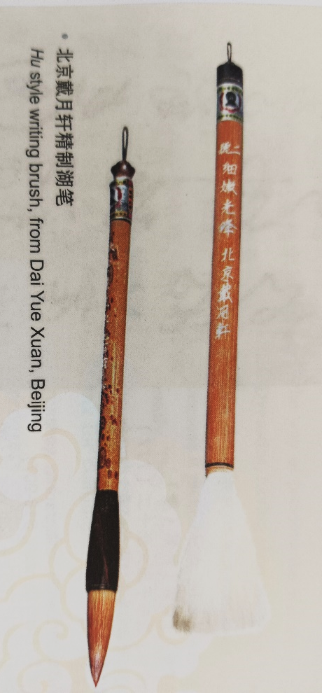
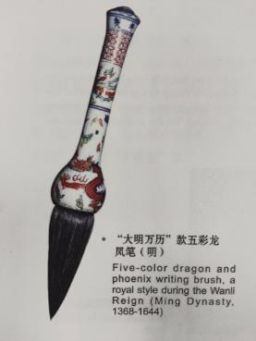
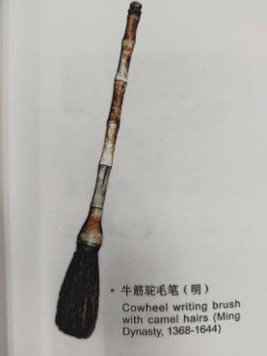
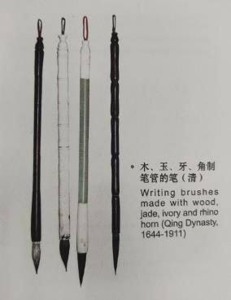

Slide 7
【二】 Materials for Making Writing Brush

Slide 8
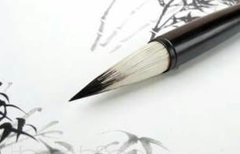
What materials do you think are often used to make the head of writing brush?
goat hair
horse hair
hair of buffalo’s tail
pig hair
mouse mustache
…

Slide 9
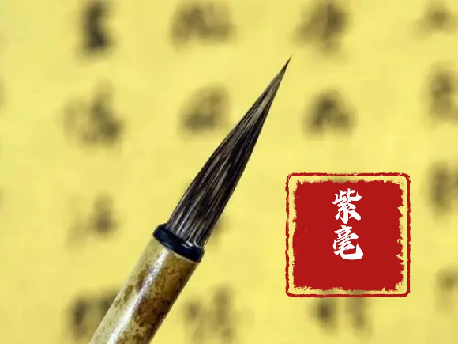
Materials for Making Writing Brush
Hare Hair 野兔毛
The earliest existing writing brush was made from hare hair.
The writing brush made from it is called “Zi Hao” 紫毫. Because it is made from the hair on the back of hare, and the color is black purple.
This writing brush has a shiny surface, with relatively stiff hair and a sharp tip.

Slide 10
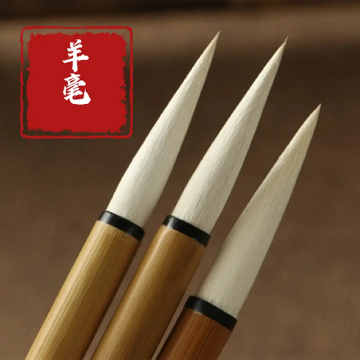
Materials for Making Writing Brush
Goat Hair
Goat hair is the most common material for making writing brushes, because it is relatively inexpensive.
The writing brush made from it is called “Yang Hao” 羊毫.
This writing brush can absorb a large amount of ink and the ink is consumed slowly.
Because goat hair is soft, this writing brush is difficult to control the writing force. The stroke written by it is round, so it is suitable for writing large characters.

Slide 11
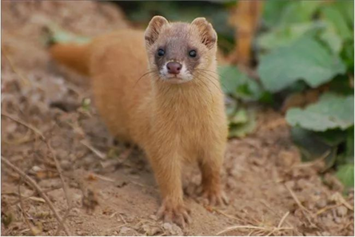
Materials for Making Writing Brush
Yellow Weasel Hair
It uses the hair on the tail of a weasel.
The writing brush made from it is called “Lang Hao” 狼毫.

Slide 12
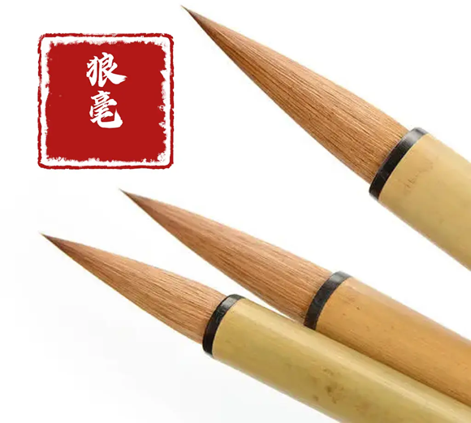
Materials for Making Writing Brush
Yellow weasel hair is harder than goat hair and softer than hare hair.
Words written by this writing brush are fluid and powerful.

Slide 13
【三】Varieties of Writing Brush

Slide 14
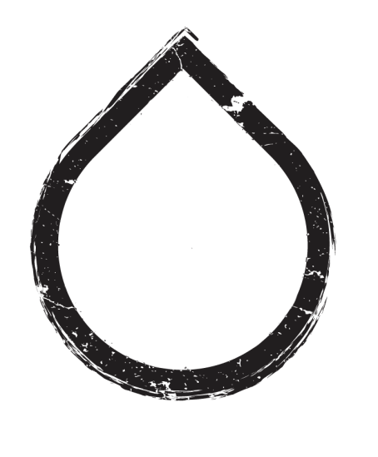
Varieties of Writing Brushes: Hardness
The soft hair writing brushes软毫
The hard hair writing brushes硬毫
The mixed hair writing brushes兼毫
More elastic
Weasels狼毫, hares紫毫, squirrel tail鼠尾毫, deers鹿毫, horses马毫, hogs猪毫 and martens貂毫
Nice for running and cursive script writing
Less elastic
Goats羊毫, chicken鸡毫, fetal hair胎发笔 or thatch grass茅草笔
Seal, official, running and cursive script writing
Take hairs of different hardness by a certain ratio
To satisfy a much wider range of needs.

Slide 15
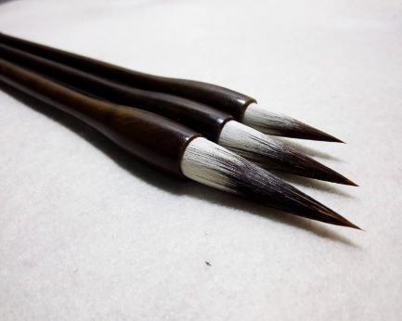
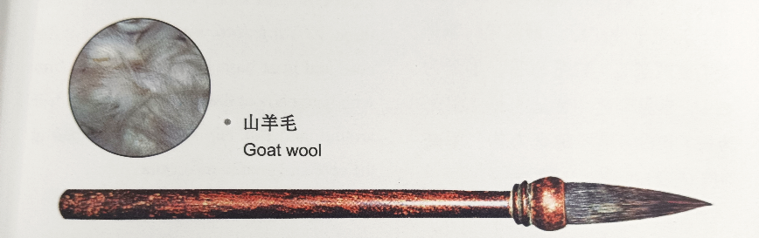
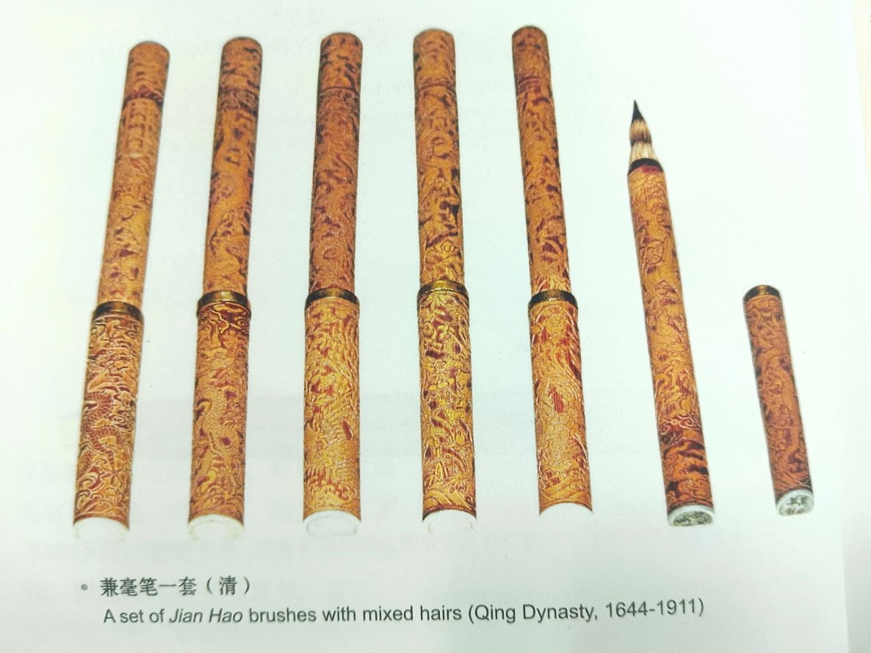

Slide 16
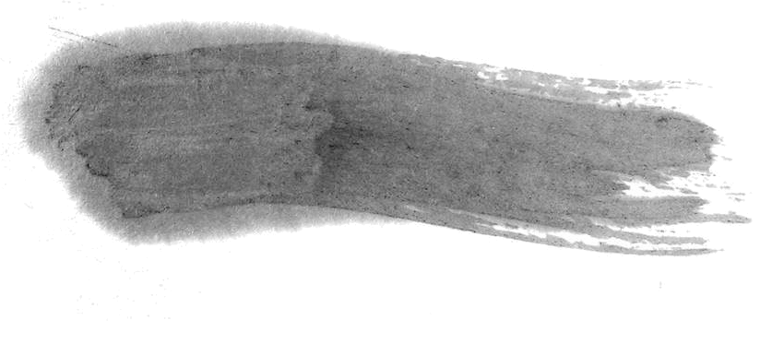
References
[1] Ji, Sunxi; Fan, Lina. [季孙歙,范丽娜]. 笔墨纸砚[M]. 合肥：黄山书社, 2012: 1-50
[2] Pan, Tianshou. [潘天寿].毛笔的性能与选择[J].中国书法, 2015(04):122-127.
[3] Martin Woesler. Chinese Language and Culture [M]. Berlin · Bochum · Dülmen · London · München · Paris: European University Press, 2022: 17-20

Slide 17
Thank YOU

