Slide 1

中国文化基础
Foundation of Chinese Cultures for Bachelor Students of Translation Studies
湖南师范大学 2021年3月3日-2021年6月16日
中国文化基础 周三第七和第八节课14:30-16:10，
上课地点：在线
助教：刘廷阳 Liu Tingyang, wiki 助教：陈柯汝 Chen Keru
吴漠汀特聘教授 Distinguished Professor Dr. Martin Woesler
湖南师范大学外国学院 Foreign Studies College, Hunan Normal University

Slide 2
Session 3 第三周
Session Overview 本节概览
Preparation:
Check: Have you chosen the topics, read the 3 texts, taken the quiz, made the homework, taken the EU Survey?
3 Students: Have you prepared ppt?
Topic Ranking List: This semesters‘ program

Slide 3
Session 3 第三周
Hitlist of Chinese cultural phenomena: This semesters‘ schedule
Order | Date | Topic | Chapter | Points | Popularity
1 | 10.03.2021 | Beverages: Milk Tea | 21 | 474 | 79%
2 | 10.03.2021 | Traditional Cuisine: Eight Major Cuisines in China | 28 | 468 | 78%
3 | 10.03.2021 | Beverages: Tea | 20 | 451 | 75%
4 | 17.03.2021 | Architecture: Architecture and Gardens, The Forbidden City | 36 | 433 | 72%
5 | 17.03.2021 | Traditional Festivals | 2 | 432 | 72%
6 | 17.03.2021 | Aesthetic ideals and social customs: The Four Most Handsome Men in Ancient China | 108 | 427 | 71%
7 | 24.03.2021 | Traditional Cuisine: Four Distinct Regional Cuisines | 24 | 423 | 71%
8 | 24.03.2021 | Education: Historical Figures, The Four Talented Women of Ancient China | 119 | 417 | 70%
9 | 24.03.2021 | Traditional Cuisine: Two Famous Dishes | 26 | 415 | 69%
10 | 31.03.2021 | Aesthetic ideals and social customs: Chinese Marriage Customs | 110 | 409 | 68%
11 | 31.03.2021 | Music and instruments: Pipa | 95 | 406 | 68%
12 | 31.03.2021 | Traditional Cuisine: The Art of Chinese Cooking | 25 | 404 | 67%
13 | 07.04.2021 | Silk and porcelain: Celadon and Celadon Song 《青花瓷》歌词 | 31 | 401 | 67%
14 | 07.04.2021 | Traditional Cuisine: Chinese Dining Etiquette | 23 | 396 | 66%
15 | 07.04.2021 | Facial Make-up: Cosmetics, Traditional Chinese Make-Up | 98 | 395 | 66%
16 | 14.04.2021 | Garden Culture: The Summer Palace | 41 | 385 | 64%
17 | 14.04.2021 | Money culture: The tradition of Red Envelope and Lucky Money | 106 | 384 | 64%
18 | 14.04.2021 | Stage entertainment: Crosstalk 相声 | 99 | 383 | 64%
19 | 21.04.2021 | Architecture | 35 | 377 | 63%
20 | 21.04.2021 | Music and instruments: Guzheng | 94 | 375 | 63%
21 | 21.04.2021 | Chinese Astrology: Twelve Animals of the Chinese Zodiac | 71 | 372 | 62%
22 | 28.04.2021 | Ancient literature: Four Folk Stories of Ancient China | 49 | 371 | 62%
23 | 28.04.2021 | Ancient literature: Chinese Classical Fairy Tales | 50 | 369 | 62%
24 | 28.04.2021 | Chinese language: Chinese Dialects | 45 | 368 | 61%
25 | 05.05.2021 | Animals: Panda | 128 | 366 | 61%
26 | 05.05.2021 | Facial Make-up: Face Changing in Sichuan Opera | 97 | 365 | 61%
27 | 05.05.2021 | Chinese Mythology: Huli-jing | 73 | 364 | 61%
28 | 12.05.2021 | Traditional Crafts: Folk Art - Chinese Paper-cutting | 19 | 364 | 61%
29 | 12.05.2021 | Science and Technology: Douyin (Tik Tok) | 8 | 362 | 60%
30 | 12.05.2021 | Chinese clothing / interieur: Chinese clothing | 112 | 361 | 60%
31 | 19.05.2021 | Facial Make-up | 96 | 360 | 60%
32 | 19.05.2021 | Beverages: The Liquor Culture of Ancient China | 22 | 357 | 60%
33 | 19.05.2021 | Premodern literature: Tang and Song (2 texts) | 51 | 357 | 60%
34 | 26.05.2021 | Chinese Medicine: The Development of Chinese Medicine | 68 | 356 | 59%
35 | 26.05.2021 | Modern and Contemporary Literature: Qian Zhongshu (Ch'ien Chung-shu) | 56 | 349 | 58%
36 | 26.05.2021 | Body movement performance: Traditional Chinese Dance | 103 | 346 | 58%
37 | 02.06.2021 | Chinese Astrology: Calendar, The 24 Solar Terms | 72 | 346 | 58%
38 | 02.06.2021 | Stage entertainment: Shadow Play | 100 | 344 | 57%
39 | 02.06.2021 | Chinese Astrology: Chinese Astrology | 70 | 338 | 56%
40 | 09.06.2021 | Chinese Writing: Chinese Characters | 9 | 336 | 56%
41 | 09.06.2021 | Landscapes and tourism: Landscape, Five Famous Mountains | 122 | 333 | 56%
42 | 09.06.2021 | Traditional Crafts: Carving | 17 | 326 | 54%
43 | 16.06.2021 | Landscapes and tourism: Tourism, Nanjing-An Ancient Capital of Six Dynasties | 126 | 319 | 53%
44 | 16.06.2021 | Garden Culture: Qingming Riverside Landscspe Garden | 42 | 317 | 53%
45 | 16.06.2021 | Traditional Crafts: Handcraft - Chinese Knots | 18 | 317 | 53%
46 |  | Fine Arts: Painting | 32 | 316 | 53%
47 |  | Chinese clothing / interieur: Cheongsam | 113 | 312 | 52%
48 |  | Silk Road - by land and by sea: Zhang Qian and the Silk Road | 89 | 309 | 52%
49 |  | Money culture: Currency, Jiaozi (A Paper Currency in Northern Song Dynasty) | 105 | 308 | 51%
50 |  | Beijing Opera: Actor Mei Lanfang | 61 | 306 | 51%
51 |  | Education: Ancient Chinese Education | 116 | 305 | 51%
52 |  | Chinese language | 44 | 304 | 51%
53 |  | Traditional Crafts: Embroidery | 14 | 304 | 51%
54 |  | Chinese Mythology: Gods and Immortals | 74 | 303 | 51%
55 |  | Chinese Writing: Calligraphy | 11 | 302 | 50%
56 |  | Landscapes and tourism: The Ancient Tea Horse Road | 123 | 300 | 50%
57 |  | Traditional Festivals: Spring Festival Couplets | 3 | 299 | 50%
58 |  | Premodern literature: Li Bai's 李白 《长干行》 and its translations | 52 | 297 | 50%
59 |  | Chinese Medicine: Acupuncture and Moxibustion | 67 | 296 | 49%
60 |  | Silk and porcelain: Silk | 29 | 296 | 49%
61 |  | Science and Technology: China's Four New Inventions | 7 | 294 | 49%
62 |  | Stage entertainment: Chinese cinema (dramas and movies) and its popularity and affection in Vietnam | 101 | 294 | 49%
63 |  | Games: Go 围棋 | 107 | 291 | 49%
64 |  | Premodern literature: Strange Stories from a Chinese Studio | 54 | 289 | 48%
65 |  | Religions: Daoism | 76 | 288 | 48%
66 |  | Science and Technology: Ancient Science and Technology | 5 | 286 | 48%
67 |  | Architecture: Bridges | 39 | 284 | 47%
68 |  | Education: Yuelu Academy (One of the Four Most Prestigious Academies) | 117 | 283 | 47%
69 |  | Landscapes and tourism: Mogao Grottoes | 124 | 283 | 47%
70 |  | Silk Road - by land and by sea: Zheng He and the Maritime Silk Road | 90 | 283 | 47%
71 |  | Ancient literature: Classical Literature | 46 | 281 | 47%
72 |  | Army and weapons: Chinese Ancient Weapons | 121 | 281 | 47%
73 |  | Aesthetic ideals and social customs: Habits, Ways of Contacting | 109 | 279 | 47%
74 |  | Architecture: Three Great Towers in China | 38 | 275 | 46%
75 |  | Fine Arts: Seal-cutting | 33 | 275 | 46%
76 |  | Silk Road - by land and by sea: Zheng He's Voyages | 91 | 275 | 46%
77 |  | Garden Culture: Gardens | 40 | 274 | 46%
78 |  | Chinese Medicine: Diagnosis and Pharmacology | 66 | 273 | 46%
79 |  | Beijing Opera | 60 | 272 | 45%
80 |  | Chinese Writing: Chinese Characters and Scripts | 10 | 272 | 45%
81 |  | Premodern literature: China's Four Great Classical Novels | 53 | 270 | 45%
82 |  | Chinese clothing / interieur: The Folding Screen | 115 | 267 | 45%
83 |  | Ancient literature: Chinese Mythology | 48 | 265 | 44%
84 |  | Chinese Medicine: Zhang Zhongjing | 69 | 264 | 44%
85 |  | Landscapes and tourism: Four State-Level Cultural Relics | 125 | 263 | 44%
86 |  | Martial Arts: Qigong | 64 | 262 | 44%
87 |  | Architecture: Four Great Pavilions | 37 | 261 | 44%
88 |  | Religions: Buddhism | 75 | 260 | 43%
89 |  | Traditional Cuisine: Chopsticks | 27 | 260 | 43%
90 |  | Westernization: The Eastward Spread of Western Learning | 92 | 260 | 43%
91 |  | Body movement performance: Chinese Lion Dancing | 104 | 259 | 43%
92 |  | Body movement performance: Stilts | 102 | 259 | 43%
93 |  | Science and Technology: Compass | 6 | 259 | 43%
94 |  | Chinese Writing: The Evolution of Calligraphy | 12 | 258 | 43%
95 |  | Chinese Writing: Ancient Writing and Painting Tool, Writing Brush | 13 | 255 | 43%
96 |  | Garden Culture: Bonsai (Penjing) | 43 | 253 | 42%
97 |  | Traditional Crafts: Lacquerware | 16 | 247 | 41%
98 |  | Chinese clothing / interieur: Batik | 114 | 242 | 40%
99 |  | Confucianism: Confucian Culture | 81 | 237 | 40%
100 |  | Westernization: The Westernization Movement | 93 | 236 | 39%
101 |  | Modern and Contemporary Literature: Novels | 57 | 234 | 39%
102 |  | Modern and Contemporary Literature: Literature, Science Fiction, and Fantasy | 59 | 233 | 39%
103 |  | Ancient literature: Yue Fu | 47 | 231 | 39%
104 |  | Modern and Contemporary Literature: Modern Literature | 55 | 231 | 39%
105 |  | Education: The Nine-Grade Official Selection System in Wei, Jin, Southern and Northern Dynasties | 118 | 229 | 38%
106 |  | Confucianism: Four Main Philosophic Schools | 79 | 226 | 38%
107 |  | Philosophical Schools (Daoism, Buddhism, Legalism): Classical Philosophy - Reading Tao Te Ching | 85 | 225 | 38%
108 |  | Minority cultures: Lisu People and Daogan Festival of Lisu Ethnic Minority | 111 | 219 | 37%
109 |  | Landscapes and tourism: Four Buddhist Shrines | 127 | 213 | 36%
110 |  | Beijing Opera: Beijing Opera Acrobatics | 62 | 211 | 35%
111 |  | Confucianism: Classical Philosophy - Confucius and Confucianism | 80 | 211 | 35%
112 |  | Martial Arts: Wushu | 63 | 211 | 35%
113 |  | Army and weapons: Terracotta Army | 120 | 210 | 35%
114 |  | Fine Arts: Bada Shanren and Qi Baishi | 34 | 210 | 35%
115 |  | Martial Arts: Huo Yuanjia | 65 | 210 | 35%
116 |  | Modern and Contemporary Literature: Contemporary Literature | 58 | 209 | 35%
117 |  | Philosophical Schools (Daoism, Buddhism, Legalism): Classical Philosophy - Daoism | 84 | 204 | 34%
118 |  | Traditional Festivals: Lattice on Ancient Chinese Windows | 4 | 203 | 34%
119 |  | Silk and porcelain: Porcelain | 30 | 197 | 33%
120 |  | Philosophical Schools (Daoism, Buddhism, Legalism): Legalism | 88 | 196 | 33%
121 |  | Confucianism: Chinese Traditional Culture-Five Constant Virtues | 83 | 195 | 33%
122 |  | Traditional Crafts: Cloisonne | 15 | 194 | 32%
123 |  | Religions: Christianity | 78 | 176 | 29%
124 |  | Religions: Islam | 77 | 171 | 29%
125 |  | Confucianism: Classical Philosophy - Reading The Analects | 82 | 170 | 28%
126 |  | Philosophical Schools (Daoism, Buddhism, Legalism): Classical Philosophy - Reading The Importance of Living | 87 | 168 | 28%
127 |  | Philosophical Schools (Daoism, Buddhism, Legalism): Classical Philosophy - Reading The Sutra of Hui-neng | 86 | 154 | 26%

Slide 4
Session 2 第二周
Order | Date | Topic | Chapter | Points | Popularity
25 | 05.05.2021 | Animals: Panda | 128 | 366 | 61%
26 | 05.05.2021 | Facial Make-up: Face Changing in Sichuan Opera | 97 | 365 | 61%
27 | 05.05.2021 | Chinese Mythology: Huli-jing | 73 | 364 | 61%
28 | 12.05.2021 | Traditional Crafts: Folk Art - Chinese Paper-cutting | 19 | 364 | 61%
29 | 12.05.2021 | Science and Technology: Douyin (Tik Tok) | 8 | 362 | 60%
30 | 12.05.2021 | Chinese clothing / interieur: Chinese clothing | 112 | 361 | 60%
31 | 19.05.2021 | Facial Make-up | 96 | 360 | 60%
32 | 19.05.2021 | Beverages: The Liquor Culture of Ancient China | 22 | 357 | 60%
33 | 19.05.2021 | Premodern literature: Tang and Song (2 texts) | 51 | 357 | 60%
34 | 26.05.2021 | Chinese Medicine: The Development of Chinese Medicine | 68 | 356 | 59%
35 | 26.05.2021 | Modern and Contemporary Literature: Qian Zhongshu (Ch'ien Chung-shu) | 56 | 349 | 58%
36 | 26.05.2021 | Body movement performance: Traditional Chinese Dance | 103 | 346 | 58%
37 | 02.06.2021 | Chinese Astrology: Calendar, The 24 Solar Terms | 72 | 346 | 58%
38 | 02.06.2021 | Stage entertainment: Shadow Play | 100 | 344 | 57%
39 | 02.06.2021 | Chinese Astrology: Chinese Astrology | 70 | 338 | 56%
40 | 09.06.2021 | Chinese Writing: Chinese Characters | 9 | 336 | 56%
41 | 09.06.2021 | Landscapes and tourism: Landscape, Five Famous Mountains | 122 | 333 | 56%
42 | 09.06.2021 | Traditional Crafts: Carving | 17 | 326 | 54%
43 | 16.06.2021 | Landscapes and tourism: Tourism, Nanjing-An Ancient Capital of Six Dynasties | 126 | 319 | 53%
44 | 16.06.2021 | Garden Culture: Qingming Riverside Landscspe Garden | 42 | 317 | 53%
45 | 16.06.2021 | Traditional Crafts: Handcraft - Chinese Knots | 18 | 317 | 53%
46 |  | Fine Arts: Painting | 32 | 316 | 53%
47 |  | Chinese clothing / interieur: Cheongsam | 113 | 312 | 52%
48 |  | Silk Road - by land and by sea: Zhang Qian and the Silk Road | 89 | 309 | 52%
49 |  | Money culture: Currency, Jiaozi (A Paper Currency in Northern Song Dynasty) | 105 | 308 | 51%
50 |  | Beijing Opera: Actor Mei Lanfang | 61 | 306 | 51%
51 |  | Education: Ancient Chinese Education | 116 | 305 | 51%
52 |  | Chinese language | 44 | 304 | 51%
53 |  | Traditional Crafts: Embroidery | 14 | 304 | 51%
54 |  | Chinese Mythology: Gods and Immortals | 74 | 303 | 51%
55 |  | Chinese Writing: Calligraphy | 11 | 302 | 50%
56 |  | Landscapes and tourism: The Ancient Tea Horse Road | 123 | 300 | 50%
57 |  | Traditional Festivals: Spring Festival Couplets | 3 | 299 | 50%
58 |  | Premodern literature: Li Bai's 李白 《长干行》 and its translations | 52 | 297 | 50%
59 |  | Chinese Medicine: Acupuncture and Moxibustion | 67 | 296 | 49%
60 |  | Silk and porcelain: Silk | 29 | 296 | 49%
61 |  | Science and Technology: China's Four New Inventions | 7 | 294 | 49%
62 |  | Stage entertainment: Chinese cinema (dramas and movies) and its popularity and affection in Vietnam | 101 | 294 | 49%
63 |  | Games: Go 围棋 | 107 | 291 | 49%
64 |  | Premodern literature: Strange Stories from a Chinese Studio | 54 | 289 | 48%
65 |  | Religions: Daoism | 76 | 288 | 48%
66 |  | Science and Technology: Ancient Science and Technology | 5 | 286 | 48%
67 |  | Architecture: Bridges | 39 | 284 | 47%
68 |  | Education: Yuelu Academy (One of the Four Most Prestigious Academies) | 117 | 283 | 47%
69 |  | Landscapes and tourism: Mogao Grottoes | 124 | 283 | 47%
70 |  | Silk Road - by land and by sea: Zheng He and the Maritime Silk Road | 90 | 283 | 47%
71 |  | Ancient literature: Classical Literature | 46 | 281 | 47%
72 |  | Army and weapons: Chinese Ancient Weapons | 121 | 281 | 47%
73 |  | Aesthetic ideals and social customs: Habits, Ways of Contacting | 109 | 279 | 47%
74 |  | Architecture: Three Great Towers in China | 38 | 275 | 46%
75 |  | Fine Arts: Seal-cutting | 33 | 275 | 46%
76 |  | Silk Road - by land and by sea: Zheng He's Voyages | 91 | 275 | 46%
77 |  | Garden Culture: Gardens | 40 | 274 | 46%
78 |  | Chinese Medicine: Diagnosis and Pharmacology | 66 | 273 | 46%
79 |  | Beijing Opera | 60 | 272 | 45%
80 |  | Chinese Writing: Chinese Characters and Scripts | 10 | 272 | 45%
81 |  | Premodern literature: China's Four Great Classical Novels | 53 | 270 | 45%
82 |  | Chinese clothing / interieur: The Folding Screen | 115 | 267 | 45%
83 |  | Ancient literature: Chinese Mythology | 48 | 265 | 44%
84 |  | Chinese Medicine: Zhang Zhongjing | 69 | 264 | 44%
85 |  | Landscapes and tourism: Four State-Level Cultural Relics | 125 | 263 | 44%
86 |  | Martial Arts: Qigong | 64 | 262 | 44%
87 |  | Architecture: Four Great Pavilions | 37 | 261 | 44%
88 |  | Religions: Buddhism | 75 | 260 | 43%
89 |  | Traditional Cuisine: Chopsticks | 27 | 260 | 43%
90 |  | Westernization: The Eastward Spread of Western Learning | 92 | 260 | 43%
91 |  | Body movement performance: Chinese Lion Dancing | 104 | 259 | 43%
92 |  | Body movement performance: Stilts | 102 | 259 | 43%
93 |  | Science and Technology: Compass | 6 | 259 | 43%
94 |  | Chinese Writing: The Evolution of Calligraphy | 12 | 258 | 43%
95 |  | Chinese Writing: Ancient Writing and Painting Tool, Writing Brush | 13 | 255 | 43%
96 |  | Garden Culture: Bonsai (Penjing) | 43 | 253 | 42%
97 |  | Traditional Crafts: Lacquerware | 16 | 247 | 41%
98 |  | Chinese clothing / interieur: Batik | 114 | 242 | 40%
99 |  | Confucianism: Confucian Culture | 81 | 237 | 40%
100 |  | Westernization: The Westernization Movement | 93 | 236 | 39%
101 |  | Modern and Contemporary Literature: Novels | 57 | 234 | 39%
102 |  | Modern and Contemporary Literature: Literature, Science Fiction, and Fantasy | 59 | 233 | 39%
103 |  | Ancient literature: Yue Fu | 47 | 231 | 39%
104 |  | Modern and Contemporary Literature: Modern Literature | 55 | 231 | 39%
105 |  | Education: The Nine-Grade Official Selection System in Wei, Jin, Southern and Northern Dynasties | 118 | 229 | 38%
106 |  | Confucianism: Four Main Philosophic Schools | 79 | 226 | 38%
107 |  | Philosophical Schools (Daoism, Buddhism, Legalism): Classical Philosophy - Reading Tao Te Ching | 85 | 225 | 38%
108 |  | Minority cultures: Lisu People and Daogan Festival of Lisu Ethnic Minority | 111 | 219 | 37%
109 |  | Landscapes and tourism: Four Buddhist Shrines | 127 | 213 | 36%
110 |  | Beijing Opera: Beijing Opera Acrobatics | 62 | 211 | 35%
111 |  | Confucianism: Classical Philosophy - Confucius and Confucianism | 80 | 211 | 35%
112 |  | Martial Arts: Wushu | 63 | 211 | 35%
113 |  | Army and weapons: Terracotta Army | 120 | 210 | 35%
114 |  | Fine Arts: Bada Shanren and Qi Baishi | 34 | 210 | 35%
115 |  | Martial Arts: Huo Yuanjia | 65 | 210 | 35%
116 |  | Modern and Contemporary Literature: Contemporary Literature | 58 | 209 | 35%
117 |  | Philosophical Schools (Daoism, Buddhism, Legalism): Classical Philosophy - Daoism | 84 | 204 | 34%
118 |  | Traditional Festivals: Lattice on Ancient Chinese Windows | 4 | 203 | 34%
119 |  | Silk and porcelain: Porcelain | 30 | 197 | 33%
120 |  | Philosophical Schools (Daoism, Buddhism, Legalism): Legalism | 88 | 196 | 33%
121 |  | Confucianism: Chinese Traditional Culture-Five Constant Virtues | 83 | 195 | 33%
122 |  | Traditional Crafts: Cloisonne | 15 | 194 | 32%
123 |  | Religions: Christianity | 78 | 176 | 29%
124 |  | Religions: Islam | 77 | 171 | 29%
125 |  | Confucianism: Classical Philosophy - Reading The Analects | 82 | 170 | 28%
126 |  | Philosophical Schools (Daoism, Buddhism, Legalism): Classical Philosophy - Reading The Importance of Living | 87 | 168 | 28%
127 |  | Philosophical Schools (Daoism, Buddhism, Legalism): Classical Philosophy - Reading The Sutra of Hui-neng | 86 | 154 | 26%

Slide 5
Session 2 第二周
Architecture (presentation by Mr. Zhào Kē 赵轲)
Traditional Festivals (pres. by Yì Míngxiá 易明霞
The Four Most Handsome Men by Péng Jiāyù 彭佳钰)

Slide 6
Architecture, Forbidden City
#

Slide 7
Architecture and Gardens

Slide 8
Questions Concerning Section A
Architecture
1. How long is the history of wooden structures in China?
2. What are the 3 categories of traditional Chinese wood buildings?
3. Which category is the most popular? How is it formed?
4. What is dou-gong? What’s its function?
5. What is the most widespread residential structure in North China? How is it related to Confucianism?
6. What is the general layout of Chinese architectural complex like?

Slide 9
7. Is the palace complex in Beijing the only one remaining in the whole country?
8. Is the construction of Buddhist temples important in Chinese architecture? What is the general layout of a Buddhist temple like?
9. What are Buddhist pavilion and pagodas? Could you name some important Buddhist pagodas in China?
10. What styles do traditional Chinese buildings' roofs have?
11. How are traditional Chinese buildings decorated?
12. How are colors used in the decoration of old buildings?
13. Have you ever been amazed at an old Chinese buildings?

Slide 10
14. Why are traditional Chinese roof tips pointing upwards?
15. Whom belonged yellow roof tiles to?

Slide 11
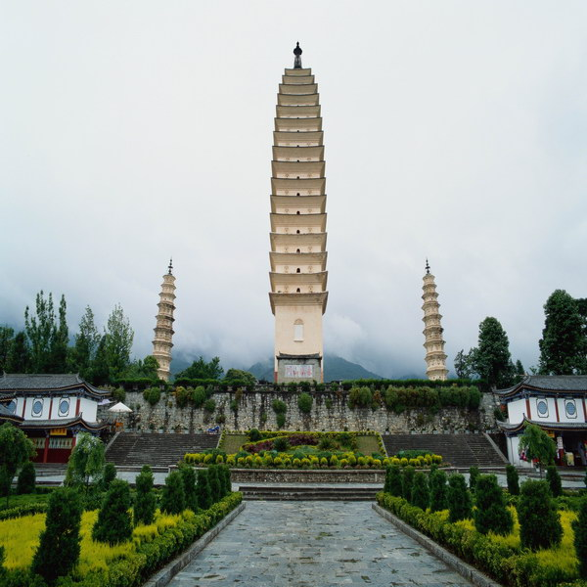
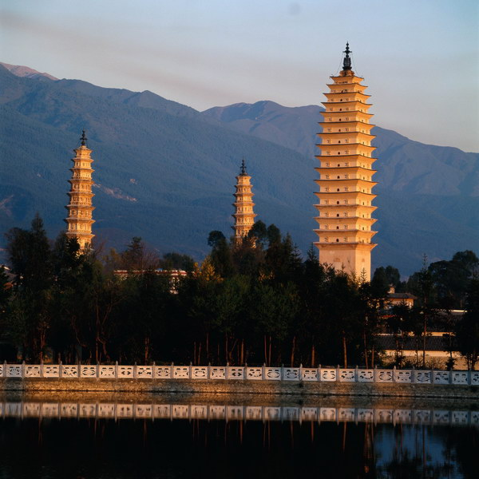
Buddhist towers

Slide 12
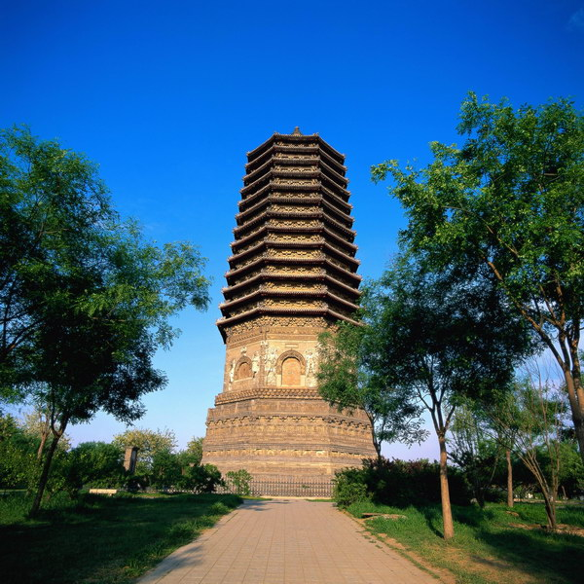
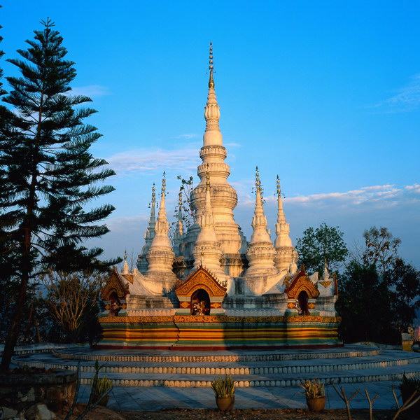
Buddhist tower & pagoda

Slide 13
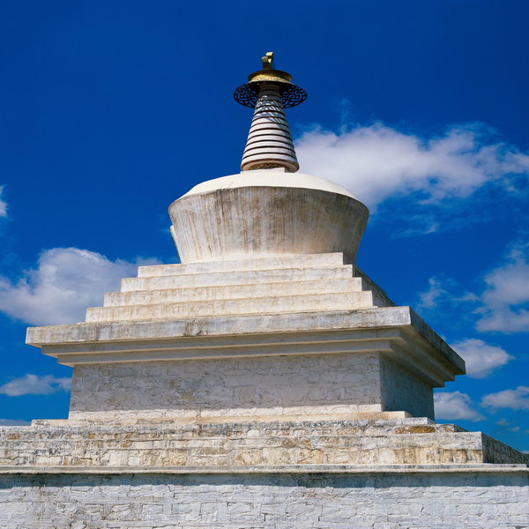
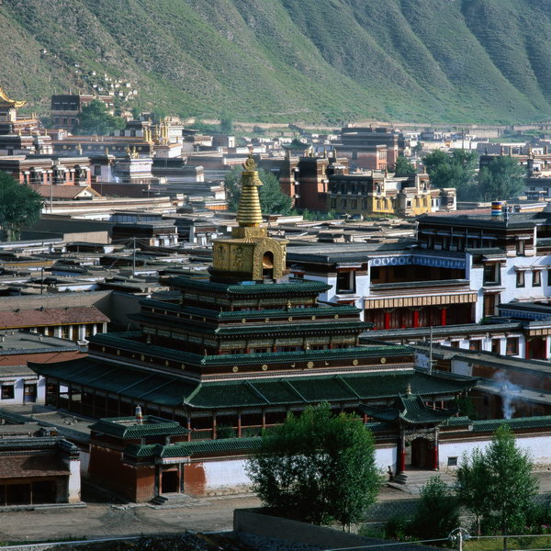
Buddhist pagodas

Slide 14
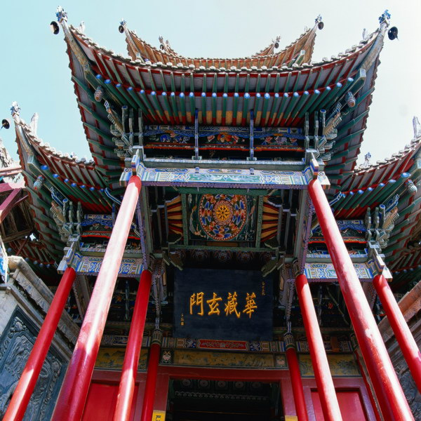
Decorations of Chinese pavilions

Slide 15
Questions Concerning Section B
Gardens
1. How did the Chinese garden grow into its present form?
2. What’s the greatest difference between European gardens and Chinese ones?
3. What are the major categories of Chinese gardens?
4. What do you know about China’s imperial gardens? In which part of China are they located? How many of them can you name?
5. What functions do they have?
6. How are China’s imperial gardens laid out? How are they decorated?

Slide 16
More Questions Concerning B
Gardens
1. In which part of China are most private gardens located? How are they laid out?
2. How are the scenes connected?
3. What do you know about the private gardens of Suzhou? What gardens there demonstrate the styles of Song, Yuan, Ming and Qing dynasties?
4. What styles do gardens in Yangzhou and Guangdong demonstrate?
5. What landscape gardens do you know? How are poets and painters related to landscape gardens?

Slide 17
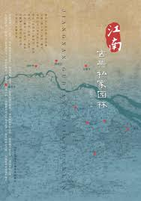
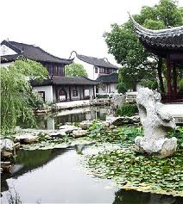
Private gardens south of the Yangtze River

Slide 18
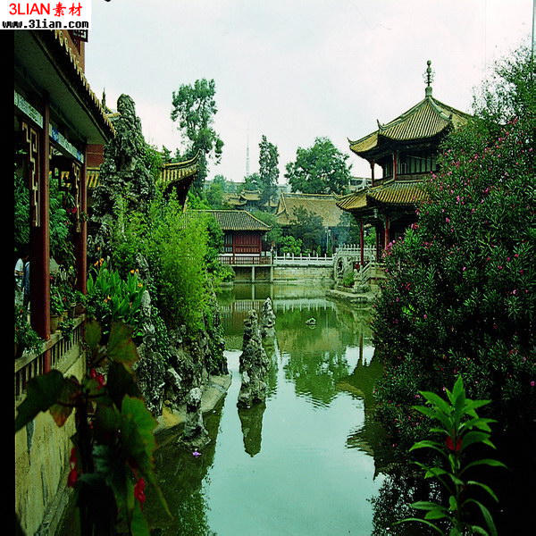
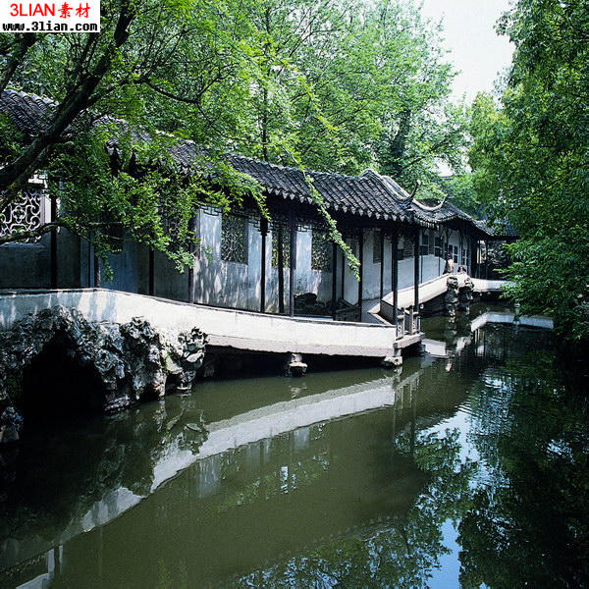
Riverside pavilions and a sightseeing veranda

Slide 19
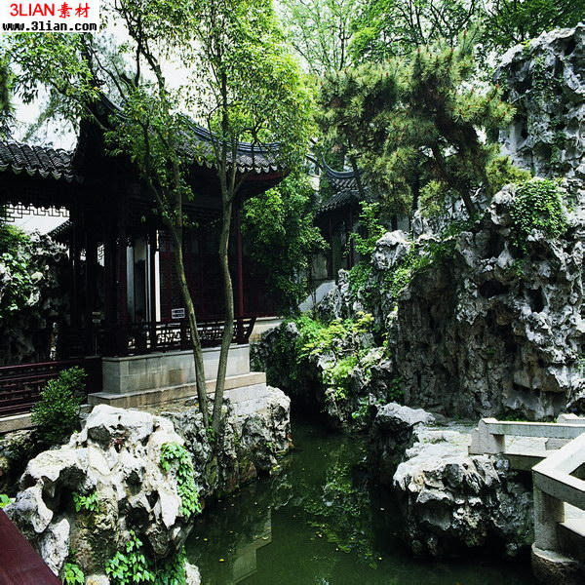
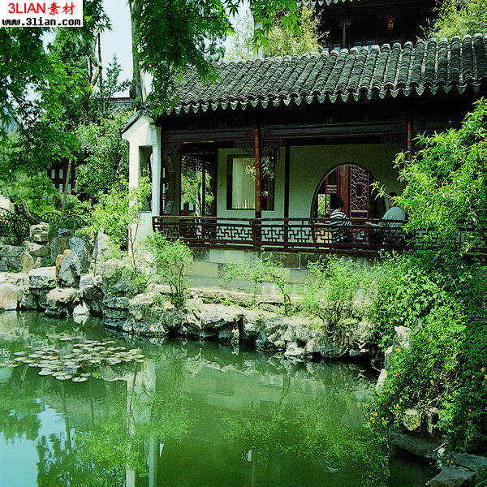
Rockery in a Chinese garden

Slide 20
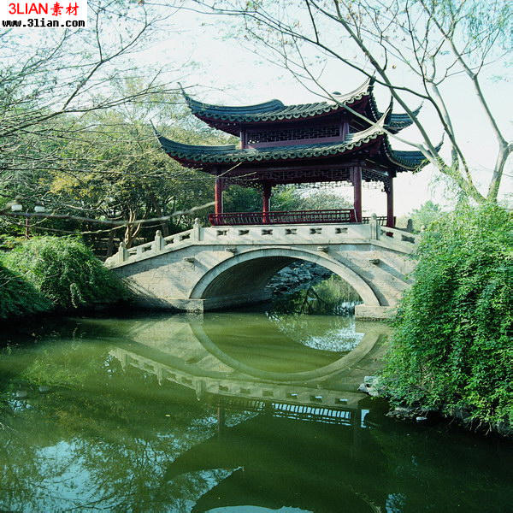
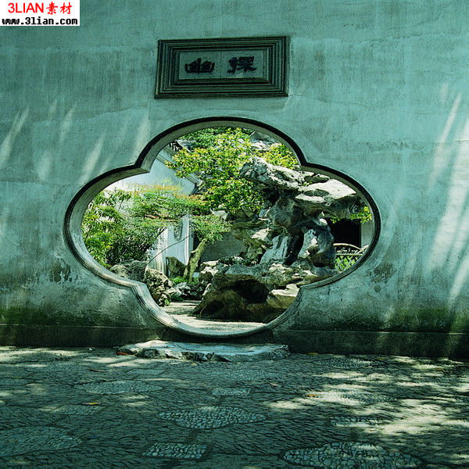
A flower-patterned door & a one-arch roofed bridge

Slide 21
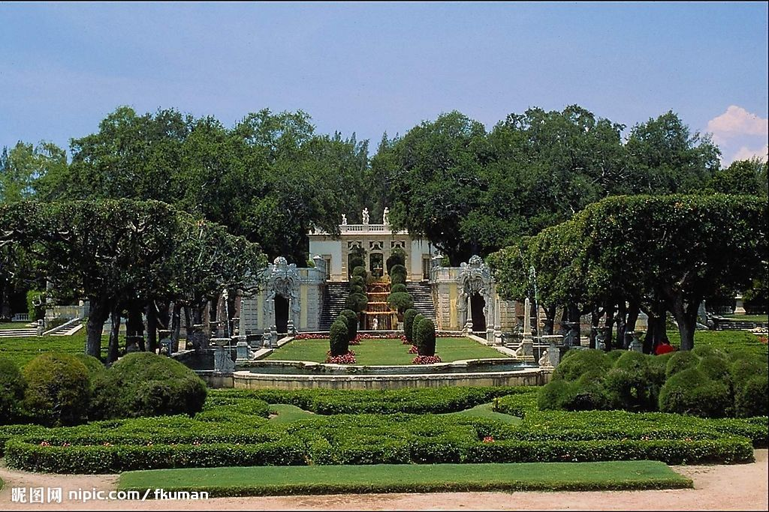
A western garden with geometrical patterns

Slide 22
Yuanmingyuan
Showcase for Western architecture and illusions
Combination of Chinese and Western arts
How do you feel about the destruction?
Should it be rebuilt?

Slide 23
Questions Concerning Section C
Summer Palace
1. What else was the Summer Palace called?
2. What did the Anglo-French invading troops do to it in 1860?
3. How did Empress Cixi have it rebuilt?
4. How important is the park in traditional Chinese gardening?
5. What’s the general layout like?

Slide 24
6. What do know about the halls in the park?
7. What is the park dominated by?
8. What do you know about the Cloud-Dispelling Hall?
9. What do you know about Cixi’s 70th birthday portrait?
10. What do you know about the Long Corridor?
11. What do you know about the Garden of Harmonious Delight?
12. What do you know about the Suzhou Street?

Slide 25
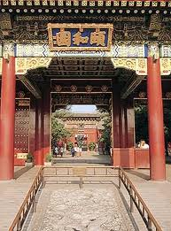
The Summer Palace

Slide 26
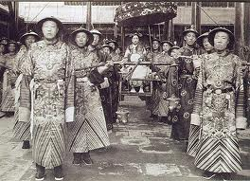
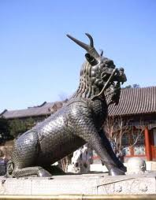
Empress Cixi & her eunuchs in the Summer Palace

Slide 27
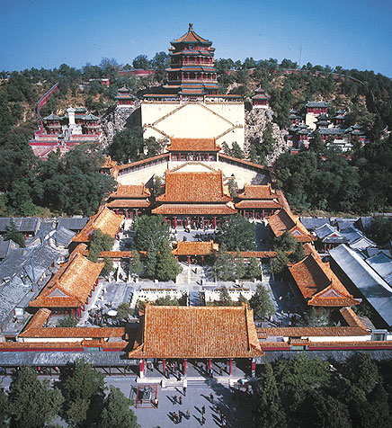
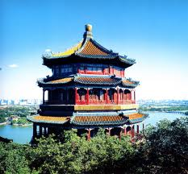
The palace on the Longevity Hill

Slide 28
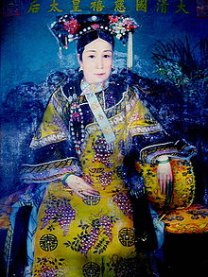
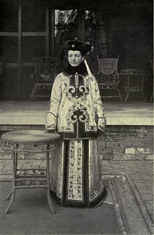
Empress Cixi and Katherine Carl in 1903

Slide 29
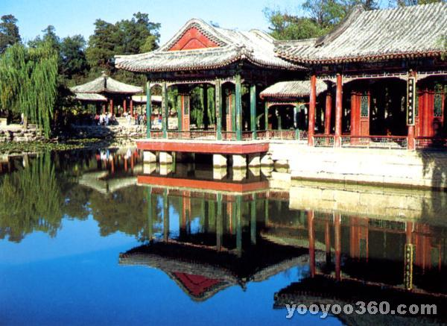
The Garden of Harmonious Delight

Slide 30
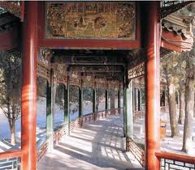
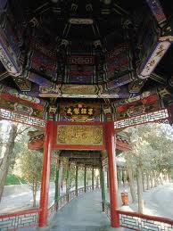
The Long Corridor, 728 m. in length, is the longest sightseeing corridor in the world.

Slide 31
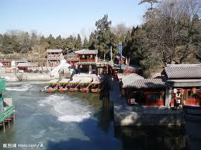
The Suzhou River in winter

Slide 32
Katharine Augusta Carl (1865–1938)
She was an American painter and author who spent nine months in China in 1903 painting a portrait of the Empress Dowager Cixi for the St. Louis Exposition. On her return to America, she published a book about her experience, entitledWith the Empress Dowager.
Katharine Carl was commissioned in the summer of 1903 to paint a portrait of the Empress Dowager Cixi for the Chinese exhibit at the 1904 Louisiana Purchase Exposition. She spent a total of nine months in China and painted four portraits of the Empress Dowager, later recording her memories as the only foreigner to live within the precincts of the Chinese imperial court in its last days in a book that was published in 1906.

Slide 33
Carl's writings of her time in China provide a unique and intimate assessment of the Empress Dowager Cixi. In the book's introduction, she says she wrote the book because "After I returned to America, I was constantly seeing in the newspapers (and hearing of) statements ascribed to me which I never made." These statements were usually at the expense of the Dowager's reputation, and Carl felt strongly enough about it to defend the Empress Dowager in writing and to try to dispel an incorrect image of Cixi that still lingers today.
Carl describes Cixi as a kind and considerate woman for her station. Cixi, though shrewd, had great presence, charm and graceful movements resulting in "an unusually attractive personality." She loved dogs and had a kennel maintained by eunuchs at the Summer Palace where she had "some magnificent specimens of Pekingese pugs and of a sort of Skye terrier." She did not like cats and some of the eunuchs who had cats made sure to keep them "within rigid bounds, on no condition allowing them to come within Her Majesty's ken.”

Slide 34
Carl describes Cixi as a loyal person, saying of her retinue: she "nursed Her Majesty through a long illness, about 25 years since, and saved her life by giving her mother's milk to drink. Her Majesty, who never forgets a favor, has always kept this woman in the Palace. Being a Chinese, she had bound feet. Her Majesty, who cannot bear to see them even, had her feet unbound and carefully treated, until now she can walk comfortably. Her Majesty has educated the son, who was an infant at the time of her illness, and whose natural nourishment she partook of. He is now a Secretary in a good yamen."
Carl described Cixi as enjoying boating on the lake, walks through the gardens and grounds of the Palace (the Imperial family rode in sedan chairs, so the eunuchs did the walking), and presentations of Chinese opera. Cixi smoked Chinese water pipes as well as European cigars through a cigar holder. At 69 Cixi was in good physical shape that when providing a tour of the Opera House to Carl, Cixi "mounted the steep and difficult steps with as much ease and lightness as I did, and I had on comfortable European shoes, while she wears the six-inch-high Manchu sole in the middle of her foot, and must really walk as if on stilts."

Slide 35
Translation exercises
中国是世界四大文明古国之一，有着悠久的历史，劳动人民用自己的血汗和智慧创造了辉煌的中国建筑文明。中国的古建筑是世界上历史最悠久、体系最完整的建筑体系，从单体建筑到院落组合、城市规划、园林布置等在世界建筑史中都处于领先地位，中国建筑独一无二地体现了的“天人合一”的建筑思想。
古代世界的建筑因文化背景的不同，曾经有大约七个独立体系，其中有的早已中断，或流传不广，成就和影响也相对有限，如古埃及、古代西亚、古代印度和古代美洲的建筑等，只有中国建筑、欧洲建筑、伊斯兰建筑被认为是世界三大建筑体系，又以中国建筑和欧洲建筑延续时代最长，流域最广，成就也更为辉煌。

Slide 36
Translation exercises
园林艺术是人们为了游览、娱乐的方便，用自己的双手创造风景的一种艺术。由于各民族、各地区人们对风景的不同理解，也就出现了不同风格的园林。归结起来，世界上的园林可分为三个系统——欧洲园林、西亚园林和中国园林。中国园林有着悠久的历史，那“虽有人作，宛自天开”的艺术原则，那熔传统建筑、文学、书画、雕刻和工艺等艺术于一炉的综合特性，在世界园林史上独树一帜，享有很高的地位。
我国地域广大，各地的地理条件各不相同，因而园林也常表现出明显的地方特性。归总起来，江南地区、广东沿海和四川一带的园林较富特色，于是便有所谓江南园林、岭南园林和蜀中园林的称谓。而北京四周及山东、山西、陕西等地的园林风格较为相像，统称为北方园林。

Slide 37
Translation exercises
世界遗产委员会评价：北京颐和园始建于公元1750年，1860年在战火中严重损毁，1886年在原址上重新进行了修缮。其亭台、长廊、殿堂、庙宇和小桥等人工景观与自然山峦和开阔的湖面相互和谐、艺术地融为一体，堪称中国风景园林设计中的杰作。
概况：颐和园是世界著名的皇家园林，它地处北京西北郊外，距京城约15公里，旧称“清漪园”。1888年重建，改名“颐和园”，耗银3000万两，历时十年。颐和园规模宏大，占地面积达293公顷，主要由万寿山和昆明湖两部分组成。各种形式的宫殿园林建筑3000余间，大致可分为行政、生活、游览三个部分。

Slide 38
Topics for discussion
1. Have you ever been to a magnificent palace, a big temple or an unusual residential house? What there impressed you most deeply?
2. Have you ever been to an imperial garden or a well-known private one? What there impressed you most deeply?
3. What buildings or gardens have been inscribed by UNESCO in the List of World Cultural Heritage?

Slide 39
See you next time!

Slide 40
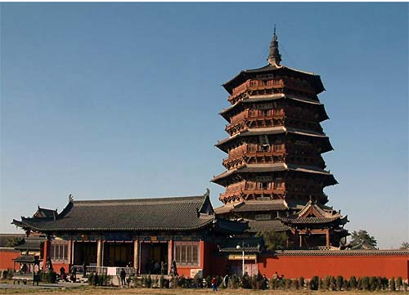
How long is the history of wooden structures in China?
世界上最高的木建筑：应县木塔

Slide 41
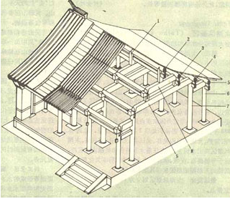
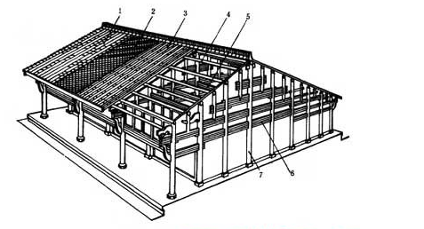
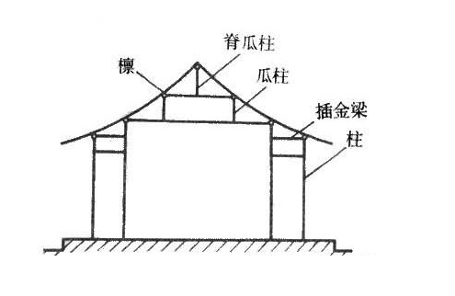
What are the 3 categories of traditional Chinese wood buildings?
穿斗式
抬梁式
井干式

Slide 42
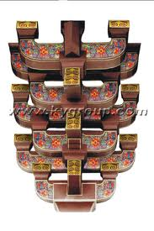
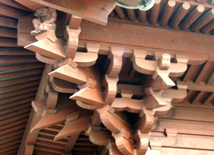
What is dou-gong? What’s its function?
A set of corbel brackets

Slide 43
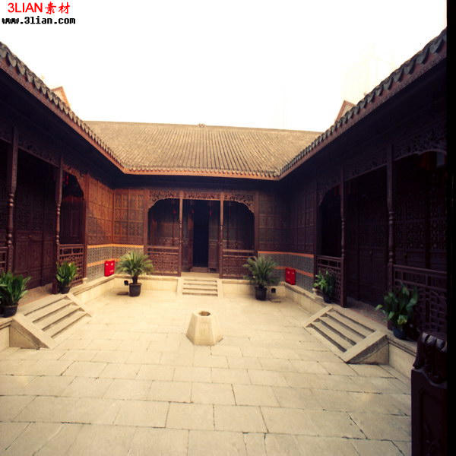
What is the most widespread residential structure in North China? How is it related to Confucianism?

Slide 44
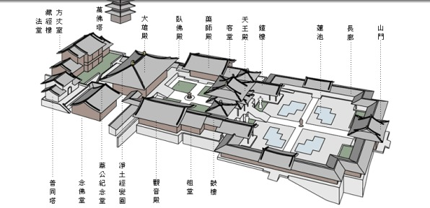
Is the construction of Buddhist temples important in Chinese architecture? What is the general layout of a Buddhist temple like?

Slide 45
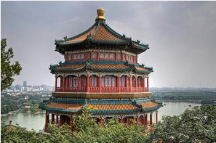
What are Buddhist pavilion and pagodas? Could you name some important Buddhist pagodas in China?

Slide 46
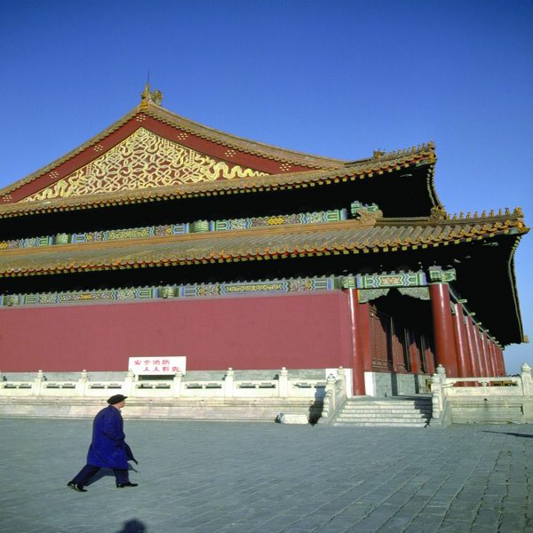
What styles do traditional Chinese buildings' roofs have?
Hipped and gabled roof of double eaves

Slide 47
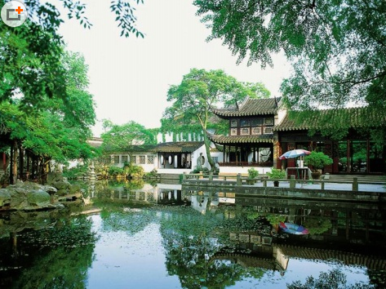
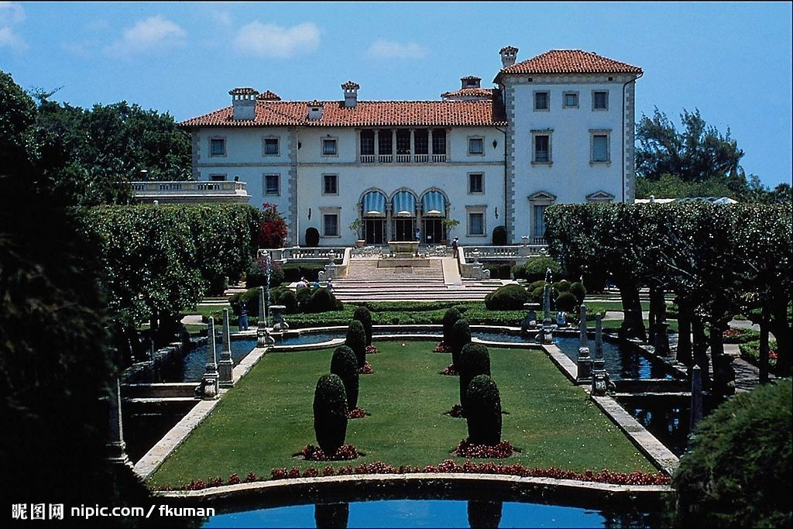
What’s the greatest difference between European gardens and Chinese ones?

Slide 48
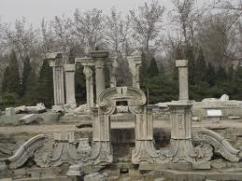
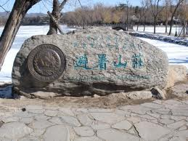
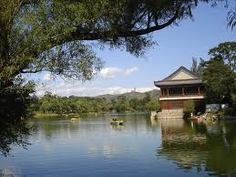
What do you know about China’s imperial gardens? In which part of China are they located? How many of them can you name?

Slide 49
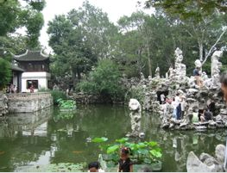
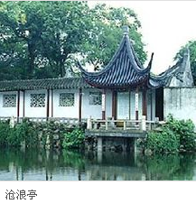
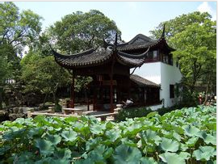
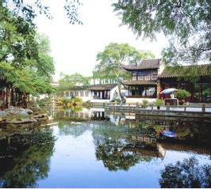
What do you know about the private gardens of Suzhou? What gardens there demonstrate the styles of Song, Yuan, Ming and Qing dynasties?
狮子林
拙政园
留园

Slide 50
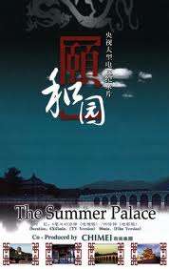
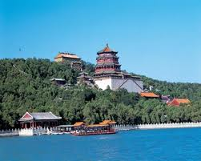
What else was the Summer Palace called?

Slide 51
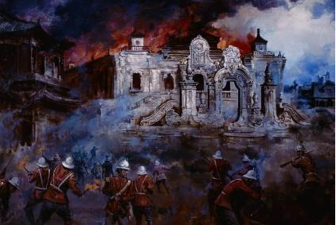
What did the Anglo-French invading troops do to it in 1860?

Slide 52
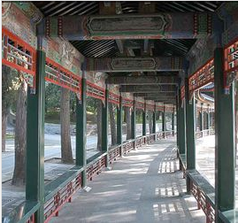
What do you know about the Long Corridor?

Slide 53
Traditional Festivals

Slide 54
2A(5) Traditional Festivals
The Spring Festival
Please prepare for WeChat quiz.

Slide 55
2A(5) Traditional Festivals
The Spring Festival
Is there a custom about clothes with spring festival?

Slide 56
2A(5) Traditional Festivals
The Spring Festival
Is there a custom about clothes with spring festival?
You put on new clothes.

Slide 57
Questions Concerning Section A
1. Why did ancient Chinese people start the year in late Jan. or early Feb.?
2. What is “年”? What does “过年” originally mean?
3. How do the Chinese celebrate the Lunar New Year?
4. What does “守岁” mean?
5. What is jiao zi? Why is it so popular with the Chinese?
6. What other customs of celebrating the New Year do you know?
7. How is the New Year celebrated abroad?

Slide 58

Why do we have fish during the Spring Festival?

Slide 59

What is “年”? What does “过年” originally mean? ？
Firecrackers (爆竹)

Slide 60

What is jiao zi? Why is it so popular with the Chinese?

Slide 61

How is the New Year celebrated abroad?

Slide 62
2A(5) Traditional Festivals
The Spring Festival
Presentation by…

Slide 63
2B(6) Traditional Festivals
The Lantern Festival
Please prepare for WeChat quiz.

Slide 64
2B(6) Traditional Festivals
The Lantern Festival
What tradition is connected with the lantern festival, „walking on …“

Slide 65
2B(6) Traditional Festivals
The Lantern Festival
What tradition is connected with the lantern festival, „walking on stilts“

Slide 66

What do you know about the lantern exhibitions?

Slide 67

What is yuan xiao symbolic of?

Slide 68
Questions concerning Section B
1. Why is Jan. 15 of the lunar calendar called the Lantern Festival?
2. What do you know about the lantern exhibitions?
3. What is yuan xiao symbolic of?
4. How is the Lantern Festival celebrated in your hometown?

Slide 69

An imperial celebration

Slide 70
2B(6) Traditional Festivals
The Lantern Festival
Presentation by…

Slide 71
The Four Most Handsome Men
The Four Most Handsome men in Ancient China
It is said that there were four most beautiful women in ancient times, and corresponding to that, it is worth mentioning that there were four most attractive men at that time.Despite that we consider these four men as attractive, this refers to more than just their appearance. They have a common feature: it proves that while their appearance is marvelous, they are also outstanding in literature. Namely, as a Chinese saying goes, they are endowed with both beauty and talent.
These four men are Pan An, King Lanling, Ji Kang, and Wei Jie.（Wang Zhenbo 2008,59-60）
The allusion of “throwing fruit to fill a carriage” originates from Pan An, which resembles movie fans nowadays to see their idols. There is a comment on Pan An’s appearance: "No more and no less." The history books also describe Pan An with three words “good-looking, well-mannered, and graceful”. Although these did not describe Pan An’s appearance in details, such as eyebrows and eyes or lips, from these side descriptions, we can know that Pan An’s appearance is far above ordinary people, and even his styles draw imitation from others.
At the same time, Pan An is known as “the flower of a county in Heyang”, and he is also one of the few men who are compared with flowers to be praised for excellent appearance. The beauty of exterior only fails to last long in this world. Pan An's talent and temperament and the devotion to his wife are also often eulogized. Pan Yue showed his unusual talent since he was a child, and he was called a child prodigy by the villagers. In his early years, he was appreciated by an official and recommended as a scholar.
Later, served as the magistrate of Heyang (now Meng County, Henan), he was diligent in political affairs, and advocated the people to plant more fruits and trees. The county was full of trees and peaches and plums everywhere, known as “Flower County”. During his administration, his political achievements were remarkable. Besides, Pan An holds a special place in the history of literature.

Slide 72
The Four Most Handsome Men
He was good at composing verse and orders, expatiation, and skilled in the choice of words and building of sentences, which fully reflects the characteristics of Taikang literature that pays attention to the beauty of form. He was expert in composing Ci lyric of sorrow and admonishment, and his current works such as Widow's Fu, Mourning Poem and other famous works are all known for their narration and empathy. Pan An can be described as both internally and externally blessed.（Liu Xixue 2003,63-64）
Gao Changgong (541-573), known as King Lanling, the grandson of Gao Huan, Emperor Shenwu, and the fourth son of Wen Xiang, Emperor Gaocheng. There is a very popular legend about King Lanling. It's believed that King Lanling was a brave and supremely skilled general. However, because he looked very sweet and it seemed hard to frighten the enemy, he often wore a half-mask when fighting, which sounds very fairytale.
Nevertheless, the beauty of King Lanling is beyond doubt and otherworldly. Book of Northern Qi Dynasty described that he was friendly looking and mentally strong, with beautiful voice and appearance.King Lanling spent half his life in military affairs, and made great achievements. While this gave him glory, it also brought bad luck. There is an old Chinese saying that the glow of a inferior from massive achievements will overshadow his superior.
Although the King Lanling did not have the idea of usurping the throne, but the incumbent felt threatened because of his existence itself. In the end, a glass of poisonous wine ended the life of the Lanling King.（Wang Zhenbo 2008,59-60）
Song Yu (about 322 BC-298 BC), as it is widely rumored, a student of Qu Yuan, was born in the capital city of Song Dynasty during the Warring States Period (now Shangqiu, Henan). Song Yu was a writer of Ci lyric of State Chu in the late Warring States period, adept in Ci lyric and even acclaimed as a great poet after Qu Yuan' reputation. Later generations often referred to them as “Qu Song”. Rumors circulate that there are many Ci lyrics from him, and Book of Han records about 16 works, but many of them are lost today.

Slide 73
The Four Most Handsome Men
His works embrace Nine Discriminations, The Fu poetry of Wind and so on. He was the first to write about sadness from Autumn and to write about women. His description of women's nature exerts a great influence on later generations such as Cao Zhi. The goddess in Song Yu's The Fu poetry of Goddess embodies the essence of pre-Qin female beauty, recounting the beauty of the goddess of Wushan Mountain in details so much so that later generations have coveted for it for thousands of years.
16 works survived, among which Nine Discriminations is believed to be truly composed by him. It is equivalent to Qu Yuan's Li Sao or A lament in the history of Chinese literature. Both poets can be called the two shining pearls in Ci lyric at their times.（Wang Zhenbo 2008,59-60）
Wei Jie (286-June 20, 312), a metaphysician and an official of the Jin Dynasty. Wei Jie was a noted talker and metaphysicist during the Wei and Jin Dynasties. He was appointed as an assistant of the prince in the matter of politics. In the fourth year of the reign of Emperor Yongjia(AD310), Wei Jie died at the age of 27. Both ancient books and ancients commented on Wei Jie's appearance. Wang Ji reckoned that, “A jade is on my side, and I feel like I am nobody”; “Wandering with Jiu is like sauntering with a pearl on the side, with him shining brightly.”
History Retold as a Mirror for rulers authored by Sima Guang goes into detail: "Wei is blessed with attractive appearance and has his own understanding when talking and sharing; Often he reckons people can be forgiven if they are inferior..." Wei Jie not only have a mere marvelous exterior, but also he can discern metaphysics from his perspective. Wei Jie’s views always amaze the concerned parties.
It is said that even three sons of the Wang family, are not as good as the first son of the Wei family, and the three sons of the Wang family were all well-known scholars at that time, and the Wei Jie could be regarded as unmatchable compared with the three in family background, appearance, and talents.（Wang Zhenbo 2008,59-60）

Slide 74
The Four Most Handsome Men
Terms and Expressions
Pan An 潘安
King Lanling 兰陵王
Ji Kang 嵇康
Wei Jie 卫玠
throwing fruit to fill a carriage 掷果盈车
scholar 秀才
expatiation 铺陈
Book of Northern Qi Dynasty 《北齐书》
the Warring States Period 战国时期
Book of Han 《汉书》
Nine Discriminations 《九辨》
The Fu poetry of Wind 《风赋》
The Fu poetry of Goddess 《神女赋》
the goddess of Wushan Mountain 巫山神女
metaphysician 玄学家
a noted talker 清谈名士
History Retold as a Mirror for rulers 《资治通鉴》
Widow's Fu 《寡妇赋》
Mourning Poem 《悼亡诗》
英文书名要用斜体
Questions
1.Who are the four most handsome men at ancient time in China?
2.Who is Gao Changgong?
3.How did Lanlin King die?
4.What works did Song Yu compose?
5.Who are the two shining pearls in Ci lyric according to the passage?
6.What History Retold as a Mirror for rulers comment on Wei Jie?
References
刘细学.古代四大美男[J].文史天地,2003(06):63-64.
王真波.四大美男都是怎么死的[J].青年文学家,2008(11):59-60.

Slide 75
Preparation for next week
Please prepare the three topics for session 4 (March 24, 2021):
7 王子涵 Traditional Cuisine: Four Distinct Regional Cuisines
8 袁静 Education: Historical Figures, The Four Talented Women of Ancient China
9 刘廷阳 Traditional Cuisine: Two Famous Dishes

Slide 76
Always here for you!
随时为你们服务
Professor Dr. Martin Woesler
吴漠汀
湖南师范大学特聘教授，博士导师
Office / 办公室: 外国语学院406
国际汉学中心308
Phone / 电话: (150) 1138 8818
(德国+49 178 2073538)
Email / 电子邮件: wmt@hunnu.edu.cn

Slide 77
Thank You

