Slide 1
中國語言文化
Session 7, Thursday Oct 24, 2024, Zhishan Bldg. 至善楼105, room 105
Martin Woesler

Slide 2
TOPICS
153. Eight Major Cuisines of China p. 1381 (Tang Xinyu/Eric)
154. Four Distinct Regional Cuisines p. 1398(Peng Jiayi/Eva)
155. Wuhan Breakfast Culture p. 1404 Chen Shanshan /Rebecca
156. Tanghulu p. 1414(Chen Mengzhu/Chris)
157. Hotpot p. 1423（Xiao Yixuan/Yuki)
158. The Art of Chinese Cooking p. 1430(Liu Zhouli/ lovia)

Slide 3
153. Eight Major Cuisines of China p. 1381 (Tang Xinyu/Eric)

Slide 4
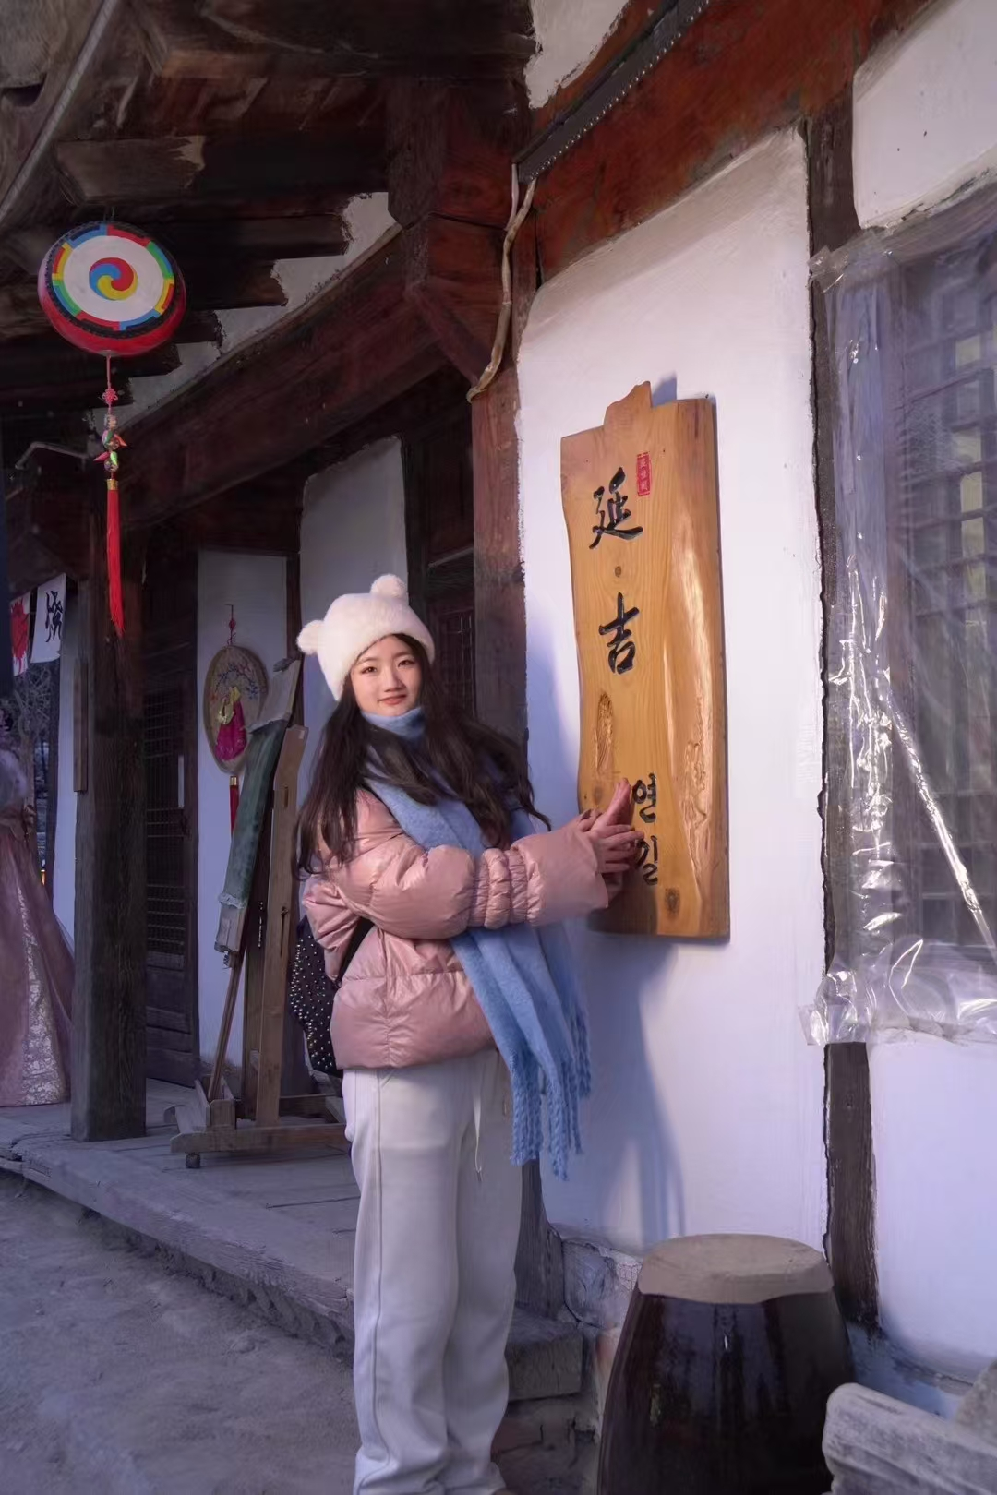
154. Four Distinct Regional Cuisines p. 1398(Peng Jiayi/Eva)

Slide 5

154. Four Distinct Regional Cuisines p. 1398(Peng Jiayi/Eva)

Slide 6

155. Wuhan Breakfast Culture p. 1404 Chen Shanshan /Rebecca

Slide 7
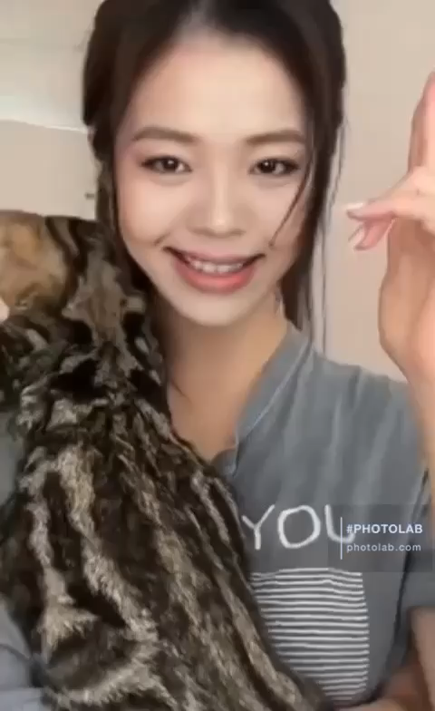
155. Wuhan Breakfast Culture p. 1404 Chen Shanshan /Rebecca

Slide 8
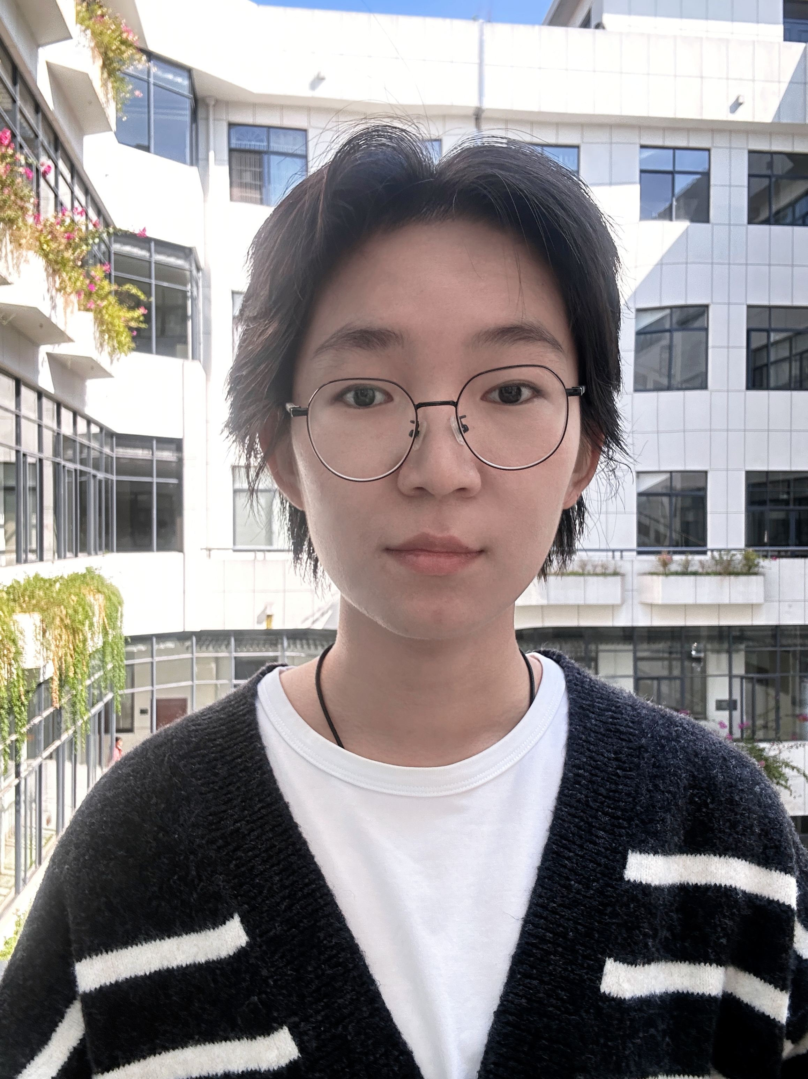
156. Tanghulu p. 1414(Chen Mengzhu/Chris)

Slide 9

156. Tanghulu p. 1414(Chen Mengzhu/Chris)

Slide 10

157. Hotpot p. 1423（Xiao Yixuan/Yuki)

Slide 11

157. Hotpot p. 1423（Xiao Yixuan/Yuki)

Slide 12
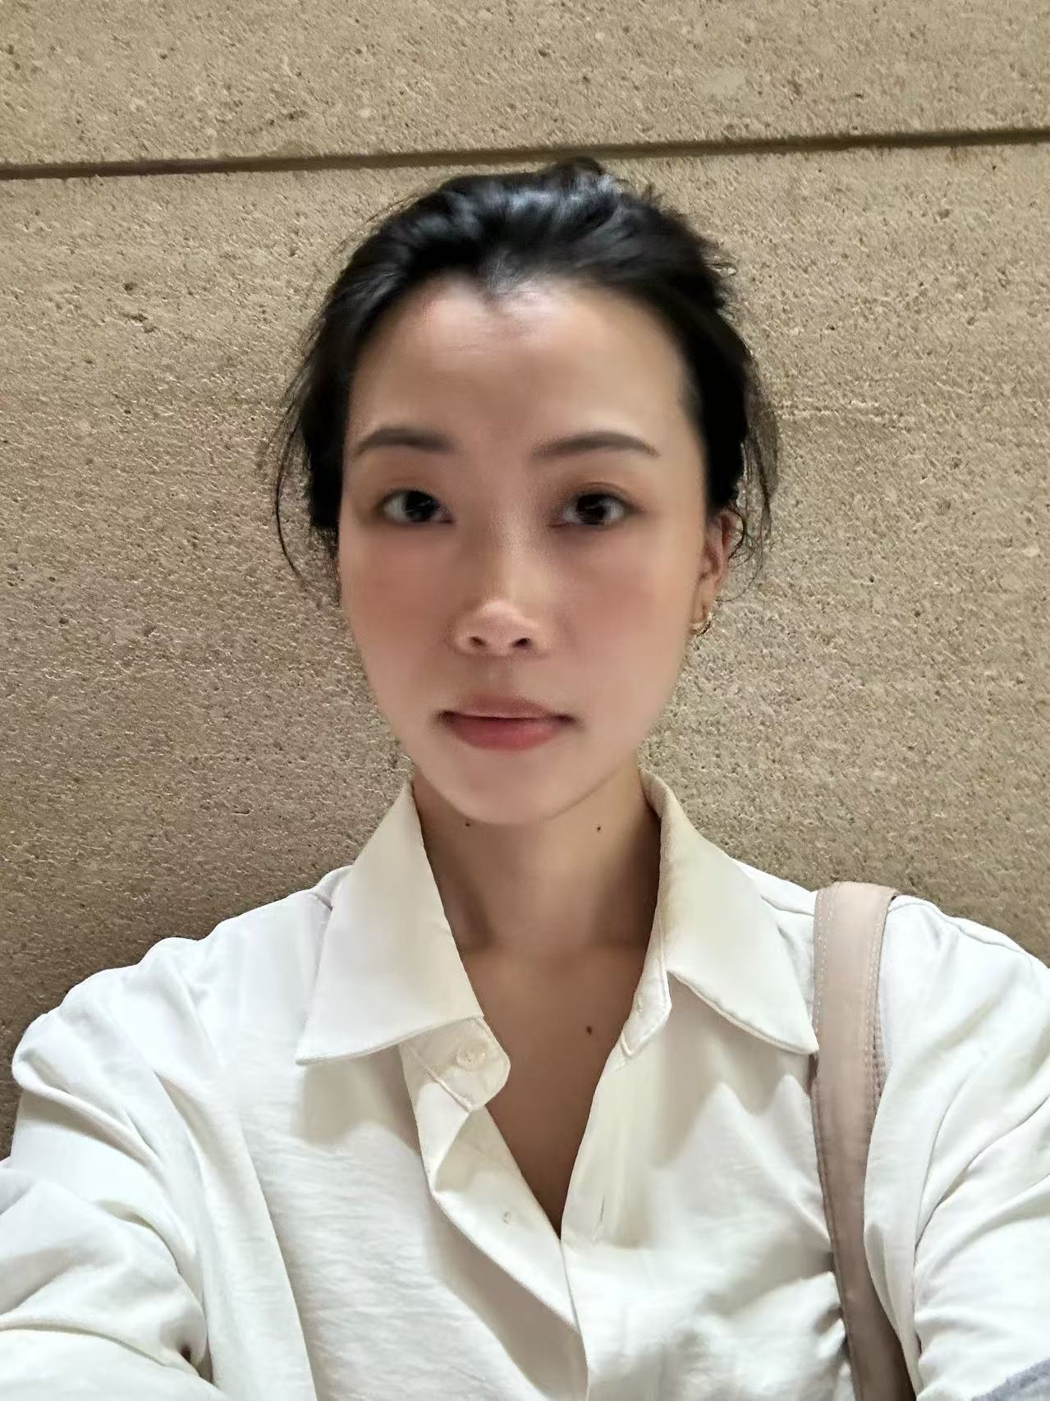
158. The Art of Chinese Cooking p. 1430(Liu Zhouli/ lovia)

Slide 13
158. The Art of Chinese Cooking p. 1430(Liu Zhouli/ lovia)

Slide 14
Prepare for next time
Homework:
1. Please read the six texts for next time in the textbook.
2. Please add your final exam paper topic and your name in the respective section above.
3. Take the surveys (EU: https://wn8ae3qwafbc11zv.mikecrm.com/9gdWrQT
, 2024: https://wn8ae3qwafbc11zv.mikecrm.com/CTrdOjm).

Slide 15
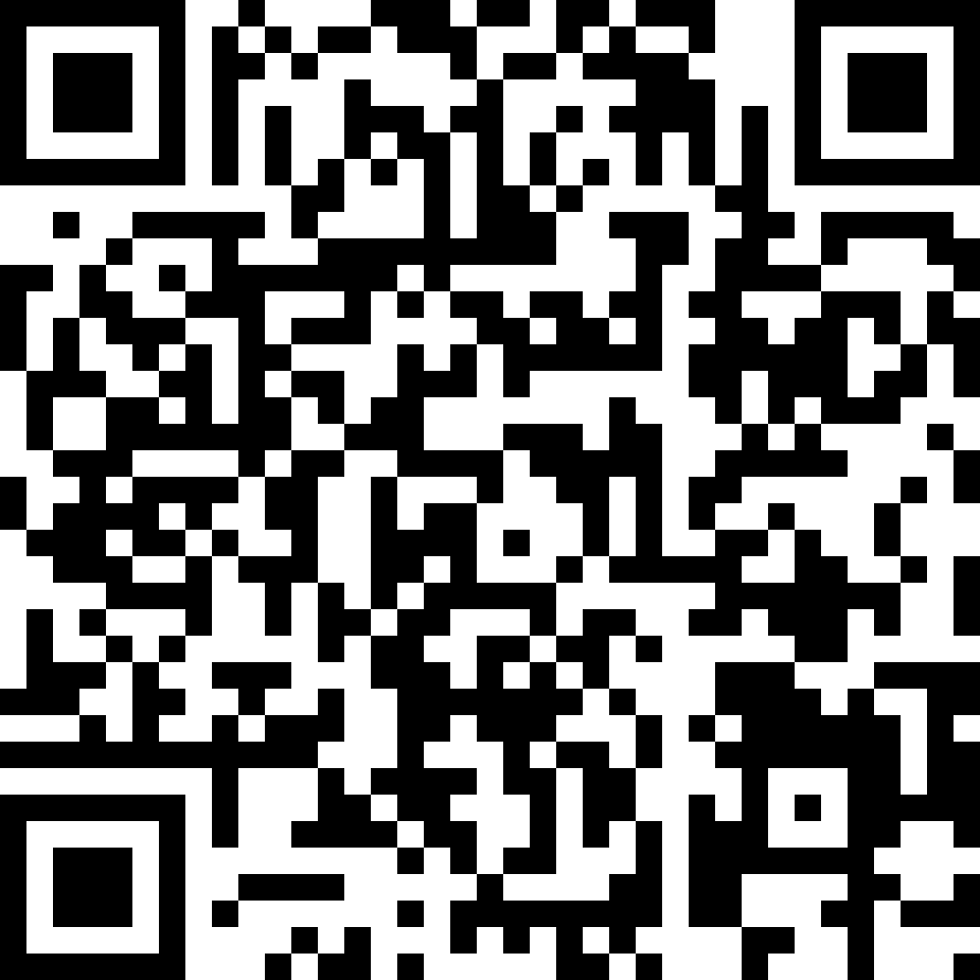

Questionnaires
EU
https://wn8ae3qwafbc11zv.mikecrm.com/9gdWrQT
2024 https://wn8ae3qwafbc11zv.mikecrm.com/CTrdOjm

