Slide 1

A comparison of Chinese and English
Presenters: Li Xinxing and Fu Hongyan

Slide 2

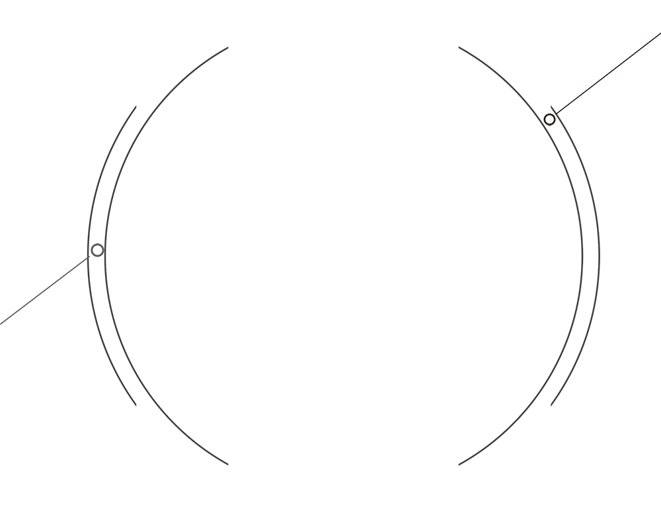
CONTENT 1
Synthetic vs Analytic
English
Chinese
Compact vs Diffusive
Hypotactic vs Paratactic
Complax vs Simplex

Slide 3

CONTENT 2
English
Passive vs Active
Chinese
Stative vs Dynamic
Abstract vs Concrete

Slide 4
Synthetic vs Analytic
Defination
A synthetic language is characterized by frequent and systematic use of inflected forms to express grammatical relationships.
An analytic language is characterized by a relatively frequent use of function words, auxiliary verbs, and changes in word order to express syntactic relations, rather than inflected forms.

Slide 5
Further Details
Changes of inflection
He moved astonishingly fast.
He moved with astonishing rapidity.
His movements astonished us by their rapidity
The rapidity of his movements was astonishing.
他的行进速度令人惊讶。
Word order
English word order is more flexible, while Chinese character is rather fixed.
Love conquers all things. All things can be conquered by love. 爱能征服一切。

Slide 6
Compact vs Diffusive
English sentences have complete subject-predicate structure which are acted by noun phrases and verb phrases.The subject is indispensable, the predicate is the center of the sentence, and the two are coordinated. English sentences are clear in subject and order, clear in level, echoing, strict and standardized, and aggregated in sentence style.
The subject-predicate structure in Chinese is much more complex, the subject not only has various forms, but also can be dispensed. And it can indicate the giving thing, the receiving thing, the time, the place, can be filled with nouns, verbs, adjectives, quantity words, or the subject can be omitted.
。

Slide 7
Hypotactic vs Paratactic
The dependent or subordianate construction or
relationship of clause with connectives.
Eg: I will despair if you don’t come.
01
Hypotactic
The arranging of clauses one aftere the other without
connectives showing the relation between them.
Eg: The rain fell, the river flooded, the house washed away.
02
Paratactic

Slide 8
Compact vs Simplex
The subordinate structure is one of the most important features of modern English. Subordinate clauses and phrases can act as both the main and subordinate components of a sentence, so written language appear long-winded.
01
Compact
The Chinese language often uses loose sentences, tight sentences, omitted sentences, running sentences or compound sentences in parallel form, mostly short and medium sentences. Most Chinese sentences have a simplified structure and are not complex and disjointed.
02
Simplex

Slide 9
Compact vs Simplex
Eg: But the mingled reality and mystery of the whole show, the influence upon me of the poetry, the lights, the music, the company, the smooth stupendous changes, and opened up such illimitable regions of delight, that when I came out into the rainy street, at twelve o’clock at night, Ifelt as if I had come from the clouds, where I had been leading a romantic life for ages, to a bawling, a splashing, link-lighted, umbrella-struggling, hackney-coach-jostling, pattern-clinking, muddy, miserable world.
整个演出既具有现实感又富有神秘色彩。诗歌、灯光、音乐、演员、光耀夺目、变换神奇的舞台背景，感染了我。整个场面是这样的令人眼花缭乱、心旷神怡。当我在午夜时分走出戏院来到雨淋淋的街道时，我感到自己是在仙境般传奇的生活了好久，而现在则已经脱离这个仙境来到另外一个世界。这里是一片呐喊声，一阵阵飞剑开来的泥浆，一盏盏路灯，一把把挤来挤去的雨伞，一辆辆争先恐后的马车，一串串踢踢踏踏的木鞋声，一片泥泞，一片悲惨。

Slide 10
Personal vs Impersonal
English commonly employes object expressions, instead of narrating in person. Things are presented in an objective tone, which means the writers and the readers are out of the picture, hiding themselves behind impersonal language. Formal written langauge often goes with an impersonal style; i;e. one in which the speaker does not directly to himselves or his readers, but avoids the pronouns I, you, we. Some of the common features of impersonal language are passive, sentences beginning with introductory, and abstract nouns.
The Chinese language focuses on subjective thinking, and this way of thinking is dominated by the thought “everything is rooted in me”, often describing objective things from the individual, or describing the people’s behavior or state, therefore the pronoun is often employed.

Slide 11
Personal vs Impersonal
Eg: It has been noted with concern that the stock of books in the library had been declining alarmingly. Students are asked to remind themselves of the rules for the borrowing and return of books, and to bear in mind the needs of other students. Penalties for overdue books will in the future be stricktly enforced.

Slide 12
Passive vs Active
Passive voice is common grammatical usage in English language. Passive voice contributes to impersonal tendency, and vice versa. There are several reasons which lead to the common passive voice phenomenon:
First: When the agents in the active sentences need not to be clearly mentioned.
Eg: The murder was caught yesterday, and it is said that he will be hanged.
Her only son was run over by a car.
Some things have been said here tonight that ought not to have been spoken.
Second: Syntactic requirement for making sentences or rhetorical need.
Eg: Some kinds of plactics can be forced through machines which separate them into long, thin strings, called fibres, and these fibers can be made into cloth.
I was astouded that he was prepared to offer me a job.

Slide 13
Passive vs Active
The usage of passive voice is limited in Chinese. In the ancient Chinese, the passive voice was expressed by “为” or “为······所.” Later, passive voice more represents the unlucky things that subjects consider as unpleasant or undesirable. Mordern Chinese , influenced by the Western language, more often uses the passive. However, the passive can be replaced by Chinese character.
l
Eg: The crops was washed away by the flood. 庄稼让大水冲跑了。
The factory was seriously demaged during the earthquake. 这家工厂在 地震中遭受到严重的破坏。

Slide 14
Stative vs Dynamic
The English people are inclined to use the noun, therefor the sentence represents itself as stative. Broadly speaking, nouns can be characterized naturally as ‘stative’ in that they refer to entities that are regarded as stable, whether these are concrete, like house, paper or abstract like hope, bravery. At the opposite pole, verbs can be equally naturally characterized as dynamic: they are fitted to indicate action, activity and temporary or changing conditions.
While the Chinese tends to use verb conjunction, which means one sentence may include more than one verb. Hence the Chineses narration presents dynamic. For example: 他想办法摆脱困境。

Slide 15
Abstract vs Concrete
The much uses of noun in English sentences lead to the abstraction of expression. An excessive reliance on the noun at the expense of the verb will, in the end, detach the mind of the writer from the realities of here and now, from when and how and in what mood the thing was done, and insensibly induce a habit of abstraction, generalization and vagueness.
While Chinese characterizes concrete, clear, direct as well as picturesque. In addition, Chinese fully takes the advantages of mataphor and image to express what people intend to say.

