Slide 1
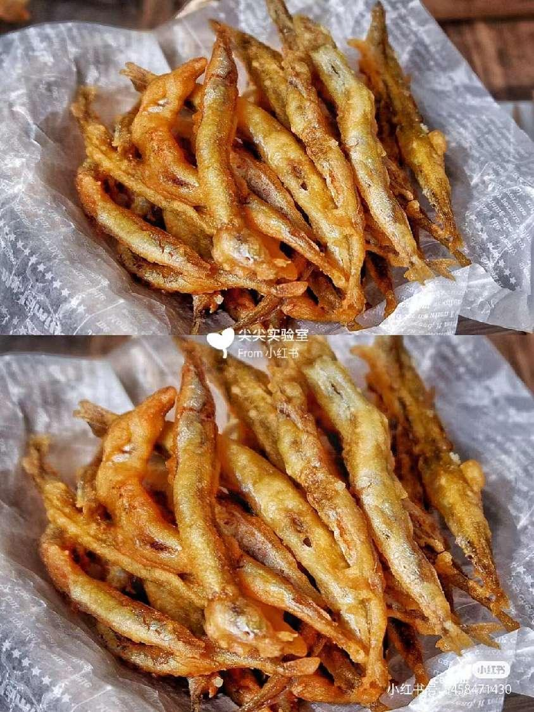
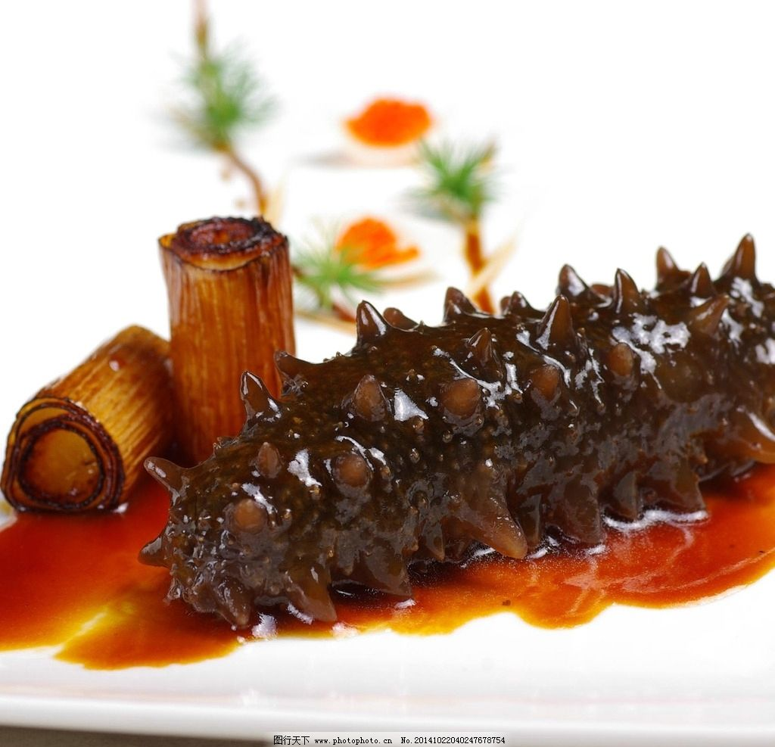
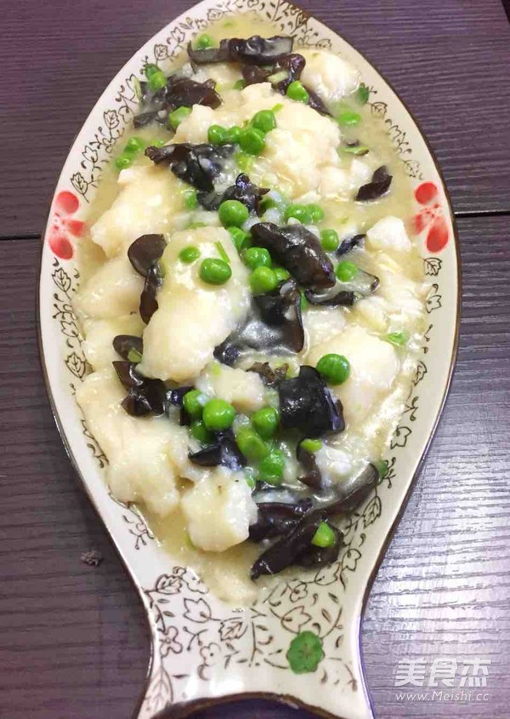
2.Shandong cuisine--鲁菜
Stewed Sea Cucumber
红烧海参
Sautéed Pickled Fish Slice
糟溜鱼片
Deep-Fried Red-Scale Fish
干炸赤鳞鱼

Slide 2
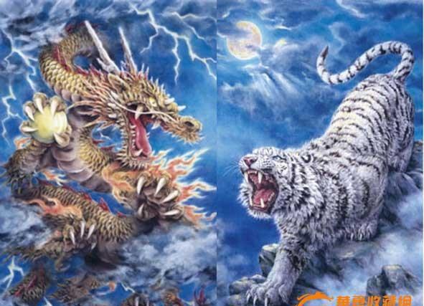
*Dragon and Tiger Locked in Battle
龙虎斗
There is an idiom called 龙争虎斗, which refers to the war between the Yellow Emperor and the Chiyou in the ancient dynasty. At that time, the totem of the Yellow Emperor was the tiger, while the totem of the Chiyou was the dragon. After a fierce battle, the Yellow Emperor won the battle. However, in order to make Chiyou's people obedient and unite all the tribes, the Yellow Emperor changed the totem from tiger to dragon. Since then, the Chinese nation has become the descendant of the dragon.
有个成语叫作龙争虎斗,指的是在上古朝代黄帝和蚩尤大战，当时黄帝一族的图腾为虎,蚩尤一族的图腾为龙,经过激烈的战斗,黄帝获得胜利。但黄帝为了使蚩尤的族人归顺,团结所有部落,便将图腾改虎为龙,从此中华民族便成为龙的传人。

Slide 3
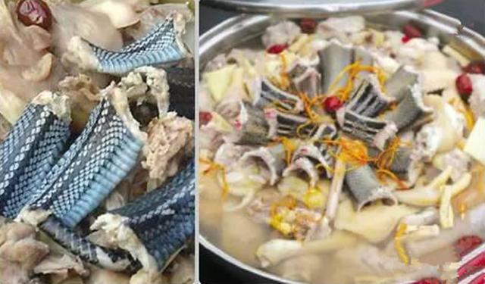
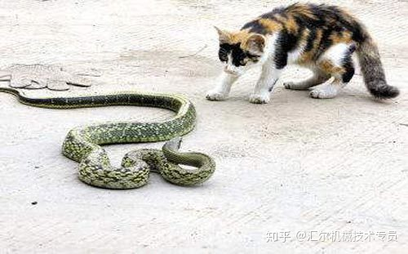
*Dragon and Tiger Locked in Battle
龙虎斗
The battle between the tiger and the dragon who will win cannot be answered on the battlefield. The Cantonese(广东人） have come up with a good idea. They bring the battle to the dinner table. They let the tiger and dragon leave their nest and go one-on-one against each other without help. Because the place was small, they had to shrink, turn into a snake and a cat. In the end, they fell into a cooking pot. The battle became a cuisine.

Slide 4
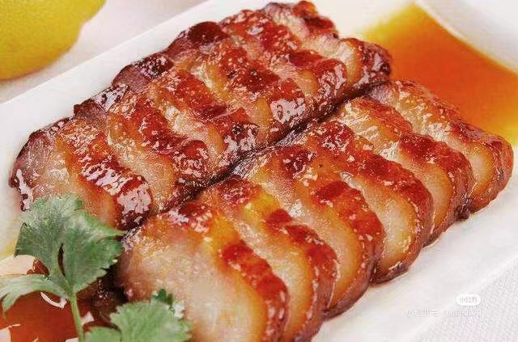
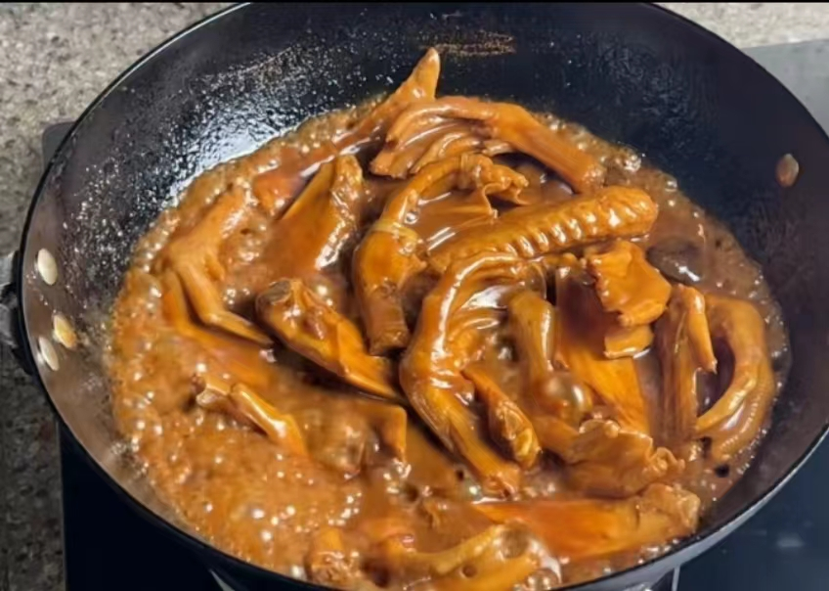
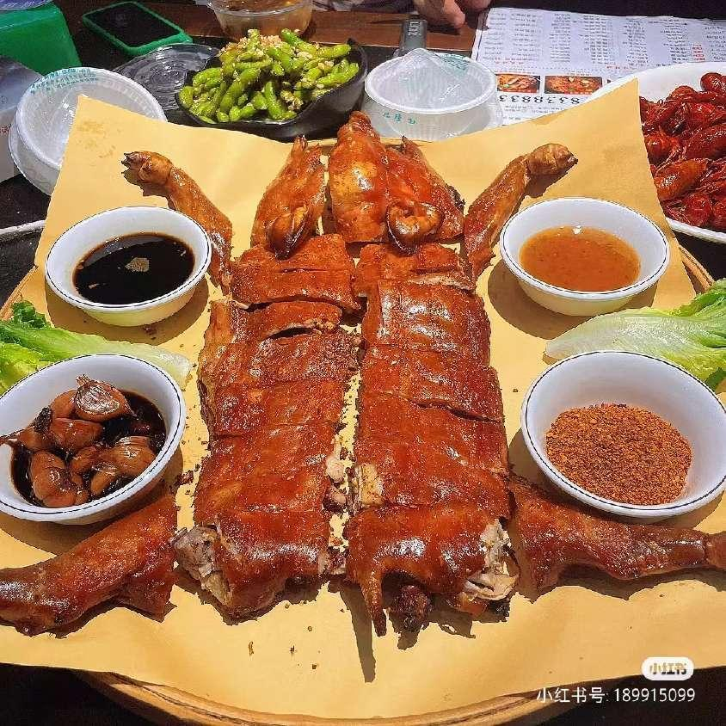
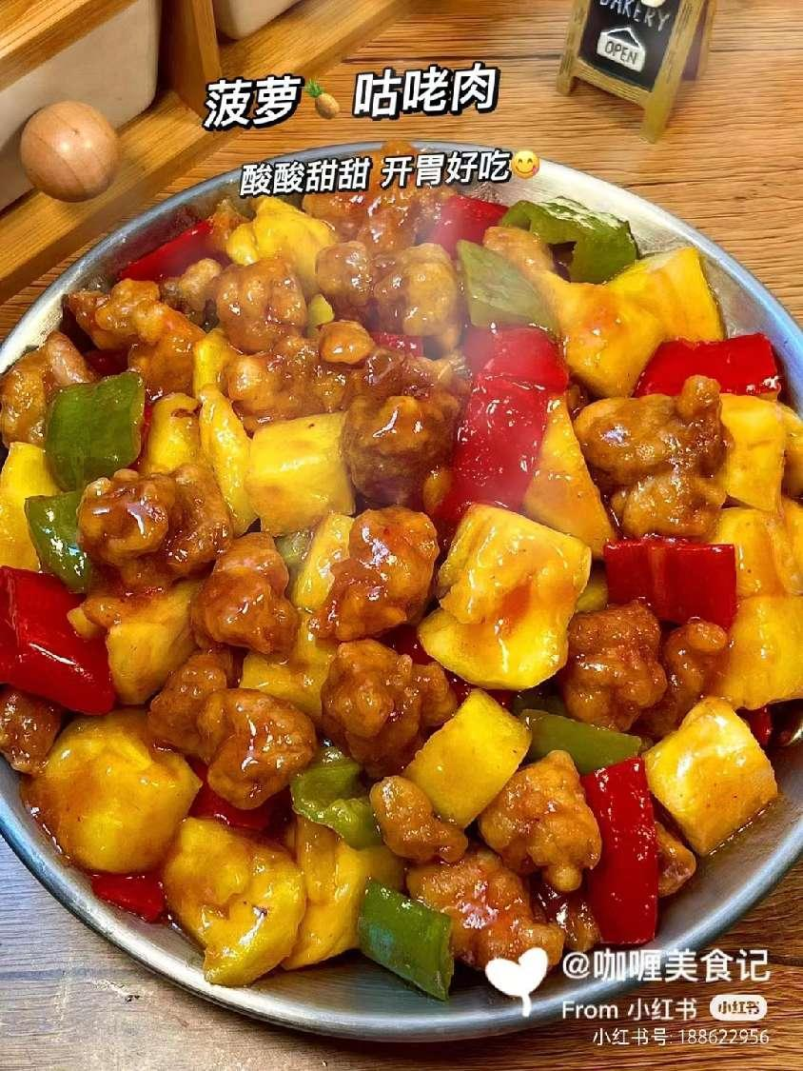
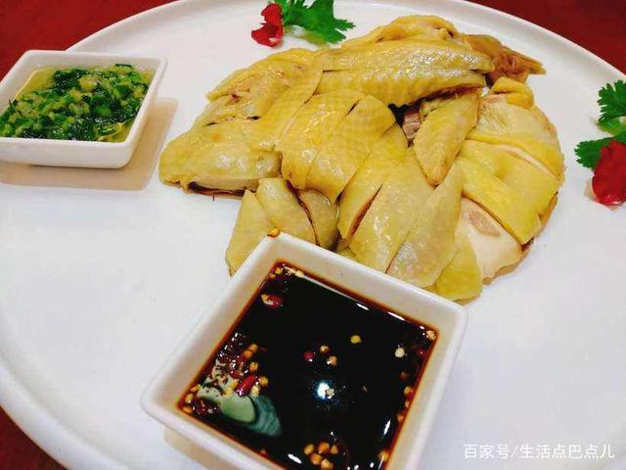
3.Guangdong cuisine--粤菜
Duck Web in Oyster Sauce
蚝油鸭掌
BBQ Pork with Honey Sauce
蜜汁叉烧
Sweet and Sour Pork
菠萝咕噜肉
Roast Suckling Pig
烤乳猪
Boiled Chicken with Sauce
白切鸡

Slide 5
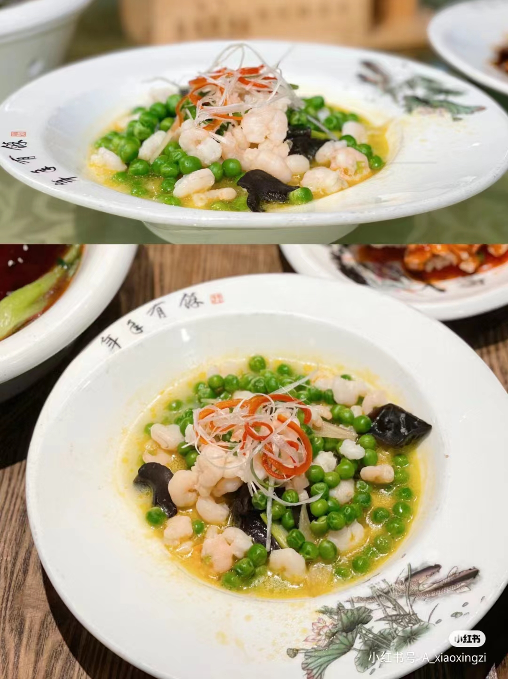
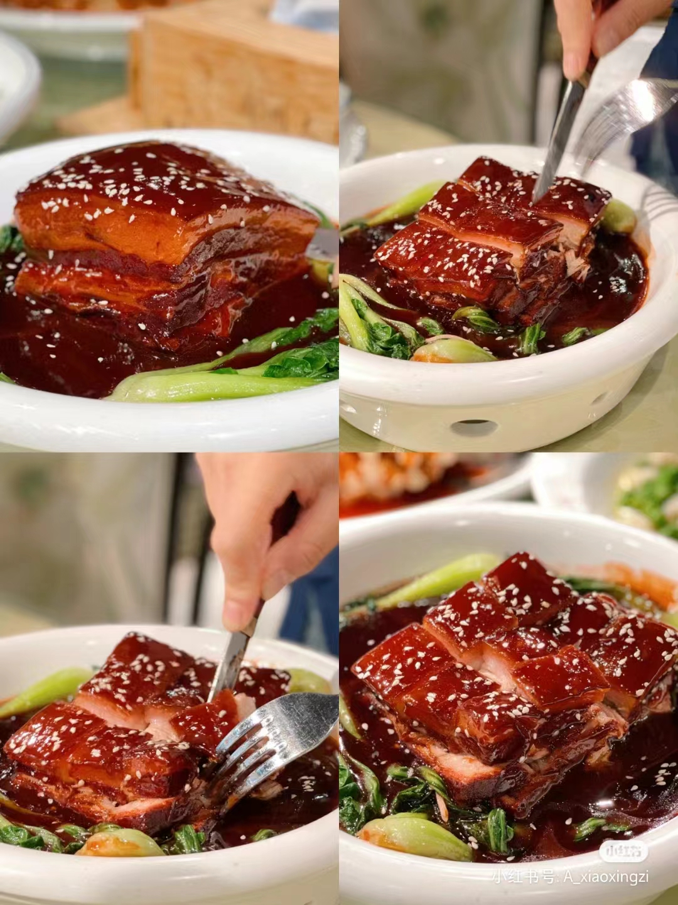
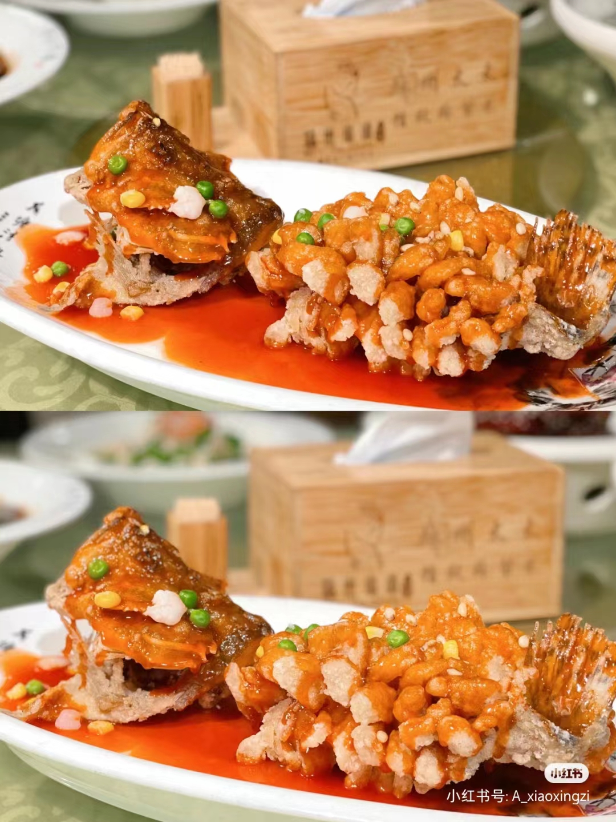
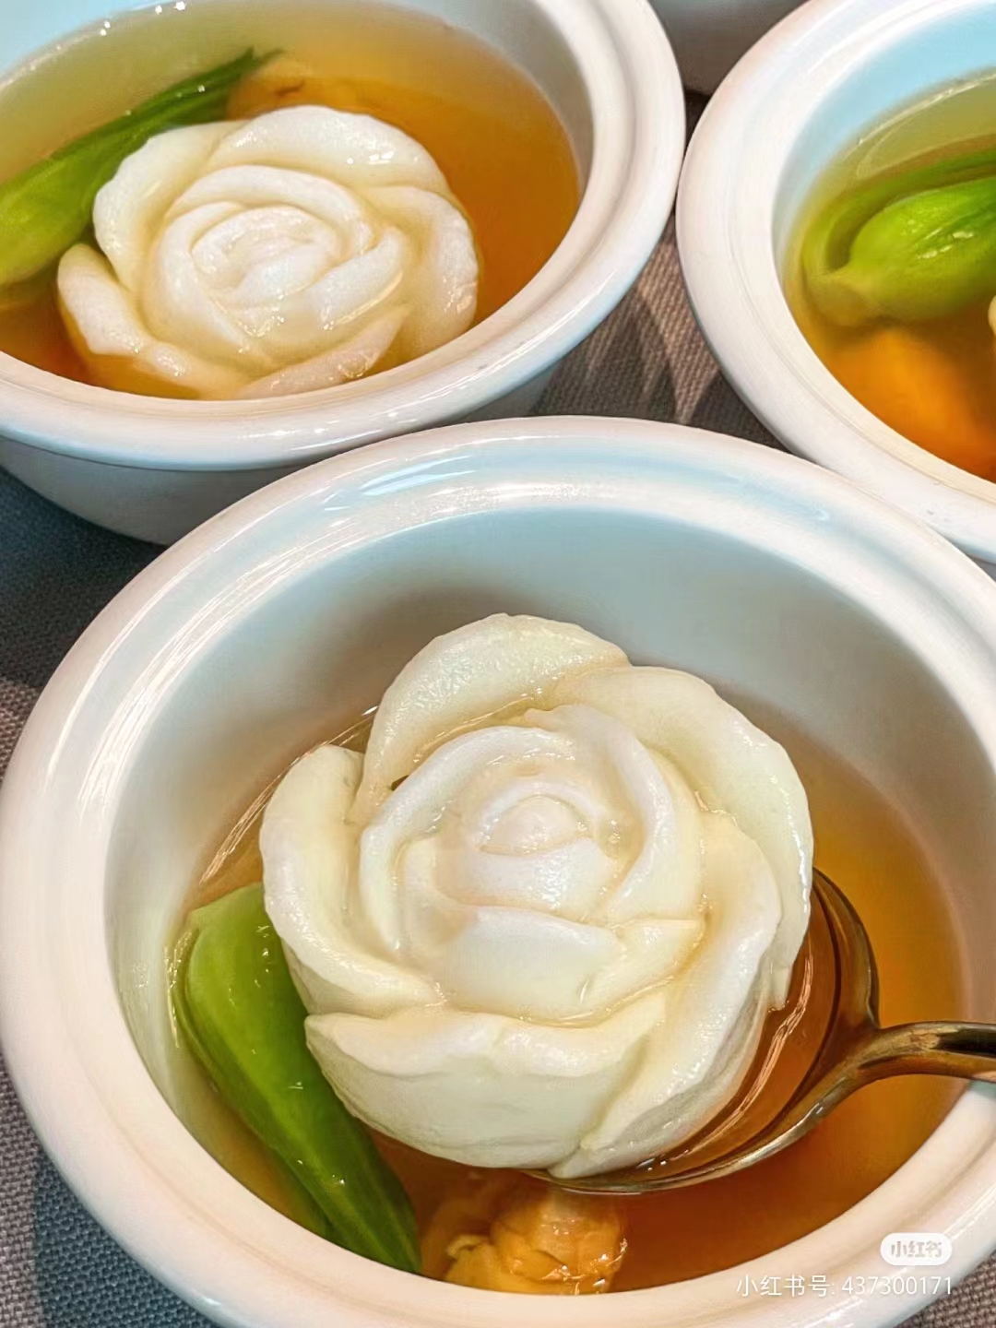
4.Jiangsu-Zhejiang cuisine--苏菜
It is popular in the middle and lower reaches of the Yangtze River and it is characteristically very sweet. In the process of cooking, cutting technique and temperature control are emphasized.

Slide 6
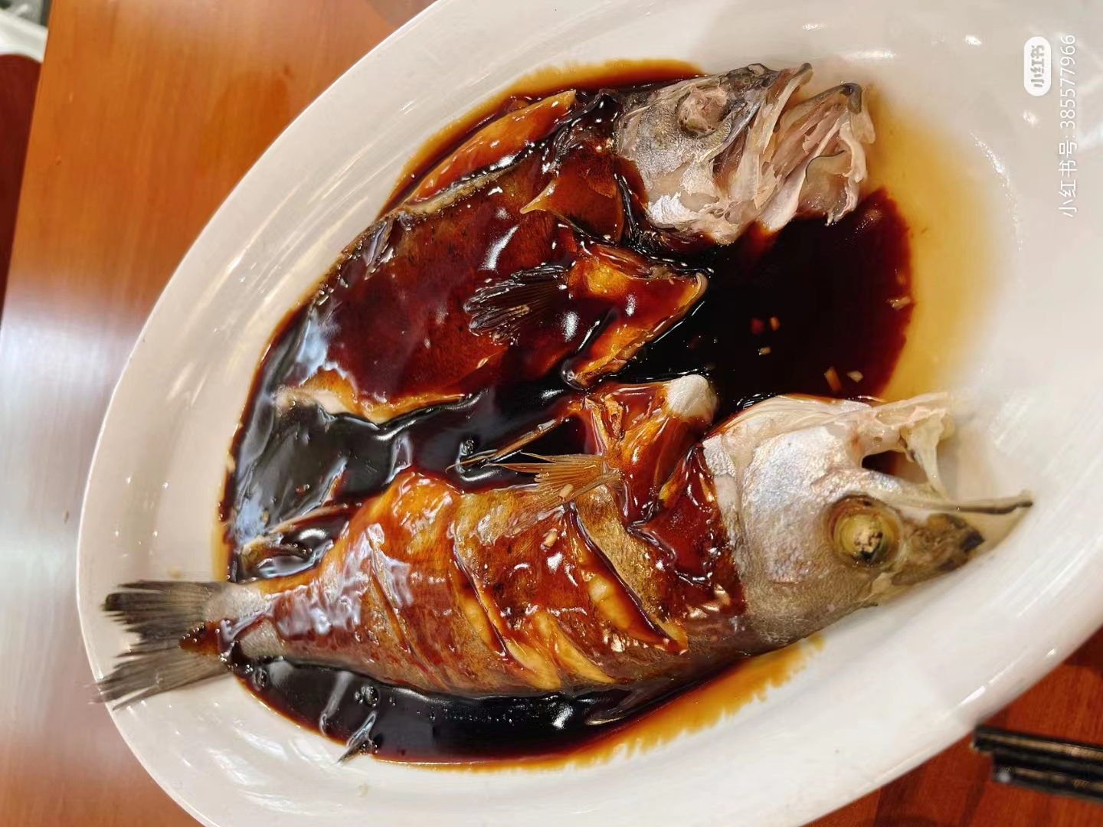
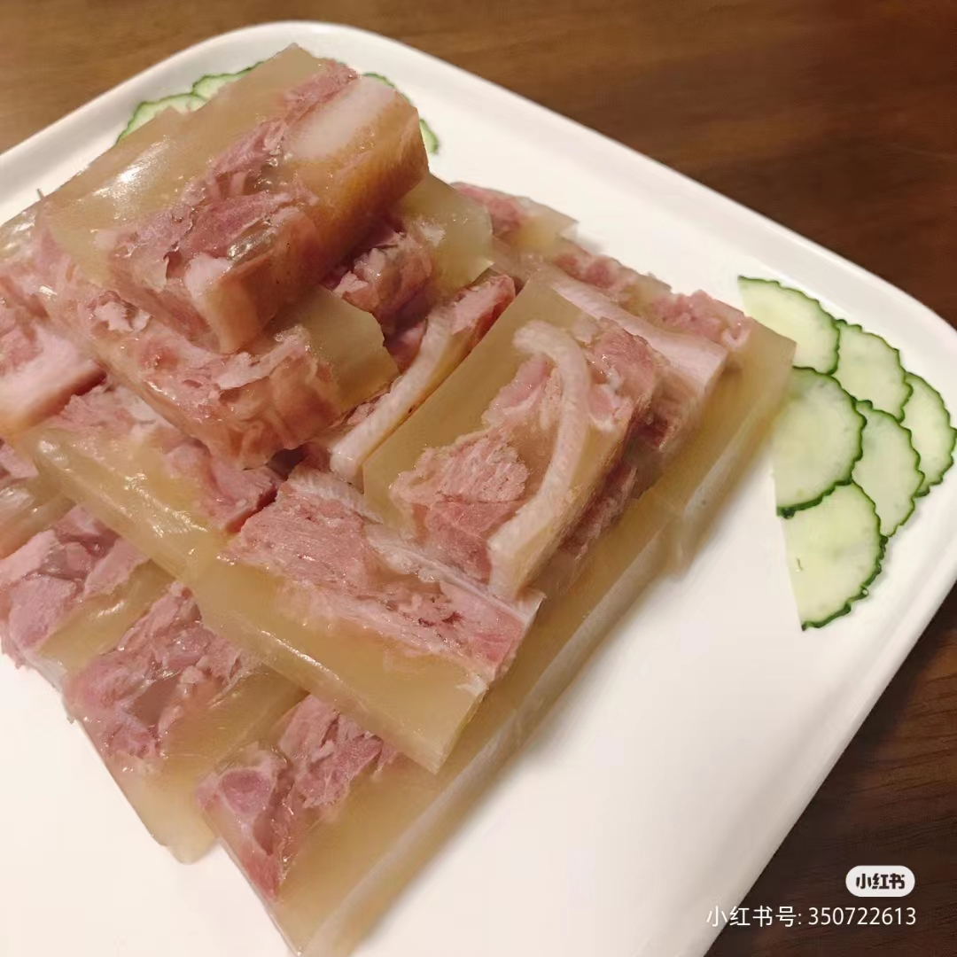
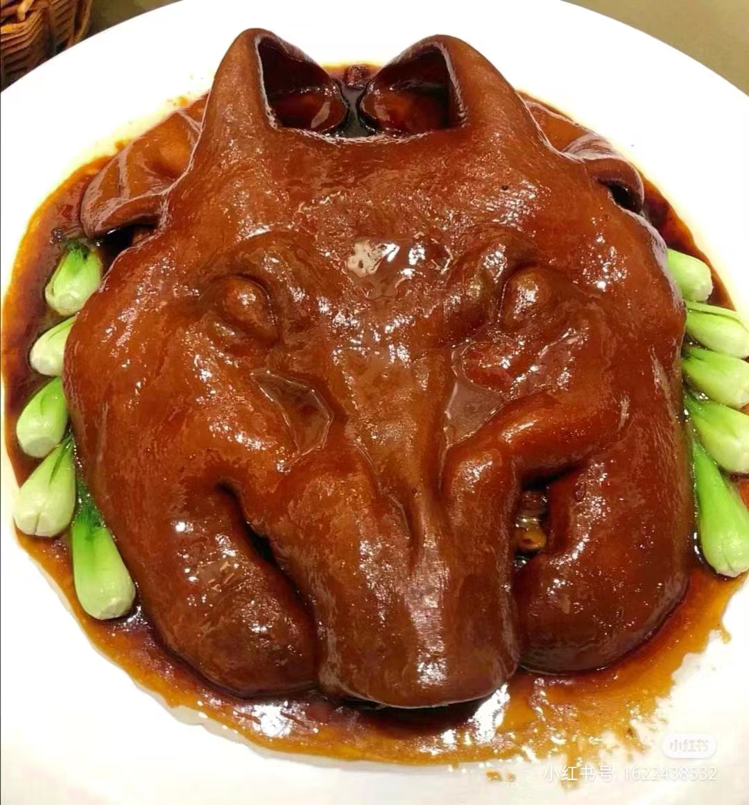
4.Jiangsu-Zhejiang cuisine--苏菜
Crystal Pork
水晶肉
West Lake Fish in Vinegar Sauce
西湖醋鱼
Simmered Pork Head
扒烧猪头

Slide 7
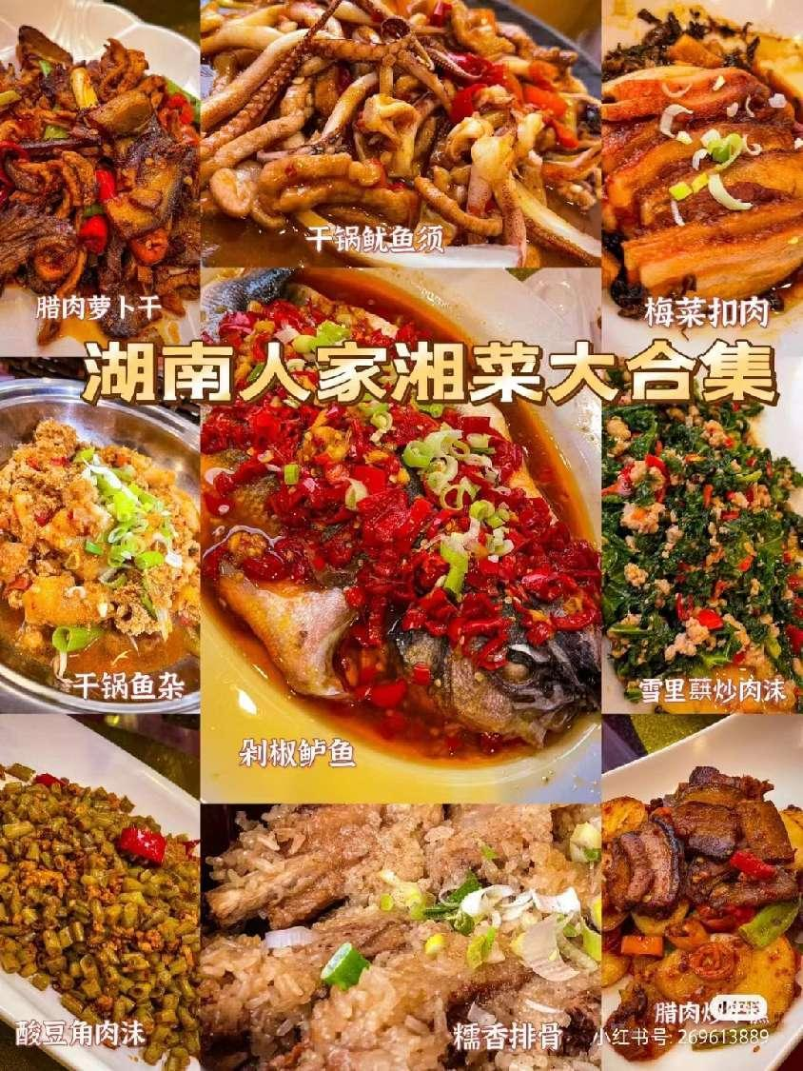
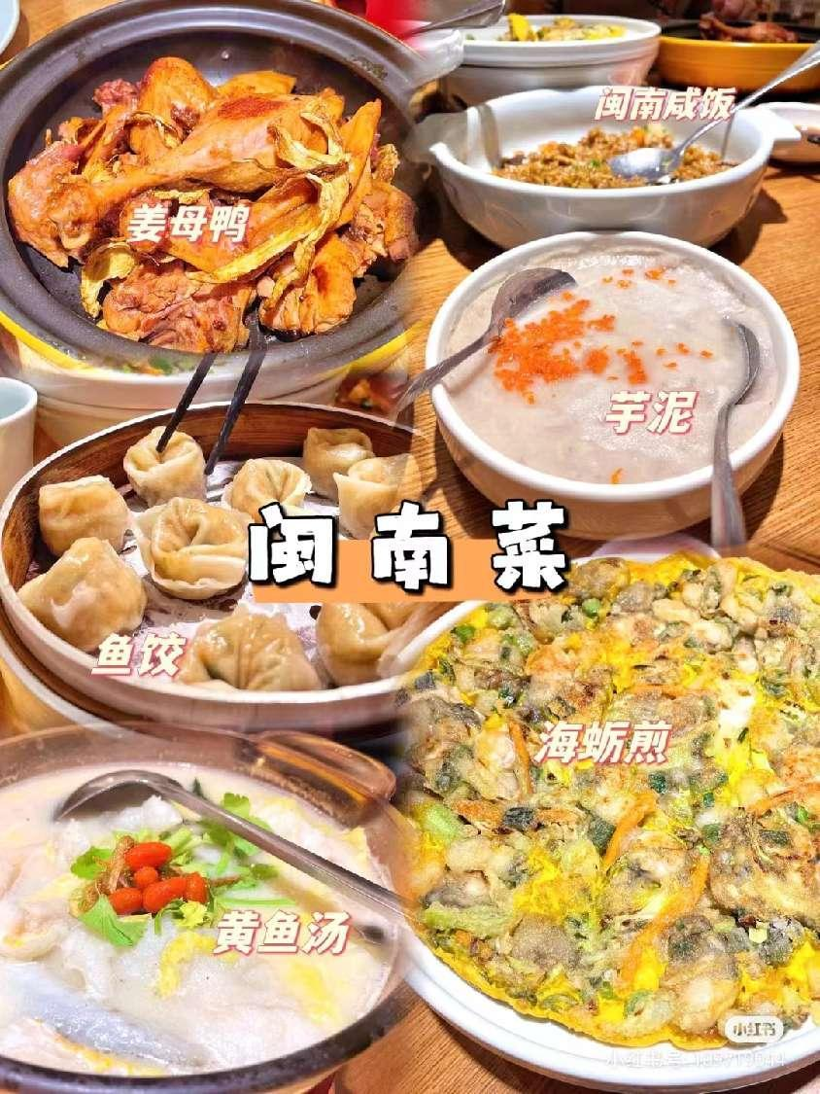
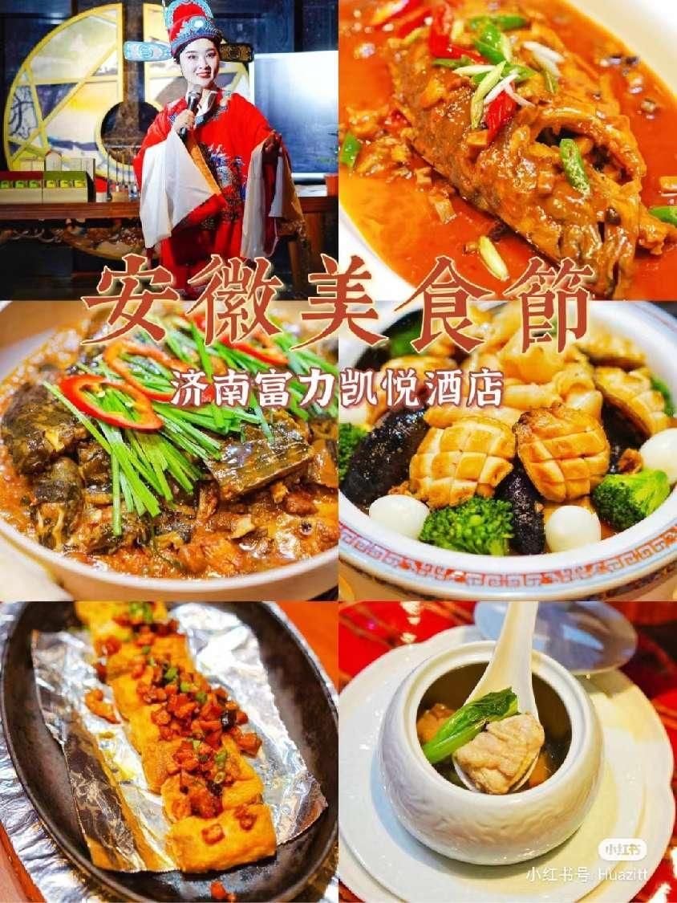

In addition to the principal cuisines mentioned above, there’re more than twenty other well-known styles, which include Peking cuisine, Henan cuisine, Hunan cuisine, Hubei cuisine, Anhui cuisine, Fujian cuisine, Muslim cuisine and vegetarian cuisine.

Slide 8
Thanks！

