Slide 1
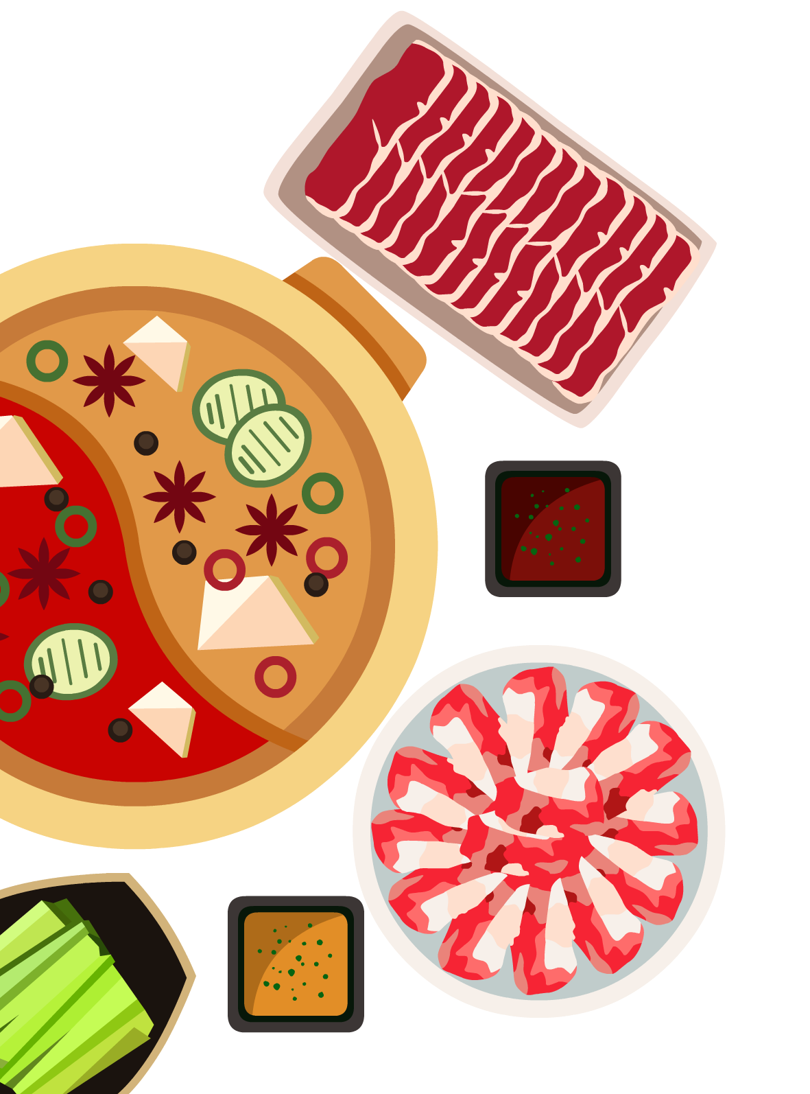
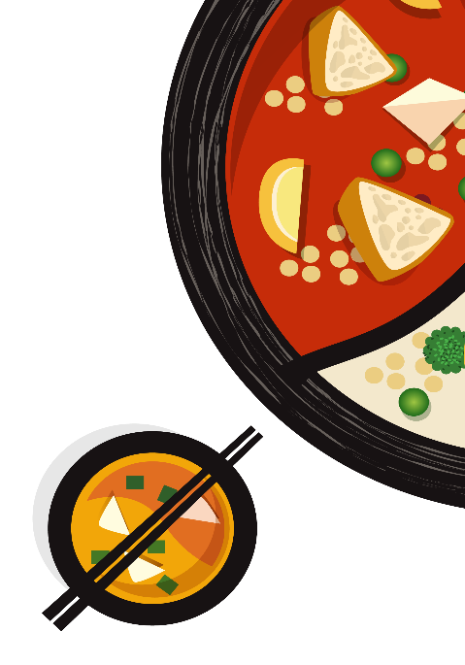
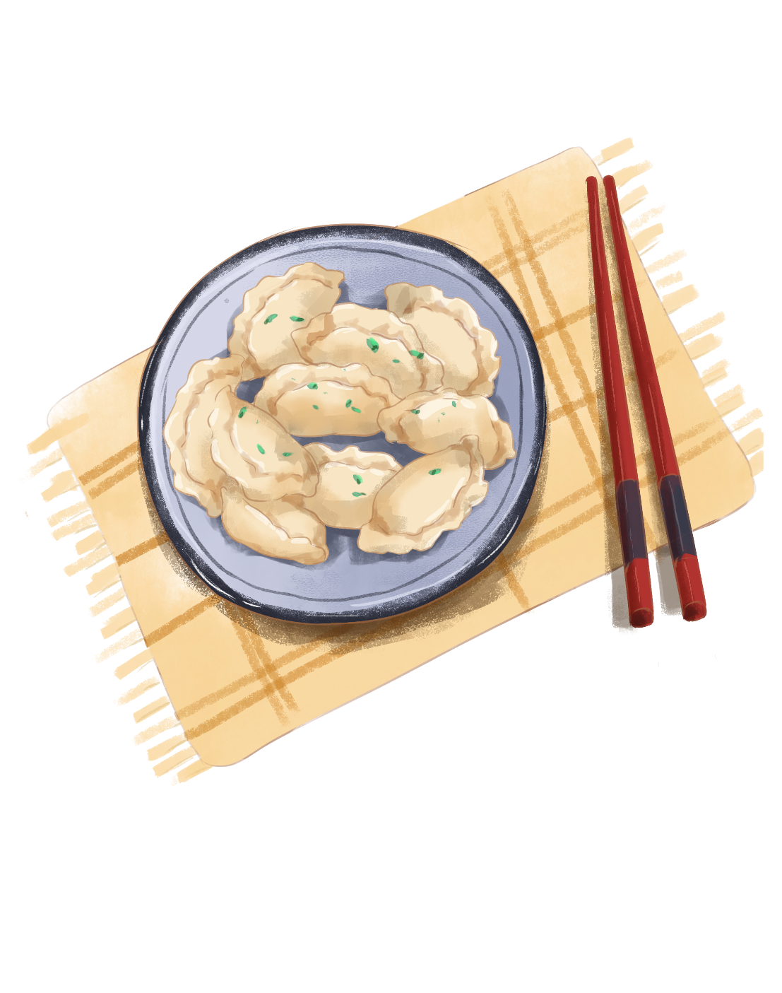
Traditional Cuisine:
Two Famous Dishes
3.08

Slide 2

目录
Peking Roast Duck
Mutton Hotpot

Slide 3

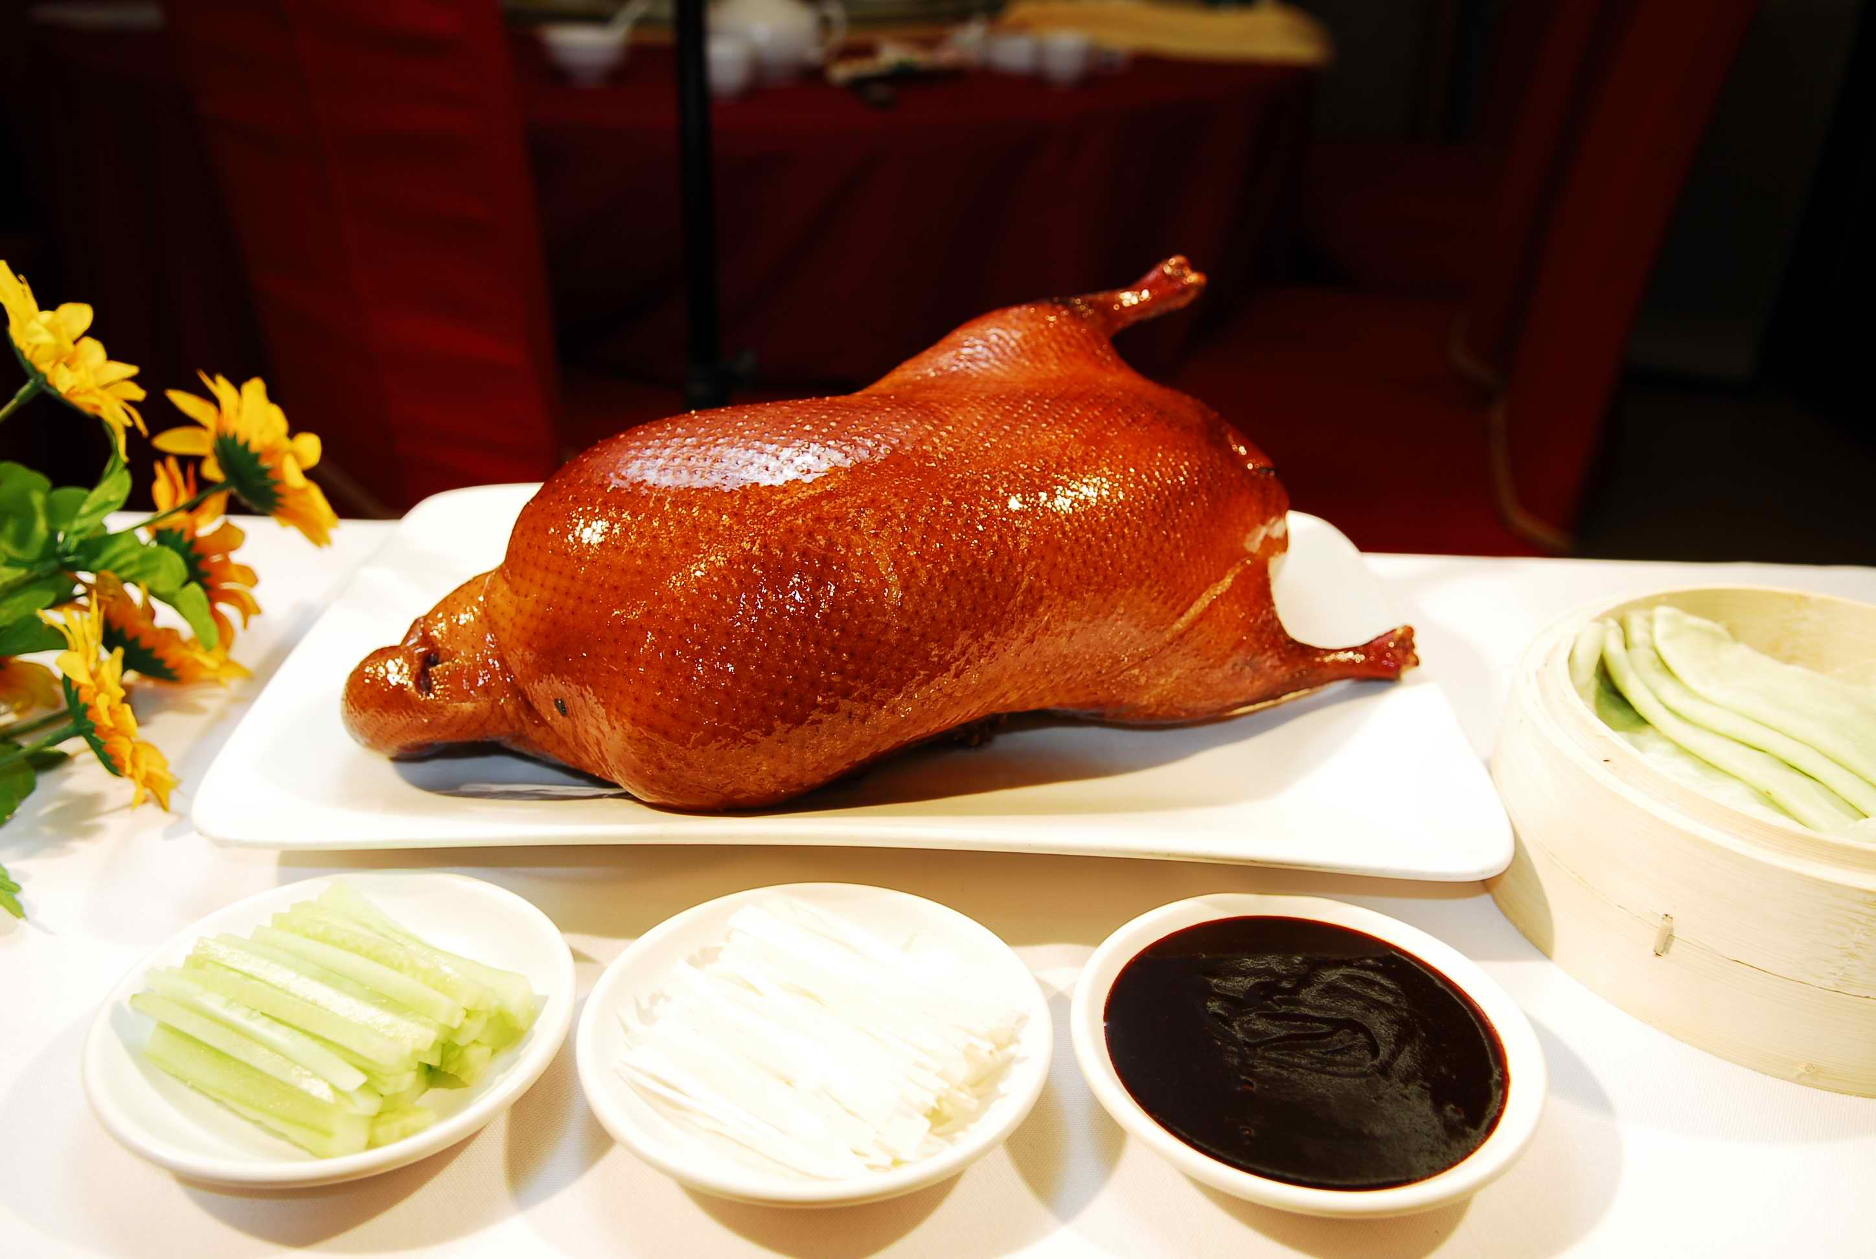
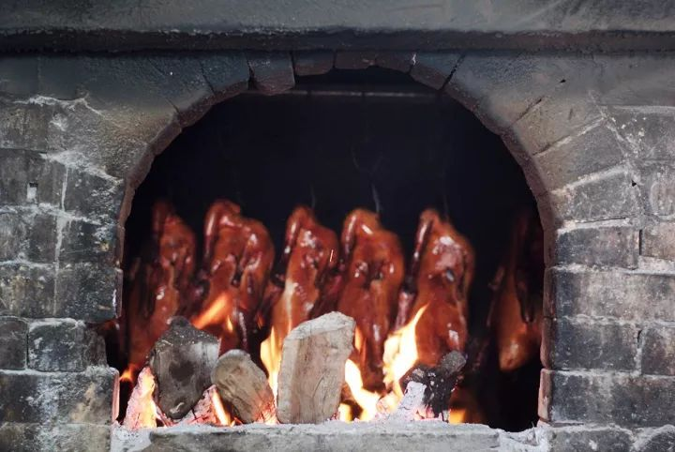
Peking Roast Duck
The type of the duck: specially bred Peking crammed (force-fed)
History:Peking Roast Duck dates back to 300 years,and originated in the Ming imperial kitchen.
Delicious favor: a combination of color, aroma and taste(色香味俱全）
Taste: a crisp skin, and a mouth-melting favor

Slide 4

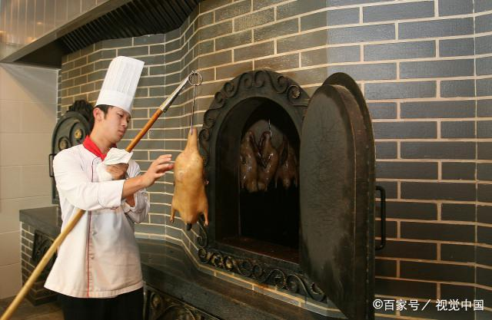
Peking Roast Duck
Peking duck is roasted in a specially constructed oven, which is square outside, has a crescent-shaped door, and is round inside, where there are two racks for hanging ducks. Underneath is a fire pit where such hardwood as date, peach and pear is used as fuel. Fruit tree branches are supposedly able to impart a fruity fragrance to the duck. Nowadays, however, electric ovens are used for environmental and sanitary reasons.

Slide 5
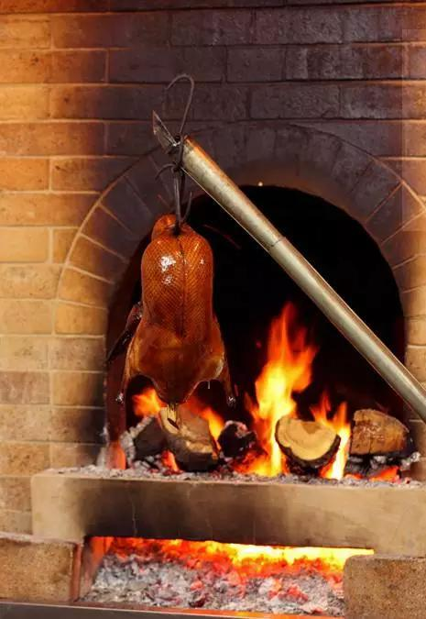

Peking Roast Duck production process
Before roasting, the duck is plucked and gutted, and has air pumped in.
Then it is brushed with a maltase solution and dried in an airy place. The duck is then half filled with water and ready for roasting.
The knack of roasting is the time and temperature. Experienced chefs are able to regulate the heat and turn each duck so that it is evenly roasted.
While the outside of the duck is roasted, the inside of the duck is steamed by the evaporating water. The duck is done when it has turned golden brown.

Slide 6
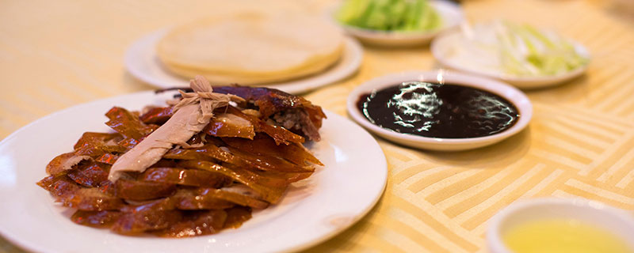
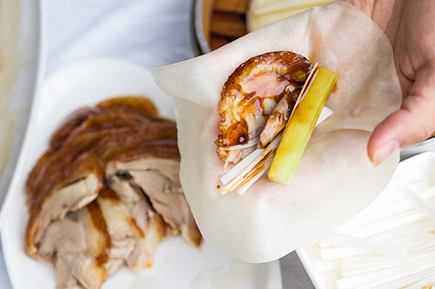
How to eat Peking Roast Duck
The first way is to dip the crispy skin of the duck in white sugar and serve a small dish of white sugar with the roast duck.
The second way is to add a few slices of roast duck and a few spring onion strips to the roast duck and roll up the roast duck with chopsticks.
The third way is to serve with garlic paste and sweet noodle sauce, with strips of radish, etc., rolled up in a lotus leaf cake.

Slide 7
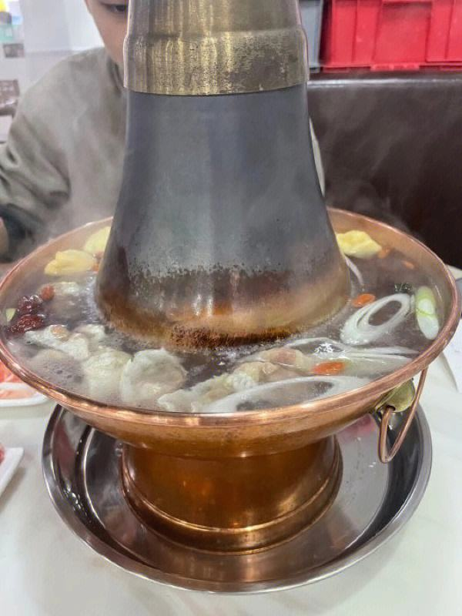
Mutton Hotpot
Mutton Hotpot, a chafing dish, is very popular with Pekingers, especially in winter.
kitchenware: the pot is a charcoal stove with a central chimney and an outer ring filled with water for cooking.
area: it originated in North China.
history: it has a history of more than one thousand years. According to historical records, when Emperor Jiajing of the Qing Dynasty (1664-1911) came to the throne in 1796, he gave a celebration banquet at which 1, 550 hotpots were used to treat the guests.

Slide 8
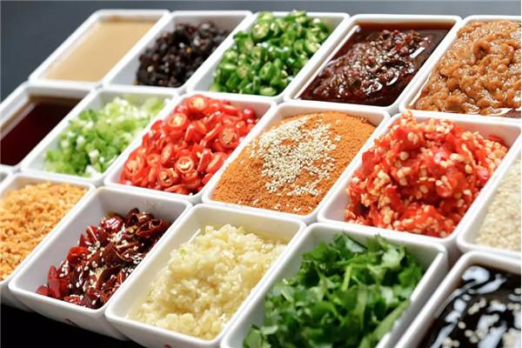
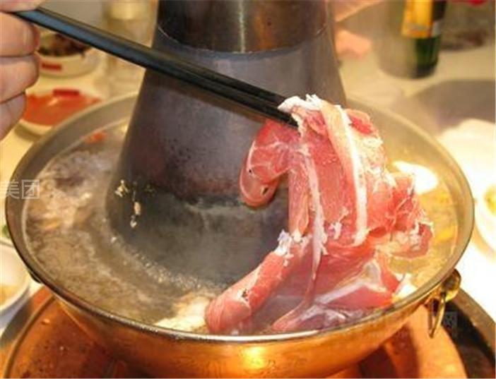
How to eat Mutton Hotpot
For such a hotpot, only tender mutton should be used, and it should be cut into paper-thin slices. The mutton is cooked at the table in the hotpot. The diner immerses a piece at a time into the boiling water in the pot. The meat is done in a few seconds. Then the diner dips it in his individual bowl of sauce, which is a blend of several ingredients: soy sauce, chili sauce, sesame paste, chopped chives, glutinous rice wine, shrimp sauce, vinegar and coriander. Besides mutton, silver noodles, Chinese cabbage, and seafood can also be cooked in this way.

Slide 9
Thanks.

