Slide 1
Chinese Literature
By: Arnold Qin

Slide 2
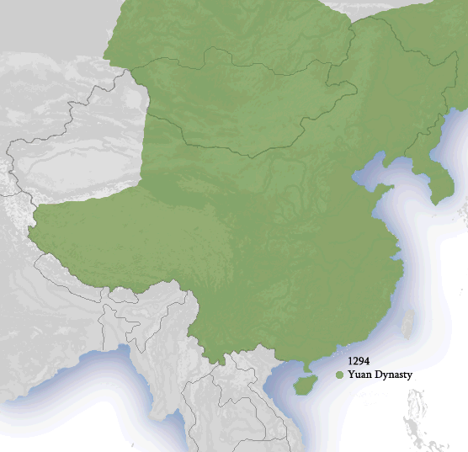
Yuan Dynasty(1271-1368)
Notes:
Although the Mongolians had ruled northern China for decades, it was not until 1271 that Kublai Khan proclaimed the dynasty in traditional Chinese style.
It is the shortest dynasty yet also the “largest” in terms of its extensive size. It was the first non-Han dynasty to rule all of China.
During this time period, chinese literature spread really far, and had its authors had very diverse backgrounds (such as Muslims, Koreans, etc.).

Slide 3
3 major elements
Maturation of colloquial literature
Widespread in Song – print circulation
No longer stuck to civil examinations
Free from certain sets of writing.
Fu no longer lufu
Poetry more lyrical
Ethnic Writers
Produced many classical and popular forms.
Notes:
Because of the Yuan’s unique political situation (for example succession was a major issue: caused lots of struggle) there is a perceivable change in Chinese literature. However, because the dynasty was so short we can only notice its effects afterwards.
The language in these texts are more focused on performance. Either simple classical chinese, or the colloquial “imitating ordinary speech”.
Book is rather confusing??
Many types of writing transformed radically. Poetry became more lyrical, like during the Tang Dynasty.
Fu, abandoned the “regulated fu” (the lufu).
Prose did not change because it was still associated with the Daoxue scholars who needed to “order the world”

Slide 4
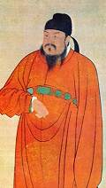
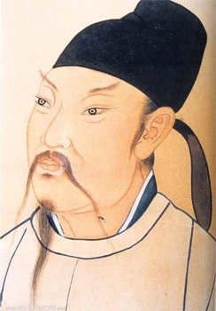
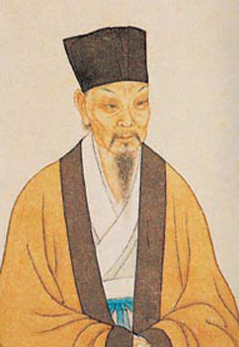
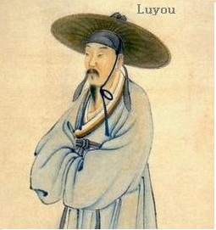
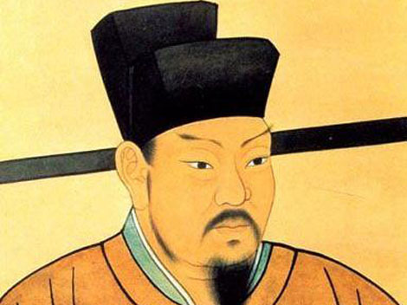
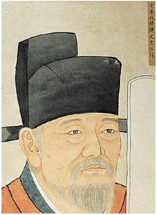
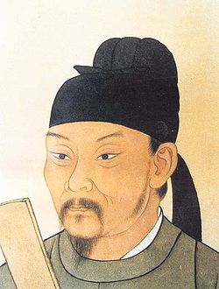
groups vs persons
Valley between the classical canon and new colloquial literature.
Popular Stories:
Plain stories: “pinghua”. Just historical narratives., northern plays (zaju),
Souther dramas (sanqu).
Readers faced issue:
Colloquial literature does not follow the same rules of preservation and
Euphemism.
Literature (especially poetry) faced constant change.
Later dynasties often re-did works, and reflected the language and
idealology of the editors rather then the original authors.
Notes:
Wang Wei
Li Bai
Su Shi
Du Fu
Ouyang Xiu
Wang Anshi
Lu You
In the past, we could use them to structure a literary history. However, now we only find groups, such as FOUR GREAT POETS OF THE YUAN. Or POETRY SOCIRTY OF MOON SPRING. And the Three Elders of Dragon Mountain.
Because the dynasty was so short, there was no rise of any single true genius, rather the Yuan liked to discuss forms of literature (both hybrid and popular)
You see, colloquial songs were considered nonserious literature, and did not have the same process of review, discussion, and selection.
We have to look at what was happening at the time, rather then what it was based on.

Slide 5
Assimilation of literature?
Lesser Confucian ideals
Confucian was really just to maintain order.
No literary inquisitions
A relationship possibly exists. Happened before in Song.
Mongols were not concerned about court infighting
Disestablishment of examinations
“Was the Jin lost because of Confucianism?” – Khubilai
For the scholars it was terrible! But for literature it was good!
Writing was no longer paired with its most important use: arguably: success in examinations.
Notes:
Court infighting happened previously- advisors would argue if something was ethical or not.
Mongols weren’t too concerned about the Chinese official’s weird obsession with writing. They were barely literate.
Funny story about Sangha, a smart but power hungry minister that was later purged/killed. Later, some high court officials tried to exile another minister on charges that they wrote a “poem eulogizing Sangha in the most profuse language!”. Khubilai responded on “what crime did he commit?? “
The examinations was a critical backbone of the education system and the typical path to social and political power. Over the years it was reintroduced on a small scale then later abused, then removed totally. It devolved into techinical skills rather then classics and poetry.
Now, inorder to rise in politics it was all based on patronage and personal recommendations. The examinations and fu were a very important part of Confuciansim.
It was thought that Confucian scholars were hated and treated poorly during this time, but no evidence supports this.

Slide 6
Yuan Literature
North/South China – 107 years of division.
Reclamation of Tang poetics.
Yuan Haowen - major influence in the north.
Good Poetry
Major historic work
Influence
Local hero
Famous teacher (because of house arrest)
Local affiliation was important in this fractured and uncertain time period (Confucian).
Notes:
107 years by the time the Jin dynasty fell.
Jin Writers – north style.
End of Jin – shift to Tang poetry style. Not Song.
Yuan emerged from the collapse of the Jin as a major figure in three ways:
1) He wrote very very good poetry. – Called poetry of Loss and chao. Maybe comparable to Du Fu!
2) Traveled and compiled a very important historical work: The Miscellaneous Compilation of Events of the Renchen Years –now lost.
Last, he had a huge influence over the first generation of northern writers in Yuan. There are two attributes to this. He was a local hero –contemporary influence on the formation of writers from Shanxi.
House arrest after fall of Jin caused him to become a famous teacher.

Slide 7
Various old holdovers
The “Various Old Holdovers from the Yellow and Fen Rivers”- one of the first recognizable groups in North after Jin.
Writings were collected and anthologized by Fang Qi
Yimin shi (former but lost state)
Hao Jing – important figure in transition to Yuan
One of the first to promoted school of Daoxue
More subjective
Wang Yun – (wenchen) Cultural Anxiety
Writing contrasted with Hao Jing’s
High political office early in Yuan
Ghost author of edicts
Notes:
It was 8 writers.
All went to war together,
All friends with Yuan Haowen
All shared similar tenor and style in poetry.
All dropped out of givernment service.
Their poetry was like nostalgia for one’s lost state.
Adopted Yuan’s model of integrity- they refused to serve the new dynasty and worked to preserve the traditions of the Jin.
Poetry was on loss and suffering – this caused the revival of Song tradition of looking at Du Fu’s poetry in its sullen deep feelings and lyricism.
One person, Hao Jing, was under house arrest for 16 years.
Because of this, his works reflected on depending on nothing outside ones self –the Daoxue philosophy.
Focused on interiority.
Poetry featured rhymes and was considered eccentric.
The poetry is praised but the writing is rather poor. Not very interesting. Dry.
Wang Yun –importance
-very very prolific – over 3k poems
Not subjective, but rather documentary essays of events and places
True for poems too.
Possibly the first “literary offical” – wrote from a sense of duty
It told about hardships in the north or detailed analyses of political events.
BORING UNPOLISHED
Only redeeming feature is that they are very detailed. Sometimes too much.
His poetry harks back to the Tang era, and he was a pioneer in the development. He really liked the Tang poets.
Like Yuan, he really wanted to preserve northern Chinese culture while under Yuan control.

Slide 8
Northern Contributions cont.
Liu Yin (1249-1293)
Compared yet differed from Xu Heng.
Served in office for very brief period.
Not a “remnant holdover” –loss of Song was traumatizing.
Ethics & Sensibility
(writing is in there…)
Learning & Practice
Politics & Cultural Production
Amazing
Chart
Notes:
Liu Yin was a complex and interesting person.
He was compared to another notable Confucian scholar: Xu Heng.
Xu willingly served the Mongols, and just encouraged them to place Confucian rule in China.
Liu, however, refused, and declined many requests to serve.
Why did he decline? Later Dynasties discussed this a lot!
He lamented the fall of the Jin. Before he held relatively no judgment about the Yuan, but now mourned the loss of the Song.
When he was young he wanted to serve, but after the Song fell he no longer wanted to.
Don’t think of it as a loss of a state, but we can view it in terms of Chinese Culture.
Liu was interested in the Daoxue as a “Chinese Way” (Hanfa). The Mongols, however, were not interested in cultural preservation.
Those traditions are very intertwined.

Slide 9
Images
Li Bai Wang Wei Du Fu Ouyang Xiu Su Shi Wang Anshi Lu You

