Slide 1
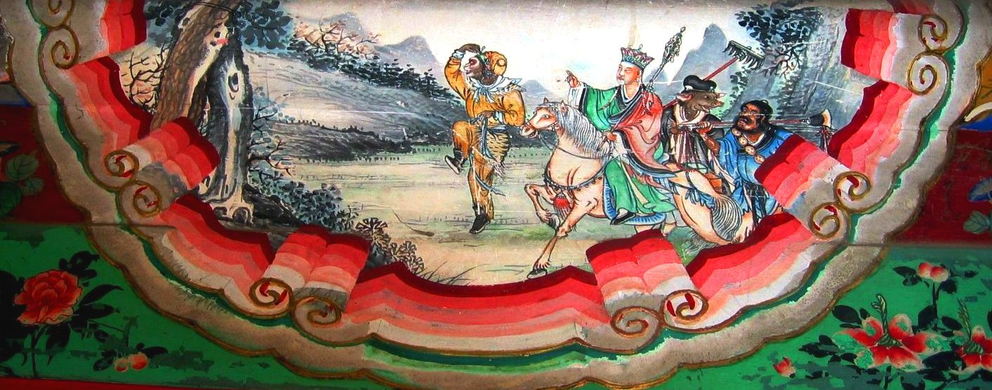
Journey to the West
By: Arnold Qin

Slide 2
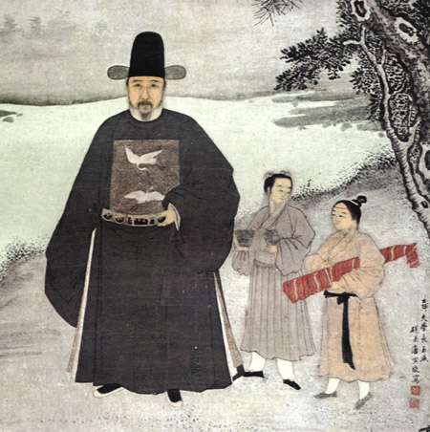
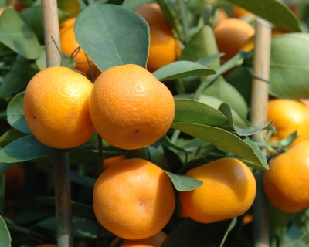
Author – Wu Cheng’en
Lianshui, Jiangsu province – moved to Huaian. (1501-1582)
Financial difficulties [1]
Wished to become a mandarin
Entered university – gained position
Resigned and went home to write
Poor and childless [ 2]
Hermit
Notes:
His father, Wu Rui, had a good primary education and was pretty adept at studying, however due to financial difficulties he would remain an artisan. Wu grew up with a similar disposition, with a great enthusiasm for literature.
Wu did take the imperial examinations several times in attempt to become a mandarin (a scholar official – standard vocab for the Ming Dynasty). However he never passed.
He did however, enter an imperial university and became an official. This happened in his middle ages, and sadly he never enjoyed his work. He resigned and sources speculate he probably spend the rest of his life writing stories/poems in his hometown.
It was during this time he rose to become an accomplished writer, and became friends with several other “famous” contemporary writers.
He became a hermit because he thought the world was corrupt and did not approve of the political climate.
He is mainly attributed to have written JTTW but he did write a lot of other poems and stories. Sadly most have been lost.
They have been described as stubborn and was very critical of society’s corruption. Again his works do not follow the classical styles, but they weren’t as vulgar as the JTTW

Slide 3
Background
Four Great Classical Novels
Social pressures – published anon
Written in vernacular tongue
Still uncertain of authorship [3]
Mythology, fantasy, adventure
Many forms & different genres
Bite-sized “episodes”
Notes:
- Regarded as one of the Four Great Classical Novel of Chinese Literature.
-
There was a trend at the time to write literature to imitate the classical literature of the Qin, Han, and Tang dynasty, which was written in Classical Chinese.
Wu however went against this and wrote THE JOURNEY TO THE WEST in common terms. Hence it is believed he published it anonymously because of the bad reputation the “vulgar” literature had.
We are still not clear who wrote the novel as it was never referenced in his other works. Buuuuut we’re pretty sure it is him.
\
The fact is has shown up in so many different forms suggest that publishers and editors felt free to revise and adapt it at will. This is a stark contrast between The Plum in the Golden vase, it was shown with a high degree of respect by publishers and editors as all later versions of the novel show very little differences.
In addition, the book is easily broken up into pieces for reading, performance, storytelling, etc. Probably helped in its popularity.

Slide 4
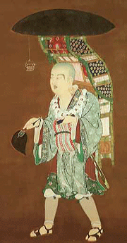
Xuanzang
Renounced family to become monk
Weakest in group
Sent off to find holy scriptures
Things always try to eat him
Stubborn… probably not smartest
Notes:
The monk Xuanzang (also referred to in the story as Tang Sanzang, meaning "Tang Tripitaka Master", with Tang referring to the Tang Dynasty and Sanzang referring to the Tripitaka, the main categories of texts in the Buddhist canon which is also used as an honorific for some Buddhist monks) is a Buddhist monk who had renounced his family to become a monk from childhood.
He is just called Tripitaka in many English versions of the story. He set off for Dahila kingdom (天竺国, an appellation for India in ancient China) to retrieve original Buddhist scriptures for China. Although he is helpless in defending himself, the bodhisattva Avalokiteśvara (Guanyin) helps by finding him powerful disciples who aid and protect him on his journey. In return, the disciples will receive enlightenment and forgiveness for their sins once the journey is done. Along the way, they help the local inhabitants by defeating various monsters and demons who try to obtain immortality by eating Xuanzang's flesh.

Slide 5
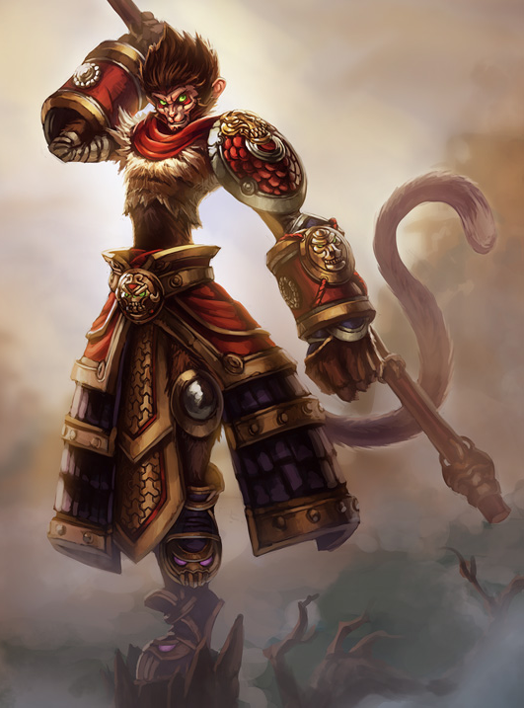
Sun Wukong
Super powerful - immortal
Demonic
Poetic, brave and fearless
Character develops during pilgrimage
“Childish”
Notes:
Sun Wukong is the name given to this character by his teacher, Subhuti, the latter part of which means "Awakened to Emptiness" (in the Waley translation, Aware-of-Vacuity); he is called Monkey King. He is born on Flower Fruit Mountain from a stone egg that forms from an ancient rock created by the coupling of Heaven and Earth. He first distinguishes himself by bravely entering the Water Curtain Cave on the mountain; for this feat, his monkey tribe gives him the title of "Handsome Monkey King".
After angering several gods and coming to the attention of the Jade Emperor, he is given a minor position in heaven as the Keeper of Horses (弼马温) so they can keep an eye on him. This job is a very low position, and when he realises that he is put into such a low position and not considered a full-fledged god, he becomes very angry. Upon returning to his mountain, he puts up a flag and declares himself the "Great Sage Equal to Heaven." Then the Jade Emperor dispatches celestial soldiers to arrest Sun Wukong, but no one succeeds. The Jade Emperor has no choice but to appoint him to be the guardian of the heavenly peach garden. The peaches in the garden bear fruit every 3,000-years, eating its flesh will bestow immortality, so Sun Wukong eats one and becomes more powerful and matchless. Later, after fairies who come to collect peaches for the heavenly peach banquet inform Sun Wukong he is not invited and make fun of him, he starts causing trouble in Heaven and defeats an army of 100,000 celestial troops, led by the Four Heavenly Kings, Erlang Shen, and Nezha. Eventually, the Jade Emperor appeals to the Buddha, who detains Wukong under a mountain called Five Elements Mountain. Sun Wukong is kept under the mountain for 500 years, and cannot escape because of a spell that was put on the mountain. He is later set free when Xuanzang comes upon him during his pilgrimage and accepts him as a disciple.
His primary weapon is the "Ruyi Jingu Bang", which he can shrink down to the size of a needle and keep in his ear, as well as expand it to gigantic proportions. The rod, originally a pillar supporting the undersea palace of the Dragon King of the East Sea, weighs 18,000 pounds, which he pulls out of its support and swings with ease. The Dragon King had told Sun Wukong he could have the staff if he could lift it, but was angry when the monkey was actually able to pull it out and accused him of being a thief; hence Sun Wukong was insulted, so he demanded a suit of armour and refused to leave until he received one. The Dragon King, unwilling to see a monkey making troubles in his favourite place, also gave him a suit of golden armour. These gifts, combined with his devouring of the peaches of immortality, three jars of elixir, and his time being tempered in Laozi's Eight-Trigram Furnace (he was put in there to be burnt to death, but instead the furnace gave him a steel-hard body and fiery golden eyes that can see very far and see through any disguise, but his eyes are weak to smoke. He is always able to recognise a demon in disguise, even though the rest of the pilgrimage cannot), makes Sun Wukong the strongest member of the pilgrimage by far. Besides these abilities, he can also pluck hairs from his body and blow on them to convert them into whatever he wishes (usually clones of himself to gain a numerical advantage in battle). Although he is a master of the 72 methods of transformation (七十二变）,[4] such as birds, which would give him the ability to fly, he can use his "somersault cloud" enabling him to travel vast distances in a single leap. The monkey, nimble and quick-witted, uses these skills to defeat all but the most powerful of demons on the journey.
Sun's behavior is checked by a band placed around his head by Guanyin, which cannot be removed by Sun Wukong himself until the journey's end. Xuanzang can tighten this band by chanting the "Ring Tightening Mantra" (taught to him by Guanyin) whenever he needs to chastise him. The spell is referred to by Xuanzang's disciples as the "Headache Sutra", which is the Buddhist mantra "oṃ maṇipadme hūṃ". Xuanzang speaks this mantra quickly in repetition.
Sun Wukong's child-like playfulness is a huge contrast to his cunning mind. This, coupled with his great power, makes him a trickster hero. His antics present a lighter side in what proposes to be a long and dangerous trip into the unknown.

Slide 6
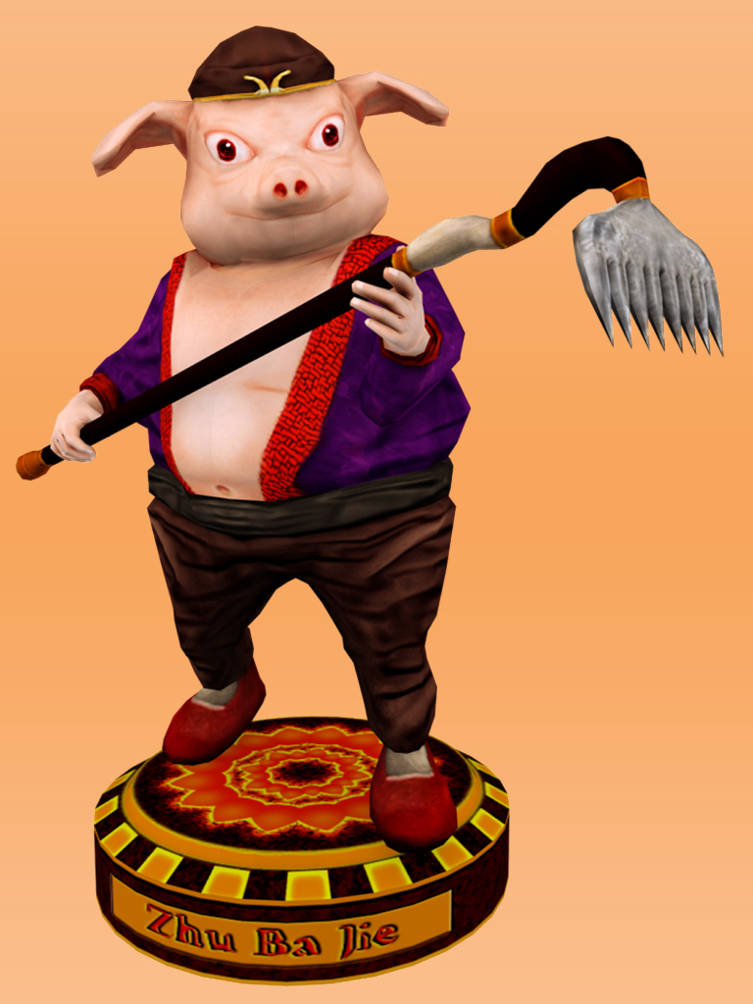
Zhu Bajie
Once an immortal
Banished due to flirting
Reincarnation Wheel Error
Commissioned to accompany monk to India
2nd strongest in team
Notes:
Pig of Eight Prohibitions
Once an immortal who was the Marshal of the Heavenly Canopy commanding 100,000 naval soldiers of the Milky Way, he drank too much during a celebration of gods and attempted to flirt with the moon goddess Chang'e, resulting in his banishment into the mortal world. He was supposed to be reborn as a human, but ends up in the womb of a female boar due to an error at the Reincarnation Wheel, which turns him into a half-man half-pig monster. Zhu Bajie was very greedy, and could not survive without eating ravenously. Staying within the Yunzhan Dong ("cloud-pathway cave"), he was commissioned by Guanyin to accompany Xuanzang to India and given the new name Zhu Wuneng.
However, Zhu Bajie's indulgence in women led him to the Gao Family Village, where he posed as a normal being and wedded a maiden. Later, when the villagers discovered that he was a monster, Zhu Bajie hid the girl away, and the girl wailed bitterly every night. At this point, Xuanzang and Sun Wukong arrived at the Gao Family Village and helped defeat him. Renamed Zhu Bajie by Xuanzang, he consequently joined the pilgrimage to the West.
His weapon of choice is the jiuchidingpa ("nine-tooth iron rake"). He is also capable of 36 transformations (as compared to Sun Wukong's 72), and can travel on clouds, but not as fast as Sun. However, Zhu is noted for his fighting skills in water, which he used to combat Sha Wujing, who later joined them on the journey. He is the second strongest member of the team.
The third and longest section of the work is chapters 13–99, an episodic adventure story in which Xuanzang sets out to bring back Buddhist scriptures from Leiyin Temple on Vulture Peak in India, but encounters various evils along the way. The section is set in the sparsely-populated lands along the Silk Road between China and India, including Xinjiang, Turkestan, and Afghanistan. The geography described in the book is, however, almost entirely fantastic; once Xuanzang departs Chang'an, the Tang capital, and crosses the frontier (somewhere in Gansu province), he finds himself in a wilderness of deep gorges and tall mountains, inhabited by demons and animal spirits, who regard him as a potential meal (since his flesh was believed to give immortality to whoever ate it), with the occasional hidden monastery or royal city-state amidst the harsh setting.
Episodes consist of 1–4 chapters and usually involve Xuanzang being captured and having his life threatened while his disciples try to find an ingenious (and often violent) way of liberating him. Although some of Xuanzang's predicaments are political and involve ordinary human beings, they more frequently consist of run-ins with various demons, many of whom turn out to be earthly manifestations of heavenly beings (whose sins will be negated by eating the flesh of Xuanzang) or animal-spirits with enough Taoist spiritual merit to assume semi-human forms.
Chapters 13–22 do not follow this structure precisely, as they introduce Xuanzang's disciples, who, inspired or goaded by Guanyin, meet and agree to serve him along the way in order to atone for their sins in their past lives.
The first is Sun Wukong, or Monkey, whose given name loosely means "awakened to emptiness" (see the character's main page for a more complete description), trapped by the Buddha for defying Heaven. He appears right away in chapter 13. The most intelligent and violent of the disciples, he is constantly reproved for his violence by Xuanzang. Ultimately, he can only be controlled by a magic gold ring that Guanyin has placed around his head, which causes him unbearable headaches when Xuanzang chants the Ring Tightening Mantra.
The second, appearing in chapter 19, is Zhu Bajie, literally "Eight Precepts Pig", sometimes translated as Pigsy or just Pig. He was previously the Marshal of the Heavenly Canopy, a commander of Heaven's naval forces, and was banished to the mortal realm for flirting with the moon goddess Chang'e. A reliable fighter, he is characterised by his insatiable appetites for food and sex, and is constantly looking for a way out of his duties, which causes significant conflict with Sun Wukong.
The third, appearing in chapter 22, is the river ogre Sha Wujing, also translated as Friar Sand or Sandy. He was previously the celestial Curtain Lifting General, and was banished to the mortal realm for dropping (and shattering) a crystal goblet of the Queen Mother of the West. He is a quiet but generally dependable character, who serves as the straight foil to the comic relief of Sun and Zhu.
The fourth is the third son of the Dragon King of the West Sea, who was sentenced to death for setting fire to his father's great pearl. He was saved by Guanyin from execution to stay and wait for his call of duty. He appears first in chapter 15, but has almost no speaking role, as throughout the story he mainly appears as a horse that Xuanzang rides on.
Chapter 22, where Sha Wujing is introduced, also provides a geographical boundary, as the river that the travelers cross brings them into a new "continent". Chapters 23–86 take place in the wilderness, and consist of 24 episodes of varying length, each characterised by a different magical monster or evil magician. There are impassably wide rivers, flaming mountains, a kingdom with an all-female population, a lair of seductive spider spirits, and many other fantastic scenarios. Throughout the journey, the four brave disciples have to fend off attacks on their master and teacher Xuanzang from various monsters and calamities.
It is strongly suggested that most of these calamities are engineered by fate and/or the Buddha, as, while the monsters who attack are vast in power and many in number, no real harm ever comes to the four travellers. Some of the monsters turn out to be escaped celestial beasts belonging to bodhisattvas or Taoist sages and deities. Towards the end of the book there is a scene where the Buddha literally commands the fulfillment of the last disaster, because Xuanzang is one short of the 81 tribulations he needs to face before attaining Buddhahood.
In chapter 87, Xuanzang finally reaches the borderlands of India, and chapters 87–99 present magical adventures in a somewhat more mundane (though still exotic) setting.
At length, after a pilgrimage said to have taken fourteen years (the text actually only provides evidence for nine of those years, but presumably there was room to add additional episodes) they arrive at the half-real, half-legendary destination of Vulture Peak, where, in a scene simultaneously mystical and comic, Xuanzang receives the scriptures from the living Buddha.

Slide 7
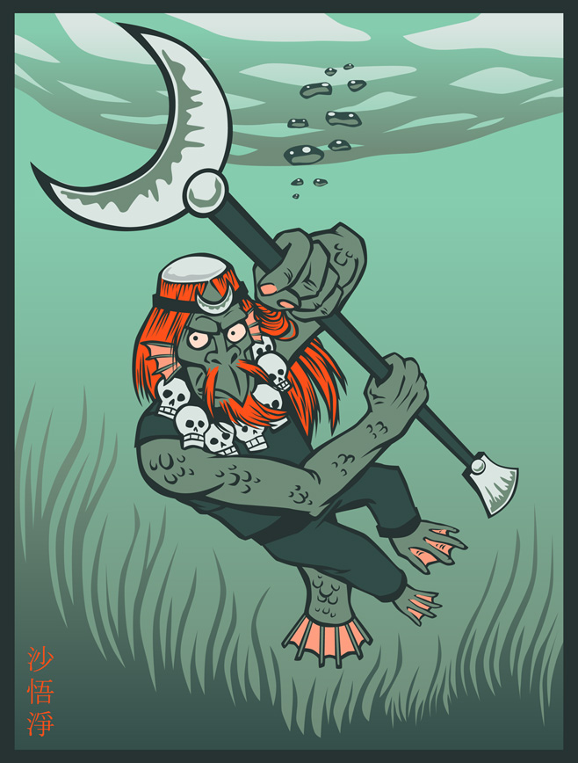
Sha Wujing
Once a General
Broke a crystal goblet
Became bridge troll
Monk & Party took him in
“Minor character” – although best characteristics
Becomes arhat
Notes:
Shā Wùjìng (literally meaning "Sand Awakened to Purity"), given the name Friar Sand or Sandy in English, was once a celestial Curtain Lifting General, who stood in attendance by the imperial chariot in the Hall of Miraculous Mist. He was exiled to the mortal world and made to look like a monster because he accidentally smashed a crystal goblet belonging to the Queen Mother of the West during a Peach Banquet. The now-hideous immortal took up residence in the Flowing Sands River, terrorising surrounding villages and travellers trying to cross the river. However, he was subdued by Sun Wukong and Zhu Bajie when Xuanzang's party came across him. They consequently took him in, as part of the pilgrimage to the West.
Sha's weapon is the yueyachan ("Crescent-Moon-Shovel" or "Monk's Spade"). He also knows eighteen transformation methods and is highly effective in water combat. He is about as strong as Zhu Bajie, and is much stronger than Sun Wukong in water. However, Zhu can defeat Sha in a test of endurance, and Sun can almost certainly defeat him both on land and in the air.
Sha is known to be the most obedient, logical, and polite of the three disciples, and always takes care of his master, seldom engaging in the bickering of his fellow disciples. He has no major faults nor any extraordinary characteristics. Perhaps this is why he is sometimes seen as a minor character.
Sha eventually becomes an arhat at the end of the journey, giving him a higher level of exaltation than Zhu Bajie, who is relegated to cleaning every altar at every Buddhist temple for eternity, but is still lower spiritually than Sun Wukong or Xuanzang, who are granted Buddhahood.

Slide 8
Part One: The Origins, Rise, and Fall of the Hero Monkey
Chapters 1-7 (intro)

Slide 9
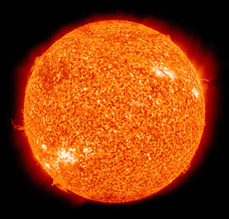
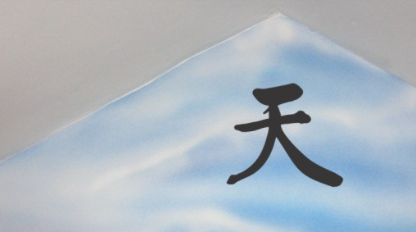
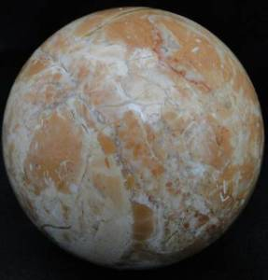
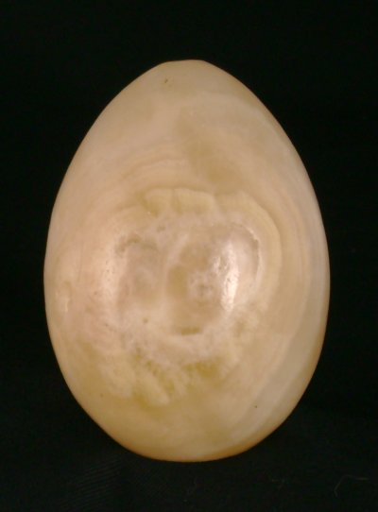
Notes:
Page one offers a creation story with some loose parallels to modern Darwinian evolutionary theory. At any rate, a stone (the earth?) is fertilized by the seeds of heaven and earth and the essences of the sun and the moon (chemicals from the stars?). This results in an embryo (early life form?) that gradually opens in time to reveal a stone egg (primordial animal?) which is exposed to the elements (environmental stresses?).

Slide 10
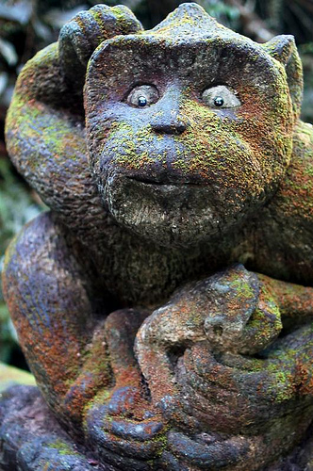
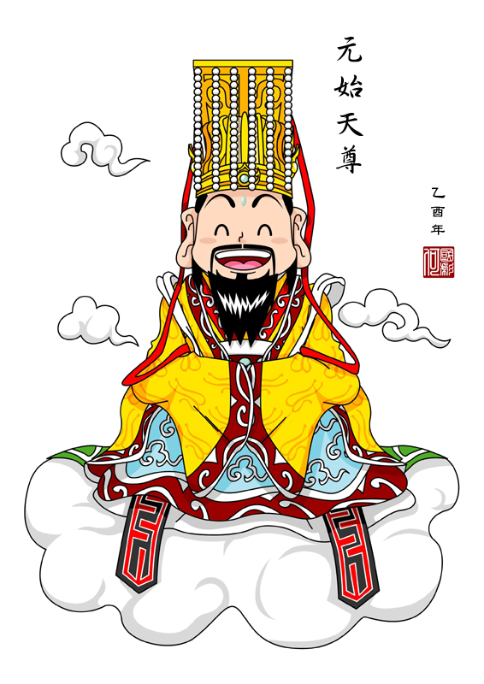
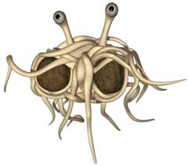
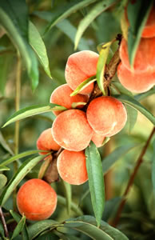
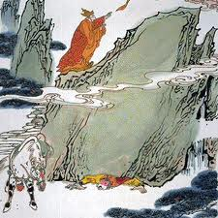

Notes:
In time the Thingamabobbie, whatever it is, is transformed into a stone monkey (sapient primate life?). This stone monkey is an extraordinary creature of boundless energy and “steely eyes” that shoot “golden light.” It immediately attracts the attention of the divine forces of intelligence, called Thousand-League-Eye and Wind-Knowing-Ears. This scene reminds me of Joseph Campbell’s description of humanity in the Bill Moyer’s interview: “We are the eyes of the earth. What else?” If Campbell is right, then maybe the stone monkey, a symbol of human intelligence, is the universe’s way of knowing itself.
Immediately we encounter a godlike figure called the Jade Emperor, to whom all forces report (top of page 2). Unperturbed, he responds blandly that sooner or later star stuff can create just about anything. Monkey and his friends cavort in a garden-of-Eden like world in which all animals are friends, and they find a rainbow and a marvelous waterfall that conceals the entrance to a cave, where the primates live. In the cave is a beautiful stone house, which the monkeys, being monkeys, ransack and destroy. Monkey then demands to be crowned king of his own kind as a reward for being brave enough to walk through the waterfall in pursuit of a road to heaven. He outlaws the word “stone” and takes the name “Handsome Monkey King” (page 5).
Sun Wukong is the name given to this character by his teacher, Subhuti, the latter part of which means "Awakened to Emptiness" (in the Waley translation, Aware-of-Vacuity); he is called Monkey King. He is born on Flower Fruit Mountain from a stone egg that forms from an ancient rock created by the coupling of Heaven and Earth. He first distinguishes himself by bravely entering the Water Curtain Cave on the mountain; for this feat, his monkey tribe gives him the title of "Handsome Monkey King".
After angering several gods and coming to the attention of the Jade Emperor, he is given a minor position in heaven as the Keeper of Horses (弼马温) so they can keep an eye on him. This job is a very low position, and when he realises that he is put into such a low position and not considered a full-fledged god, he becomes very angry. Upon returning to his mountain, he puts up a flag and declares himself the "Great Sage Equal to Heaven."
Then the Jade Emperor dispatches celestial soldiers to arrest Sun Wukong, but no one succeeds. The Jade Emperor has no choice but to appoint him to be the guardian of the heavenly peach garden. The peaches in the garden bear fruit every 3,000-years, eating its flesh will bestow immortality, so Sun Wukong eats one and becomes more powerful and matchless. Later, after fairies who come to collect peaches for the heavenly peach banquet inform Sun Wukong he is not invited and make fun of him, he starts causing trouble in Heaven and defeats an army of 100,000 celestial troops, led by the Four Heavenly Kings, Erlang Shen, and Nezha. Eventually, the Jade Emperor appeals to the Buddha, who detains Wukong under a mountain called Five Elements Mountain. Sun Wukong is kept under the mountain for 500 years, and cannot escape because of a spell that was put on the mountain. He is later set free when Xuanzang comes upon him during his pilgrimage and accepts him as a disciple.

Slide 11
Part Two: Xuanzang
Chapters 8-12

Slide 12
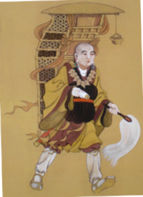
Xuanzang
Chapters 8-12: biography + background
Buddhist Monk
Sets off to find Buddhist scriptures in India
Was an actual character in real life
17 year journey to India
“Typical Monk”
Notes:
Only following this introductory story is the nominal main character, Xuanzang (Tang Sanzang), introduced. Chapters 8–12 provide his early biography and the background to his great journey. Dismayed that "the land of the South knows only greed, hedonism, promiscuity, and sins", the Buddha instructs the bodhisattva Avalokiteśvara (Guanyin) to search Tang China for someone to take the Buddhist sutras of "transcendence and persuasion for good will" back to the East. Part of the story here also relates to how Xuanzang becomes a monk (as well as revealing his past life as a disciple of the Buddha named "Golden Cicada" (金蟬子) and comes about being sent on this pilgrimage by Emperor Taizong, who previously escaped death with the help of an official in the Underworld).

Slide 13
Part Four: Ending
Rewards for everyone!
Crew each gets awarded.
Buddhist Enlightenment

Slide 14
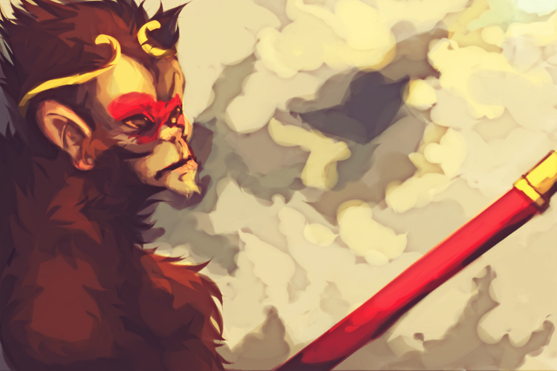
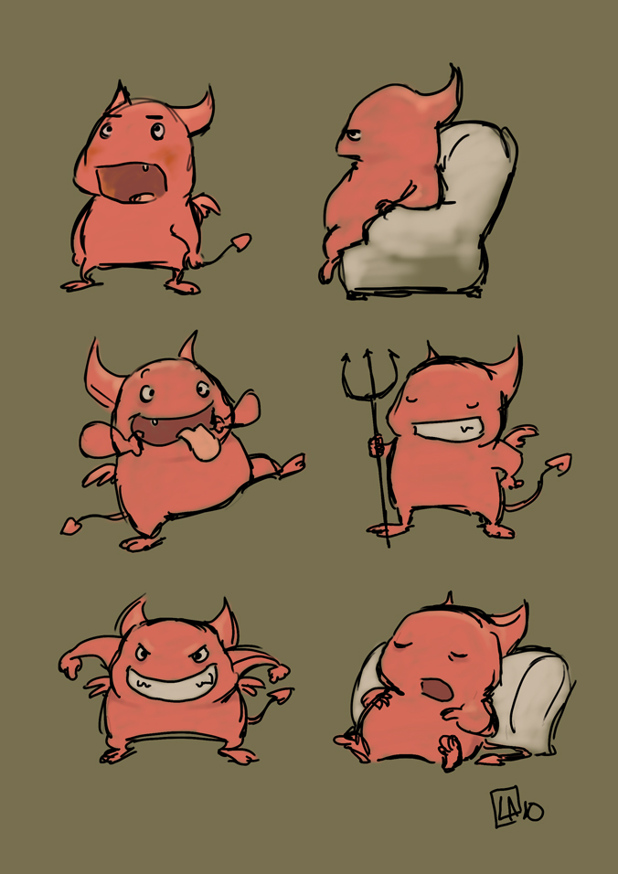
Section Three
Chapters:13-99
Notes:
The third and longest section of the work is chapters 13–99, an episodic adventure story in which Xuanzang sets out to bring back Buddhist scriptures from Leiyin Temple on Vulture Peak in India, but encounters various evils along the way. The section is set in the sparsely-populated lands along the Silk Road between China and India, including Xinjiang, Turkestan, and Afghanistan. The geography described in the book is, however, almost entirely fantastic; once Xuanzang departs Chang'an, the Tang capital, and crosses the frontier (somewhere in Gansu province), he finds himself in a wilderness of deep gorges and tall mountains, inhabited by demons and animal spirits, who regard him as a potential meal (since his flesh was believed to give immortality to whoever ate it), with the occasional hidden monastery or royal city-state amidst the harsh setting.
CITATION
-http://www.leisladams.com/2010/07/18/lil-demons/
- Other picture from deviant art
Episodes consist of 1–4 chapters and usually involve Xuanzang being captured and having his life threatened while his disciples try to find an ingenious (and often violent) way of liberating him. Although some of Xuanzang's predicaments are political and involve ordinary human beings, they more frequently consist of run-ins with various demons, many of whom turn out to be earthly manifestations of heavenly beings (whose sins will be negated by eating the flesh of Xuanzang) or animal-spirits with enough Taoist spiritual merit to assume semi-human forms.
Chapters 13–22 do not follow this structure precisely, as they introduce Xuanzang's disciples, who, inspired or goaded by Guanyin, meet and agree to serve him along the way in order to atone for their sins in their past lives.
The first is Sun Wukong, or Monkey, whose given name loosely means "awakened to emptiness" (see the character's main page for a more complete description), trapped by the Buddha for defying Heaven. He appears right away in chapter 13. The most intelligent and violent of the disciples, he is constantly reproved for his violence by Xuanzang. Ultimately, he can only be controlled by a magic gold ring that Guanyin has placed around his head, which causes him unbearable headaches when Xuanzang chants the Ring Tightening Mantra.
The second, appearing in chapter 19, is Zhu Bajie, literally "Eight Precepts Pig", sometimes translated as Pigsy or just Pig. He was previously the Marshal of the Heavenly Canopy, a commander of Heaven's naval forces, and was banished to the mortal realm for flirting with the moon goddess Chang'e. A reliable fighter, he is characterised by his insatiable appetites for food and sex, and is constantly looking for a way out of his duties, which causes significant conflict with Sun Wukong.
The third, appearing in chapter 22, is the river ogre Sha Wujing, also translated as Friar Sand or Sandy. He was previously the celestial Curtain Lifting General, and was banished to the mortal realm for dropping (and shattering) a crystal goblet of the Queen Mother of the West. He is a quiet but generally dependable character, who serves as the straight foil to the comic relief of Sun and Zhu.
The fourth is the third son of the Dragon King of the West Sea, who was sentenced to death for setting fire to his father's great pearl. He was saved by Guanyin from execution to stay and wait for his call of duty. He appears first in chapter 15, but has almost no speaking role, as throughout the story he mainly appears as a horse that Xuanzang rides on.
Chapter 22, where Sha Wujing is introduced, also provides a geographical boundary, as the river that the travelers cross brings them into a new "continent". Chapters 23–86 take place in the wilderness, and consist of 24 episodes of varying length, each characterised by a different magical monster or evil magician. There are impassably wide rivers, flaming mountains, a kingdom with an all-female population, a lair of seductive spider spirits, and many other fantastic scenarios. Throughout the journey, the four brave disciples have to fend off attacks on their master and teacher Xuanzang from various monsters and calamities.
It is strongly suggested that most of these calamities are engineered by fate and/or the Buddha, as, while the monsters who attack are vast in power and many in number, no real harm ever comes to the four travellers. Some of the monsters turn out to be escaped celestial beasts belonging to bodhisattvas or Taoist sages and deities. Towards the end of the book there is a scene where the Buddha literally commands the fulfillment of the last disaster, because Xuanzang is one short of the 81 tribulations he needs to face before attaining Buddhahood.
In chapter 87, Xuanzang finally reaches the borderlands of India, and chapters 87–99 present magical adventures in a somewhat more mundane (though still exotic) setting.
At length, after a pilgrimage said to have taken fourteen years (the text actually only provides evidence for nine of those years, but presumably there was room to add additional episodes) they arrive at the half-real, half-legendary destination of Vulture Peak, where, in a scene simultaneously mystical and comic, Xuanzang receives the scriptures from the living Buddha.

Slide 15
Citations
Shi Changyu (1999). "Introduction." in trans. W.J.F. Jenner, Journey to the West, volume 1. Seventh Edition. Beijing: Foreign Languages Press. pp. 1–22.
Hu Shih (1942). "Introduction". Monkey. New York: Grove Press. pp. 1–5.
Our book.
http://www.vbtutor.net/xiyouji/psunwukong.htm
Numerous other sites at home
Picture citations are on appropriate slides

