Slide 1






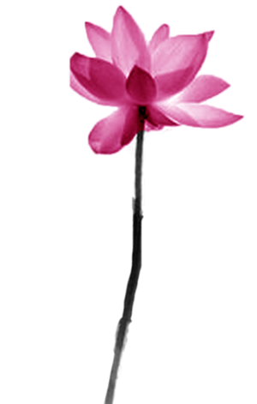
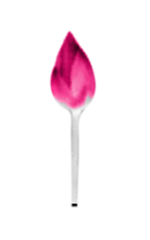
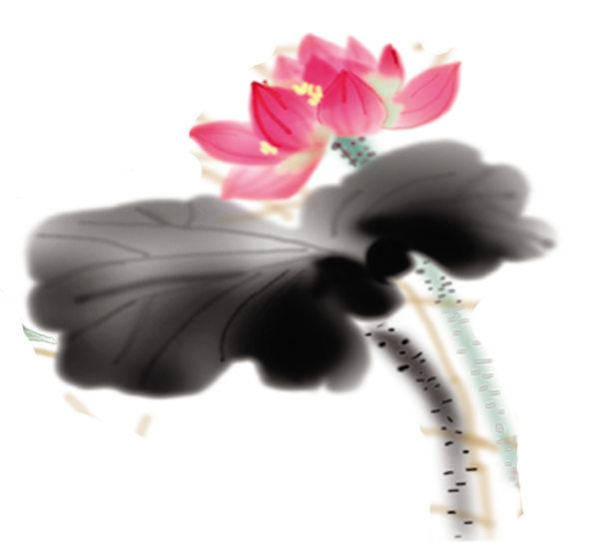



Chopsticks
By Hu Jin
Jiang Qiwei
`

Slide 2


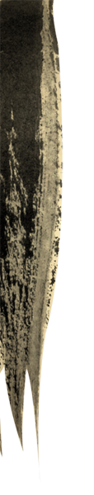

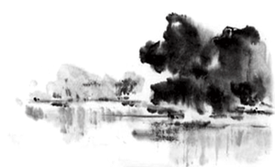
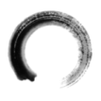
Introduction
Culture
Translation

Slide 3
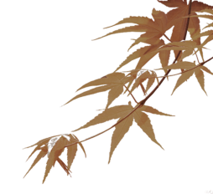
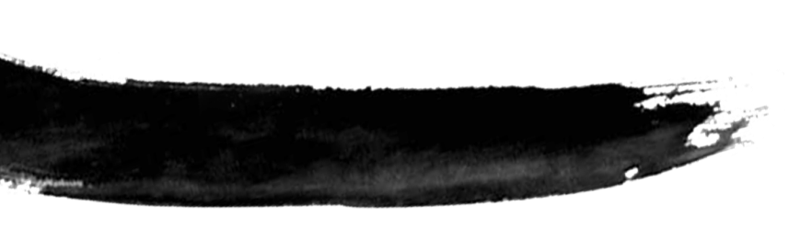
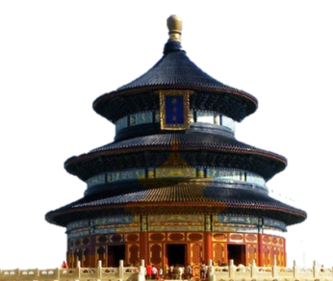
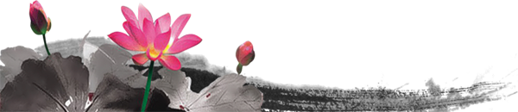
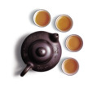
Introduction
Definition: a pair of thin sticks that are used for eating with, especially in some Asian countries
Types: bamboo, wood, jade, ivory, gold, plastic, stainless steel, etc.

Slide 4
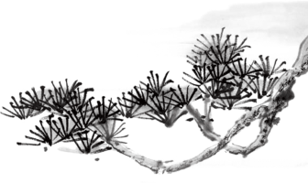
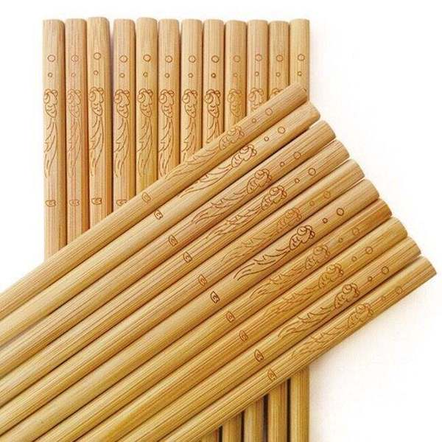
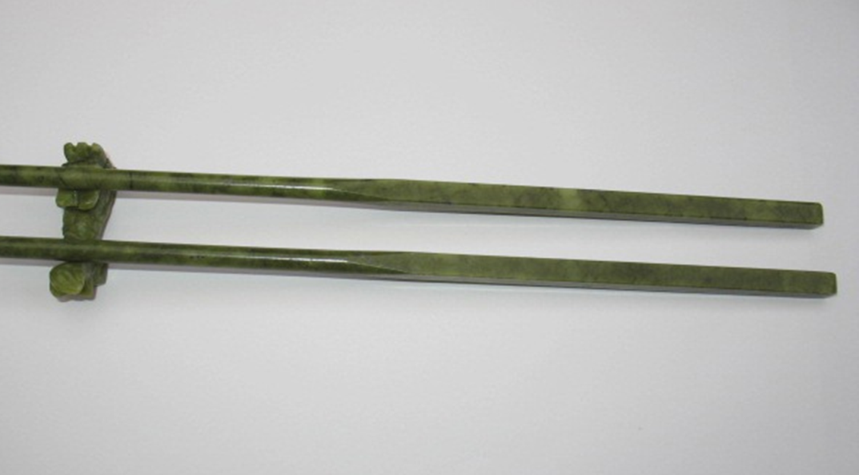
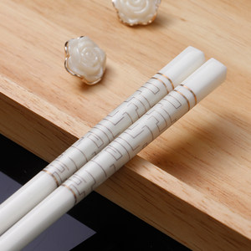
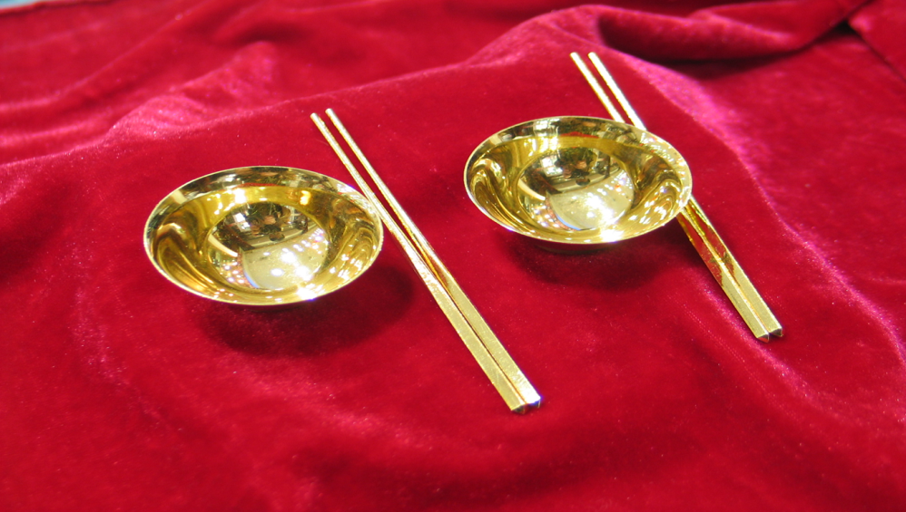

Slide 5
Introduction
History:
Xia Dynasty
“chopsticks” V.S.“快子”
good luck
wealth and status

Slide 6
Culture
symbol of human civilization
cultural revolution of Chinese cuisines
traditional Chinese cultural symbol
chopsticks dance (intangible cultural heritage)

Slide 7
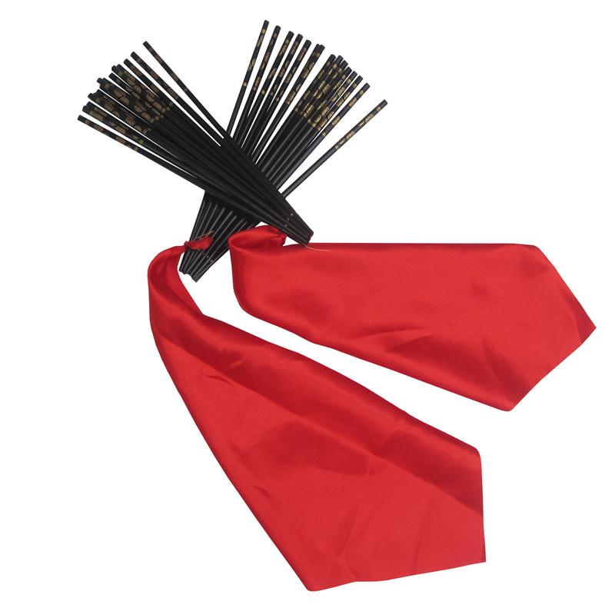
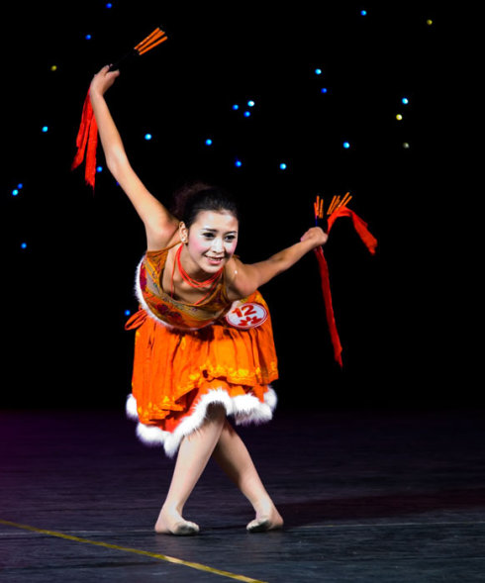
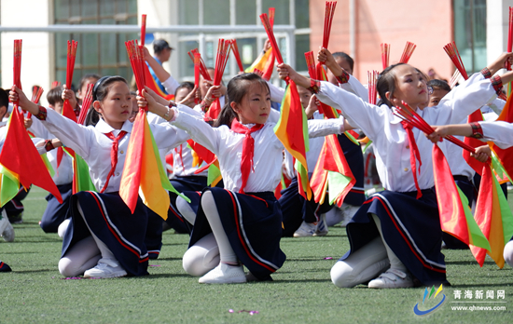

Slide 8
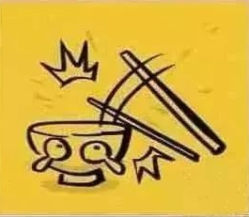
Cultural taboos
Don’t use chopsticks to hit the side of your bowl.

Slide 9
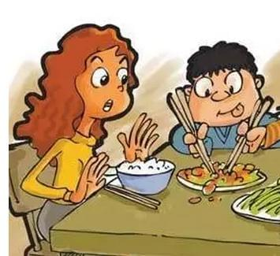
Don’t use chopsticks to poke at every dish casually.

Slide 10
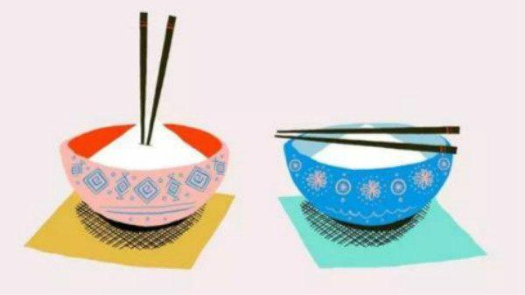
It is rude to stick the chopsticks in the bowl.

Slide 11
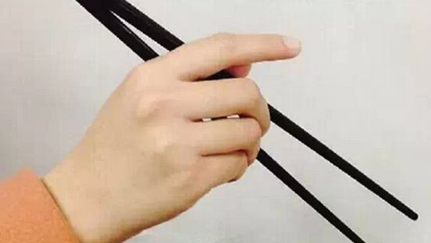
Do not stretch out your index finger while eating.

Slide 12
Translation
- Free translation
所赐之物，非赐汝金。盖赐卿之箸，表卿之直也。
The Emperor Li Longji once granted a pair of gold chopsticks to the prime minister Song Jing to praise his honesty.

Slide 13


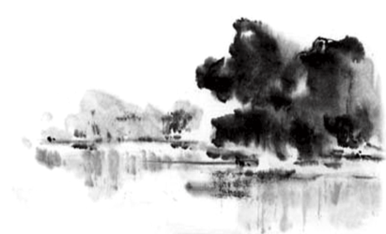
Thanks!
PPT模板下载：www.1ppt.com/moban/ 行业PPT模板：www.1ppt.com/hangye/
节日PPT模板：www.1ppt.com/jieri/ PPT素材下载：www.1ppt.com/sucai/
PPT背景图片：www.1ppt.com/beijing/ PPT图表下载：www.1ppt.com/tubiao/
优秀PPT下载：www.1ppt.com/xiazai/ PPT教程： www.1ppt.com/powerpoint/
Word教程： www.1ppt.com/word/ Excel教程：www.1ppt.com/excel/
资料下载：www.1ppt.com/ziliao/ PPT课件下载：www.1ppt.com/kejian/
范文下载：www.1ppt.com/fanwen/ 试卷下载：www.1ppt.com/shiti/
教案下载：www.1ppt.com/jiaoan/

