Slide 1
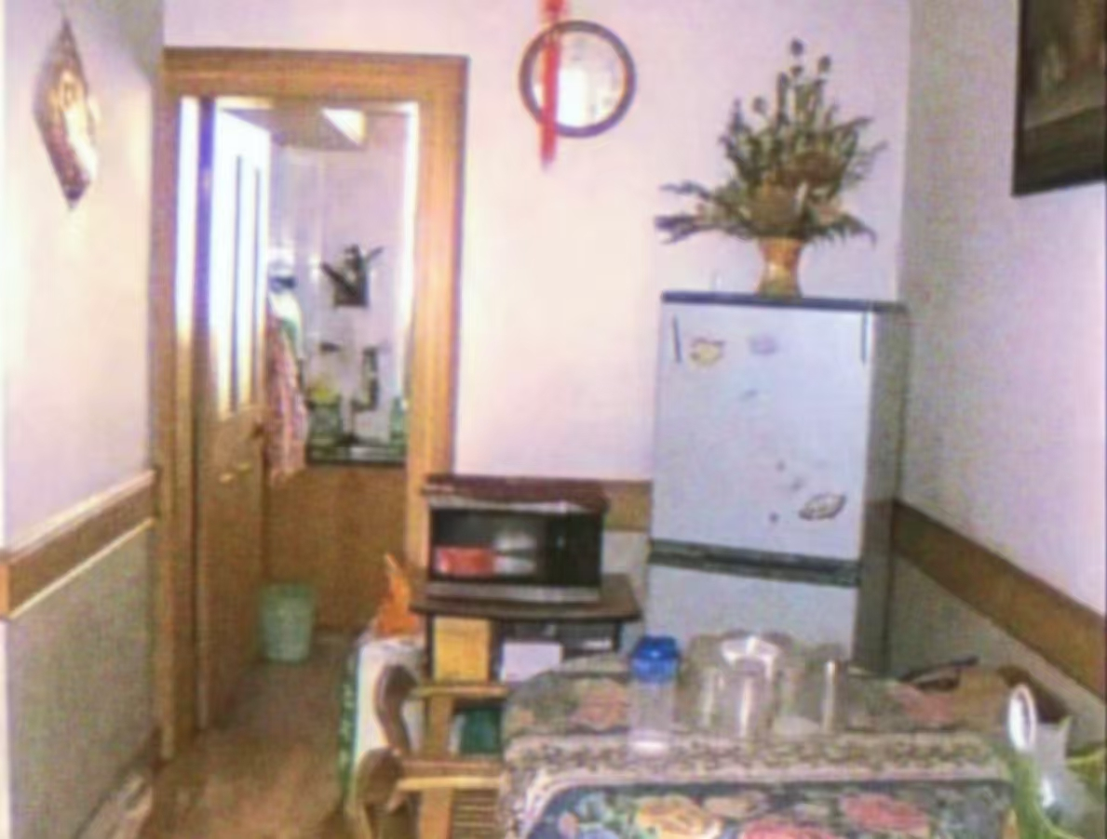
Chinese
Dreamcore
中式梦核
Speaker: 章子熙

Slide 2
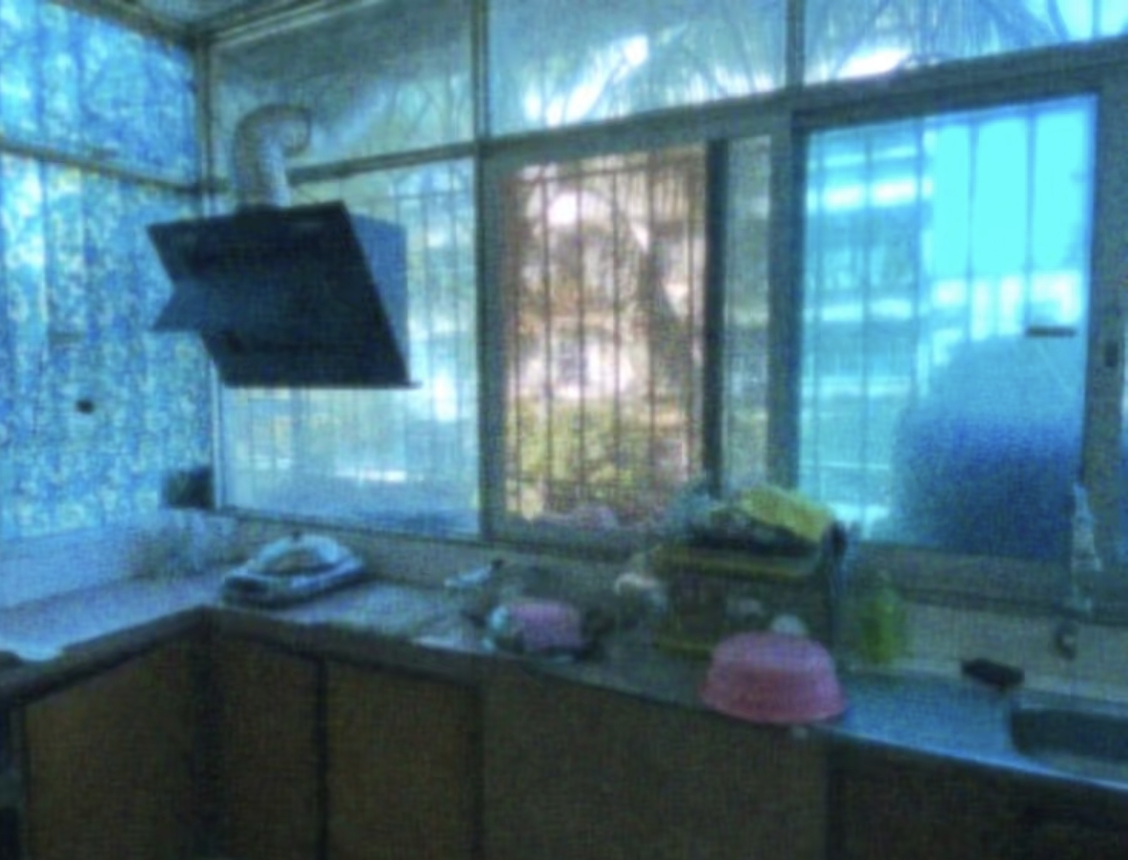
CONTENT
PART 1
The Concept of Chinese Dreamcore
PART 2
The Characteristics of Chinese Dreamcore
PART 3
The Reasons for Popularity

Slide 3
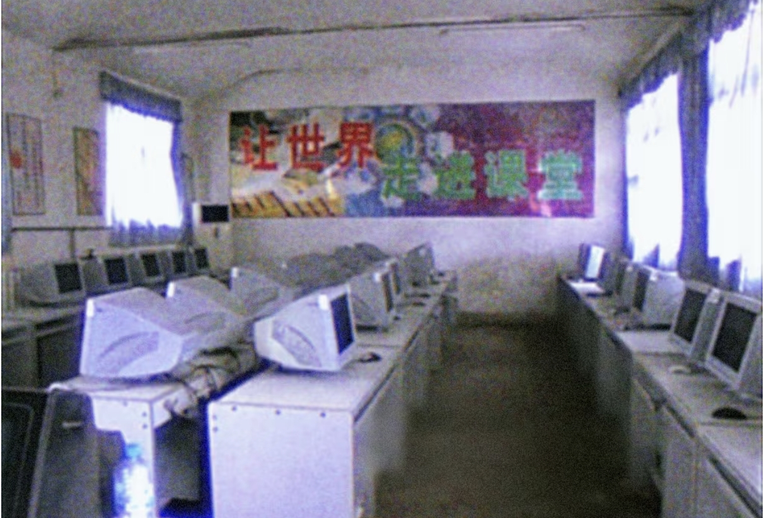
PART 1
The Concept of Chinese Dreamcore
中式梦核的概念

Slide 4
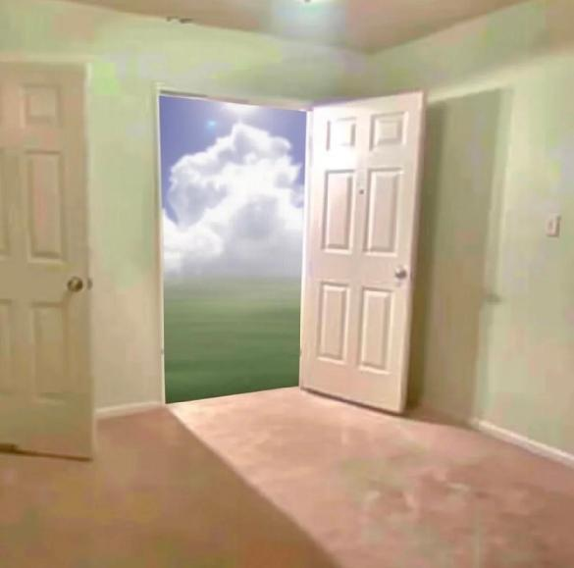
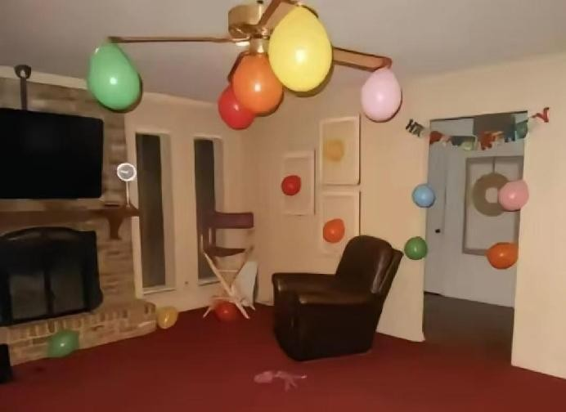
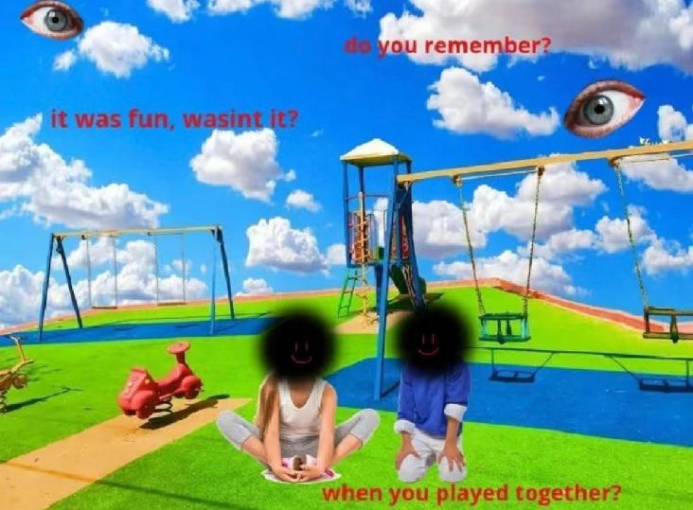
Dreamcore is a surrealist aesthetic that combines elements of surrealism, fantasy, and the subconscious，often employing themes related to dreams, daydreams, or nightmares.
梦核是一种结合了超现实、幻想和潜意识等元素的超现实主义美学，通常采用与梦、白日梦或噩梦相关的主题
梦核的概念

Slide 5
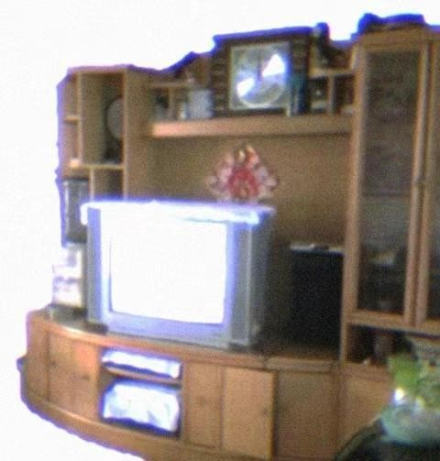
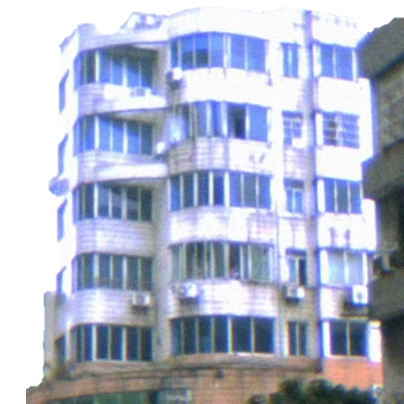
中式梦核
Chinese Dreamcore is a Sinicized surrealist aesthetic derived from Dreamcore, which utilizes visual media such as images or videos for expression.而“中式梦核”是根据“梦核”衍生而来的中国化超现实主义美学，运用图像或者视频等媒介呈现
“Chinese Dreamcore” is about nostalgic melancholy, It intertwines relics from the early 2000s with cryptic text, evoking the haze of an aged dream.“中式梦核”的本质是怀旧伤感。来自千禧年间的旧物件与意义不明的文字交织，如同在一场老旧的梦境里。

Slide 6
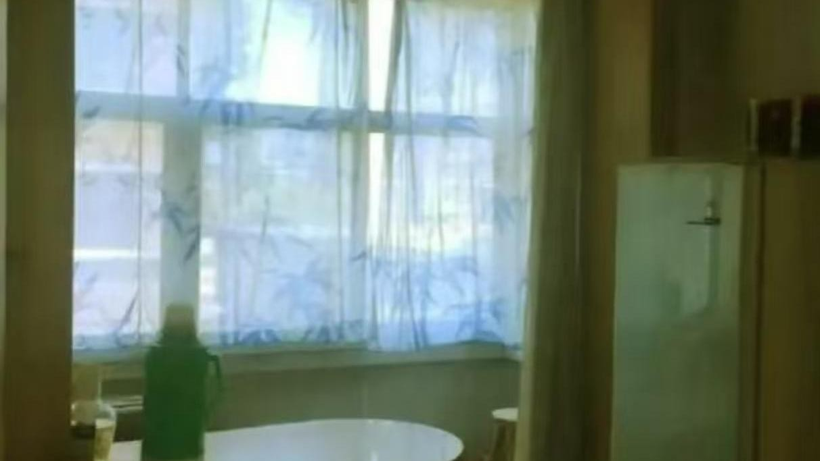
PART 2
The Characteristics of Chinese Dreamcore
中式梦核的特点

Slide 7
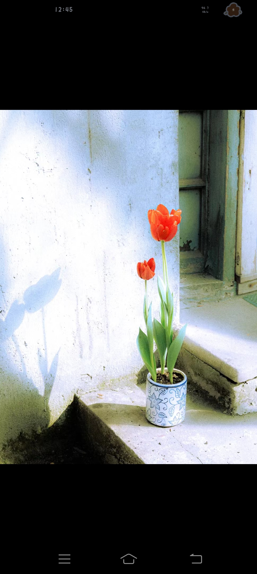

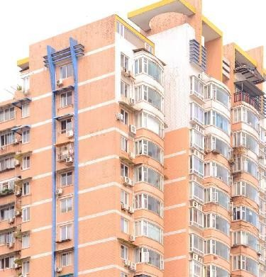
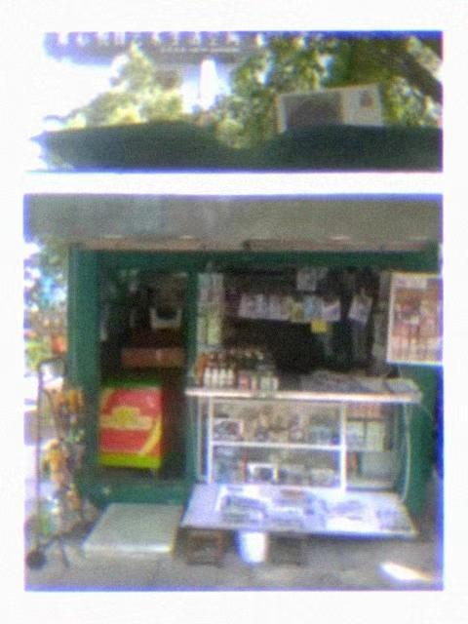

01 Architecture Elements
建筑元素
scenes filled with Chinese life
充满中国生活气息的场景
nostalgic architectural styles
具有年代感的中式建筑风格

Slide 8
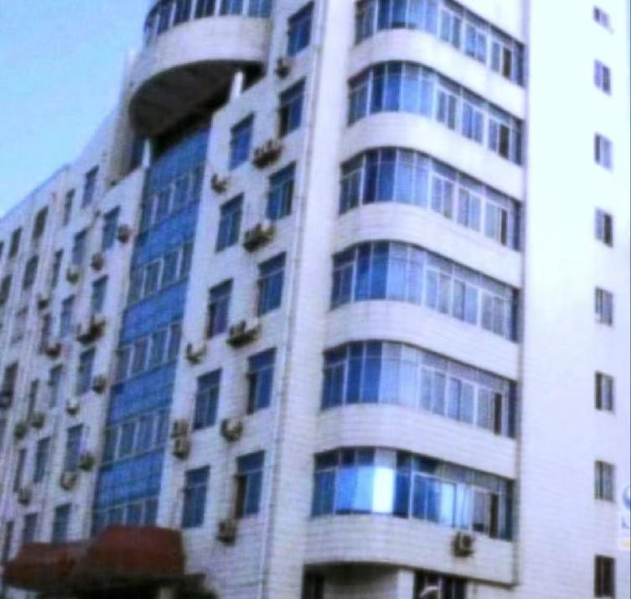
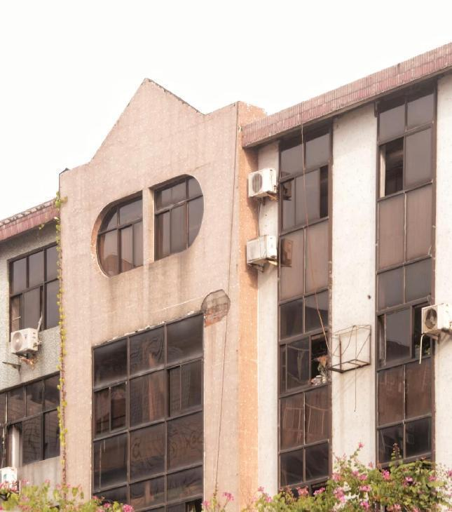
Aged blue and amber-glass architecture,these dreamy yet slightly futuristic windows reflected people's fantasies about the new century at the millennium's end. They also capture the fading glow of that bygone era." 蓝色或者茶色玻璃的90年代老旧建筑,梦幻与略带科技感的玻璃是世纪末的人们对世纪初的幻想，更代表了世纪末的余晖

Slide 9

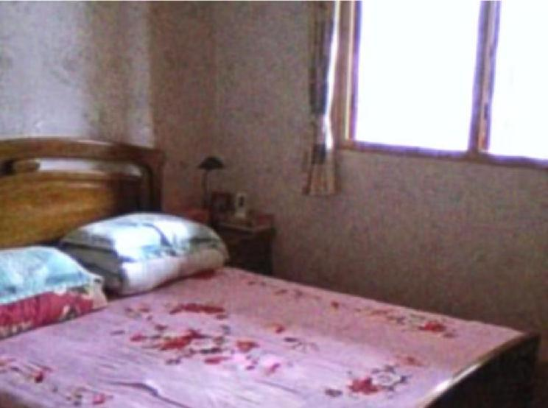
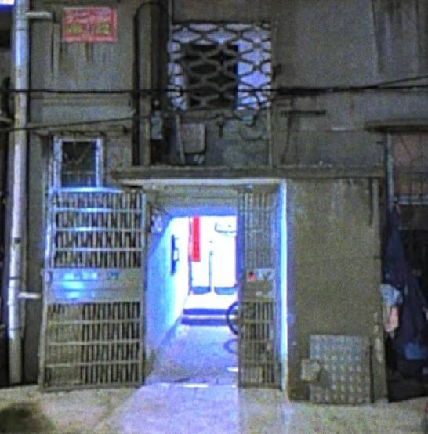
02 Decoration Elements
装饰元素
"Millennium-era apartment buildings with their floral bedsheets and wooden furniture—it’s like stepping back into those warm, happy childhood days."
千禧年家属单元楼以及特有的床单家具，仿佛又回到了那个童年温馨又美好的童年

Slide 10
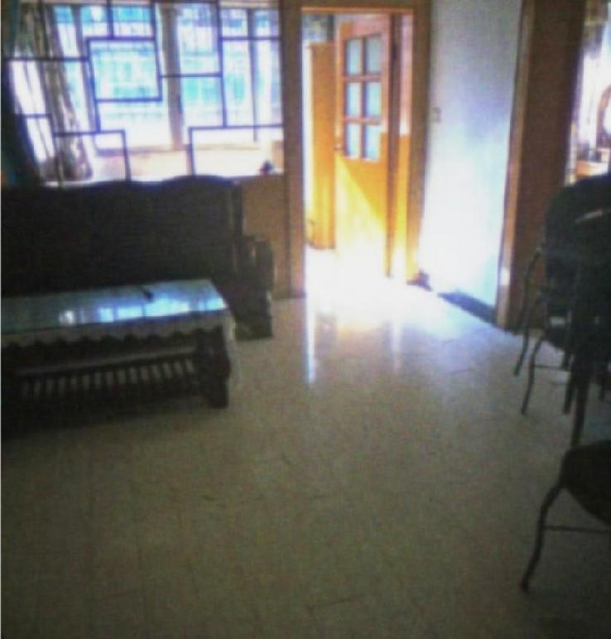
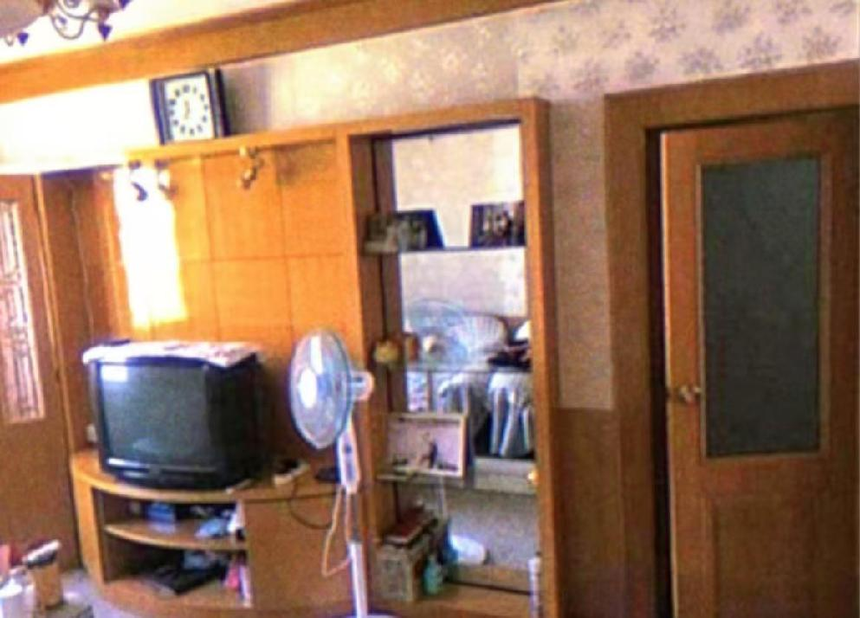
Yellow-wood decorated houses 黄木装修的老房子

Slide 11
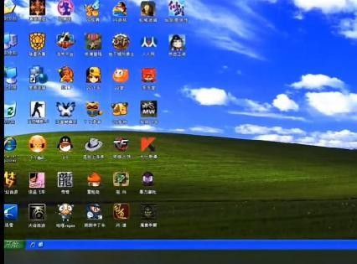


03 Internet Elements
网络元素
China's 2000s internet memories merge with dreamlike warmth, crafting a digital nostalgia dream.2000年代的中式网络记忆与温暖梦幻的氛围结合在一起，创造了一场数字怀旧的梦。
The vintage internet scenes transport people back to that pure and beautiful era.这些古早网络画面将人们拉进了那个纯净又美好的年代。

Slide 12
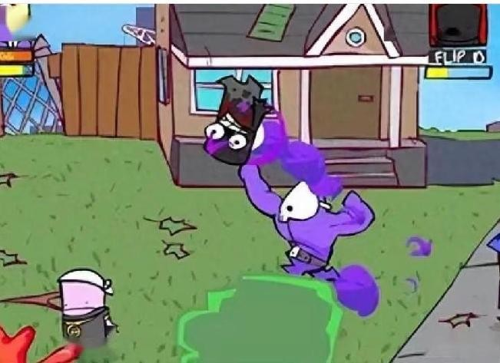

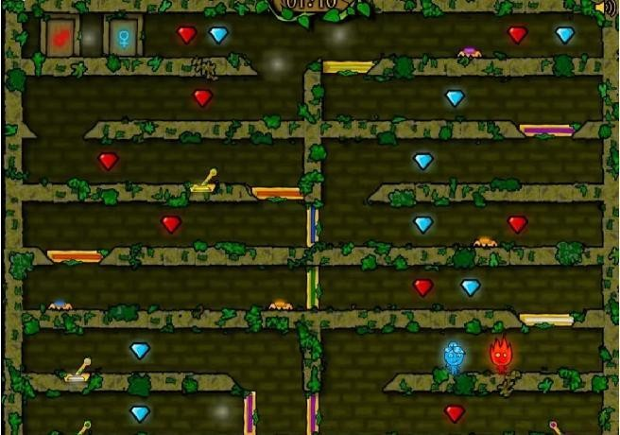
Guess that game
猜猜看
狂扁小朋友
DAD N’ ME
奥比岛
AOBI
森林冰火人
Fireboy and Watergirl

Slide 13
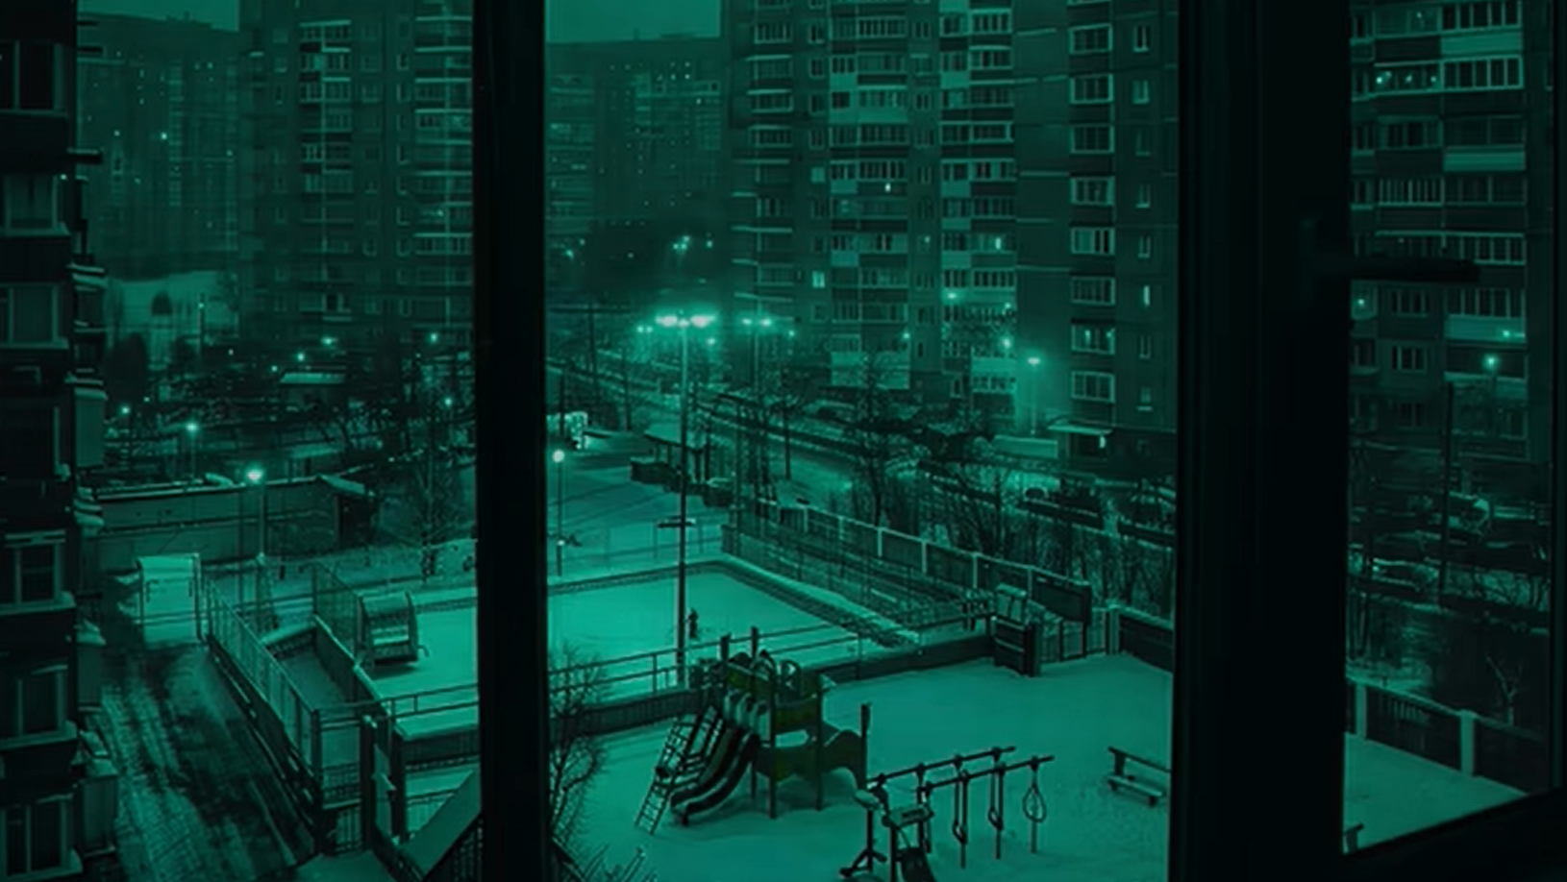
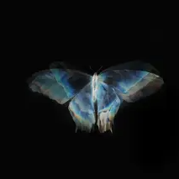


04 Music Pairing 音乐搭配
Background music is typically slow and soothing, deepening immersion while amplifying the unsettling, eerie, or dreamy mood of the work.
背景音乐多以慢速音乐为主，节奏舒缓，能够营造出一种沉浸感，同时也加深了作品整体的不安、诡异或梦幻的情绪。

Slide 14
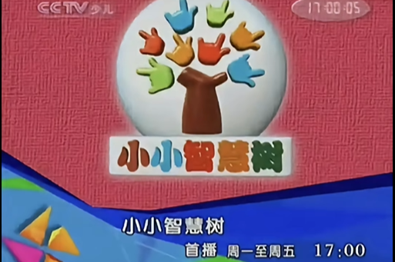
PART 3
The Reasons for Popularity
受欢迎的原因

Slide 15

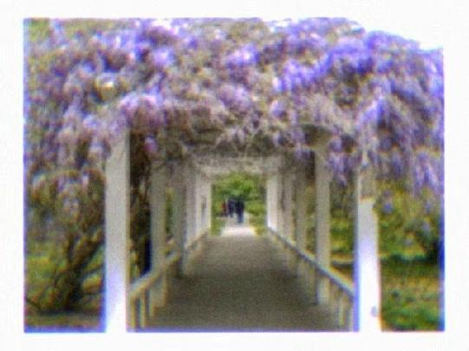

01 The Infinite Possibilities and Psychedelia of Dreams
无限可能与迷幻的梦
Dreams have long been a popular theme in artistic creation. In Dreamcore videos, the grainy textures, lo-fi pixels, and psychedelic music effortlessly immerse viewers in a dreamlike state.
梦在艺术创作中是一个很受欢迎的主题，梦核视频创作中的噪点、低保真的像素与迷幻的音乐很容易让人们感觉沉浸在梦中。
The elements of Chinese Dreamcore are the familiar objects from our childhood, making viewers feel as if they have traveled through time to relive those carefree years.而中式梦核的元素则是我们熟悉的童年事物，让观看者仿佛穿越时空，重温那段无忧无虑的岁月。

Slide 16
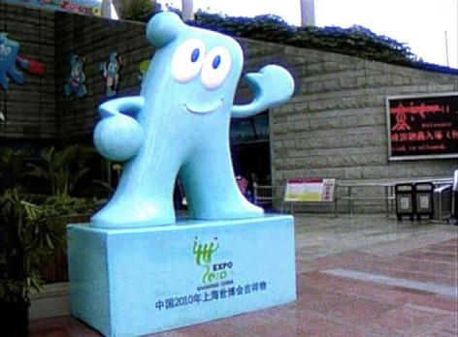

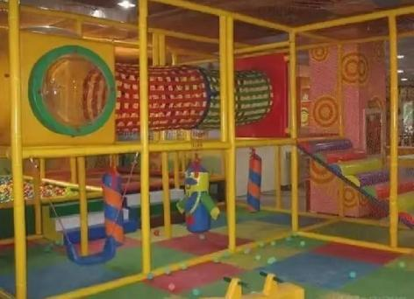
02 Nostalgia for the Millennium Era
对千禧年的追忆
People born in the millennium had short childhoods. As society rapidly developed under the push of progressive ideas, feelings of anxiety, pressure, and confusion grew inside them. The strong desire to relive childhood, mixed with the stress of fast-paced modern life, became the soil that gave birth to "Chinese Dreamcore."千禧年出生的人们在短暂的童年之后，整个社会在进步观念的助推下加速发展，焦虑、压抑、迷茫的情绪在心底翻涌，怀念童年的强烈愿望与快节奏生活的现实压力成为了孕育“中式梦核”的土壤。

Slide 17
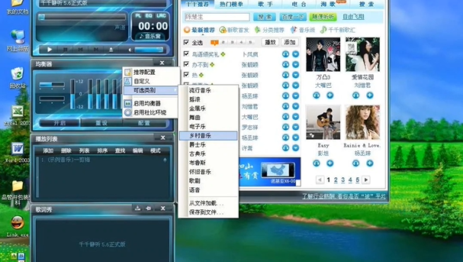
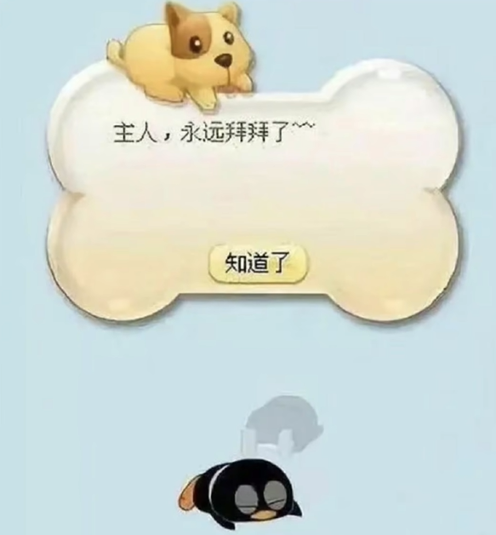
Thank You！

