Slide 1
Ezra Pound's translation theory and its application in Cathay

Slide 2
CONTENTS
1
2
3
4
Introduction
An Analysis of Ezra Pound's
Translation Theory
Ezra Pound's Translation
Practices in Cathay
Conclusion

Slide 4
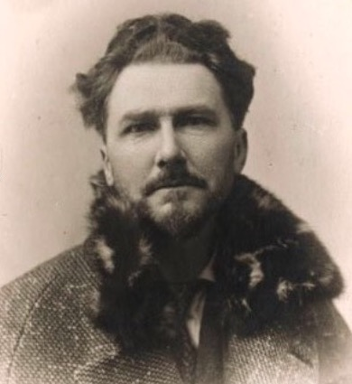
Introduction
Ezra Weston Loomis Pound
Ezra Weston Loomis Pound (1885-1972) is an American poet and a pillar in the early Modernist movement.
He is regarded as the pioneer of Imagist and Vortist movement, as well as the communicator of classical Chinese poems and Chinese Confucianism.

Slide 5
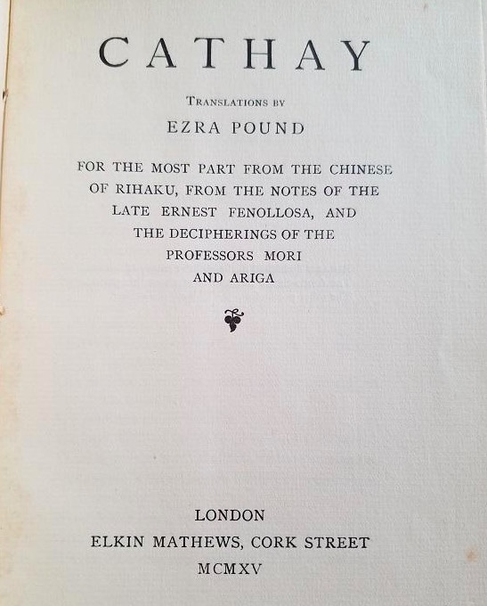
Introduction
Cathay
《华夏集》
Cathay (1915) is a collection of classical Chinese poetry translated into English by modernist poet Ezra Pound based on Ernest Fenollosa's notes that came into Pound's possession in 1913.
The volume's 15 poems are seen less as strict translations and more as new pieces in their own right and in his bold translations of works from a language he was unfamiliar with.

Slide 7
Ezra Pound’s Translation Theory
Pound’s Concept of “Energy in Language”
Pound’s Theory of “Luminous Details”

Slide 8
Ezra Pound’s Translation Theory
Pound’s Concept of “Energy in Language”
This concept is the core of Pound’s translation theory. Hugh Kenner notes in The Pound Ezra (1971) that Pound began in 1911 to think of “translation as a model for the poetic art: blood brought to ghosts”. Here “blood” is a metaphor for energy in language.
He speaks about the way in which words transmit electricity among themselves, generate and intergenerate certain qualities and combinations of energy by their very position in a work.

Slide 9
Ezra Pound’s Translation Theory
Pound’s Theory of “Luminous Details”
Pound’s translation theory focuses upon the precise rendering of details, of individual words, and of single or even fragmented images.
As Pound defines, “an image is not an equation of mathematics, not something about a, b, and c, having to do with form, but about sea, cliffs, night, have something to do with mood.” Pound argues that creation or recreation of whatever can shape perfect image is a good translation means.
Vortex, as Pound defines, is “the point of maximum energy”, Vortex was understood as a cluster of words, a network of words brought together in a radiant node.

Slide 11
The original poem was written by the famous Tang Dynasty poet Li Bai and Pound's translation of the poem is as follow:
送友人
Taking Leave of a Friend
李白
青山横北郭，白水绕东城。
此地一为别，孤蓬万里征。
浮云游子意，落日故人情。
挥手自兹去，萧萧班马呜。
Li Bai
Blue mountains to the north of the walls,
White river winding about them;
Here we must make separation
And go out through a thousand miles of dead grass.
Mind like a floating wide cloud.
Sunset like the parting of old acquaintances
Who bow over their clasped hands at a distance.
Our horses neigh to each other as we are departing.

Slide 12
Ezra Pound’s Translation Practices in Cathay
The original is a parting scene with poetic beauty. Images in the line go in pair, like “青山”, “白水”, “北郭” and “东城”, “横” and “绕”. The whole poem features rich and various images, and perfect fusion and human feelings.
It could be seen that the major images in Li Bai’s poem had all been presented by the translation: “blue mountain” as to “青山”, “the north of the wall” as to “北郭”, “dead grass” as to “孤蓬”, “floating wide could” as to “浮云”.

Slide 13
Ezra Pound’s Translation Practices in Cathay
When translating poems, Pound always chose those which could strike a chord with him so that he could bring his own feelings into the translation of the original poem. And the translation of a poem should also be succinct and implicit, highlight the beauty of image, and grasp the rhythm of the poet's inner world.

Slide 14
Ezra Pound’s Translation Practices in Cathay
Transmitting the beauty of image on one hand, Pound also tries to combine his feelings with that of the poet, and then to convey the mode of thinking and emotion in the original poem into the target language.
He emphasizes each single image and individual detail which he thinks reveal the truth of the original poem.

Slide 16
Conclusion
The translator should sense and grasp the spirit in the original poem completely. Only when the translator has this spirit in mind can he select the best words to reproduce the beauty. Images are to be represented to express the spirit.
Recreation can be used in translating Chinese classical poems when literal translation can not reach the effect of reproducing beauty.

Slide 17


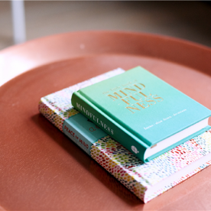
Reference
[1]Gentzler, E. A Contemporary Translation
Theories[M]. Shanghai: Shanghai Foreign
Language Education Press, 2004:14.
[3]Nida, E. A. The Theory and Practice of
Translation[M]. Shanghai: Shanghai Foreign
Language Education Press, 2003:128.
[2] Kenner, W. H. (1972). The Pound Ezra:
The age of Ezra Pound, T.S. Eliot, James
Joyce and Wyndham Lewis. London:
Faber and Faber Limited.
[4]陶乃侃，（2006）《庞德与中国文化》，
北京：首都师范大学出版社
[5]赵毅衡，（1985）《远游的诗神-
中国古典诗歌对美国新诗运动的影响》，
成都：四川人民出版社
[6]祝朝伟，（2005）《构建与反思：
庞德翻译理论研究》，
上海：上海译文出版社

Slide 18
THANKS！

