Slide 1

中国语言文化 Chinese Language & Culture for Master Students of Translation Studies
湖南师范大学 2022年2月25日-2021年6月10日 中国文化基础 周四第九和第十节课THU 16:10-17:45，
上课地点：线上VooV 727-962-7576 （外国语学院大楼613室）
助教：Lan Qi 兰綺, session 10
吴漠汀特聘教授 Distinguished Professor Dr. Martin Woesler
培高德 教授 Professor Dr. Cord Eberspächer
湖南师范大学外国学院 Foreign Studies College, Hunan Normal University

Slide 2
Schedule 学期题目
Session Rank Topic Percent
1 – Organizational Things
2 2 Literature: Ancient literature: Chinese Classical Fairy Tales 71%
2 5 Literature: Ancient literature: Chinese Mythology 67%
2 7 Literature: Ancient literature: Four Folk Stories of Ancient China 65%
3 17 Language: Chinese Language 57%
3 4 Language: Chinese Dialects 70%
3 16 Minority Languages in China 58%
3 13 Language: Chinese Folk Argot 61%
4 1 Movies: Chinese Movies 73%
5 8 Song: Celadon and the Celadon Song 《青花瓷》歌词 64%
5 18 Song: Marriage Accompanying Songs in Hunan 57%
5 12 Social Media: Douyin (Tik Tok) 61%
6 14 Literature: Ancient Literature - Four satirical novels in ancient China 60%
6 15 Literature: Ancient literature: Classical Literature 58%
6 32 Literature: Premodern literature - Li Bai's “The River-Merchant's Wife: A Letter” and its translations 53%
6 34 Literature: Ancient Literature: The Classic of Mountains and Seas 53%
7 3 Global Impact of Chinese Culture 70%
7 6 Global Impact of Chinese Language 66%
8 25 Translation: Oral Interpreting from and into Chinese 55%
8 28 Translation: Written Translation from and into Chinese 54%
8 37 Translation: Artificial Intelligence in Translation 52%
Session Rank Topic Percent
9 35 Literature: Tang and Song - Classical Prose Movement of late Tang Dynasty and Song Dynasty 53%
9 9 Literature: Premodern literature: Strange Stories from a Chinese Studio 64%
9 21 Literature: Premodern literature: Tang-Song 56%
9 22 Literature: Ancient Literature - Take Su Shi as an example. Relegation Literature in Ancient China 55%
9 11 Literature: Premodern literature - China's Four Great Classical Novels 63%
10 19 Language: How the language shapes the mind (comparison with other languages) 57%
10 24 Language Styles (official, formal, written, colloquial, slang, sociolects, dialects, regionalects etc.) 55%
10 30 Language: Ambiguity of Chinese Language (e.g. Tang poetry) 54%
10 39 Language: Rhethorics and Propaganda in China 51%
11 10 Stage entertainment: Crosstalk 相声 63%
12 26 Chinese Writing: Chinese Characters 54%
12 36 Chinese Writing: Calligraphy 53%
12 33 Traditional Festivals: Spring Festival Couplets 53%
13 20 Literature: Modern Literature: Qian Zhongshu (Ch'ien Chung-shu) 56%
13 23 Literature: Modern Literature 55%
13 29 Literature: Modern and Contemporary Literature: Literature, Science Fiction, and Fantasy 54%
13 40 Literature: Contemporary Literature 50%
14 38 Opera: Peking Opera 52%
14 41 Opera: Peking Opera Actor Mei Lanfang 50%
14 42 Opera: Hunan Flower-drum Opera (Huagu Opera) 50%
15 27 Globalization: The Westernization Movement 54%
15 31 Globalization: The Eastward Spread of Western Learning 53%

Slide 3
Session 10 第十周
Session Overview 本节概览
Preparation:
Follow WeChat Group and course website http://bit.ly/LANG2022
Read textbook texts
Answer quizzes
Translate Homework
Correct translation of fellow student
Presenting students: prepare
Ppt
Podium Discussion (Arguments need to be uploaded on Wiki)
Literature Review and Handout
Wiki Article on the topic
Online Participants: Start VooV 775-353-554. (All students need to turn on camera or will be blocked by student assistant. If Tencent does not work, here is an emergency Zoom session: https://bit.ly/ZOOMCOURSE.)
Start your final exam paper now!

Slide 4
Session 10 第十周
Session 10, Thu April 28, 2022 – Literature
Translation Homework [[28]]
Read in preparation
Topic 1[edit]
What you need to read: Language: How the language shapes the mind (comparison with other languages)
Take a quiz [[29]]
Topic 2[edit]
What you need to read: Language Styles (official, formal, written, colloquial, slang, sociolects, dialects, regionalects etc.)
Take a quiz [[30]]
Topic 3[edit]
What you need to read: Language: Ambiguity of Chinese Language
Take a quiz [[31]]
Topic 4[edit]
What you need to read: Language: Rhethorics and Propaganda in China
Take a quiz [[32]]

Slide 5
Session 10 第十周
Session 10, Thu April 28, 2022 – Literature
Student presentations
How the language shapes the mind (comparison with other languages)[edit]
Please download this pptx on How the Language Shapes the Mind created by 黎溢佳 Li Yijia 徐舞 Xu Wu
Literature Review of how the language shapes the mind by 李欣Lixin
Text Book of how the language shapes the mind by 颜媛 Yan Yuan 聂薇 Nie Wei
Language Styles (official, formal, written, colloquial, slang, sociolects, dialects, regionalects etc.)[edit]
Plesae download this pptx on Language Styles created by 李颖Li Ying (part 1-3) 庹树梅 Tuo Shumei (part 4-5)
Text Book of Language Styles by 卞王倩 Bian Wangqian (part 1-3) 王思琪 Wang Siqi (part 4-5)
Language: Ambiguity of Chinese Language (e.g. Tang poetry)[edit]
Plesae download this pptx on Ambiguity of Chinese Language created by 邝雨琪 Kuang Yuqi （Part 1-2) 刘唱 Liu Chang (part3-4)
Text Book of Ambiguity of Chinese Language by 廖诗韵 Liao Shiyun 李媛 Li Yuan
Language: Rhethorics and Propaganda in China[edit]
Plesae download this pptx on Rhethorics and Propaganda in China created by 梁思婷 Liang Siting (part 1) 李梓婕Li Zijie (part 2)
Textbook of Rhethorics and Propaganda in China by 周皓熙 Zhou Haoxi (part 1) 张白鹭 Zhang Bailu (part 2)
Teacher presentation for session 10[edit]
Media:10_Chinese_Language.pptx

Slide 6
Historical Discussion „Language Coins Thinking“
Aristotle: Difference of languages only external (Peri Hermeneias 16a1)
Xunzi: Cognition independent of language (22:276)
Zhuangzi: If one has grasped something, one can forget the words (26:407)
Vico, Herder begin to point out differences (climate, time, place, national character). Herder: language and writings of the "Sineses" were partly responsible for their "slave culture", Hegel: letter writing = "intelligent", Humboldt: subjectivity, national character, Wittgenstein: language creates world, Sapir-Whorf hypothesis: "language forms thinking",

Slide 7
Historische Diskussion „Sprache prägt Denken“
Lohmann: China's backwardness and its "radically different thinking" went back to language (eg. morphology/types of words not clearly delimited=>no subject, less individualism), Granet: "unclear", "not abstract", "magical"; Hansen: Chinese could not develop truth, only describe the world externally (also later Hall, Ames), Hansen: only mass nouns => missing individuality; Bauer 1981: By missing tense every innovation fails; Kohlberg: Chinese would not know freedom of thought (because they could not develop hypotheses)
Chinese writing aesthetically transfigured: Müller 1685 search for "universal language/key", Fenollosa 1972, Pound "graphic poetics" 1983
Literature: Lang 1981, Höhenrieder 2004, Roetz 2004, BJOAF 30 (2006)9-37

Slide 8
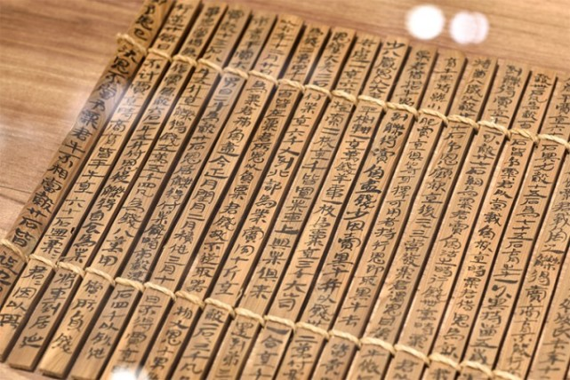
Characters

Slide 9
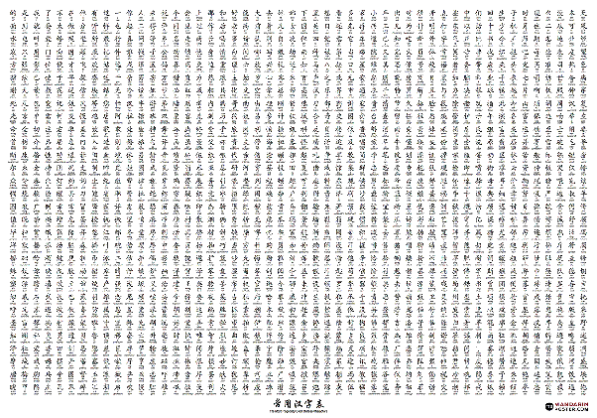
Mass of characters (about 40,000, of which 5,000 are frequently used, minimum 2,000)

Slide 10
Methodology of language acquisition
Copy
Repetition character
Memorization
Striving for a given ideal => in writing no variation, no creativity desired

Slide 11
English
[forest]
forest

Slide 12
Deutsch
[forest]
forest
pronounciation
meaning
writing

Slide 13
Chinesisch
[lin]
林
pronounciation
meaning
writing

Slide 14
Language, writing => thinking, culture, mentality
Language acquisition (less close connection between pronunciation and spelling) takes several years (students 8 years 4000 characters; Chinese for foreigners: 1600 lessons until university entrance qualification, German for Chinese: 1000 lessons)
Attempts to abolish the Chinese script because of "modernization obstacle" failed (irony: introduction of computer script saved)

Slide 15
Do Chinese read faster?
Yes. The same content can be captured faster.

Slide 16
Are Chinese books thinner?
Yes. The same content can be expressed with fewer characters.

Slide 17
Do Chinese write faster?
Yes. Handwriting takes longer, but input methods allow a syllable to be selected after only 2.3 keystrokes of input. Association methodology and AI make characters even faster to select.
At some schools, students no longer learn handwriting, but type on IPad

Slide 18
=> Do Chinese think faster?
The speed of cognitive operations can be measured: neurophysiological clock frequency of brain waves.
Similarly with computers: measurement in GHzIt is generally-humanly the same speed
=> No

Slide 19
=> Are Chinese thinking differently?
Methodology of language acquisition and conventions prevail also in knowledge acquisition, but Chinese is just as capable of knowledge acquisition/creativity/individuality/thinking, differences exist e.g. in emphases (snow important for Eskimos, traditions), but Chinese e.g. at Harvard University overrepresented (not because of different thinking: social causes)
=> no.

Slide 20
Life in the bubble
Facts
Chinese bubble
German bubble
Are we aware that we are living in a bubble?
Are we able to watch from outside of the bubble?
Example: Self-perception „We are the good guys.“ Foreign perception „They are the bad guys!“

Slide 21
2. Charakteristika of the communication: Paradoxa
Capitalism => "Chinese-style socialism"
"No interference in internal affairs" <-> Scarborough reef (Philippines) is occupied in 2012
Imperialist West enforced colonialism with army (<-> Zheng He fleet)
Core values of socialism: democracy, human rights ('collective'), rule of law, equality (, freedoms in comp. <-> reality)
Africa "no strings attached" <-> influence on presidential elections

Slide 22
Indirectness
The boss thinks, you…
Why does‘nt he tell me directly?!

Slide 23
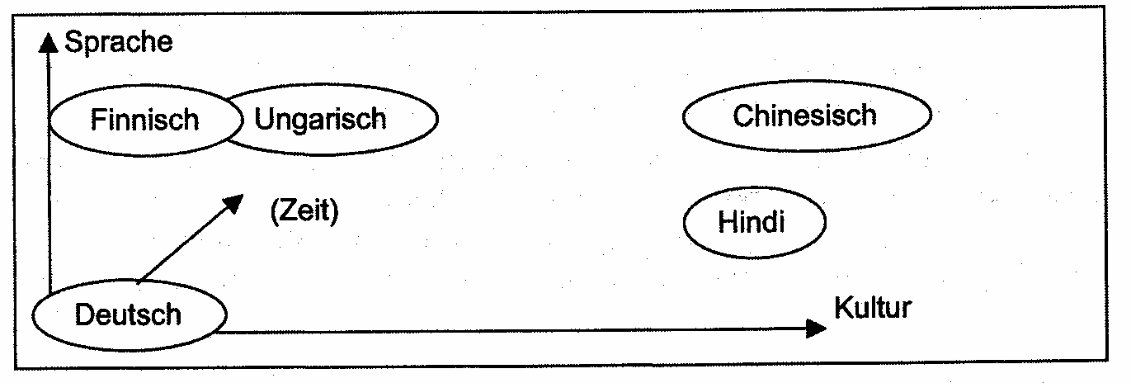
Family realations of culture and language
Cultural Comparison: Distant and Affine Cultures on the Example of Translation Problems of Literary Texts
Woesler, "Der literarische Übersetzungsprozess und die Kulturpole Deutschland - China", in: China.Literatur.Übersetzen. Beiträge eines Symposiums zu Ehren von Ulrich Kautz, Peter Lang, Bern 2006, S. 39-57, hier S. 44

Slide 24
我完了！
audio-kommunikative Kompetenz (完了)
situative Kompetenz
He made it!
I am knocked out!

Slide 25

B
A
audio-kommunikative Kompetenz (完了)
situative Kompetenz (Kritik vor anderen)
soziokulturelle Kompetenz (Höherstehender)
--
-
+
-

Slide 26
SMITH
audio-kommunikative Kompetenz (完了)
situative Kompetenz (Kritik vor anderen)
soziokulturelle Kompetenz (Höherstehender)
kognitive Kompetenz (Kollektivismus, Traditionen, Kalligraphie)

Slide 27
Tel. 5174886
audio-kommunikative Kompetenz (完了)
situative Kompetenz (Kritik vor anderen)
soziokulturelle Kompetenz (Höherstehender)
kognitive Kompetenz (Kollektivismus, Traditionen, Kalligraphie, (volks)religiös-mythische Traditionen, z.B. Aberglauben – 514 – „Ich will sterben.“)
五 5 我 Ich
一 1 要 will
七 7 气 mich ärgern
四 4 死 zu Tode.
八八 88 拜拜 Bye-bye!
六 6 了 [Partikel]

Slide 28
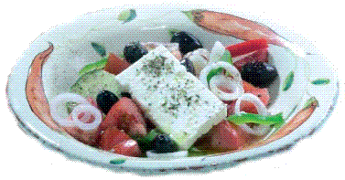

audio-kommunikative Kompetenz (完了)
situative Kompetenz (Kritik vor anderen)
soziokulturelle Kompetenz (Höherstehender)
kognitive Kompetenz (Kollektivismus, Traditionen, Kalligraphie, (volks)religiös-mythische Traditio-nen, z.B. Aberglauben – 514 – „Ich will sterben.“)
Indirektheit
kulturelle Traditionen (Sonnenbräune, Magerkeit, freizügige Bekleidung, Zubereitungsart, Naturwahrnehmung)

Slide 29
Rules of Speech
Das Wichtigste zuerst Das Leichtverdauliche zuerst
Trennung Sache / Person Einheit von Sache / Person
These / Antithese Fokus auf Gemeinsamkeiten
entweder - oder sowohl - als auch
deduktiv induktiv
Redundanzvermeidung Redundanz = Relevanz
Sachdominanz Beziehungs- und Machtdominanz

Slide 30
Aims of Personality Development
mündig, offen-direkt
leistungsmotiviert
aktiv, selbständig
analytisch-forschend
kreativ (originell)
entfaltend
konfliktfähig
respektvoll, zurückhaltend
pflichtbewußt und fleißig
geduldig, rezeptiv
ausgleichend
reproduktiv-adaptiv
selbstregulierend
konflikttolerant

Slide 31
Preferred teaching form and learning behavior
selbständiges Arbeiten
Gruppenarbeit
Theorie und Praxis (dual)
Diskurs/Kontroverse
Vergleiche anstellten
das Wissen erarbeiten
Lernen ist Denken
Memorieren
Vorträge, Referate
viel Theorie
Lehrer erklärt, Schüler fassen zusammen
Interpretation
das Wissen sammeln
erst lernen - dann denken
aktive Kompetenz
rezeptive Bildung

Slide 32
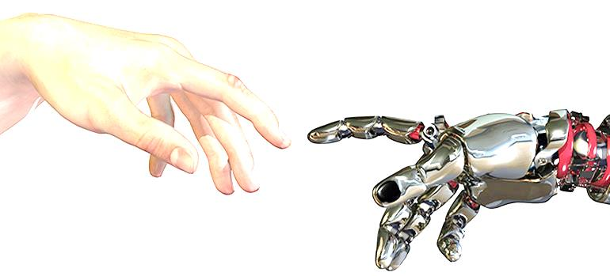
Communication 1.0 - 5.0
Literature:
Niklas Luhmann. Die Gesellschaft der Gesellschaft. 1997
Dirk Baecker. Studien zur nächsten Gesellschaft. Frankfurt 2007
1.0 Orality 2.0 Script (5000 years ago) 2.1 Pictograms → Phonetic
3.0 Printing Press (1150/568 years ago, mass audience)
4.0 Digitization (electronic)
German
5.0 Virtual
(AI takes over)

Slide 33
Abstract
Virtual Communication
AI has taken over
Humans are objects of manipulation (customers, voters)
Algorithms analyze multimodal communication
Algorithms compare personality profile with Big Data, base decisions on correlations

Slide 34
Abstract
Algorithms target not just explicit, but implicit communication (incl. thoughts)
Algorithms predict future and simulate imminent future
Mightier algorithms replace human court decisions
Sets of algorithms manage houses, cities, societies

Slide 35
Research
Describes examples (phenomenological level)
Analyzes benefits (security enhancement)
Warns of abuse, harmful developments (addiction)
Raises ethical questions (e.g. exoskeletal ethics, gamification)

Slide 36
Intro
This paper deals with big/bad ai
Systemic disincentives lead to enslavement of humans (like the unregulated use of derivatives led to financial crisis)

Slide 37
1 History of media epochs
Literature:
Niklas Luhmann. Die Gesellschaft der Gesellschaft. 1997
Dirk Baecker. Studien zur nächsten Gesellschaft. Frankfurt 2007
1.0 Orality 2.0 Script (5000 years ago) 2.1 Pictograms → Phonetic
3.0 Printing Press (1150/568 years ago, mass audience)
4.0 Digitization (electronic)
German
5.0 Virtual
(AI takes over)

Slide 38
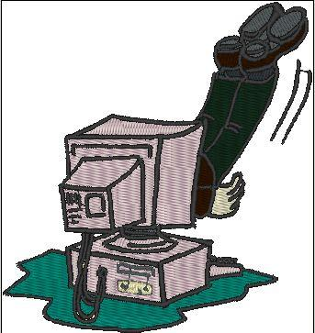

4.0
5.0
Luhmann
5.0 Artificial Intelligence (Inside the machine)
4.0 Digitization Luhmann: „Surface and Depth of the machine“
„I am root, I am in charge“

Slide 39
2 Types of Communicative Acts
Texts
Surf behavior
Consumer behavior
‘Likes’
Duration/Attention
habits/repetitiveness/occurrences
identification (Raj Kannan 2020)
social interaction incl. friendships, sexual relationships
mobility behavior/pattern

Slide 40
3 Types of Analysis
General
True identity (Verschuere 2016)
Personality profile: Big Five Personality Inventory: Openness to Experience, Consciousness, Extroversion, Agreeableness, Neuroticism “OCEAN” (Golbeck 2011), ‘likes’ (AI-Demand 2020)
Mobility profile/pattern
Health (Daley 2020)
Job
Financial credit-worthiness
Consumer Behavior
Secrets

Slide 41

4.0 → 5.0
4 Unique quality of media epoch 5.0
subject → object
active → passive
tool → puppeteer
free internet → surveillance tool
direct → indirect
explicit → implicit
voice/words → preferences/thoughts/dreams/wishes/ values (experiments with brain scanners in worker hats: Shanghai, Peking)
“centralization → decentralization” → (de)centralization, concentration
man-man → man-machine & machine-machine

Slide 42
5 Types of Manipulation
Priming consumers
Filter bubbles
lies spread faster (Vosoughi et al. 2018)
Change of political attitude
Use of private information/dependencies
Identity theft

Slide 43
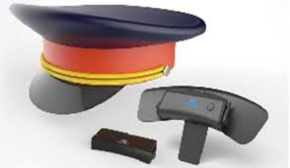
6 Consequences
Virtual Communication “hidden”, but consequences “real”
transparent user
Less will to discuss
Populism
Polarization
incentive to stay “hidden”
Thinking tackled
Victims discriminated by Controllers
Exoskeleton ethics

Slide 44
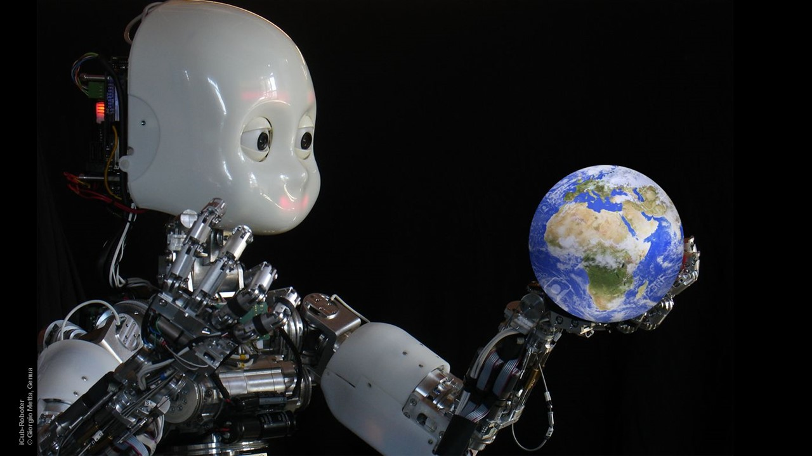
7 Prediction of the Future
The imminent future behavior of a human can be predicted
With many analyzed humans, the imminent future of reality can be predicted => simulation
Little AI and Big AI (good AI/bad AI) (cf. Euchner 2019)

Slide 45
Conclusion and Outlook
Data has succeeded oil as resource no. 1
Legislation is delayed
Europe: Privacy – US / China: Tech Companies
guide the youth: screen time, personal data, addiction
algorithms tackle the innermost sanctum of personality, our thoughts
change of paradigms: The cause-based decision-making by humans is replaced by the correlation-based decision-making by algorithms
AI took the wrong development path, when it changed from serving humans to trying to manipulate humans for economic or political profit.
AI-education (e.g. German Credit Score): humans learn exoskeletal ethics, forget inner ethical judgment
become aware, define legislation to a) protect privacy, b) give the user the control

Slide 46
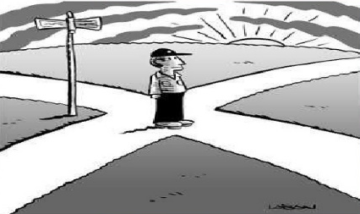
Conclusion and Outlook
New developments open new possibilities. We need to make sure that not only a few tech companies and terrorists use the powerful new technology to achieve their goals, but that the mass of smart device users emancipate themselves from addiction to and manipulation by technology and gain back their dignity, privacy and free will.

Slide 47
Preparation for next week
Please prepare all texts for session 11, answer quizzes, translate, correct
Topics:
11 10 Stage entertainment: Crosstalk 相声 63%

Slide 48
Always here for you! 随时为你们服务
Professor Dr. Martin Woesler 吴漠汀 湖南师范大学特聘教授，博士导师
Office / 办公室: 外国语学院415
国际汉学中心309
Phone / 电话: (150) 1138 8818 (德国+49 178 2073538) Email / 电子邮件: wmt@hunnu.edu.cn

Slide 49
Thank You

