Slide 1







Minority Languages
in China
Presenters: Liu Jiayu -- English Translation
Liao Lujia -- English Translation

Slide 2
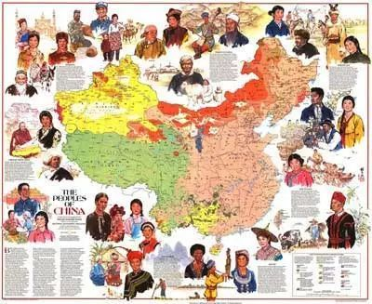

Questions:
1. Can you list some minority languages in China?
2. Does anyone know how to speak at least one minority language in China?

Slide 3

Ⅳ
Ⅲ
Ⅱ
Ⅰ
Catalogue
Definition
Measures
Significance
Use

Slide 4




Ⅰ
Definition
https://www.ypppt.com/
What is a minority language?

Slide 5
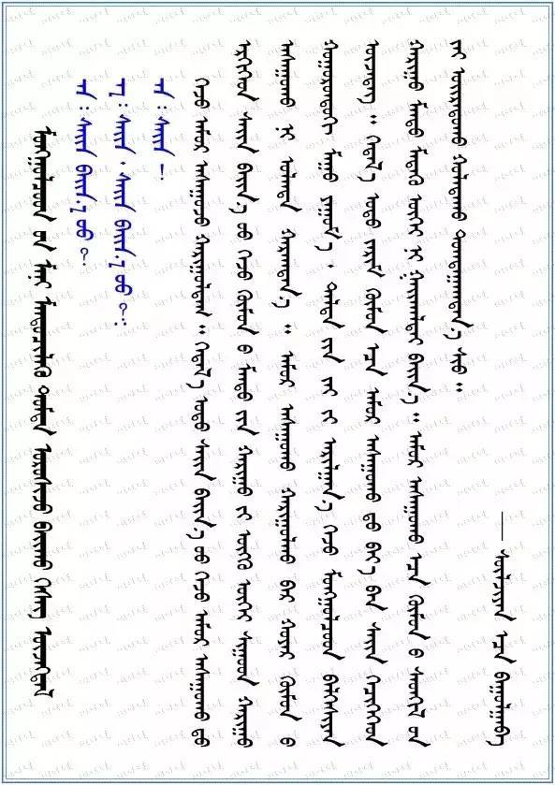

Definition
A minority language is an independent language system belonging to an independent nation.
e.g. Mongolian language（蒙古语）
2. minority languages = dialects?

Slide 6
Ⅱ
Use
The general situation
and use of minority languages

Slide 7
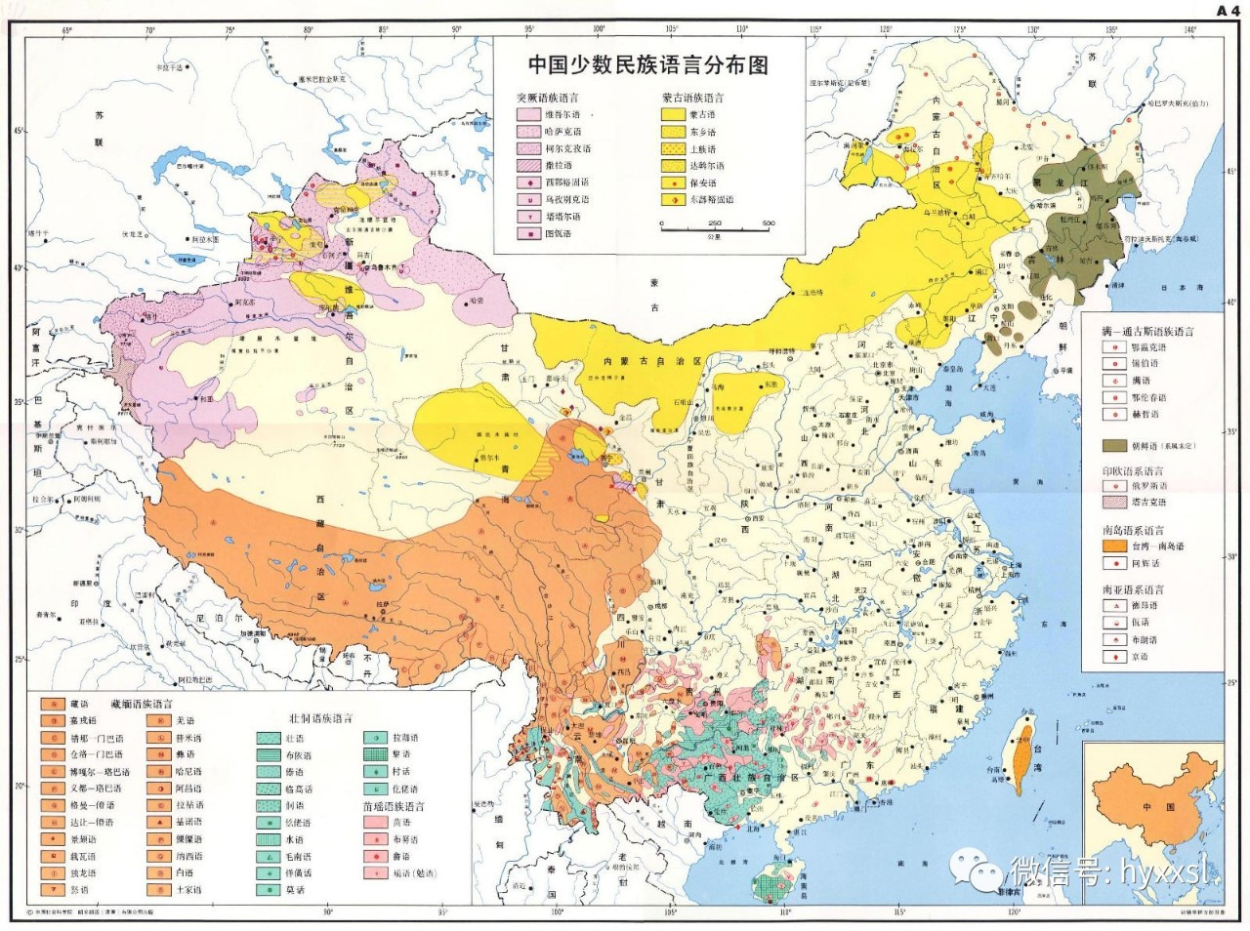
Distribution map
of minority languages
in China

Slide 8

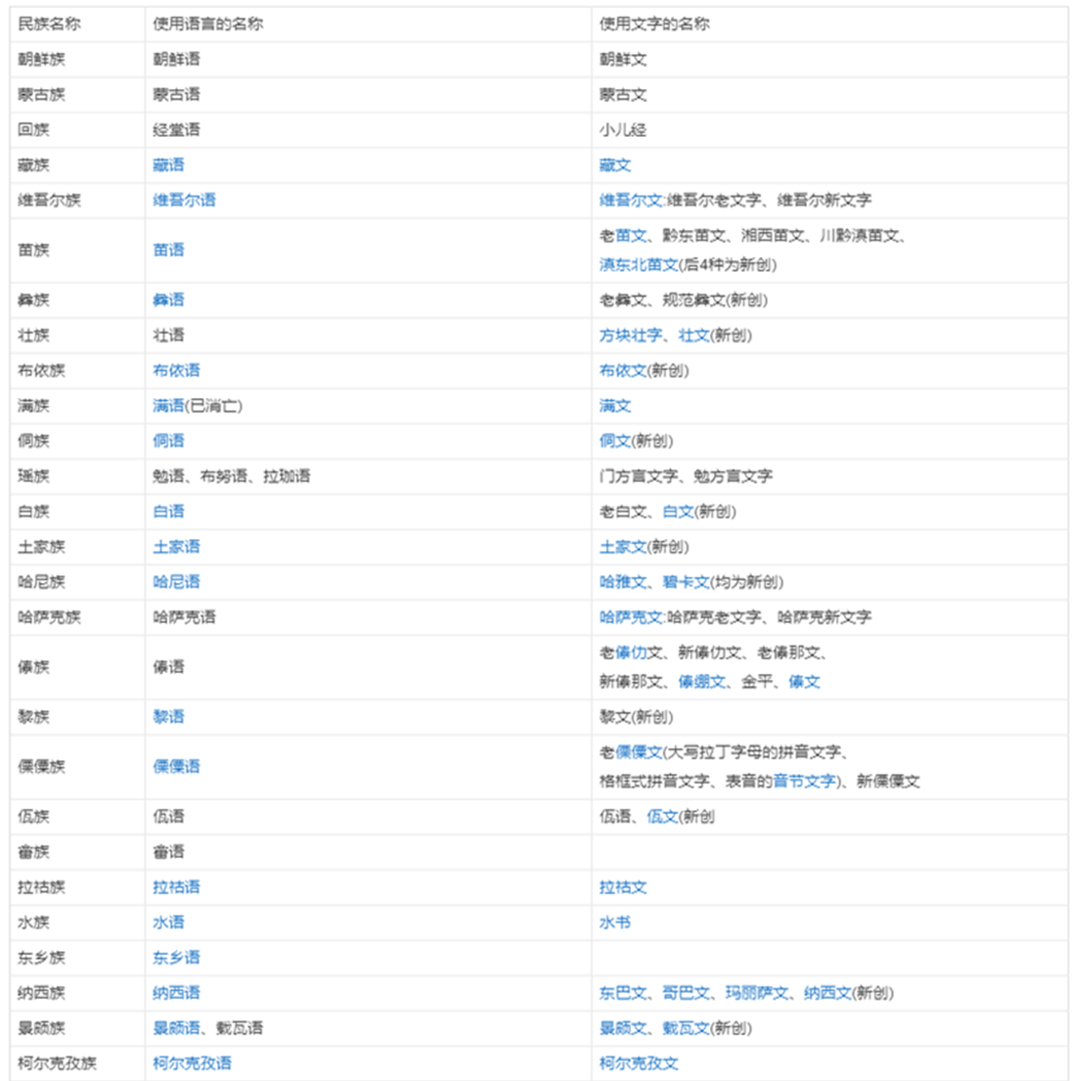
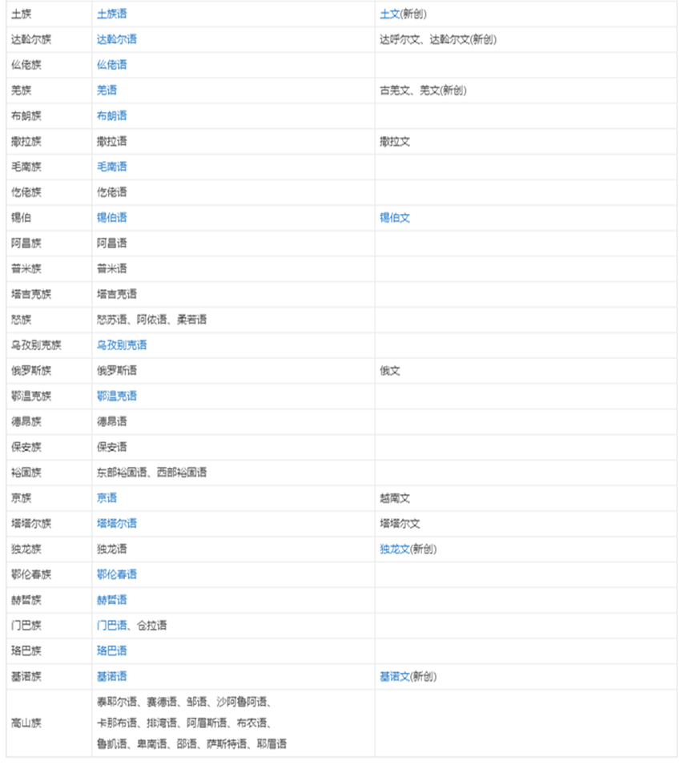

Slide 9
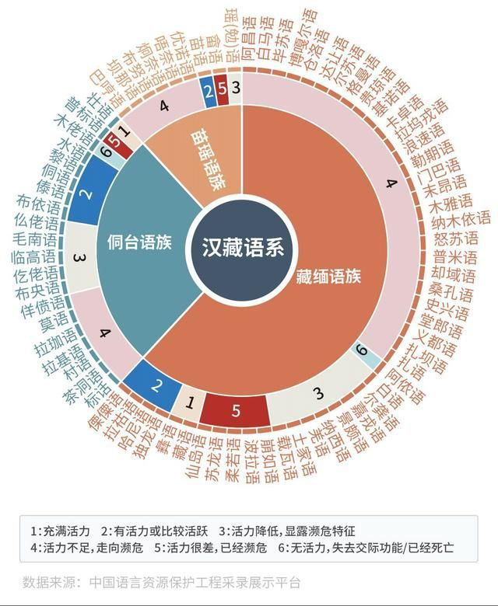

In China, more than 120 ethnic minority languages are in use, of which about half are spoken by less than 10,000 people, and more than 20 are spoken by less than 1,000 people. These languages are basically on the verge of extinction.
1: Be energetic
2: Energetic or relatively active
3: Decreased vitality, showing an endangered trend
4: Lack of vitality, towards the endangered
5: Vitality is poor and endangered
6: No energy, no communicative function/dead

Slide 10
Ⅲ
Significance
Why should we protect and inherit minority languages in China?

Slide 11
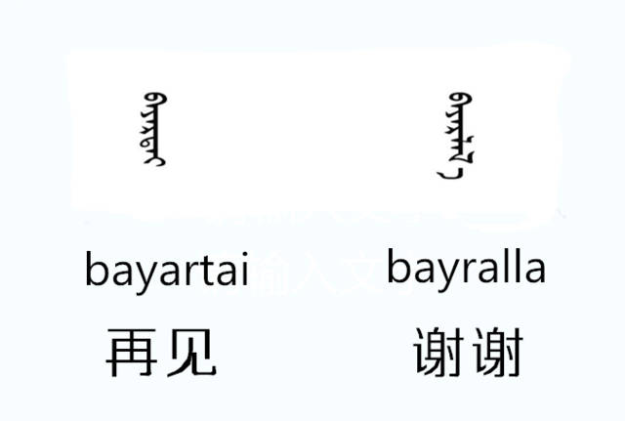
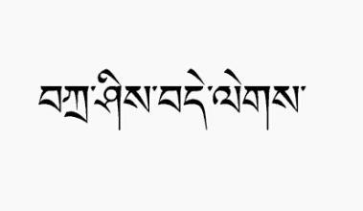
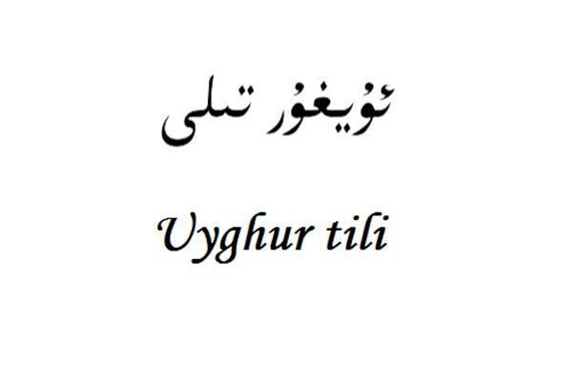


Why should we protect and inherit minority languages in China?
An important part of Chinese minority culture
The important basis of national identity
An important role in ethnic unity and social stability.

Slide 12
Ⅳ
Measures
How to protect and inherit minority languages?

Slide 13
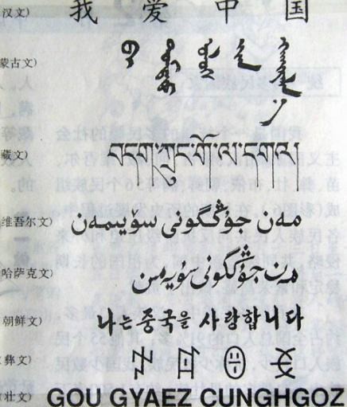

Measures to protect and inherit minority languages in China?
Sound legislation
Academic research
Education
Public services

Slide 14
Thanks for watching!

