Slide 1
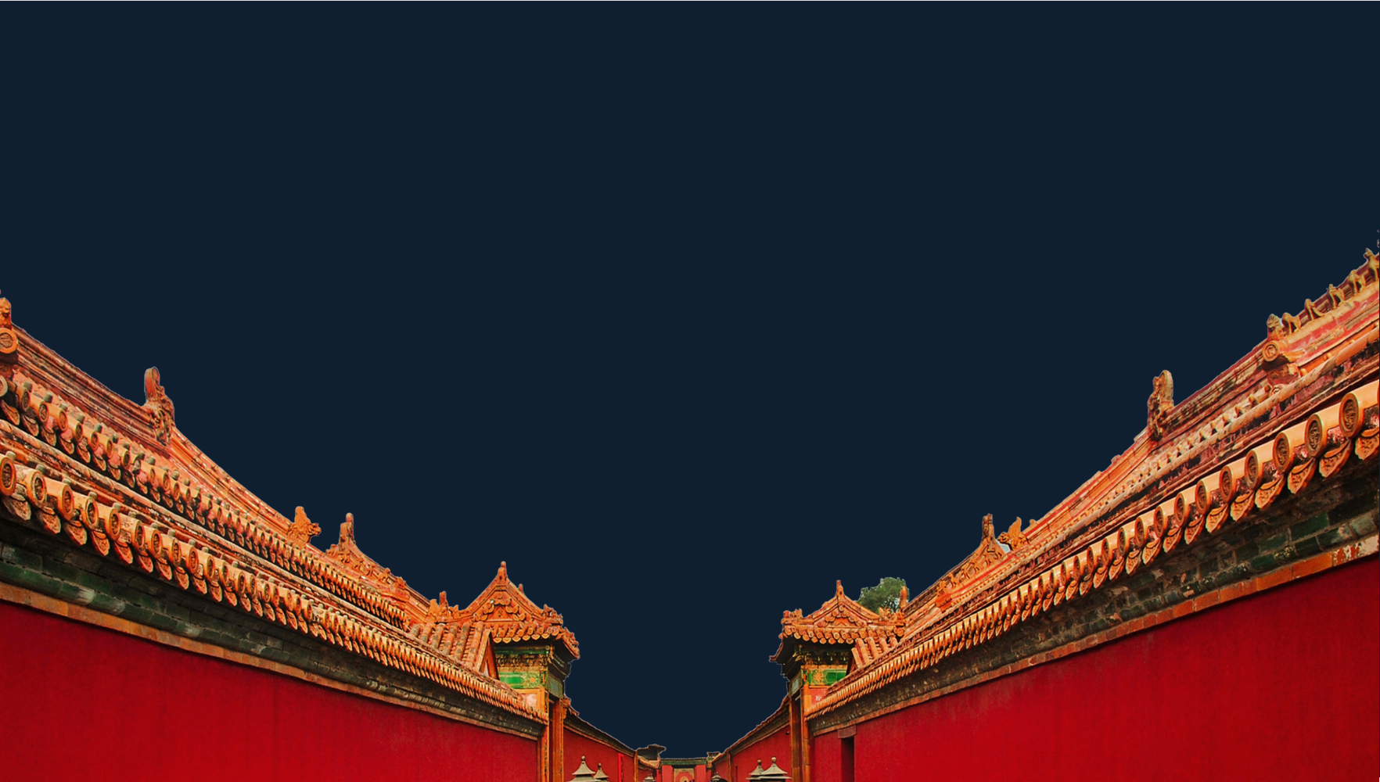
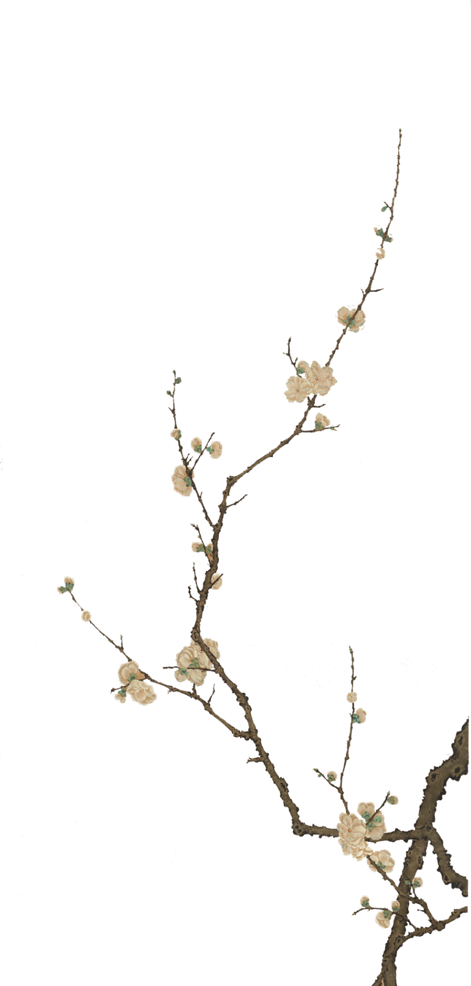
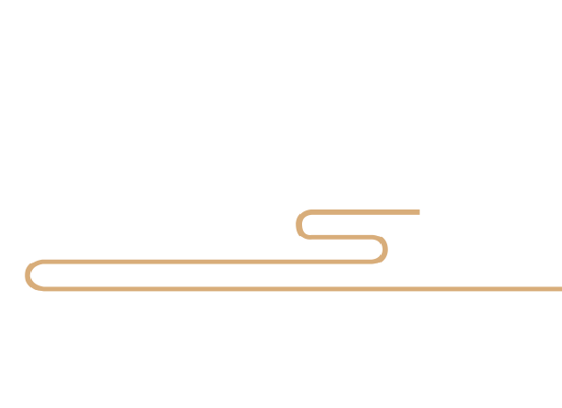
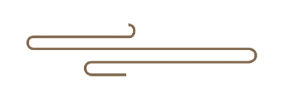
The
Forbidden City
Ding Qian
202130092296

Slide 2
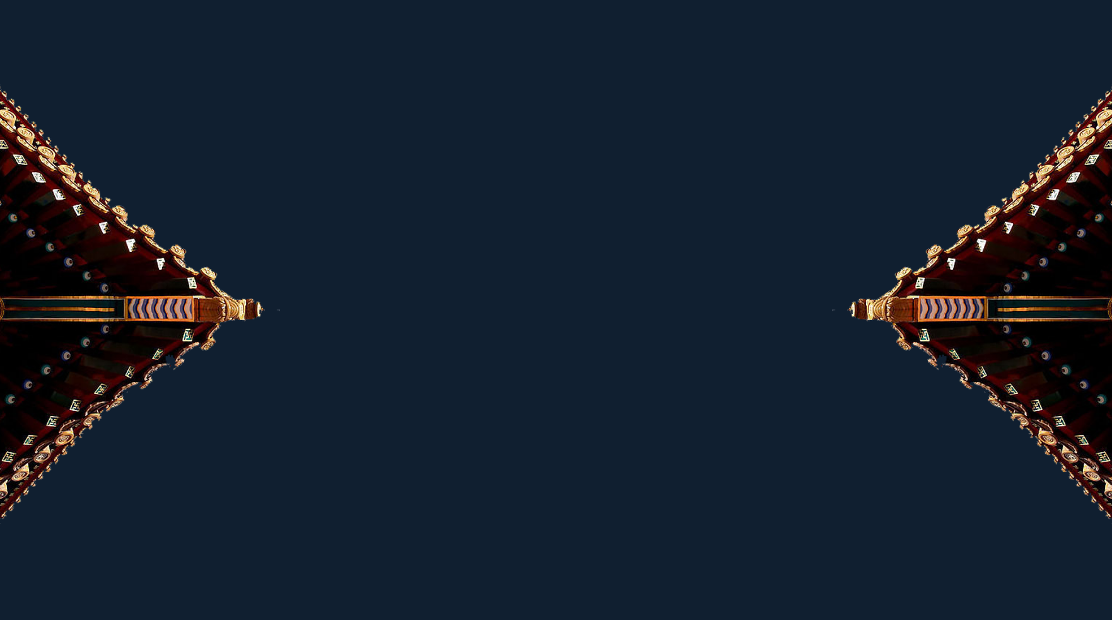
Contents
01
Introduction
02
The layout
03
The collections

Slide 3
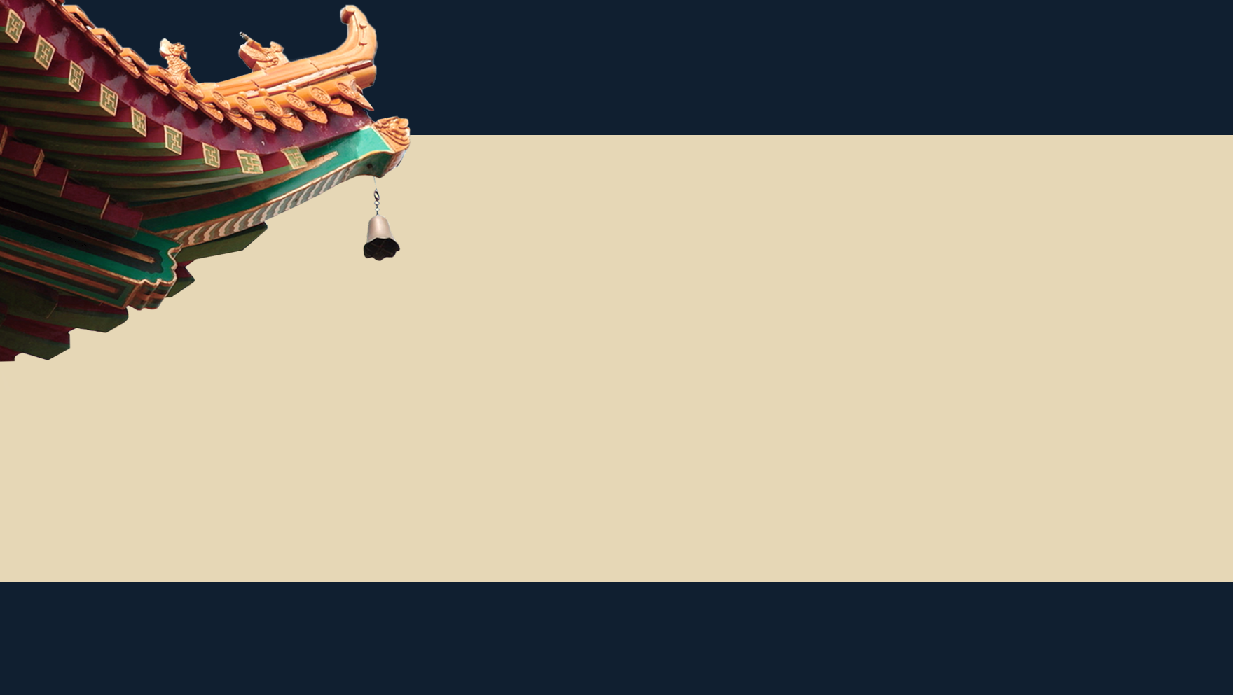
Introduction
The Forbidden City (紫禁城) is a palace complex in Dongcheng District, Beijing, China, at the center of the Imperial City of Beijing .
Zi, or "Purple", refers to the North Star, which in ancient China was called the Ziwei Star（紫微星）. The emperor of heaven lived in Ziwei palace, while the human emperor claimed to be the "son of heaven " who was ordered by heaven. His residence should be a symbol of Ziwei palace to correspond to the heaven emperor.
Jin , or " Forhidden ", referred to the fact that nobody could enter or leave the palace without the emperor ' s permission
Cheng means a castle, fortification, or city

Slide 4

Introduction
The Forbidden City was constructed from 1406 to 1420, and was the former Chinese imperial palace and winter residence of the Emperor of China from the Ming dynasty (since the Yongle Emperor) to the end of the Qing dynasty, between 1420 and 1924. The Forbidden City served as the home of Chinese emperors and their households and was the ceremonial and political center of the Chinese government for over 500 years.
The Forbidden City was listed as the first batch of key cultural relics under national protection in 1961. It was declared a world cultural heritage in 1987, and listed by UNESCO as the largest collection of preserved ancient wooden structures in the world .
Today, the site is most commonly known in Chinese as Gugong , which means the "Former Palace". The museum which is based in these buildings is known as the "Palace Museum" (故宫博物院).

Slide 5

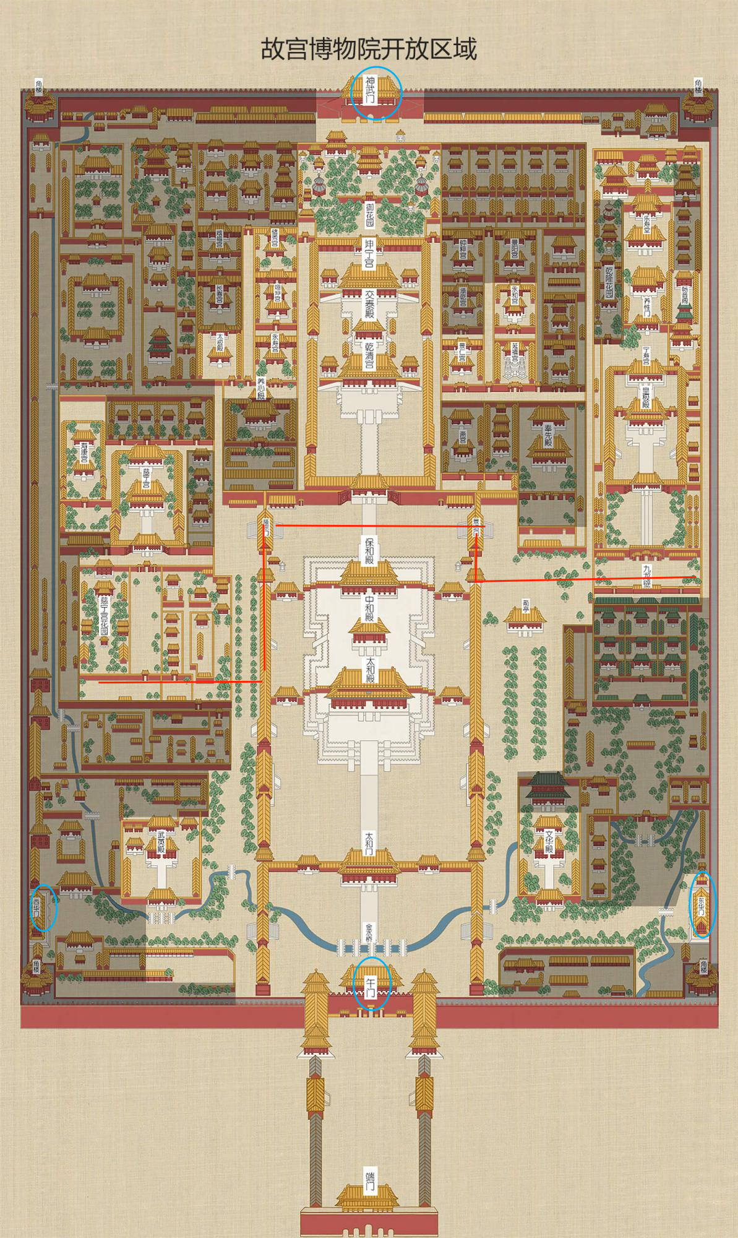
The layout
Measuring 961 meters in length and 753 meters in width, the Forbidden City is composed of 980 buildings with 8,707 bays of rooms and surrounded by a moat as wide as 52 meters.
There is a gate on each side, including the Meridian Gate （午门）in the south, the Shenwu Gate（神武门）in the north, the Donghua（东华门） Gate in the east and the Xihua Gate in the west（西华门）

Slide 6
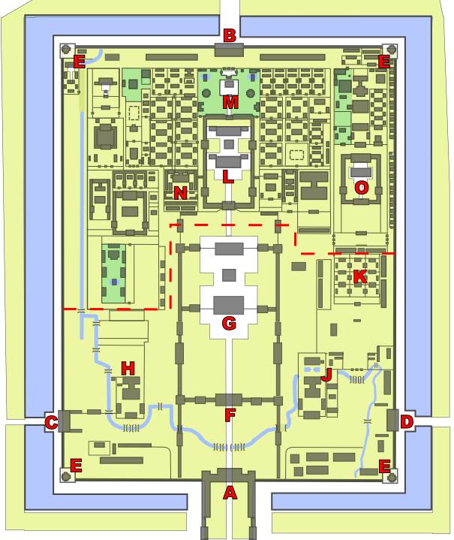
The layout
Measuring 961 meters in length and 753 meters in width, the Forbidden City is composed of 980 buildings with 8,707 bays of rooms and surrounded by a moat as wide as 52 meters.
There is a gate on each side, including the Meridian Gate （午门）in the south, the Shenwu Gate（神武门）in the north, the Donghua（东华门） Gate in the east and the Xihua Gate in the west（西华门）

Slide 7
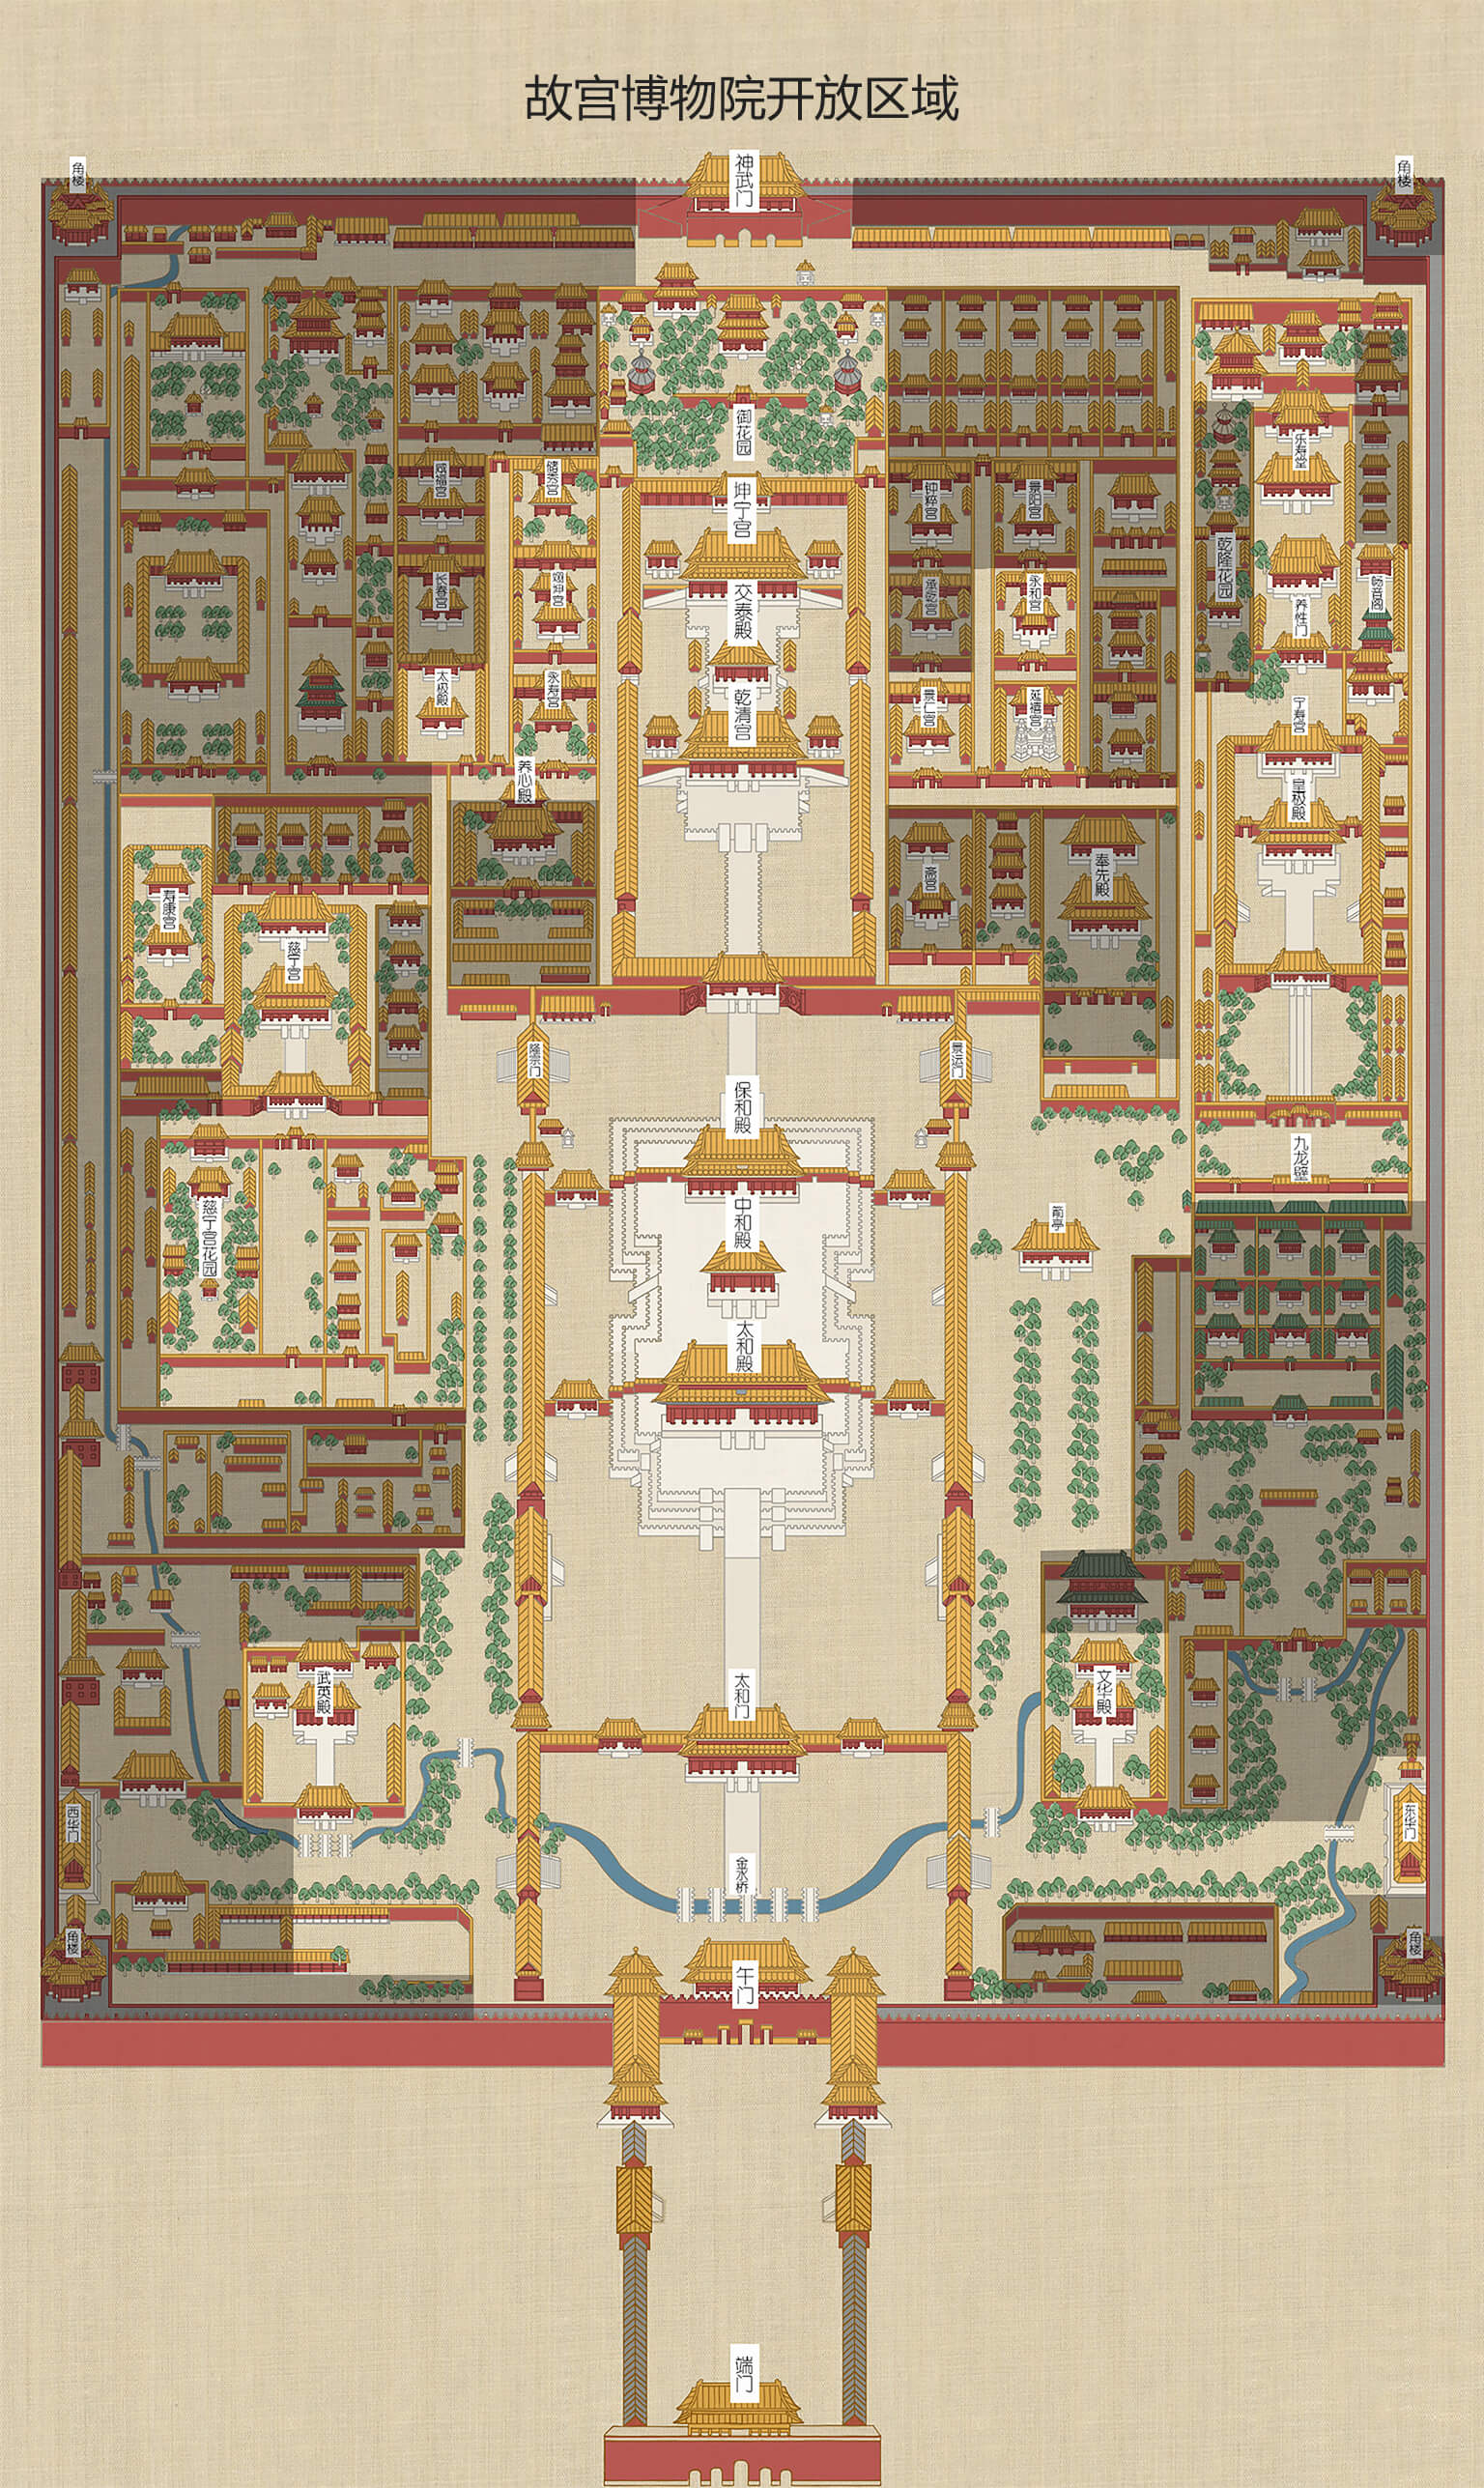
The layout
The Forbidden City consists of two parts: the outer court and the inner court.
The outer court centers on Hall of Supreme Harmony（太和殿）, Hall of Central Harmony（中和殿), Hall of Preserving Harmony(保和殿）, and the east of the Wenhua Hall, the west of the Martial Arts Hall for the two wings, becoming the place where the court held the ceremony.
Behind the outer court was the inner court, including the Palace of Heavenly Purity, the Hall of Union and Peace, Palace of Earthly tranquility, the imperial garden and the six east and west palaces, where the emperor handled daily government affairs and the emperor and concubines lived.
https://pano.dpm.org.cn/gugong_pano/index.html

Slide 8

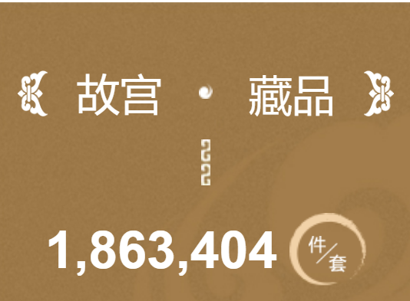
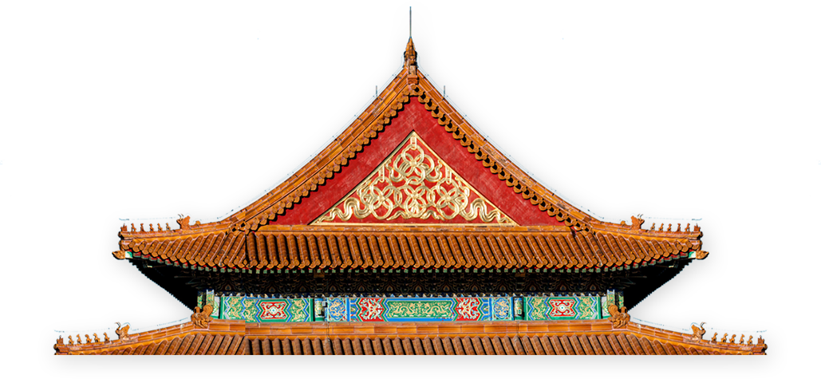
The collections
The collections of the Palace Museum are based on the Qing imperial collection, including paintings, ceramics(陶器), seals, sculptures, brocade, bronze wares(青铜器), enamel objects(珐琅), etc. According to latest audit, it has 1,863,404 pieces of art.

Slide 9
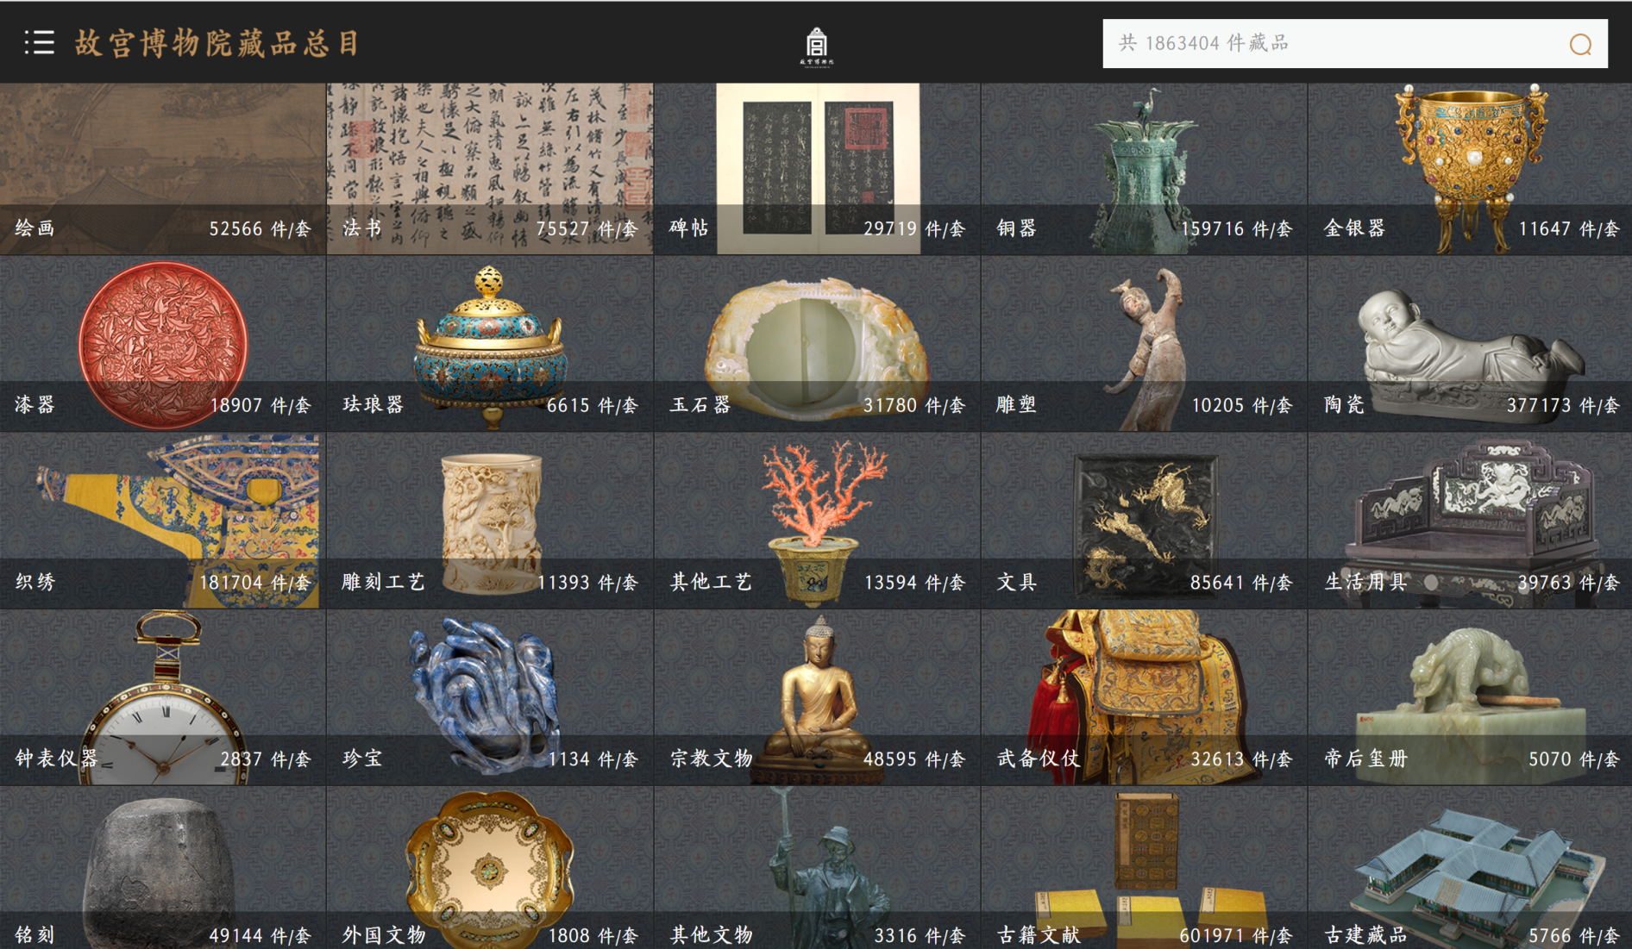

Slide 10
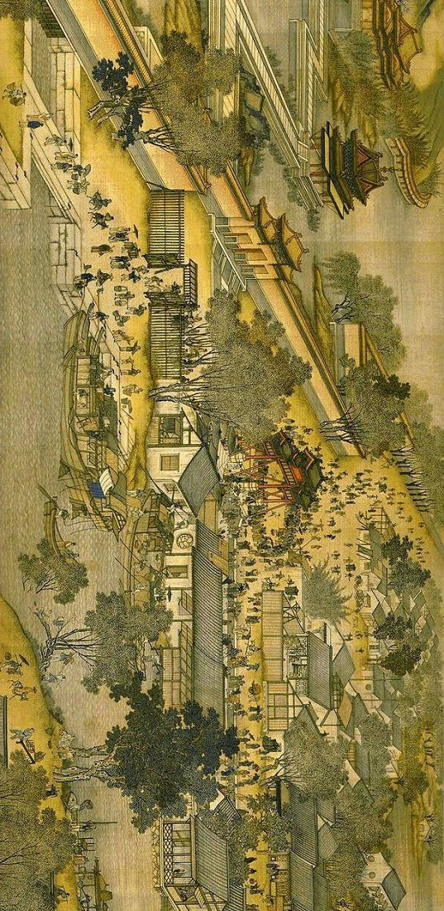
The collections
Along the River During the Qingming Festival (Qingming Shanghe Tu) is a handscroll of painting by the Song dynasty painter Zhang Zeduan (1085–1145) .
It captures the daily life of people and the landscape of the capital, Bianjing (present-day Kaifeng) during the Northern Song.
Along the River During the Qingming Festival
清明上河图

Slide 11
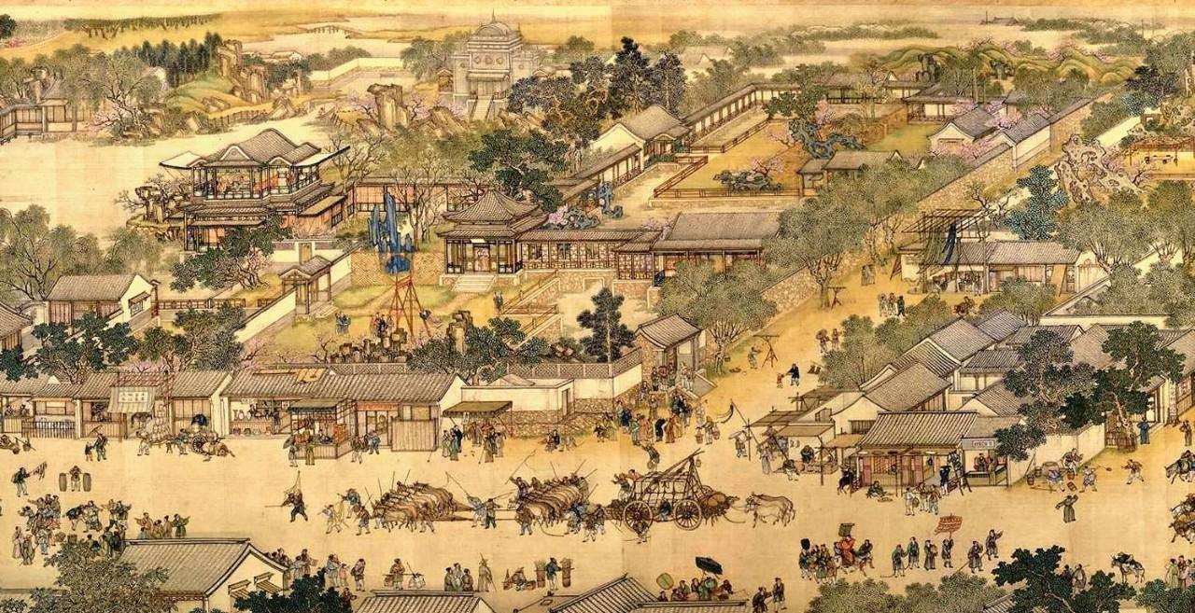
The collections
https://minghuaji.dpm.org.cn/paint/appreciate?id=592d80e225aac624977fee2e19452c1f
Read right to left, as a viewer unrolled it, successive scenes reveal the lifestyle of all levels of the society from rich to poor as well as economic activities in rural areas and the city, and offer glimpses of period clothing and architecture.The painting is considered to be the most renowned work among all Chinese paintings, and it has been called "China's Mona Lisa."

Slide 12
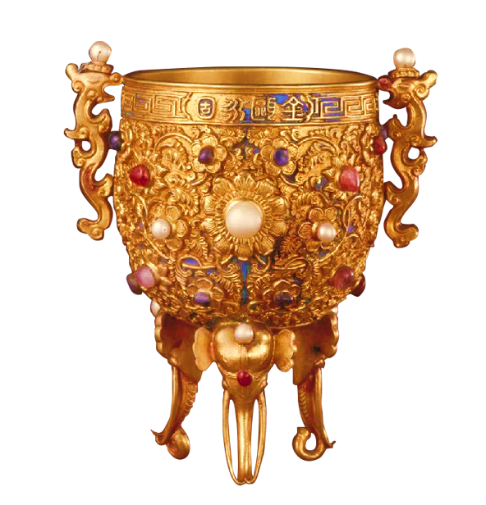
The collections
This wine cup is a cornerstone of the imperial collection of Qing Dynasty. In 1739, Emperor Qianlong ordered it made on his 30th birthday, engraving “Jinou Yonggu,” a wish of eternal stability for the Qing Dynasty.
The foot of the cup looks like the elephant trunk, and it symbolizes the steady authority and control of territory.
According to the record from Qing dynasty, Emperor Qianlong highly valued manufacture of the cup. They fully took advantage of gold, diamond, and precious jades from the government bank, and every step of the work was designed in a highly accurate level.
Jinou Yonggu Cup of Emperor Qianlong
乾隆金瓯永固杯

Slide 13
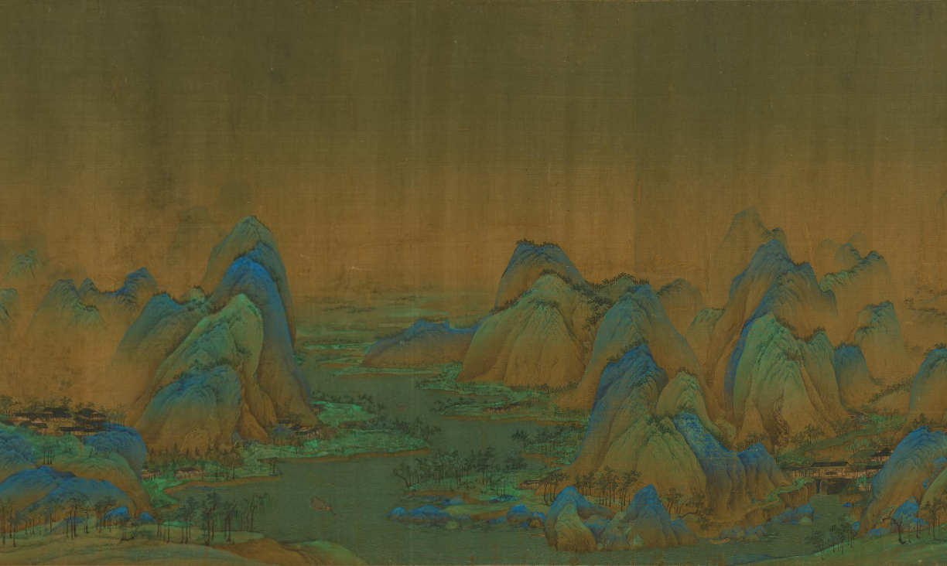
The collections
The painting is the only extant work by Wang Ximeng who created it at the age of seventeen. It is a masterpiece of "blue-green landscape"(qinglü shanshui).
It is stunning in its sweeping scale, rich coloration, and the expressive minute details. On a single piece of silk, mountain formations and groupings of infinite variety rise and fall between a cloudless sky and rippling waters, extending as far as the eye can see in all directions. Punctuating the spectacular scene, thatched houses, bridges, and antlike figures are described in fine detail.
Thousands miles of mountains and rivers
千里江山图
https://minghuaji.dpm.org.cn/paint/appreciate?id=b0a15b3767a5c12089ec45563741112b

Slide 14
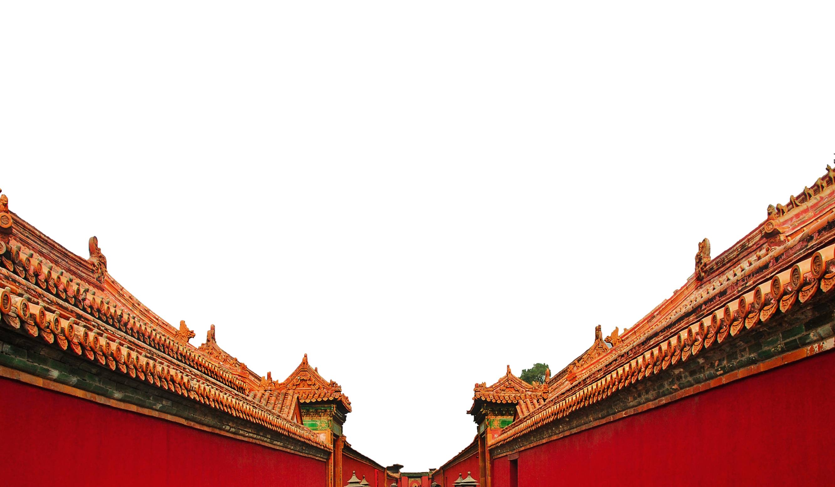
Thanks for your watching

