Slide 1

中国文化基础 Foundation of Chinese Cultures for Bachelor Students of Translation Studies
湖南师范大学 2021年3月3日-2021年6月16日 中国文化基础 周三第七和第八节课14:30-16:10，
上课地点：在线
助教：刘廷阳 Liu Tingyang, wiki 助教：陈柯汝 Chen Keru
吴漠汀特聘教授 Distinguished Professor Dr. Martin Woesler
湖南师范大学外国学院 Foreign Studies College, Hunan Normal University

Slide 2
Session 11 第十一周
Session Overview 本节概览 and Quizzes
Classroom presentation no. 28 on paper cutting by Yao Yang 么阳. 这是quiz的链接：https://ks.wjx.top/vj/hWic51g.aspx
Classroom presentation no. 29 on tiktok by Huang Xiaolan黄笑兰. 这是quiz的链接： https://ks.wjx.top/vj/YyKMJyZ.aspx
Classroom presentation no. 30 on Chinese clothing by Shu Lin 舒琳. 这是quiz的链接：https://ks.wjx.top/vj/rPvogih.aspx

Slide 3
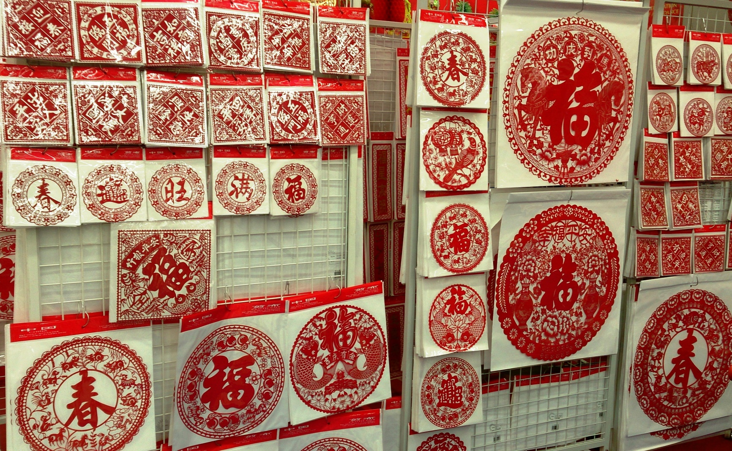
Session 11 第十一周
Classroom presentation no. 28 on paper cutting by Yao Yang 么阳. 这是quiz的链接：https://ks.wjx.top/vj/hWic51g.aspx
CC Licence „ProjectManhattan“

Slide 4

Session 11 第十一周
Classroom presentation no. 29 on tiktok by Huang Xiaolan黄笑兰. 这是quiz的链接： https://ks.wjx.top/vj/YyKMJyZ.aspx

Slide 5
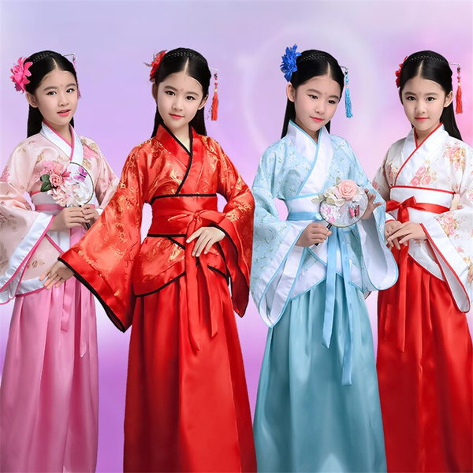
Session 11 第十一周
Classroom presentation no. 30 on Chinese clothing by Shu Lin 舒琳. 这是quiz的链接：https://ks.wjx.top/vj/rPvogih.aspx

Slide 6
Session 11 第十一周
Session Overview 本节概览 and Quizzes this presentation may be delivered any time soon:
10 Aesthetic ideals and social customs: Chinese Marriage Customs Presentation on Marriage Customs by Dù Xīnyǔ 杜心语 (Quiz has been taken)

Slide 7
Session 11 第十一周
Hitlist of Chinese cultural phenomena: This semesters‘ schedule
Order | Date | Topic | Chapter | Points | Popularity
1 | 10.03.2021 | Beverages: Milk Tea | 21 | 474 | 79%
2 | 10.03.2021 | Traditional Cuisine: Eight Major Cuisines in China | 28 | 468 | 78%
3 | 10.03.2021 | Beverages: Tea | 20 | 451 | 75%
4 | 17.03.2021 | Architecture: Architecture and Gardens, The Forbidden City | 36 | 433 | 72%
5 | 17.03.2021 | Traditional Festivals | 2 | 432 | 72%
6 | 17.03.2021 | Aesthetic ideals and social customs: The Four Most Handsome Men in Ancient China | 108 | 427 | 71%
7 | 24.03.2021 | Traditional Cuisine: Four Distinct Regional Cuisines | 24 | 423 | 71%
8 | 24.03.2021 | Education: Historical Figures, The Four Talented Women of Ancient China | 119 | 417 | 70%
9 | 24.03.2021 | Traditional Cuisine: Two Famous Dishes | 26 | 415 | 69%
10 | 31.03.2021 | Aesthetic ideals and social customs: Chinese Marriage Customs | 110 | 409 | 68%
11 | 31.03.2021 | Music and instruments: Pipa | 95 | 406 | 68%
12 | 31.03.2021 | Traditional Cuisine: The Art of Chinese Cooking | 25 | 404 | 67%
13 | 07.04.2021 | Silk and porcelain: Celadon and Celadon Song 《青花瓷》歌词 | 31 | 401 | 67%
14 | 07.04.2021 | Traditional Cuisine: Chinese Dining Etiquette | 23 | 396 | 66%
15 | 07.04.2021 | Facial Make-up: Cosmetics, Traditional Chinese Make-Up | 98 | 395 | 66%
16 | 14.04.2021 | Garden Culture: The Summer Palace | 41 | 385 | 64%
17 | 14.04.2021 | Money culture: The tradition of Red Envelope and Lucky Money | 106 | 384 | 64%
18 | 14.04.2021 | Stage entertainment: Crosstalk 相声 | 99 | 383 | 64%
19 | 21.04.2021 | Architecture | 35 | 377 | 63%
20 | 21.04.2021 | Music and instruments: Guzheng | 94 | 375 | 63%
21 | 21.04.2021 | Chinese Astrology: Twelve Animals of the Chinese Zodiac | 71 | 372 | 62%
22 | 28.04.2021 | Ancient literature: Four Folk Stories of Ancient China | 49 | 371 | 62%
23 | 28.04.2021 | Ancient literature: Chinese Classical Fairy Tales | 50 | 369 | 62%
24 | 28.04.2021 | Chinese language: Chinese Dialects | 45 | 368 | 61%
25 | 05.05.2021 | Animals: Panda | 128 | 366 | 61%
26 | 05.05.2021 | Facial Make-up: Face Changing in Sichuan Opera | 97 | 365 | 61%
27 | 05.05.2021 | Chinese Mythology: Huli-jing | 73 | 364 | 61%
28 | 12.05.2021 | Traditional Crafts: Folk Art - Chinese Paper-cutting | 19 | 364 | 61%
29 | 12.05.2021 | Science and Technology: Douyin (Tik Tok) | 8 | 362 | 60%
30 | 12.05.2021 | Chinese clothing / interieur: Chinese clothing | 112 | 361 | 60%
31 | 19.05.2021 | Facial Make-up | 96 | 360 | 60%
32 | 19.05.2021 | Beverages: The Liquor Culture of Ancient China | 22 | 357 | 60%
33 | 19.05.2021 | Premodern literature: Tang and Song (2 texts) | 51 | 357 | 60%
34 | 26.05.2021 | Chinese Medicine: The Development of Chinese Medicine | 68 | 356 | 59%
35 | 26.05.2021 | Modern and Contemporary Literature: Qian Zhongshu (Ch'ien Chung-shu) | 56 | 349 | 58%
36 | 26.05.2021 | Body movement performance: Traditional Chinese Dance | 103 | 346 | 58%
37 | 02.06.2021 | Chinese Astrology: Calendar, The 24 Solar Terms | 72 | 346 | 58%
38 | 02.06.2021 | Stage entertainment: Shadow Play | 100 | 344 | 57%
39 | 02.06.2021 | Chinese Astrology: Chinese Astrology | 70 | 338 | 56%
40 | 09.06.2021 | Chinese Writing: Chinese Characters | 9 | 336 | 56%
41 | 09.06.2021 | Landscapes and tourism: Landscape, Five Famous Mountains | 122 | 333 | 56%
42 | 09.06.2021 | Traditional Crafts: Carving | 17 | 326 | 54%
43 | 16.06.2021 | Landscapes and tourism: Tourism, Nanjing-An Ancient Capital of Six Dynasties | 126 | 319 | 53%
44 | 16.06.2021 | Garden Culture: Qingming Riverside Landscspe Garden | 42 | 317 | 53%
45 | 16.06.2021 | Traditional Crafts: Handcraft - Chinese Knots | 18 | 317 | 53%
46 |  | Fine Arts: Painting | 32 | 316 | 53%
47 |  | Chinese clothing / interieur: Cheongsam | 113 | 312 | 52%
48 |  | Silk Road - by land and by sea: Zhang Qian and the Silk Road | 89 | 309 | 52%
49 |  | Money culture: Currency, Jiaozi (A Paper Currency in Northern Song Dynasty) | 105 | 308 | 51%
50 |  | Beijing Opera: Actor Mei Lanfang | 61 | 306 | 51%
51 |  | Education: Ancient Chinese Education | 116 | 305 | 51%
52 |  | Chinese language | 44 | 304 | 51%
53 |  | Traditional Crafts: Embroidery | 14 | 304 | 51%
54 |  | Chinese Mythology: Gods and Immortals | 74 | 303 | 51%
55 |  | Chinese Writing: Calligraphy | 11 | 302 | 50%
56 |  | Landscapes and tourism: The Ancient Tea Horse Road | 123 | 300 | 50%
57 |  | Traditional Festivals: Spring Festival Couplets | 3 | 299 | 50%
58 |  | Premodern literature: Li Bai's 李白 《长干行》 and its translations | 52 | 297 | 50%
59 |  | Chinese Medicine: Acupuncture and Moxibustion | 67 | 296 | 49%
60 |  | Silk and porcelain: Silk | 29 | 296 | 49%
61 |  | Science and Technology: China's Four New Inventions | 7 | 294 | 49%
62 |  | Stage entertainment: Chinese cinema (dramas and movies) and its popularity and affection in Vietnam | 101 | 294 | 49%
63 |  | Games: Go 围棋 | 107 | 291 | 49%
64 |  | Premodern literature: Strange Stories from a Chinese Studio | 54 | 289 | 48%
65 |  | Religions: Daoism | 76 | 288 | 48%
66 |  | Science and Technology: Ancient Science and Technology | 5 | 286 | 48%
67 |  | Architecture: Bridges | 39 | 284 | 47%
68 |  | Education: Yuelu Academy (One of the Four Most Prestigious Academies) | 117 | 283 | 47%
69 |  | Landscapes and tourism: Mogao Grottoes | 124 | 283 | 47%
70 |  | Silk Road - by land and by sea: Zheng He and the Maritime Silk Road | 90 | 283 | 47%
71 |  | Ancient literature: Classical Literature | 46 | 281 | 47%
72 |  | Army and weapons: Chinese Ancient Weapons | 121 | 281 | 47%
73 |  | Aesthetic ideals and social customs: Habits, Ways of Contacting | 109 | 279 | 47%
74 |  | Architecture: Three Great Towers in China | 38 | 275 | 46%
75 |  | Fine Arts: Seal-cutting | 33 | 275 | 46%
76 |  | Silk Road - by land and by sea: Zheng He's Voyages | 91 | 275 | 46%
77 |  | Garden Culture: Gardens | 40 | 274 | 46%
78 |  | Chinese Medicine: Diagnosis and Pharmacology | 66 | 273 | 46%
79 |  | Beijing Opera | 60 | 272 | 45%
80 |  | Chinese Writing: Chinese Characters and Scripts | 10 | 272 | 45%
81 |  | Premodern literature: China's Four Great Classical Novels | 53 | 270 | 45%
82 |  | Chinese clothing / interieur: The Folding Screen | 115 | 267 | 45%
83 |  | Ancient literature: Chinese Mythology | 48 | 265 | 44%
84 |  | Chinese Medicine: Zhang Zhongjing | 69 | 264 | 44%
85 |  | Landscapes and tourism: Four State-Level Cultural Relics | 125 | 263 | 44%
86 |  | Martial Arts: Qigong | 64 | 262 | 44%
87 |  | Architecture: Four Great Pavilions | 37 | 261 | 44%
88 |  | Religions: Buddhism | 75 | 260 | 43%
89 |  | Traditional Cuisine: Chopsticks | 27 | 260 | 43%
90 |  | Westernization: The Eastward Spread of Western Learning | 92 | 260 | 43%
91 |  | Body movement performance: Chinese Lion Dancing | 104 | 259 | 43%
92 |  | Body movement performance: Stilts | 102 | 259 | 43%
93 |  | Science and Technology: Compass | 6 | 259 | 43%
94 |  | Chinese Writing: The Evolution of Calligraphy | 12 | 258 | 43%
95 |  | Chinese Writing: Ancient Writing and Painting Tool, Writing Brush | 13 | 255 | 43%
96 |  | Garden Culture: Bonsai (Penjing) | 43 | 253 | 42%
97 |  | Traditional Crafts: Lacquerware | 16 | 247 | 41%
98 |  | Chinese clothing / interieur: Batik | 114 | 242 | 40%
99 |  | Confucianism: Confucian Culture | 81 | 237 | 40%
100 |  | Westernization: The Westernization Movement | 93 | 236 | 39%
101 |  | Modern and Contemporary Literature: Novels | 57 | 234 | 39%
102 |  | Modern and Contemporary Literature: Literature, Science Fiction, and Fantasy | 59 | 233 | 39%
103 |  | Ancient literature: Yue Fu | 47 | 231 | 39%
104 |  | Modern and Contemporary Literature: Modern Literature | 55 | 231 | 39%
105 |  | Education: The Nine-Grade Official Selection System in Wei, Jin, Southern and Northern Dynasties | 118 | 229 | 38%
106 |  | Confucianism: Four Main Philosophic Schools | 79 | 226 | 38%
107 |  | Philosophical Schools (Daoism, Buddhism, Legalism): Classical Philosophy - Reading Tao Te Ching | 85 | 225 | 38%
108 |  | Minority cultures: Lisu People and Daogan Festival of Lisu Ethnic Minority | 111 | 219 | 37%
109 |  | Landscapes and tourism: Four Buddhist Shrines | 127 | 213 | 36%
110 |  | Beijing Opera: Beijing Opera Acrobatics | 62 | 211 | 35%
111 |  | Confucianism: Classical Philosophy - Confucius and Confucianism | 80 | 211 | 35%
112 |  | Martial Arts: Wushu | 63 | 211 | 35%
113 |  | Army and weapons: Terracotta Army | 120 | 210 | 35%
114 |  | Fine Arts: Bada Shanren and Qi Baishi | 34 | 210 | 35%
115 |  | Martial Arts: Huo Yuanjia | 65 | 210 | 35%
116 |  | Modern and Contemporary Literature: Contemporary Literature | 58 | 209 | 35%
117 |  | Philosophical Schools (Daoism, Buddhism, Legalism): Classical Philosophy - Daoism | 84 | 204 | 34%
118 |  | Traditional Festivals: Lattice on Ancient Chinese Windows | 4 | 203 | 34%
119 |  | Silk and porcelain: Porcelain | 30 | 197 | 33%
120 |  | Philosophical Schools (Daoism, Buddhism, Legalism): Legalism | 88 | 196 | 33%
121 |  | Confucianism: Chinese Traditional Culture-Five Constant Virtues | 83 | 195 | 33%
122 |  | Traditional Crafts: Cloisonne | 15 | 194 | 32%
123 |  | Religions: Christianity | 78 | 176 | 29%
124 |  | Religions: Islam | 77 | 171 | 29%
125 |  | Confucianism: Classical Philosophy - Reading The Analects | 82 | 170 | 28%
126 |  | Philosophical Schools (Daoism, Buddhism, Legalism): Classical Philosophy - Reading The Importance of Living | 87 | 168 | 28%
127 |  | Philosophical Schools (Daoism, Buddhism, Legalism): Classical Philosophy - Reading The Sutra of Hui-neng | 86 | 154 | 26%

Slide 8
Session 11 第十一周
Order | Date | Topic | Chapter | Points | Popularity
25 | 05.05.2021 | Animals: Panda | 128 | 366 | 61%
26 | 05.05.2021 | Facial Make-up: Face Changing in Sichuan Opera | 97 | 365 | 61%
27 | 05.05.2021 | Chinese Mythology: Huli-jing | 73 | 364 | 61%
28 | 12.05.2021 | Traditional Crafts: Folk Art - Chinese Paper-cutting | 19 | 364 | 61%
29 | 12.05.2021 | Science and Technology: Douyin (Tik Tok) | 8 | 362 | 60%
30 | 12.05.2021 | Chinese clothing / interieur: Chinese clothing | 112 | 361 | 60%
31 | 19.05.2021 | Facial Make-up | 96 | 360 | 60%
32 | 19.05.2021 | Beverages: The Liquor Culture of Ancient China | 22 | 357 | 60%
33 | 19.05.2021 | Premodern literature: Tang and Song (2 texts) | 51 | 357 | 60%
34 | 26.05.2021 | Chinese Medicine: The Development of Chinese Medicine | 68 | 356 | 59%
35 | 26.05.2021 | Modern and Contemporary Literature: Qian Zhongshu (Ch'ien Chung-shu) | 56 | 349 | 58%
36 | 26.05.2021 | Body movement performance: Traditional Chinese Dance | 103 | 346 | 58%
37 | 02.06.2021 | Chinese Astrology: Calendar, The 24 Solar Terms | 72 | 346 | 58%
38 | 02.06.2021 | Stage entertainment: Shadow Play | 100 | 344 | 57%
39 | 02.06.2021 | Chinese Astrology: Chinese Astrology | 70 | 338 | 56%
40 | 09.06.2021 | Chinese Writing: Chinese Characters | 9 | 336 | 56%
41 | 09.06.2021 | Landscapes and tourism: Landscape, Five Famous Mountains | 122 | 333 | 56%
42 | 09.06.2021 | Traditional Crafts: Carving | 17 | 326 | 54%
43 | 16.06.2021 | Landscapes and tourism: Tourism, Nanjing-An Ancient Capital of Six Dynasties | 126 | 319 | 53%
44 | 16.06.2021 | Garden Culture: Qingming Riverside Landscspe Garden | 42 | 317 | 53%
45 | 16.06.2021 | Traditional Crafts: Handcraft - Chinese Knots | 18 | 317 | 53%
46 |  | Fine Arts: Painting | 32 | 316 | 53%
47 |  | Chinese clothing / interieur: Cheongsam | 113 | 312 | 52%
48 |  | Silk Road - by land and by sea: Zhang Qian and the Silk Road | 89 | 309 | 52%
49 |  | Money culture: Currency, Jiaozi (A Paper Currency in Northern Song Dynasty) | 105 | 308 | 51%
50 |  | Beijing Opera: Actor Mei Lanfang | 61 | 306 | 51%
51 |  | Education: Ancient Chinese Education | 116 | 305 | 51%
52 |  | Chinese language | 44 | 304 | 51%
53 |  | Traditional Crafts: Embroidery | 14 | 304 | 51%
54 |  | Chinese Mythology: Gods and Immortals | 74 | 303 | 51%
55 |  | Chinese Writing: Calligraphy | 11 | 302 | 50%
56 |  | Landscapes and tourism: The Ancient Tea Horse Road | 123 | 300 | 50%
57 |  | Traditional Festivals: Spring Festival Couplets | 3 | 299 | 50%
58 |  | Premodern literature: Li Bai's 李白 《长干行》 and its translations | 52 | 297 | 50%
59 |  | Chinese Medicine: Acupuncture and Moxibustion | 67 | 296 | 49%
60 |  | Silk and porcelain: Silk | 29 | 296 | 49%
61 |  | Science and Technology: China's Four New Inventions | 7 | 294 | 49%
62 |  | Stage entertainment: Chinese cinema (dramas and movies) and its popularity and affection in Vietnam | 101 | 294 | 49%
63 |  | Games: Go 围棋 | 107 | 291 | 49%
64 |  | Premodern literature: Strange Stories from a Chinese Studio | 54 | 289 | 48%
65 |  | Religions: Daoism | 76 | 288 | 48%
66 |  | Science and Technology: Ancient Science and Technology | 5 | 286 | 48%
67 |  | Architecture: Bridges | 39 | 284 | 47%
68 |  | Education: Yuelu Academy (One of the Four Most Prestigious Academies) | 117 | 283 | 47%
69 |  | Landscapes and tourism: Mogao Grottoes | 124 | 283 | 47%
70 |  | Silk Road - by land and by sea: Zheng He and the Maritime Silk Road | 90 | 283 | 47%
71 |  | Ancient literature: Classical Literature | 46 | 281 | 47%
72 |  | Army and weapons: Chinese Ancient Weapons | 121 | 281 | 47%
73 |  | Aesthetic ideals and social customs: Habits, Ways of Contacting | 109 | 279 | 47%
74 |  | Architecture: Three Great Towers in China | 38 | 275 | 46%
75 |  | Fine Arts: Seal-cutting | 33 | 275 | 46%
76 |  | Silk Road - by land and by sea: Zheng He's Voyages | 91 | 275 | 46%
77 |  | Garden Culture: Gardens | 40 | 274 | 46%
78 |  | Chinese Medicine: Diagnosis and Pharmacology | 66 | 273 | 46%
79 |  | Beijing Opera | 60 | 272 | 45%
80 |  | Chinese Writing: Chinese Characters and Scripts | 10 | 272 | 45%
81 |  | Premodern literature: China's Four Great Classical Novels | 53 | 270 | 45%
82 |  | Chinese clothing / interieur: The Folding Screen | 115 | 267 | 45%
83 |  | Ancient literature: Chinese Mythology | 48 | 265 | 44%
84 |  | Chinese Medicine: Zhang Zhongjing | 69 | 264 | 44%
85 |  | Landscapes and tourism: Four State-Level Cultural Relics | 125 | 263 | 44%
86 |  | Martial Arts: Qigong | 64 | 262 | 44%
87 |  | Architecture: Four Great Pavilions | 37 | 261 | 44%
88 |  | Religions: Buddhism | 75 | 260 | 43%
89 |  | Traditional Cuisine: Chopsticks | 27 | 260 | 43%
90 |  | Westernization: The Eastward Spread of Western Learning | 92 | 260 | 43%
91 |  | Body movement performance: Chinese Lion Dancing | 104 | 259 | 43%
92 |  | Body movement performance: Stilts | 102 | 259 | 43%
93 |  | Science and Technology: Compass | 6 | 259 | 43%
94 |  | Chinese Writing: The Evolution of Calligraphy | 12 | 258 | 43%
95 |  | Chinese Writing: Ancient Writing and Painting Tool, Writing Brush | 13 | 255 | 43%
96 |  | Garden Culture: Bonsai (Penjing) | 43 | 253 | 42%
97 |  | Traditional Crafts: Lacquerware | 16 | 247 | 41%
98 |  | Chinese clothing / interieur: Batik | 114 | 242 | 40%
99 |  | Confucianism: Confucian Culture | 81 | 237 | 40%
100 |  | Westernization: The Westernization Movement | 93 | 236 | 39%
101 |  | Modern and Contemporary Literature: Novels | 57 | 234 | 39%
102 |  | Modern and Contemporary Literature: Literature, Science Fiction, and Fantasy | 59 | 233 | 39%
103 |  | Ancient literature: Yue Fu | 47 | 231 | 39%
104 |  | Modern and Contemporary Literature: Modern Literature | 55 | 231 | 39%
105 |  | Education: The Nine-Grade Official Selection System in Wei, Jin, Southern and Northern Dynasties | 118 | 229 | 38%
106 |  | Confucianism: Four Main Philosophic Schools | 79 | 226 | 38%
107 |  | Philosophical Schools (Daoism, Buddhism, Legalism): Classical Philosophy - Reading Tao Te Ching | 85 | 225 | 38%
108 |  | Minority cultures: Lisu People and Daogan Festival of Lisu Ethnic Minority | 111 | 219 | 37%
109 |  | Landscapes and tourism: Four Buddhist Shrines | 127 | 213 | 36%
110 |  | Beijing Opera: Beijing Opera Acrobatics | 62 | 211 | 35%
111 |  | Confucianism: Classical Philosophy - Confucius and Confucianism | 80 | 211 | 35%
112 |  | Martial Arts: Wushu | 63 | 211 | 35%
113 |  | Army and weapons: Terracotta Army | 120 | 210 | 35%
114 |  | Fine Arts: Bada Shanren and Qi Baishi | 34 | 210 | 35%
115 |  | Martial Arts: Huo Yuanjia | 65 | 210 | 35%
116 |  | Modern and Contemporary Literature: Contemporary Literature | 58 | 209 | 35%
117 |  | Philosophical Schools (Daoism, Buddhism, Legalism): Classical Philosophy - Daoism | 84 | 204 | 34%
118 |  | Traditional Festivals: Lattice on Ancient Chinese Windows | 4 | 203 | 34%
119 |  | Silk and porcelain: Porcelain | 30 | 197 | 33%
120 |  | Philosophical Schools (Daoism, Buddhism, Legalism): Legalism | 88 | 196 | 33%
121 |  | Confucianism: Chinese Traditional Culture-Five Constant Virtues | 83 | 195 | 33%
122 |  | Traditional Crafts: Cloisonne | 15 | 194 | 32%
123 |  | Religions: Christianity | 78 | 176 | 29%
124 |  | Religions: Islam | 77 | 171 | 29%
125 |  | Confucianism: Classical Philosophy - Reading The Analects | 82 | 170 | 28%
126 |  | Philosophical Schools (Daoism, Buddhism, Legalism): Classical Philosophy - Reading The Importance of Living | 87 | 168 | 28%
127 |  | Philosophical Schools (Daoism, Buddhism, Legalism): Classical Philosophy - Reading The Sutra of Hui-neng | 86 | 154 | 26%

Slide 9
Session 11 第十一周
Please prepare for next time
Facial Make-up by Su Xiao 苏潇
Liquor by Teng Bixia 滕璧霞
Tang and Song literature by Zhào Kē 赵轲

Slide 10
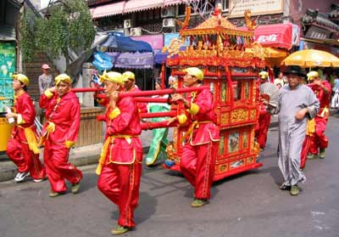
(晚一點：) Marriage (Dù Xīnyǔ 杜心语)

Slide 11
Always here for you! 随时为你们服务
Professor Dr. Martin Woesler 吴漠汀 湖南师范大学特聘教授，博士导师
Office / 办公室: 外国语学院406
国际汉学中心308
Phone / 电话: (150) 1138 8818 (德国+49 178 2073538) Email / 电子邮件: wmt@hunnu.edu.cn

Slide 12
Thank You

