Slide 1
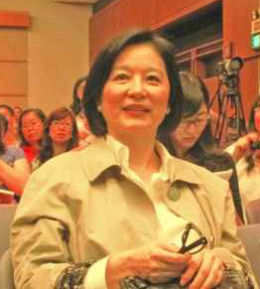
Zhang Jie
1937
Modern Chinese Writer
By Erica B. Oaks
http://hkmdbnews.com/?tag=zhang-yimou

Slide 2
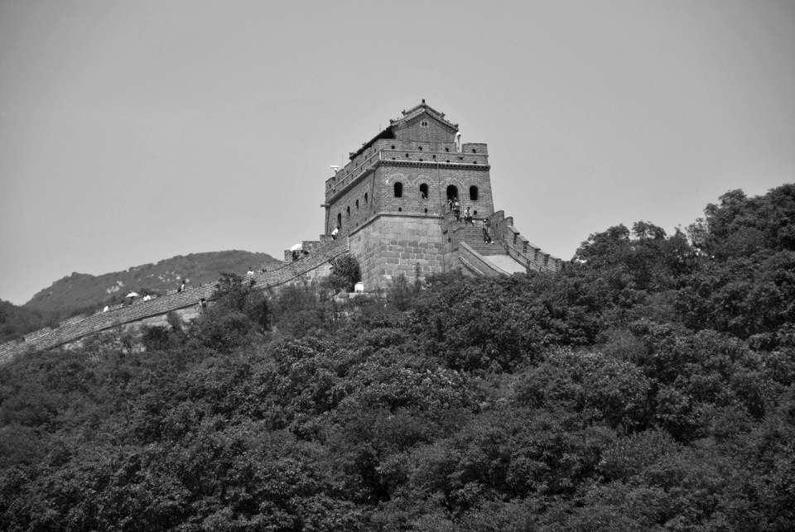
Zhang Jie was born in Beijing (Peking)
The Great Wall of China by Erica Oaks

Slide 3
Communism in China – Founding
The Communist Party of China was founded by Chen Duxiu and Li Dazhao in the French concession of Shanghai in 1921 as a study society and an informal network. Mao soon set up his own branch in Changsha, also establishing a branch of the Socialist Youth Corps. He also opened a bookstore under the control of his new Cultural Book Society, whose purpose was to propagate revolutionary literature throughout Hunan. By 1921, small groups of Marxists existed in six Chinese cities: Shanghai, Peking, Changsha, Wuhan, Canton and Tsinan, with a further group having been founded by Chinese students in Paris. It was decided that they should send delegates for a central meeting, which began in Shanghai on July 23, 1921. http://en.wikipedia.org/wiki/Mao_Zedong
http://en.wikipedia.org/wiki/History_of_the_Communist_Party_of_China
‘Revolution is not a dinner party, nor an essay, nor a painting, nor a piece of embroidery; it cannot be so refined, so leisurely and gentle, so temperate, kind, courteous, restrained and magnanimous. http://koolkwotes.blogspot.com/2010/08/revolution-is-not-dinner-party-nor.html
— Mao, 1893 – 1976. February 1927.
A revolution is an insurrection, an act of violence by which one class overthrows another.’

Slide 4
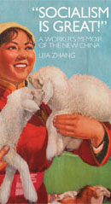
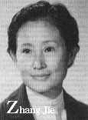
Zhang Jie
had to join the Communism Party like many other writers
But did not gave in
http://digital.library.upenn.edu/women/_generate/authors-Z.html

Slide 5
2 important Faces in Chinese Literature:
a. The First face in the 1920s. It started with the fall of the Empire and the disintegration of the Old Traditional Literacy. The beginning of the ‘Chinese Literature Modern Classics was born’ Lu Xun, Lao She, Cao Yu, Mao Deng, Ba Jin
b. The Second face during the 1980s. A period of relative relaxation begins that allowed the ‘emerge of new climate of cultural creativity’. The distinction of what it was ‘Revolutionary Literature between – Modern Literature’ was well noticed. The young writers that had to remain silence had been awaken! In this face: Zhang Jie, Wang Meng, Liu Xiabo, Wang Shuo, Hao Shaogong and many more.
http://www.upf.edu/materials/huma/central/historia/lite/temes/6postm.htm

Slide 6
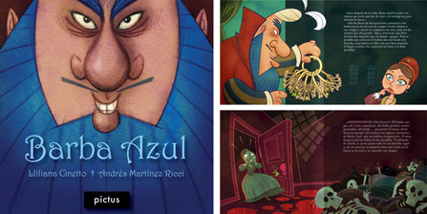
Zhang Jie felt in love with stories of the Brothers Grimm
http://www.studiobanana.org/noticias-banana/?currentPage=25

Slide 7
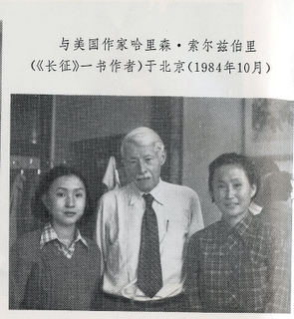
Zhang Jie First time out of China and writer Harrison Salisbury at UCLA US-Chinese writers conference 1982 http://wandermonkeycc.blogspot.com/2011/06/photos-of-zhang-jie.html#comment-form
http://books.google.com/books?id=g6conZp yrHEC&pg=PA65&lpg=PA65&d q=Zhang+Jie+study+economics&source=bl&ots= KF9QpH8WcC&sig=UDPEQRy0Op_ SFaGSG0dOaRLu6hA&hl=en&sa=X&ei= WdS9UK26CYfQygHjrIGoBg&ved=0CFMQ6AEw BQ#v=onepage&q=Zhang%20Jie%20study%20econom ics&f=false

Slide 8
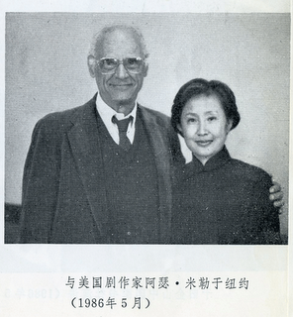
Zhang Jie Henry Miller – writer that faced censor NY 1984 http://wandermonkeycc.blogspot.com/2011_06_01_archive.html

