Slide 1
Garden Culture
Suzhou Gardens
梁丹 Anne

Slide 2
Ⅰ
Ⅱ
Ⅲ
Ⅳ
Ⅴ
The History of Suzhou Gardens
The Art of Construction in Suzhou Gardens
The Ecological Beauty of Suzhou Gardens
The inheritance of traditional aesthetic art in modern times
Questions for interaction

Slide 3
The History of Suzhou Gardens
Ⅰ

Slide 4
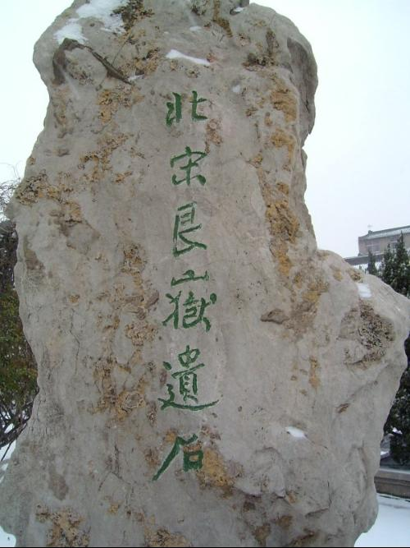
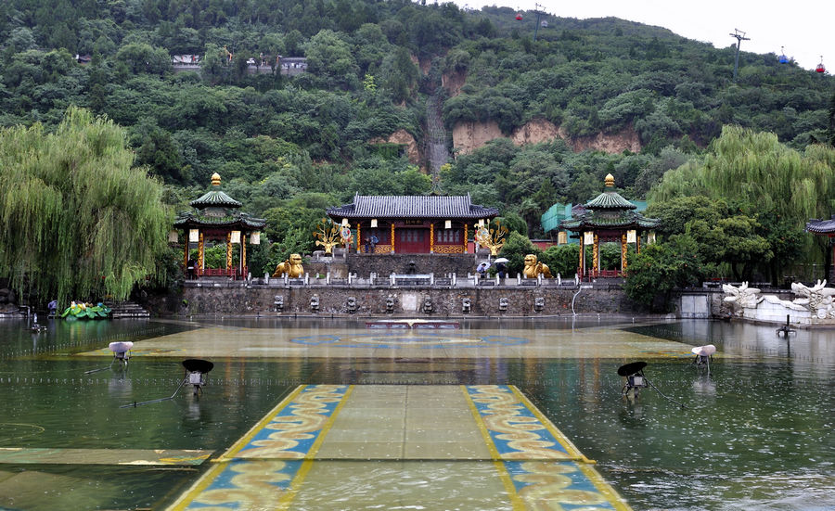
The History of Suzhou Gardens
The history of Suzhou gardens dates back to the Spring and Autumn and Warring States periods when the states of Wu and Yue engaged in gardening activities.
However, it was during the Tang and Song dynasties that the true essence of Suzhou gardens began to take shape. The gardens of this era were predominantly imperial, characterized by grandeur and opulence. Among the most representative were the "Shoushan Gengyu"（寿山艮岳） of the Song dynasty and the "Huaqing Palace"（华清宫） of the Tang dynasty.

Slide 5
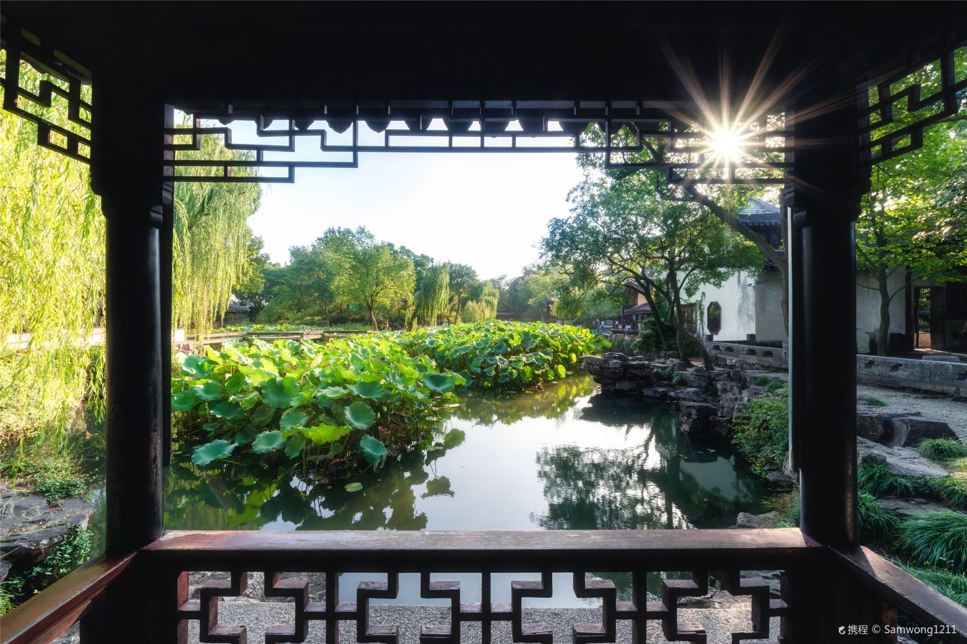
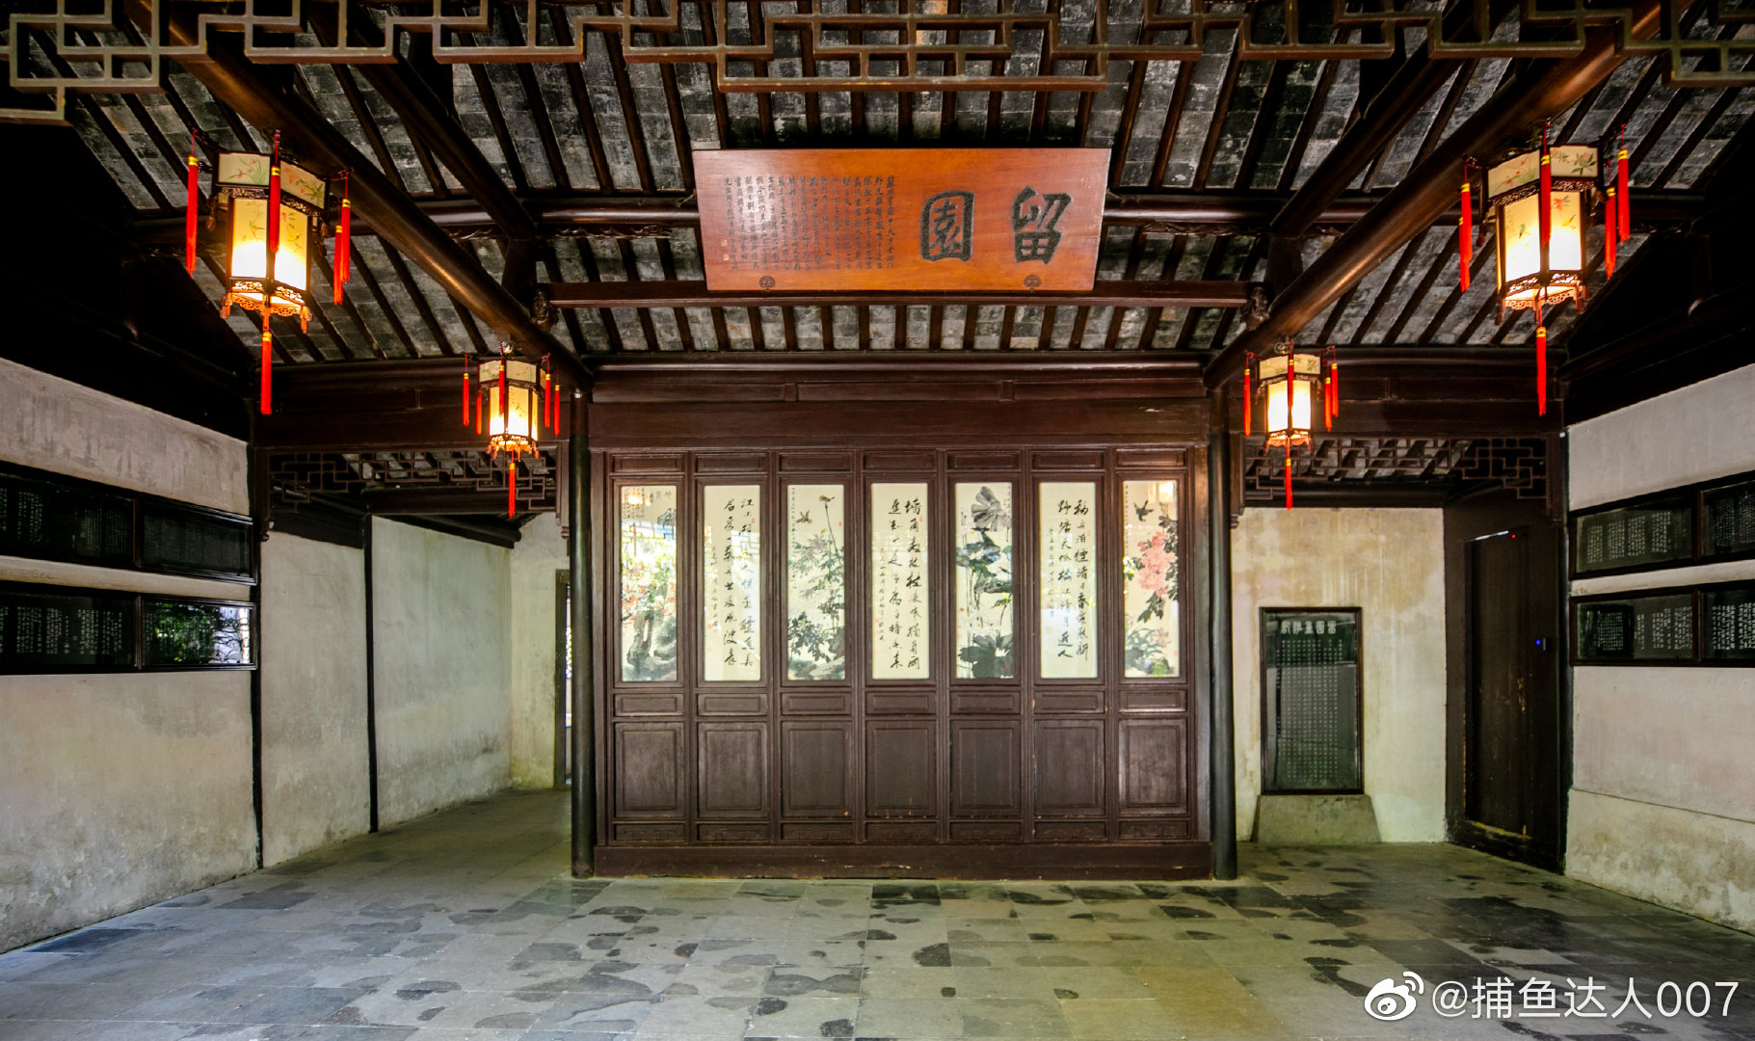
The History of Suzhou Gardens
The Ming and Qing dynasties witnessed the peek of Suzhou garden development. This period was marked by an abundance of private gardens, each with its own unique style. The most notable examples include the "Humble Administrator's Garden" of the Ming dynasty and the "Lingering Garden" of the Qing dynasty. These gardens not only innovated in terms of gardening techniques but also elevated the cultural connotations, setting the standard for Chinese garden art.

Slide 6
The Art of Construction in Suzhou Gardens
Ⅱ

Slide 7

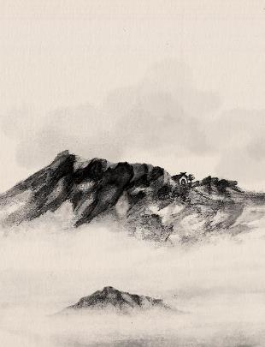

The Principle of "Unity of Heaven and Man"
Unity of Heaven and Man
As early as the Western Zhou period, the concept of "Unity of Heaven and Man" had already taken root. According to the I Ching (Book of Changes), there is a harmonious resonance between humans and heaven, with a mutual seeking of like qi.

Slide 8
The Principle of "Unity of Heaven and Man"
Unity of Heaven and Man
Among the most famous expressions of this concept is found in Zhuangzi's Qi Wu Lun(On the Equality of Things), where it is said, "Heaven and Earth and I were born together, and all things and I are one." This idea later flourished in the field of aesthetics and became one of the guiding principles in many artistic domains.

Slide 9
The Principle of "Unity of Heaven and Man"
In Suzhou gardens, the concept of "Unity of Heaven and Man" is taken to its zenith by the garden creators and artisans. Suzhou gardens place great importance on integrating nature into artificially constructed landscapes, using mountains and water as the skeleton, and trees and flowers as the flesh and blood.
Unity of Heaven and Man

Slide 10
The Principle of "Unity of Heaven and Man"
Pavilions, terraces, towers, and bridges are arrayed around the water, with some extending directly over it, such as the "Small Flying Rainbow" and "Small Canglang." Looking north from Small Canglang, one can see the Small Flying Rainbow reflected in the water.
Unity of Heaven and Man

Slide 11
The Principle of "Unity of Heaven and Man"
Moreover, the pool surface mirrors the clouds in the sky and the surrounding trees, allowing visitors to view bridges, clear water, trees, sky, and clouds from a single perspective. This small space encapsulates the beauty of the entire natural world.
Unity of Heaven and Man

Slide 12
The construction technique of dynamic and static combination
The principle of "combining dynamic and static" is a common sight in garden design. For instance, the profoundness of mountains and the liveliness of water offer a striking contrast that complements each other. In terms of spatial arrangement, larger structures within the garden, such as pavilions, towers, and halls, are static.
The construction technique of dynamic and static combination

Slide 13
The construction technique of dynamic and static combination
However, garden designers skillfully employ winding paths and corridors to create a sense of extension and meandering movement, crafting an artificial beauty in motion. This approach presents an aesthetic that blends dynamic and static elements. Take the Liu Yuan garden as an example, where a corridor over 670 meters long weaves through the garden, connecting all the landscapes into a cohesive whole.
The construction technique of dynamic and static combination

Slide 14
The construction technique of dynamic and static combination
The construction technique of dynamic and static combination
It achieves a perfect balance of twists and turns on the ground level and variations in height on the vertical plane, allowing visitors to enjoy the delight of changing scenery with each step in the confined space.

Slide 15
The construction technique of dynamic and static combination
"Silence makes the fish leap, and stillness enhances the fragrance of the lotus." （人静鱼白跃，风定荷更香）The dynamic and static states of the garden scenery are intertwined. The philosopher Wang Fuzhi once pondered the dialectical relationship between dynamic and static: "Dynamic implies stillness," and "stillness implies dynamic."
The construction technique of dynamic and static combination

Slide 16
The construction technique of dynamic and static combination
The construction technique of dynamic and static combination
Therefore, stillness contains "motion," and "motion" does not abandon "stillness." The relationship between dynamic and static landscapes is precisely like this. In Chinese gardens, the scenery is never fragmented but emphasizes the intrinsic interaction between different elements.

Slide 17
The construction technique of dynamic and static combination
The construction technique of dynamic and static combination
In this interaction, the elements blend with each other, combining dynamic and static elements and transforming each other, making the garden subtly unique in the eyes of different visitors in different seasons and at different times. It is not only a visual enjoyment but also a spiritual interest.

Slide 18

The Ecological Beauty of Suzhou Gardens
$$Ⅲ$$

Slide 19
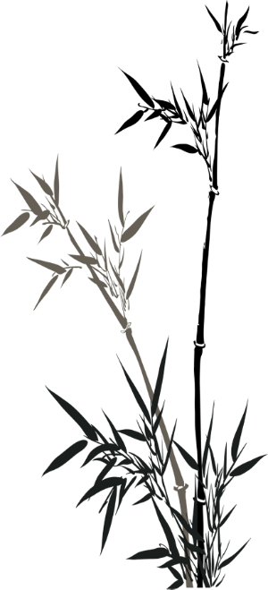
The Ecological Beauty of Suzhou Gardens
The Verdant Charm of Vegetation
The Ecological Grace of Dynamic Water Features

Slide 20
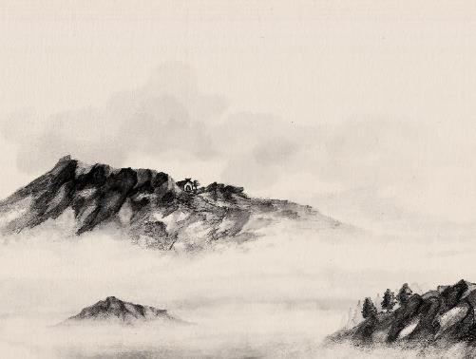
The Verdant Charm of Vegetation
The enchantment of Suzhou gardens is inextricably linked to their diverse array of plants. These plants not only serve as visual focal points but also play a crucial role in the ecological cycle. Through photosynthesis, they absorb harmful carbon dioxide and release refreshing oxygen, creating a pleasant breathing environment for visitors. Moreover, the plants in Suzhou gardens not only beautify the surroundings but also provide essential elements for the survival of birds and insects, which plays a key role in maintaining ecological diversity and balance.

Slide 21
The Ecological Grace of
Dynamic Water Features
The element of water holds a significant place in the design of Suzhou gardens, existing in various forms, but the most captivating is the so-called "living water." This refers to water bodies that are continuously sourced and flow naturally. This type of water has the ability to self-purify due to its flowing nature, effectively maintaining water quality. Ensuring the vitality of water bodies is a top priority when designing water features in Suzhou gardens. In the past, without modern machinery, how did ancient craftsmen ingeniously keep the water in the gardens flowing?

Slide 22
The Ecological Grace of
Dynamic Water Features
Drawing inspiration from the natural cycle, ancient craftsmen cleverly applied this principle to the construction of Suzhou gardens. They used techniques such as "diverting," "borrowing," and "excavating" to connect the garden's water bodies with Suzhou's extensive waterway network, creating a closed-loop system. In this system, water cycles continuously through processes like evaporation, condensation, precipitation, and absorption by plants and runoff. It mains the vitality of the water bodies while also serving to purify and oxygenate, offering visitors a water scenery that is both ecologically rich and aesthetically pleasing.

Slide 23
The inheritance of traditional aesthetic art in modern times
Ⅳ

Slide 24
Suzhou gardens, from their names to their layouts, and from their mountains, waters, flowers, and trees to their pavilions and towers, all exude an astonishing aura of cultural and artistic significance. Therefore, it is our unwavering duty to inherit and promote the art of classical gardens, merging it with modern times. Firstly, we must vigorously promote the aesthetics of gardens to inspire a deeper understanding of garden art among visitors. According to data from the Suzhou Culture, Radio, Television, and Tourism Bureau, Suzhou gardens, as a popular tourist destination, attract a large number of visitors during holidays. However, behind the bustling tours, most visitors only engage in superficial visits, taking photos at popular internet-famous spots.

Slide 25
Secondly, integrating garden art with modern technology is another path to innovatively inheriting this art. In today's era of rapid development in the internet and artificial intelligence, we can utilize these technologies to preserve garden data, establishing comprehensive garden information databases for better protection of these cultural heritage sites. Through online platforms such as websites and applications, people can experience the charm of garden art without even stepping outside. Moreover, the maturity of virtual reality (VR) technology offers new possibilities for the dissemination of garden art, allowing the historical appearance of gardens to be recreated.

Slide 26
Finally, It is crucial to cultivate a group of architects who understand traditional aesthetics and possess modern architectural skills. As China undergoes reform, opening-up, and modernization, the landscape design are trending towards internationalization. However, we are also glad to see that traditional Chinese aesthetic elements are increasingly being integrated into modern architecture. China's construction industry should establish firm cultural confidence, strengthening the study and inheritance of traditional Chinese architectural aesthetics and technology in higher education and professional training. By combining traditional garden aesthetics with modern architecture, we can achieve innovative development in the art of gardens.

Slide 27
Questions for interaction
Ⅴ

Slide 28
Questions for interaction
Questions
1: When did Suzhou gardens begin to develop?
2: Can you tell me one famous garden in Tang Dynasty?
3. Can you tell us two famous Suzhou gardens?

Slide 29
Thank you for listening

