Slide 1
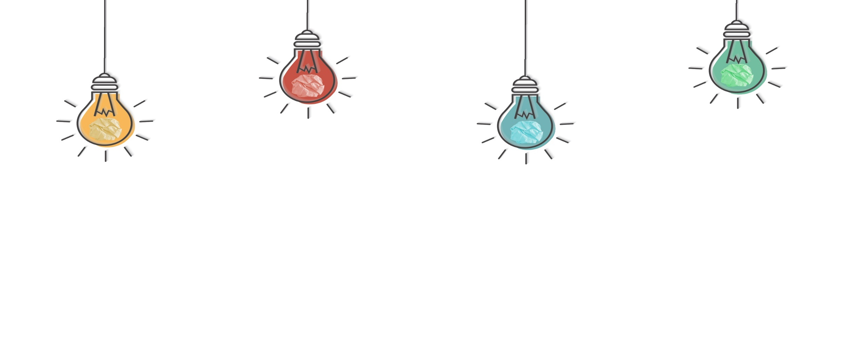
The Influence of Traditional Chinese Philosophy
in Contemporary Times
Presenter:Quan Yonghui
全永慧
English Translation

Slide 2

CONTENTS
01
Philosophy
02
Influence of the Yinyang Doctrines on TCM

Slide 3

PART 01
Philosophy

Slide 4
PART 01
What is Philosophy?
Origins of philosophy in ancient Greece
Philosophy (from the Greek phílosophía , meaning ‘the love of wisdom’) is the study of knowledge, or "thinking about thinking".
phílosophía=phílos(love)+sophía(wisdom)
Retrieved from https://www.philosophybasics.com/general_whatis.html

Slide 5
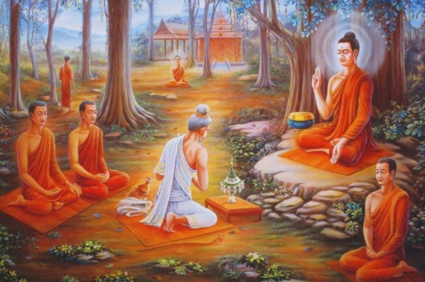
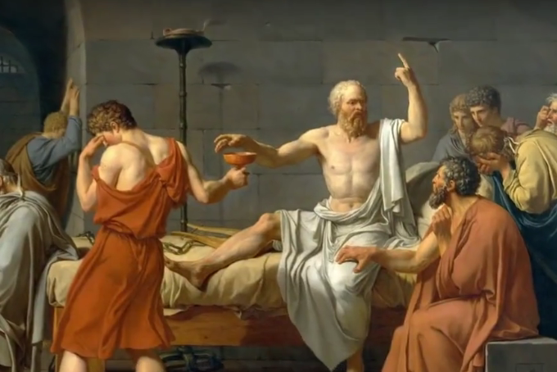

Slide 6
PART 01
Main Divisions of Philosophy
Metaphysics 形而上学/玄学
The branch of philosophy that studies the nature of existence and truth
Epistemologhy 认识论
The branch of philosophy that studies the nature and scope of knowledge
Value Theroy 价值论
Ethics The branch of philosophy that studies & evaluates human conduct
Aesthetics The branch of philosophy that studies the nature of beauty

Slide 7
Metaphysics 形而上学/玄学
What is the world be like?
What is the nature of reality?
What kind of being am I?
To understand the fundamental nature of the world, of the universe, and of being.

Slide 8
Epistemologhy 认识论
The study of knowledge, esp the critical study of its validity有效性, methods and scope范围.
Is the world really what I think it is?
Is everything I see , think and experience actually true?
If it isn’t then what is true?
What is the best way to figure out the truth?

Slide 9
Value Theroy 价值论
How do I know if I am right?
How will I ever know I am wrong?
Can I ever be certain about anything?
Ethics 伦理 The study of how humans should live with each other
Aesthetics 美学 The study of beauty and art

Slide 10
Traditional Chinese Philosophy
It originates in the Spring and Autumn period (春秋) and Warring States period（战国时期）
Seven stages:
the Pre-Qin philosophy 先秦哲学
the Study of Confucian Classics in the Han Dynasty 汉代经学
the Metaphysics of the Wei and Jin Dynasties 魏晋玄学
the Buddhist philosophy during the Sui and Tang Dynasties 隋唐佛学
Neo-Confucianism in the Song and Ming Dynasties 宋明理学
the Practical Thought in the Ming and Qing Dynasties 明清实学
Textual Studies in the late Qing Dynasty 乾嘉朴学
（Chinese Language and Culture中国语言文化 Textbook）

Slide 11
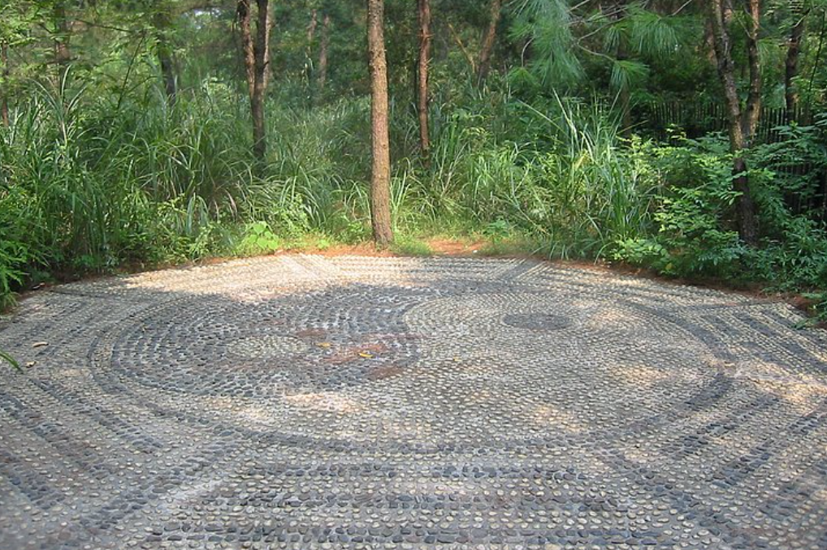

Slide 12

PART 02
The Influence of the Yinyang Doctrines on TCM

Slide 13
PART 02
The Yinyang Philosophy
The philosophy is at least 3,500 years old, discussed in the ninth-century BCE text known as I Ching or Book of Changes, and influences the philosophies of Taoism and Confucianism.
The yin-yang philosophy says that the universe is composed of competing and complementary forces of dark and light, sun and moon, male and female.
（https://www.philosophybasics.com/general_whatis.html）

Slide 14
PART 02
Traditional Chinese Medicine/TCM
It is a medicine that combines modern medical knowledge with a holistic（整体的） approach to medical diagnosis and treatment.
Adapted from Traditional Chinese Medicine by Tang, Jin-Ling et al. The lancet ,372(9654）

Slide 15
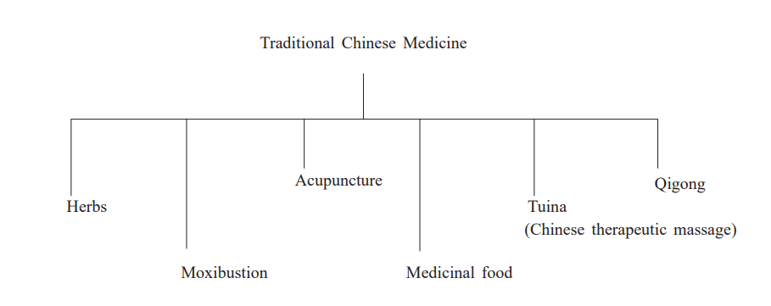
Different methods of treatment in Chinese medicine

Slide 16
PART 02
Medical Use of the Yinyang Doctrines
The principles of yin and yang are an important part of Huangdi Neijing. Written about 2,000 years ago, it is the earliest Chinese medical book. It is believed that to be healthy, one needs to balance the yin and yang forces within one's own body.

Slide 17
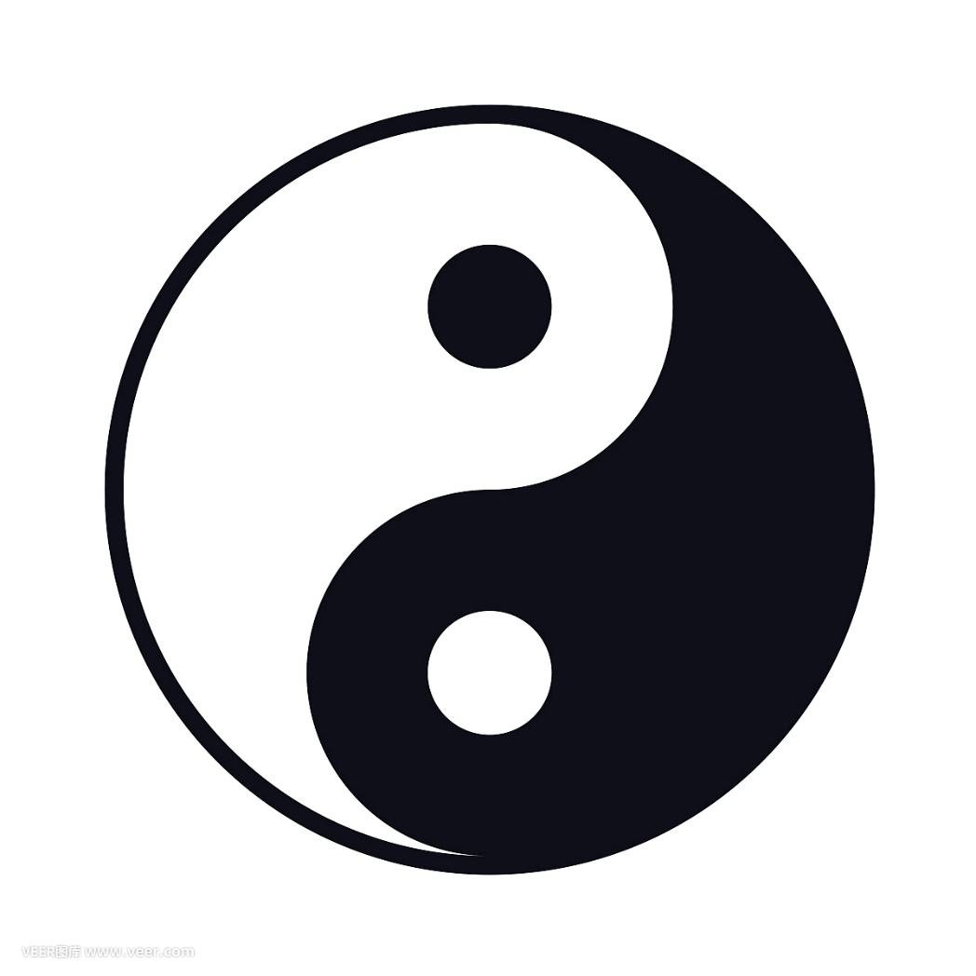
The Yinyang Symbol
Classic Yin Yang Symbol
The symbol represents the primal
opposing but complementary forces
found in all things in the universe.

Slide 18
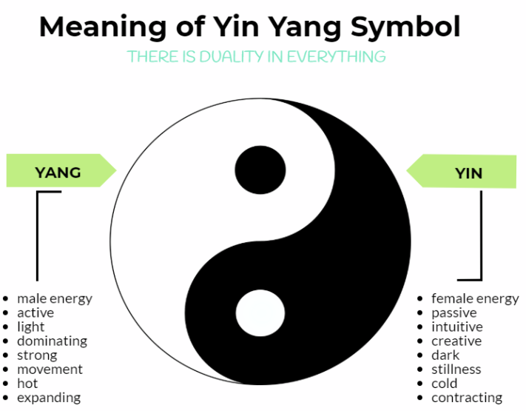

Slide 19
PART 02
General Principles of Diagnosis 诊断总纲领
Proper diagnosis involoves inspecting the complexion(面色) and feeling the pulse（把脉） and first differentiating yin and yang. Su Wen《素问》
善诊者，察色按脉，先别阴阳
The four examinations四诊: Looking Listening/Smelling Asking Palpation

Slide 20
Basic Concepts of TCM
Yin refers largely to the material aspects of the organism(有机体) and yang to function.
A circulation of qi(energy) and blood
The organs work together by regulating and perserving qi and blood through the so called channels(脉络).
Disease occours after a disturbance in yin-yang or flow of qi or blood, or disharmony in the organs caused by pathogens(病原体) and climate factors.
Adapted from Traditional Chinese Medicine by Tang, Jin-Ling et al. The lancet ,372(9654）

Slide 21
References
[1]肖平. Basic English For TCM purposes[M]. 3. 湖南中医药大学, 2020.
[2]Wang Jie 王杰.(2020). 中国传统哲学的发展脉络 [The Developmentof Traditional Chinese Philosophy]. 新华文摘 Xinhua News Digest(24)45.
[3]Paul U. Unschuld. Traditional Chinese Medicine and Public Health
[4]Lee H, PhD. The Challenges Facing Traditional Chinese Medicine in the West. [J]. Asia-Pacific Biotech, No. 1 2001., Vol. 5(1).
[5]https://www.philosophybasics.com/general_whatis.html

Slide 22

Thank You

