Slide 1
中國語言文化
Session 2, Thursday Sep 16, 2025, 613
19:00-19:45; 19:55-20:40; 20:50-21:35中国语言文化-25级MITA专硕, 3-16周[连续]，晚上1-3节, 腾龙楼613教室 (学委：找邓老师调课)
Martin Woesler

Slide 2
Session 2
Teacher presentation (continued)
Student presentations:
Luó Yǔyān 罗语嫣 - Zhuazhou
Qū Yuèníng 曲悦宁 - Mazu culture
Lǐ Zhuóshàn 李卓善 - Black Myth: Wukong
Zhāng Mǐnjié 张敏杰 - Traditional Cuisine: Eight Major Cuisines of China
Qín Míngwén 秦铭雯 - Twelve Animals of the Chinese Zodiac
Zēng Lín 曾琳 - Chinese Writing: Calligraphy
Dèng Xuě 邓雪 - Panda
Guō Xiǎopèi 郭晓佩 - Body movements performance: traditional Chinese dance
Zhāng Xiāorán 张潇然 - Chinese Ancient Weapons
Zēng Língkǎi 曾凌楷 - Chinese dreamcore

Slide 3
跨文化知识的例子:
常态分布
A
的
文
化
标
准
B
的
文
化
标
准
偶尔 频繁
弱 握手 强
Alexander Thomas 教授的常态分布

Slide 4
Täglich drei Mahlzeiten. / 三餐
Die Künstlerin Liu Yang 刘扬, geboren 1976 in Peking, eröffnete 2004 nach Absolvieren der Berliner Kunsthochschule in Berlin ihr eigenes Atelier. Sie zeigt die Kulturunterschiede D-C in Symbolen.
中德文化比较

Slide 5
Kontakte / 人际关系

Slide 6
Laune Wetter / 心情和天气

Slide 7
Lebensstil / 生活方式

Slide 8
1970
2006
Transport / 交通工具

Slide 9
Senioren im Alltag / 老人的生活方式

Slide 10
Ich / 自我

Slide 11
Sonntags auf der Straße / 周末街景

Slide 12
Das Kind / 孩子

Slide 13
Schönheitsideal / 美丽的标准

Slide 14
Bei Bauchschmerzen / 胃痛时的饮品

Slide 15
Pünktlichkeit / 准时

Slide 16
Reisen / 旅游

Slide 17
Warteschlange / 排队

Slide 18
Duschzeiten / 淋浴

Slide 19
Vorstellung vom Anderen / 理想中的对方

Slide 20
Meinung / 意见

Slide 21
Party / 聚会

Slide 22
Im Restaurant / 餐厅分贝

Slide 23
Umgang mit Problemen / 处理问题

Slide 24
Neuheiten / 对待新的事物

Slide 25
Ärger / 对待愤怒

Slide 26
Im Trend / 时尚

Slide 27
Chef / 领导

Slide 28

跨文化知识的例子： 观点的转换
0.8

Slide 29
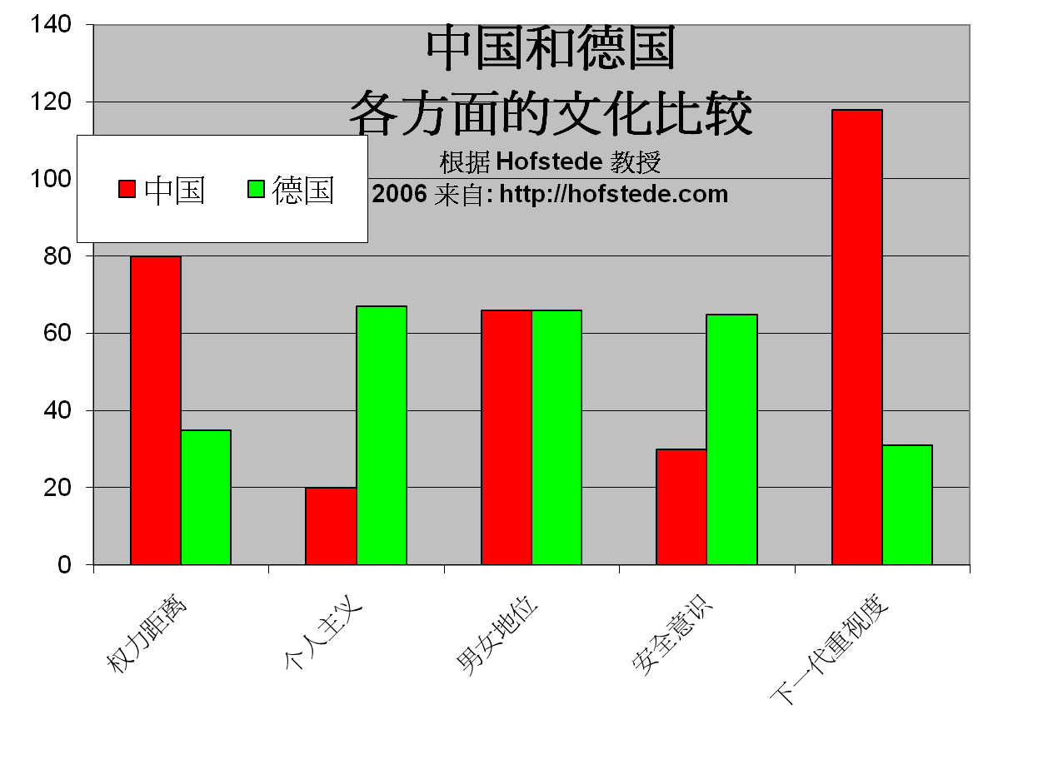
跨文化知识的例子:
类别比较

Slide 30
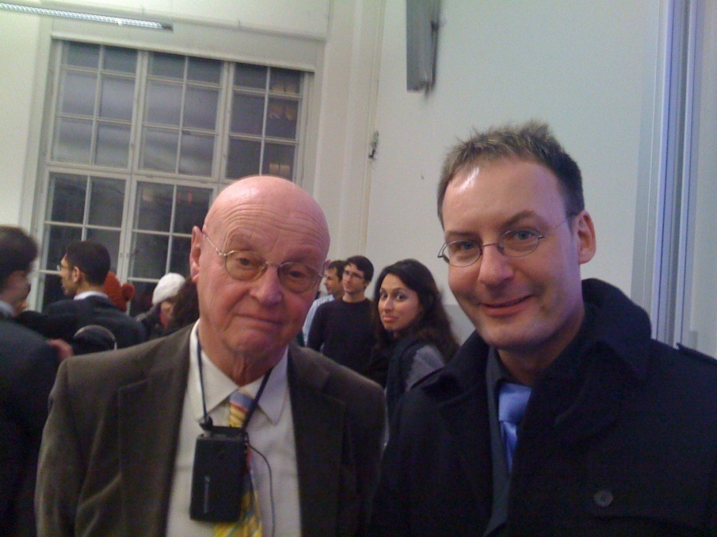

Slide 31
参考文摘
Hall, Edward T. (1977), Beyond Culture, New York: Anchor Book/Doubleday
Hofstede, G. (2006): Lokales Denken, globales Handeln. München:dtv
Oberg , K. (1960): Cultural shock : ajustment to new cultural environments , in Practical Anthropology , Bd . 7 , S . 177 – 182
Thomas, A. (2003): Handbuch interkulturelle Kommunikation und Kooperation, 2 Bde, 2. Aufl. Göttingen: Vandenhoeck & Ruprecht, ISBN 978-3-525-46186-0
Woesler, M. (2006): A new model of intercultural communication - critically reviewing, combining and further developing the basic models of Permutter, Yoshikawa, Hall, Hofstede, Thomas, Hallpike, and the social-constructivism, Europäischer Universitätsverlag, ISBN 978-3-89966-188-0, 52 S.

Slide 32
纲 要
1, 传统的文化比较模块
2, 新的文化比较模块
3, 跨文化知识的例子
4, 构建全球化能力为国际性事业做准备
5, 讨论

Slide 33
Building Globalization Capabilities to Prepare for International Careers
构建全球化能力为国际性事业做准备
China's labor market is increasingly globalized (many jobs involve overseas work, major multinational corporations have entered China, overseas job opportunities, international investment flowing into China) ---- Cross-cultural competence is not optional but mandatory, because the world has already entered China.
Chinese undergraduate students often cannot find satisfactory jobs, so they hope to pursue further studies.
Global trend: McKinsey research found that the number of production workers is decreasing (15%), while the number of intermediary (44%) and advanced (41%) intermediary workers is increasing.
One solution: Study abroad for advanced degrees (First choice: United States; 2. United Kingdom; 3. Germany) ------- Language, cross-cultural experience, personal development
中国劳工市场日益全球化（许多工作涉及海外，全球各大跨国企业已经进入中国， 海外工作机会，国际投资涌入中国）----跨文化能力不是选择性的，而是必须有的，因为世界已经进入中国。
中国本科生常无法找到让自己满意的工作，所以他们希望深造。
全球趋势：麦肯锡研究发现，生产工人数量在减少（15%），中间商（44%）及高级（41%）的中间商数量在增加
一种解决方法：出国深造（首选：美国；2 . 英国；3. 德国）
-------语言，跨文化经验，个人发展

Slide 34
The New "International Talent„
新的“国际化人才”
McKinsey's Latest Research Results
The number of "production personnel" is declining (production lines, etc.) ---- only 15% in the United States, many jobs replaced by machines. Web 2.0 [AI]
"Dialogue and interaction personnel" dominate (e.g., salespersons, middle managers) --- still 44% in the United States
In interactive communication work, the portion requiring higher skills is increasing (complex judgments and decisions, such as nurses, CFOs, general managers) --- today accounts for 41% in the United States, they receive the highest salaries at their respective levels
麦肯锡的最新研究结果
  “生产人员”数量下降（生产线等）----在美国只有15%，很多工作被机器代替。Web2.0
  “对话互动人员”占统治地位（例如销售人员，中层管理人员）---在美国仍然还有44%
  在互动交流的工作中，需要较高技巧性的部分在增加 (复杂的判断和决定，例如像护士、财务总监、总经理）---今天在美国还占41%，他们在各自级别中获得最高的薪金

Slide 35
How to Teach International Relations Courses to Post-2000s University Students
如何为00后大学生讲授国际关系课程
Fifth Annual Teaching Community Conference Keynote Report | Yan Xuetong
On January 8, 2022, the Fifth Annual Conference of the Political Science and International Relations Teaching Community, jointly organized by Tsinghua University's Institute of International Relations and Peking University Press, was successfully held at Beijing Xijiao Hotel. The conference adopted a hybrid offline and online format, with over 100 participants from dozens of institutions nationwide in the political science and international relations academic community.
Professor Yan Xuetong, Dean of Tsinghua University's Institute of International Relations and Senior Professor of Liberal Arts at Tsinghua University, delivered a keynote report titled "How to Teach International Relations Courses to Post-2000s University Students." Professor Yan's report was mainly divided into four parts.
First, Professor Yan believes that generational differences among students are very obvious. Current undergraduate students are basically all post-2000s, who have unique characteristics in their ideological concepts, aesthetic standards, and values. Additionally, post-2000s students live in the digital age and have stronger abilities in obtaining and mastering information and knowledge, which requires teachers to change their original teaching concepts, adjust teaching content, and communicate and exchange with students with a humble attitude.
第五届教学共同体年会主题报告 | 阎学通
2022年1月8日，由清华大学国际关系研究院与北京大学出版社联合举办的第五届政治学与国际关系教学共同体年会在北京西郊宾馆成功举行。会议采用了线下与线上相结合的模式，来自全国数十所院校的100多位政治学与国际关系学界的人士参加了会议。
清华大学国际关系研究院院长、清华大学文科资深教授阎学通老师发表了题为“如何为00后大学生讲授国际关系课程”的主题报告。阎老师的报告主要分为四个部分。首先，阎老师认为学生的代际差别是十分明显的，当前的本科学生基本上已全部是00后，他们在思想观念、审美标准、价值观上都有独特之处。此外，00后学生身处数字化时代，在获取与掌握信息和知识方面能力更强，这就需要教师改变原有的教学观念，调整教学内容，以虚心的态度与学生沟通和交流。

Slide 36
How to Teach International Relations Courses to Post-2000s University Students
如何为00后大学生讲授国际关系课程
Second, Professor Yan summarized the characteristics of post-2000s students' understanding of the world and proposed relevant teaching suggestions accordingly. Professor Yan believes that post-2000s university students often have a strong sense of superiority and self-confidence, often viewing other countries with a "condescending" attitude, viewing international affairs with "wishful thinking," and believing that China can easily achieve its foreign policy goals. They often view the world through a binary division of China versus foreign countries, viewing all countries outside China as the same type of country, viewing universal human values such as peace, morality, fairness, and justice as uniquely Chinese traditions, believing that only China is just and innocent, while other countries, especially Western countries, are "evil," and that Westerners have a natural hatred for China. Additionally, post-2000s university students are deeply influenced by internet concepts, treating viewpoints of internet influencers such as economic determinism, conspiracy theories, and debt as weapons as common sense.
其次，阎老师总结了00后学生对世界的认识特点，并据此提出了相关的教学参考建议。阎老师认为，00后大学生往往具有强烈的优越感和自信心，常以“居高临下”的心态看待其他国家，以“愿望思维”看待国际事务，认为中国很容易实现对外政策目标。他们常以中国与外国两分的方法看待世界，将中国之外的其他国家视为同一类国家，将和平、道德、公平、正义等人类的普世价值观视为中国独有的传统，认为只有中国是正义的和无辜的，其他国家特别是西方国家是“邪恶”的、西方人对中国有着天然仇恨。另外，00后大学生深受网络观念影响，把经济决定论、阴谋论、债权武器等网红们的观点当作常识。

Slide 37
如何为00后大学生讲授国际关系课程
In response, Professor Yan suggests that when teaching international relations courses to post-2000s university students: 1) Combine current events with knowledge transmission to help students understand objective facts and avoid blind confidence; 2) Make historical comparisons to help students understand the differences between present and past, recognizing the tortuous nature of historical development; 3) Help students recognize the diversity of the world, avoiding the binary epistemology of China versus foreign; 4) Help students define concepts, establish common standards and definitions, and improve the interest and quality of student participation in discussions; 5) Use mind maps to enhance students' logical thinking and critical thinking abilities, reducing the influence of internet influencers; 6) Introduce new concepts or new things from the digital age, using online life as an example to help students understand the characteristics of the digital age.
Third, regarding online teaching under the current pandemic, Professor Yan believes that online teaching needs to keep students online and focused on classroom instruction. Generally, online teaching classes should preferably have fewer than 30 students, teachers should require all students to turn on their video, and students should read textbooks in advance to understand the teaching content. Additionally, teachers should appropriately reduce teaching content, use dialogue-based teaching to maintain student attention, and teaching PPTs should use more diagrams for easier student understanding.
对此，阎老师建议，在对00后大学生讲授国际关系课程时，一是结合时事传授知识，使学生了解当前客观事实，避免盲目自信；二是进行历史比较，使学生了解当下与以往的区别，认识到历史发展的曲折性；三是帮助学生认识世界的多样性，避免中外两分的认识论；四是帮助学生界定概念，建立共同标准和定义，提高学生参讨论的兴趣和质量；五是运用思维导图，增强学生思维的逻辑性和批判思维能力，降低网红的影响；六是介绍数字时代的新观念或新事物，以网络生活为例，帮助学生了解数字时代的特点。
再次，针对当前疫情下的线上教学，阎老师认为线上教学需要保持学生在线并专注于课堂教学。通常情况下，线上教学课容量小于30人为宜，教师最好要求所有学生开启视频，学生应提前阅读教材了解教学内容。另外，教师还应注意适当减少教学内容，以对话方式教学保持学生的注意力，教学PPT也应多用图解以便于学生理解。

Slide 38
如何为00后大学生讲授国际关系课程
In response, Professor Yan suggests that when teaching international relations courses to post-2000s university students: 1) Combine current events with knowledge transmission to help students understand objective facts and avoid blind confidence; 2) Make historical comparisons to help students understand the differences between present and past, recognizing the tortuous nature of historical development; 3) Help students recognize the diversity of the world, avoiding the binary epistemology of China versus foreign; 4) Help students define concepts, establish common standards and definitions, and improve the interest and quality of student participation in discussions; 5) Use mind maps to enhance students' logical thinking and critical thinking abilities, reducing the influence of internet influencers; 6) Introduce new concepts or new things from the digital age, using online life as an example to help students understand the characteristics of the digital age.
Third, regarding online teaching under the current pandemic, Professor Yan believes that online teaching needs to keep students online and focused on classroom instruction. Generally, online teaching classes should preferably have fewer than 30 students, teachers should require all students to turn on their video, and students should read textbooks in advance to understand the teaching content. Additionally, teachers should appropriately reduce teaching content, use dialogue-based teaching to maintain student attention, and teaching PPTs should use more diagrams for easier student understanding.
对此，阎老师建议，在对00后大学生讲授国际关系课程时，一是结合时事传授知识，使学生了解当前客观事实，避免盲目自信；二是进行历史比较，使学生了解当下与以往的区别，认识到历史发展的曲折性；三是帮助学生认识世界的多样性，避免中外两分的认识论；四是帮助学生界定概念，建立共同标准和定义，提高学生参讨论的兴趣和质量；五是运用思维导图，增强学生思维的逻辑性和批判思维能力，降低网红的影响；六是介绍数字时代的新观念或新事物，以网络生活为例，帮助学生了解数字时代的特点。
再次，针对当前疫情下的线上教学，阎老师认为线上教学需要保持学生在线并专注于课堂教学。通常情况下，线上教学课容量小于30人为宜，教师最好要求所有学生开启视频，学生应提前阅读教材了解教学内容。另外，教师还应注意适当减少教学内容，以对话方式教学保持学生的注意力，教学PPT也应多用图解以便于学生理解。
https://mp.weixin.qq.com/s/GcftpDXIBDFJ26E570VHcg

Slide 39
纲 要
1, 传统的文化比较模块
2, 新的文化比较模块
3, 跨文化知识的例子
4, 构建全球化能力为国际性事业做准备
5, 讨论

Slide 40
Chinese languages & Cultures
About Chinese culture around the world: the importance
About the course: the contents
About the studying: preview the unit; answer questions; interpret the text; solve exercises on course homepage; discuss and translate.
About homework: prepare pptx, read
About grading: 30% from homework/ classroom performance; 70% from the final test

Slide 41
About the teaching
1. I will ask you to answer the questions after each section and see if they have previewed the text and how well they’ve mastered it.
2. I will interpret cultural phenomena from an international perspective, terms and expressions of high frequency in the text.
3. I will introduce related topics and invite students to comment.
4. Grade students’ contributions and essays.

Slide 42
Prepare for next time
Read the chapters in the textbook
For the students who are presenting:
5 min. ppt presentation with own perspective
Interaction with fellow students

Slide 43
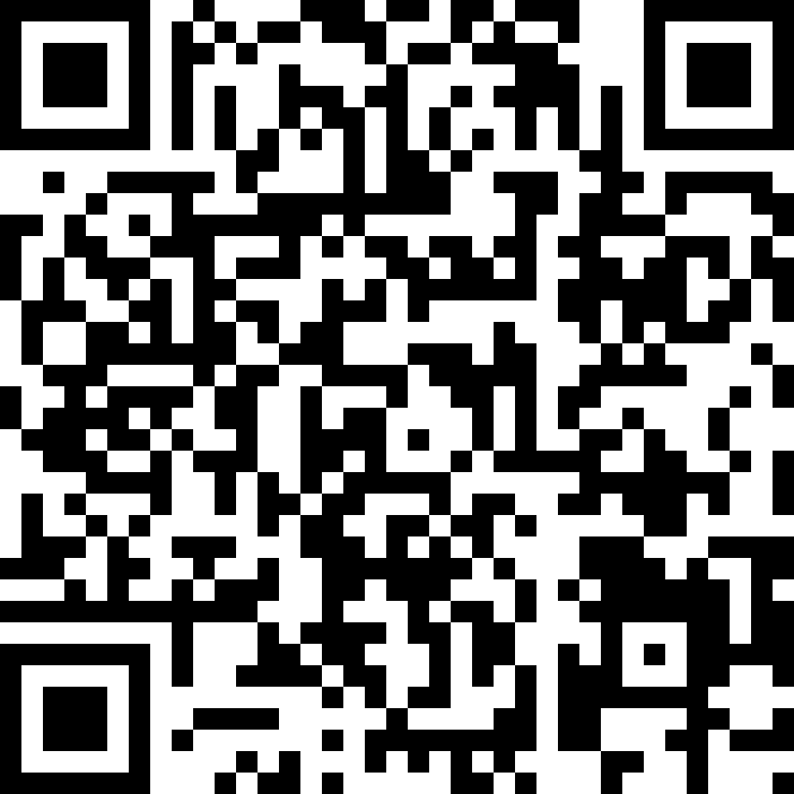

Questionnaires
EU
https://wn8ae3qwafbc11zv.mikecrm.com/9gdWrQT
2024 https://wn8ae3qwafbc11zv.mikecrm.com/CTrdOjm

