Slide 1
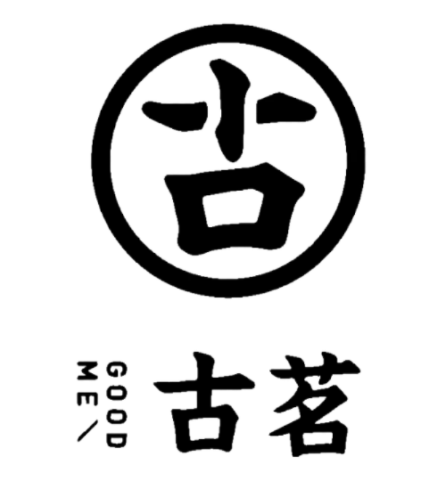
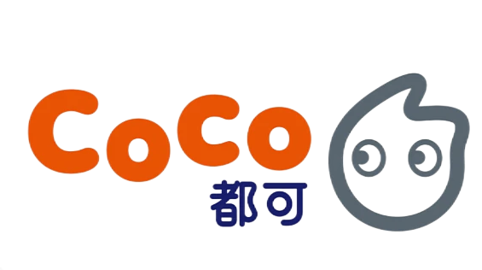

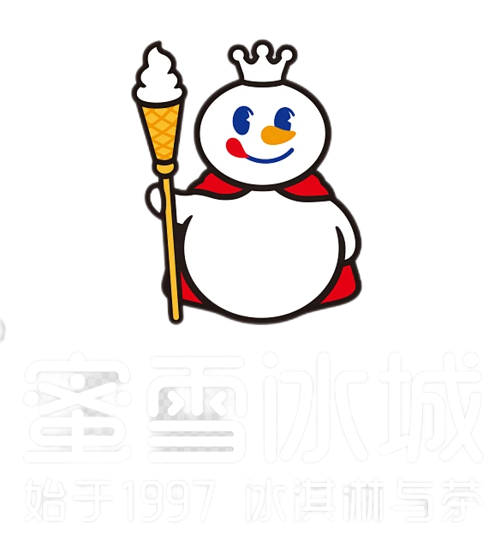

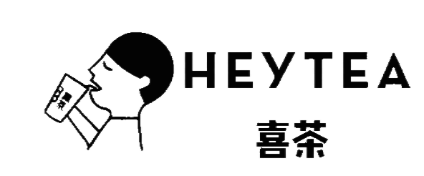

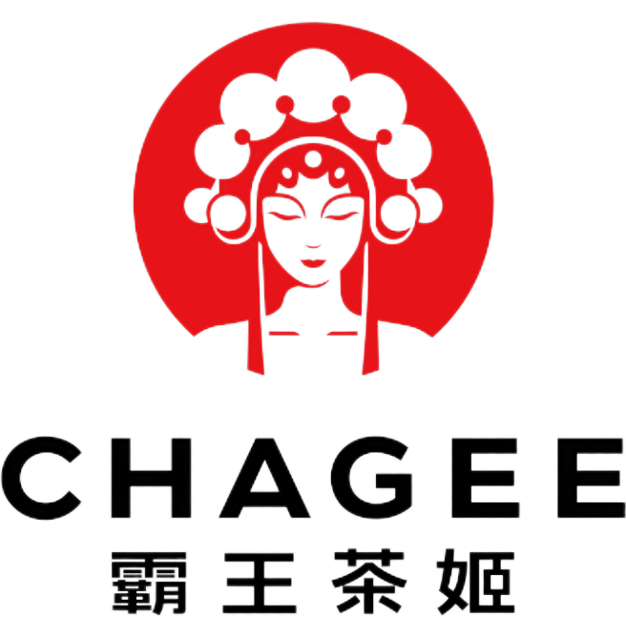
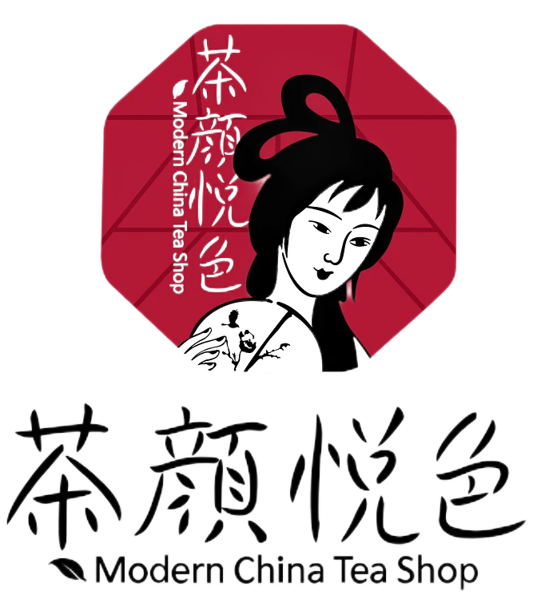
Are you familiar with these logos?

Slide 2

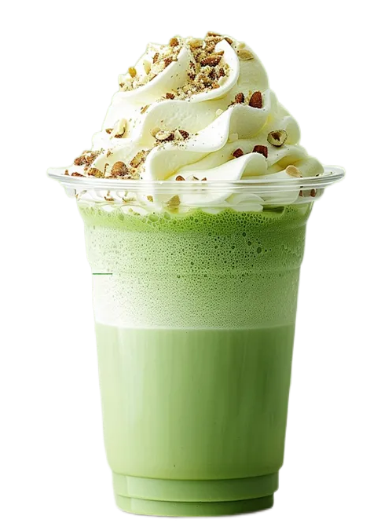
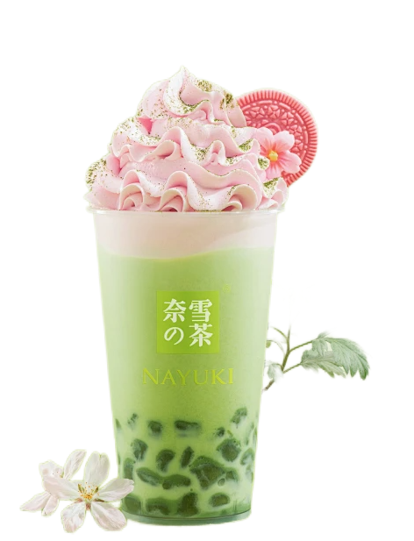

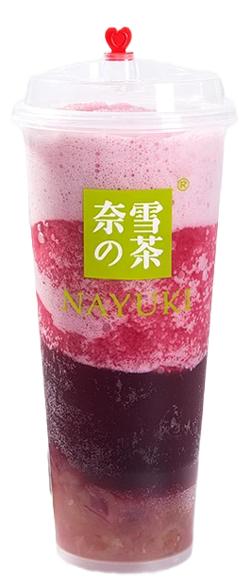
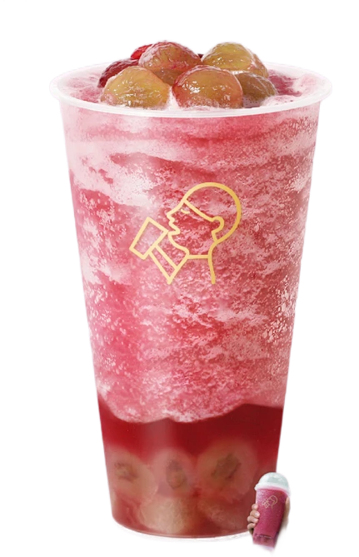

Chinese Milk Tea Culture
Reporter:李祖熠

Slide 3

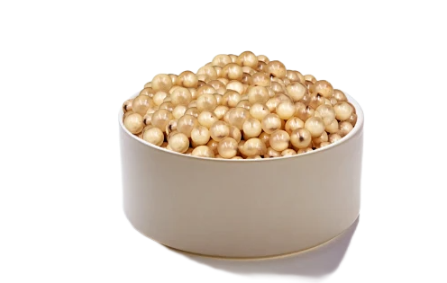
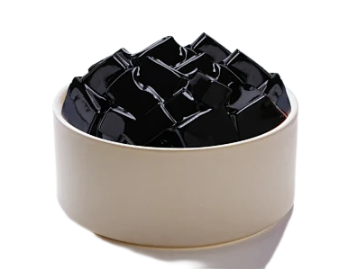
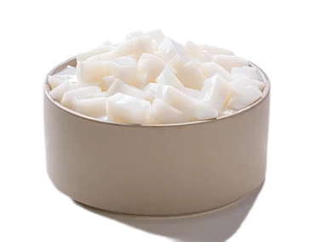
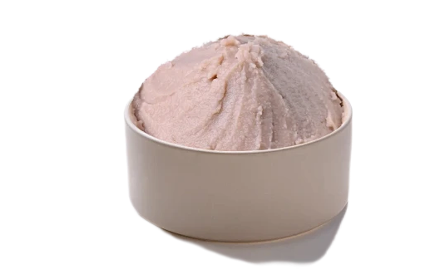
The history of milk tea: From the wisdom of nomadic people to its global popularity
Introduction to classic milk teas available on the market
contents
Why has milk tea become a "social currency" for the middle generation?
The 'Chinese style Innovation' Password Behind Milk Tea

Slide 4
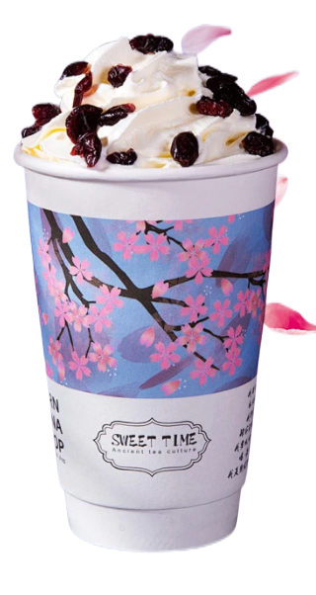
01
01
The history of milk tea: From the wisdom of nomadic people to its global popularity

Slide 5
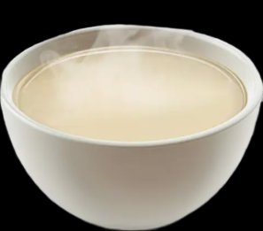
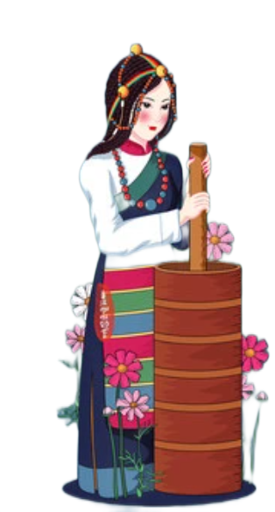
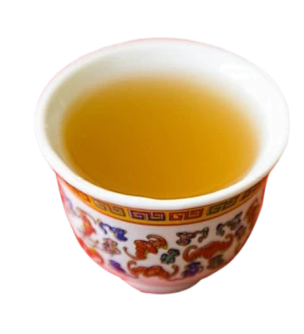
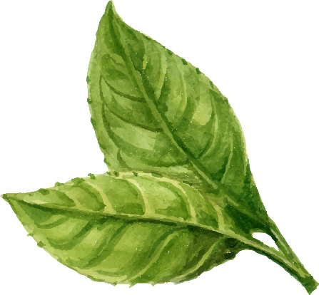
Historical Tracing:
The true achievement of combining tea with milk, though, belongs to the nomadic people in northwest China. Back then, in the cold northern climate, the herders of these nomadic tribes made a remarkable discovery: by mixing milk from their cattle and sheep with tea and heating it, they could not only feel warm but also replenish their energy and nutrition. This simple wisdom was the prototype of milk tea.

Slide 6
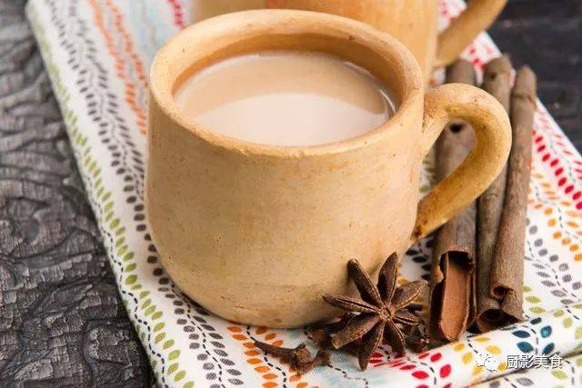
Historical Tracing:
The Silk Road, as a bridge for cultural exchange, enabled milk tea to be further spread in the Middle East and South Asia. They add spices to the milk tea to make its flavor more rich

Slide 7
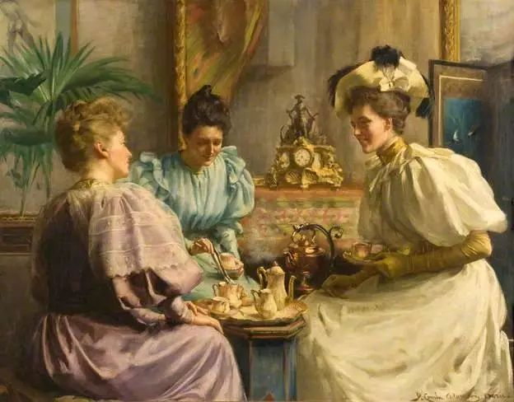
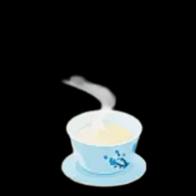
Historical Tracing:
With the wild expansion of British colonists around the world, many local products from the East, including Chinese milk tea, were also brought to the Western world. Due to differences in climate and dietary habits, the British gave up using spices but to use various types of tea bags to make milk and add maple syrup as a seasoning, thus giving birth to the prototype of modern milk tea.

Slide 8
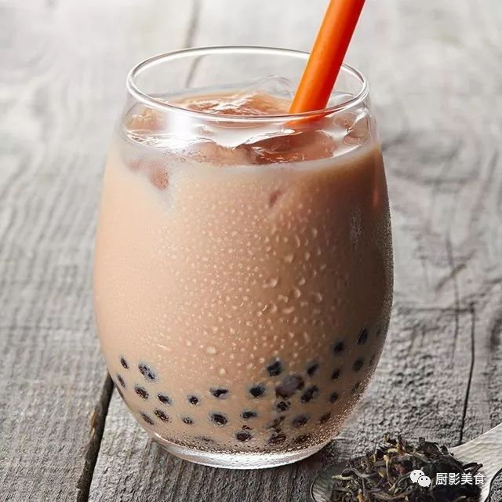
Historical Tracing:
In the spring of 1980, Ms. Lin Xiuhui from Taiwan added the local snack to her milk tea. The shape of cooked local snack resembled black pearls, so they named it “Bubble Tea". By now, modern milk tea has taken shape initially

Slide 9
02
02
Introduction to classic milk teas available on the market

Slide 10

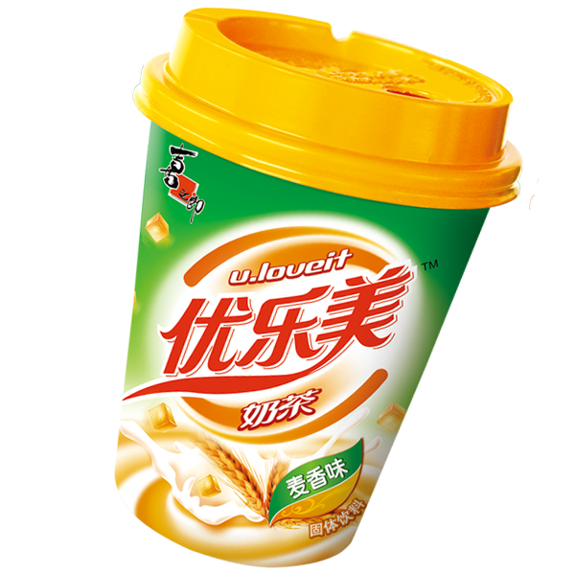
Powdered milk tea
•Non-dairy creamer(植脂末)
• Easy and quick to operate, with low costs
•The taste is sweet and greasy.

Slide 11


Fresh milk tea
•Made from fresh milk and fresh tea soup
• The milk flavor and tea flavor are well balanced.

Slide 12
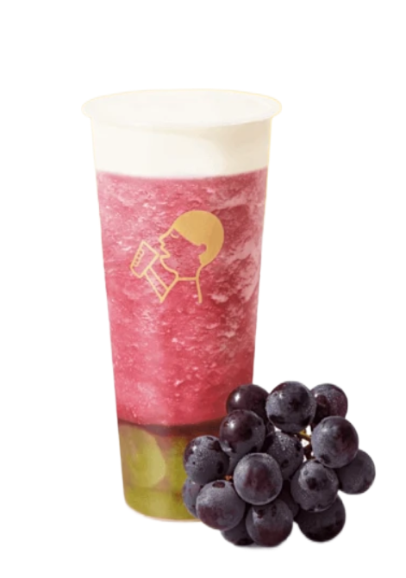
Fruit tea
• A rich and layered taste
• It pays more attention to the flavor of fruits and the refreshing taste
• To meet the demand for health and low fat.

Slide 13
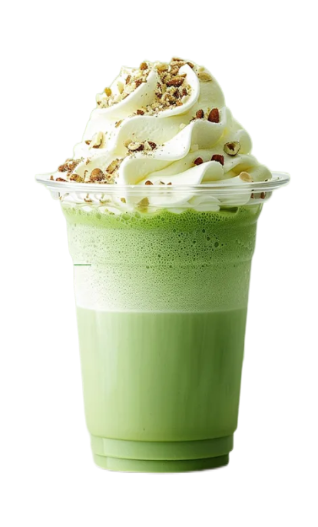
03
03
Why has milk tea become a "social currency" for the new generation?

Slide 14
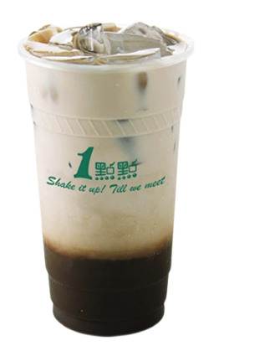
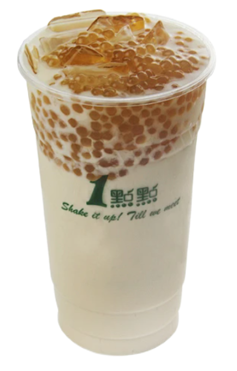
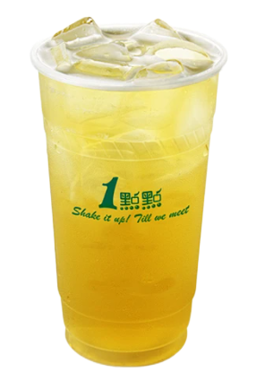
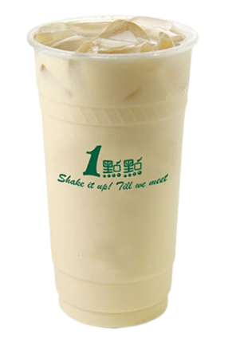
From a physiological perspective：
The sugar in milk tea prompts the brain to secrete dopamine, thereby generating an optimistic mood. The stimulation of taste buds enables the brain to form memory perceptions. Therefore, for most people, sweetness is equivalent to happiness. The physiological satisfaction makes the act of drinking milk tea a physical desire.

Slide 15
From a psychological perspective：
Compared with other food cultures, the milk tea culture, while satisfying the physiological needs of the taste buds, it has eliminated the complex etiquette . It combines the fashionable and petty bourgeois(小资) significance of coffee beverages and at the same time achieves the sense of ritual（仪式感） of wine- drinking. This enables modern milk tea to strike a subtle psychological balance among various food cultural meanings.

Slide 16
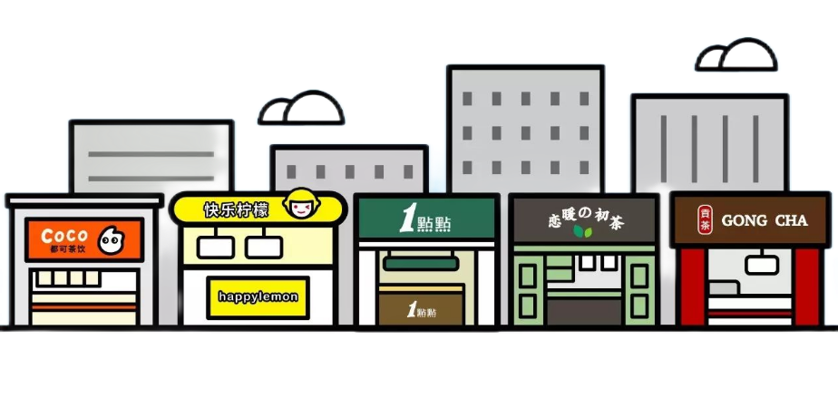
Overall, the “Millennials” (千禧一代)of the 21st century grew up during a period of rapid social transformation in our country. They need a sense of identity and an outlet for expression. Milk tea, which is relatively inexpensive and carries multiple cultural meanings, has gradually evolved into a form of social currency among young people. The act of sharing or recommending milk tea serves as a code for mutual identity confirmation. They seek group identity through common interests and thus engage in social interaction.

Slide 17
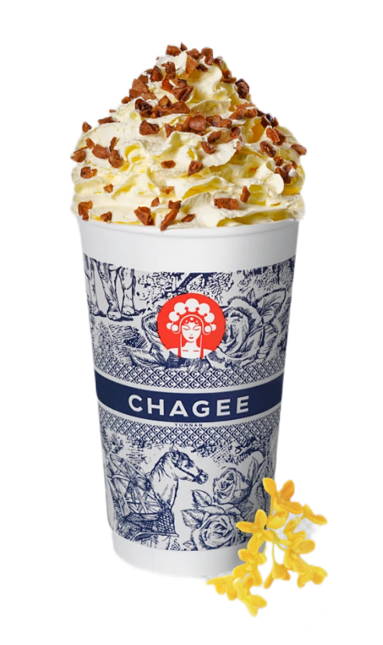
04
04
The 'Chinese style Innovation' Password Behind Milk Tea

Slide 18
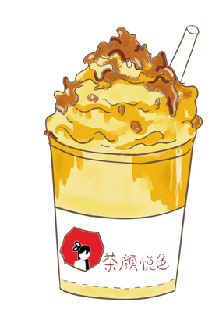
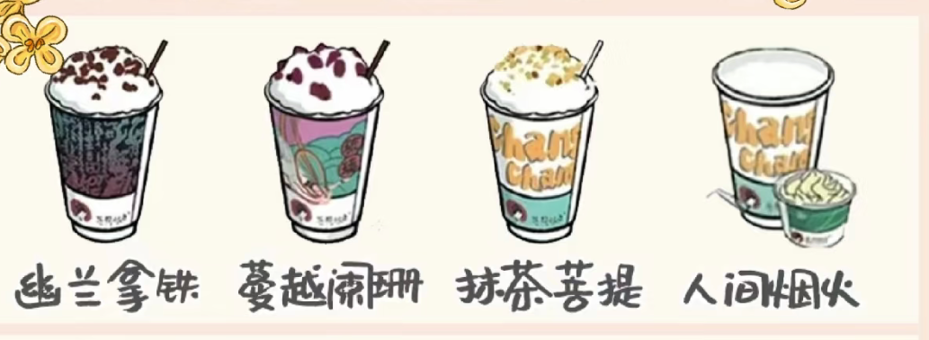
Milk Tea, Chinese style
•Break through with a "Chinese style" approach:
Pure tea and pure milk
Poetic product names
Traditional store decoration
• "revitalizing traditional culture for the younger generation“
• become an important city name card.

Slide 19
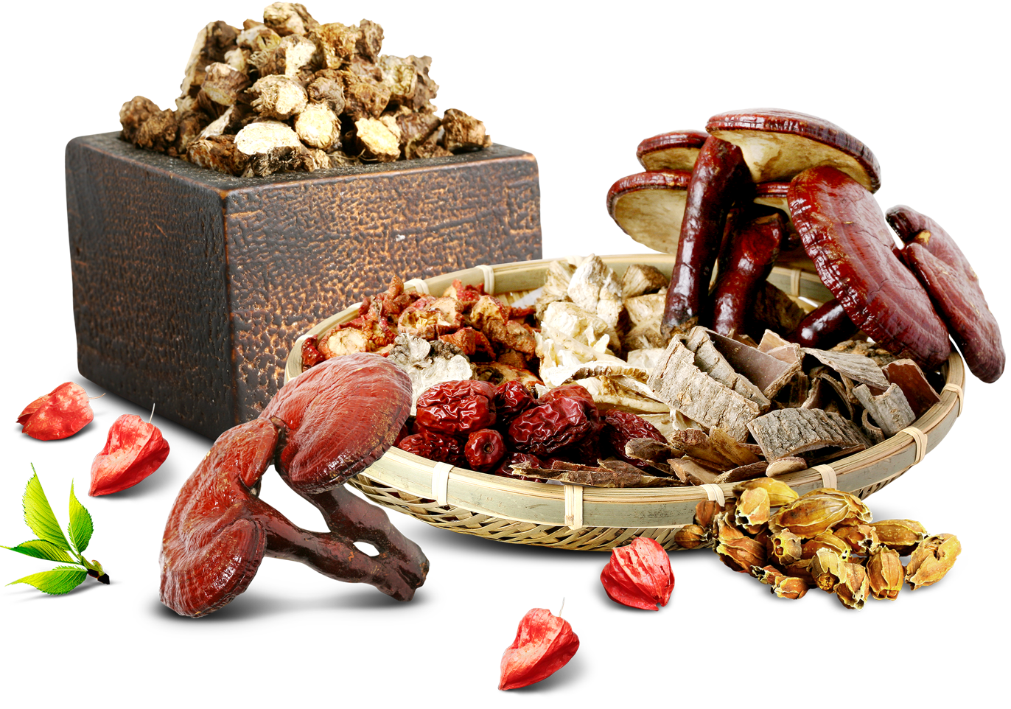
One Root of Medicine and Food
•traditional Chinese medicine (TCM) culture is being accepted by the new generation.
• TCM-flavored milk tea is rooted in the traditional TCM concept of “one root of medicine and food.“
•possess certain medicinal values and flavor of beverage.

Slide 20

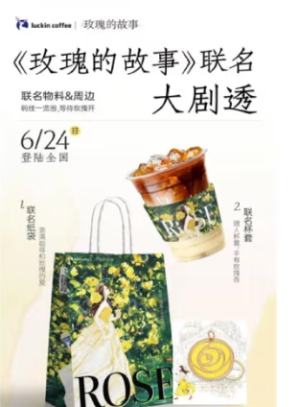
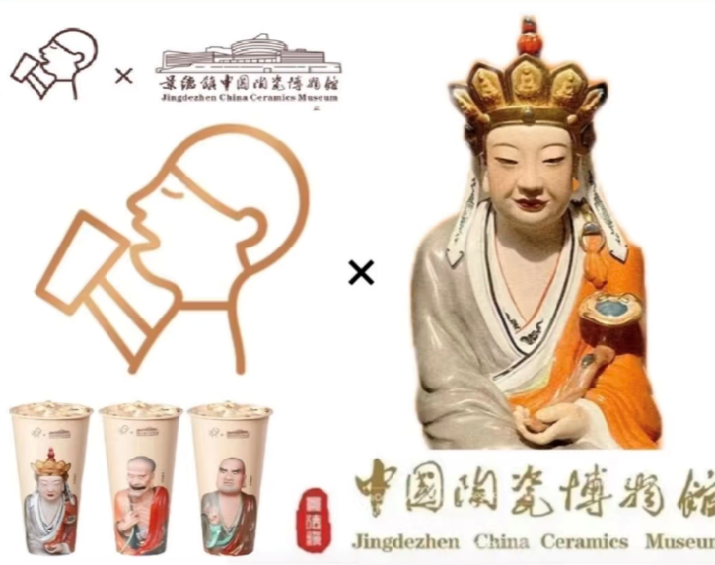
IP Jointly
To stand out in a highly saturated market, IP collaborations have become an effective marketing approach that milk tea brands can find. This approach not only helps them rapidly enhance their popularity and capture market share but also serve as an important way to break through cultural boundaries

Slide 21
Milk tea, not just milk tea:
A thousand years ago, milk tea was a warm current that sustained life on horseback; After a thousand years, it has become a cultural messenger in the context of globalization. From the survival wisdom of nomadic peoples to the new consumption wave, a cup of milk tea embodies a dialogue between tradition and modernity. It is also a vivid footnote to the “breaking boundaries and inheritance“(破界与传承) of this era.

Slide 22
THANK YOU

