Slide 1

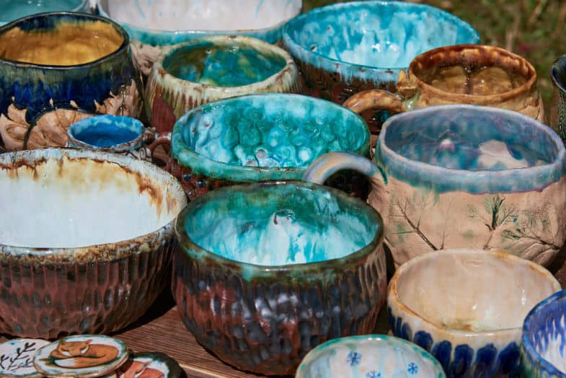
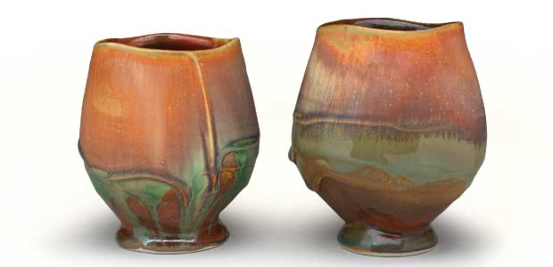
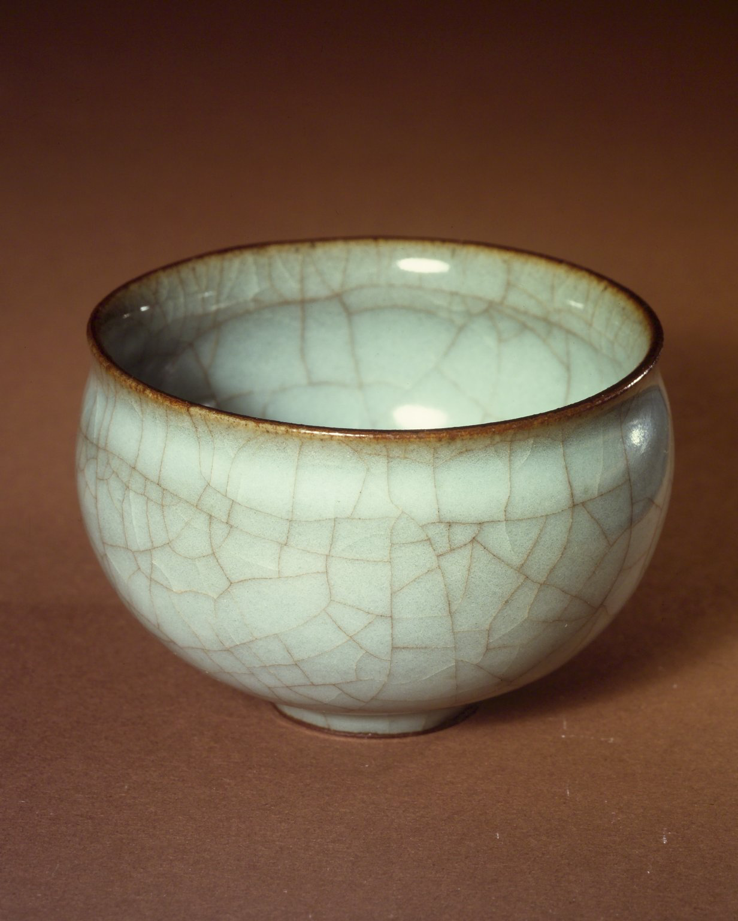
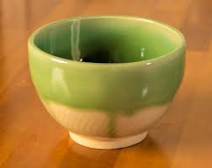
Origination
Today, celadon has two basic meanings.
One refers to a reduction-fired, iron- containing glaze originating in China that creates a translucent（半透明的） green glaze with a velvet texture（质感，质地）.
The other refers to any article or ware with a celadon glaze.
Notes:
https://www.ypppt.com/

Slide 2
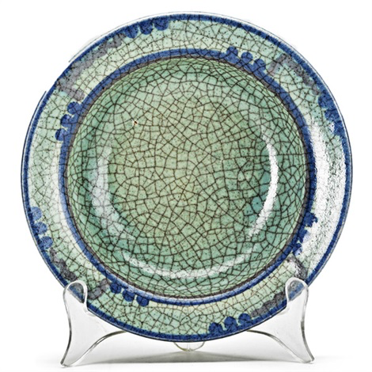
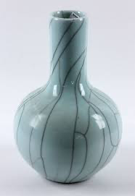
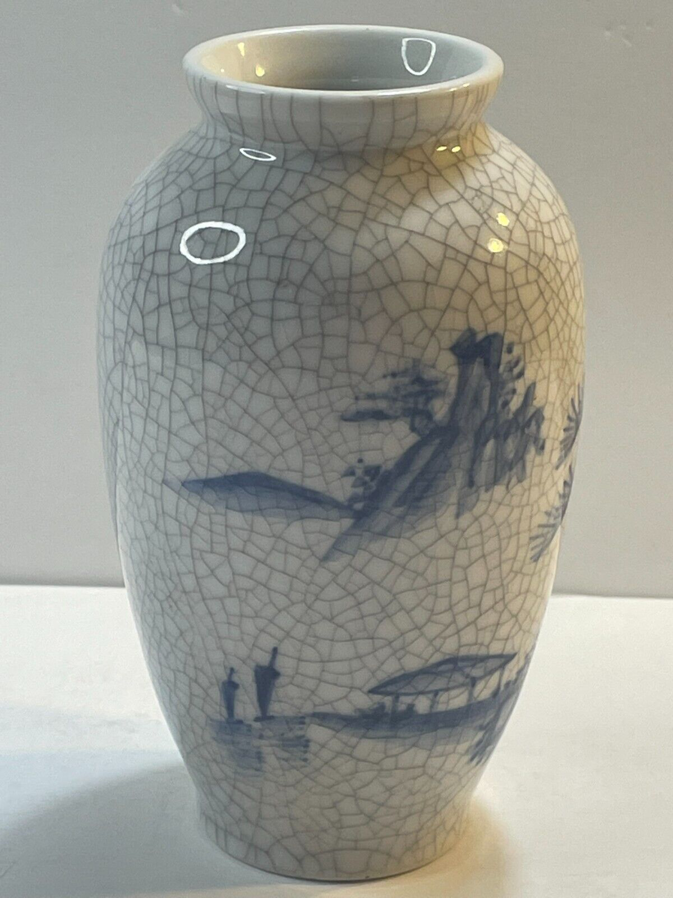
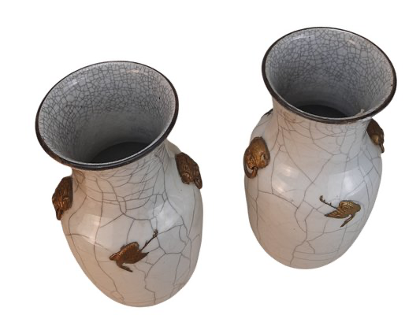
Origination
One type of celadon, known as “crackleware”, has broad and fine cracks on its surface.
These characteristics appear in the glaze as a result of the firing process when the glaze shrinks more than the body of the pottery. The potters from the Song Dynasty cleverly used the crackle in the glaze for a decorative effect. That is how a world-famous brand of ceramics was born in ancient China.
Notes:
https://www.ypppt.com/

Slide 3


PART.04
The Celadon Song

Slide 4

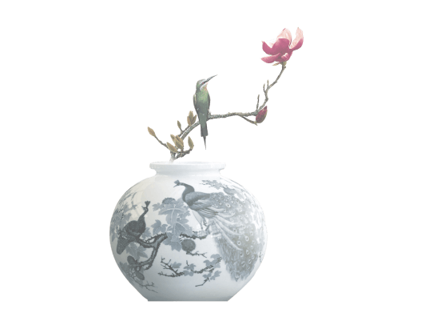
你隐藏在窑烧里千年的秘密
极细腻犹如绣花针落地
帘外芭蕉,惹骤雨门环惹铜绿
而我路过那江南小镇惹了你
在泼墨山水画里,你从墨色深处被隐去
天青色等烟雨,而我在等你
炊烟袅袅升起,隔江千万里
在瓶底书汉隶仿前朝的飘逸,就当我为遇见你伏笔
天青色等烟雨,而我在等你
月色被打捞起,晕开了结局
如传世的青花瓷自顾自美丽,你眼带笑意
天青色等烟雨,而我在等你
炊烟袅袅升起,隔江千万里
在瓶底书汉隶仿前朝的飘逸
就当我为遇见你伏笔
天青色等烟雨,而我在等你
月色被打捞起,晕开了结局
如传世的青花瓷自顾自美丽,你眼带笑意
The Celadon Song
素胚勾勒出青花, 笔锋浓转淡
瓶身描绘的牡丹,一如你初妆
冉冉檀香透过窗, 心事我了然
宣纸上走笔, 至此搁一半
釉色渲染仕女图, 韵味被私藏
而你嫣然的一笑,如含苞待放
你的美一缕飘散, 去到我去不了的地方
天青色等烟雨, 而我在等你
炊烟袅袅升起, 隔江千万里
在瓶底书汉隶, 仿前朝的飘逸
就当我为遇见你伏笔
天青色等烟雨, 而我在等你
月色被打捞起, 晕开了结局
如传世的青花瓷自顾自美丽, 你眼带笑意
色白花青的锦鲤跃然于碗底
临摹宋体落款时却惦记著你

Slide 5
The Celadon Song
Do you like Zhou Jielun and Fang Wenshan’s pop song “Blue-and-White Porcelain”?
What on earth is it about, a love story or the making of blue-and-white porcelain?

Slide 6



Thanks!

