Slide 1



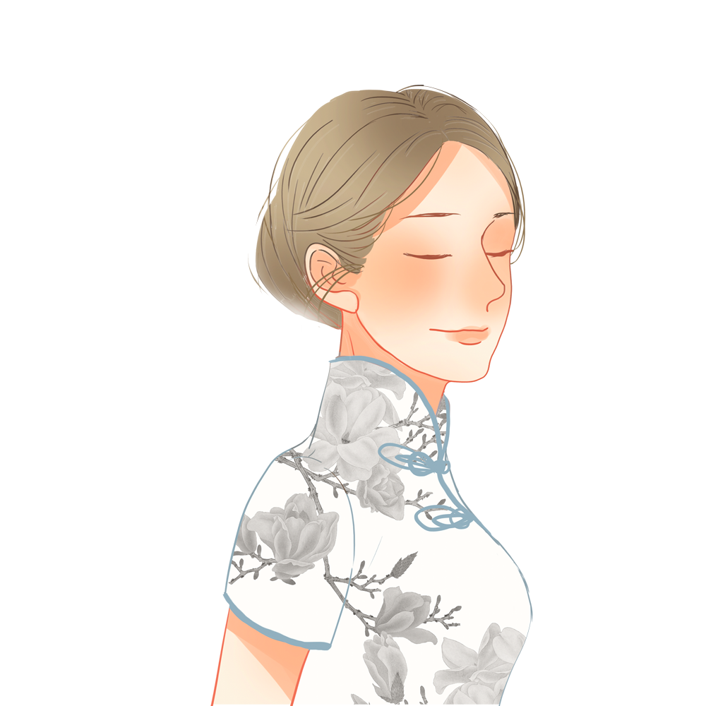
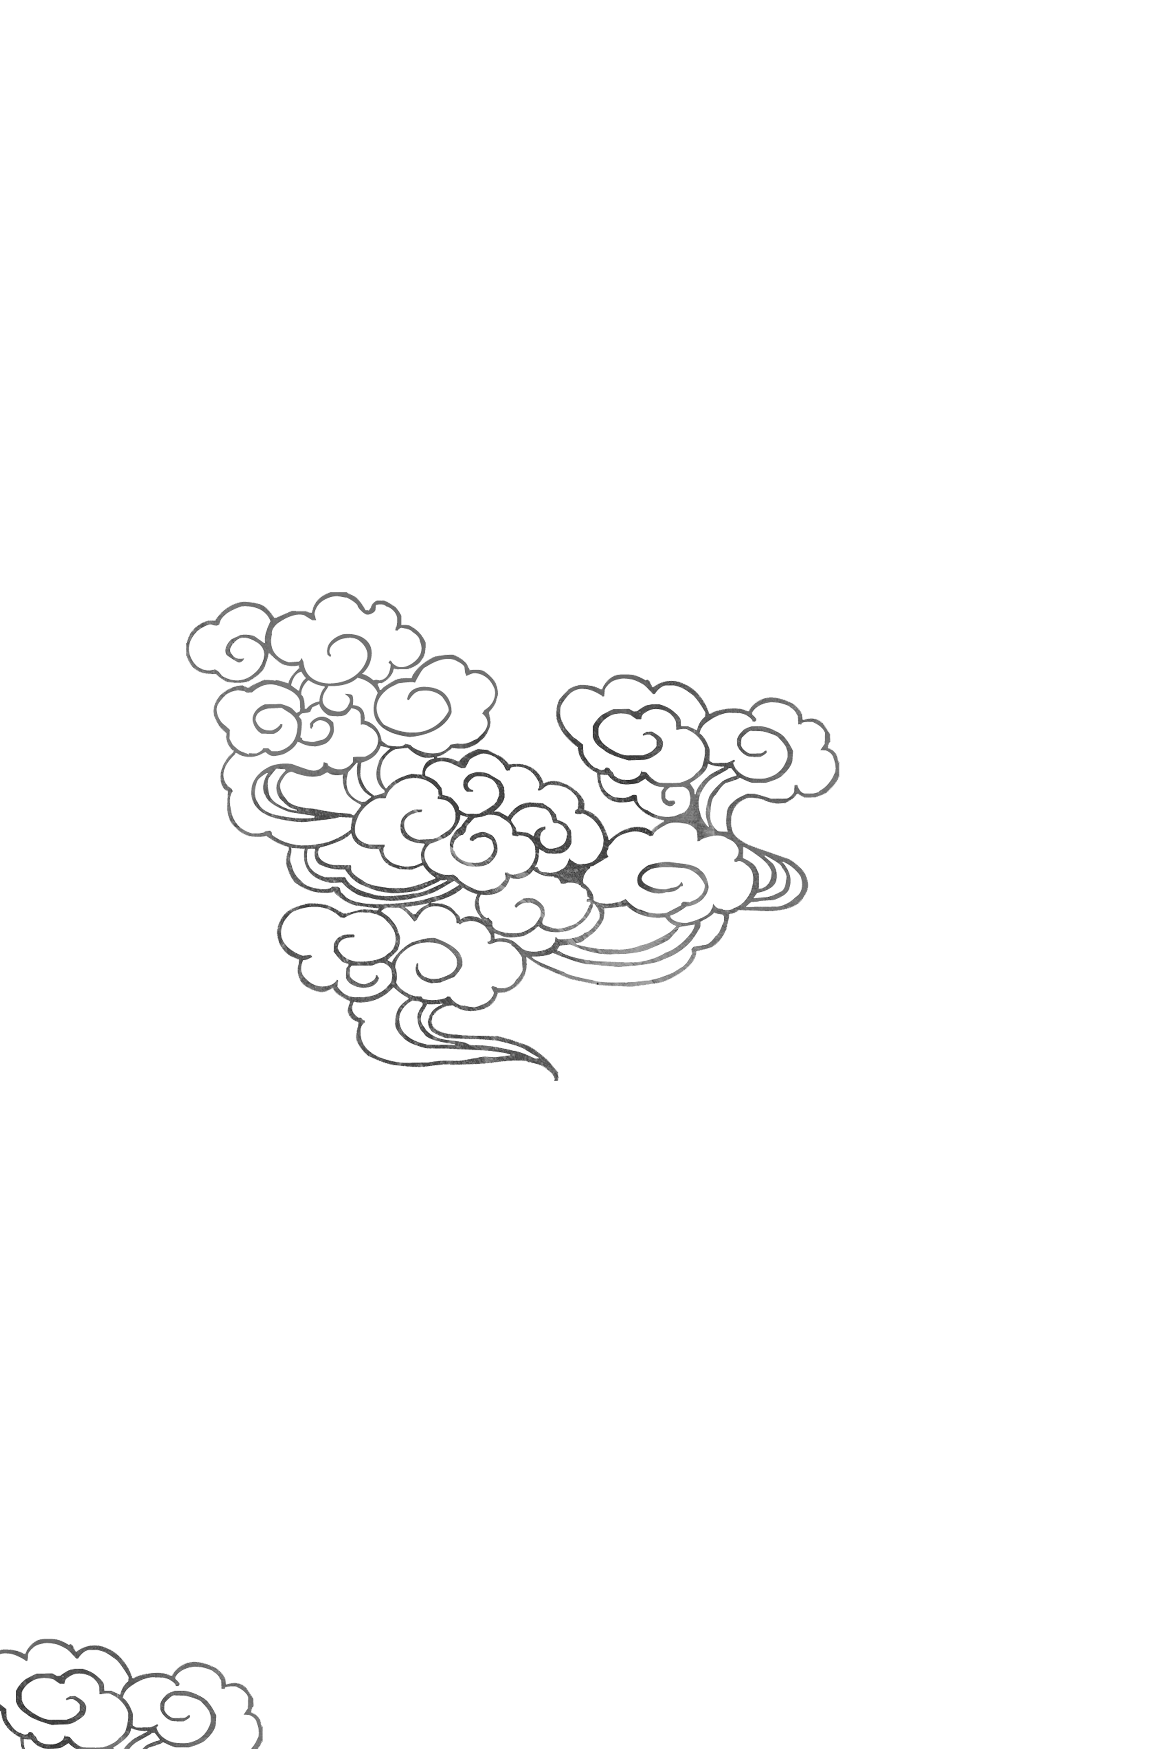
The Summer Palace

Slide 2
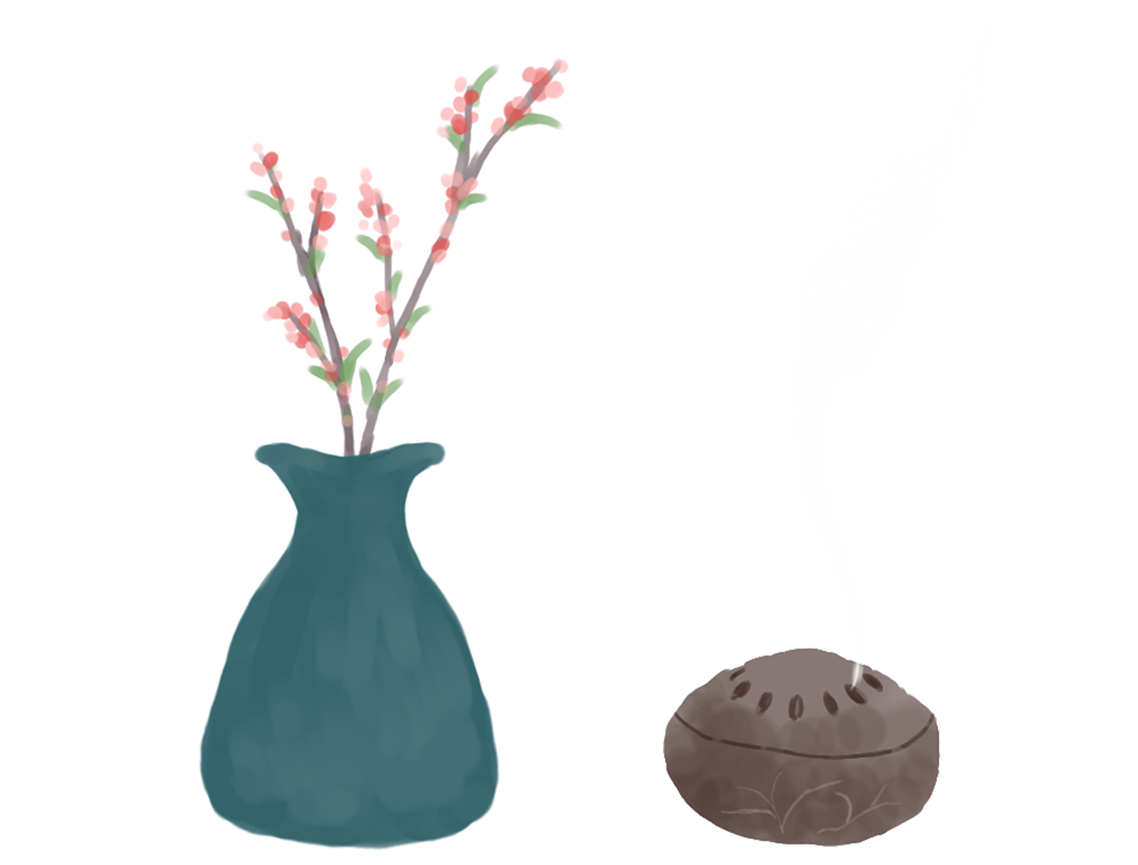
Contents
第四章
第三章
第二章
第一章
摄图网，给你创意和灵感摄图网，给你创意和灵感摄图网，给你创意和灵感
摄图网，给你创意和灵感摄图网，给你创意和灵感摄图网，给你创意和灵感
摄图网，给你创意和灵感摄图网，给你创意和灵感摄图网，给你创意和灵感
Changes of Name
History and Tourist sights
Translations

Slide 3

Changes of Name
One of the largest and finest imperial resorts in China.
“Gold Mountain Traveling Palace”
The Qingyiyuan (the Park of Pure Ripples)

Slide 4
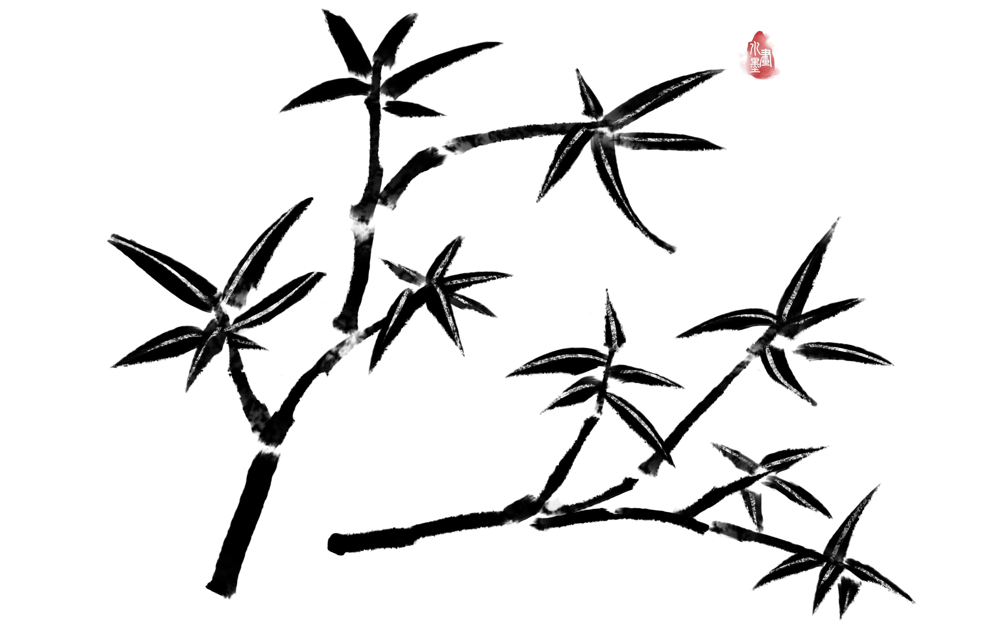
History and Tourist sights
Located in the northwestern outskirts of Beijing, the Summer Palace covers an area of 3.4 km2, three-quarters of which is covered with shallow lakes. Most of its buildings were burned and looted by the Anglo-French joint forces in 1860 during the Second Opium War.

Slide 5
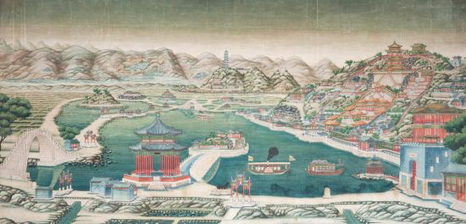
In 1888, Empress Dowager Cixi ordered the Summer Palace to be rebuilt and enlarged with funds originally designated for the Chinese navy. She renamed it Yiheyuan.
The work took eight years to finish, and consequently a new garden appeared. It became a public park in
1924 after Puyi, the last Qing emperor, abdicated and was ousted from the Forbidden City.

Slide 6
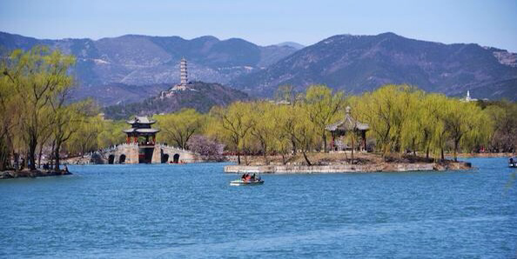
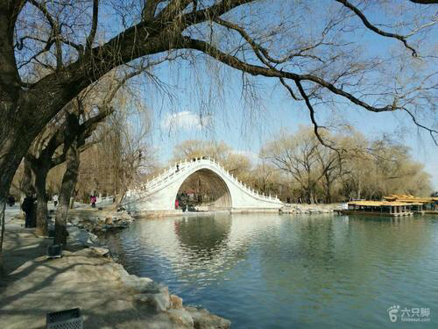
the Longevity Hill
万寿山

Slide 7
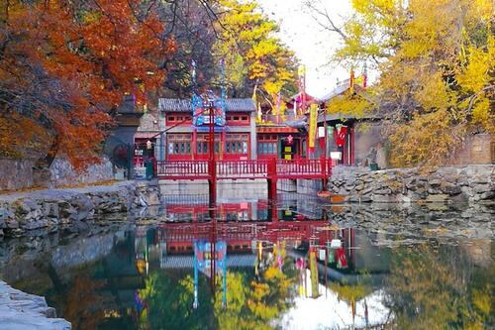
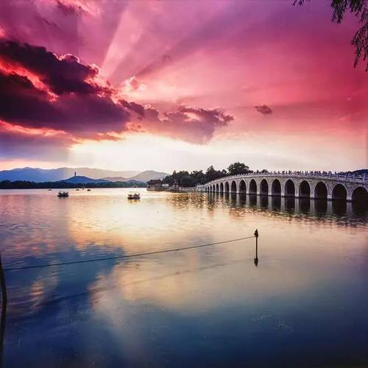
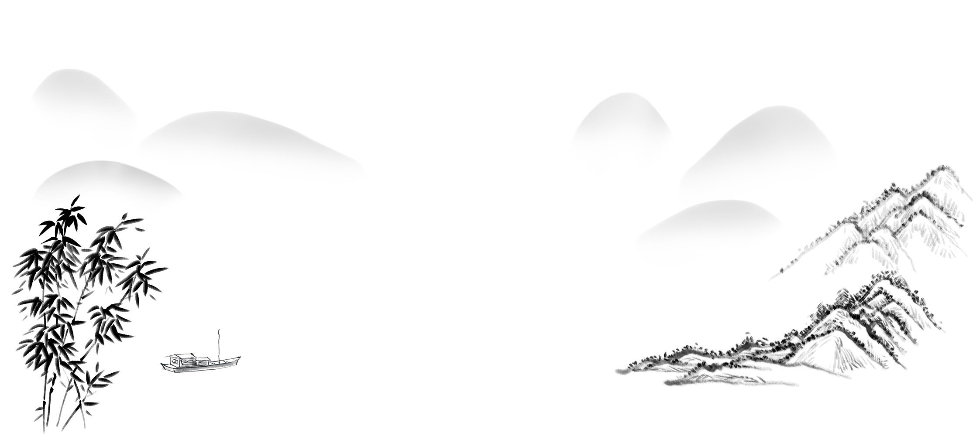
Lake Kunming
昆明湖

Slide 8
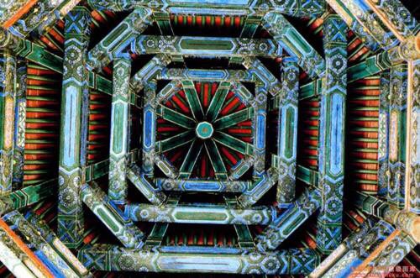
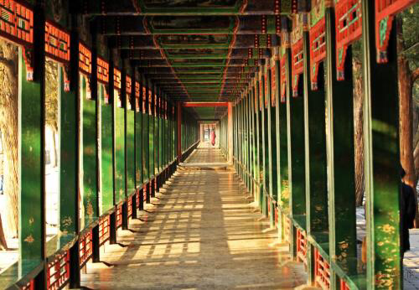
中国风
Long Corridor
长廊

Slide 9
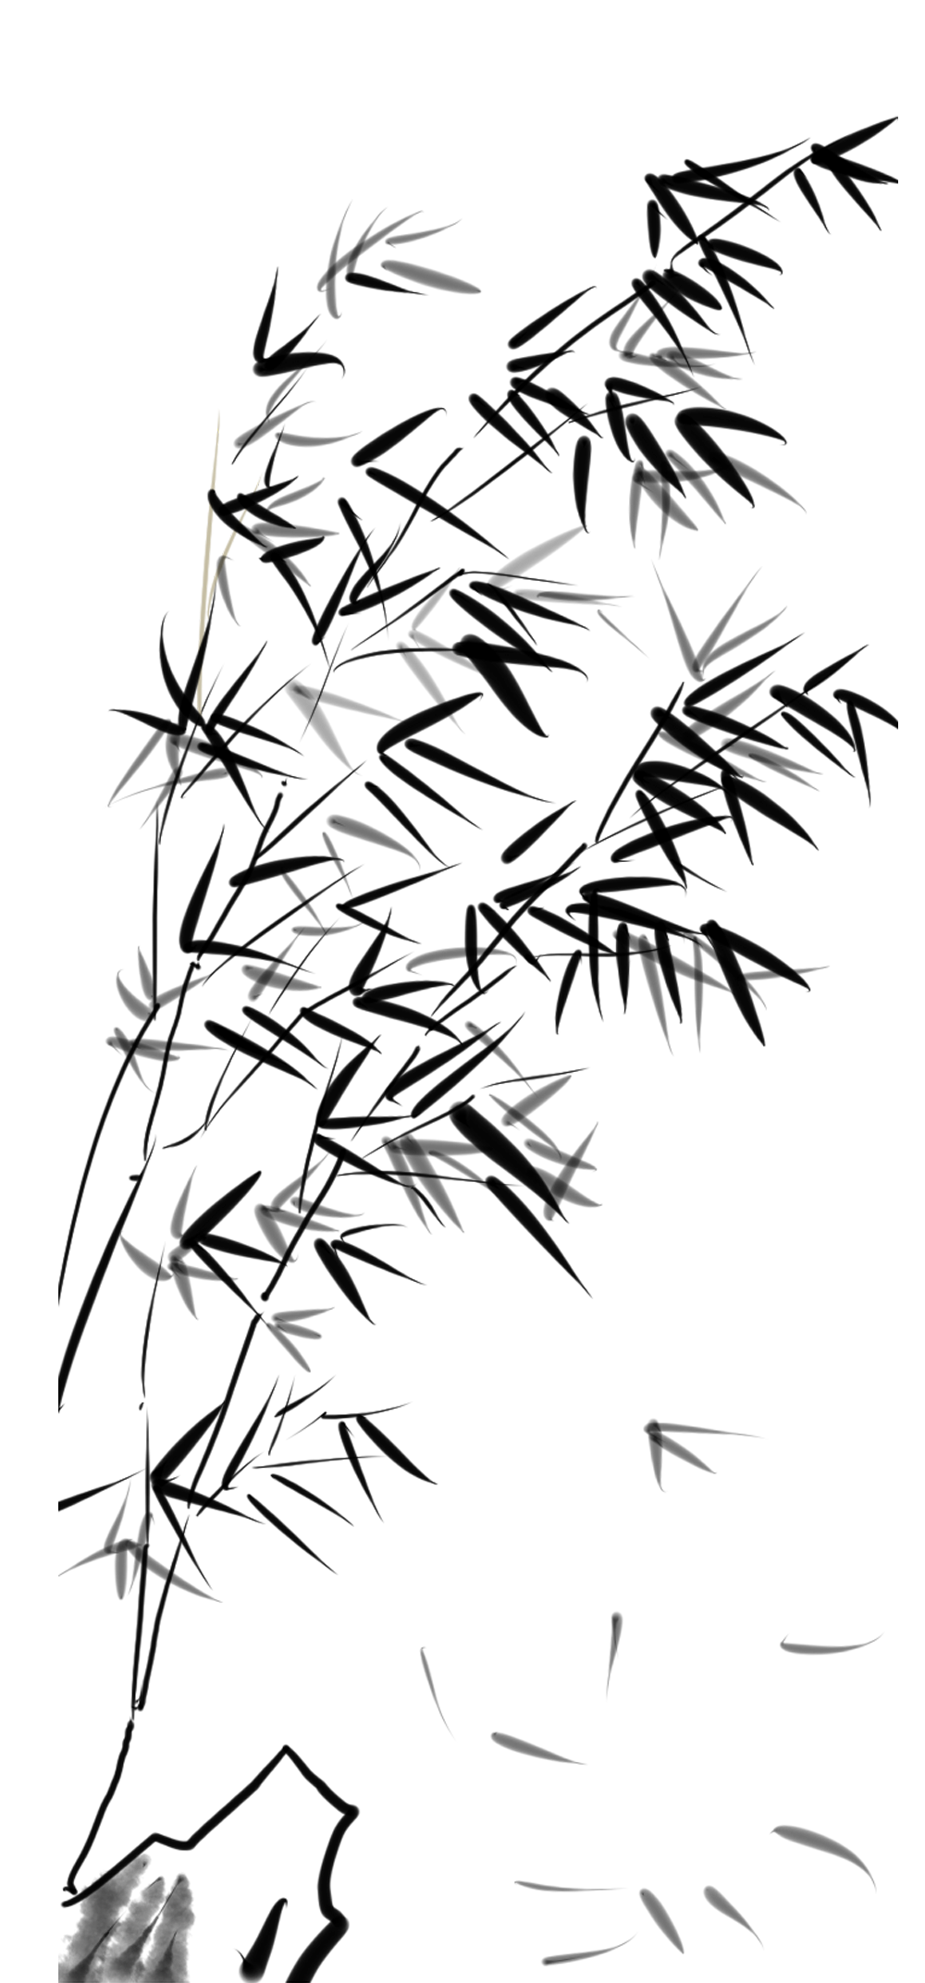
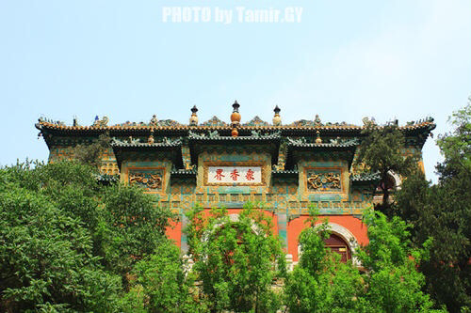
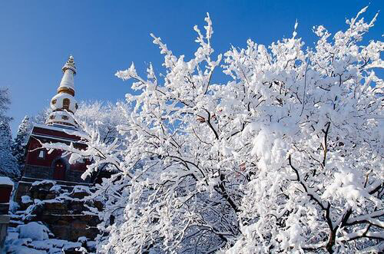

Slide 10
As its name implies，the Summer Palace was used as a summer residence by China's imperial rulers--as a retreat from the main imperial palace now known as the Palace Museum or Forbidden City-a pleasureground in the countryside，yet near to the city.
Translations
The Summer Palace

Slide 11
Yihe Garden The Qingyiyuan(transliteration)
The Summer Palace the Park of Pure Ripples

