Slide 1

Crosstalk 相声
Ludy 吕迪
2024/10/17

Slide 2
01
Definition and History
02
Four Basic Skills
Contents
03
Forms and Characteristics
04
Famous Artists and Works
05
Cultural Significance

Slide 3
01
Definition and History

Slide 4
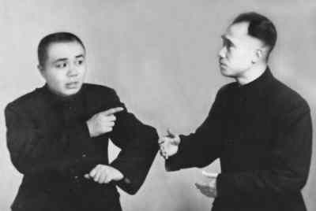
Definition and History
Crosstalk, in the ancient time known as onomatopoeia, originally refers to imitate others’ voices.
It is integrated with imitating oral skills and other folk art forms. It is generally believed to be formed during the Emperor Xianfeng (1850—1861) and Emperor Tongzhi (1861—1874) period in Qing dynasty(1636-1912).
It’s a folk vocal art that uses jokes or funny questioning and answering to make the audience laugh.
Notes:
链接：https://pan.baidu.com/s/1dBUOykZfGkjoJj8YrmZuTw?pwd=7788
提取码：7788

Slide 5
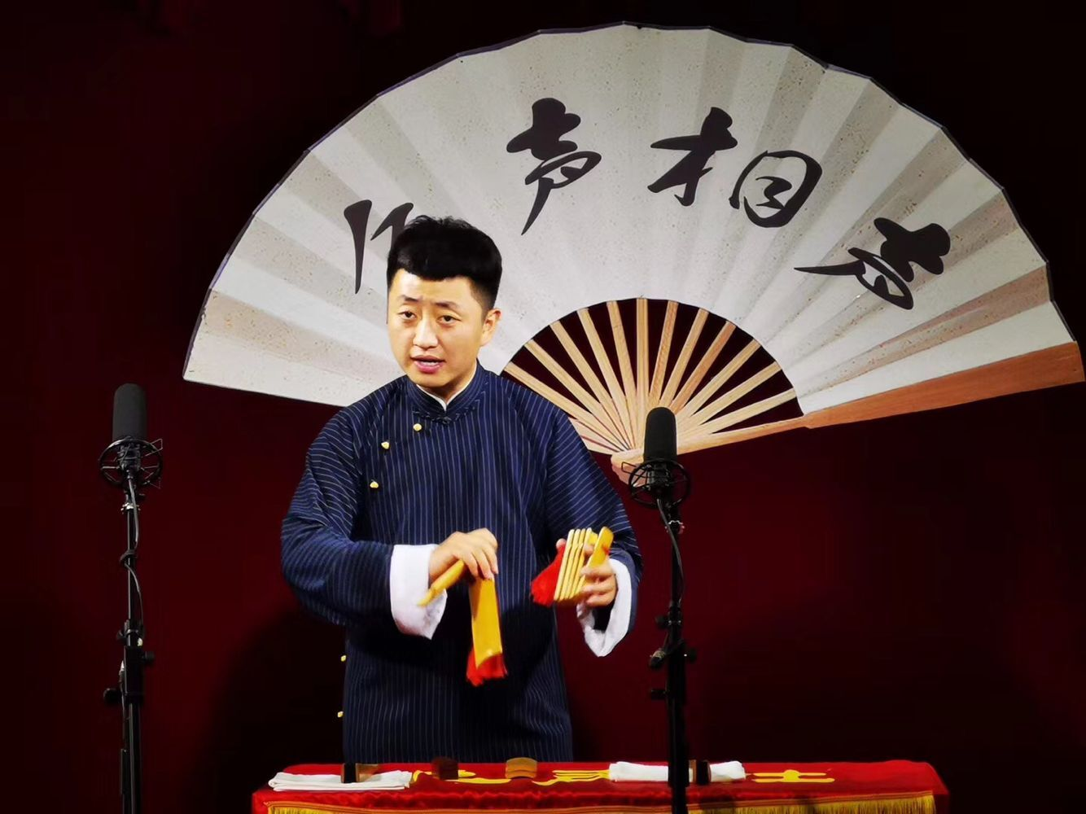
The crosstalk art almost
disappeared but has been reborn and developed very rapidly especially
since the founding of the People’s Republic of China.
It is no longer only played in several cities in the north, or spread only within the citizens, but also spread from the north to the whole country, and from the city to the countryside,
from China to the world.

Slide 6

02
Four basic skills

Slide 7
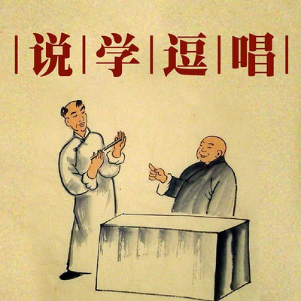
Four basic skills
Speaking 说 tell jokes, stories, lantern riddles, drinking games, etc.
Imitating 学 dialects of various provinces, various local operas, folk arts, etc.
Teasing 逗 gag and tease
Singing 唱 sing Taiping Lyrics, opera lyrics, songs, etc.

Slide 8
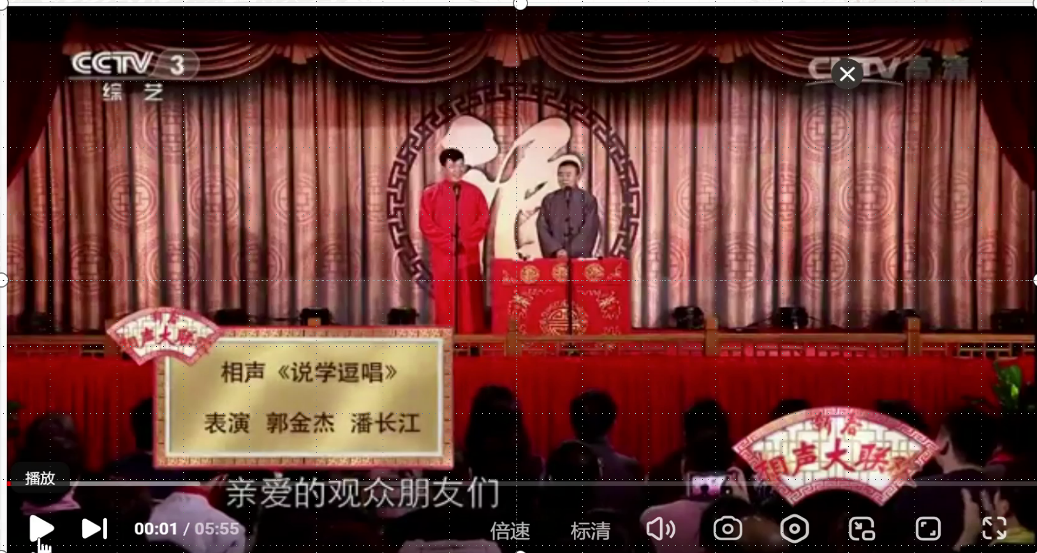
A video link
潘长江说相声《说学逗唱》，郭金杰来拆台，包袱横飞台下观众听嗨了,综艺,喜剧综艺,好看视频 (baidu.com)

Slide 9
03
Forms and Characteristics

Slide 10
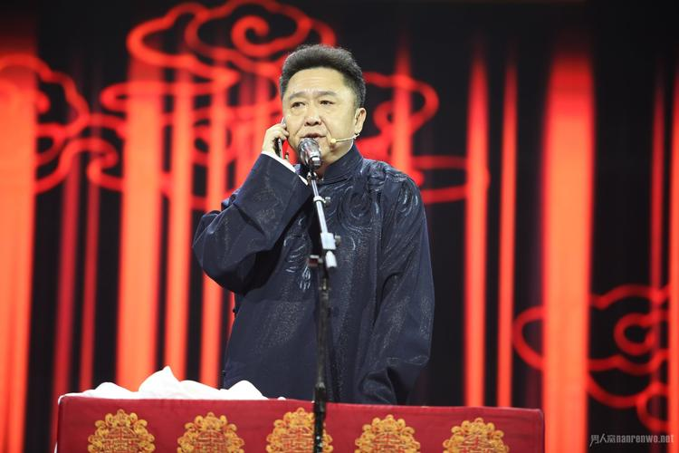
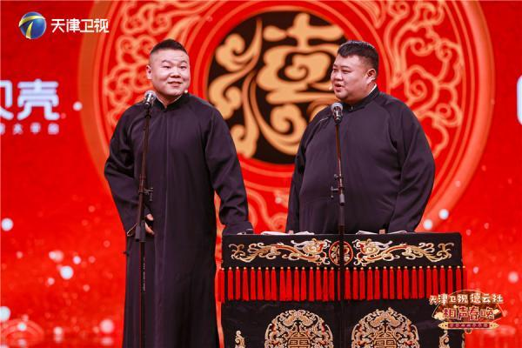
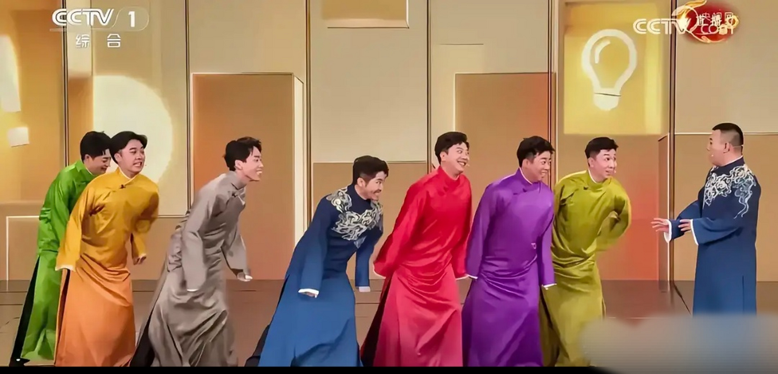
Forms
The main forms of Chinese crosstalk include
stand-up crosstalk pair crosstalk group crosstalk
单口相声 对口相声 群口相声

Slide 11
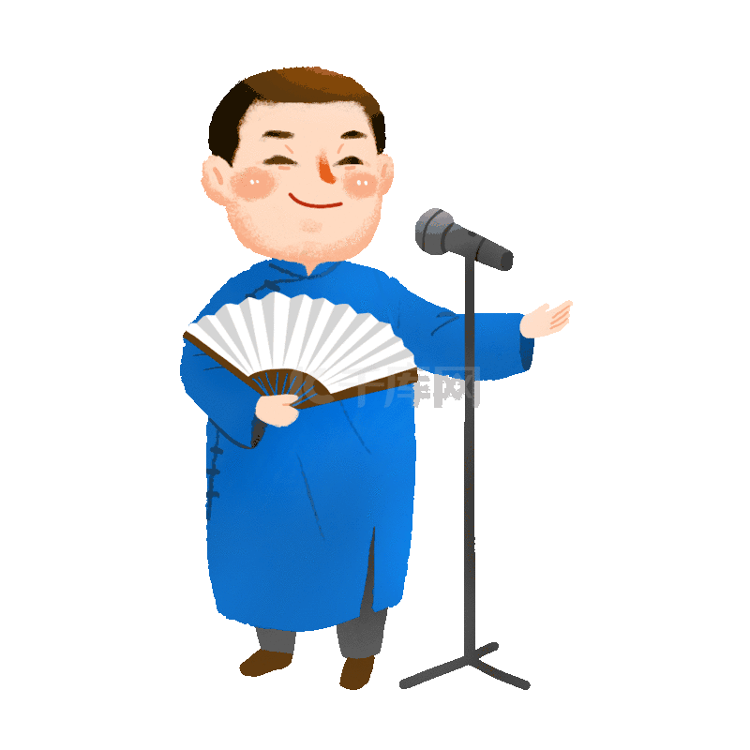
stand-up crosstalk
It is performed by an actor.
This form of crosstalk is the simplest, with actors using their own words and expressions to achieve the humorous effect of the whole show.

Slide 12
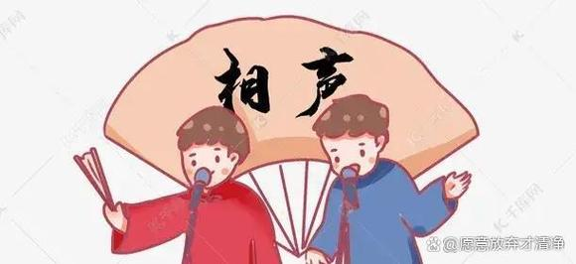
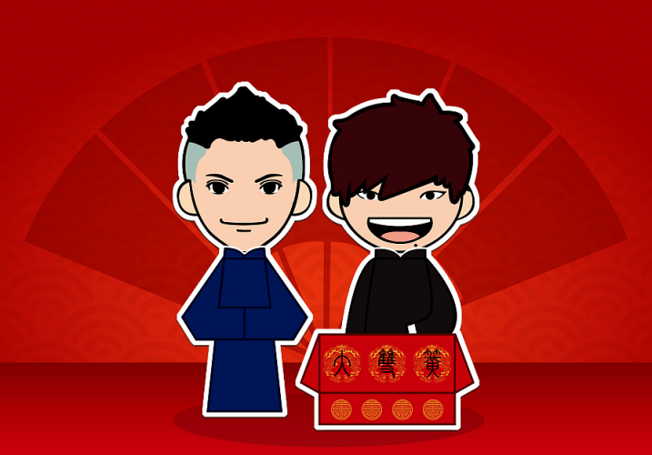
pair crosstalk
It is performed by two actors.
One acts as the main character to make fun with jokes for audience (捧哏)and another acts as the secondary character to help the main character to create laughter(逗哏). The pair crosstalk, which two actors communicate their sense of humor through interaction and dialogue, is the most popular form in China.

Slide 13
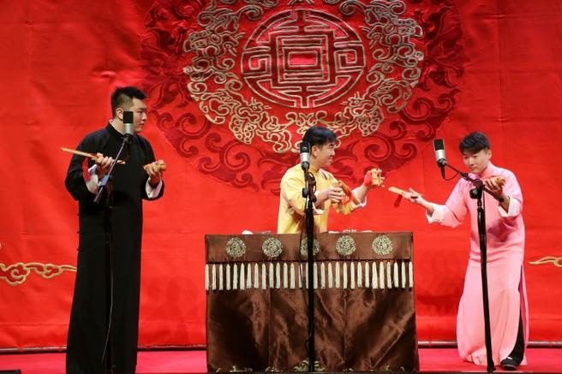
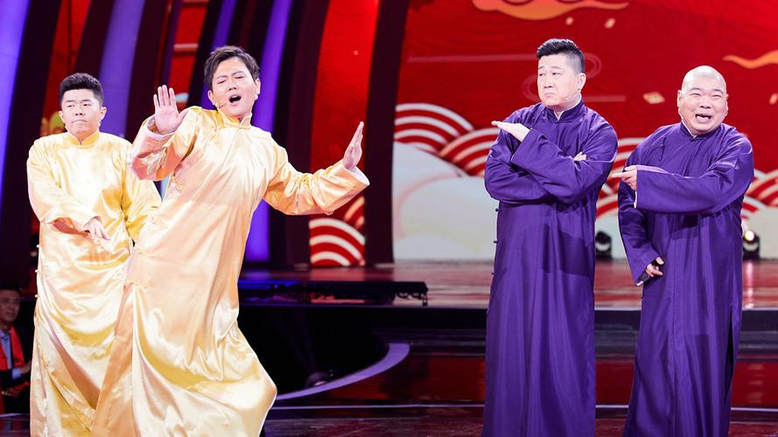
group crosstalk
It is performed by three or more people. Actors perform their respective duties and cooperate with each other to complete the humorous effect of the whole show.
Group crosstalk needs more cooperation, and the structure should be more rigorous.

Slide 14
Two Characteristics
the art of “speaking”
the art of "laughter"
interdependent
complementary

Slide 15
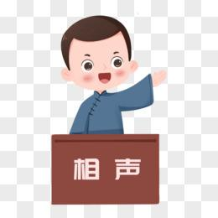
the art of “speaking”
perform with words
shorten the distance between the stage and the audience
directly communicate with the audience and perform with the audience’s cooperation and tacit understanding to obtain artistic effect

Slide 16
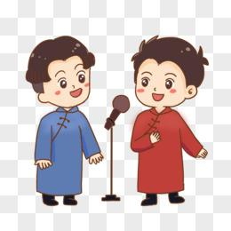
the art of “laughter”
a weapon to expose contradictions,
shape characters and evaluate life
humor and satire
a tool of cultural expression and social criticism, which can satirize backword phenomena and praise the truth and beauty

Slide 17

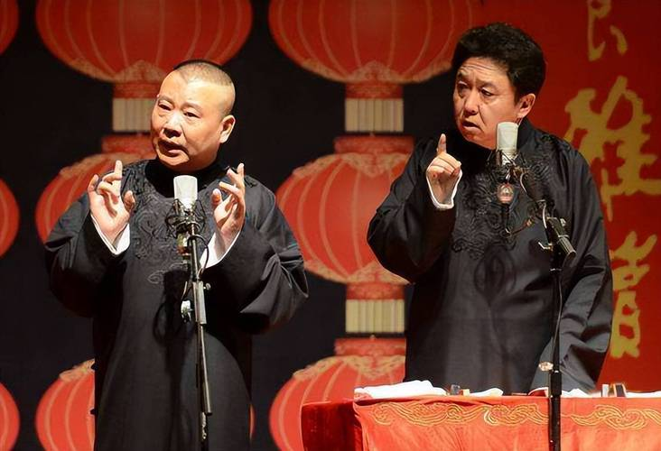
Laughter
Comedy:mainly comes from plot and comic characters
Crosstalk:mainly comes from “baofu” (jokes)
the charm of the language

Slide 18
04
Famous Artists and Works

Slide 19
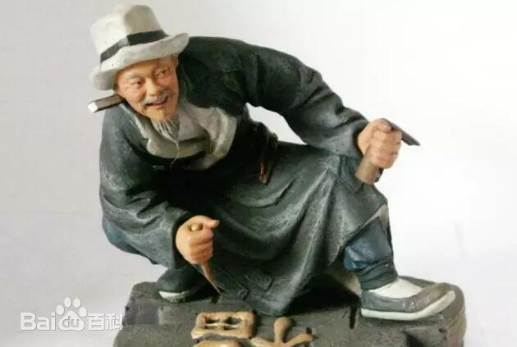
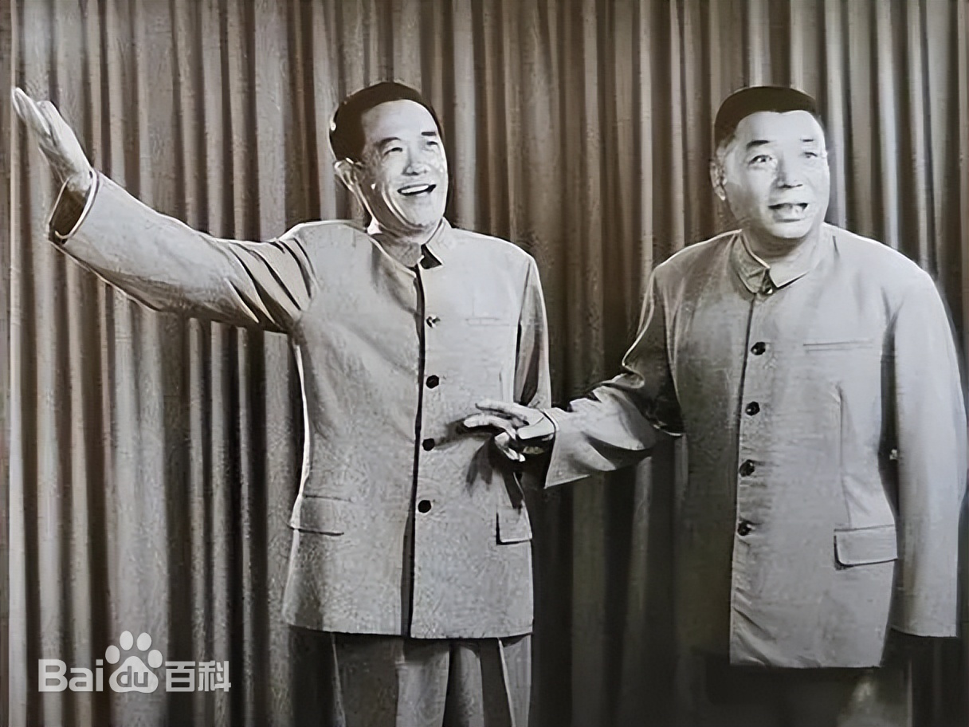
Zhu Shaowen
“Ancestor”of crosstalk art
Stage name: Qiong Bupa, which means not afraid of poverty 穷不怕
Hou Baolin
A pioneering master
60 years of art career
Works: Drama Talks, Drunkenness

Slide 20
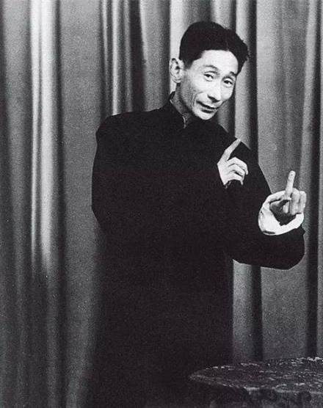
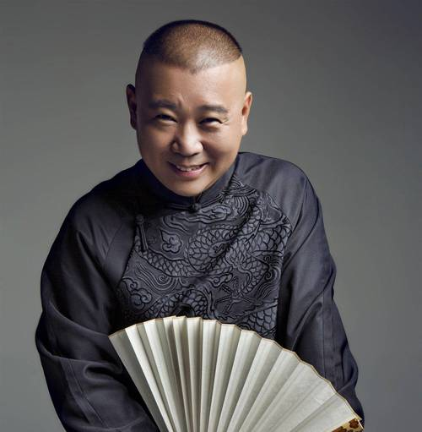
Ma Sanli
Created the unique “Ma’s Style of Crosstalk”
Works:Eating Yuanxiao (dumpling), Selling Tickets, the Yellow Crane Tower
Guo Degang
Founded Deyun society
Bring crosstalk into the world

Slide 21
05
Cultural Significance

Slide 22
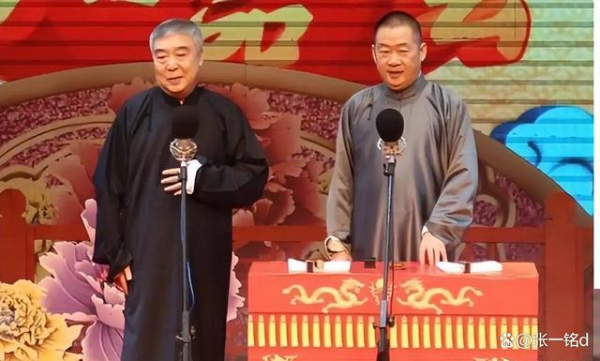
Inheritance and Innovation
As a traditional art form, crosstalk carries the essence of excellent traditional Chinese culture. Through the creative transformation and innovative development of traditional culture, crosstalk not only retains traditional elements, but also constantly absorbs new social content and the spirit of The Times, giving it a new lease of life in modern society.

Slide 23
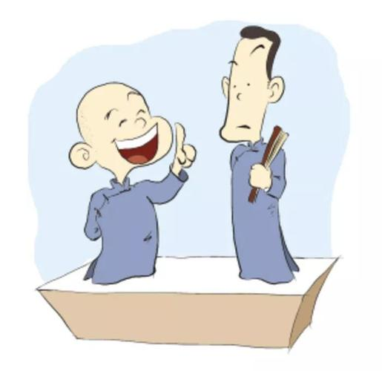
Informative and Entertaining
While inheriting history and culture, crosstalk also incorporates a large number of informative content, such as lantern riddles, couplets, and characters, showing the charm of Chinese language and characters as well as the intelligence and resourcefulness of actors.
This combination of knowledge and entertainment makes crosstalk an art form that not only benefits intellectual development but also brings joy to the audience.

Slide 24
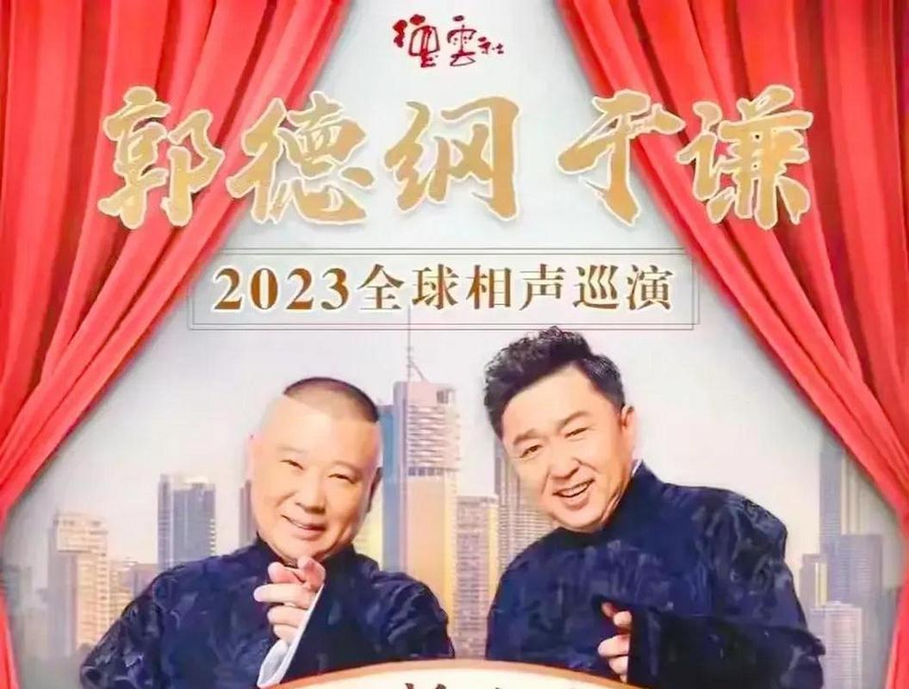
Cultural Confidence and Overseas Communication
The art of crosstalk tells about traditional Chinese culture through humorous language and expression forms, and embodies cultural confidence. Besides, crosstalk is played all over the world. Perhaps more foreigners are attracted by crosstalk.
Crosstalk, based on its special features, builds cultural confidence and also spread Chinese culture to the whole world.

Slide 25
Thanks for your listening
吕迪/Ludy
2024/10/17

