Slide 1
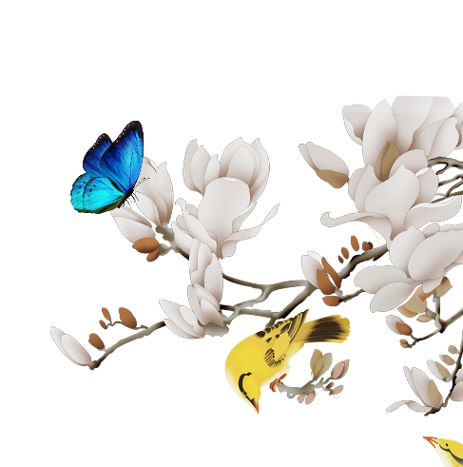

The Past and Present of Taoism
DaiZhen

Slide 2
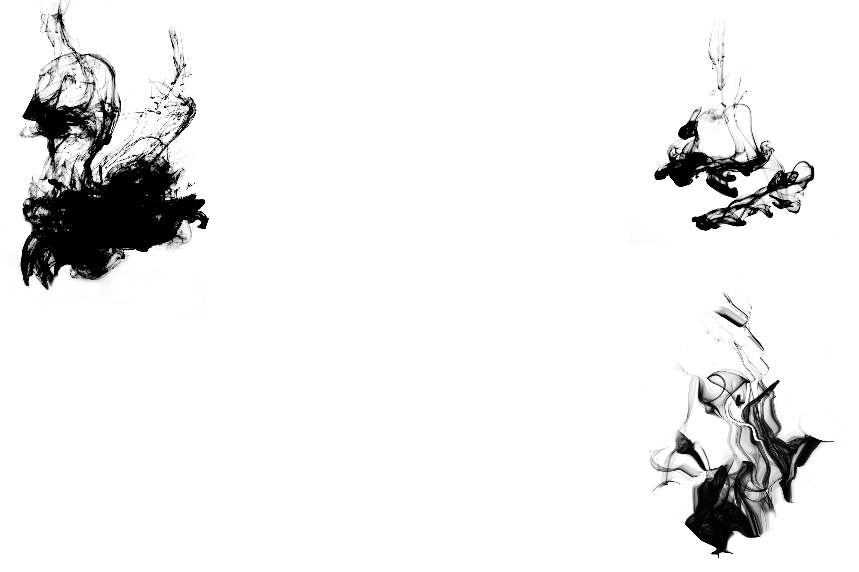
行业PPT模板http://www.1ppt.com/hangye/
Content
1
2
3
The Content of Taoism
The Practical Significance of Taoism
The Origin of Taoism

Slide 3
Part
1
The Origin of Taoism

Slide 4
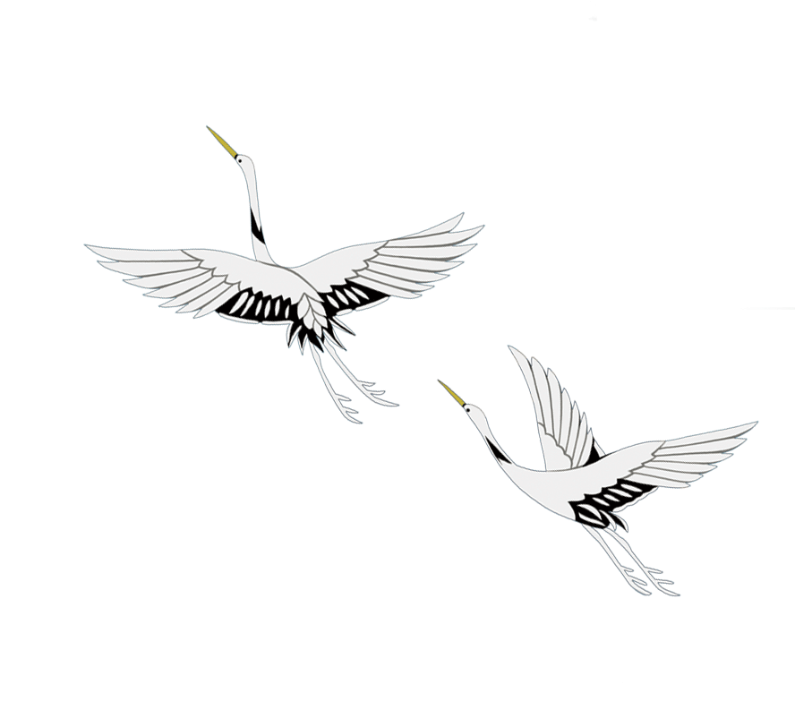
The only major indigenous religion originating from China. Originating from the late Eastern Han Dynasty, based on ancient witchcraft and the art of immortality, with Laozi's Tao Te Ching as the classic, it has a history of thousands of years through the evolution and development of various dynasties.
Taoism

Slide 5
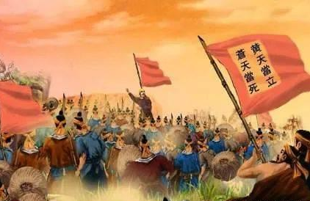
Zhang Jiao was one of the founders of Taoism, who launched a massive peasant uprising with the slogan: "苍天已死，黄天当立"

Slide 6
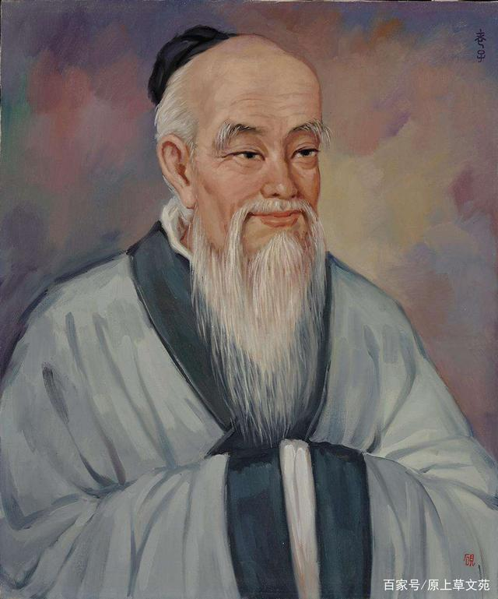
Three Major Principles of Laozi
Benevolence: Maintaining a friendly attitude towards all things in the universe, seeking universal harmony.
Simplicity: Freeing oneself from desires, maintaining simplicity in body and mind.
Humility: Suppressing the ego, avoiding dominance and coercion.

Slide 7
Part
2
The Content of Taoism

Slide 8
The "Tao" and Water in Taoism
Definition of "Tao": The way the universe operates, the path of natural events.
Symbolism of Water: Represents effortless action and wisdom in accordance with nature.

Slide 9
Cosmology in Taoism
Cosmic Harmony:
The universe is an embodiment of order and harmony.
Interaction of Yin and Yang: The fundamental forces in the universe, operating through mutual interaction.

Slide 10
Sects and Evolution of Taoism
Major Sects: Celestial Masters, Way of the Great Peace, Zhengyi Taoism, Quanzhen School, etc.
Evolutionary Process:
From the late Eastern Han Dynasty to modern times, it has undergone multiple reforms and mergers.
Notes:
模板来自于： 第一PPT https://www.1ppt.com/

Slide 11
Part
3
The Practical Significance of Taoism

Slide 12

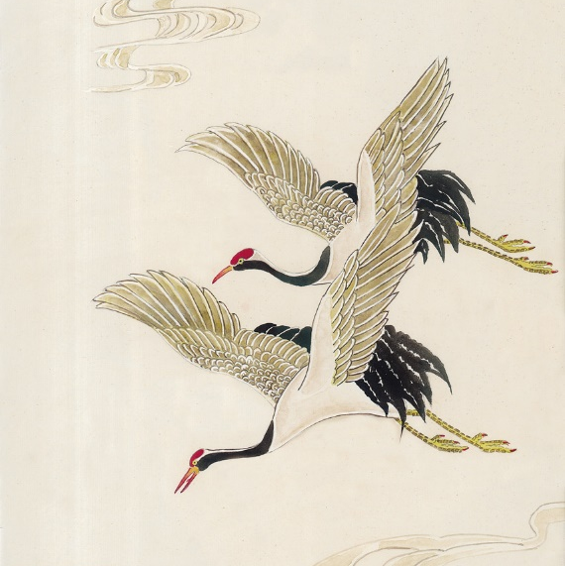
Cultural Inheritance: As an integral part of traditional Chinese culture, Taoism carries profound philosophical and moral concepts.

Slide 13
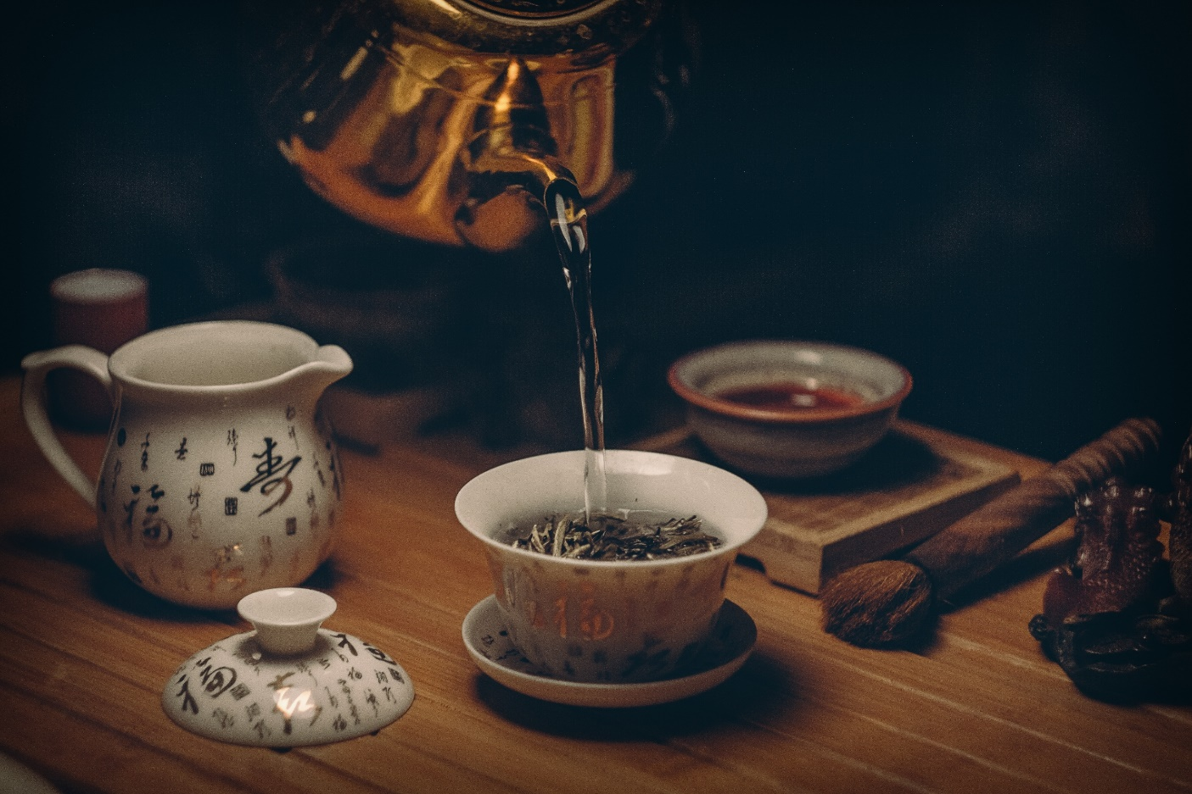
Social Harmony: The teachings and practices of Taoism contribute to the cultivation of moral qualities in individuals and the promotion of social harmony.
Physical and Mental Health: Taoism emphasizes physical and mental well-being and longevity, exerting a positive influence on contemporary lifestyles and health concepts.

Slide 14
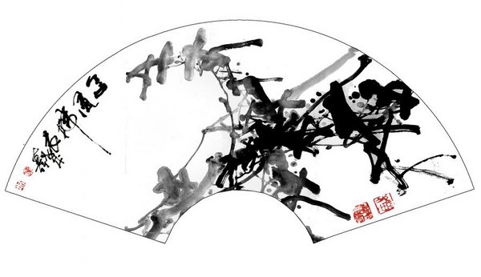
International Exchange
As a part of Chinese traditional culture, Taoism plays an important role in international cultural exchange, contributing to a better understanding and recognition of China worldwide.

Slide 15
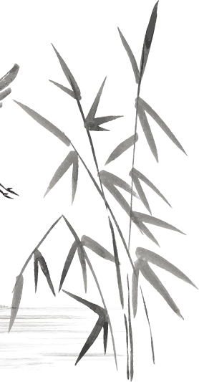

In modern times, we should respect Daoism as a valuable cultural heritage, appreciating its wisdom and practices while understanding its relevance in today's world.

Slide 16
Thank
You!

