Slide 1
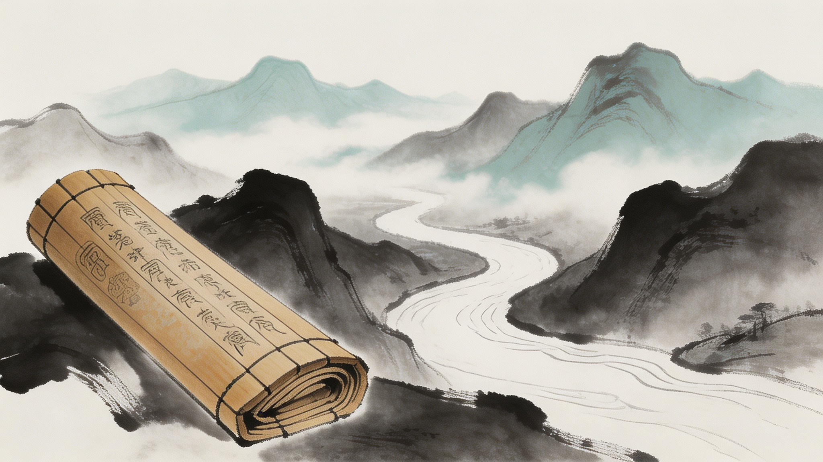
The Art of War
by Sun Tzu
A Timeless Guide to Strategy, Leadership, and Victory
Notes:
Welcome everyone. Today, we embark on a journey through one of the most influential texts in human history: "The Art of War" by Sun Tzu. This ancient Chinese masterpiece is not just about warfare; it's a profound guide to strategy, leadership, and achieving victory in any competitive field. Let's explore its timeless wisdom together.

Slide 2
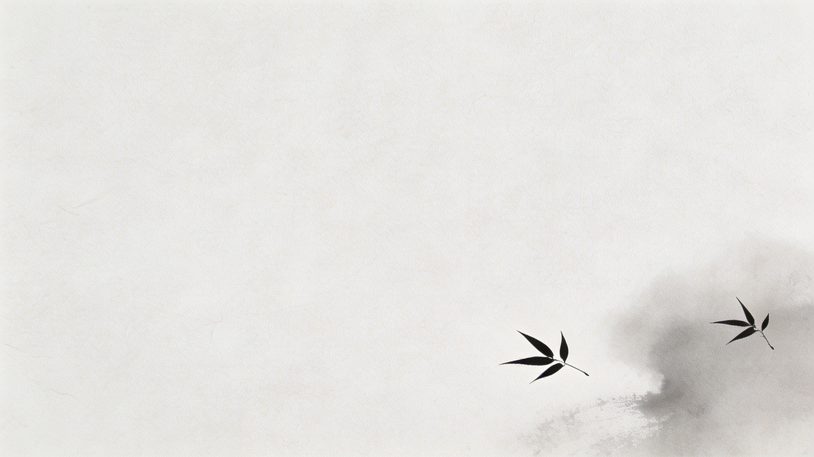
CONTENTS
01
02
03
04
Introduction
The Author
The Structure
Core Principles
.
05
06
07
Famous Stratagems
Modern Applications
Conclusion
Notes:
Here's an overview of what we'll cover today. We'll start with an introduction to the book, then look at its author, Sun Tzu. We'll break down its structure into thirteen chapters and dive into its core principles. We'll also explore some famous stratagems and discuss how these ancient teachings apply to our modern world in business, leadership, and even sports. Finally, we'll conclude with the enduring wisdom of Sun Tzu.

Slide 3
Introduction - What is The Art of War?
Known in Chinese as Sūn Zǐ Bīng Fǎ
The Art of War is one of the earliest and most influential military strategy books extant
during the Spring and Autumn Period (~5th century BCE).
“A guide to achieving success through careful planning, situational awareness, and understanding the fundamental dynamics of struggle.”
Notes:
So, what exactly is "The Art of War"? Despite its title, it's much more than a military manual. Written over 2,500 years ago, it's a foundational text on strategy and philosophy. Its core message is that the highest form of victory is to win without fighting. It teaches us to rely on strategy, psychological insight, and meticulous preparation rather than sheer force. Its principles are so powerful that they've been adapted across countless fields, proving their timeless relevance.

Slide 4
The Author - Sun Tzu (孙武)
Historical Figure
Sun Tzu, also known as Sun Wu, was a revered military general, strategist, and philosopher of ancient China.
Traditionally, he is believed to have served as a military advisor to King Helü of the state of Wu during the tumultuous Spring and Autumn period.
Notes:
The mastermind behind this work is Sun Tzu, a legendary figure from ancient China. While historical records of his life are scarce, his legacy lives on through his writing. A famous story about him demonstrates his uncompromising approach to discipline. When tasked with training the king's concubines, he showed that a commander's authority must be absolute by enforcing the ultimate punishment on those who disobeyed. This story highlights a key theme: the necessity of clear command and strict adherence to rules.

Slide 5
The Structure of the Book: The Thirteen Chapters
01. Laying Plans
06. Weak Points and Strong
10. Terrain
02. Waging War
07. Maneuvering an Army
11. The Nine Situations
03. Attack by Stratagem
08. Variation of Tactics
12. The Attack by Fire
.
04. Tactical Dispositions
09. The Army on the March
13. The Use of Spies
.
05. Energy
Notes:
The book itself is structured into thirteen distinct chapters, each a masterclass on a different facet of strategy. From the initial planning stages in "Laying Plans" to the crucial role of intelligence in "The Use of Spies," Sun Tzu covers every aspect of conflict. This structure provides a comprehensive framework for understanding and executing strategy in any domain.

Slide 6
CORE PRINCIPLES
“Prudence in Warfare” First: The opening states “War is a matter of life and death, a way to survival or death, a matter of survival or destruction, which must not be ignored”, advocating for calm and rationality, treating war as the last means to resolve conflicts
Comprehensive evaluation (Five Factors and Seven Calculations): Proposed the “Five Factors” for assessing victory or defeat: Morale (political/public support), Heaven (timing), Earth (terrain), General (leadership ability), and Method (discipline)
Morale
Heaven
Earth
General
Method
Notes:
Now, let's delve into the heart of "The Art of War"—its core principles. These are the fundamental ideas that make the book so powerful and universally applicable.

Slide 7
Core Principle 1: Win Without Fighting
"To win one hundred victories in one hundred battles is not the acme of skill. To subdue the enemy without fighting is the acme of skill."
—— 百战百胜，非善之善者也；不战而屈人之兵，善之善者也。《孙子兵法·谋攻篇》
Diplomacy
。
Deterrence
Subversion
Economic Warfare
Modern Analogy · 现代商业映射
Notes:
The most famous and central tenet is "to subdue the enemy without fighting." Sun Tzu argues that winning every battle is not the highest skill; the true master achieves their goal without conflict. This can be done through diplomacy, building a deterrent force, or undermining the enemy's resolve. In modern business, think of it as building a brand so strong that customers choose you over competitors without needing a price war.

Slide 8
Core Principle 2: Know Yourself and Your Enemy
“If you know the enemy and know yourself, you need not fear the result of a hundred battles.”
—— 知己知彼，百战不殆。
Application: The Dual Lens of Insight
To act with certainty, one must first look inward to understand inherent strengths, limitations, and available resources. Equally critical is the outward gaze: gathering clear intelligence on competitors—their strategies, vulnerabilities, and true capabilities. This balance of self-awareness and external vigilance eliminates the fog of uncertainty.
Notes:
Another cornerstone is the principle of "knowing yourself and your enemy." Sun Tzu states that this knowledge is the foundation of victory. Knowing yourself means understanding your own capabilities and limits. Knowing your enemy means gathering intelligence about their strategies and weaknesses. This is why he dedicates a whole chapter to the use of spies—information is power. In business, this translates directly to conducting thorough SWOT analyses and competitive research.

Slide 9
Core Principle 3: All Warfare is Based on Deception
“All warfare is based on deception. Hence, when able to attack, we must seem unable; when using our forces, we must seem inactive; when we are near, we must make the enemy believe we are far away; when far away, we must make him believe we are near.”
—— 兵者，诡道也。
Misdirection
Feigned Weakness / Strength
Creating Opportunities
Notes:
Sun Tzu also teaches that "all warfare is based on deception." This isn't about being unethical; it's about gaining a strategic advantage through misdirection and surprise. You might appear weak when you are strong, or far when you are near. The goal is to create opportunities by manipulating your opponent's perception. In modern terms, think of a company leaking false information to keep competitors off balance.

Slide 10
Core Principle 4: Subtlety and Surprise Tactics
Regular troops for containment,;surprise troops for decisive victory
Targeting the weak points
"Align with the orthodox to combine, and use the unorthodox to triumph."
“to attack weak points instead of strong ones”
—— 以正合，以奇胜。
—— 避实击虚。
Key Takeaway
Notes:
Speed and preparation go hand in hand. Sun Tzu emphasizes that speed is the essence of war, allowing you to strike where the enemy is unprepared. However, this speed must be built on a foundation of meticulous preparation. The successful general, he says, makes all his calculations before the battle even begins. This balance between careful planning and rapid execution is crucial for success in any field.

Slide 11
Core Principle 5: Use the Terrain
"He who knows the art of war recognizes the importance of the land."
—— 知地知天，胜乃可全。
Understanding the Environment
Sun Tzu dedicates two full chapters (Chapters 10 & 11) to the profound importance of terrain. He argues that victory is not merely won by force, but by recognizing the lay of the land and using the natural environment to one’s strategic advantage. Adapting to the conditions of the battlefield—whether it be distance, danger, or openness—allows a commander to turn the landscape into an ally rather than an obstacle.
Notes:
Finally, Sun Tzu stresses the importance of understanding and using the terrain. He devotes two entire chapters to different types of ground and how to leverage them. In a modern context, "terrain" isn't just physical geography. It can be market segments, customer demographics, or even online platforms. Understanding the environment you operate in is key to finding the best strategic position.

Slide 12
Famous Stratagems - Part 1
Deceive the Sky to Cross the Sea (瞒天过海)
Besiege Wei to Rescue Zhao (围魏救赵)
Meaning: Hide a large-scale operation in plain sight by making it appear ordinary. The key is to mask the extraordinary within the mundane, so the opponent lowers their guard and overlooks the true intention.
Meaning: Instead of directly confronting the enemy to save an ally, attack their vital and undefended home base. This forces the aggressor to retreat and relieve the pressure on your side.
Notes:
For example, "Deceive the Sky to Cross the Sea" means hiding a big plan in plain sight. A business might use this by leaking a small update to cover a major product launch. Another strategy is "Besiege Wei to Rescue Zhao," which involves attacking an enemy's weak point to relieve pressure elsewhere. In business, this could mean countering a competitor's price cut by targeting their most profitable market.

Slide 13
Famous Stratagems - Part 2
Stratagem 3: Kill with a Borrowed Knife (借刀杀人)
Stratagem 4: Wait at Leisure for the Exhausted (以逸待劳)
To defeat a formidable enemy indirectly by manipulating a third party to act on your behalf, thus preserving your own strength while achieving the desired outcome.
Conserve your energy and resources while allowing the opponent to expend theirs in pursuit. Strike only when they are weakened and vulnerable due to overextension.
Notes:
"Kill with a Borrowed Knife" involves using a third party to achieve your goal, like getting a regulator to investigate a competitor. And "Wait at Leisure for the Exhausted" is about conserving your strength. A company with deep pockets might use this strategy to outlast a competitor in a price war, knowing the competitor can't sustain the losses.

Slide 14
Conclusion - The Wisdom of Sun Tzu
The Art of War is far more than a historical military manual; it is a timeless guide to strategic thinking that transcends battlefields and eras. Its core lies not in the art of fighting, but in the art of seeing — providing a profound framework to anticipate challenges, align resources, and act with intentionality in navigating the complexities of any competitive landscape.
Plan Thoroughly
Know Thyself
Strategic Victory
Be Adaptable
Harmony with Nature
Final Thought
The true "art of war" is not the art of destruction, but the art of wisdom. It is the ability to achieve your highest objectives with the least amount of unnecessary conflict, to turn potential strife into alignment, and to lead with a vision that outlasts the moment. In this way, the principles of Sun Tzu remain not just relevant, but essential, for leaders navigating an ever-changing world.
Notes:
In conclusion, "The Art of War" offers a profound framework for strategic thinking. Its key takeaways—plan thoroughly, know yourself and your competition, seek strategic victory, be adaptable, and use your environment—are as relevant today as they were 2,500 years ago. The true art lies in achieving your goals with wisdom and minimal conflict.

Slide 15
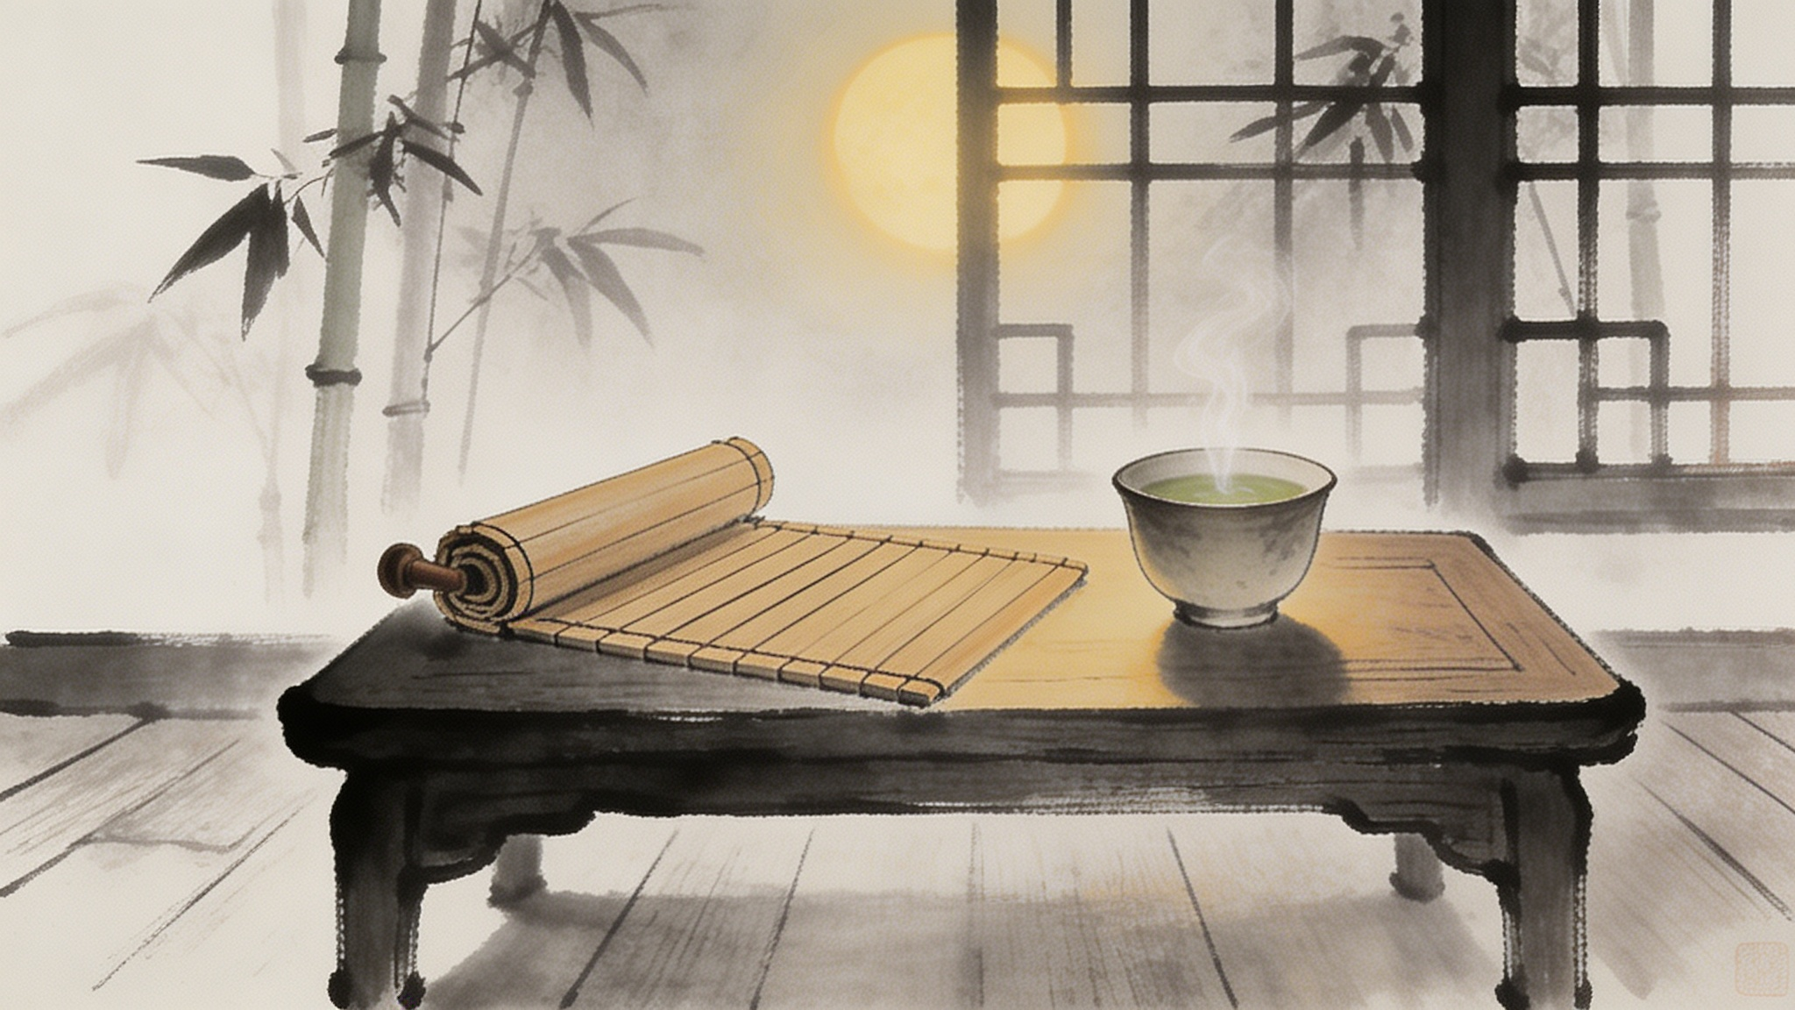

Thank You
Notes:
Thank you again for joining me. I hope this exploration of Sun Tzu's wisdom has given you valuable insights that you can apply in your own life and work.

