Slide 1


哦耶！
终于轮到我汇报了
汇报人：李松林 Solin

Slide 2
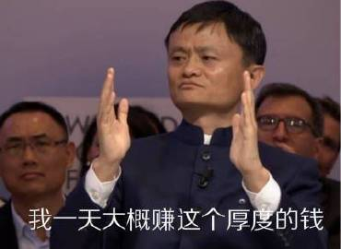
淘宝
Taobao

Slide 3


尊敬的公主王子们请看目录
1
Taobao's history and development
2
Taobao Technological Innovations
3
Money-Saving Tips

Slide 4

PART 01
公主王子们
这是第一部分
Part 1 Taobao’s history and development

Slide 5

Part1
Taobao’s history and development
Establishment (2003):
Taobao was established by Alibaba Group in 2003 as an online trading platform.
01
Launch of Alipay (2004):
To increase the security of transactions, Taobao introduced Alipay, an online payment tool.
02
Overtaking Competitors (2005):
Taobao quickly surpassed eBay EachNet to become China's largest online shopping platform.
03

Slide 6

Part1
Taobao’s history and development
Launch of Taobao Mall (2008):
The launch of Taobao Mall (later known as Tmall) marked Taobao's entry into the B2C business.
04
05
"Double 11" Shopping Festival (2009):
Taobao first launched the "Double 11" shopping festival in 2009, which later became the world's largest online shopping event.
Continuous Growth (2010 to Present):
Taobao has continued to grow, becoming one of the world's largest online retail platforms.
06

Slide 7
让你们看看什么才是专业
Q1 Who established Taobao ?
Ma Yun
Q2 How many stages of Taobao’s development?
6

Slide 8

PART 02
公主王子们
这是第二部分
Part2 Taobao Technological Innovations

Slide 9

01
AI Fitting Room:
Taobao has introduced an AI fitting room feature that combines artificial intelligence with fashion styling. It uses AIGC technology to analyze billions of users' size data and a vast array of clothing images to recommend suitable outfits. Users can search for "ifashion" on the Taobao app, upload their photos, and experience AI-powered virtual fitting.

Slide 10
02
WeChat Pay Integration:
Taobao announced that starting from September 27, 2024, it fully integrated WeChat Pay, allowing consumers to use WeChat Pay for purchases on Taobao. This move signifies a more open internet landscape in China and a significant step forward in the online shopping experience. Over 90% of Taobao and Tmall merchants now support WeChat Pay, and users can utilize this feature after updating to the latest version of the Taobao app.

Slide 11

03
AI Dressing:
The Outfit Anyone project, an open-source one-click clothing change virtual try-on initiative by Alibaba, allows users to experience it online through ModelScope or the Hugging Face community. Users can select an AI model, upload or choose tops and bottoms, and then click to run, presenting the synthesized dressing effect. This technology offers consumers a new shopping experience and also provides convenience for fashion designers, models, and e-commerce professionals.

