Slide 1
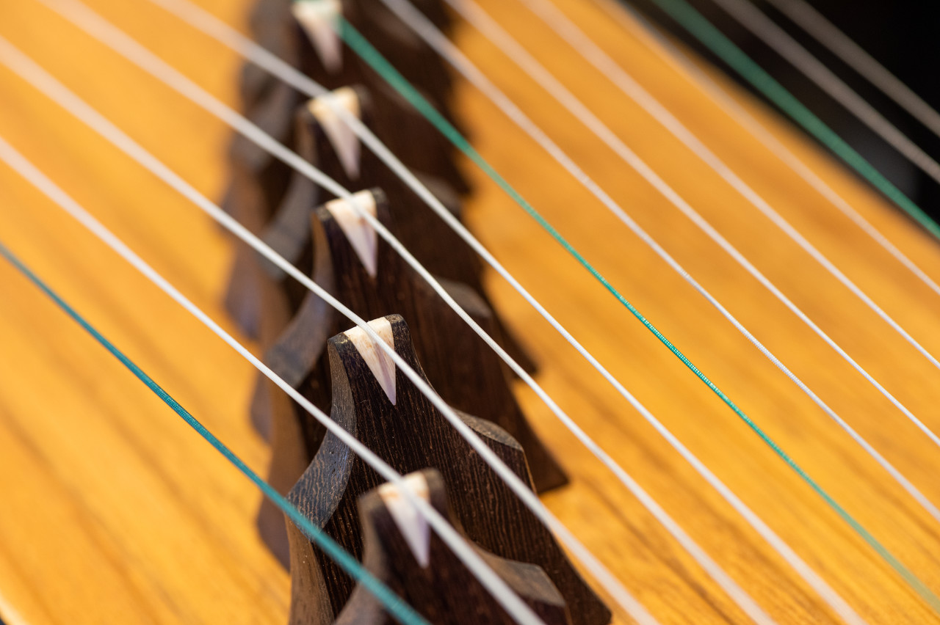
Let's Start with a Mystery!
How many strings does a Guzheng typically have?
A) 7
B) 16
C) 21
D) 25
THE ANSWER IS
C) 21
✨ Fun Fact
While modern Guzhengs almost always have 21 strings, ancient versions could have as few as 12 or as many as 26 strings. The 21-string configuration became standard in the 1960s for its rich range and versatility.
Notes:
Hello everyone! Welcome to our journey into the world of the Guzheng. Let's start with a fun question. Look at this beautiful instrument. Can you guess how many strings it typically has? Is it 7, 16, 21, or 25? Take a moment to think... The answer is C) 21! While modern Guzhengs are standardized to 21 strings for their versatility, ancient versions varied quite a bit. This is just the first glimpse into the fascinating history of this instrument.

Slide 2
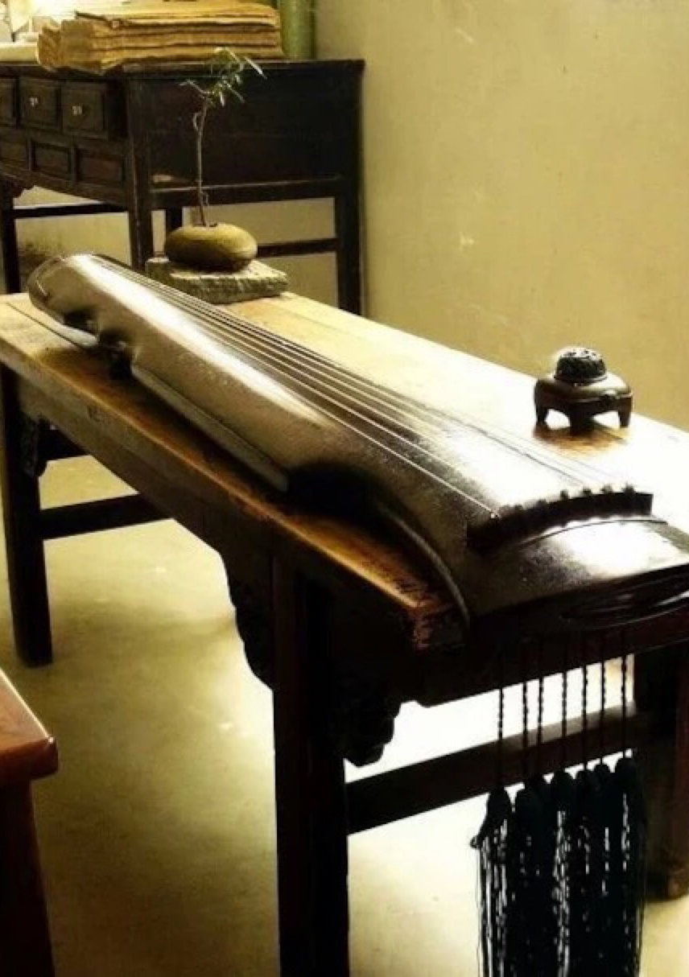
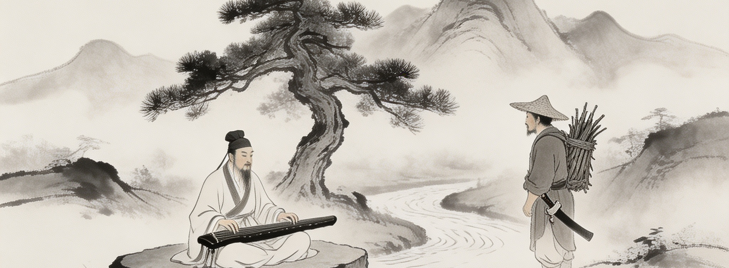
Guzheng vs. Guqin: A Tale of Two Instruments
Cousins with Distinct Personalities
Both are ancient Chinese plucked string instruments, but they have evolved into very different instruments with unique histories and characters.
Guqin (古琴): The "Father"
Over 3,000 years old, favored by scholars for self-cultivation and deep thinking.
Guzheng (古筝): The "People's"
Over 2,500 years old, with a populist origin and a vibrant presence in folk music.
🎵 Guzheng · 古筝
21 Strings | Movable Bridges | Bright & Resonant | For Performance
🎶 Guqin · 古琴
7 Strings | No Bridges | Deep & Quiet | For Self-Cultivation
Boya and Ziqi: A Soulful Bond
The famous legend of Boya (琴师) and Ziqi (樵夫) symbolizes the profound connection between music and understanding. After Ziqi's death, Boya broke his Guqin forever.
Notes:
Often confused, the Guzheng and Guqin are actually quite different. The Guqin, over 3,000 years old, was the instrument of scholars, known for its deep, introspective sound. The Guzheng, while also ancient, has a brighter sound and a more populist history. Their differences are clear in their strings, bridges, and cultural roles. And who can forget the touching story of Boya and Ziqi, a testament to the power of music to connect souls, forever linked to the Guqin.

Slide 3
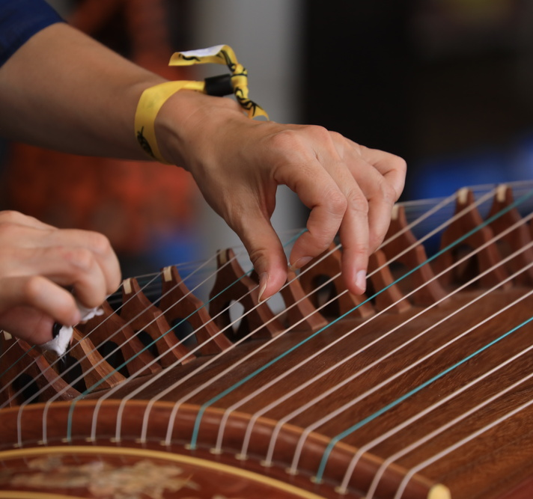
The Magic of Guzheng: Three Key Features
01. Movable Bridges (可移动的琴码)
Each string rests on a small, individual bridge. These bridges can be moved to precisely tune each note, giving the player incredible flexibility.
02. Expressive Left-Hand Techniques (丰富的左手技巧)
While the right hand plucks, the left hand presses the strings on the left side of the bridges. This allows for techniques like sliding and vibrating, creating a singing, vocal-like quality.
03. Bright and Resonant Tone (明亮清脆的音色)
The Guzheng produces a bright, clear, and projectable sound. Its 21 strings offer a wide range, suitable for both delicate melodies and powerful passages.
Notes:
So, what makes the Guzheng so special? Three key features stand out. First, the movable bridges allow for precise tuning and incredible flexibility. Second, the expressive left-hand techniques, like sliding and vibrating, give the music a voice-like quality. And third, its bright and resonant tone, supported by 21 strings, makes it incredibly versatile, capable of playing everything from traditional melodies to modern music.

Slide 4
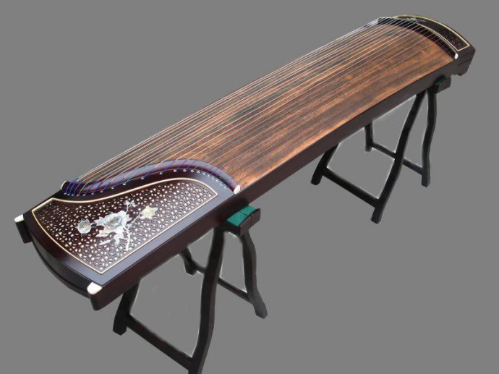
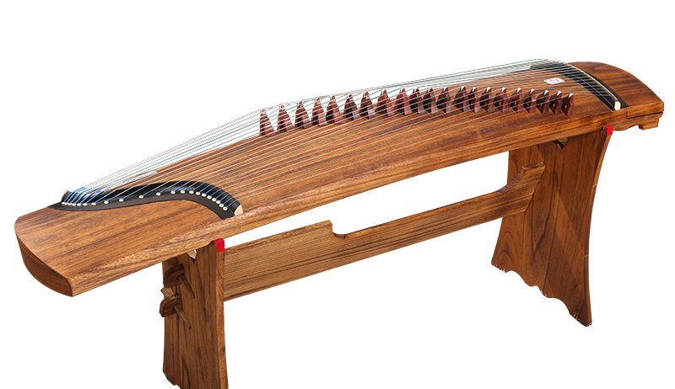
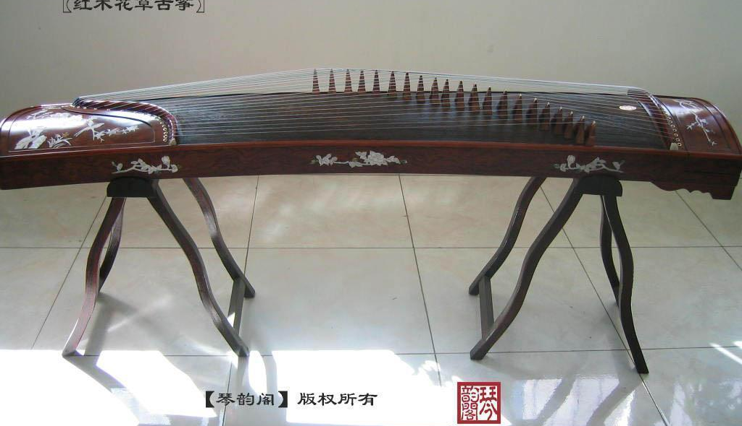
Anatomy of a Guzheng & The Price Game
Basic Components (Part 1)
• Soundboard (面板):Paulownia wood, key for resonance.
• Baseboard (底板):Hard woods (e.g., Rosewood) for structure.
• Bridges (琴码):Transfer string vibrations to the soundboard.
Basic Components (Part 2)
• Yueshan (岳山):Fixed end bridges anchoring all strings.
• Strings (琴弦):Steel core wrapped in nylon for tone.
• Sound Holes (出音孔):Strategically placed to project sound.
What Drives the Price?
1. Wood Grade & Age (The biggest factor)
2. Luthier's Craftsmanship
3. Artistic Decoration/Carving
4. Reputation of Brand/Maker
Plain / Unadorned Guzheng
Elaborately Carved Guzheng
Notes:
Let's take a closer look at what makes up a Guzheng. From the Paulownia wood soundboard to the movable bridges, every part plays a role. Now, for a quick game. Looking at these two instruments, which one do you think is more expensive? The plain one or the ornate one? The answer is almost always the ornate one. The quality of the wood, the craftsmanship, and the decoration are the main factors that drive up the price.

Slide 5
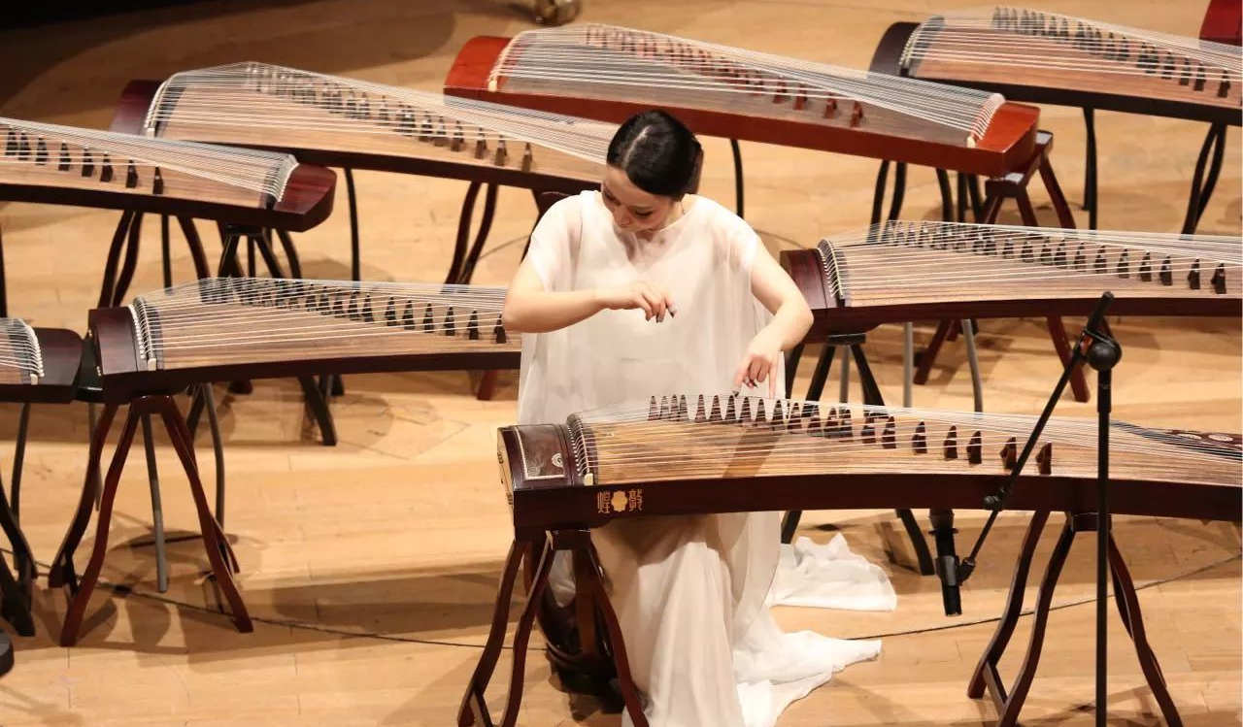
Tradition or Innovation?
Inheriting Traditions while Embracing Innovation (守正创新)
Why "守正" (Preserving the Core)
•Cultural Heritage:Preserve traditional repertoire and playing techniques.
•Foundation of Artistry:Mastery of tradition is the solid base for any meaningful innovation.
Why "创新" (Embracing Innovation)
Conclusion
The Guzheng's future is not about choosing one path over the other,
but walking both paths hand in hand.
•Relevance to Youth:Connect with younger generations through new music styles.
•Expanding Voice:Fusion with pop, jazz, electronic music, and cross-genre collaboration.
•Global Appreciation:Adapt to international audiences to make the Guzheng accessible worldwide.
Notes:
Finally, we come to a crucial question: should the Guzheng stick to tradition or embrace innovation? The answer is both. We must "守正" - preserve its rich cultural heritage and traditional techniques, as this is the foundation of its artistry. But we must also "创新" - embrace new music, new collaborations, and new audiences to ensure it remains relevant and vibrant. The Guzheng's future is a harmonious journey of honoring the past while fearlessly exploring the future.

