Slide 1
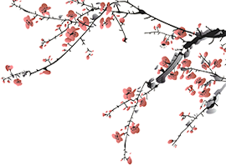



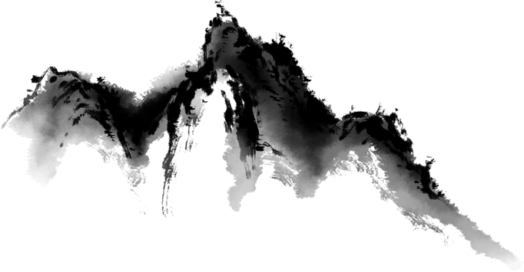
Mahjong：
An Ancient Chinese Card Play
姜自强
2025.2.28

Slide 2
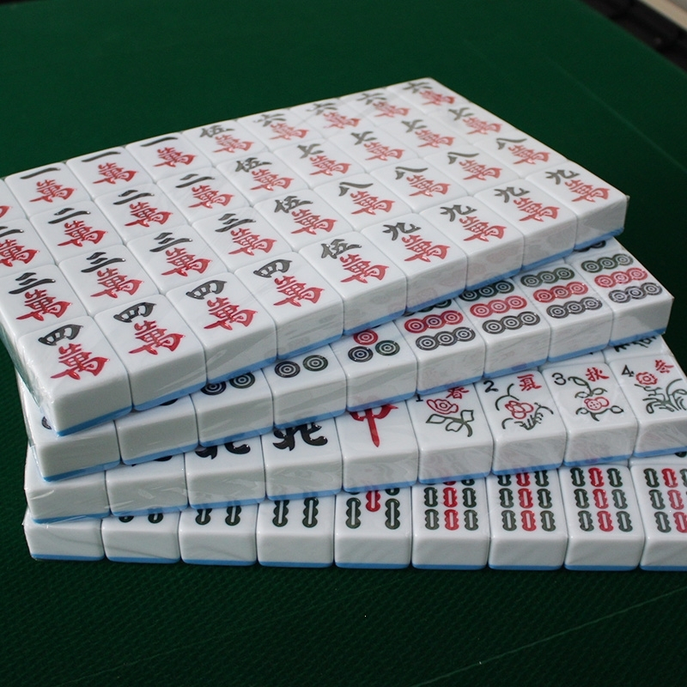

Slide 3
words and expressions
英文 | 中文 | 英文 | 中文
Ye Zi Xi | 叶子戏 | mahjong | 麻将
tile | 瓦片；麻将牌 | wind tile | 风牌[麻将的四个方向牌：东南西北]
suit | 花色 | draw tile | 摸牌
dot | 筒子 | discard tile | 打牌
bamboo | 条子 | claim pairs | 碰牌
character | 万子 | decalre pungs | 杠牌

Slide 4
Content
contents
01
The Origin and History of Mahjong
04
The Modern Development and International Influence of Mahjong
02
The Composition and Rules of Mahjong
05
Future Outlook for Mahjong
03
The Cultural Connotations of Mahjong

Slide 5
01
The Origin and History of Mahjong

Slide 6
Evolution of Mahjong from Ancient Games
Part 01
Part 02
Part 03
Origins in Ye Zi Xi
Development in Ming and Qing Dynasties
Modern Popularity and Cultural Shifts
Ye Zi Xi appeared in the Song Dynasty as a paper card game. It laid the foundation for mahjong’s development. Over centuries, mahjong evolved from simple paper cards to complicated tile sets, reflecting cultural and social changes.
During the Ming and Qing Dynasties, mahjong tiles were made of bamboo or bone, with simple patterns.The game became more complex and popular, spreading across social classes.
In modern China, mahjong was restricted after the founding of the People's Republic but regained popularity with reform and opening up. It became a symbol of leisure and social interaction, reflecting changing societal values.

Slide 7
02
The Composition and Rules of Mahjong

Slide 8
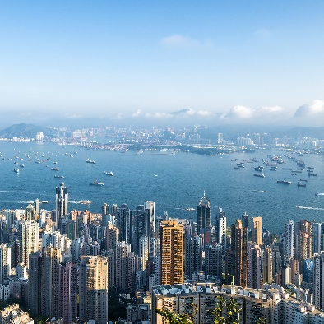
Structure of a Mahjong Set
Suits and Tiles
Basic Gameplay Mechanics
Strategies and Skills
A standard mahjong set includes 136 tiles divided into three suits: dots, bamboos, and characters, each with numbers 1- 9. Additional tiles include winds (east, south, west, north) and dragons (red, green, white), adding complexity.
Players draw and discard tiles to form combinations like sequences, pungs, and pairs. Winning requires strategic thinking and understanding of opponents' moves.
Players use strategies like "waiting for a tile" to increase winning chances. Resect is necessary, reflecting our cultural values.

Slide 9
03
The Cultural Connotations of Mahjong

Slide 10
Philosophical Foundations
Yin and Yang Balance
Taoist Ideals
Social and Ethical Dimensions
The game’s design reflects yin and yang, with tiles representing harmony between heaven, earth, and humanity. Players strive for balance and harmony in their tile combinations.
The pursuit of natural harmony is central to mahjong, corresponding with Taoist principles. Players adapt and combine tiles to achieve best outcomes.
Mahjong fosters social interaction and equality, regardless of age, gender, or occupation. Norms like respecting opponents and avoiding cheating reflect traditional values.
01
02
03

Slide 11
04
The Modern Development and International Influence of Mahjong

Slide 12

单击添加章节标题

Slide 13
Diversification of Mahjong Forms
National and international competitions like the World Mahjong Championship promote standardization and professionalism. These events attract experts and elevate mahjong’s status as a competitive sport.
Competitive Mahjong
1
2
3
Emergence of Online Mahjong
Global Spread
Online mahjong games offer convenience and variety, attracting global players. They provide diverse gameplay options and high- quality graphics.
Mahjong’s popularity has spread to Japan, Europe, and the Americas, becoming a cultural bridge. It enhances cultural exchange and fosters international friendships.

Slide 14
05
Future Outlook for Mahjong

Slide 15

Technological Advancements
Integration of VR and AR
Virtual and augmented reality technologies will create immersive mahjong experiences. Players can enjoy realistic game environments and enhanced interactions.
Global Cultural Exchange
Increased international competitions and cultural events will further promote mahjong globally.It will serve as a vital medium for spreading Chinese culture.
Enduring Cultural Legacy
Mahjong will continue to be a symbol of Chinese culture, blending entertainment, social interaction, and cultural heritage.Its unique charm ensures its lasting impact and relevance in the modern world.

Slide 16
Thank you

