Slide 1
Pre-modern Chinese Literature through the end of the Ming Dynasty
Highlights

Slide 2
詩
P
O
E
T
R
Y

Slide 3
☆Book of Songs ☆
folksongs
ballads
court songs
sacrificial songs
http://www.chinaknowledge.de/Literature/Classics/shijing.html#xiaoya
(c. 600 B.C.)

Slide 4
２．小雅２．１．鹿鳴之什２．１．１．鹿鳴（１６１）
呦呦鹿鳴，食野之苹。我有嘉賓，鼓瑟吹笙。
吹笙鼓簧，承筐是將。人之好我，示我周行。
呦呦鹿鳴，食野之蒿。我有嘉賓，德音孔昭。
視民不恌，君子是則是傚。我有旨酒，嘉賓式燕以敖。
呦呦鹿鳴，食野之芩。我有嘉賓，鼓瑟鼓琴。
鼓瑟鼓琴，和樂且湛。我有旨酒，以燕樂嘉賓之心。
The Minor Odes, 1st Decade, The deer cry
Hoo, hoo, cry the deer nibbling the black southernwood in the fields. I have a lucky guest. Let me play my zither, blow my reed-organ.
Blow my reed-organ, trill their tongues, take up the baskets of offerings. Here is a man that loves me and will teach me the ways of Zhou.
Hoo, hoo, cry the deer nibbling the white southernwood of the fields. I have a lucky guest, whose fair fame is very bright.
He sees to it that the common people do not waver, of all gentlemen he is the pattern and example. I have good wine; let my lucky guest now feast and play.
Hoo, hoo, cry the deer nibbling the wild garlic of the fields. I have a lucky guest. I play my zithers, small and big.
Play my zithers, small and big. Let us make music together, let us be merry, for I have good wine to comfort and delight the heart of a lucky guest.

Slide 5
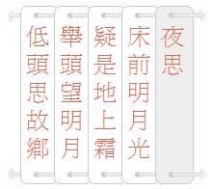
☆Tang Dynasty☆
http://
The 300 Tang Poems
Lu Zhaolin
Luo Binwang
Yang Jiong
Wang Bo
Du Fu
Li Bai →
http://youtu.be/y9T_9jrPepA

Slide 6
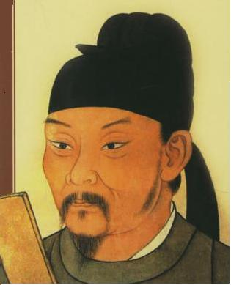
Du Fu
http://youtu.be/I8cxaCVRrHQ ”杜甫登高”

Slide 7
☆Ming Dynasty☆
Romance of the 3 kingdoms
Water Margin
Journey to the West
Golden Lotus

Slide 8
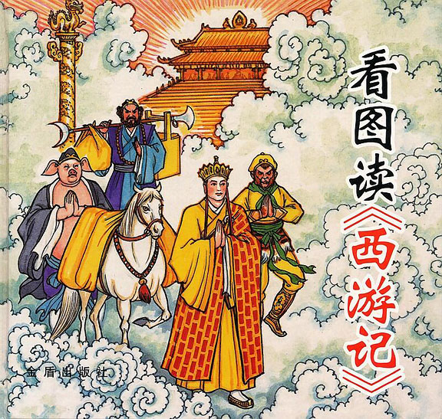
Journey to the West
http://youtu.be/C7iCAnDlwtM

Slide 9
Summary
This book can be divided into three sections.
The first section describes Sun Wu Kong's origins. He is born from a rock on the summit of Flower Fruit Mountain and goes on to become the king of the monkeys. 300 years later, he learns the way of immortality and various other powerful magical skills from an immortal far away from his home. When he returns, he trains his monkeys into a lethal army, takes a powerful weapon from the Eastern Dragon King by force, and cancels his and all monkeys' names from the Book of Life and Death, releasing them from the endless circle of death and rebirth. This triggers a series of events, which includes Wu Kong defeating the Heavenly warriors sent to capture him, getting a post in Heaven only to leave it in anger when he finds out it has no rank whatsoever, returning yet again as The Great Sage Equal of Heaven, and lastly, committing a series of crimes. He steals quite a variety of things, including the Heavenly Empress's peaches, the dishes prepared for an important banquet, all the holy wine, and the pills of immortality created by Lao Tzu. This results in a terrible war between Heaven and Flower Fruit Mountain. At the end of the war, Wu Kong is captured and punished. As no weapon or lighting can harm him, he is burnt in Lao Tzu's furnace for 49 days, which only manages to transform his eyes into Golden Fiery Eyes and make him really angry. So when the furnace is opened, he leaps out of it and proceeds to wreck total havoc in Heaven, fighting thousands of Heavenly soldiers by himself. But the Heavenly Emperor asks the Buddha for help, who crushes Wu Kong underneath the Mountain of Five Elements. He is trapped there for 500 years. Thus ends the first section.
The second section is about Tan San Zang's origins. His father is killed and impersonated, and his mother taken away forcibly by thieves. He himself is abandoned to float down a river by his mother to prevent him from being killed by the thieves. Luckily, he is found by the head monk of a monastery. Eventually, he manages to save his mother and revenge his father. Happily, his father is resurrected by a dragon king. This section also describes the Emperor of Tang, who fails to save another dragon king, resulting in his death. He manages to return to life, and holds a religious ceremony, 'Shui Lu Da Hui', for the dead. The now grown-up San Zang is chosen to conduct this ceremony. The Goddess Guanyin and her disciple disguise themselves as monks and tell him to go to the Western Heaven to fetch the holy scriptures. After that, they reveal their true forms and leave. Thus Tang San Zang starts on his pilgrimage to the Western Heavens.
The third section is the main section of the book. Tang San Zang rescues Sun Wu Kong from the mountain. They meet Zhu Ba Jie and Sha Wu Jing later who become San Zang's disciples. Throughout the journey, Tan San Zang is regularly attacked and kidnapped by demons as they want to gain immortality by eating his flesh. This section describes the difficulties they meet, the demons they fight, and all the adventures they have on the way. Sun Wu Kong is the strongest of the group and the main fighting power, but he faces conflicts with his master a few times because of his tendency to kill. Zhu Ba Jie is significantly weaker, and he is also lazy, greedy and lustful, though he is a great help when fighting demons in rivers or seas. He and Wu Kong are constantly quarrelling and Wu Kong likes to play tricks on him. Sha Wu Jing is the weakest one, but he is hardworking and patient. He also does his best to help his elder brothers.
The fourth and last section is the shortest. They finally reach the Western Heavens and bring back the scriptures to China. At the end of the book, Tang San Zang and his disciples attain Buddhahood.

Slide 10
Resources
http://www.chinese-poems.com/
http://web.cn.edu/kwheeler/chinese_poetry.html
http://www.chinaknowledge.de/Literature/Classics/shijing.html#xiaoya
http://www.foreignercn.com/index.php?option=com_content&view=article&id=2890:tang-poetry-&catid=1:history-and-culture&Itemid=114
http://www.vbtutor.net/xiyouji/summary.htm

