Slide 1
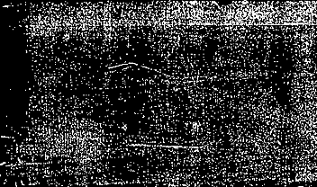


The Origin of
Machine Translation

Slide 2
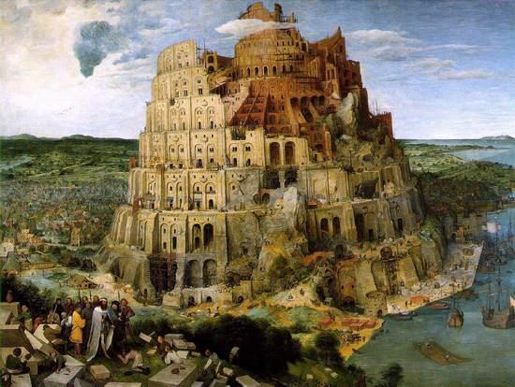

A Legend of Babel Tower
According to the Bible, the tower is located in Shinar. At that time, people made bricks, burn them thoroughly. They had bricks for stone, and bitumen for mortar. They built this tower with its top in heaven and want to make a name for themselves.
The Lord saw the city and the tower made by mortals. And the Lord said, “Look, they are one people, and they have all one language; this is only the beginning of what will do; nothing that they propose to do will be impossible for them. Come, let us go down, and confuse their language there, so that they will not understand one another's speech”.
So the Lord scattered them abroad from there over the face of all the earth, and they left off building the city. Therefore it was called Babel.
Notes:
根据圣经旧约《创世纪》中的记载，大洪水劫后，诺亚的子孙们在巴比伦附近的示拿地定居。说着同样语言的人类联合起来兴建巴别塔，这让上帝深为他们的虚荣和傲慢而震怒。于是他悄悄地离开天国来到人间，变乱了人类的语言，无法交流的人们作鸟兽散，巴别塔的伟念也就轰然倒塌。

Slide 3
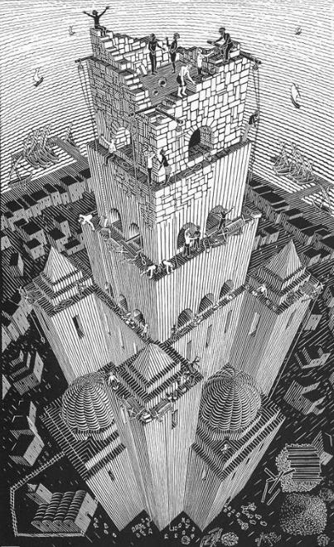
A Legend of Babel Tower
This is a legend in Bible that explains the origin of different human languages.
However, the emergence of a technology, which broke the legend of Babel Tower, made the communication between people around the world no longer an obstacle. This technology is “Machine Translation”.
Notes:
The description of the birth of language in the Bible is full of damnation. Although this is not the case at all, the differences of language do add many barriers to human communication.
Is the great tower of Babel destined to exist only in fantasy? Sadly, the answer to this question is still "yes". However, after the birth of the world's first computer ENIAC in 1946, scientists put forward the idea of using computers to realize automatic translation between different languages.

Slide 4
CONTENTS
01.
Introduction to Machine Translation
02.
The Origin Idea and Emergence
03.
The Early Practice
04.
Setbacks and Development

Slide 5
Introduction To Machine Translation
Machine Translation refers to the process of using a machine (computer) to automatically translate a natural language (source language) sentence into another language (target language) sentence.
  The natural language here refers to human language used daily (such as English, Chinese, Japanese, etc.), which is different from languages created by humans for specific purposes (such as computer programming languages).
      E.g.
    How are you? 怎么是你？
    How old are you? 怎么老是你？

Slide 6
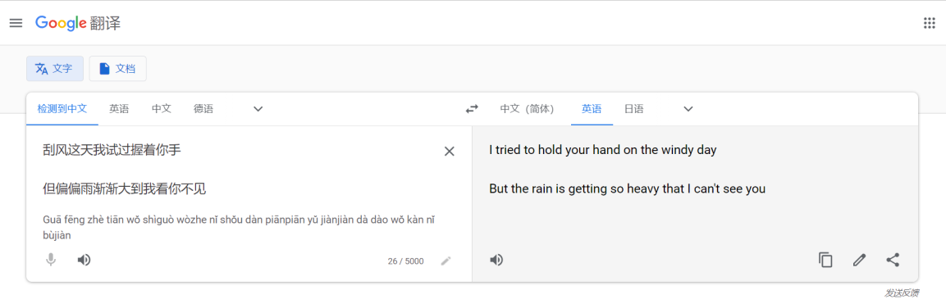
If we want to translate the lyrics “ 刮风这天我试过握着你手, 但偏偏雨渐渐大到我看你不见” into English, then we can open “Google Translation” and input this sentence in Chinese. Then we can know the corresponding English is “I tried to hold your hand on the windy day, but the rain is getting so heavy that I can't see you”.

Slide 7


Also, we can translate the text in picture. Through OCR technology, the text in picture can be recognized, and then redisplayed on the picture after the translation.

Slide 8
The Origin Idea and Emergence
Actually, someone proposed the idea of using mechanical devices for language translation as early as ancient Greek era.
In the 17th century, Descartes and Leibniz proposed the idea of using machine dictionaries to implement language translation.
In the middle of the 17th century, the "Universal Language" movement proposed to design an intermediary language as a universal language without ambiguity. It attempts to classify and encode all concepts and entities in the world to realize their correspondence between various languages.
In 1903, German scholar Rieger proposed a number grammar. This grammar, with the aid of a dictionary, can translate one language into many other languages by machinery. And the term “Machine Translation” is proposed for the first time.

Slide 9
At the beginning of the 1930s, French scientist Artsouni put forward the idea of using a machine for translation, and produced a machine called a "mechanical brain" in 1933, which obtained a patent for a "translator". The storage device of this kind of mechanical brain can hold thousands of characters, and the data can be retrieved through the wide paper tape behind the keyboard. However, due to the outbreak of World War II, Artsouni’s mechanical brain could not be installed and used.
In 1933, the Soviet inventor Peter Troyanskii designed a machine that translates one language into another, and registered his invention on September 5 of the same year. In May 1941, this experimental translator was already operational. In 1948, he planned to develop an "electro-mechanical machine" on this basis. However, due to the indifferent reaction of Soviet scientists and linguists at the time, Troyansky's translator was not supported and ended in failure.

Slide 10
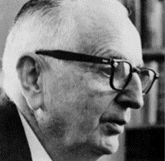
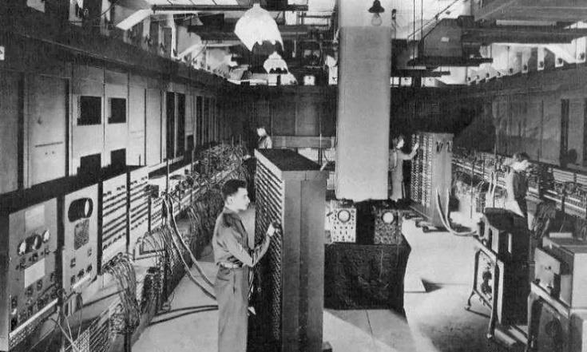
In 1946, the first electronic computer, ENIAC(electronic numerical integrator and computer), was born.
In 1947, American scientist Warren Weaver, a pioneer of information theory, put forward the idea of using computer for automatic language translation in the letter which is written to Norbert Wiener.
In 1949, W. Weaver published the famous memorandum called Translation, formally proposing the idea of Machine Translation which laying the foundation for machine translation research in the United States and the world.

Slide 11
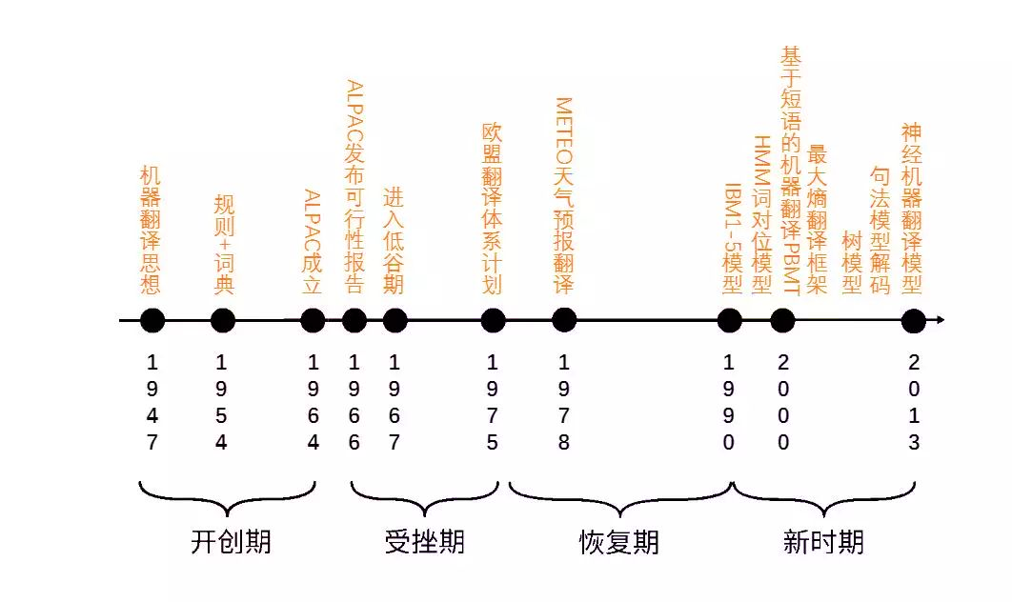
Notes:
This is the development after the born of computer. It seems that the machine translation develops only with the computer technology and programmers, but it’s not all true. Just pay attention to the rule and dictionary. In fact, in a long period of time the machine translation is based on this model, that is to say, is closely linked with linguists.

Slide 12
The Early Practice
Three procedures to achieve machine translation
1. Understanding
2. Transforming
3. Generating
Notes:
So in this early practice of machine translation, how it links with linguistics and linguists. Normally, we consider machine translation
Do you feel a little familiar?
In fact

Slide 13
Chomsky's transformational generative linguistics. The traditional rule-based machine translation is studied on this basis. In the process of translation, the language is first transformed into symbols or mathematical expressions in accordance with grammatical rules by logical thinking, and then its source language and target language are transformed into parameters and variables understandable by the computer, so that the computer can complete the translation instructions.
Montague semantics. Richard Montague made further efforts to achieve more accurate conversion from natural language to target language. In universal grammar, he proposed to establish (in an ideal state) an unambiguous connotative logic artificial language system IL. In rule-based machine translation, IL is used as an intermediate language to overcome the contradiction between the accuracy of denotative logic and the connotative complexity of natural language. After that, he established a complete IL semantics on the basis of model theory. The "intermediary" method has become the mainstream method of machine translation since its implementation, especially in multilingual translation.
Halliday's systemic functional linguistics. The systemic functional language school represented by Halliday holds that semantics is affected by context and text translation cannot be separated from context. It also puts forward five basic units of language, namely "sentence", "clause", "phrase", "word" and "morpheme". Based on this theory, an example is given to demonstrate the main process of machine translation, that is, segmentation, translation layer by layer, and finally correct the lexical and grammatical errors of the translation according to the internal structure of the target language.

Slide 14
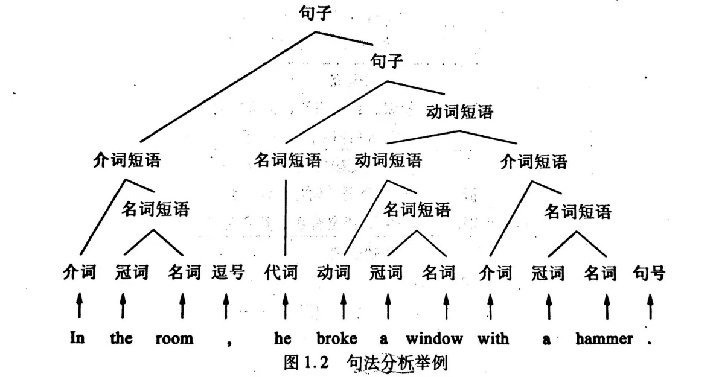
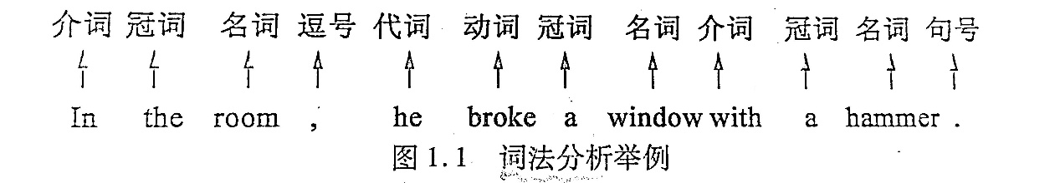
  1. How to understand?
“In the room, he broke a window with a hammer.”
  →Lexical, syntactic and semantic analysis (词法、句法、语义分析)
Notes:
划分句子成分——主谓宾定状补等 How？
谓语通常由动词短语构成，主语和宾语通常是由名词短语构成，补语和状语通常是由介词短语构成
识别句子的各类短语 How？
可以通过词性 How？
冠词加上名词构成一个名词短语，介词加上名词构成一个介词短语

Slide 15
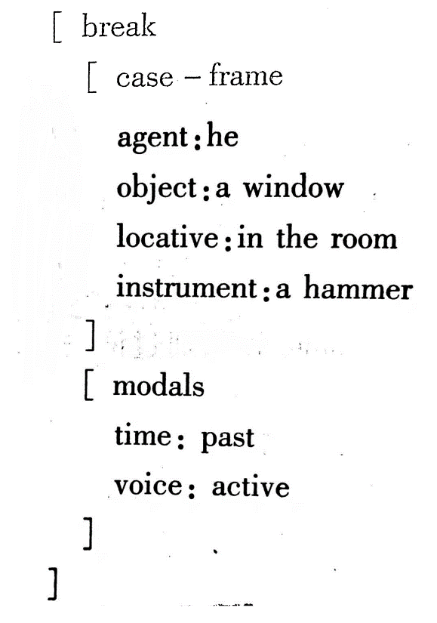
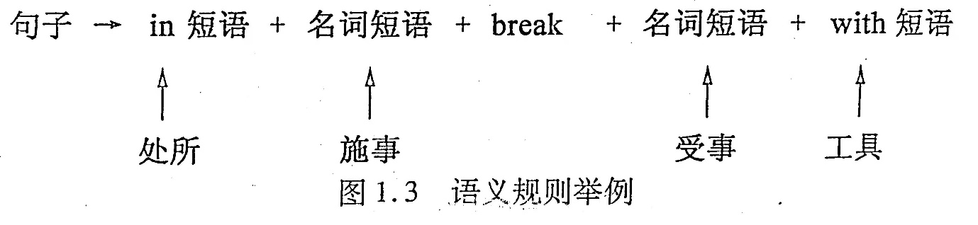
“In the room, he broke a window with a hammer.”

Slide 16
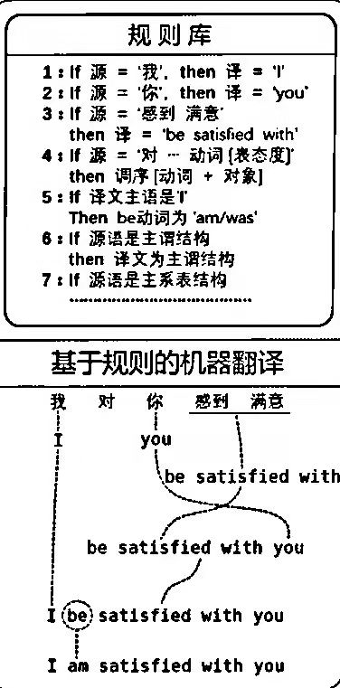
  2. Transforming
  3. Generating

Slide 17
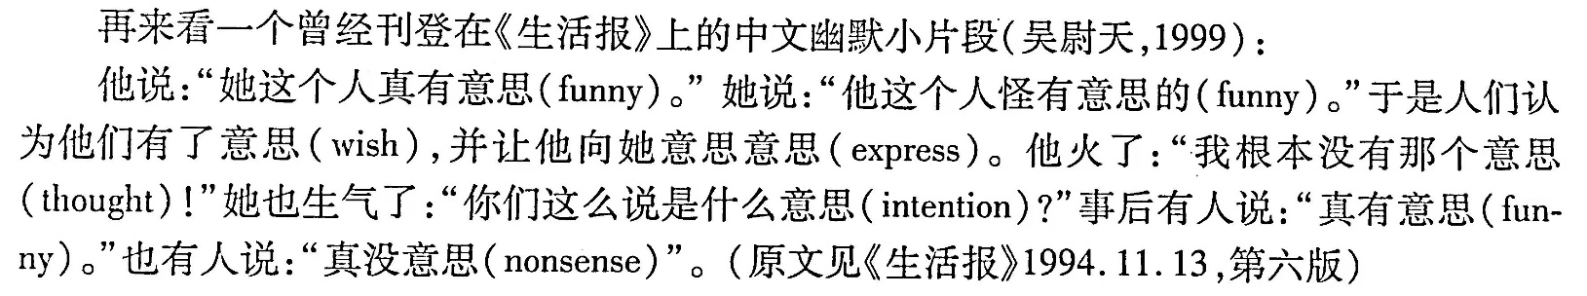
The Setbacks and Development
Misunderstandings
  -in words
“打电话”、“打今天起”、“一打铅笔”
  -in sentence structure
“Put the block in the box on the table”
  -in the meaning

Slide 18
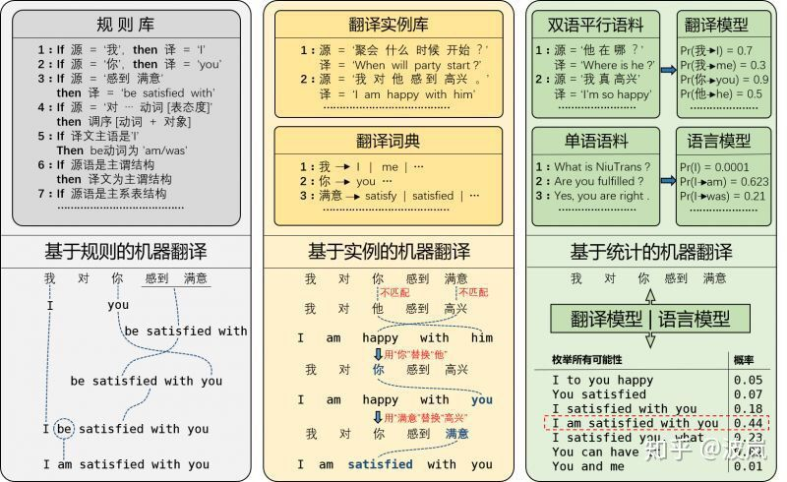

Slide 19
Summary
Machine translation, also known as automatic translation, is a process of using computers to transform one natural language into another.
Its research is based on linguistics, mathematics and computer science.
Linguists provide dictionaries and grammatical rules suitable for computer processing, mathematicians formalize and code the materials provided by linguists, and computer scientists provide software means and hardware equipment for machine translation and program design.

Slide 20
Reference
[1] 陈鄞. 自然语言处理基本理论和方法 [M]. 哈尔滨: 哈尔滨工业大学出版社, 2017.
[2] 高梦璐. 语言学知识在机器翻译发展领域的应用 [J]. 校园英语 · 上旬, 2018.
[3] 李沐, 刘树杰, 张冬冬等. 机器翻译 [M]. 北京: 高等教育出版社, 2018.
[4] 吴军. 数学之美 [M]. 北京: 人民邮电出版社, 2014.
[5] https://zhuanlan.zhihu.com/p/400847203
[6] https://zhuanlan.zhihu.com/p/84867190

Slide 21

Thanks!

