Slide 1
Traditional Cuisine:
Breakfast Culture of Wuhan
----by Wei Jingting
Let’s“guo zao”.

Slide 2
Contents
What is Wuhan?
What are the breakfasts of Wuhan?
How does the breakfast culture of Wuhan come into being?

Slide 3
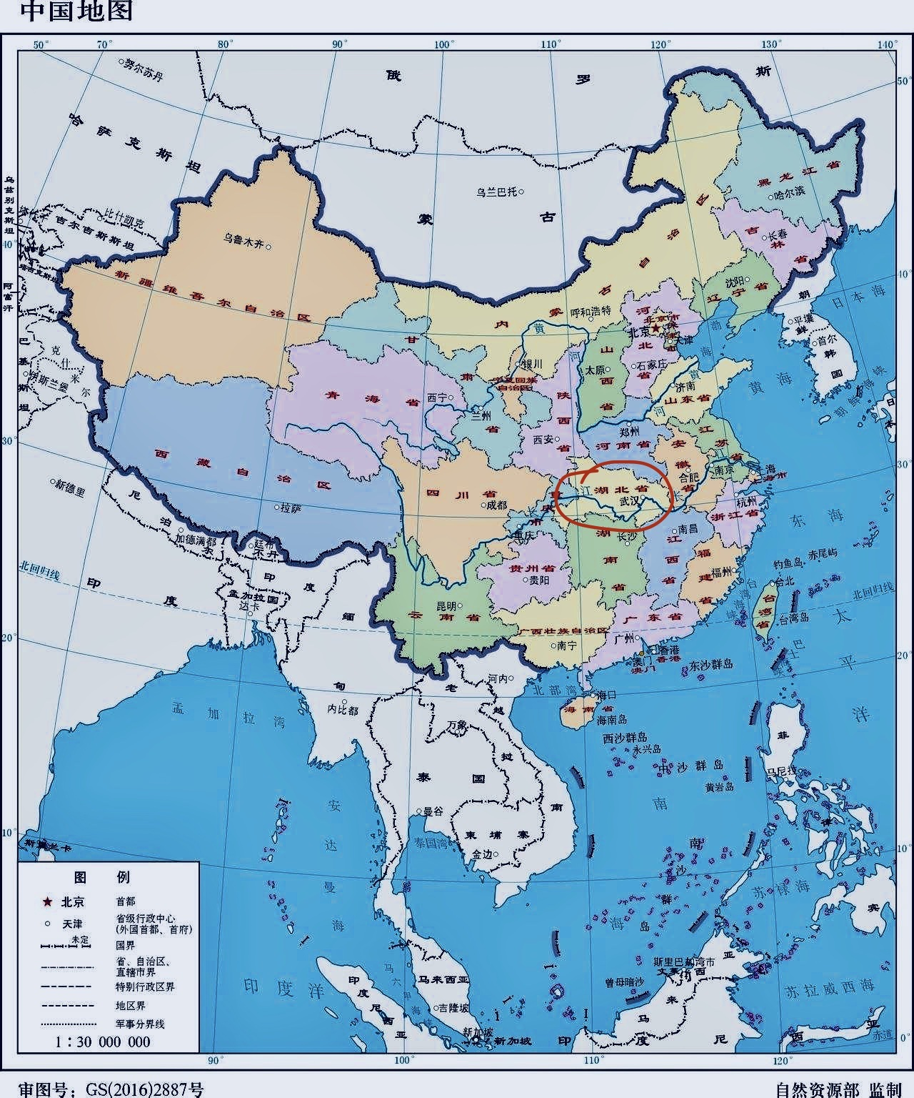
What is Wuhan？
Geography
History
Wuhan is the capital of Hubei province, the only sub-provincial city in six central provinces, a mega-city, the central city of central China, an important industrial base, a scientific and educational base and a comprehensive transportation hub.
Wuhan is located in the eastern part of Hubei Province,which is in the center part of China ,at the confluence of the Yangtze River and the Han River, with a low centre and high north-south terrain, and a vast alluvial plain in the centre. Wuhan has a subtropical monsoon climate with abundant rainfall, heat, cold winters and hot summers. The city is crisscrossed by rivers and lakes.
The Wuhan region has a long geographical history. Archaeological discoveries date back to the early and middle Neolithic period, 8,000-6,000 years ago, and the local establishment of Wuhan began in the Western Han Dynasty, as Sha Xian County, Jiangxia County

Slide 4
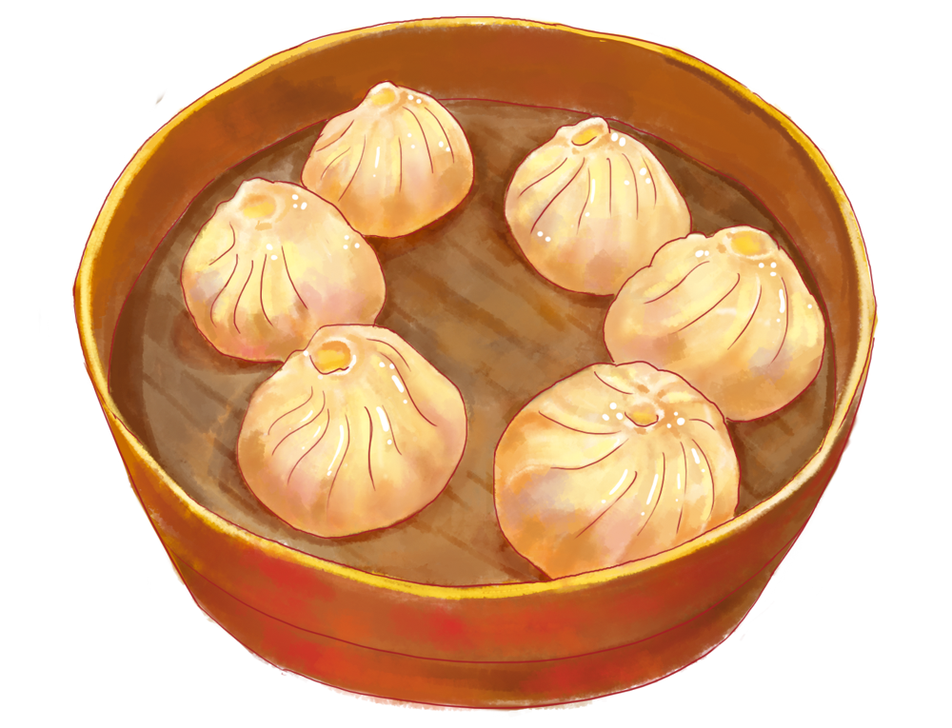
What are the breakfasts of Wuhan?
There are many famous snacks in Wuhan, among which hot dry noodles
and bean pies(豆皮) are the first choices of Wuhan people. In addition, bean noodles（豆粿）and fried rice buns（面窝） are also very popular.

Slide 5
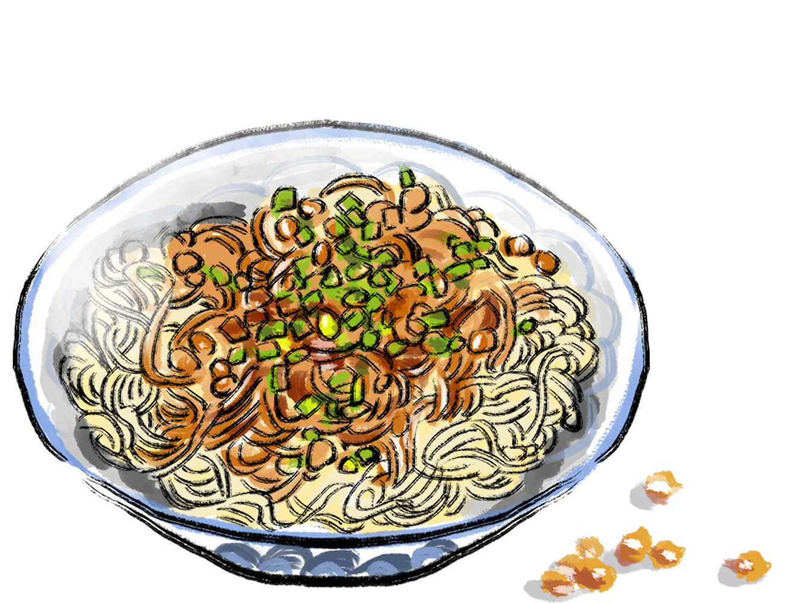
Hot dry noodles
Wuhan hot dry noodles are one of the traditional snacks of the Wuhan area. It is said that in the early 1930s, a man called Li Bao sold cold noodles and noodles in soup in the area of Guandi Temple in Hankow.
One summer evening, Li Bao had a lot of noodles left to sell, he accidentally spilled sesame oil from the oil pot on the noodles. On a whim, he mixed the sesame oil into the noodles and then fanned the noodles to cool them. The next morning, he put the noodles mixed with sesame oil in boiling water, then drained the water into a bowl and added sesame sauce and other sauce to sell the noodles. After that , Li Bao was asked what kind of noodles he was selling and he blurted out that they were "hot dry noodles".

Slide 6
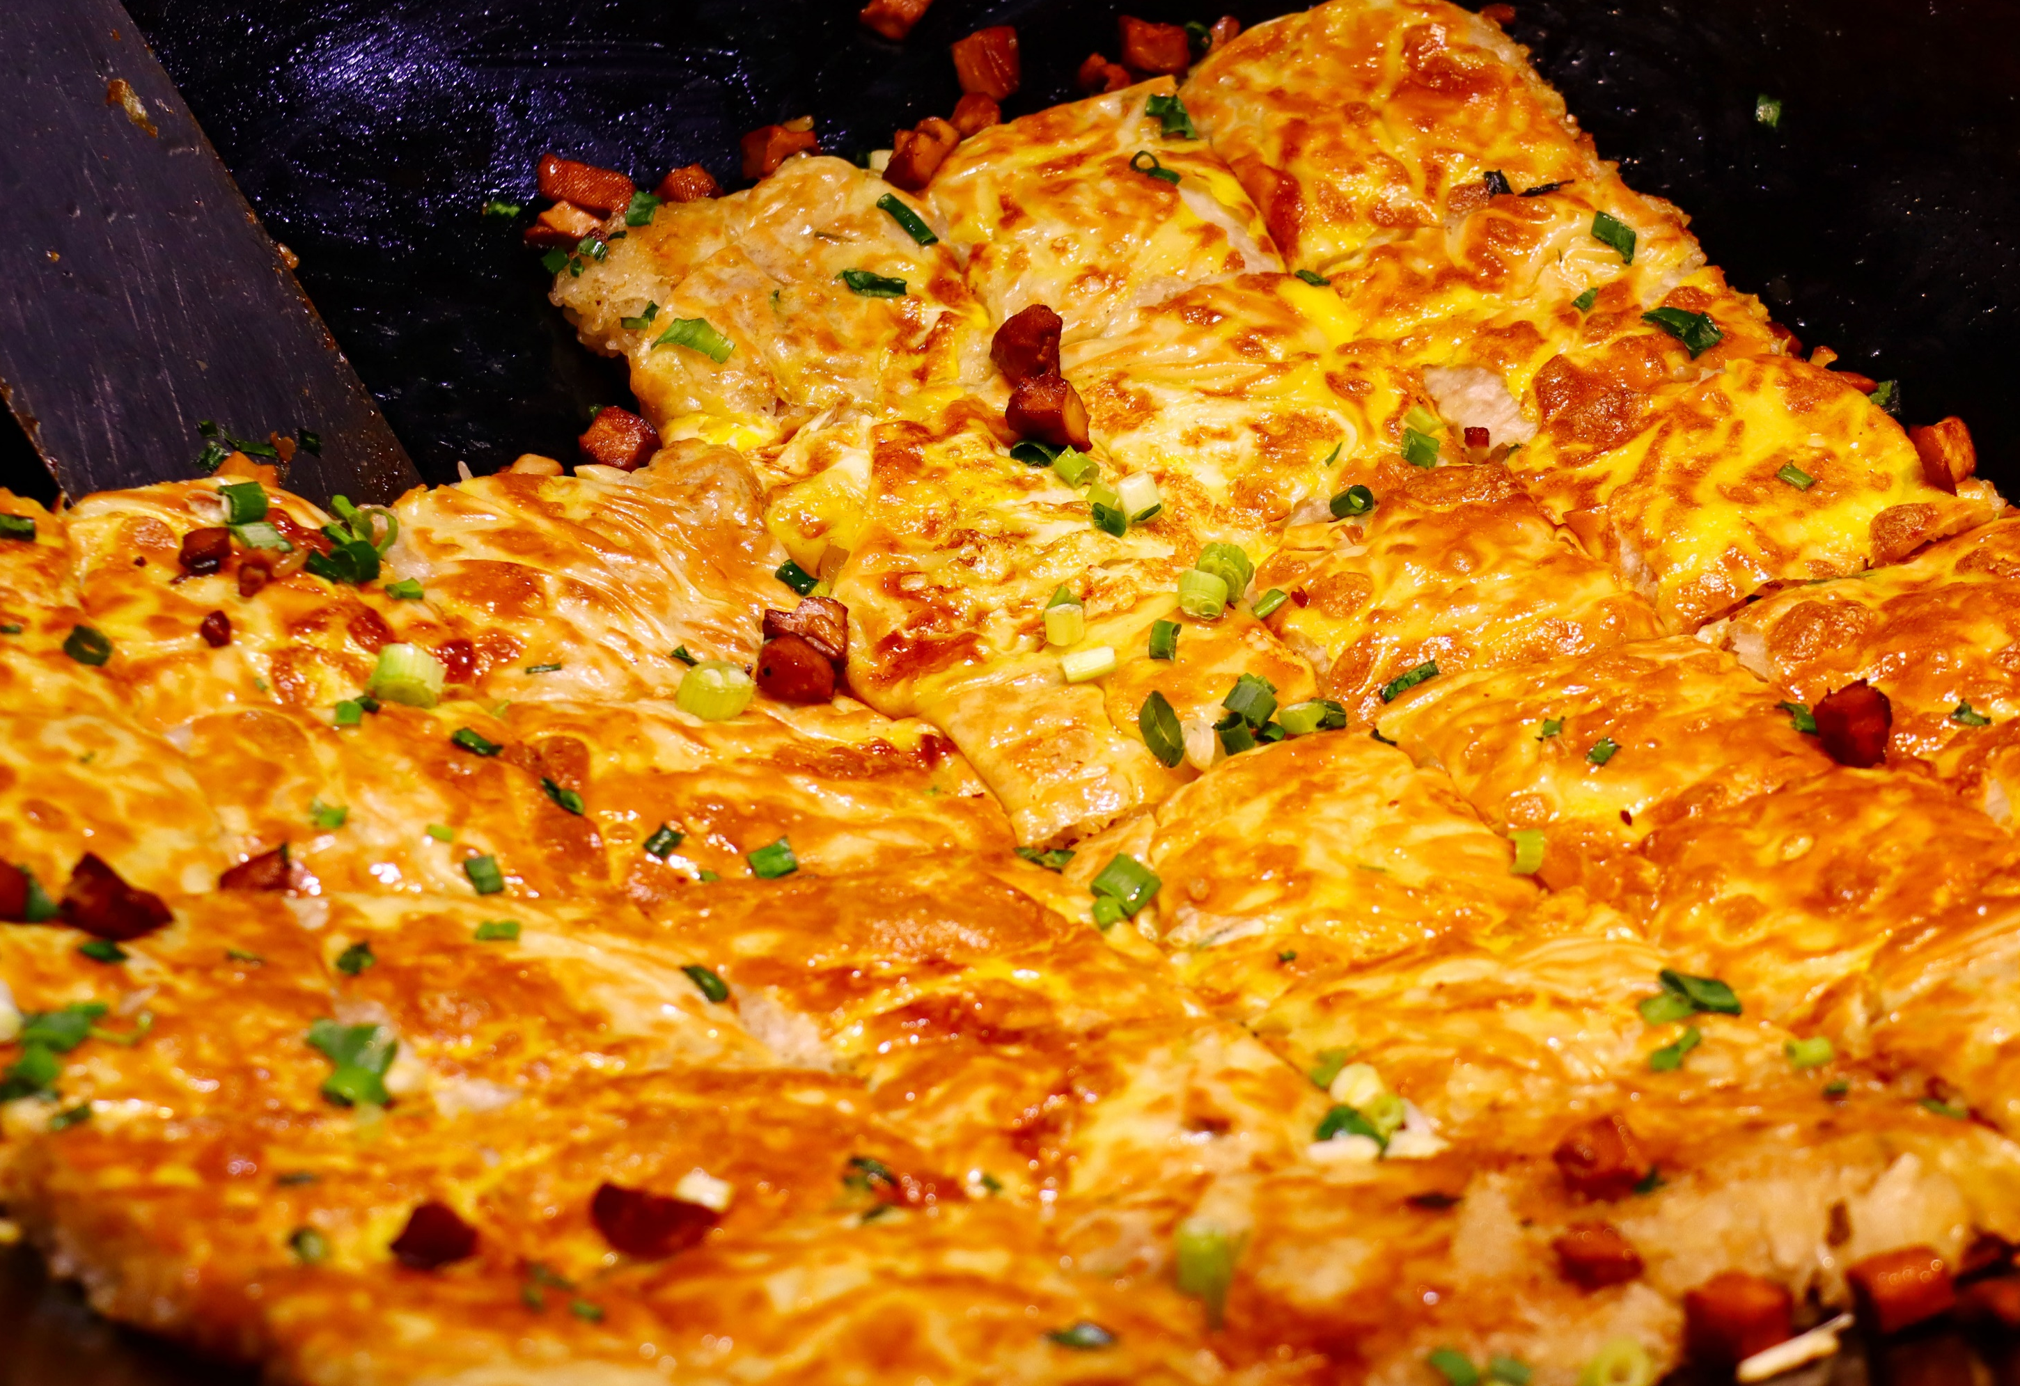
Bean pies(豆皮)
The bean pies are a snack of Huangpi. The preparation method is to mix beans and rice to grind, spread them into thin skins in the pot, and wrap them with cooked rice, diced meat and other fillings, and fry them with oil. The bean skin is golden ,shiny and crispy.

Slide 7
Bean noodles are a traditional food of farmers in the middle and lower reaches of the Yangtze River, mainly in southeastern Hubei, southwestern Anhui and Jiangxi.
Bean noodles（豆粿）

Slide 8
Fried rice buns（面窝）
Wuhan people love to eat fried rice buns for breakfast. In the streets and alleys of Wuhan, you can see a steaming frying pan with golden buds rolling around inside, emitting a tempting aroma.

Slide 9
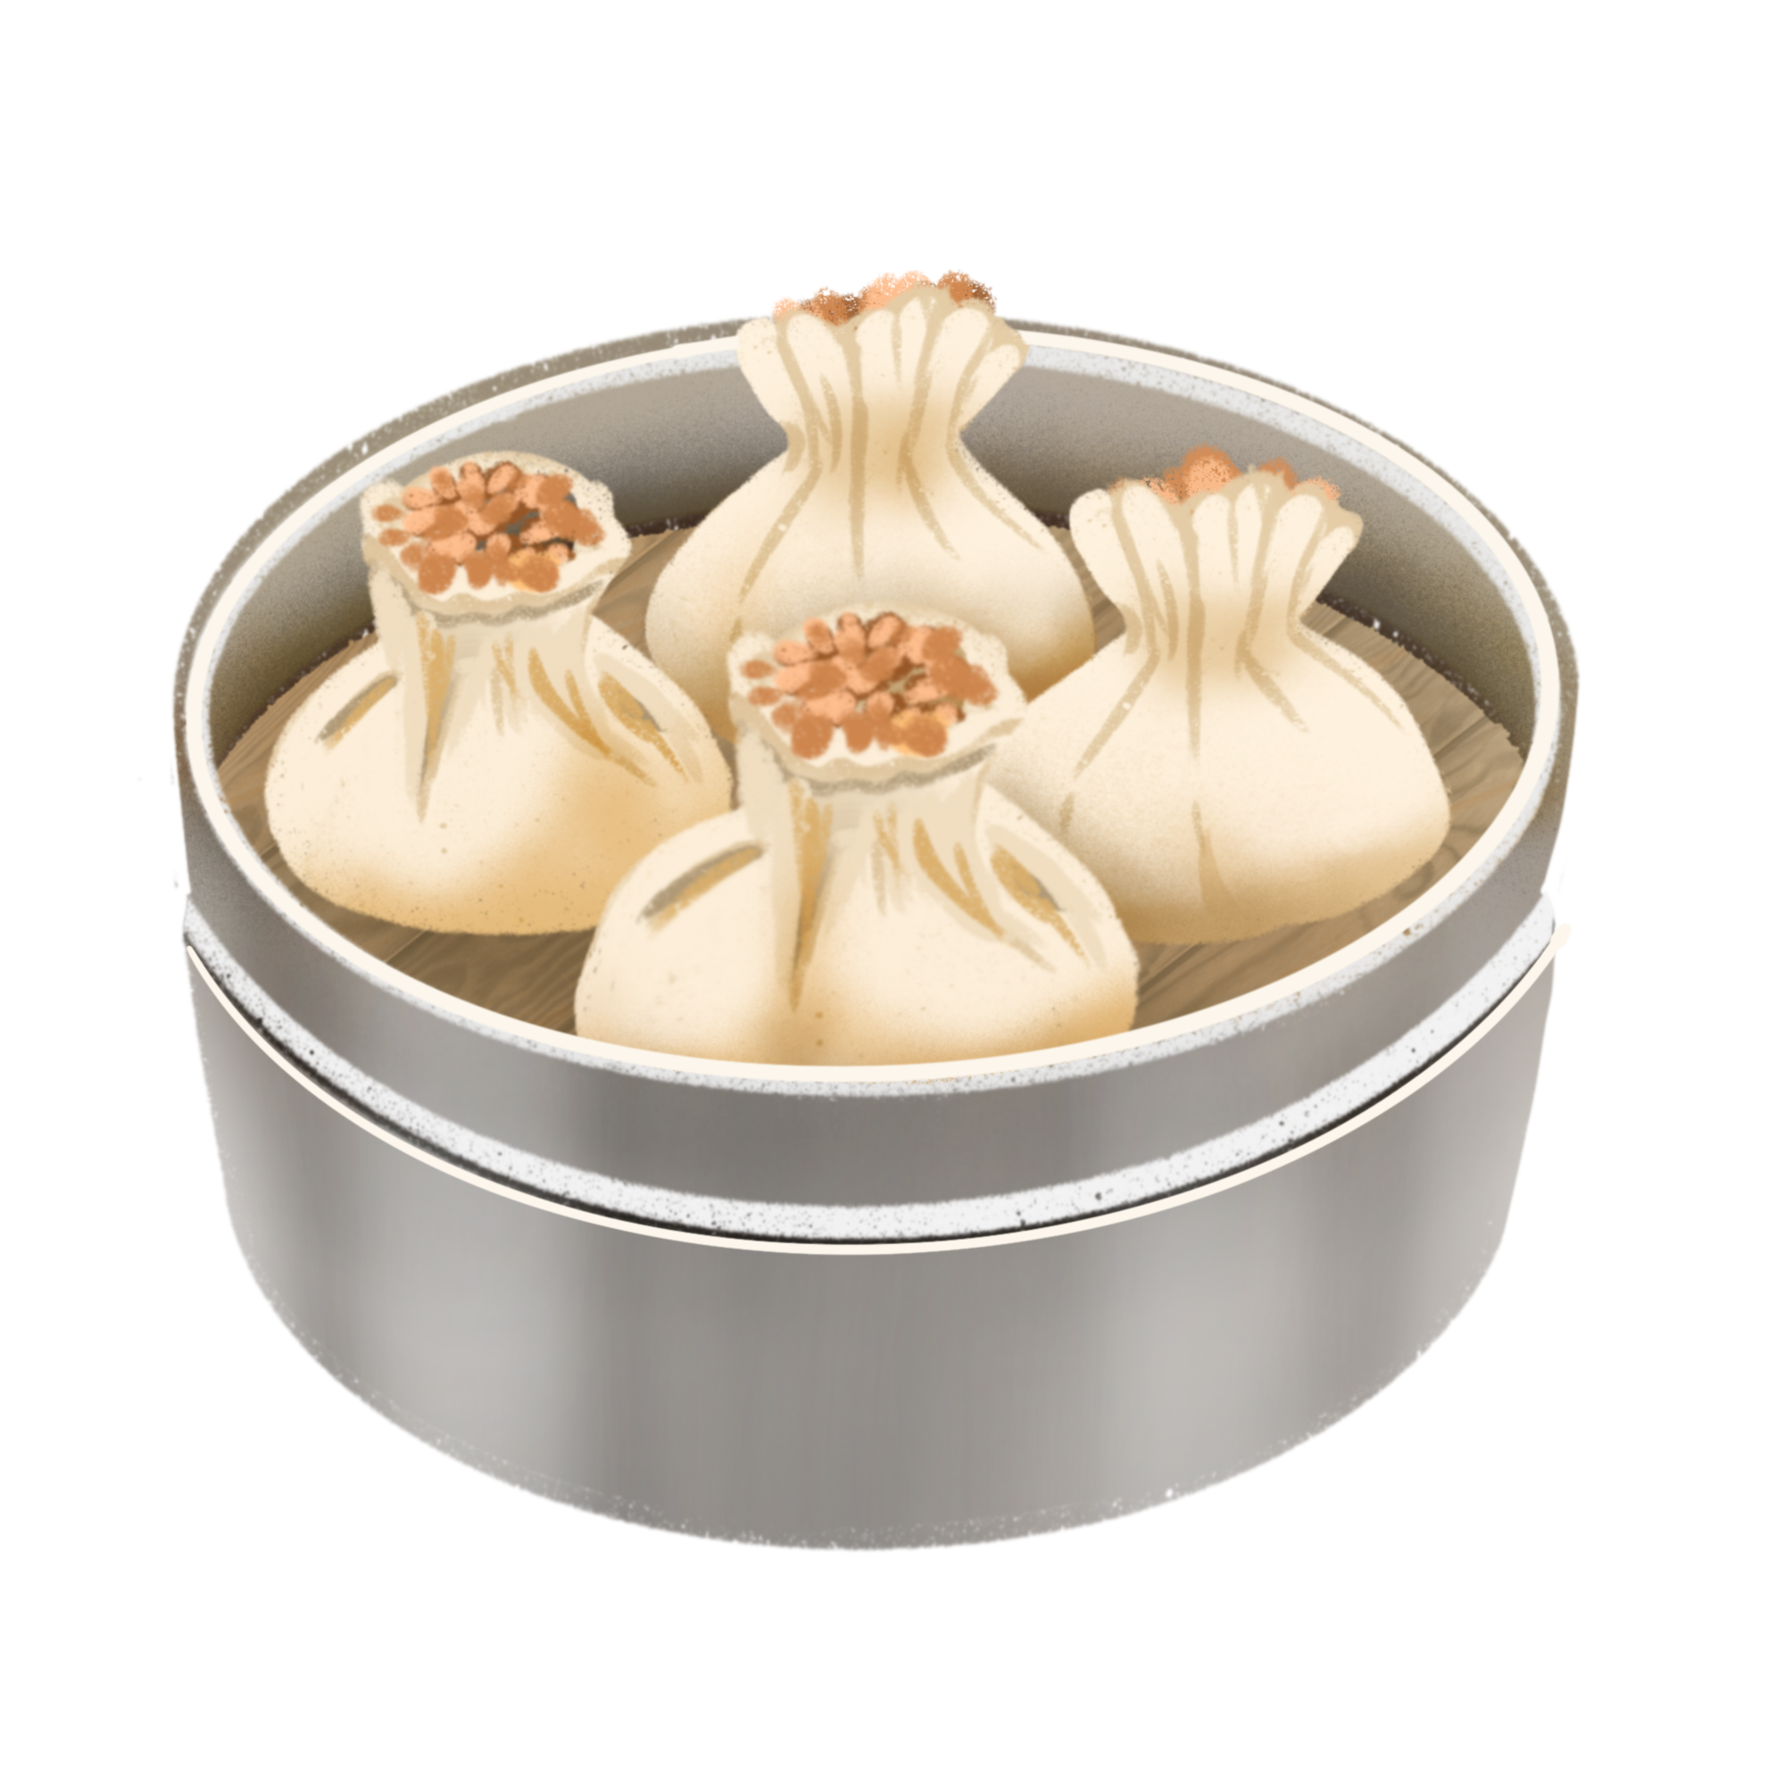
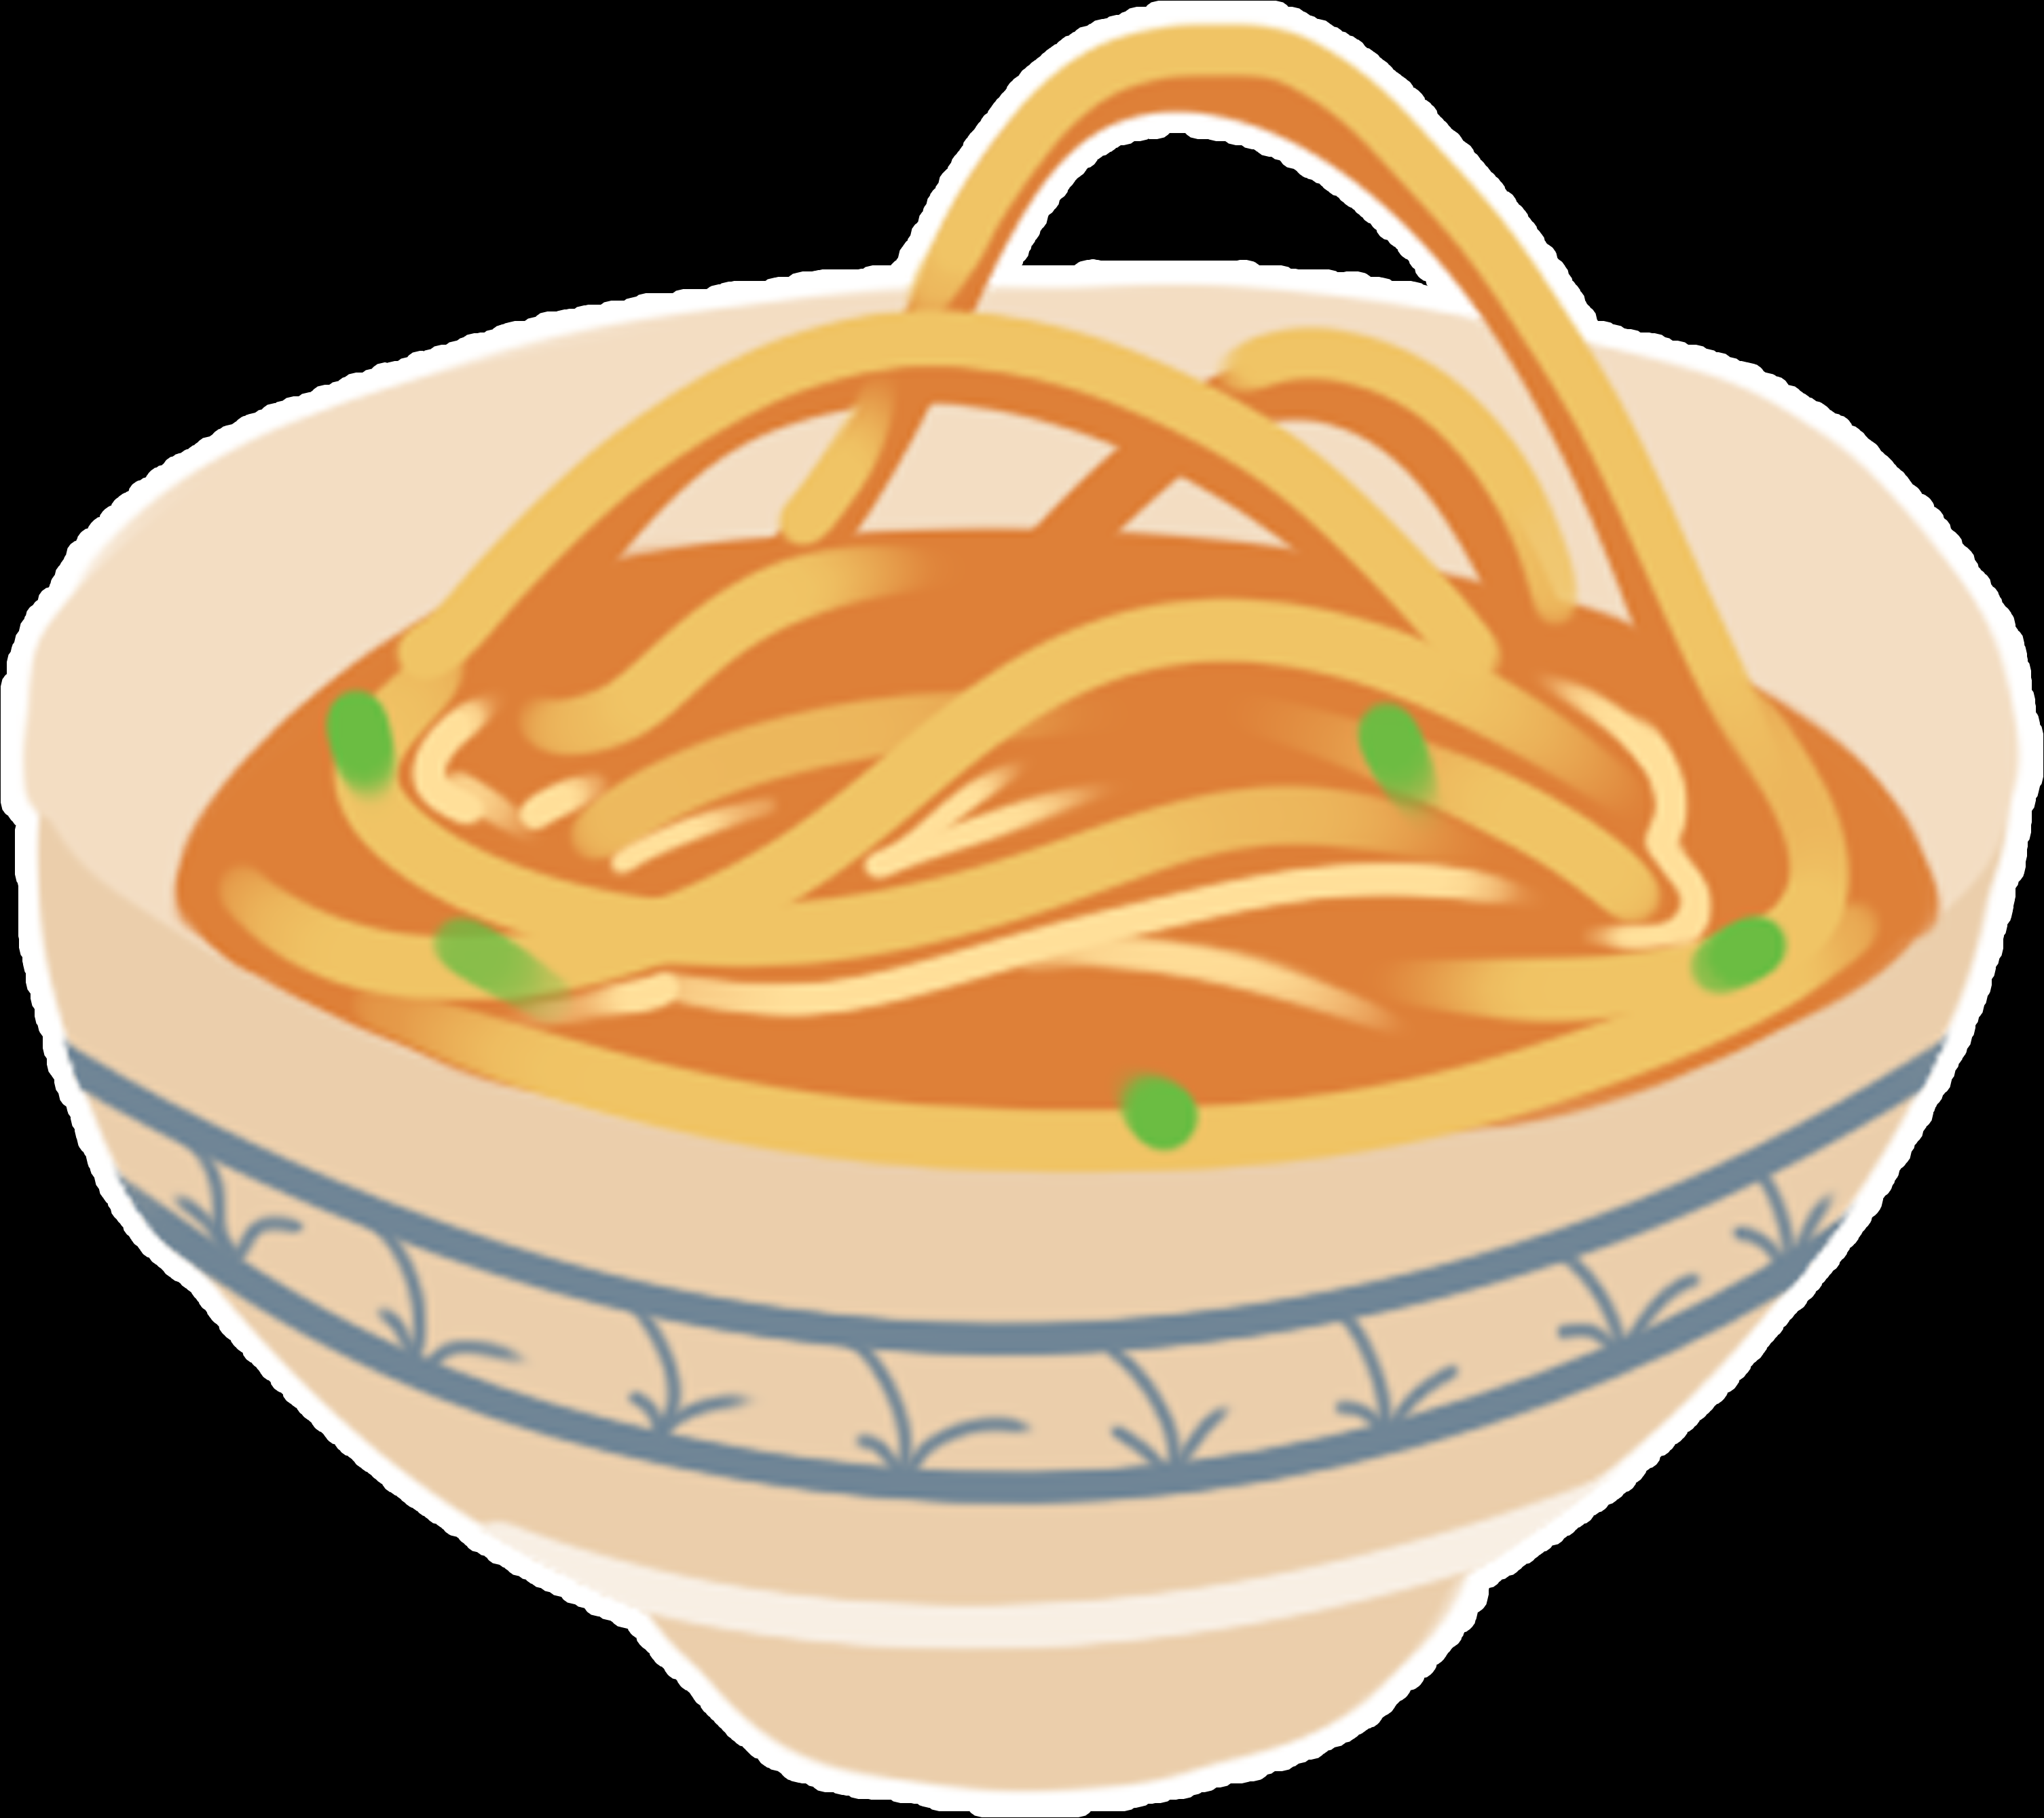
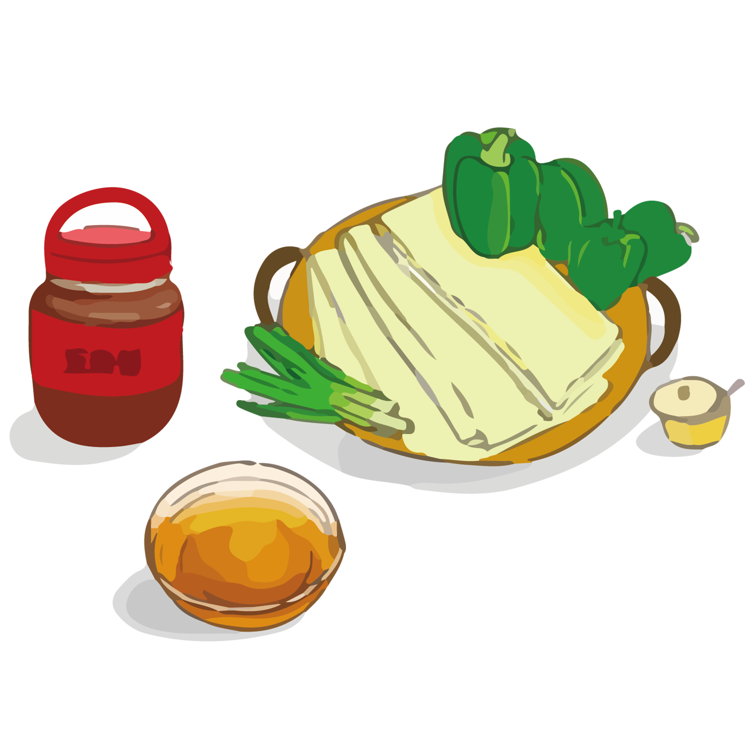
How does the breakfast culture of Wuhan come into being?
Geographic Reasons:
Basin in the vast impact plain, the climate of Wuhan is warm and humid monsoon climate. Such an advantaged geographical environment provides the growth of crops with suitable conditions.
Ancient Recordation :
Chu Ci vividly reflects the food style and characteristics of Hubei region at that time, shows the achievements of the art of Hubei cuisine in the pre-Qin period.
Historical Reasons :
In the 19th century, Wuhan was once reduced to leasing land. Then, the light industry developed fast. During the golden ten years in the era of the Republic of China, the flour processing was further developed which led to a increasing proportion of flour food in Wuhan
Population Composition :
The population composition of Hubei has been very complex since ancient times. In addition, the mobility of people in Wuhan province is very strong, which brought an impact on the local diet. So the local diet and the foreign diet are integrated and then developed.

