Slide 1




Ambiguity of Chinese Language
(e.g. Tang Poetry)
Wang Yashu 王雅姝 English translation
Lu Yuqin 陆玉琴 Korean translation
2022.11.25

Slide 2


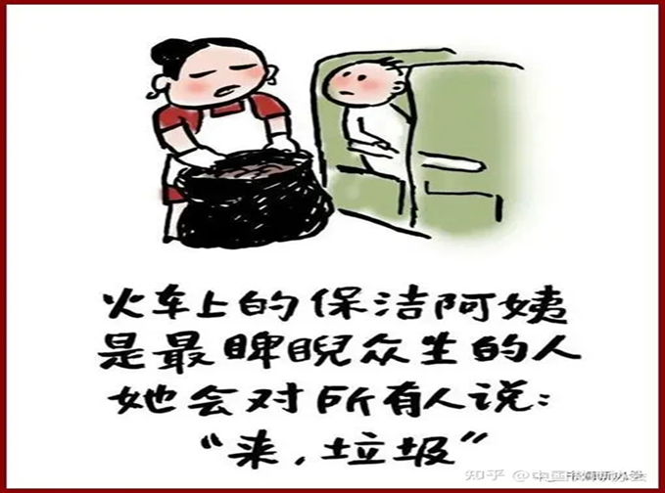
The Ambiguity in Chinese Language
When a cleaner on the train says, ”Here, litter.”

Slide 3
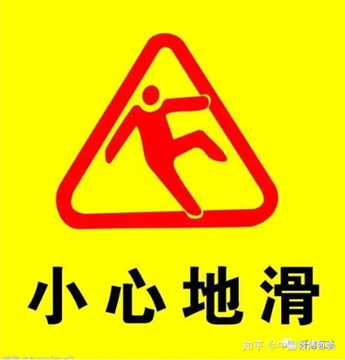
The Ambiguity in Chinese Language
Can you talk about the ambiguity in these words?
① A caution
② Slip carefully

Slide 4
The Ambiguity in Chinese Tang Poem
牧 童 遥 指 杏 花 村。 (杜牧 《清明》)
How can you translate “杏花村”？（杏花： apricot ）
① He points at Apricot Village faraway．
(translated by 吴钧陶)
②He points at a distant hamlet nestling amidst apricot blossoms．
(translated by杨宪益、戴乃迭)

Slide 5
The Ambiguity in Chinese Tang Poetry
挥 手 自 兹 去。 (李白 《送友人》)
As for “挥手”，which version do you think is more accurate?
①Who bow over their clasped hands at a distance.
(translated by Ezra Pound)
② You wave your hand and go your way.
(translated by 许渊冲)

Slide 6
壹
Why does Ambiguity exist?

Slide 7
Factors contributing to ambiguity
Grammatical
Rhetoric
Cultural
Chinese VS English
Metaphor, pun,
hyperbole…
Culture-loaded words
and expressions
Parataxis VS Hypotaxis

Slide 8
贰
Ambiguity in Tang Poetry

Slide 9
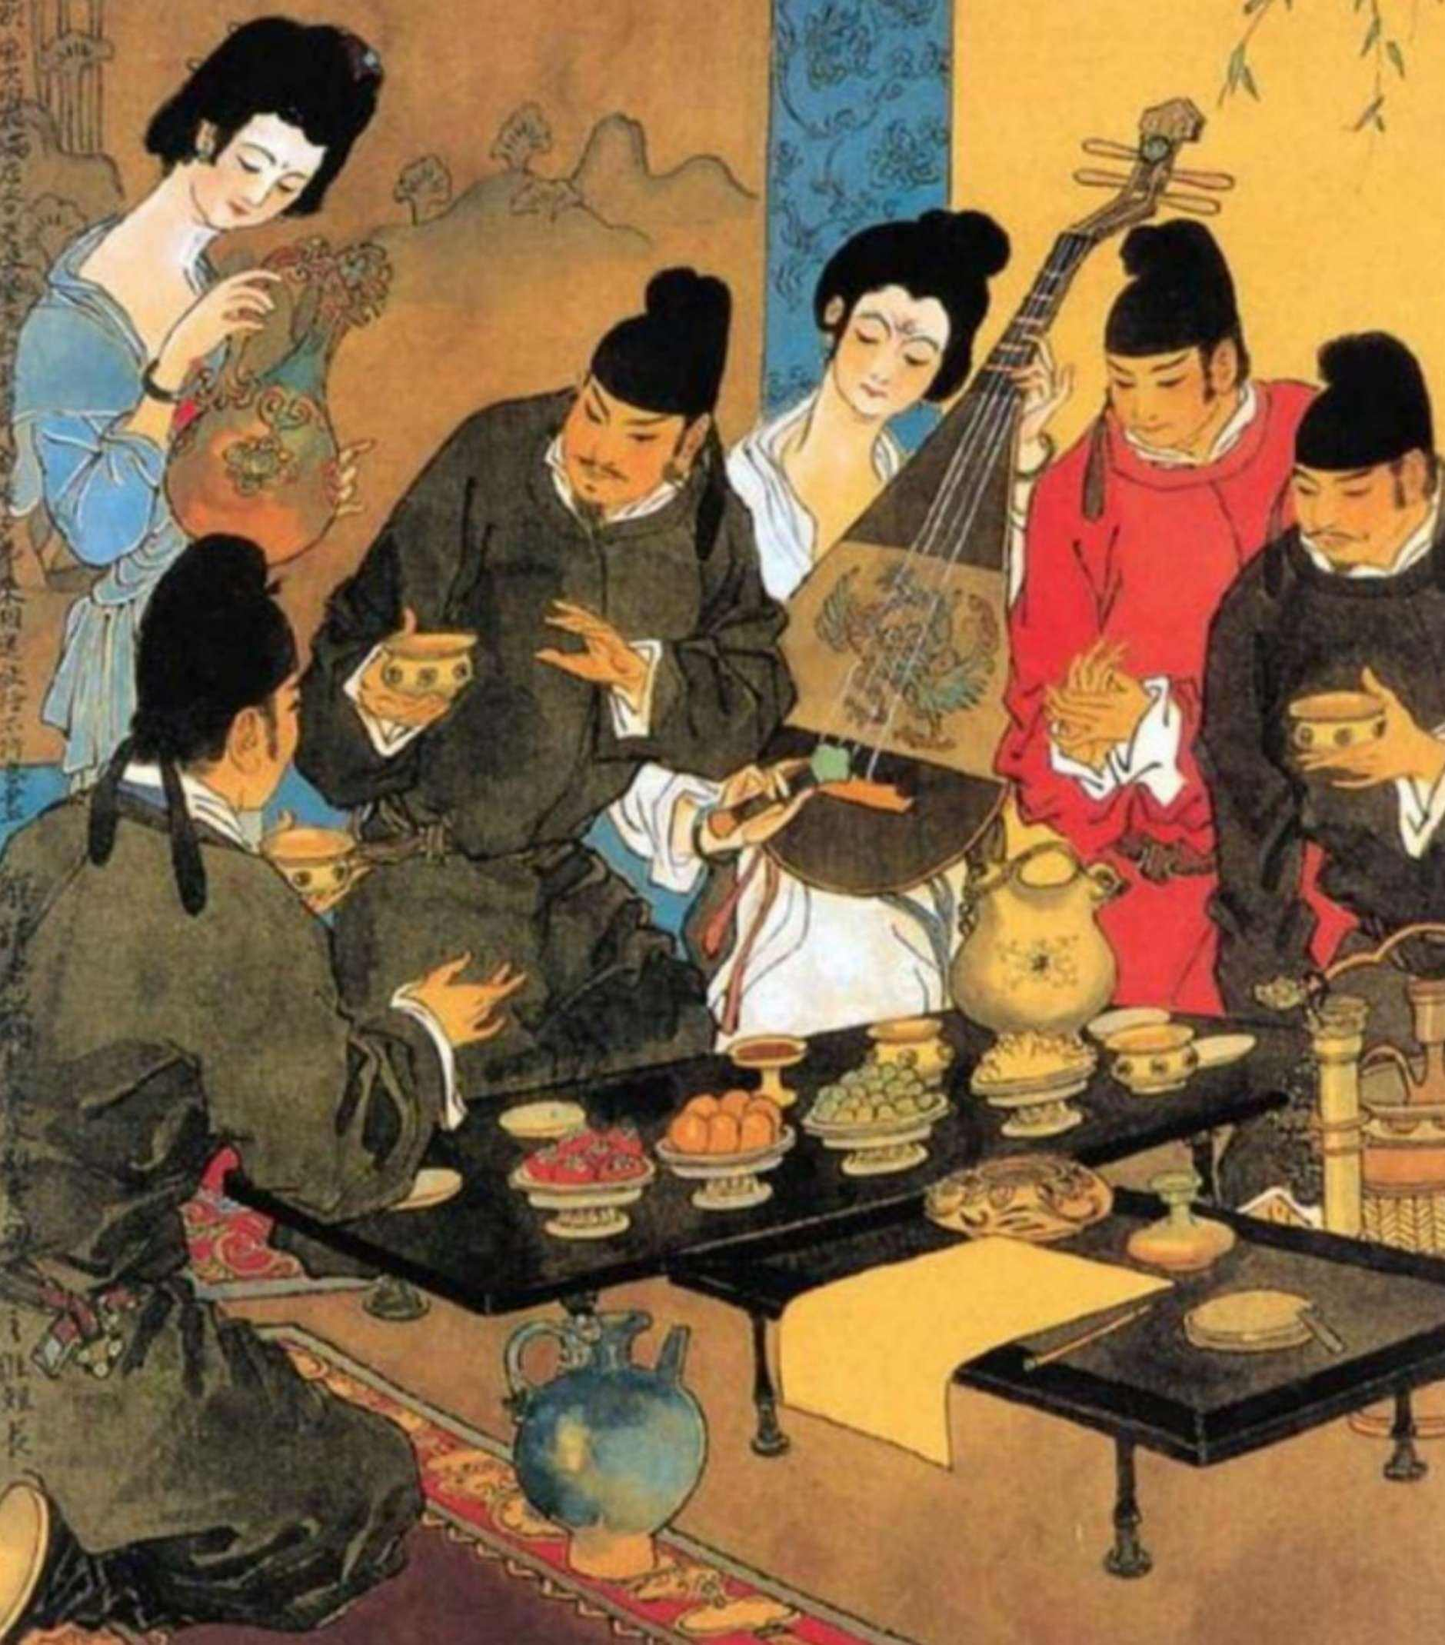
Example
金陵酒肆留别
李白
风吹柳花满店香，吴姬压酒唤客尝。
金陵子弟来相送，欲行不行各尽觞。
请君试问东流水，别意与之谁短长。

Slide 13
1. Thou’lt: (archaic) contraction of thou shalt.
2. Ere: a poetic word for before.

Slide 14


Re-understand our own language and culture through the perspective of another language.

Slide 15
References
Lai Shixiong. (2011). Chinese Fuzzy Linguistics: Retrospect and Prospect. Foreign Language Teaching and Research 33(1): 7-14.
Song Yanyun. (2007). On Ambiguity of Modern Chinese (Master's thesis). Available from CNKI.
Gillon, B.S. (1990). Ambiguity, generality, and indeterminacy: Tests and Definitions. Synthese 85: 391–416. The Netherlands: Kluwer Academic Publishers.
Grace Qiao Zhang. (1998). Fuzziness --- Vagueness --- Generality --- Ambiguity. Journal of Pragmatics 29(1): 13-31.
Friedrich Schlegel. A History of Ambiguity. Lyceum Fragmente 8, in KSA II, p. 148. Princeton University Press.
Feng, Q. (2022). Translating Seven Types of Ambiguity in Classical Chinese Poetry. International Journal of Chinese and English Translation & Interpreting.
Lv, Shuxiang (ed.). (2002). A Comparative Study on English Translation of Old Gems (《中诗英译比录》). Beijing: Zhonghua Book Company.
Wang Jiankai. (2017). A New Interpretation Elicited by the Translation: Reshaping the Meaning of the Original Text by the English Translation of Ambiguities in Ancient Chinese Poetry (译文引出的新解：中国古诗歧义英译对原文意义的重塑). New Perspectives in Translation Studies 9: 2-7.

Slide 16
Thanks for your
listening!

