Slide 1

Literature: Modern and Contemporary Literature
–Science Fiction and Fantasy

Slide 2

目录
Contents
Representative
figures
Introduction
Influence

Slide 3


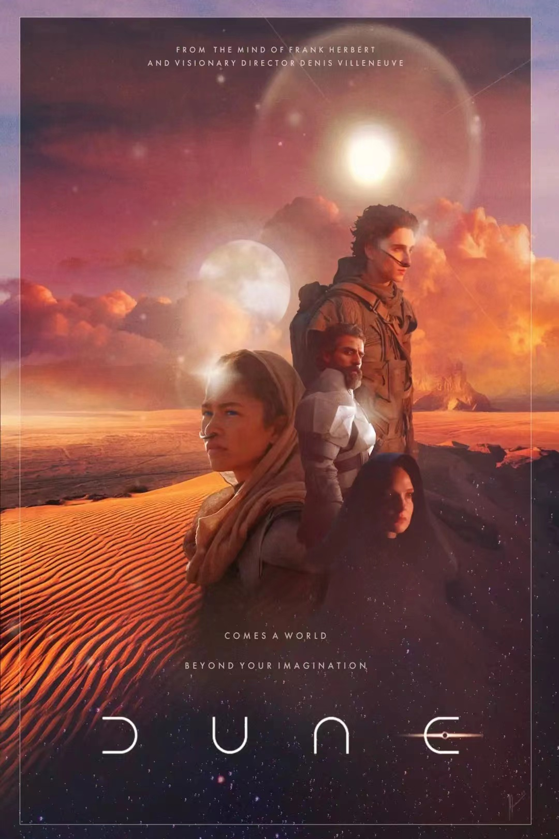
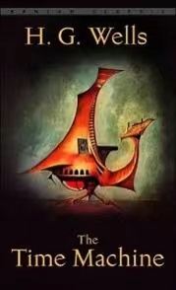



Science Fiction & Fantasy
Science fiction is a literary genre that originated in the modern West. It is the only type of literature that has never been seen in traditional Chinese literature. Sci-fi is defined as a novel that makes reasonable assumptions on the basis of respecting scientific conclusions.
Fantasy can be divided into Oriental Fantasy and Western fantasy according to the cultural background. The story structure is mostly set by myths, religions and ancient legends. The difference between fantasy and science fiction is that its background is usually biased towards the world structure that is 100% irrational or unpredictable. Fantasy novels prefer the past, that is, to seek background basis or similarity in history, while science fiction will prefer the continuation of existing science and technology to strengthen imagination.

Slide 4


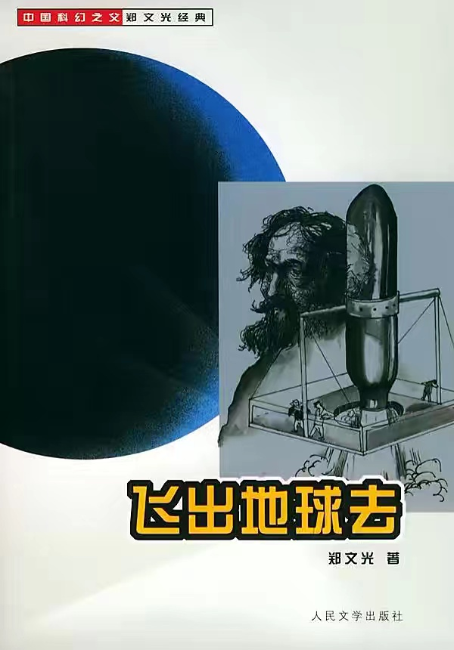
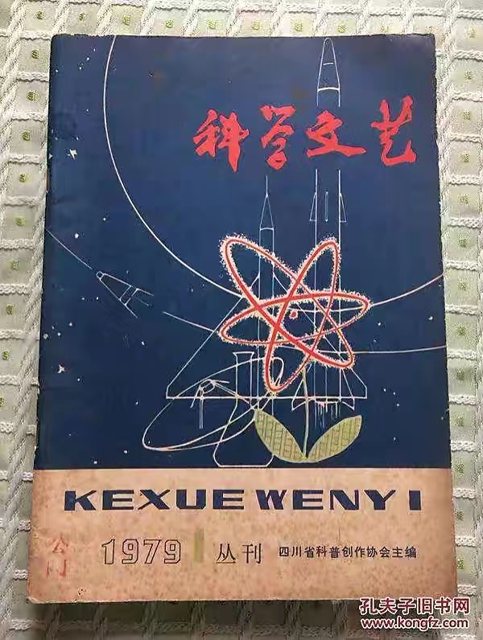
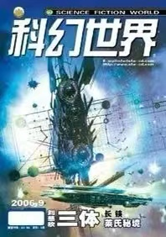
Chinese Sci-fi
From the founding of the people's Republic of China in 1949 to the beginning of the cultural revolution in 1966. With the establishment of new China, the war ended, literature and education were revived on the basis of social stability, science fiction creation in the mainland flourished.
From 1976 to 1984. After the cultural Revolution, a large number of science fiction novels have been published. Old writers resume their creation, and new writers continued to emerge, forming a new upsurge of science fiction.
From 1990 to now. During this period, the number of Chinese science fiction writers doubled, and the style and content of their works became increasingly rich.

Slide 5
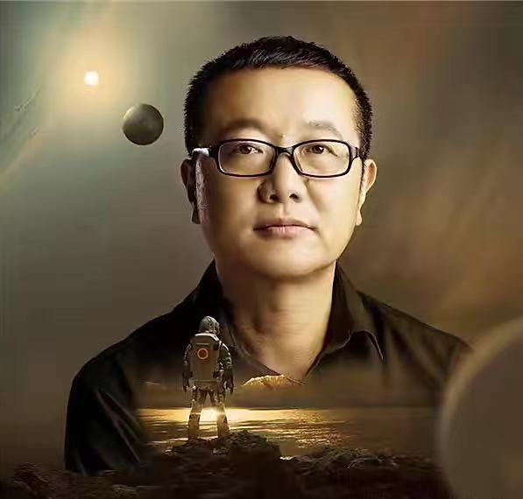
Liu Cixin (刘慈欣)
Liu Cixin is the main representative writer of contemporary Chinese science fiction and is known as the leader of Chinese science fiction. He was born in 1963 in Yangquan City, Shanxi Province. receiving his technical education from North China University of Water and Electricity. After graduation, he worked as a computer engineer at a power plant. Liu Cixin started writing relatively late. However, he is a very prolific writer.

Slide 6
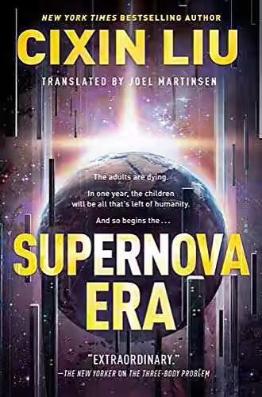
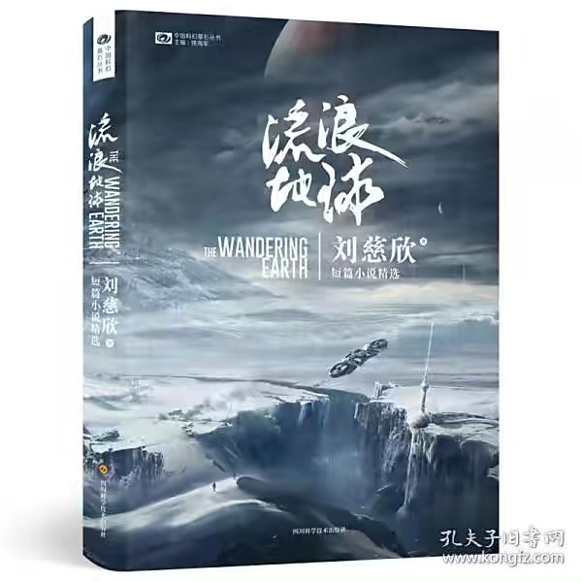
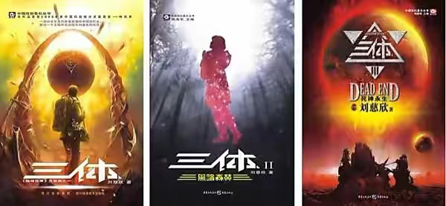
Supernova Era
The Wandering Earth
The Three-Bodies Problem

Slide 7
In 1999 the Galaxy Award (eleventh) First Prize: “Take Her Eyes”
In 2000 the Galaxy Award (twelfth) Grand Prize: “The Wandering Earth”
In 2001 the Galaxy Award (thirteenth) Readers Nomination Award: “Village Teacher”
In 2002 the Galaxy Award (Fourteenth) Readers Nomination Award: “Swallowed”
In 2003 the Galaxy Award (Fifteenth) Readers Nomination Award “The Thinker”
In 2004 the Galaxy Award (Sixteenth): “Mirror”
In 2006 the Galaxy Award (Eighteenth) Special Award: “The three-bodies Problem”
In 2010 the Galaxy Award (Twenty-second) Grand Prize: “The Death’s End”
……

Slide 8

Chen Qiufan (陈楸帆）
Chen Qiufan, born in Guang Dong in 1981, received education in Peking University. He is also one of the leaders of Chinese science-fiction and a cyberpunk novelist, called by others the “Chinese William Gibson”. His works which are famous for realism and new-wave style, have won many awards at home and abroad, like The Galaxy Award.

Slide 9
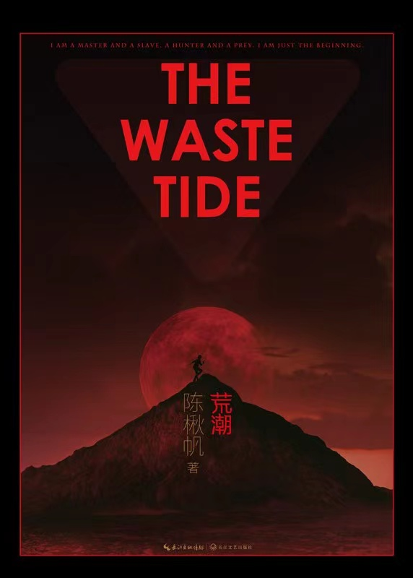

The Waste Tide
The Algorithms for Life

Slide 10


Rebecca F. Kuang (匡灵秀)
Rebecca was born in Guangzhou. When she was four years old, her family emigrated to the United States. Kuang grew up in Dallas, Texas, and later went to Georgetown University. Rebecca always liked writing. her first novel was published when she was only 22 years old. Her debut novel, The Poppy War, is a war fantasy setting inspired by the history and culture of China. The Poppy War is a dark fantasy genre. The plot is largely based on the history of China in the middle of the 20th century. The conflict refers to the Second Sino-Japanese War, but the scenery is inspired by the Song Dynasty. The novel accurately recreates the social, mythological, and philosophical realities of China of the chosen era.

Slide 11
Chinese Fantasy
Although "fantasy" has a long tradition in China, Chinese fantasy literature in the 21st century is the product of a new era under the influence of Western Fantasy. The massive publication of fantasy books in 2005 made it known as the "first year of fantasy". Since 2005, the combination of Internet, books and periodicals has jointly created the prosperity of China's fantasy surface in a very short time, and the number of authors and works has reached an alarming astronomical number.

Slide 12
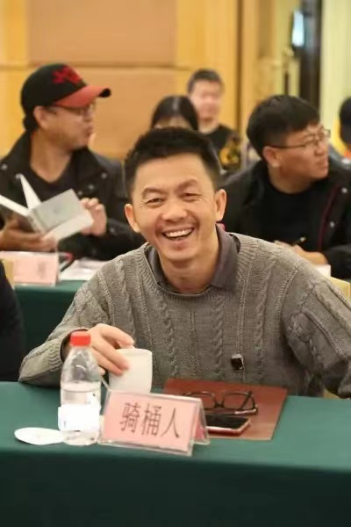
The Bucket Rider (骑桶者）
The Bucket Rider, born in 1972, is a Chinese fantasy literature writer, whose pseudonym comes from Kafka‘s short story “The Bucket Rider". He won the title of Best Author of Douban Reading twice, participated in editing China's best fantasy novel collection of the year, once served as the executive editor of Kyushu Fantasy, and founded Nine Songs, an electronic magazine of fantasy literature.

Slide 13



归墟
鲲与虫
漂浮在空中的兰若

Slide 14
Jiang Nan (江南)
Jiang Nan, whose real name is Yang Zhi, was born in Shucheng, Anhui Province on July 13, 1977. He is a contemporary Chinese writer. His works are rich, involving science fiction, fantasy, martial arts novels and other fields, but the highest achievement lines in his fantasy novels.

Slide 15
九州缥缈录
天之炽
龙族

Slide 16

Influence
In addition to enriching people's spiritual world, science fiction and fantasy plays a more important role. As we all know, in science fiction and fantasy, the predictions made by the author are both optimistic and pessimistic. Many writers believe that scientific progress can often make the world a better place. While some writers' predictions tend to be pessimistic, which more reveals the bad side of the impact of scientific progress on human society. However, whether optimistic or pessimistic, most of them have a common purpose, which is to make better progress of human civilization. Pessimistic predictions can make people pay attention to the problems in the development of civilization and overcome them, while optimistic predictions can stimulate people's enthusiasm to realize a better future. science fiction and fantasy promotes the development of human civilization with its foresight and enlightenment. This foresight is reflected in science, economy, politics, social life and even ecological environment, which has made a certain contribution to the exploration of the correct direction of human civilization and progress.

Slide 17
Thank Your for Listening

