Slide 1

Theory and Practice
彭娟 陶冶

Slide 2
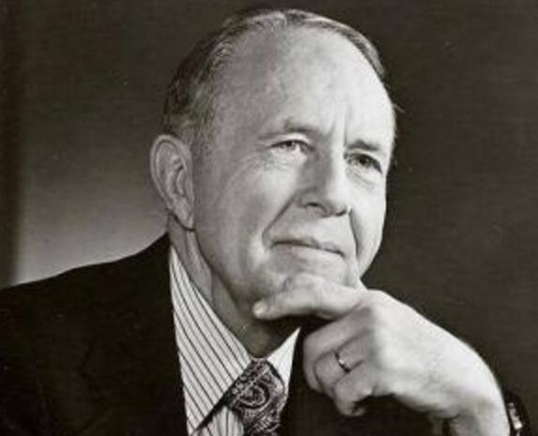
Functional Equivalence Theory
Eugene A. Nida, an outstanding translation theorist and lecturer in America, was born in November,1914 and was dead in August, 2011. Some translation theories were proposed by him. It was known to all that his influence was the greatest in current translation field.
Eugene A.Nida

Slide 3
According to Nida's dynamic equivalence or functional equivalence,
the translation aimed at letting the meaning become clear understanding to
current people, although it was unavoidable to fail to get the accurate form
of the works in the original message.
Translation was the production of a functional target text keeping a link
with a given source language which was elaborated based on the needed
function to the target language .

Slide 4
The minimal connotation of functional equivalence refers to the readers in a translated passage would understand it in sense that they would know how the readers of the original language should have known and accepted it.
In his works, Theory and Practice of Translation, Nida gave Translation: “ reproducing the closest natural equivalence of source language in receptor language both in content and style”.
Nida’s definition meant if people translate the text, they need focus on three actors: the natural equivalence, the meaning priority and the significance of style.
Nida stressed the meaning but not form and thought absolute equivalence or correspondence did not exist in real translation process.

Slide 5
1, literal translation
Morphemes and terms have fixed definitions, general words and equivalent phrases have the most commonly used basic meanings, and literal translation is when the conversion unit in the original text corresponds to the morpheme or word with the corresponding fixed or most commonly used meanings in the target language.

Slide 6
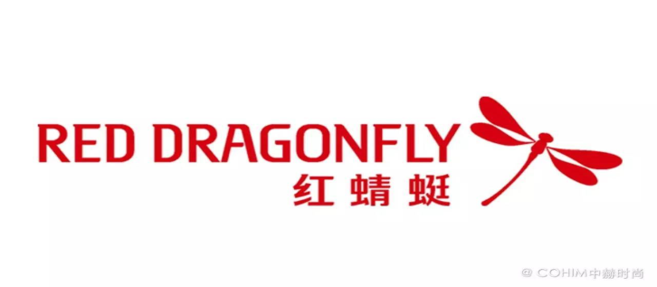

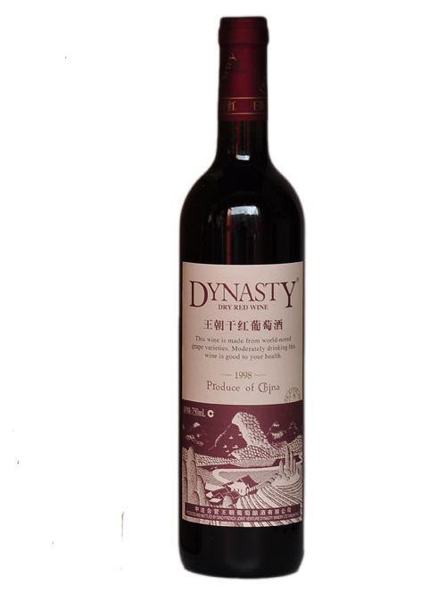
Examples:
红蜻蜓 Red Dragonfly
Apple
苹果
Dynasty
王朝

Slide 7
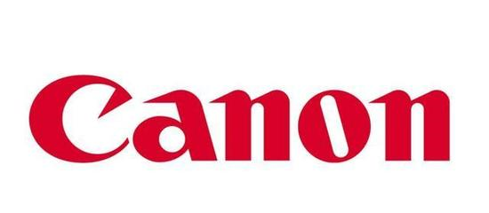
2. Transliteration
Transliteration is the translation of the sound of a source language into a language with similar or identical pronunciation.
Examples:
ADD YOUR TITLE
佳能

Slide 8
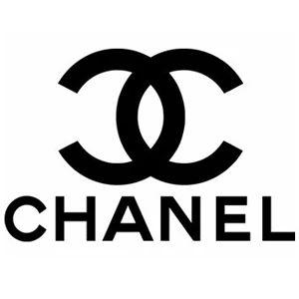
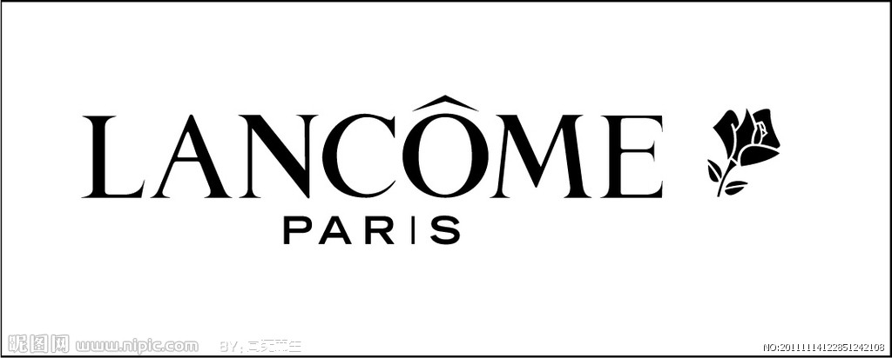
香奈儿
ADD YOUR TITLE
兰蔻

Slide 9
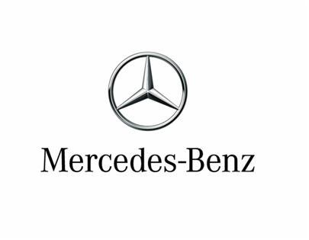

奔驰
阿迪达斯

Slide 10
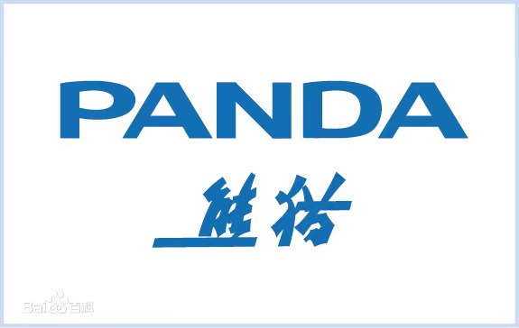
3, Free Translation
According to the main idea of the original text translation, do not do word for word translation.
熊猫电视机
Panda

Slide 11


4, literal translation Plus Free Translation
Starbucks
星巴克
Unilever
联合利华

Slide 12
Conclusion
In general, trademark translation is a very deep knowledge, but also a very difficult art. If you want to truly master the skills of translation, you must adopt different methods according to different situations. Translation needs to combine culture and customs to better restore the original intention.
Therefore, in trademark translation, the translator must guide the translation practice well according to the theory of "functional equivalence". In other words, translators are required to combine various methods such as transliteration and free translation to translate the trademark into a style and show the characteristics of the trademark itself, so as to better compete. Therefore, a good company cannot do without good trademark translation. Only by integrating trademark translation into culture can it truly guide the company's continuous progress.
In general, trademark translation is a very deep knowledge, but also a very difficult art. If you want to truly master the skills of translation, you must adopt different methods according to different situations.Translation needs to combine culture and customs to better restore the original intention.
Therefore, in trademark translation, the translator must guide the translation practice well according to the theory of "functional equivalence theory". In other words, translators are required to combine various methods such as transliteration and free translation to translate the trademark into a style and show the characteristics of the trademark itself, so as to better compete.

Slide 13
In general, trademark translation is a very deep knowledge, but also a very difficult art. If you want to truly master the skills of translation, you must adopt different methods according to different situations. Translation needs to combine culture and customs to better restore the original intention.
Therefore, in trademark translation, the translator must guide the translation practice well according to the theory of "functional equivalence". In other words, translators are required to combine various methods such as transliteration and free translation to translate the trademark into a style and show the characteristics of the trademark itself, so as to better compete. Therefore, a good company cannot do without good tr ademark translation. Only by integrating trademark translation into culture can it truly guide the company's continuous progress.
Therefore, a good company cannot do without good trademark translation. Only by integrating trademark translation into culture can it truly guide the company's continuous progress.

Slide 14
T H A N K S

