Slide 1


Unit 6 Fine Arts
Welcome to QQ online classroom

Slide 2
Questions Concerning Section A Painting
1. How long is the history of Chinese traditional painting?
2. What is the greatest difference between Chinese traditional painting and Western painting?
3. Why do Chinese artists emphasize the shifting perspective?
4. What are the 2 major categories of Chinese painting?
5. What do you know about Gu Kaizhi’s theory of painting? How important is his theory in the history of Chinese painting?

Slide 3
6. What are the 4 components of a Chinese traditional painting? How are painting and poetry related?
7. What are pines, bamboo and plum flowers symbolic of in Chinese traditional painting?
8. What does Qi Baishi think of the relationship between the necessary parts of Chinese graphic art?
9. What is fascinating about Qi’s work?

Slide 4
Questions Concerning Section B Calligraphy
1. What is calligraphy?
2. What 5 categories are Chinese scripts classified into?
3. How did the zhuan script come into being? What else may it be called? What did Li Si do about it?
4. Why was xiaozhuan further simplified? What is lishu?
5. What is the regular script? How long is its history?
6. What are the characteristics of the cursive hand?
7. What is the running hand? To what do Chinese artists often compare kaishu, xingshu and caoshu?
8. What do you know about Wang Xizhi?

Slide 5
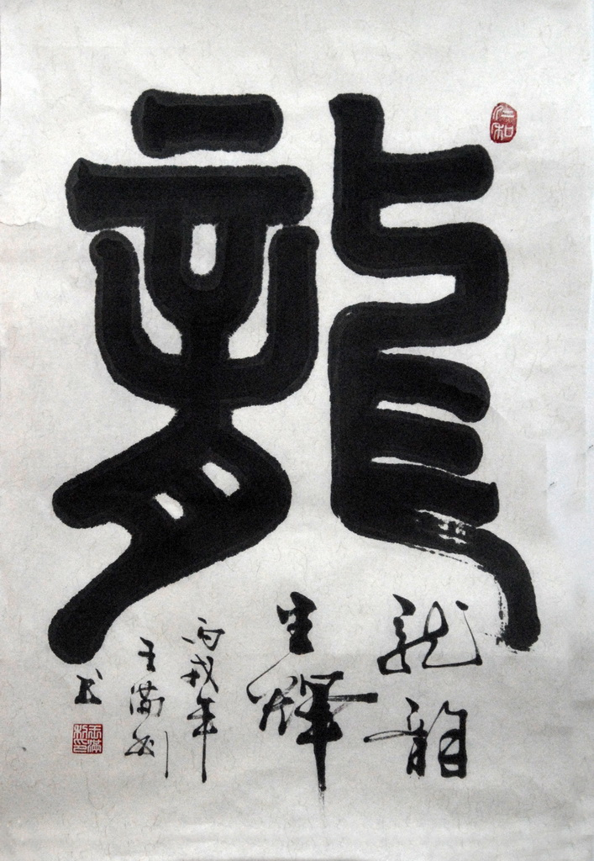
The seal script

Slide 6
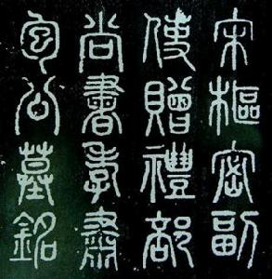
The seal script

Slide 7
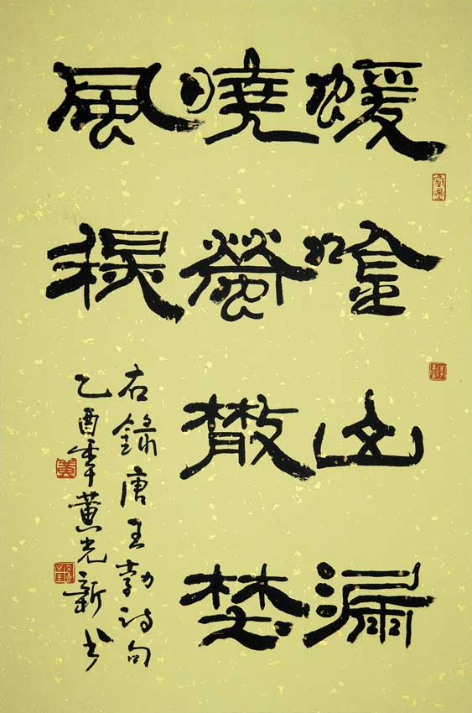
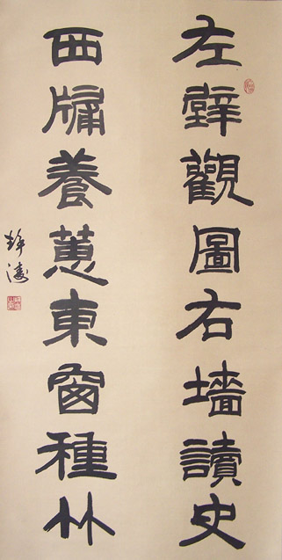
The official script

Slide 8
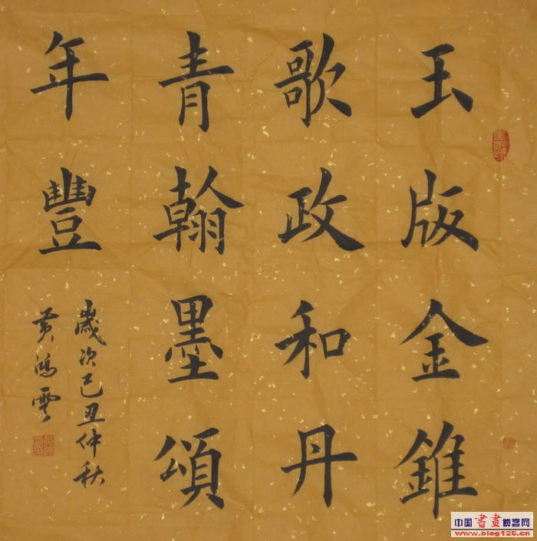
The regular script

Slide 9
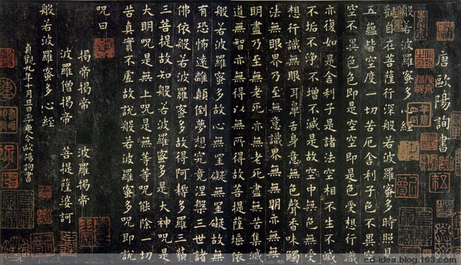
The regular script

Slide 10
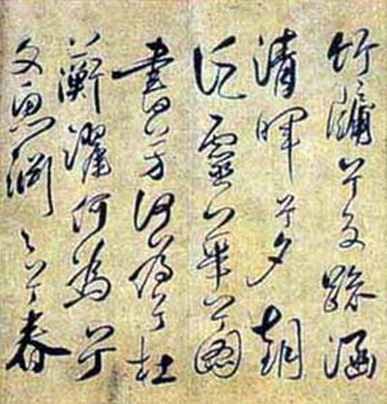
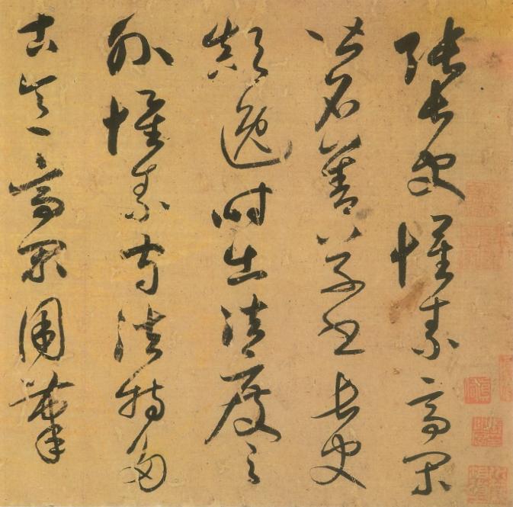
The cursive hand

Slide 11
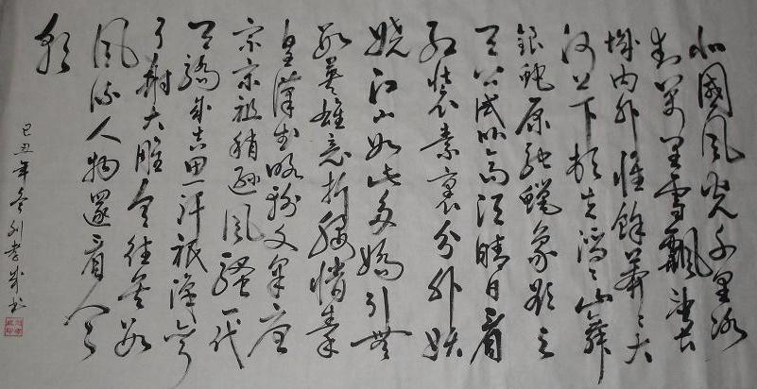
The cursive hand

Slide 12
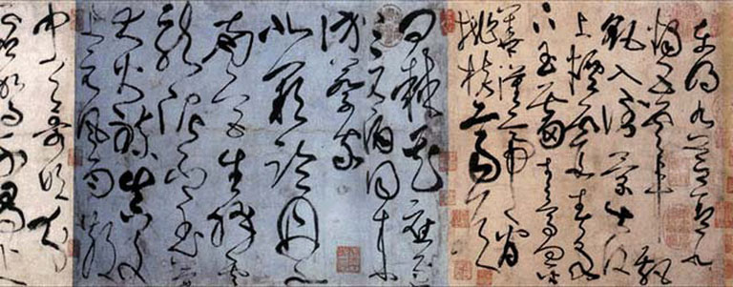
The cursive hand

Slide 13
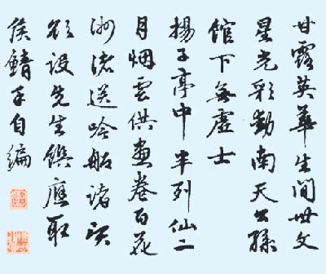
The running hand

Slide 14
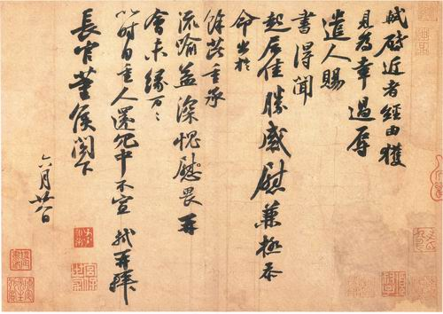
The running hand, by Su Shi

Slide 15
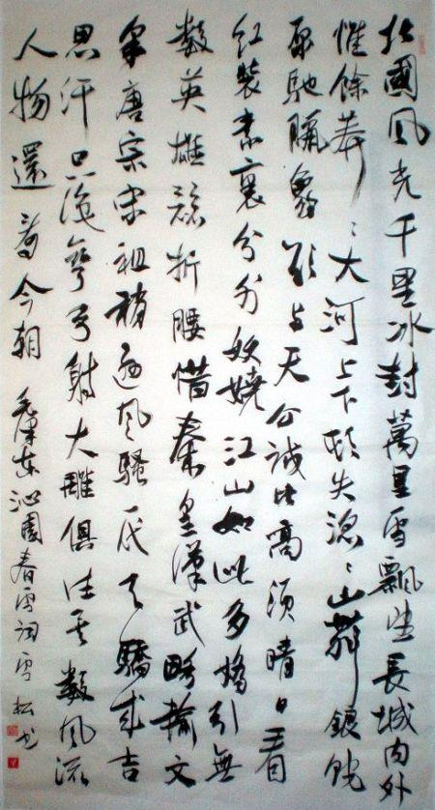
《沁园春 雪》in either the running hand or the cursive hand

Slide 16
Questions Concerning Section C Seal-Cutting
1. What are the 4 arts in traditional Chinese culture?
2. How long is the history of seal-cutting?
3. Why did seal-cutting flourish in the Qin Dynasty?
4. What was an official seal for? What about a private seal?
5. What are the 2 designs of seal-cutting?
6. How can seals be cut as works of art?

Slide 17
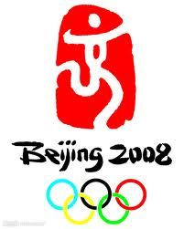
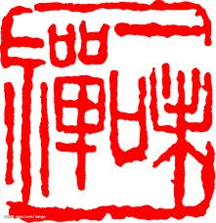
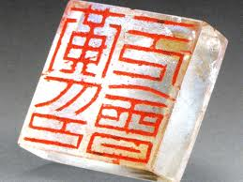

Relief or intaglio?

Slide 18
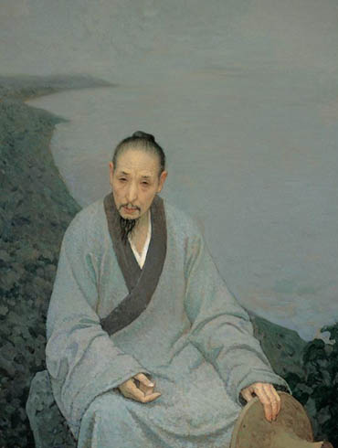
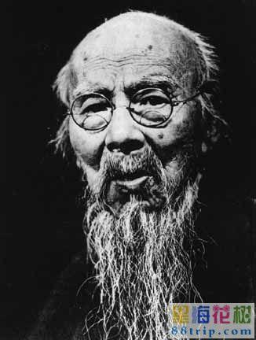
D. Bada Shanren and Qi Baishi

Slide 19
Questions Concerning Section D
1. Why did Zhu Da hate Manchu northerners or Qing officials?
2. What religious scriptures did Zhu Da study?
3. When did Zhu Da begin to paint for a living?
4. Why do the birds in Zhu Da paintings always hold their heads high? Why are their eyes strangely big?
5. What does he mean by his strange picture of peacocks?
6. How did Zheng Banqiao comment on his works?
7. What are the characteristics of his works?
8. How did Qi Baishi make a living before he became a painter?
9. What is peculiar about Qi’s paintings?

Slide 20
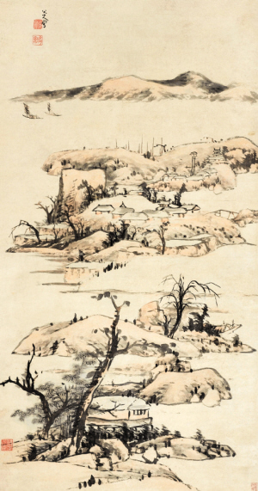
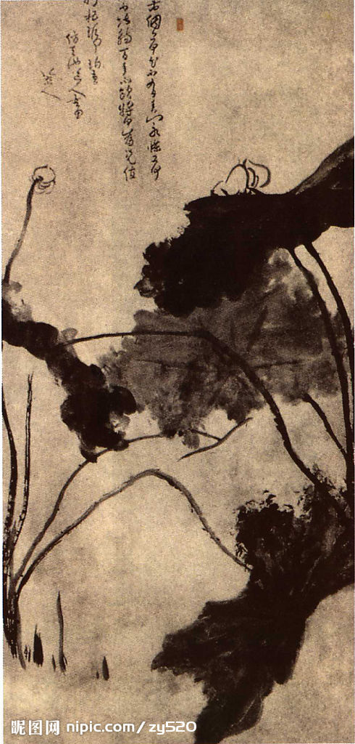
八大山人

Slide 21
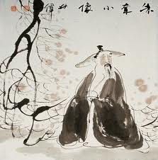
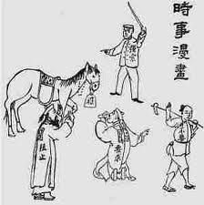
Zhu Da’s caricature and self-portrait

Slide 22
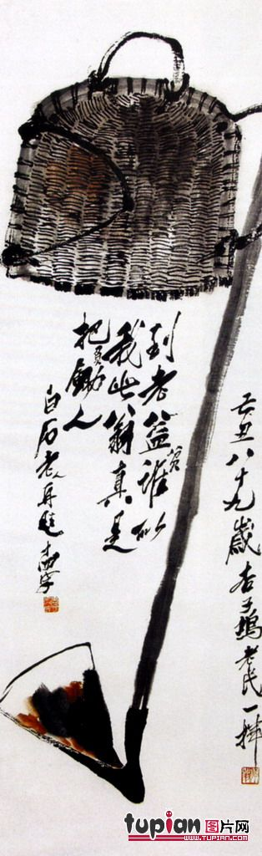
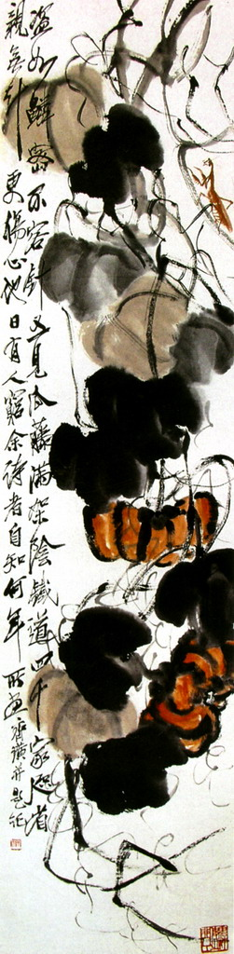
齐 白 石

Slide 23
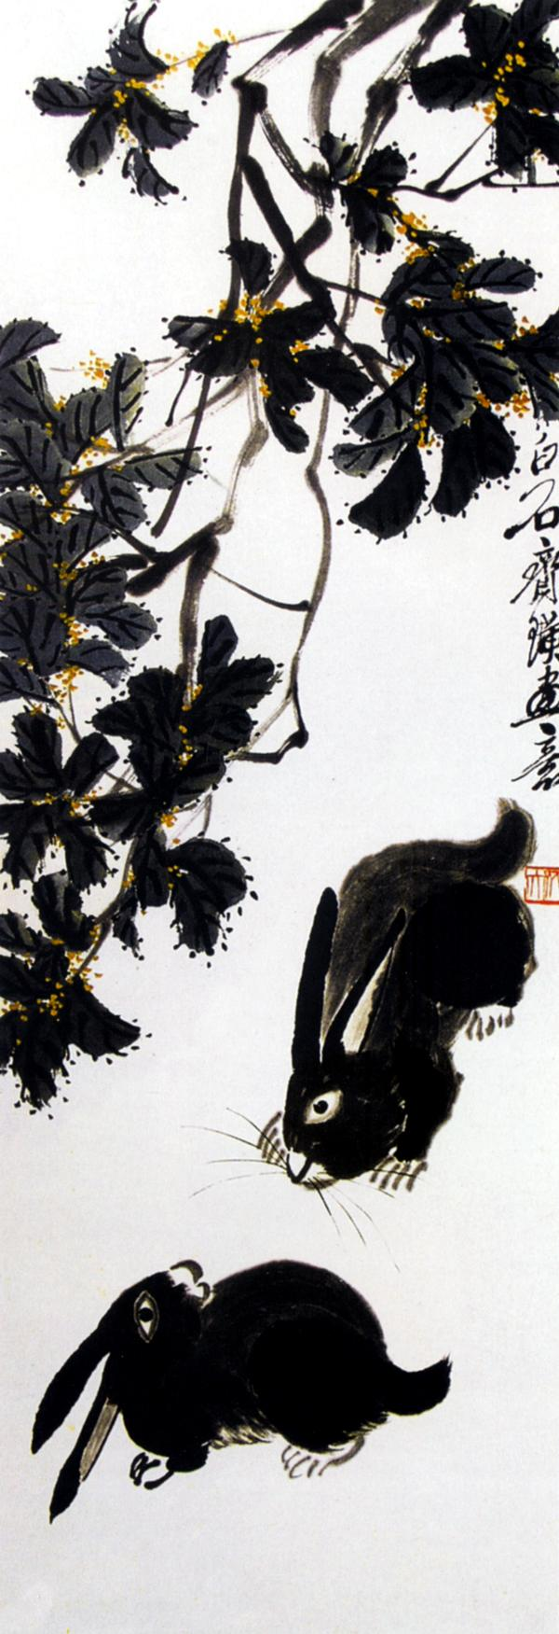
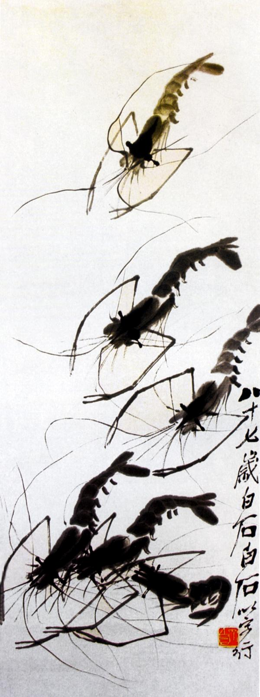
齐白石 名画—— 兔、虾

Slide 24
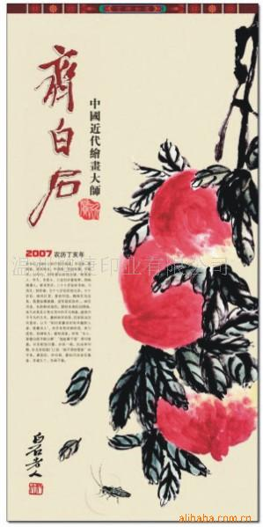
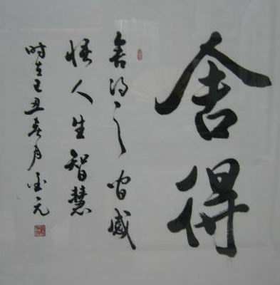
白石书法、画册

Slide 25
Translation
王羲之是1600年前我国晋朝的一位大书法家，被人们誉为“书圣”。绍兴市戒珠寺内有一个墨池，传说就是他当年洗笔的地方。王羲之7岁练习书法，勤奋好学。17岁时他把父亲秘藏的前代书法论著偷来阅读，看熟了就练着写。他每天坐在池子边练字，送走黄昏，迎来黎明，写完了多多少少的墨水，写烂了多多少少的笔头，每天练完字就在池水里洗笔，天长日久竟将一池水都洗成了墨色，这就是人们今天在绍兴看到的传说中的墨池。

Slide 26
白石老人不喜欢照像。三十年代中期经人介绍，郑景康到他家中为他照了十二张像，白石老人送郑一幅《虾子》；周维善为他画了一张像，老人送周一幅《东方朔偷桃》的人物画。过几天，老人在客厅写了个牌子，说“双方不合算”，以后再有人照像、画像，概不应酬。
白石老人对自己的艺术很欣赏。艾青多次陪外宾拜访他，有一次外宾走后，老人很不高兴。艾青问为什么，他说：“外宾看了我的画，没有称赞我。”艾青说：“外宾称赞了，你听不懂。”老人说他要的是外宾伸出大拇指。后艾青回忆这件事，感慨地说：“老人多天真哟！”

Slide 27
Topics for discussion
1. What else do you know about traditional Chinese painting? Can you introduce a famous Chinese painting?
2. Do you know any story of Wang Xizhi and his calligraphy?
3. Do you know how to appreciate Bada Shanren’s or Qi Baishi’s paintings?

Slide 28
See you next time!

Slide 29
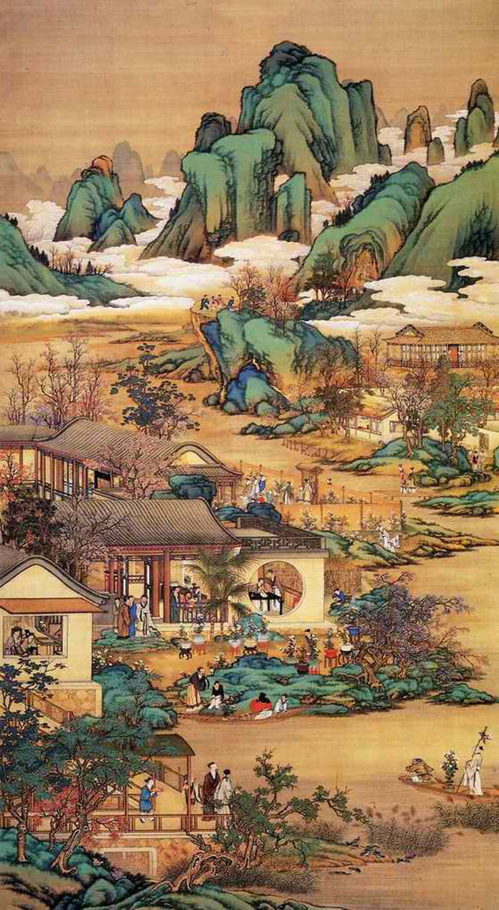
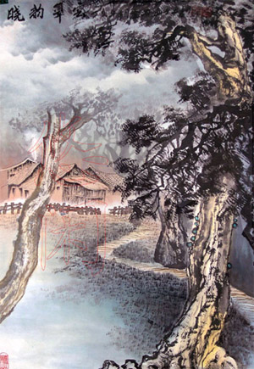
How long is the history of Chinese traditional painting?

Slide 30
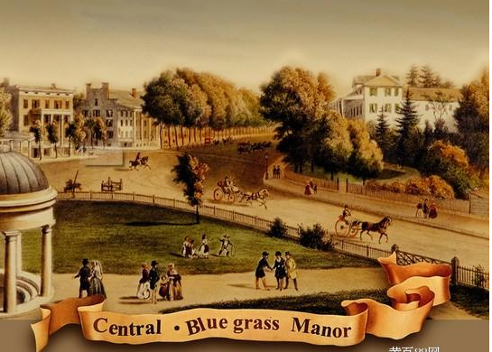
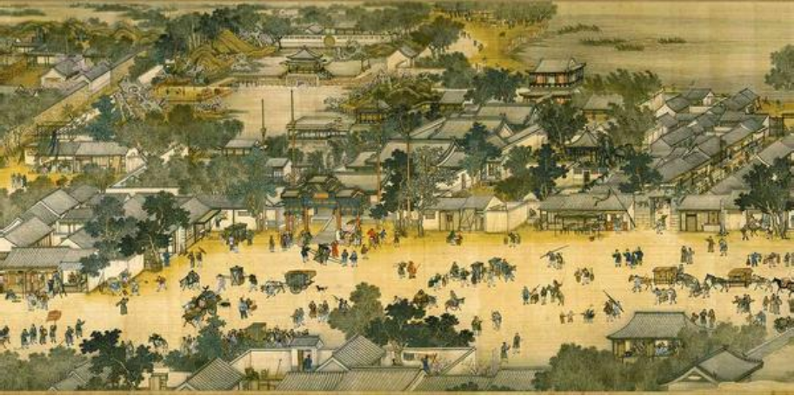
What is the greatest difference between Chinese traditional painting and Western painting?

Slide 31
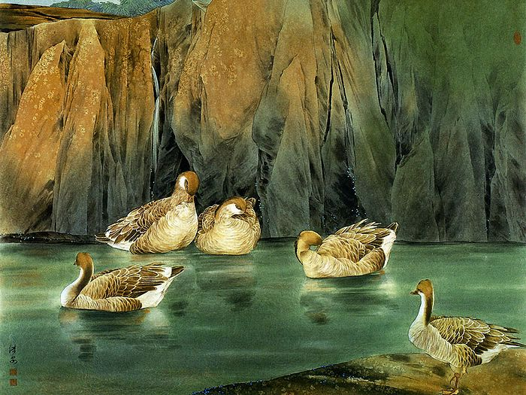
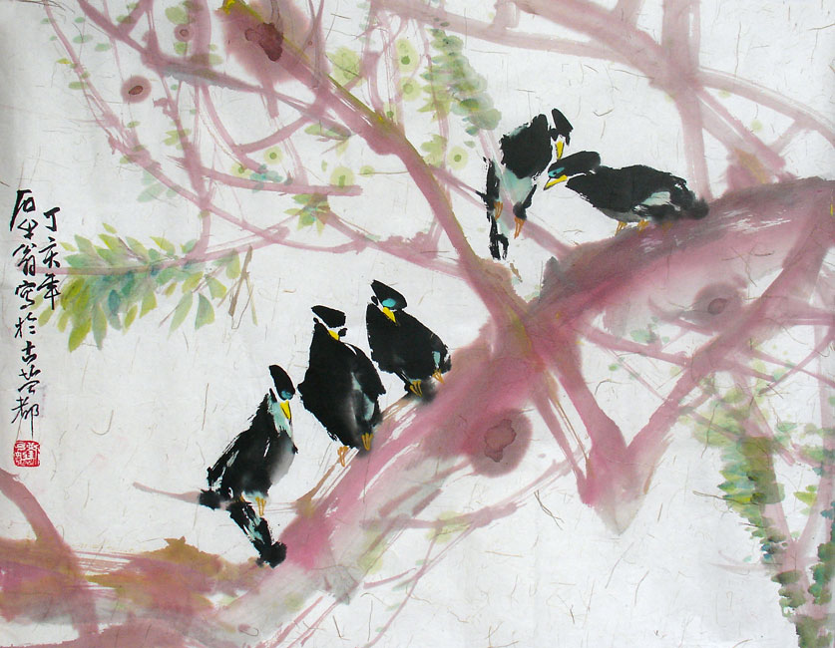
What are the 2 major categories of Chinese painting?

Slide 32
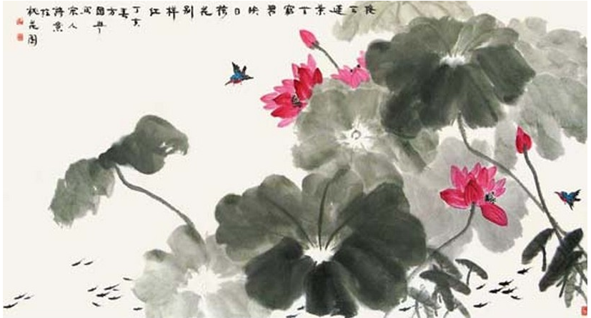
What are the 4 components of a Chinese traditional painting? How are painting and poetry related?

Slide 33
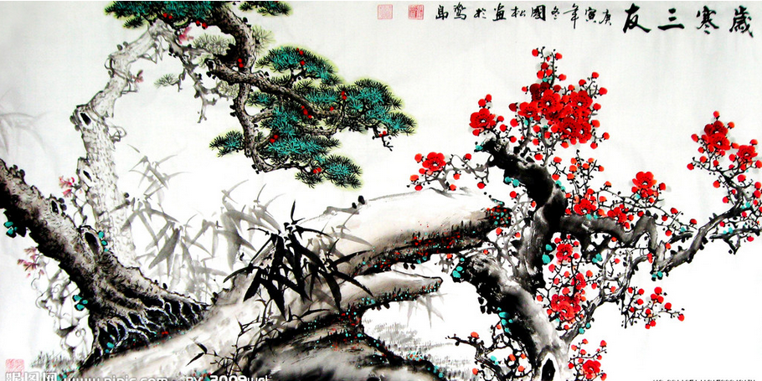
What are pines, bamboo and plum flowers symbolic of in Chinese traditional painting?

Slide 34
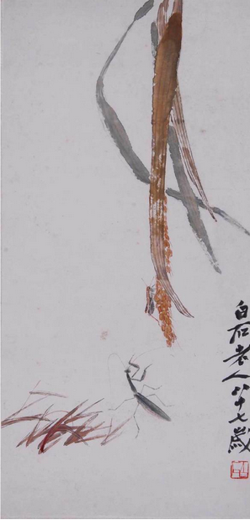
What is fascinating about Qi’s work?
齐白石《稻穗草虫》

Slide 35
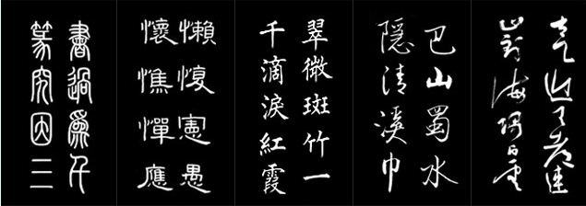
What 5 categories are Chinese scripts classified into?

Slide 36
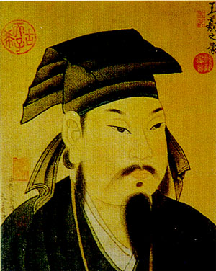
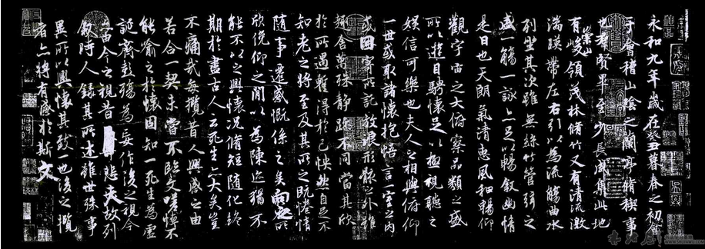
What do you know about Wang Xizhi?
王羲之《兰亭序》（Preface to the Orchid Pavilion Collection）

Slide 37
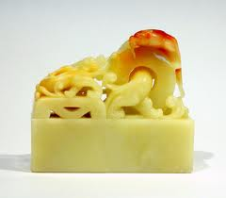
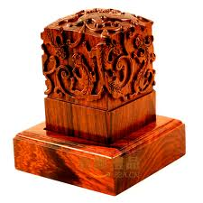
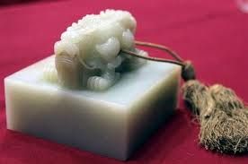
How long is the history of seal-cutting?
Jade\wooden seals

Slide 38
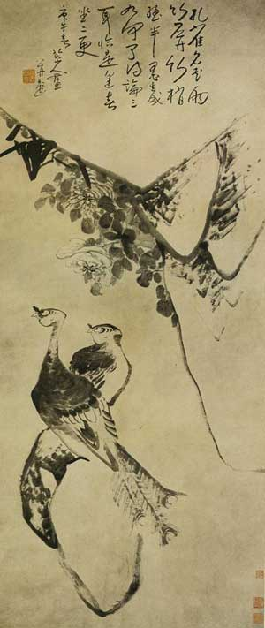
Why do the birds in Zhu Da paintings always hold their heads high? Why are their eyes strangely big?
《孔雀竹石图》

