Slide 1


The Rise of Mobile Payments
Alipay
WeChat Pay
Launched in 2004, Alipay pioneered online payments for e-commerce transactions.
Integrated into WeChat in 2013, it quickly became a daily necessity for millions.
By 2020, over 85% of smartphone users in China adopted mobile payment systems.

Slide 2





E-commerce: Reshaping Retail
Taobao Launch
JD.com Expansion
Live Commerce
Alibaba's C2C platform revolutionizes online shopping in China in 2003.
JD.com's B2C model gains traction, focusing on authentic products and fast delivery.
Integration of live streaming and e-commerce creates a new shopping experience. Like tiktok or Kuaishou

Slide 3


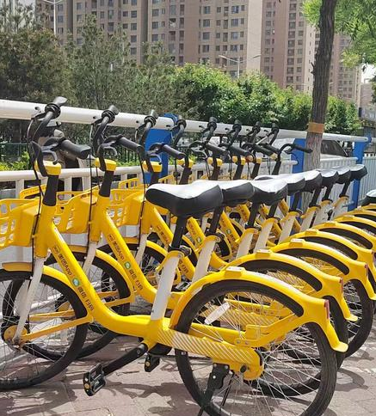
Bike-Sharing: Urban Mobility Reimagined
Year
Users (millions)
Bikes (millions)
2016
28
2
2018
235
23
2020
340
19

Slide 4


Disscustion:Challenges and Future Prospects
Pros
e.g:
Cons
e.g:
Potential for Global Expansion
Threats from Data Privacy
Chinese innovations are increasingly adopted and adapted worldwide.
Balancing innovation with user privacy remains a key challenge for tech companies.
Can you name more?

Slide 5



Summary
Ancient China
New China
Future China？

Slide 6
Question:
What do you think is the next new great invention that will change people's everyday routine?

Slide 7


Thanks for wathcing
主讲人：AiPPT 时间：20XX.XX

