Slide 1
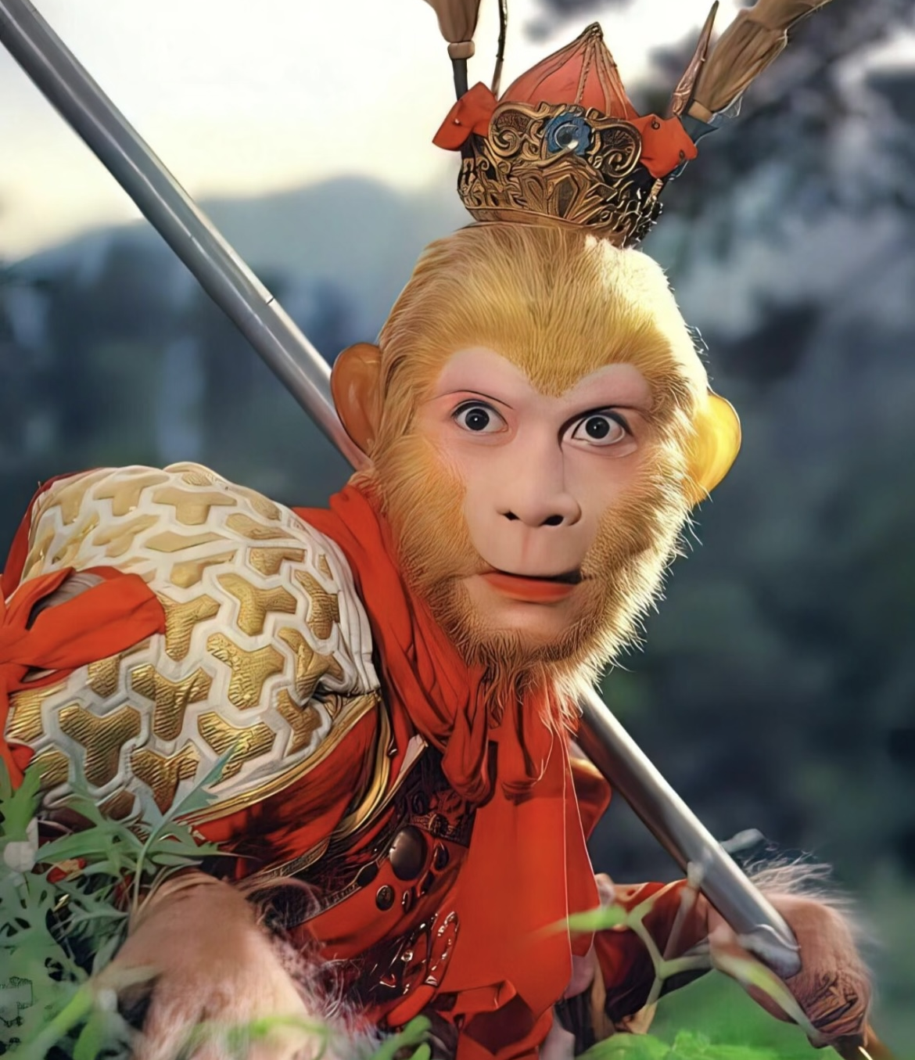
Sun Wukong
呔！俺老孙来也！
presenter：刘 丹

Slide 2
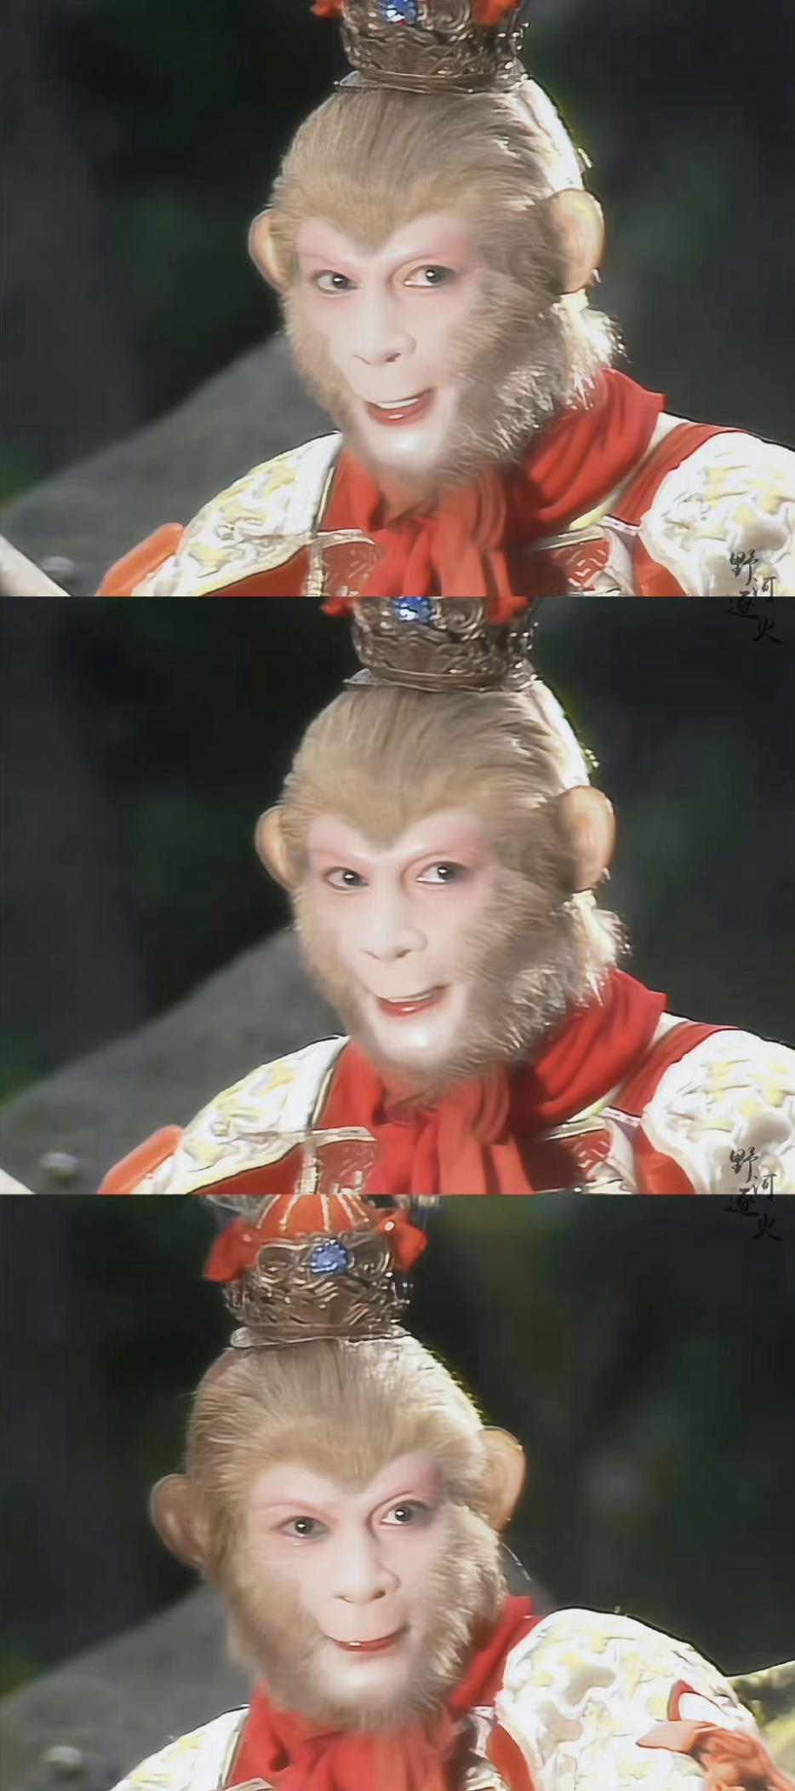
Brief Introduction
He is a main character in the classic novel Journey to the West.
He was born on the Flower-Fruit Mountain of the East Purvavideha Continent.
His other titles: Handsome Monkey-King; Sun Wukong; the Keeper of Horses; the Great Sage Equalling Heaven; Victorious Fighting Buddha

Slide 3
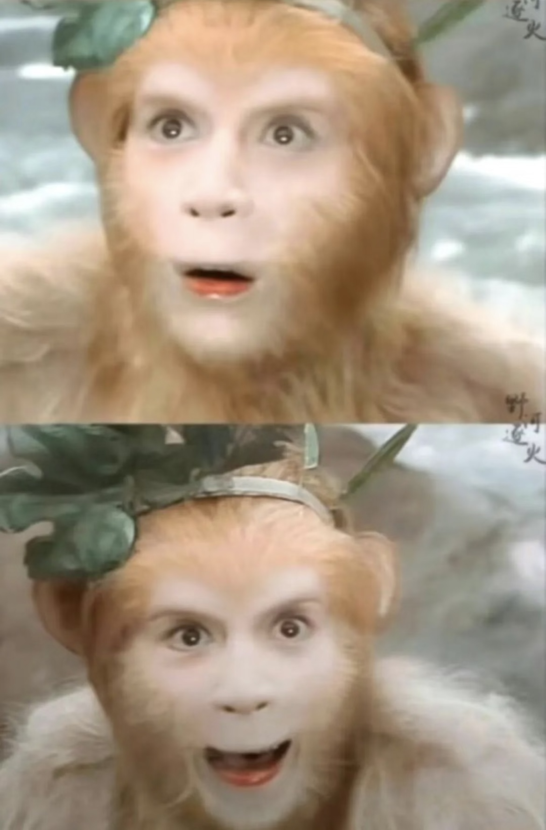
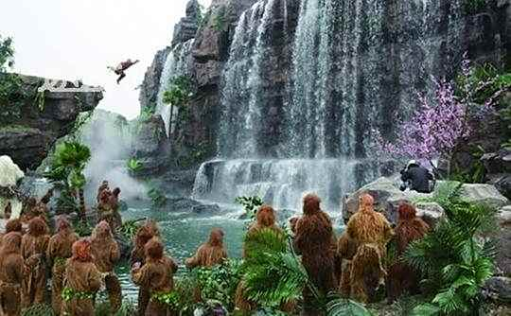
Becoming the “Handsome Monkey-King”
Sun Wukong led the monkey group to discover the Water Curtain Cave.

Slide 4
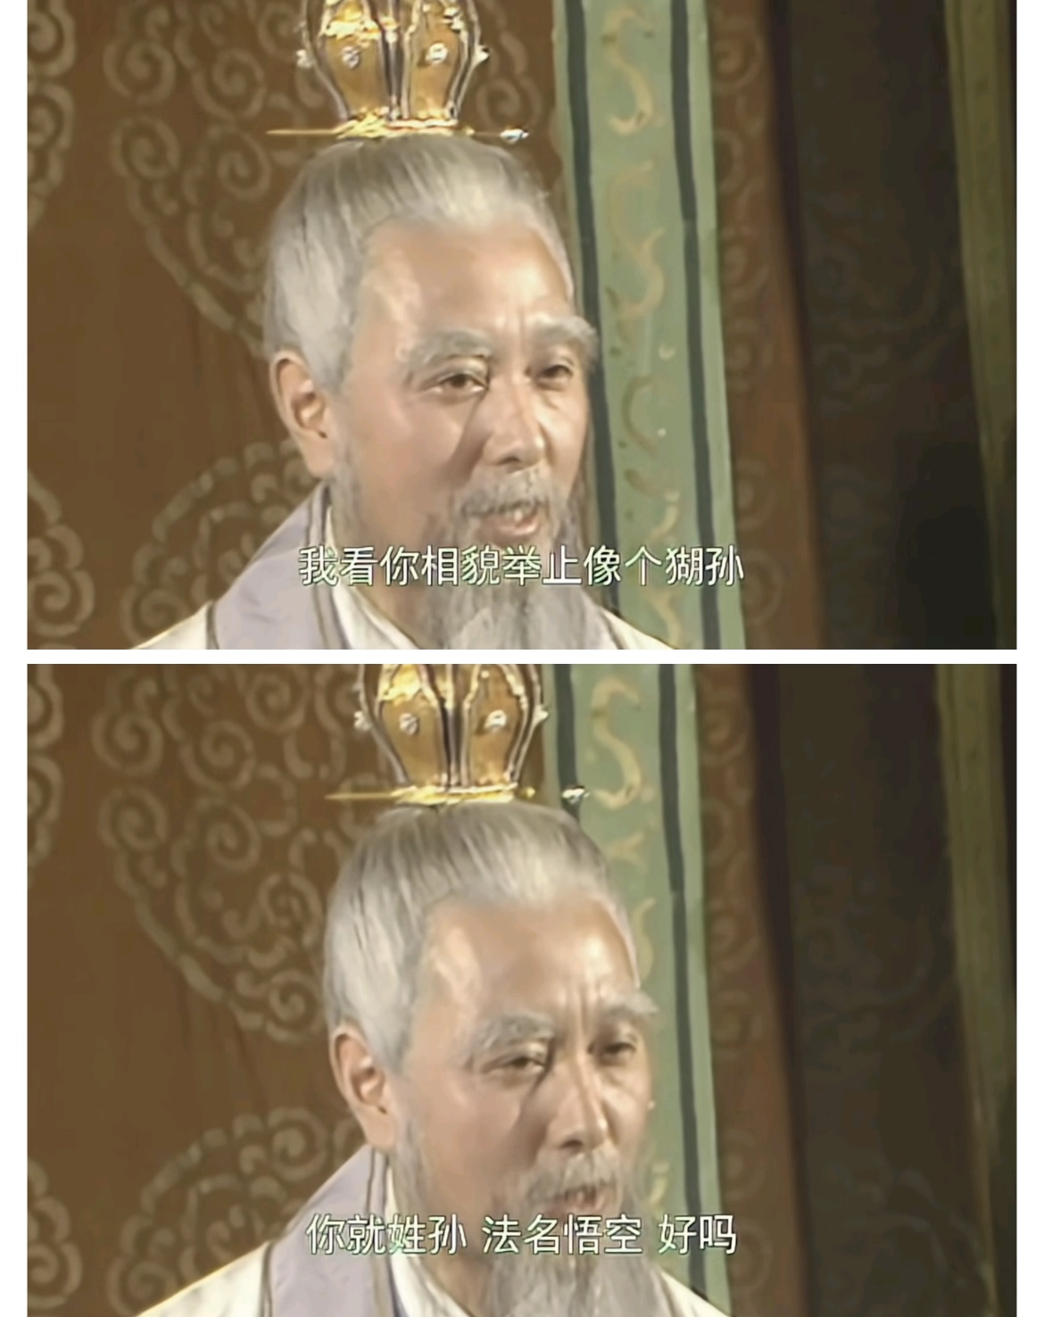
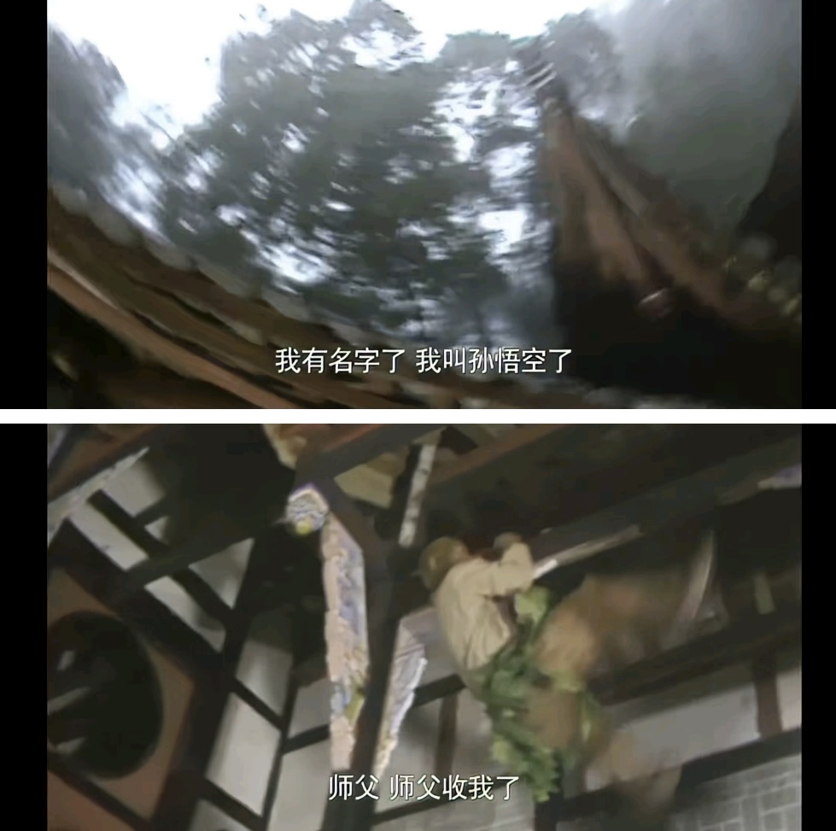
Learning Skills from Subhuti
Subhuti named him “Sun Wukong”.
“Sun”（孙） has the similar pronunciation with the word “monkey” in Chinese.（猢狲）
“Wukong”（悟空） is a Buddhist term that means “to comprehend the emptiness”.

Slide 5
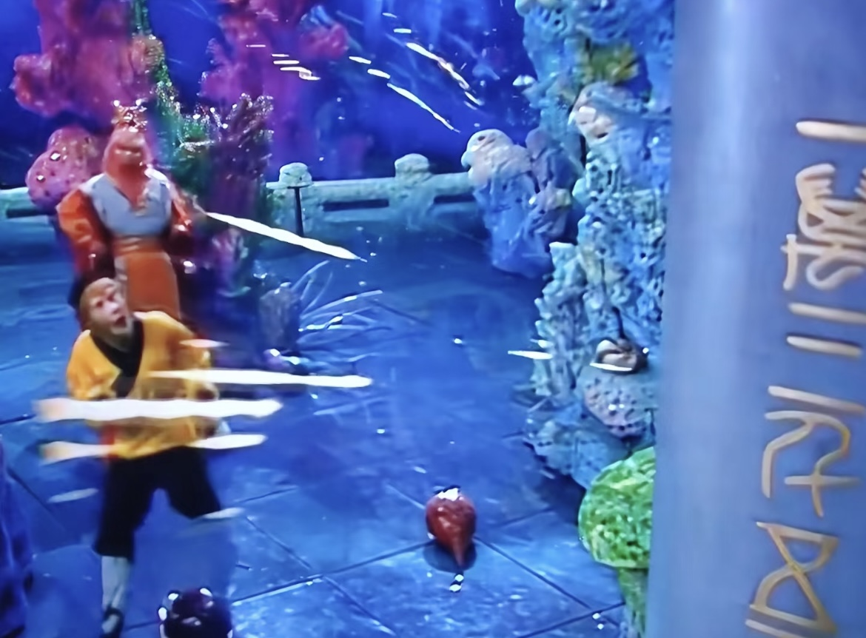
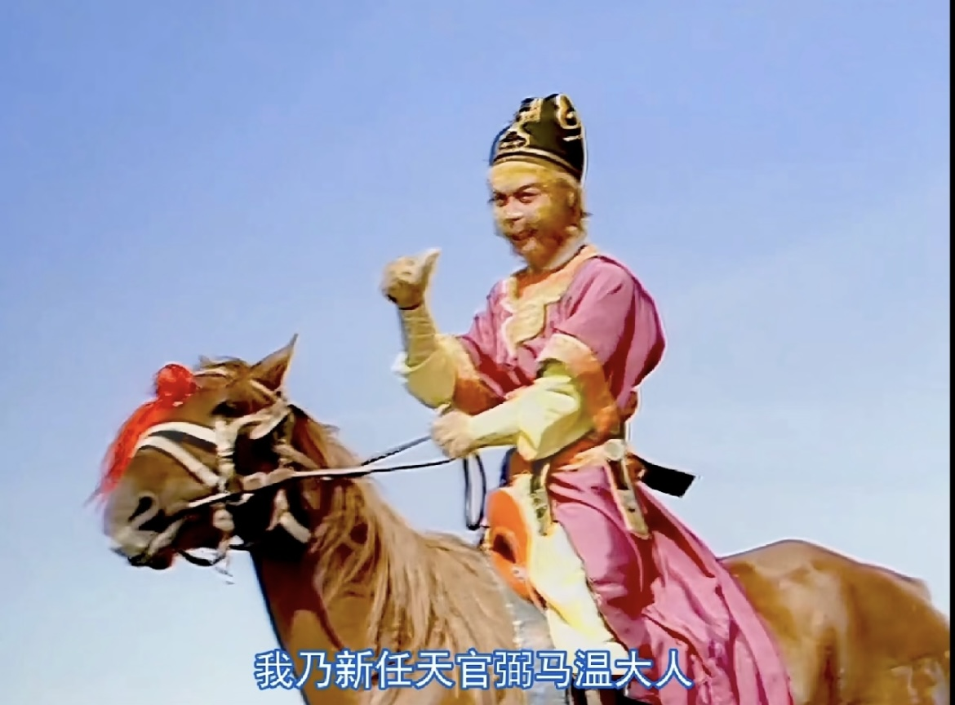
Havoc in Heaven
He acquired a suitable weapon—the Gold-Banded Cudgel. Later, he ruined the book of life and death.
The Emperor appointed him as “the Keeper of Horses”.
Sun Wukong declared himself as the “Great Sage Equalling Heaven”.

Slide 6
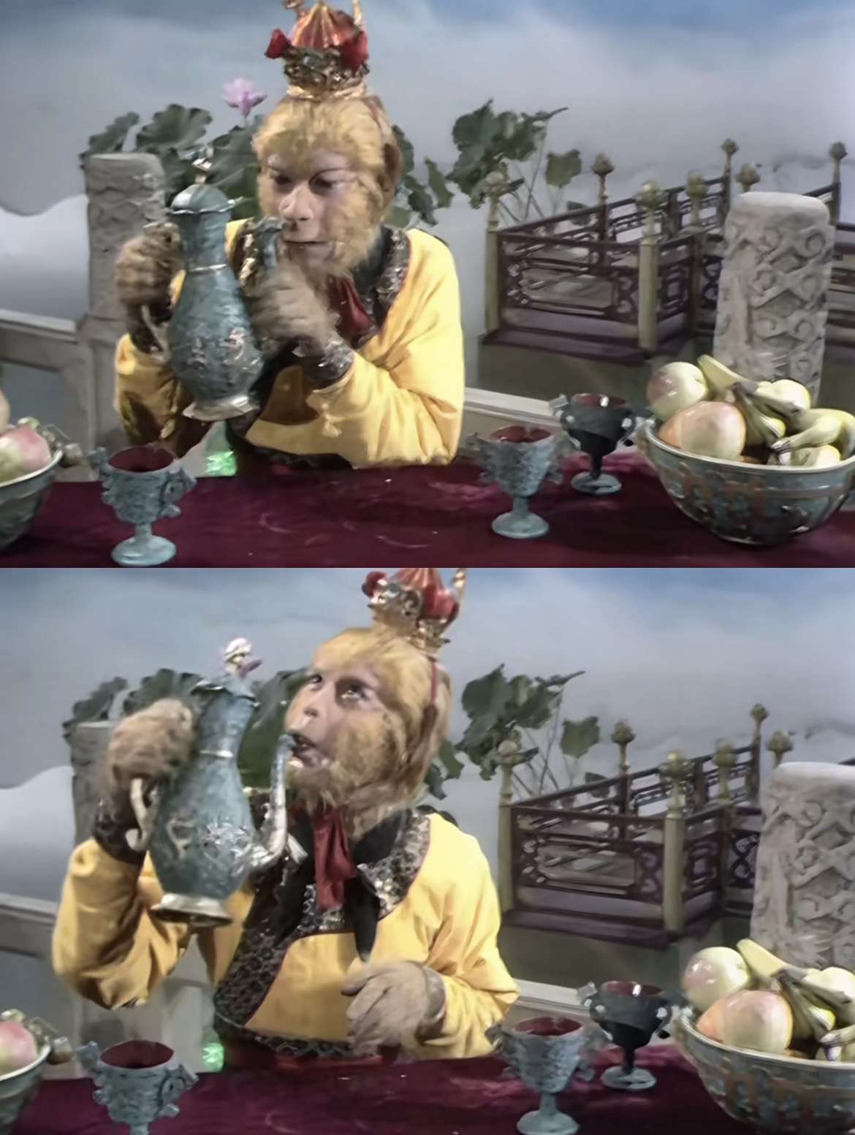
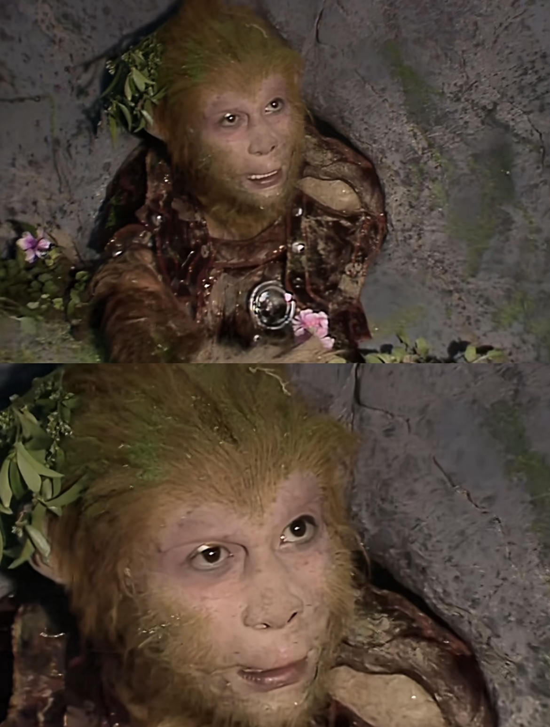
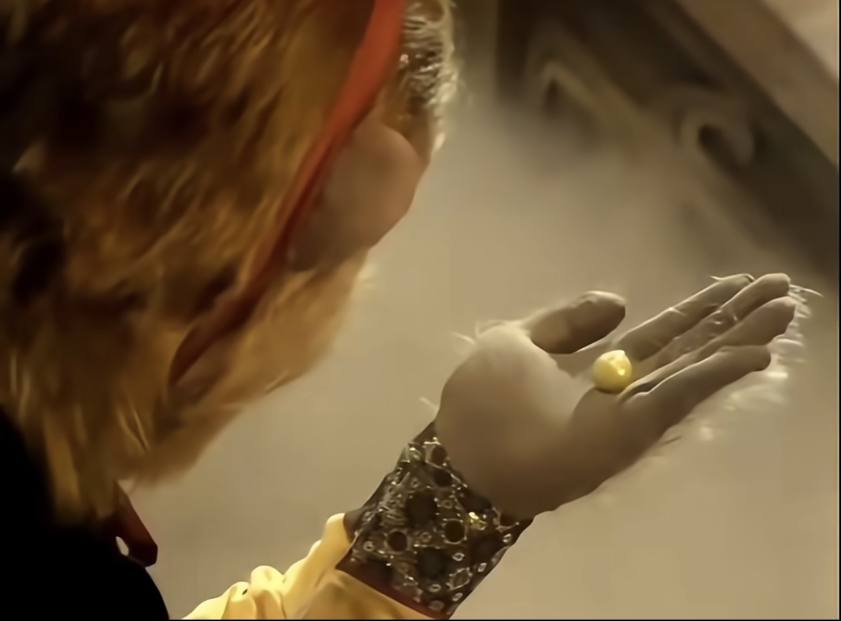
Havoc in Heaven
Sun Wukong caused troubles, ate the golden pills, and engaged in fierce battles with the celestial troops.

Slide 7
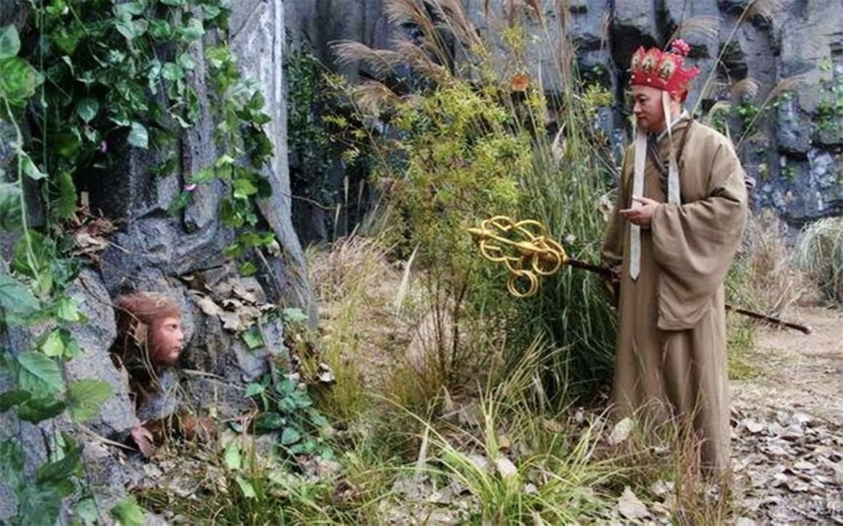
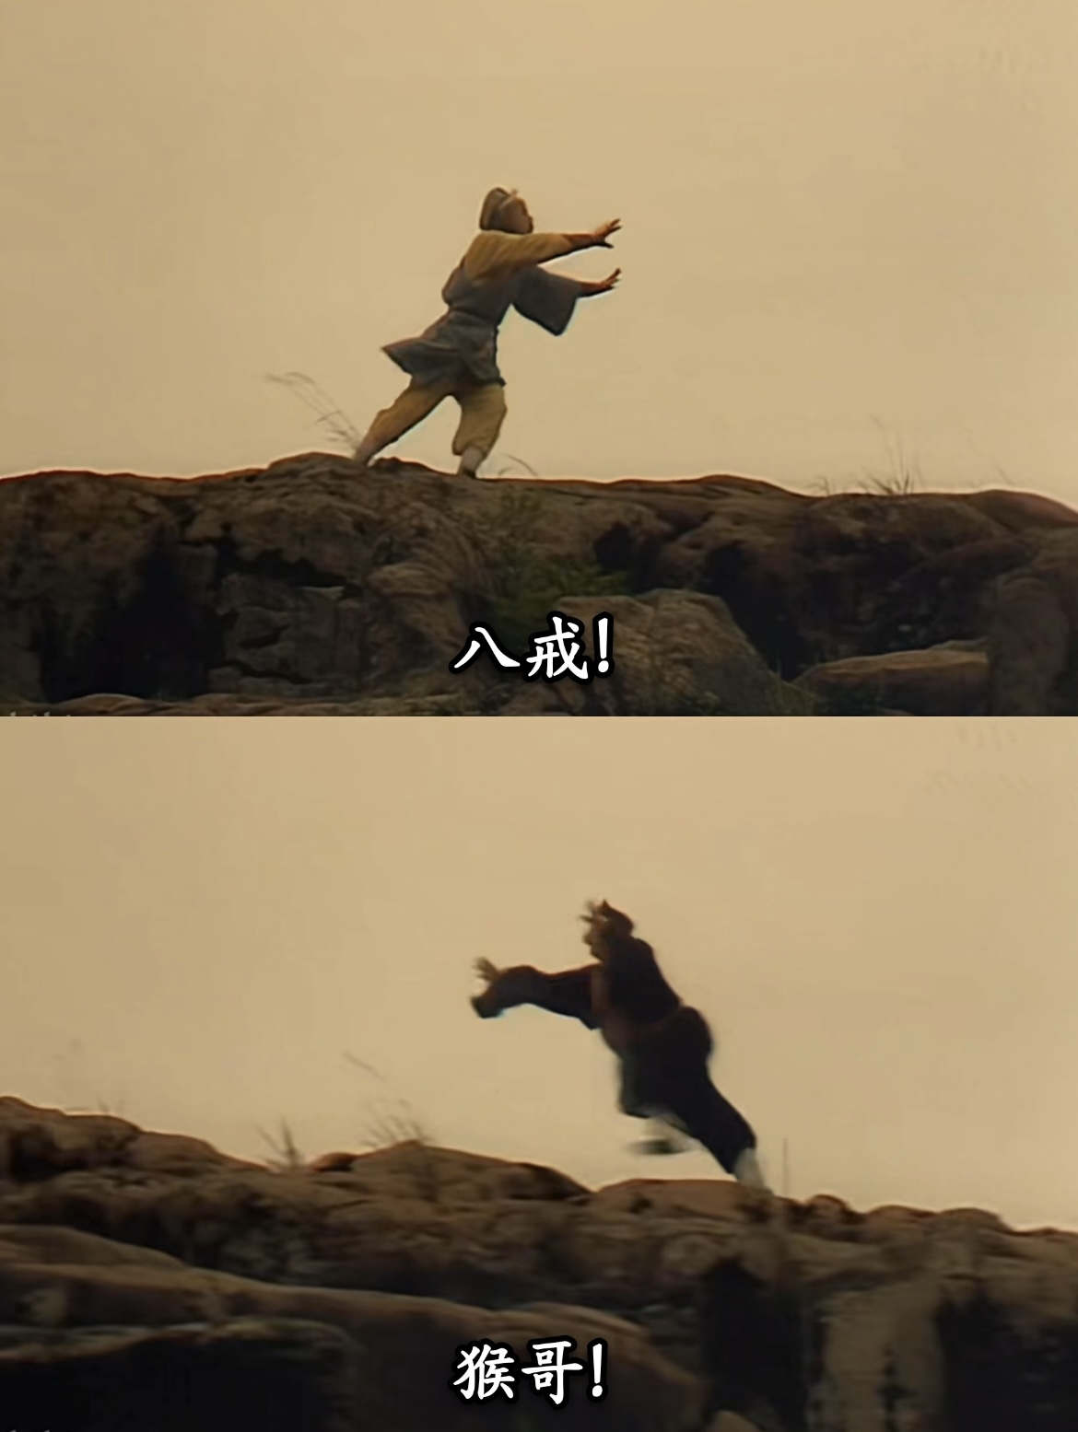
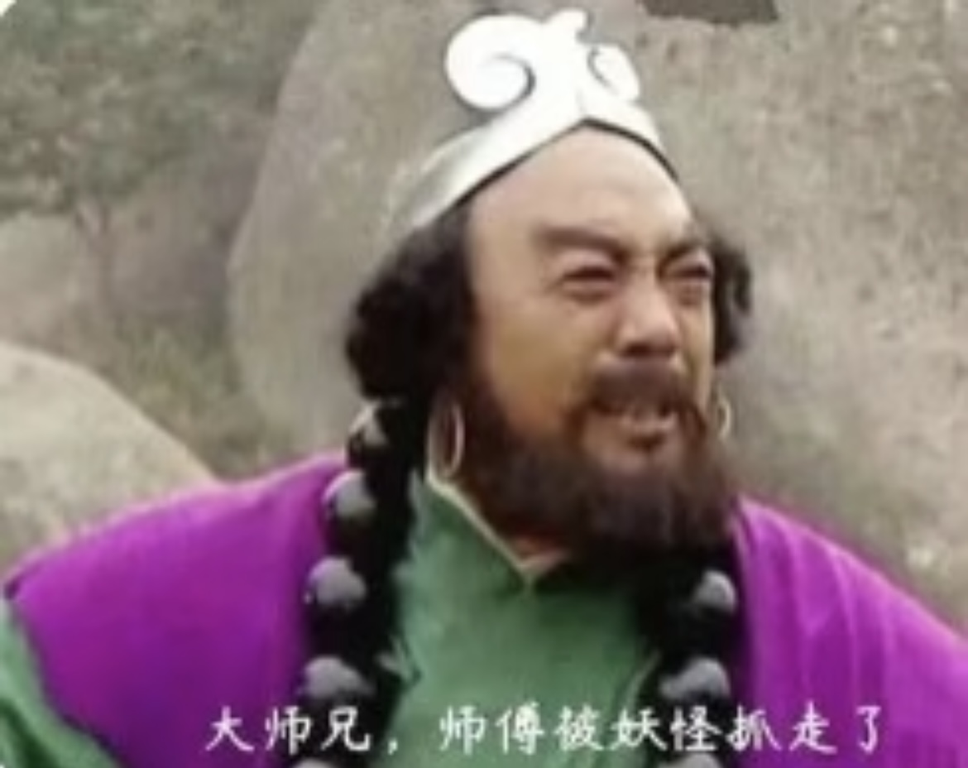
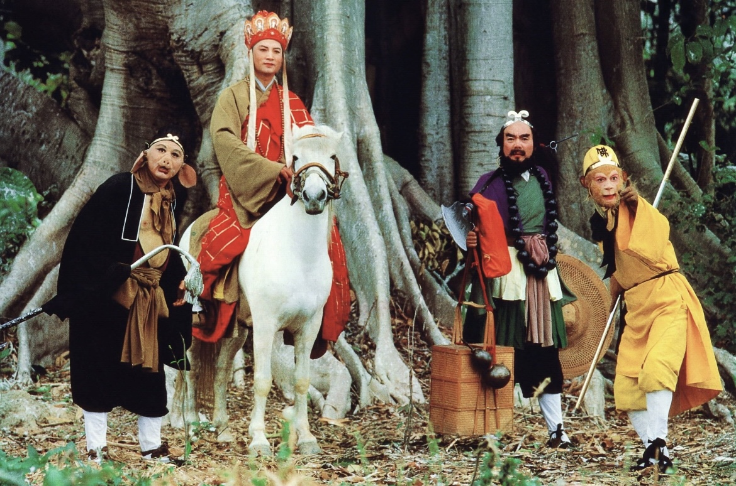
Journey to the West
Sun Wukong was rescued by Tang monk and became his disciple.
He set out on the journey to achieve the Sutras.
大师兄，师父被妖怪抓走了！
大师兄，二师兄被妖怪抓走了！
大师兄，师父和二师兄都被妖怪抓走了！

Slide 8
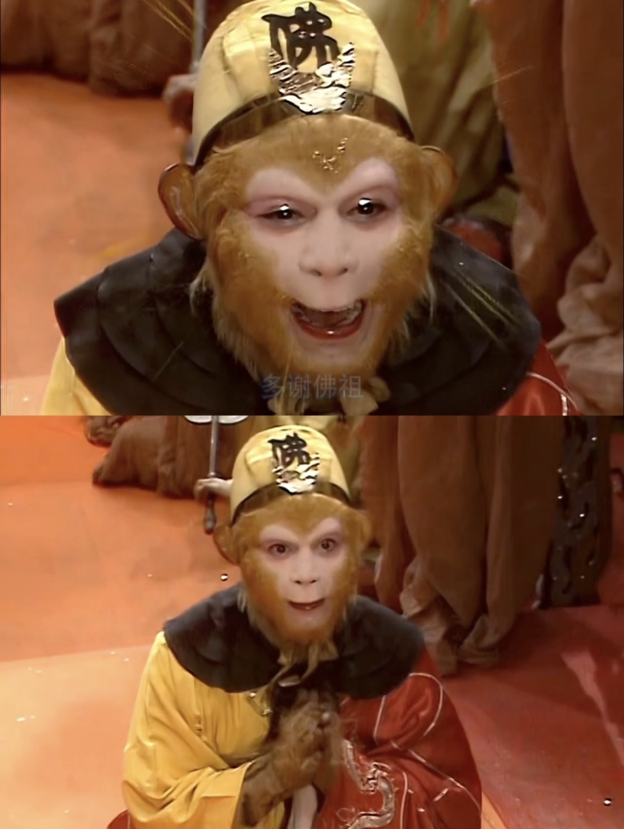
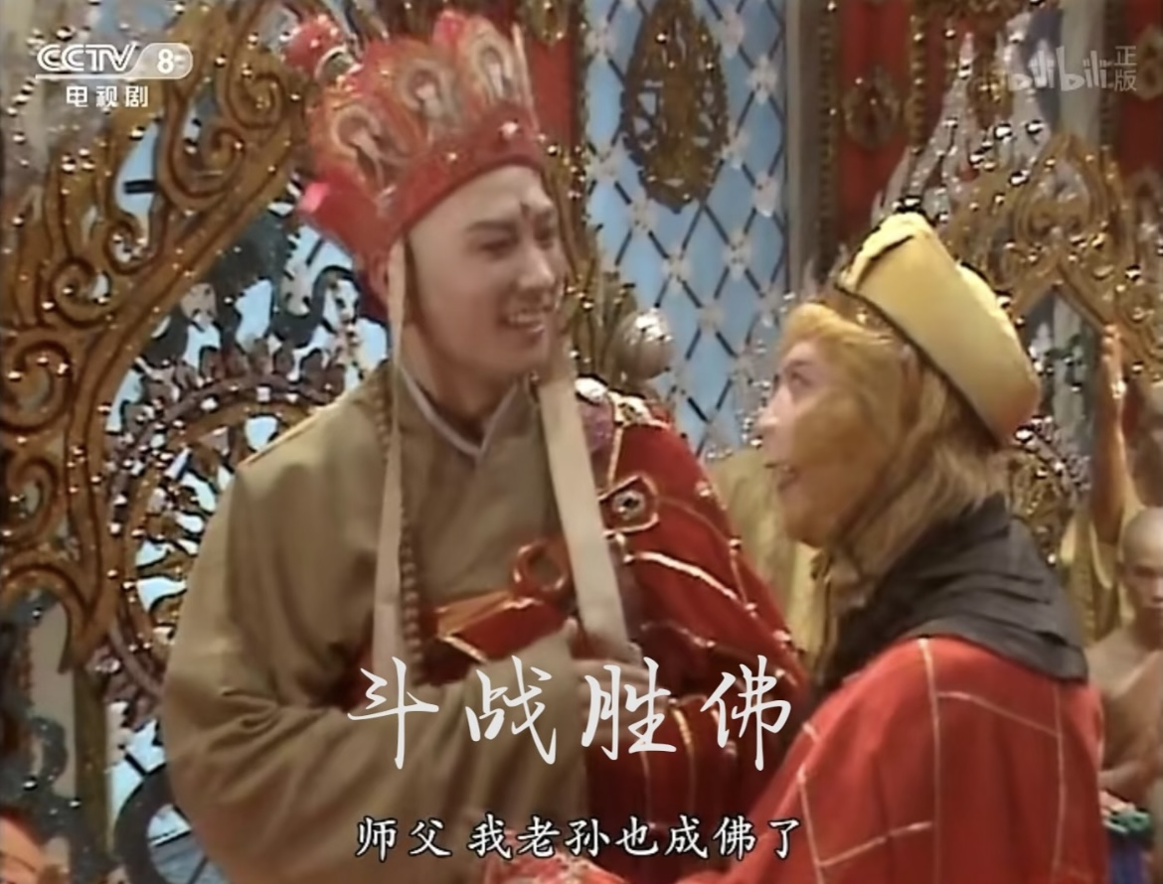
Journey to the West
He reached the Thunder Temple in the West and got the true Sutras.
The Buddha bestowed upon him the title of “Victorious Fighting Buddha”.

Slide 9
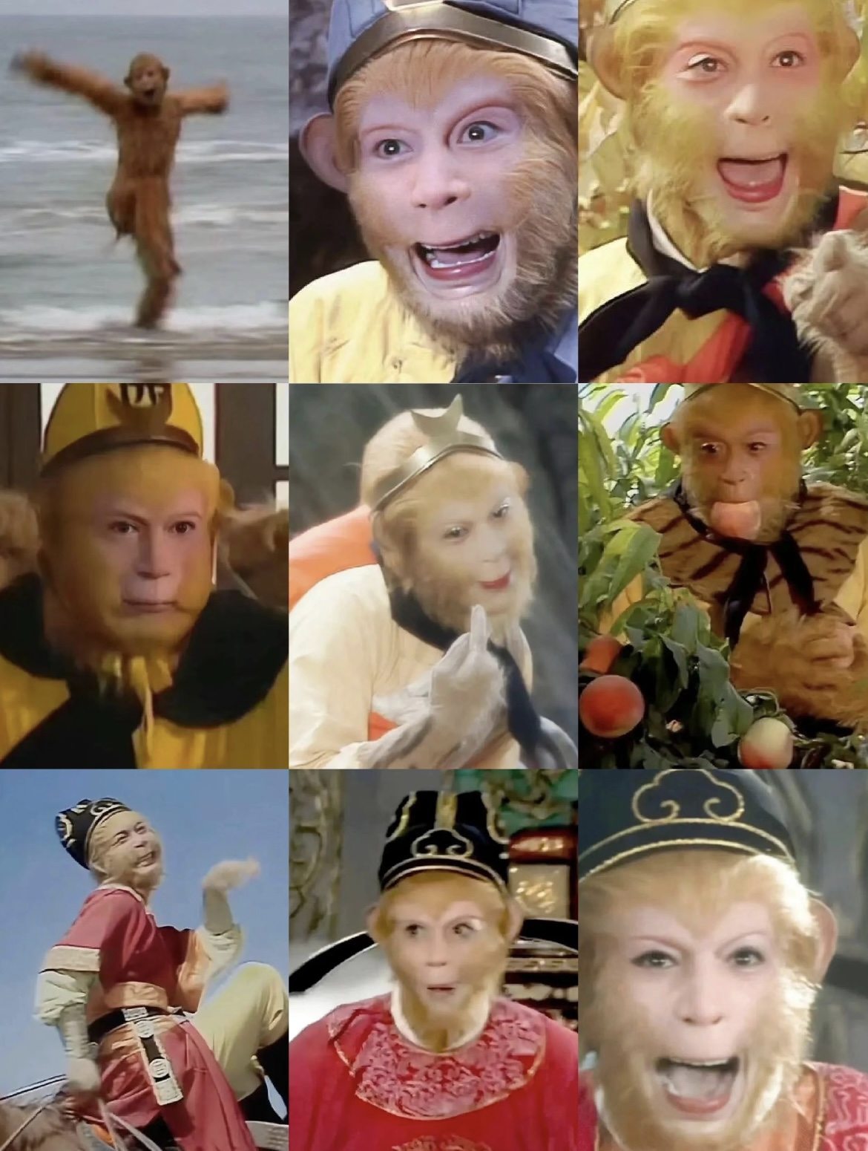
Sun Wukong’s Personality
He is the representative of courage and rebellion.
He is positive and optimistic.
He is just and kind.

Slide 10
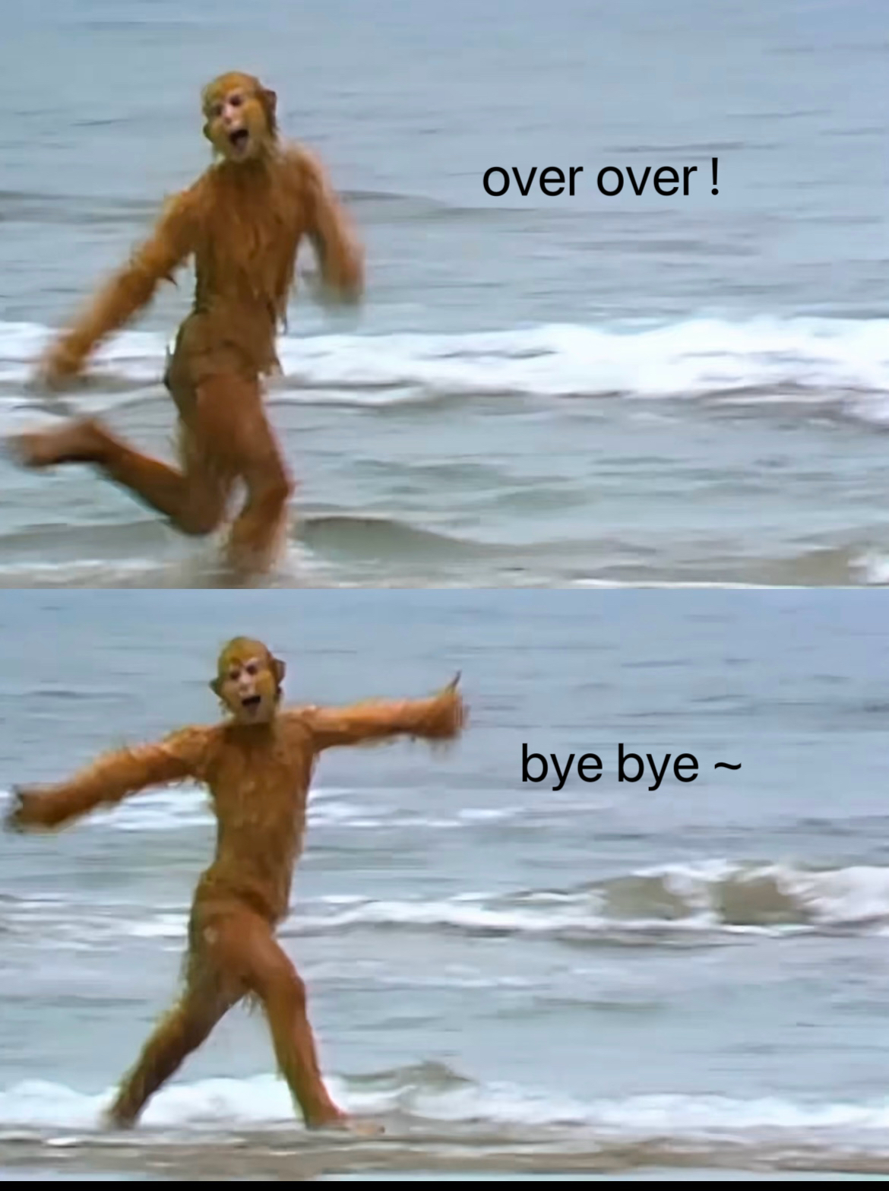
Thank you !
资料来源：百度百科；小红书

