Slide 1
Chinese Language and Culture
Zhang Qian and the Silk Road
Presenter: Li Liqin
Partner: Guo Lu
2020.12.28

Slide 2
Introduction of Zhang Qian
Two Missions to the Western Regions
CONTENT
Significance
Translation Tips

Slide 3
PART 01
Introduction of Zhang Qian

Slide 4
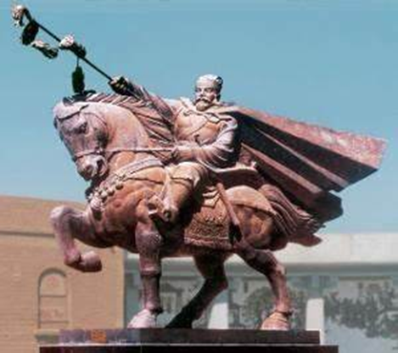
Introduction
Born: 164 BC in Hanzhong, Shaanxi, China
Died: 114 BC
Occupation: serve as a Gentleman(郎) from 140 BC and 134 BC /explorer / official / diplomat in the Han Dynasty
Title: “The first Chinese to see the world with eyes opening”;
“The pioneer of the Silk Road”;
“The Columbus in the East”.
Contribution: Cultural and economic exchanges/ prosperity of China in the Han Dynasty/ add vitality to the whole world.

Slide 5
PART 02
Zhang Qian’s Two Missions to the Western Regions

Slide 6
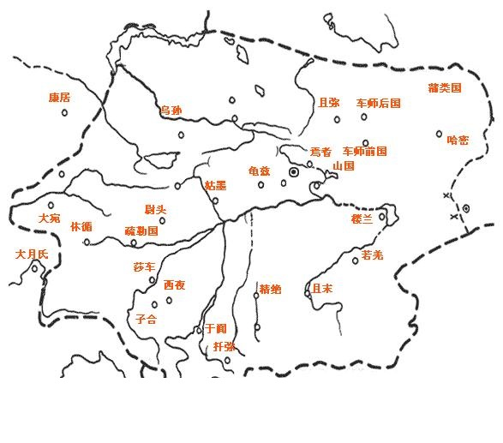
Western Regions
In the narrow sense:
The west of Yumen Pass and Yangguan
The east of today's Pamir Plateau
The southeast of Balkhesh Lake
The southernmost point: Xinjiang
In the broad sense: Refers to broader areas that can be reached through the geographic location of western regions in the narrow sense, including the central and western regions of Asia.

Slide 7
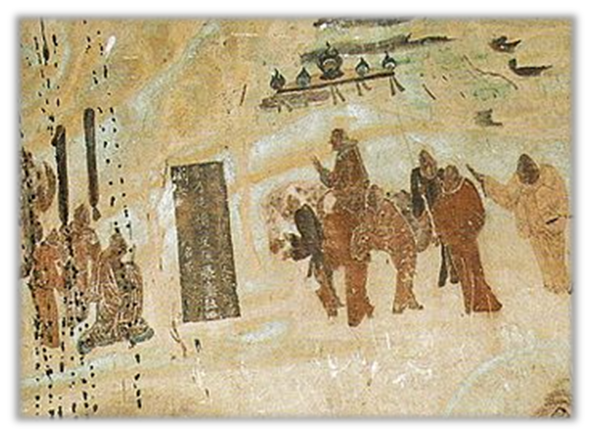
The First Mission 139 BC - 126 BC
Background
1
36 small states scattered around the Tarim Basin
The nomadic Xiongnu tribes controlled what is now Inner Mongolia and dominated the Western Regions (the areas neighbouring the territory of the Han Dynasty)
The exploitation and enslavement of the Xiongnu
Darouzhi was defeated by the Xiongnu and bore grudge
2
Purpose
The Emperor Wu was determined to remove the threat and made active preparations for the military counterattack.
Unite with the Darouzhi to attack the Xiongnu.

Slide 8
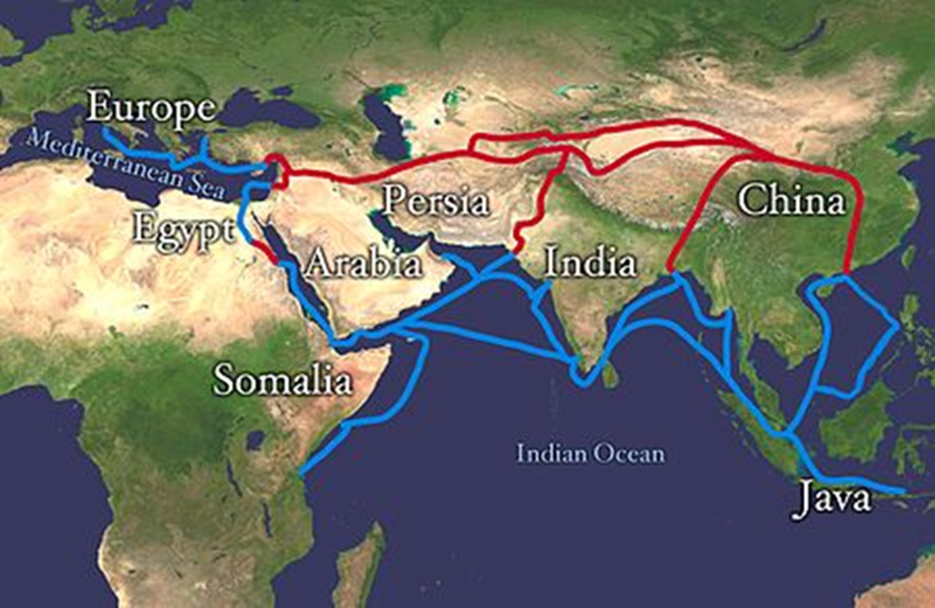
The First Mission 139 BC – 126 BC
3
Process
In 139 BC, Zhang Qian led more than 100 men to ride horses westward from Chang 'an (today’s Xi 'an). After entering the Hexi Corridor, he was captured by the Xiongnu, detained for ten years. After many tribulations, Zhang Qian finally reached the Darouzhi, but by this time the Darouzhi had settled down and the King had no desire to revenge.
4
Result
Zhang failed to achieve his goal and returned to Chang 'an, the capital of the Han Dynasty, in 126 BC.

Slide 9
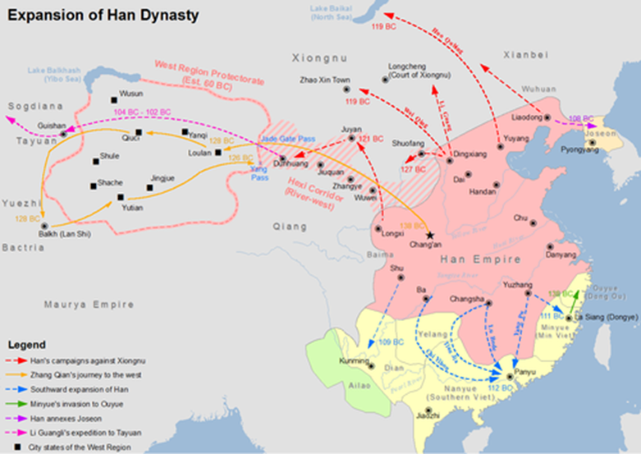
The Second Mission 119 BC – 115 BC
1
Background
The conflicts between the Wusun and the Xiongnu
The Han Dynasty won a great victory in the third military counterattack against the Xiongnu
2
Purpose
Prevent the power of Xiongnu from rising again
Persuade the Wusun ruler to wage a united war against the Xiongnu

Slide 10
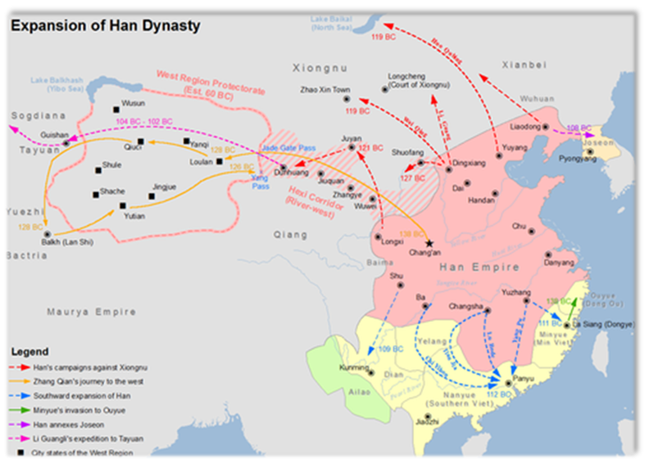
The Second Mission 119 BC – 115 BC
3
Process
Zhang Qian led a diplomatic mission of 300 people, each equipped with two horses.
They carried silk, gold and more than 10,000 cattle and sheep.
They failed to persuade the ruler and unite with the Han empire.
The Wusun ruler dispatched dozens of emissaries back to China.
4
Result
The purpose of contacting Wusun and attacking Xiongnu was still not achieved.
Established friendly relations with western countries and strengthen economic and cultural exchanges.

Slide 11
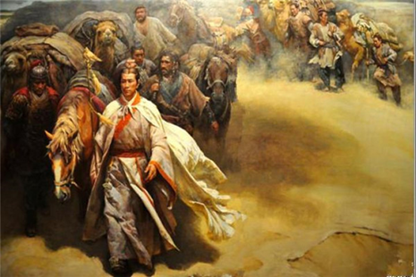
PART 03
Significance

Slide 12
Zhang Qian and the Silk Road
Significance 1
The Silk Road gets its name from the lucrative Chinese silk trade, a major reason for the connection of trade routes into an extensive transcontinental network.
Besides, it laid the foundation of the present Silk Road: China put forward the strategic concept of One Belt And One Road, which revitalized the ancient silk road. The silk road has become an important historical symbol of "One Belt And One Road", which makes us hold high the banner of peaceful development and actively develop economic partnership with countries along the route.

Slide 13
Zhang Qian and the Silk Road
Significance 2
Zhang Qian’s missions to the Western Regions exposed him to local conditions and customs. As a result, the Han Dynasty began to understand the western regions and established friendly relationships. Later, the Protectorate of the Western Regions was established to handle official relations with the West, which laid a foundation for the government’s jurisdiction of the Western Regions.

Slide 14
Significance 3
Diplomatic construction
Significance 4
Economic and cultural exchanges
It advocated the diplomatic concept of equal and honest exchanges, thus building a bridge of friendly exchanges between The Han Empire and western countries, promoting the cultural and economic exchanges between the East and the West, laying a solid foundation for the prosperity of the Han Dynasty and the opening up of later generations.
Zhang Qian's mission to the West opened up land transportation between China and Central Asia, West Asia, South Asia and even to Europe. Since then, the Chinese have sold silk, tea, lacquer ware and other products to the West and Central Asia through this channel, while introducing gems, glassware and other products from Europe, West Asia and Central Asia.

Slide 15
PART 04
Translation Tips

Slide 16
Translation Tips
Transliteration
The Translation of the names of Chinese places should follow the Scheme of the Chinese Phonetic Alphabet. For example, Hanzhong (汉中), Daxia (大夏), Dayuan (大宛), Wusun (乌孙). However, In Xinjiang, some names of places are transliterated from the pronunciation of the minority nationalities since Xinjiang is home to many ethnic groups. For example, Turpan (吐鲁番)，Kashgar (喀什).
Conventionalization
Although the transliteration of some terms like Darouzhi (大月氏) and Kanfu are not accurate, it has been accepted and used by the public and has been used for a long time, so there is no need to change it, and this is called Conventionalization.

Slide 17
THANKS
Presenter: Li Liqin
Partner: Guo Lu
2020.12. 28

