Slide 1




How to Make People
Read Classics Again?
Xie Xiaoying

Slide 2



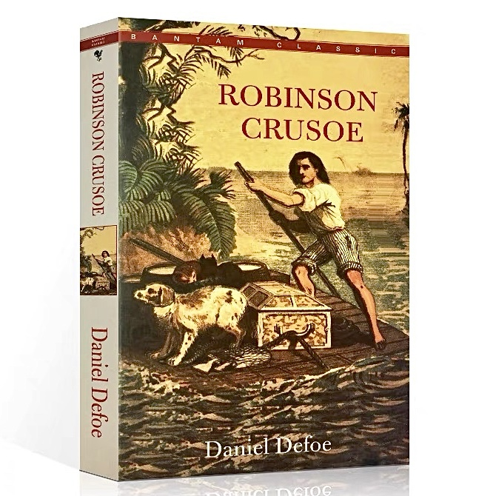
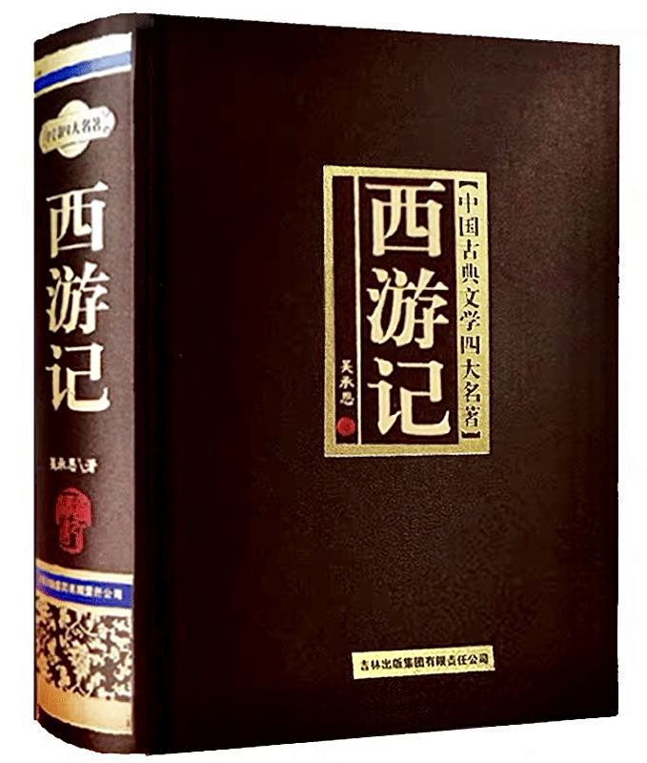
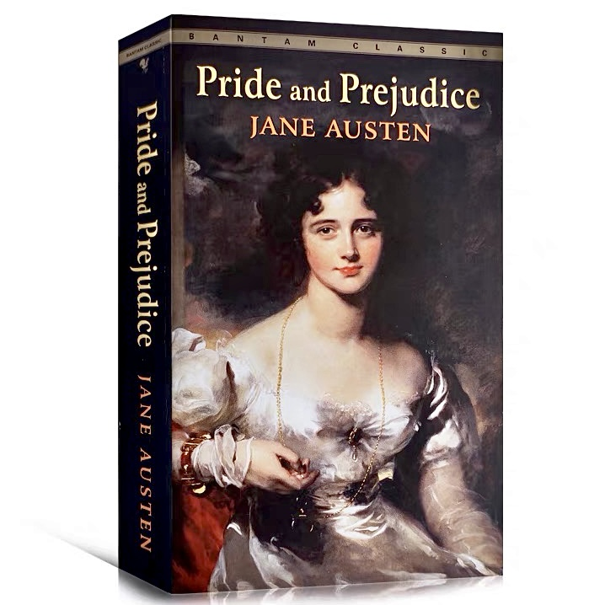
The classic refers to a book which is well known and considered to be of very high quality, setting standards for other books.

Slide 3





Reading classics can not only enable readers to acquire knowledge and broaden the horizon, but also help them edify the sentiment and purify the mind.
While in this Internet era, information explodes and is broken down into pieces during the process of dissemination. Therefore, people's reading habits have changed, showing a trend of fragmentation.

Slide 4
Fragmented reading refers to small amount of text reading within short and discontinuous time segments, whose main carriers include mobile phones, e-books, the Internet and other electronic terminals.
Such phenomenon does bring great challenges to the classics reading:
On the one hand, traditional paper books are increasingly neglected and the digital reading rate is rising sharply.
On the other hand, people's reading time is squeezed, so it's becoming more and more difficult to read classics nowadays.

Slide 5
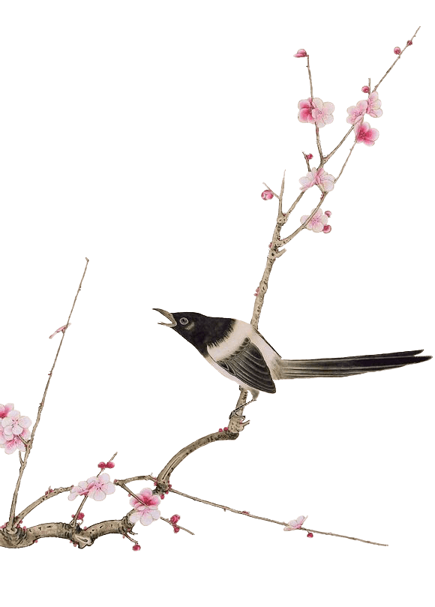
？
What Should Schools Do
to Make People Read Classics Again

Slide 6

1.
Relevant Courses Should Be Set Up
To deepen students’ understanding of classics, schools can set up various courses and let professional teachers to explain them in class.
The forms and contents should be diversified so that students can choose according to their own interests. For instance, those who want to know more about western culture may choose the course about western classics; And those who’re interested in Chinese literature may choose the course about Tang poems.

Slide 7

2.
Various Activities Should Be Held
Organizing activities, such as the debate, the writing competition, the sharing session and the knowledge contest, is an effective way to promote classics reading. Schools ought to provide more stages for students to learn about classics and share their opinions with others.
Moreover, schools can invite experts to give the speech or lecture on classics. There is no doubt that some people don’t read classics because of the difficulty in comprehension. If the expert explains them in detail and shares some useful skills, it will be much easier for students to read classics.

Slide 8
3.
Libraries Should Play a Role
As a main source of information in schools, the library is responsible for arousing students’ enthusiasm for classics reading by innovating the service, improving the quality of librarians, training the reading promoters, etc.
More resources, including the database and the
e-resource, should be provided for students. And the book review can be post online to attract more people to read classics. What’s more, librarians are supposed to be familiar with the books so as to recommend proper ones when students ask them.

Slide 9
4.
Teachers Should Set an Example
As the saying goes, “Teachers are not only disseminators of knowledge, but also models.” To promote classics reading, teachers themselves ought to have a good command of classics, guiding students to get a further understanding of classics.
It is suggested that teachers explore hot topics from the classics and discuss them in class, which may effectively enlighten students on classics reading. Besides, it is also a good idea for teachers to assign some reading tasks after class, to make students learn more about classics.

Slide 10
Thanks!

