Slide 1
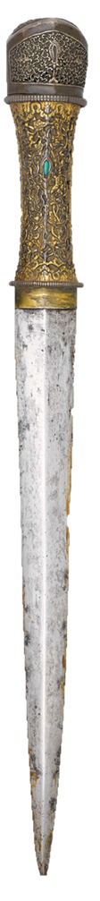
Chinese Ancient Weapons
英语口译 张潇然
MTI, English Interpretation Zhang Xiaoran
2025年10月16日

Slide 2
Ⅰ
Basic Concepts and Weapons’ Origin
Content
Ⅱ
Weapons and Their Evolution
Ⅲ
Contributions to Humanity
Ⅳ
Modern Mission

Slide 3
Ⅰ
Basic Concepts and Weapons’ Origin

Slide 4
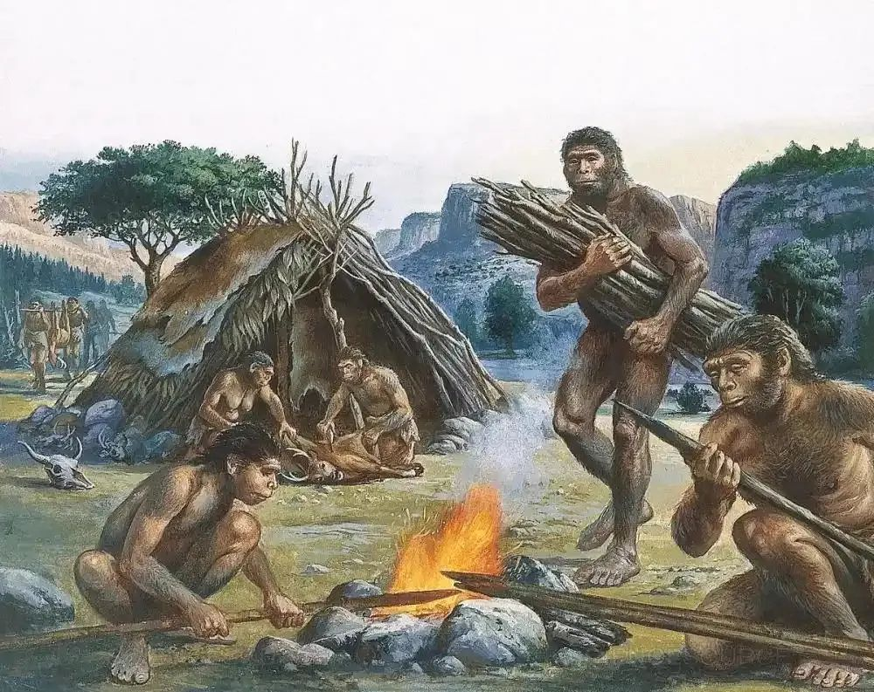
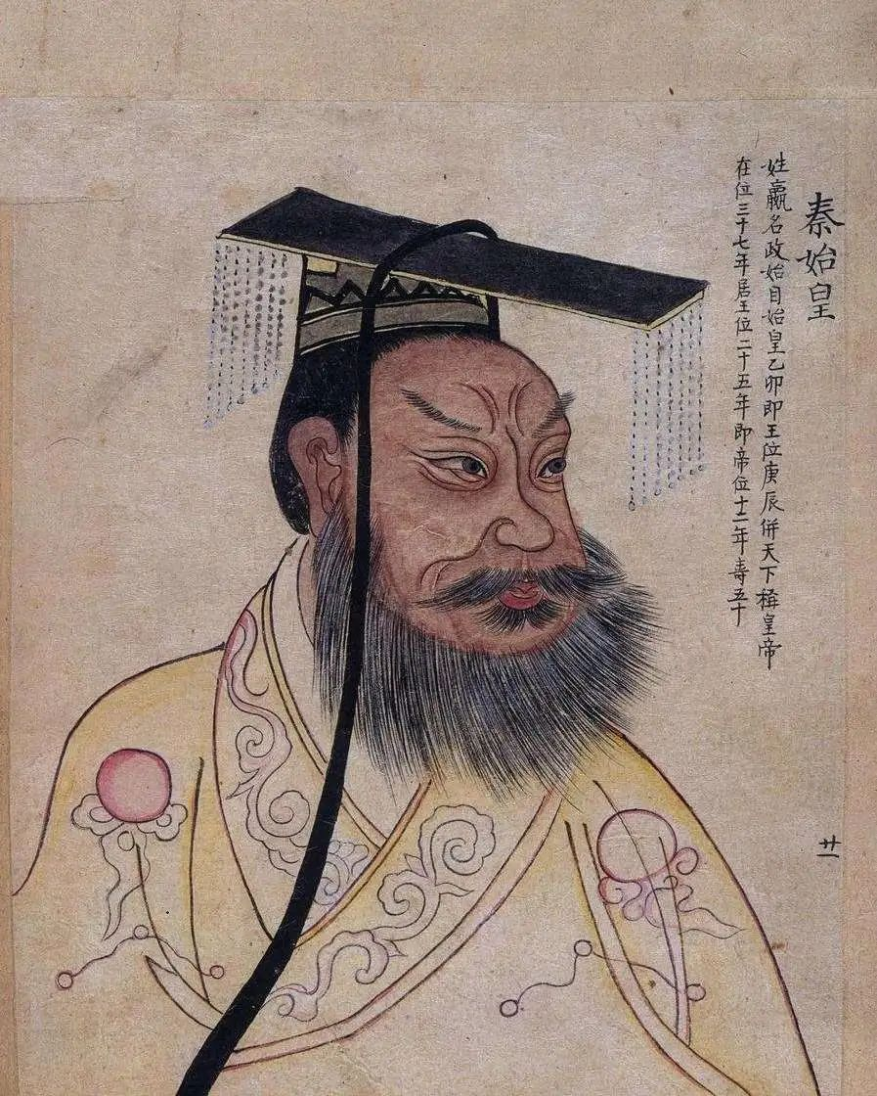
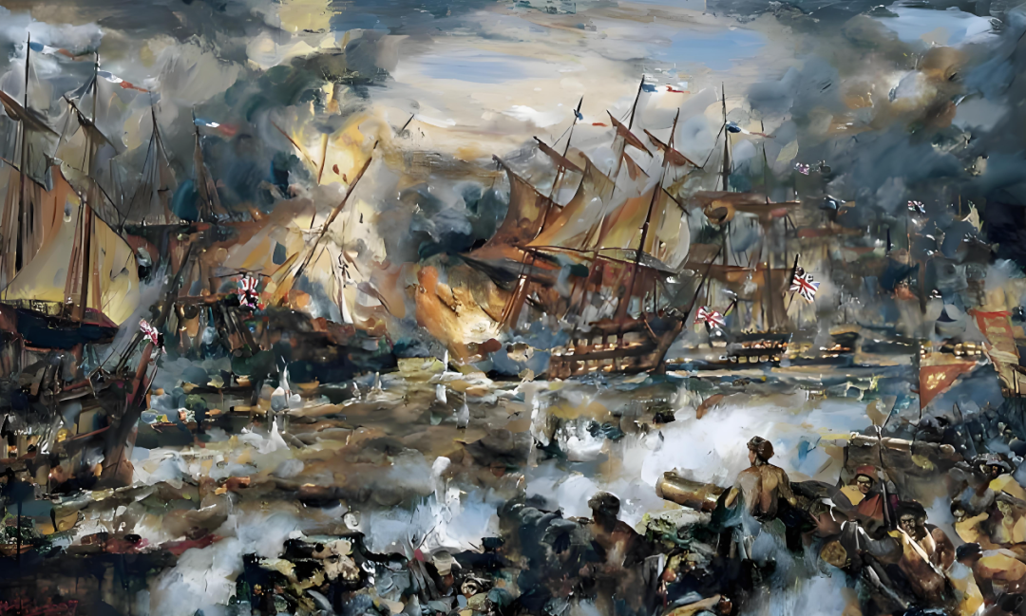
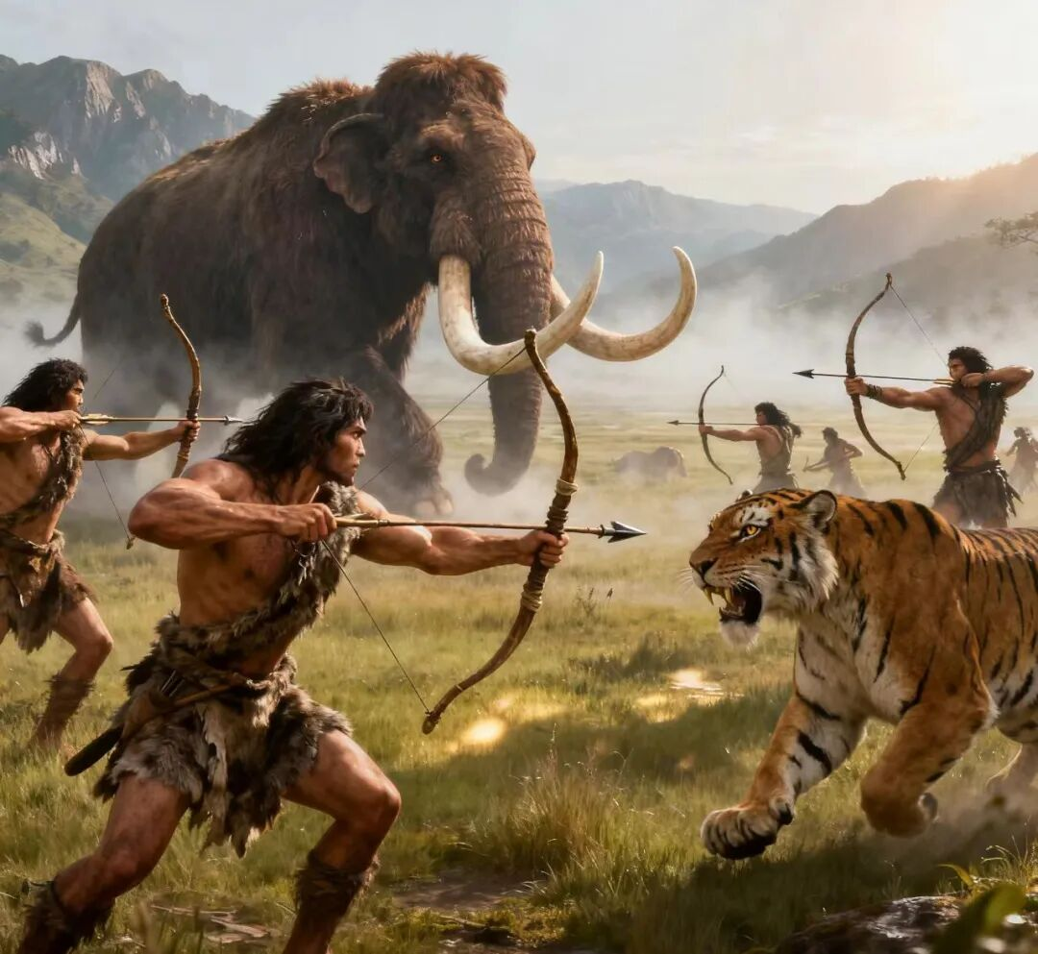
Basic Concepts and Weapons’ Origin
1
2
3
How do we define “weapon”?
Why do we use weapons?
What does “ancient” mean?

Slide 5
Ⅱ
Weapons and Their Evolution

Slide 6
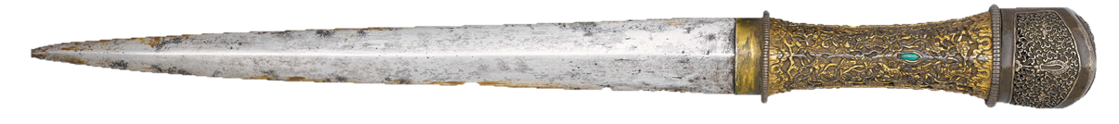
Weapons and Their Evolution
short weapons
long weapons
1
Stone Age weapons ( prehistoric period, not actually ancient China)
Bronze Age weapons(bronze)
Iron Age weapons(steel or mixed)
2
cold weapons
firearms(gunpodwer)
3

Slide 7
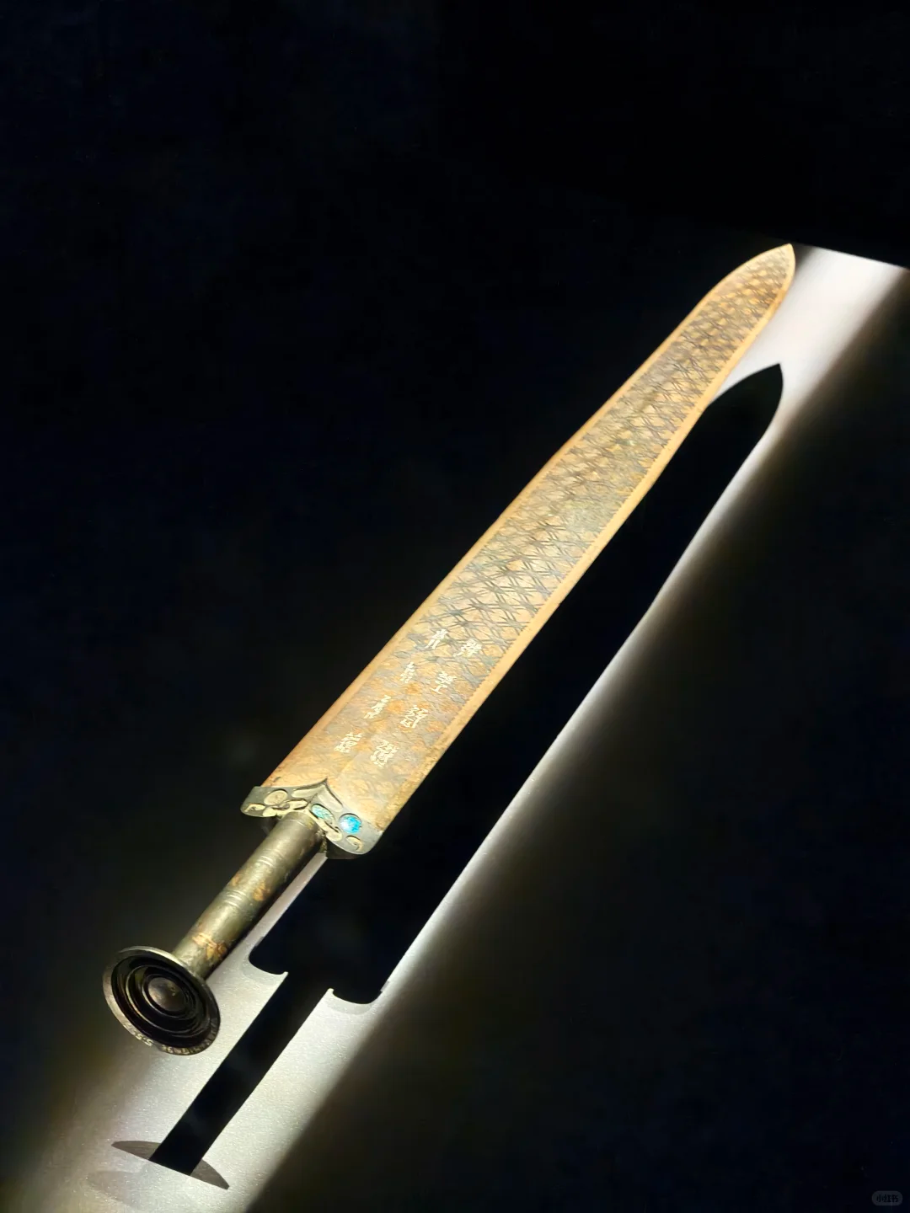
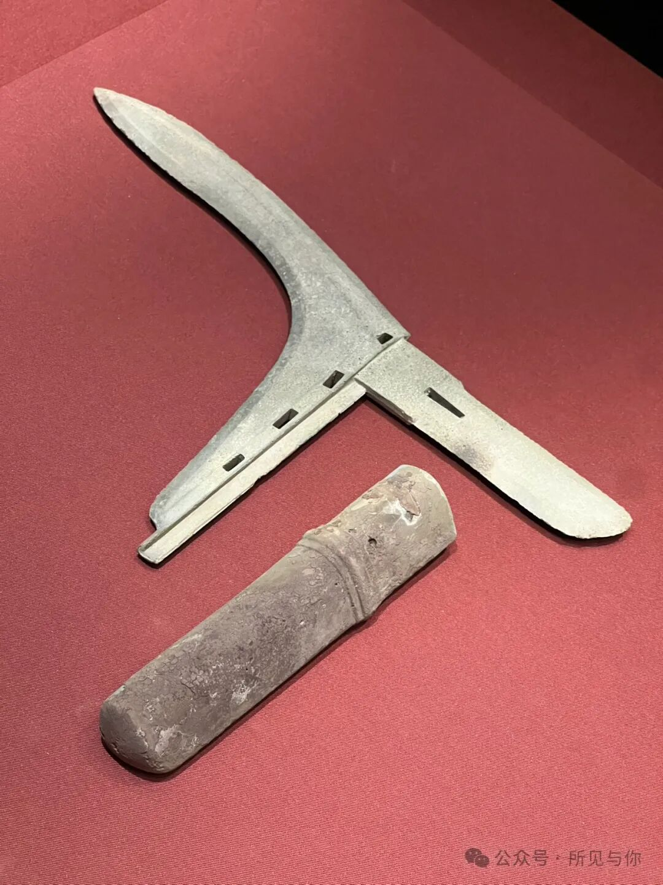
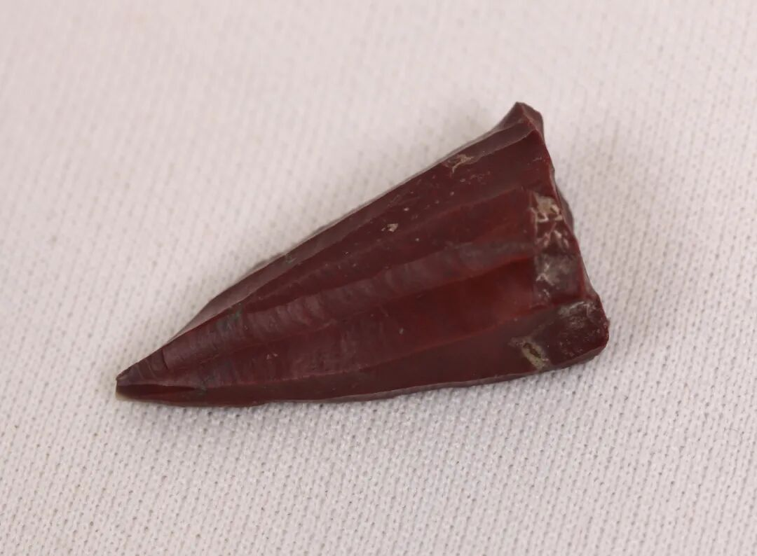
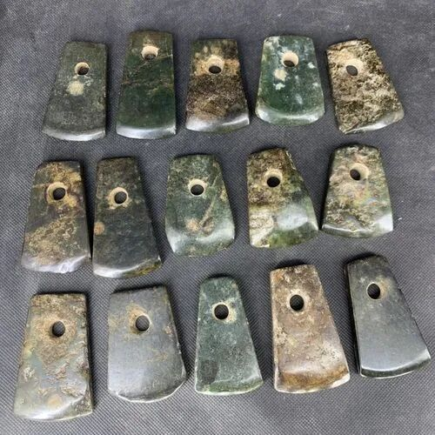
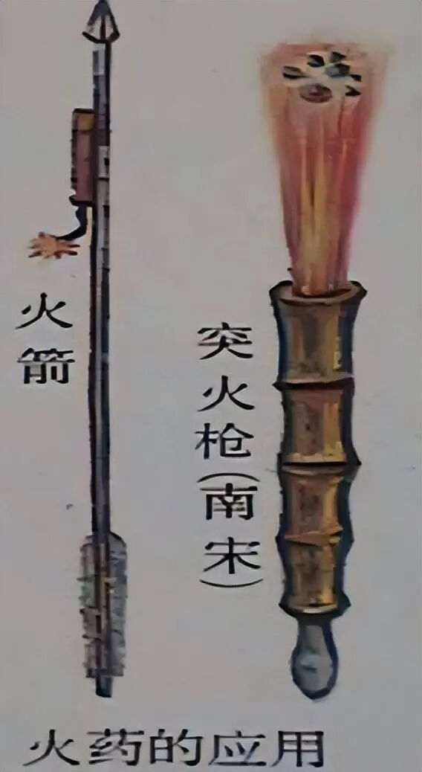
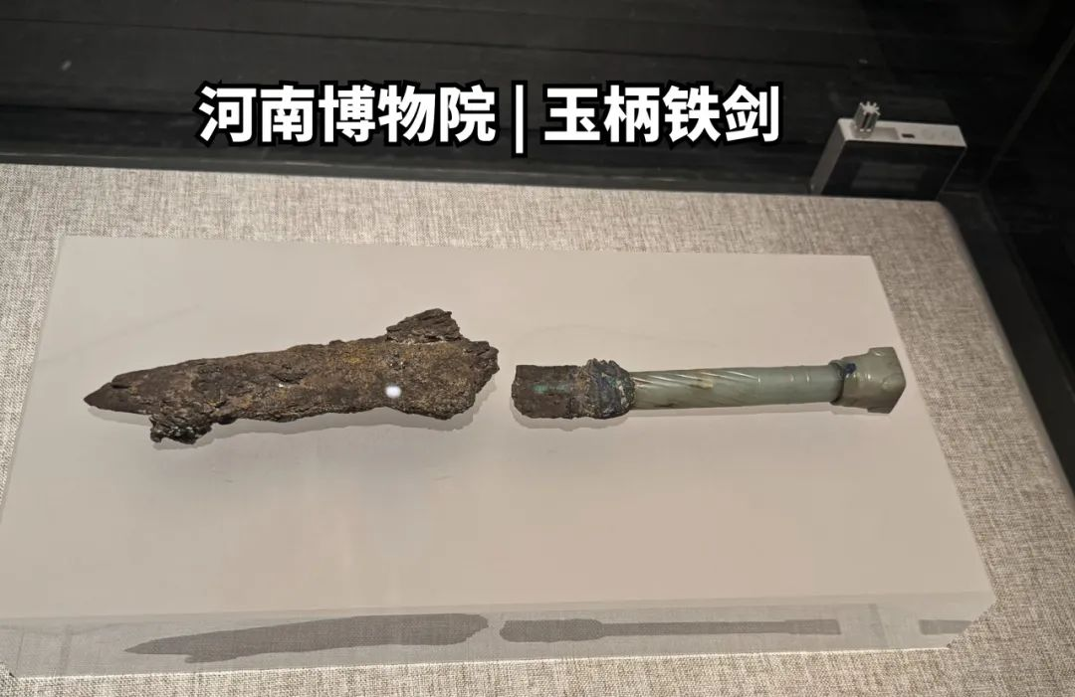
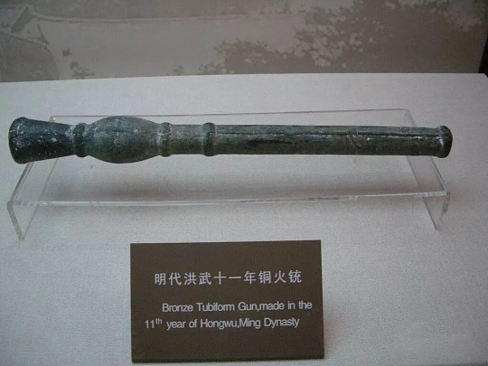
Weapons and Their Evolution
Stone Arrowhead
Stone Axe
Sword of Goujian, King of Yue
Iron Dagge
Tubiform Gun
Fire Arrow
Iron Sword

Slide 8
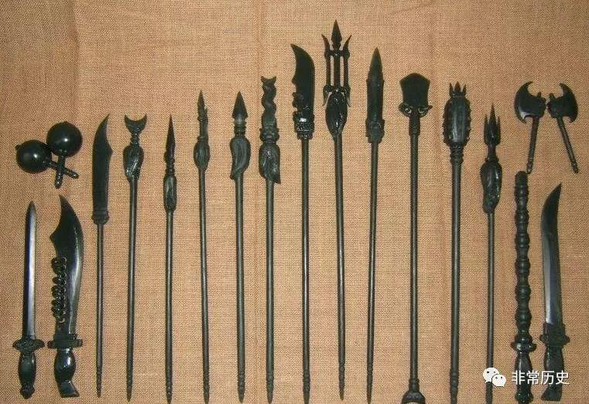
Weapons and Their Evolution
Broadsword / Sabre | Hammer / War Hammer
Spear | Claw
Straight Sword | Trident-shaped Halberd
Halberd | Staff
Battle Axe | Long Lance
Yue (Ceremonial Battle Axe) | Club / Short Staff
Hook Sword | Tonfa
Fork / Trident | Meteor Hammer
Iron Whip | Mace (Jiǎn)
The Eighteen Martial Arts/ The Eighteen Weapons

Slide 9
Ⅲ
Contributions to Humanity

Slide 10
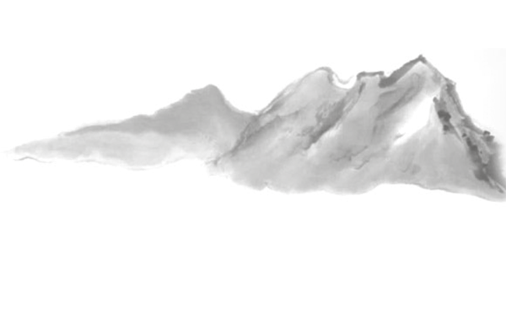
Contributions to Humanity
Age of Exploration
Development of capitalism and productive forces
Technological Progress
Splendid Culture
gunpowder

Slide 11
Ⅳ
Modern Mission

Slide 12
Modern Mission
cultural exchange and mutual learning
1
No discord, no concord/we fight before we know each other→make friends through martial arts
2
Translation studies
3

Slide 13
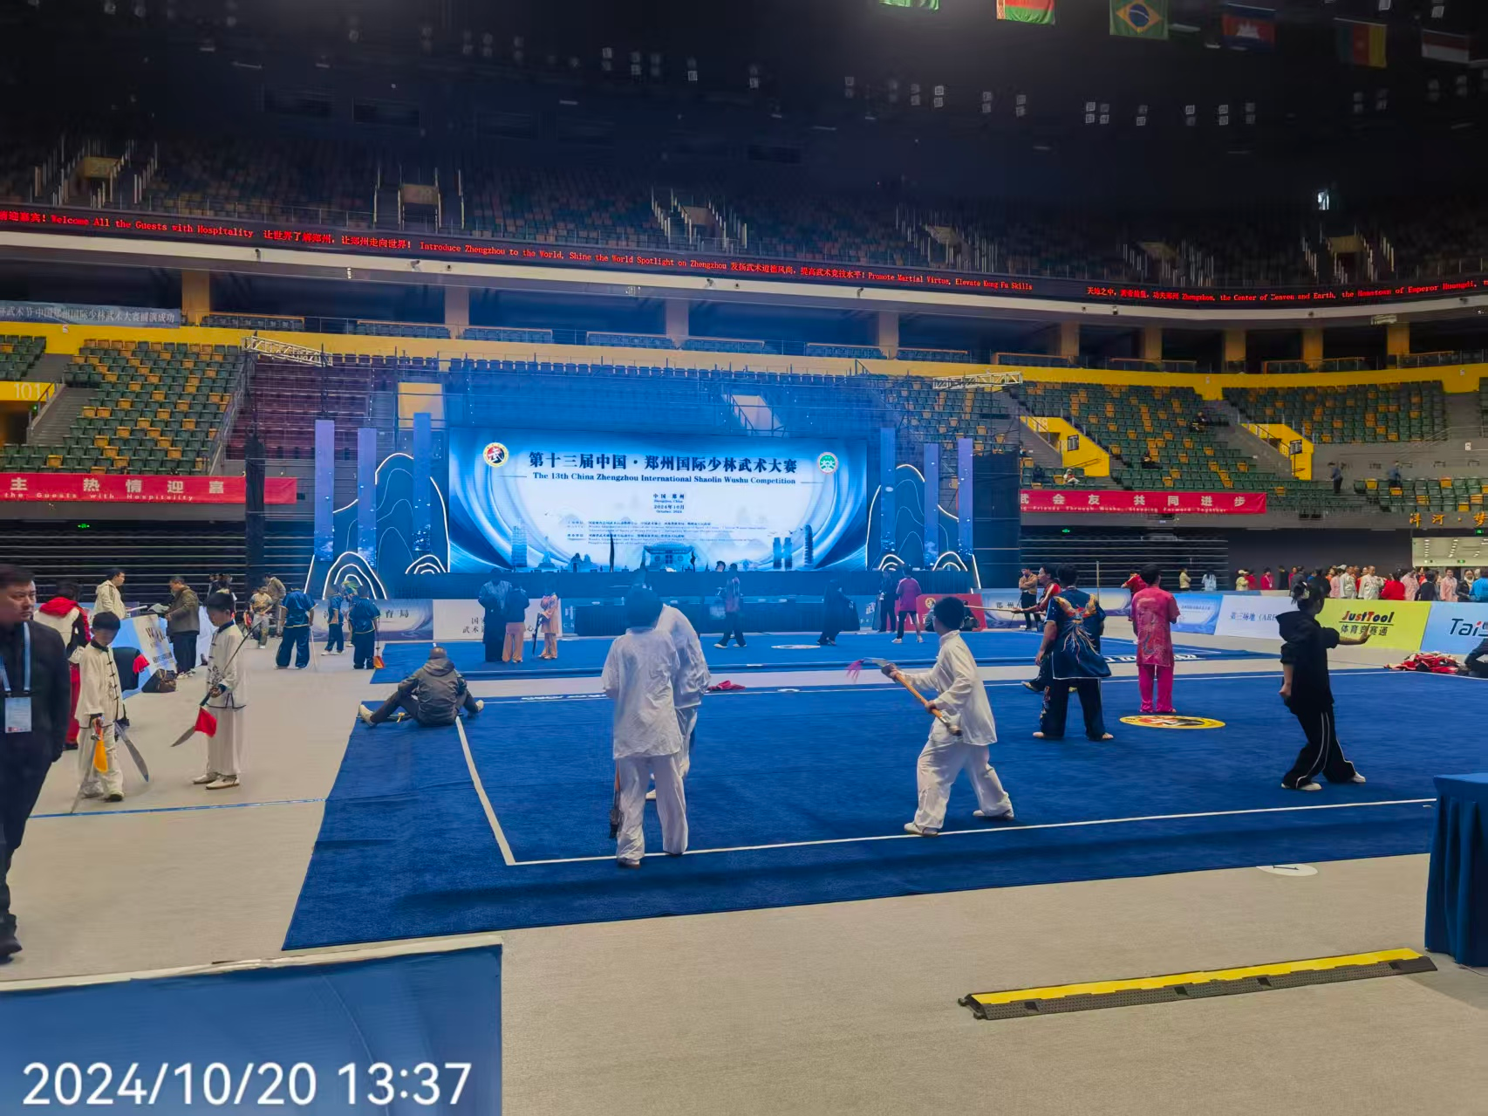
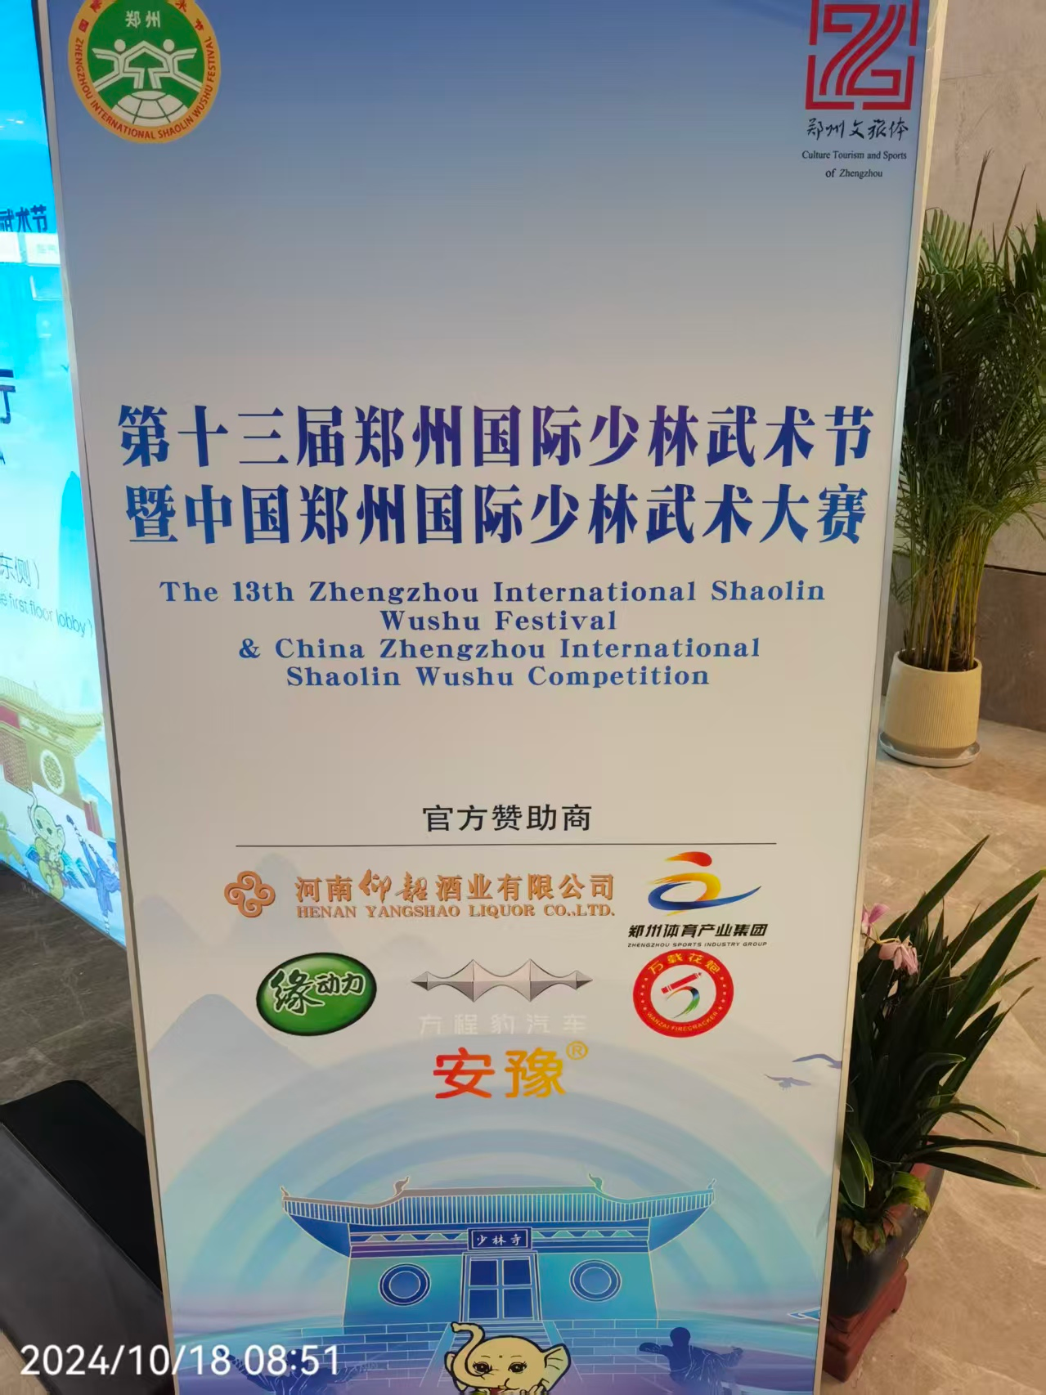
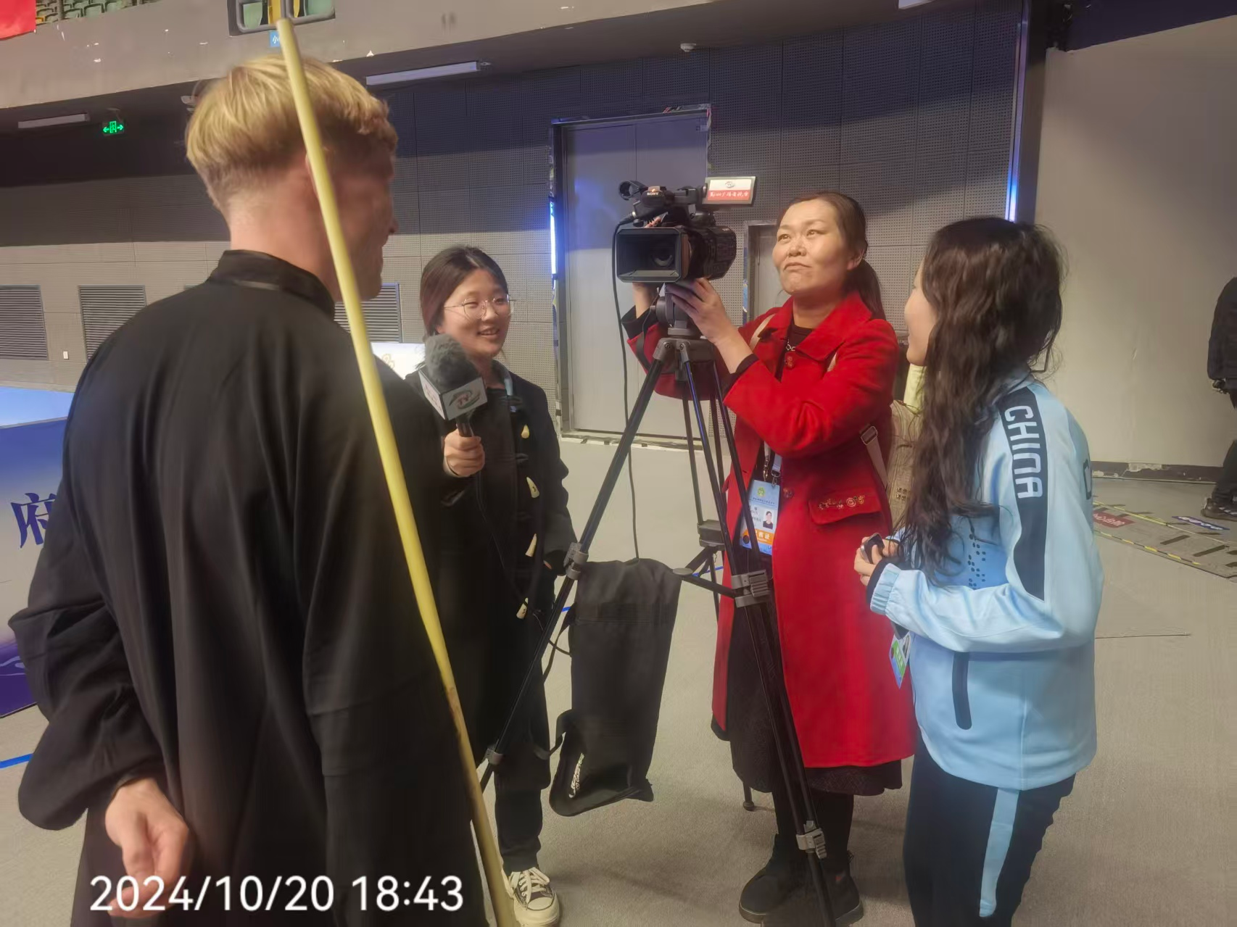
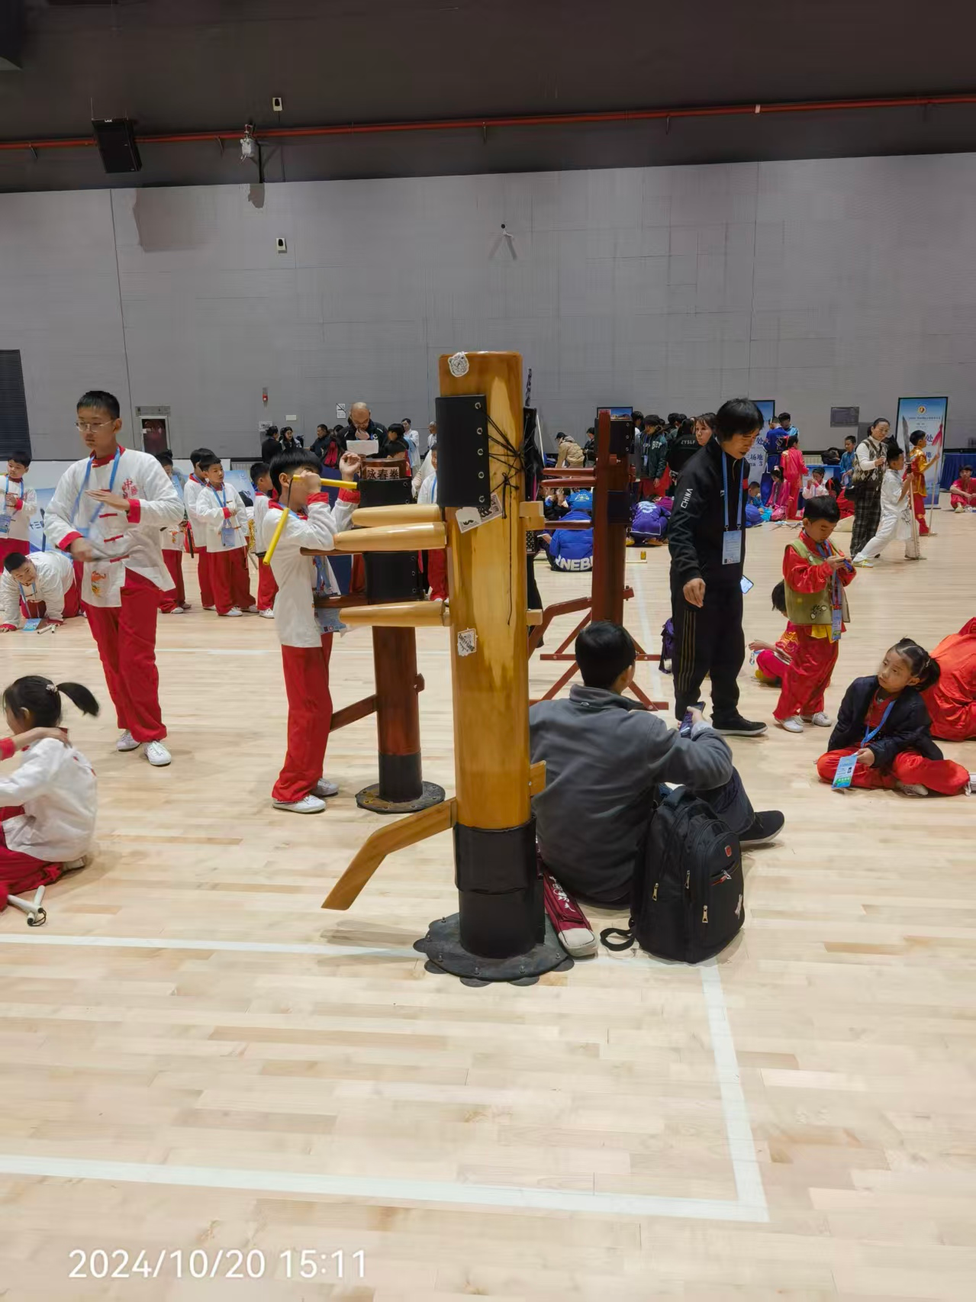
Modern Mission

Slide 14
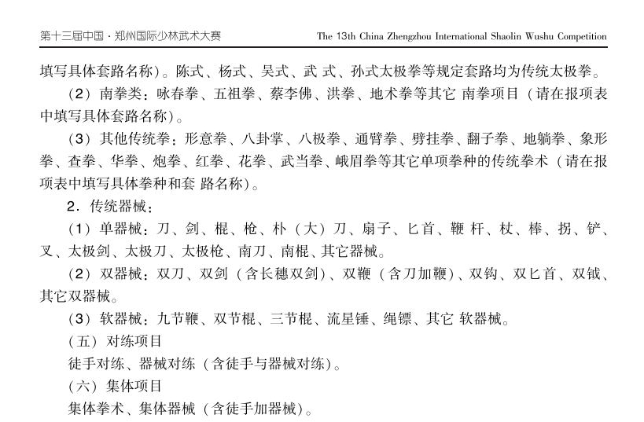
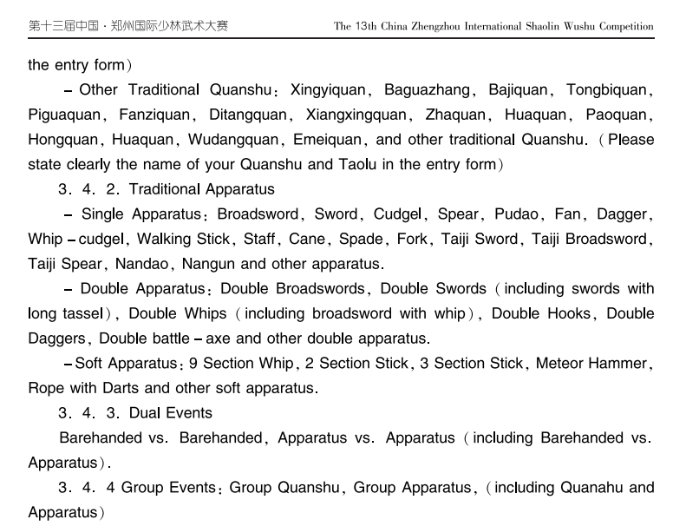
Modern Mission
Nunchucks？

Slide 15
Thanks for listening
Any corrections and criticism will be appreciated

