Slide 1

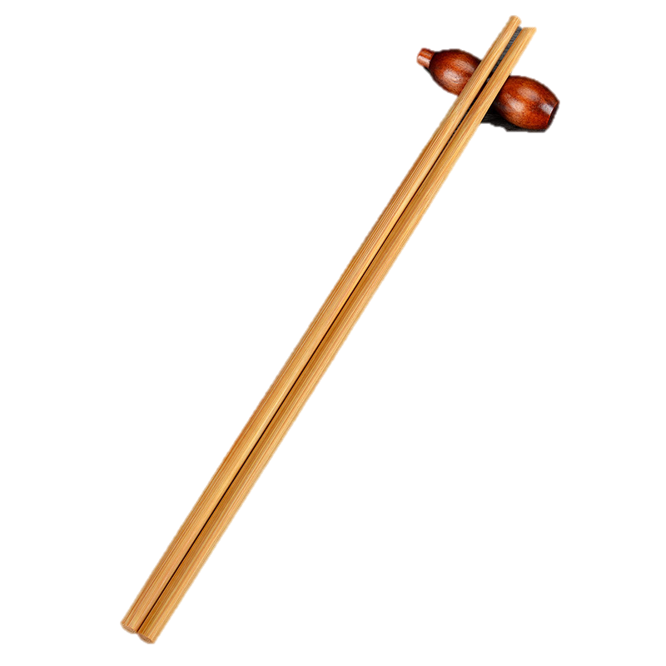
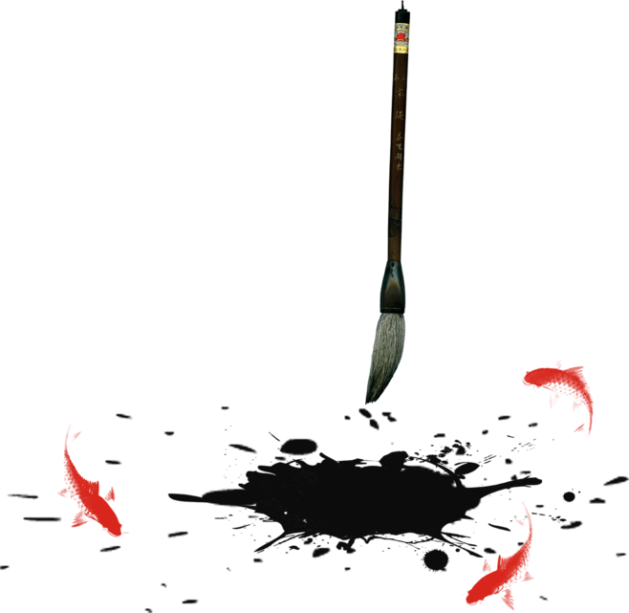
Chopsticks

Slide 2
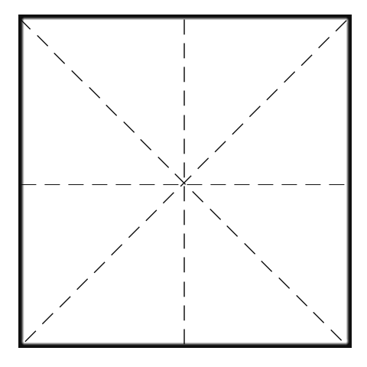
Contents
壹
The Origin of Chopsticks
贰
Etiquette of Chopsticks
叁
Cultural Wisdom in Chopsticks

Slide 3

Part 1
The Origin of Chopsticks

Slide 4
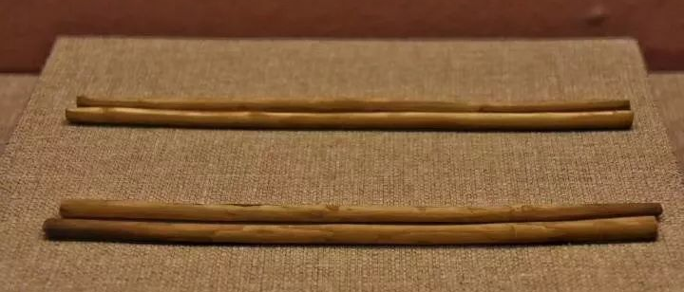
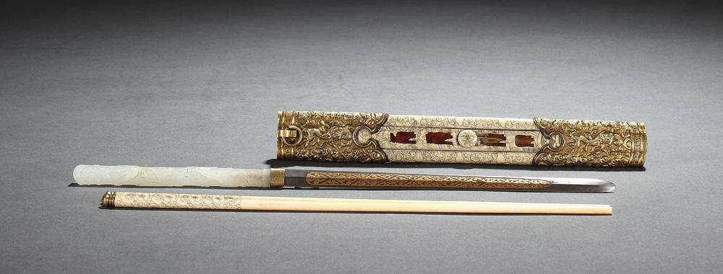
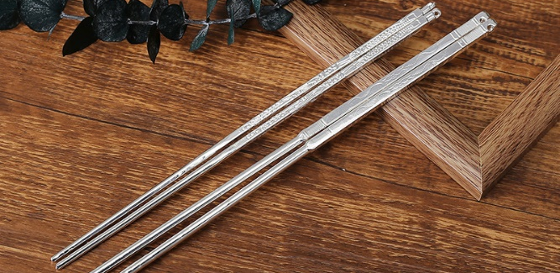

The Origin of Chopsticks
Chopsticks have a very long history of at least 3000 years. They probably started as simple tree branches.
Tree branches
Ivory Chopsticks
Silver Chopsticks

Slide 5
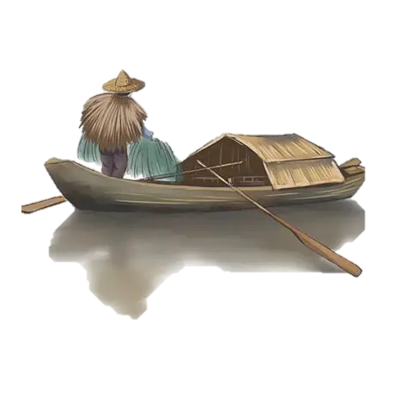

Zhu(箸) Zhu(住)
Ships stopping in the route would mean an accident or disaster.
Kuai(筷) Kuai(快)
Ships can move swiftly and smoothly.

Slide 6
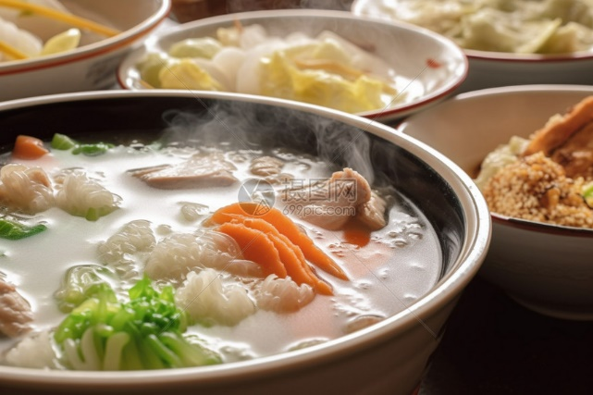
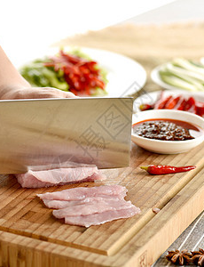
Chinese like to eat steaming hot meals.
Chinese dishes are cut into small pieces in the kitchen, which are just the right size to pick up with chopsticks.

Slide 7
Part 2
Etiquette of Chopsticks

Slide 8
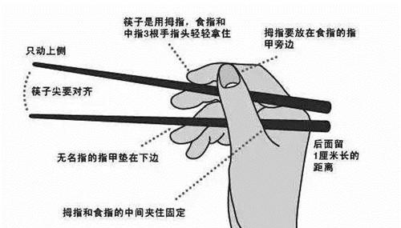

Etiquette of Chopsticks

Slide 9
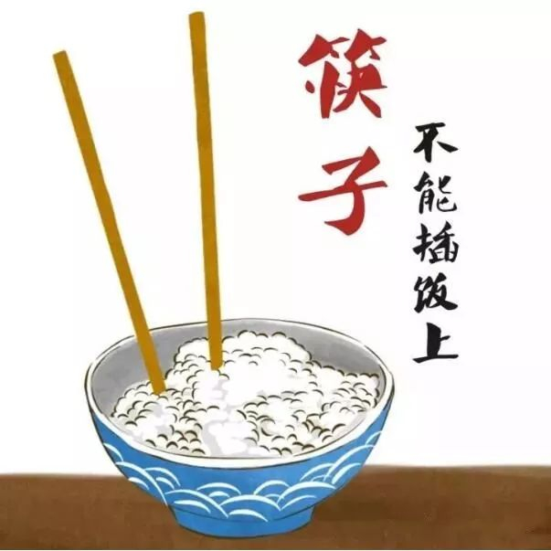
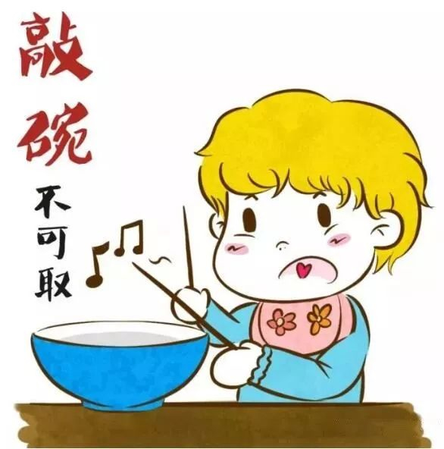
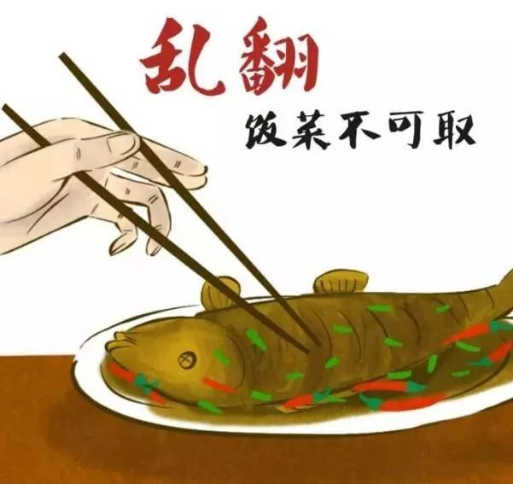
Etiquette of Chopsticks
Don’t rummaging through the food in a dish with chopsticks.
Don’t stick chopsticks vertically into a bowl of rice.
Don’t hit the bowl with chopsticks.

Slide 10
Part 3
Cultural Wisdom in Chopsticks

Slide 11
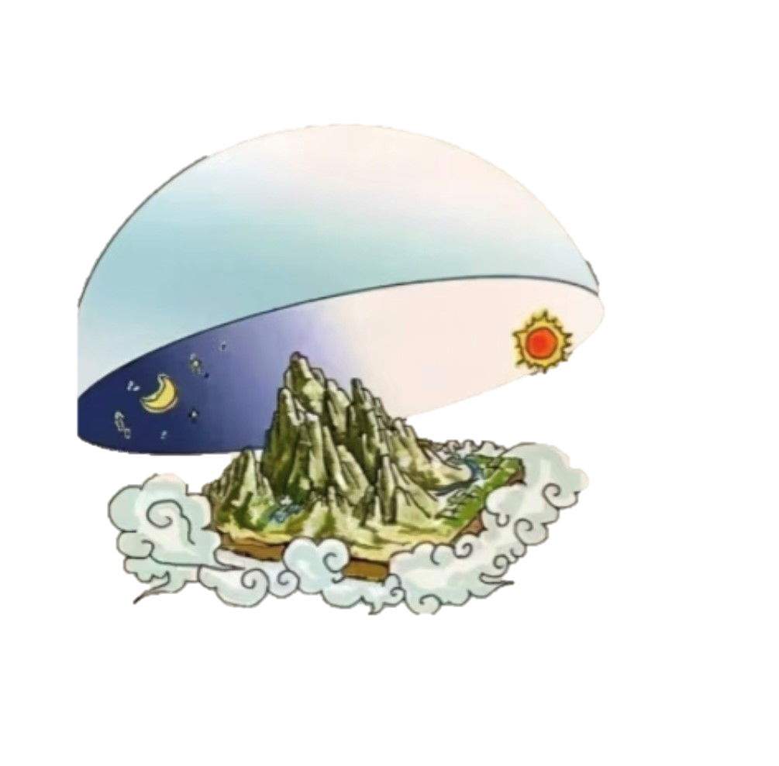
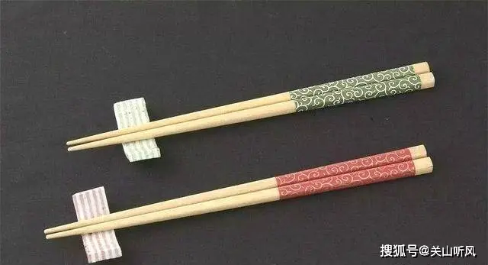
One end being square and the other round symbolizes the old idea that the Earth was square and Heaven was round which is Chinese basic understanding of the world.
facilitate picking up food and to avoid injuring the mouth
to prevent them from rolling and slipping out of the hand

Slide 12
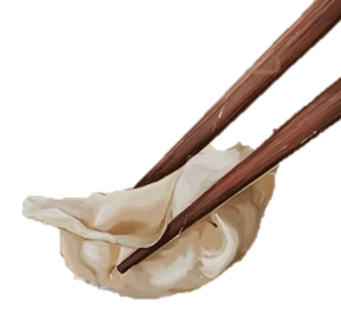
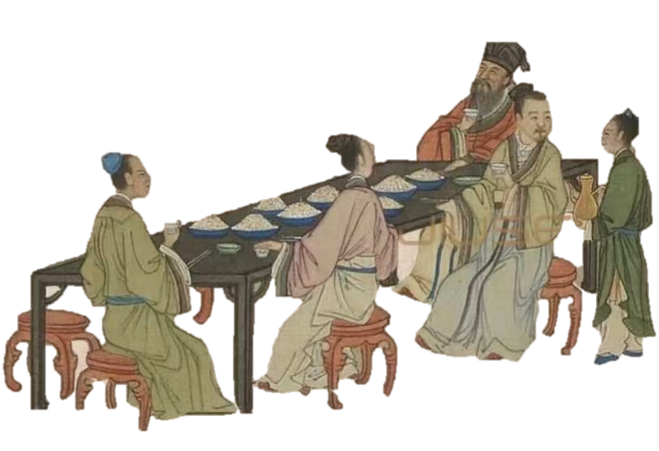
The standard length of chopsticks is seven cun and six fen (approximately 25 centimeters).
7 kinds of emotions and 6 kinds of desires
It also takes account both practicality and comfort.

Slide 13
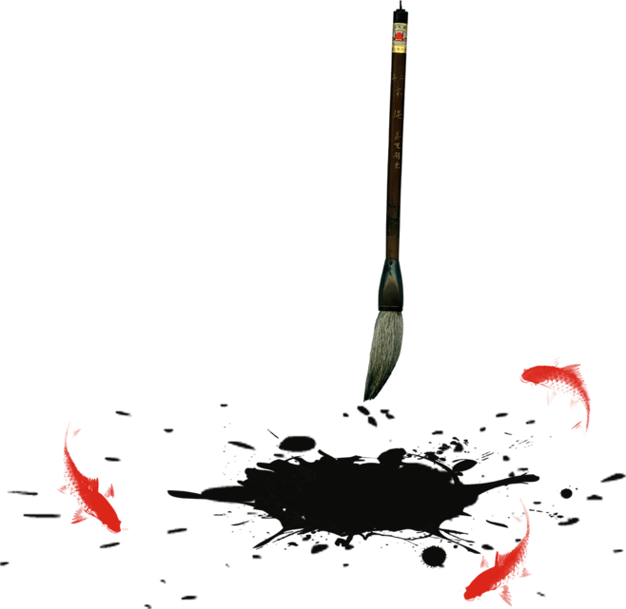
Thanks for Listening

