Slide 1
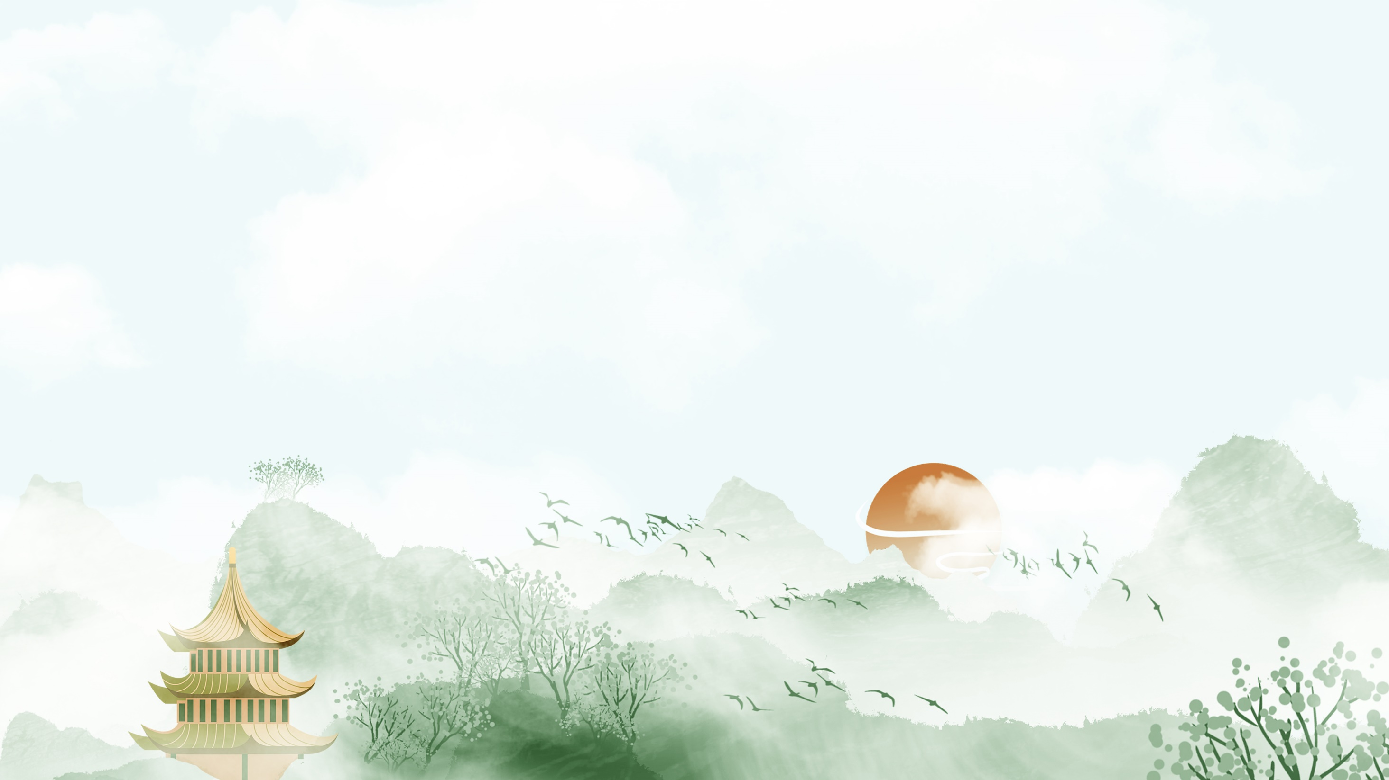
Chinese Paper-cutting
Presenter：Liu Xin

Slide 2

Brief introduction
Classification
Methods and techniques
Common features
Contents

Slide 3
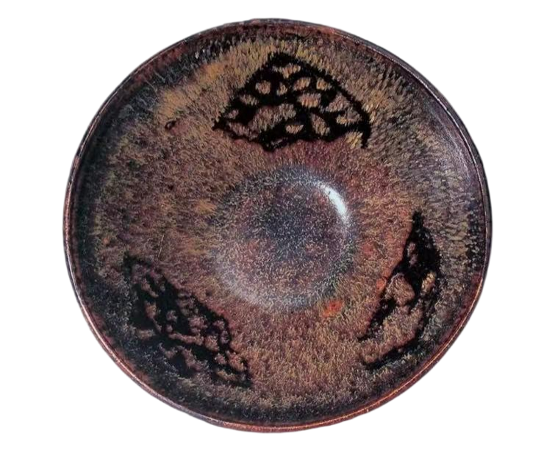
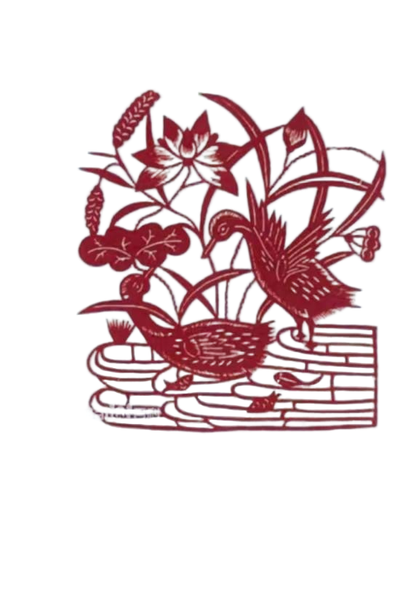
Brief introduction
Paper was invented in the Western Han Dynasty.
There were already artists who cut paper as a profession during the Song Dynasty.
In the Ming and Qing Dynasties, the art of paper-cutting reached its heyday.

Slide 4
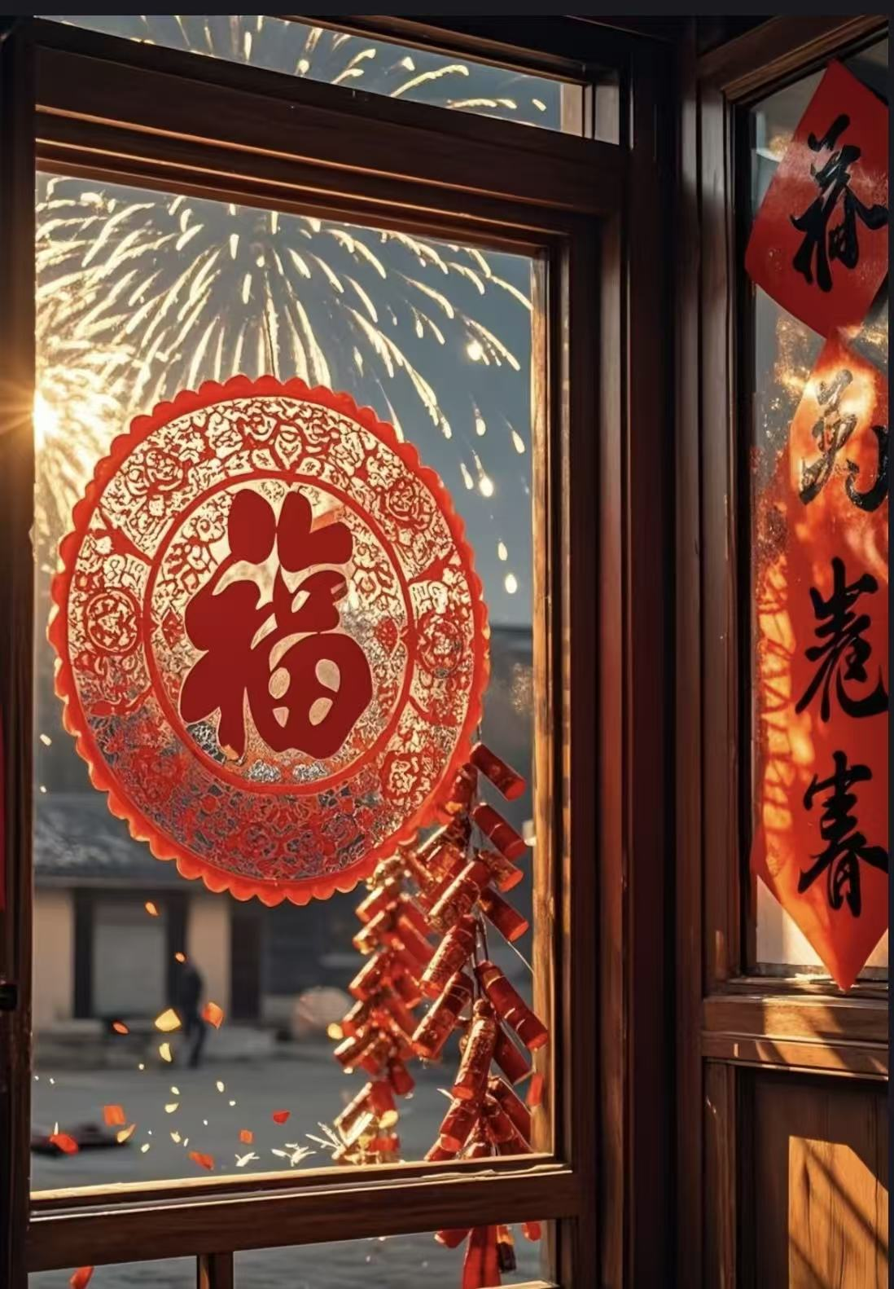
Brief introduction
The warm water washes my feet,
And the paper cut uplifts my soul.
暖汤濯我足，
剪纸招我魂。
杜甫《彭衙行》

Slide 5
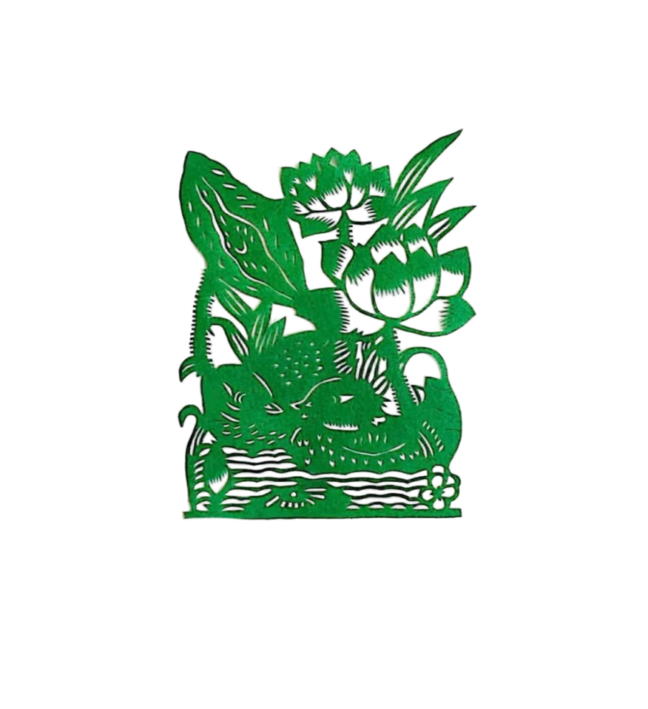
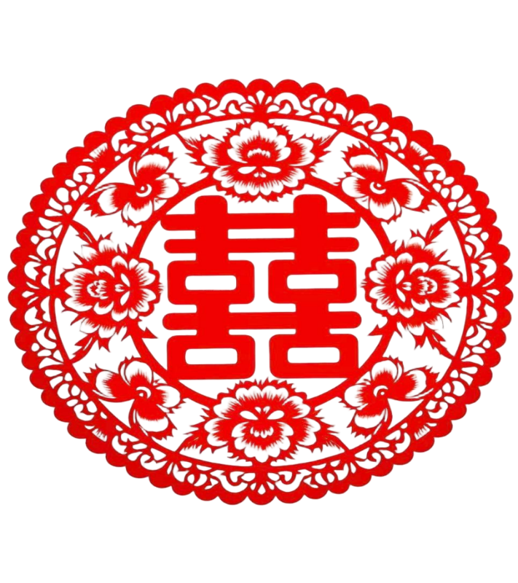
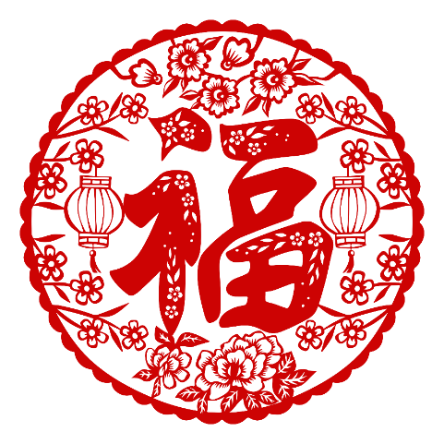
Classification—Monochrome Paper-Cutting 单色剪纸
The most basic form, has only one color such as red, green and so on.
Mainly used for window decorations and embroidery base patterns.

Slide 6
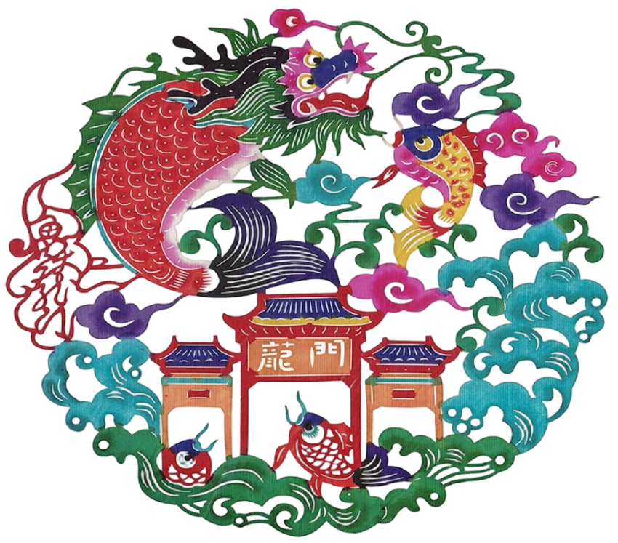
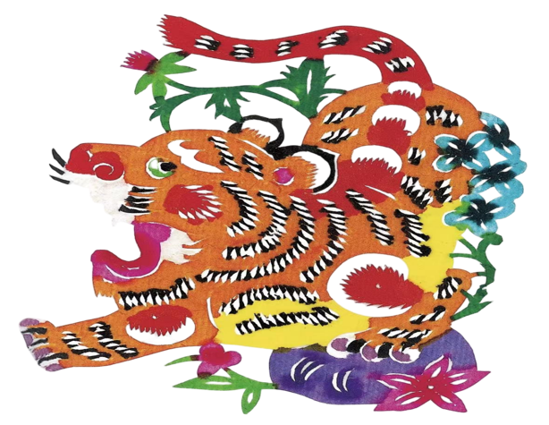
Classification—Colorful paper-cutting 彩色剪纸

Slide 7
Classification—Colorful paper-cutting 彩色剪纸
A variety of colors, creating a visual impact.
The form and technique of color paper-cutting is gradually increasing, with dot dyeing, overlaying, color separation and color filling.

Slide 8

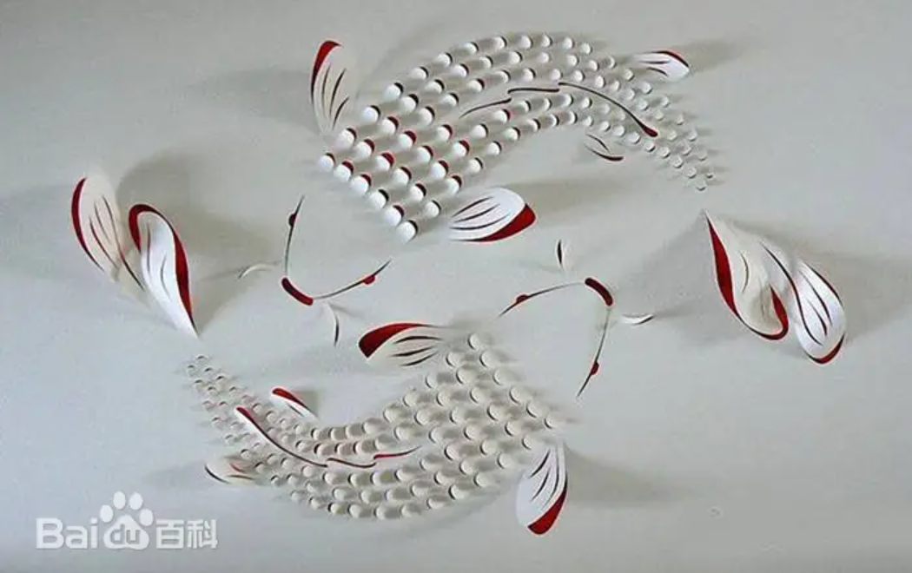
Classification—Three-dimensional paper-cutting
立体剪纸
It can be monochrome or colored.
It is a new type of paper-cutting that resembles sculpture, and can be used for ornamental modelling.

Slide 9
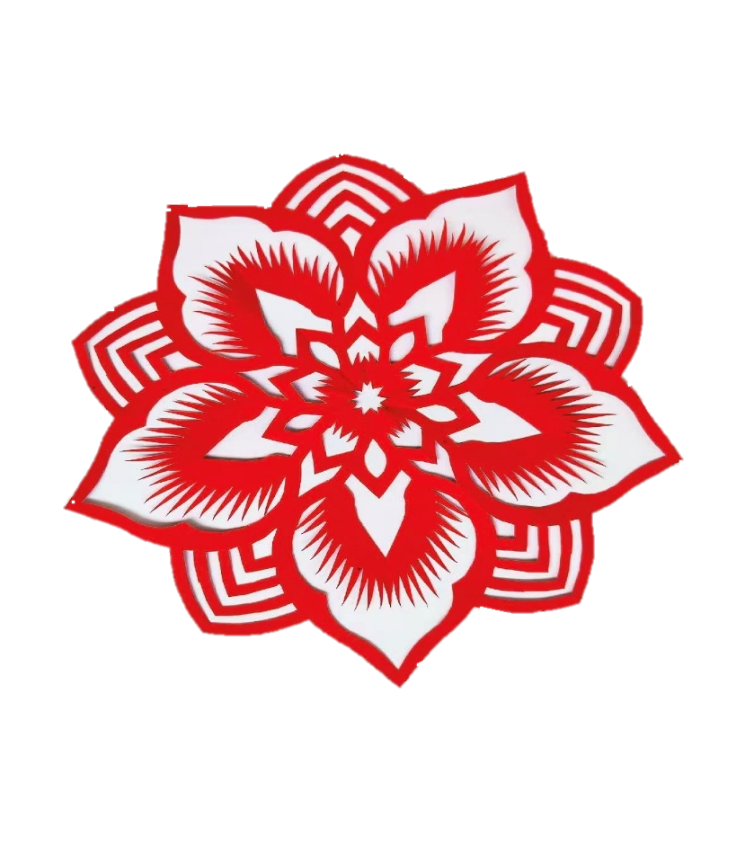
Methods and techniques—Folding 折叠
Folding paper to produce a repetitive pattern is one of the basic paper-cutting techniques.
A symmetrical pattern, is mainly used for cutting flowers and topiary flowers.

Slide 10
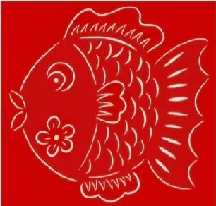
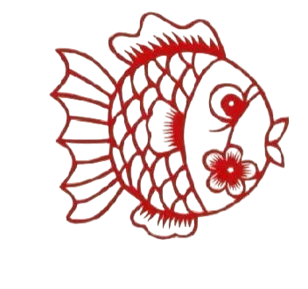
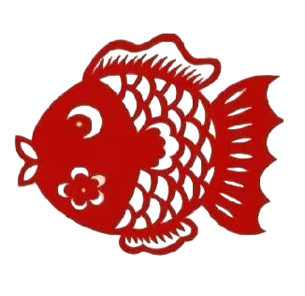
Methods and techniques—Yin-Yang carving 阴阳刻
Yin carving: to carve away the outline that represent the structure of the image.
Yang carving: is the opposite way, where the blanks are removed and the outline lines are retained.
Yin-Yang carving: combination of Yin carving and Yang carving.

Slide 11
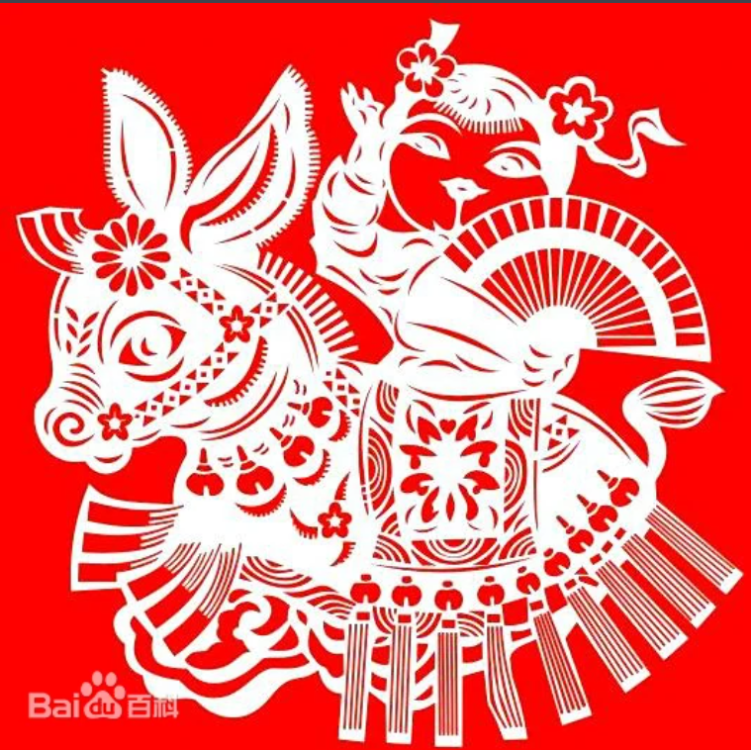
Methods and techniques—perforation 刺孔
Using a knife or scissor to outline the basic shape on the paper, and then use a needle to puncture holes in the design.

Slide 12
Common features
There are many images in paper-cutting, and one of the similarities is the exaggeration of the subject. Through paper-cutting, people make up beautiful images to promote the creativity of man in conquering nature, to build their ideal world, and to inspire the courage to continue the struggle.

Slide 13
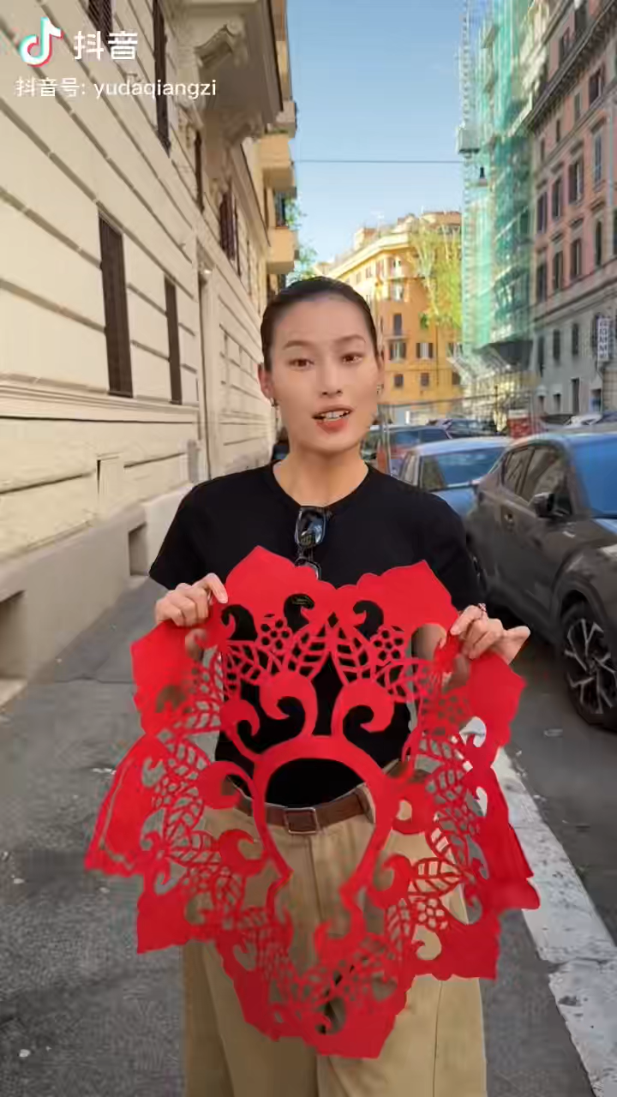

Slide 14
Thanks

