Slide 1
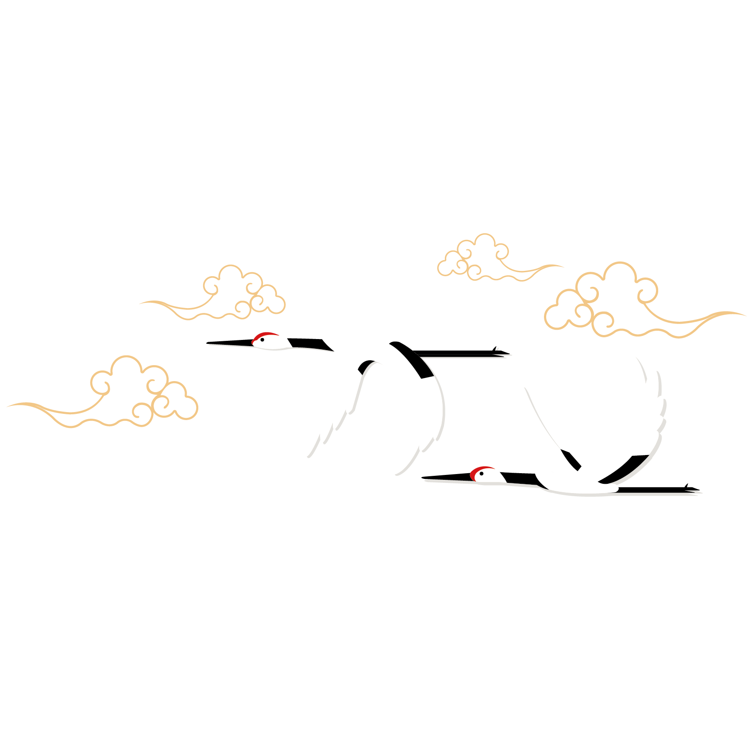
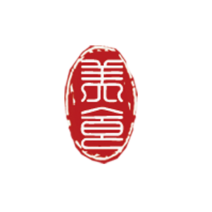
Chinese Knots
——Ding Zhongxia

Slide 2
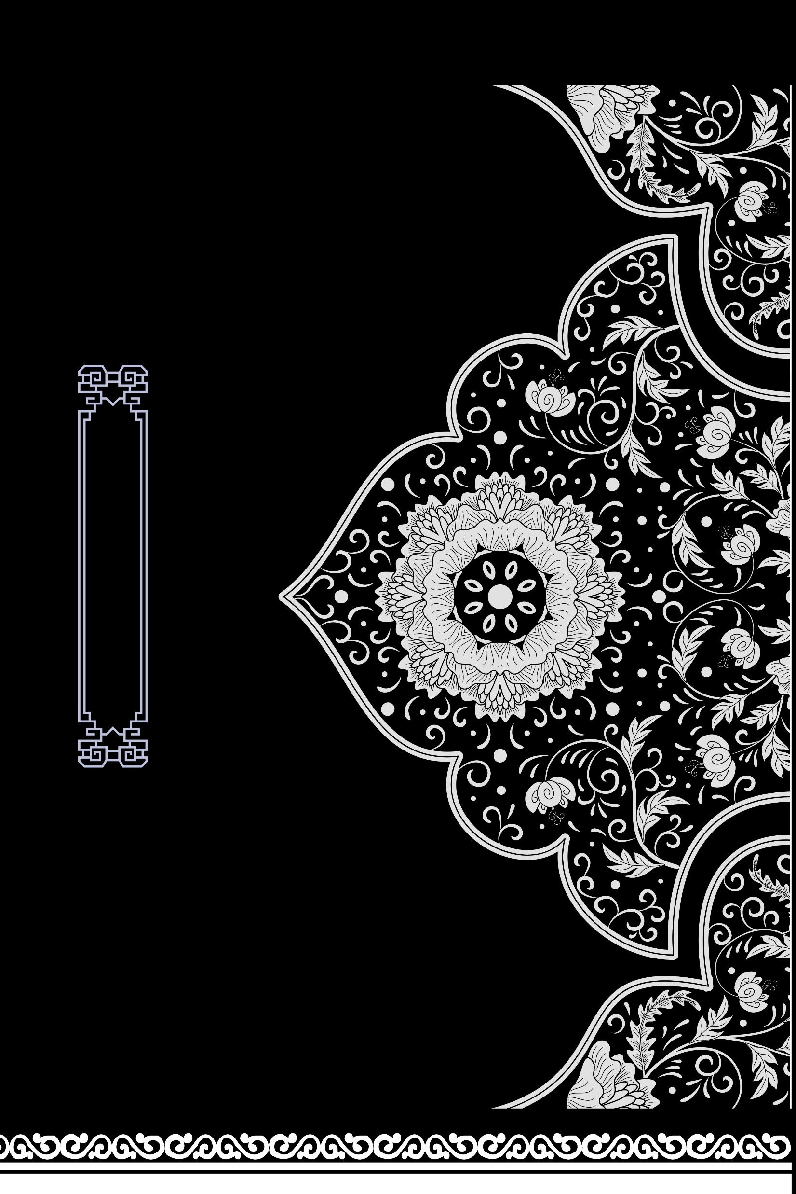
1.A Brief Introduction about Chinese Knots
Chinese Knots
2.The Classification of Chinese Knots
3.The Cultural Connotations of Chinese Knots and Translations

Slide 3
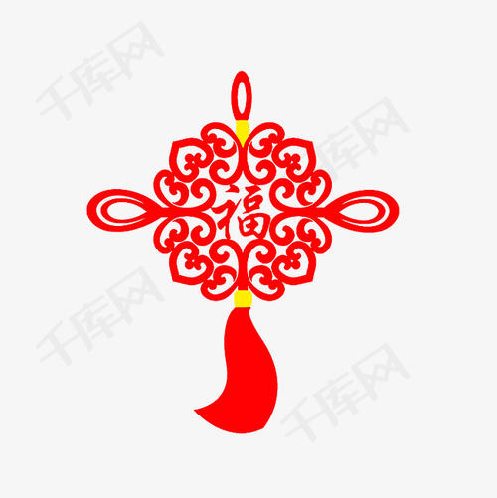
1.A Brief Introduction about Chinese Knots
The Chinese knot is a hand-woven handicraft unique to China. The exquisiteness and wisdom displayed on it are just one aspect of the ancient Chinese civilization.
It originally evolved from the sewing of the Paleolithic period, to the ritual memorial of the Han Dynasty, and then into decorative craft.
The jade worn by people in the Zhou Dynasty was often decorated with Chinese knots, and there were also Chinese knot patterns on the bronzes of the Warring States Period.

Slide 4
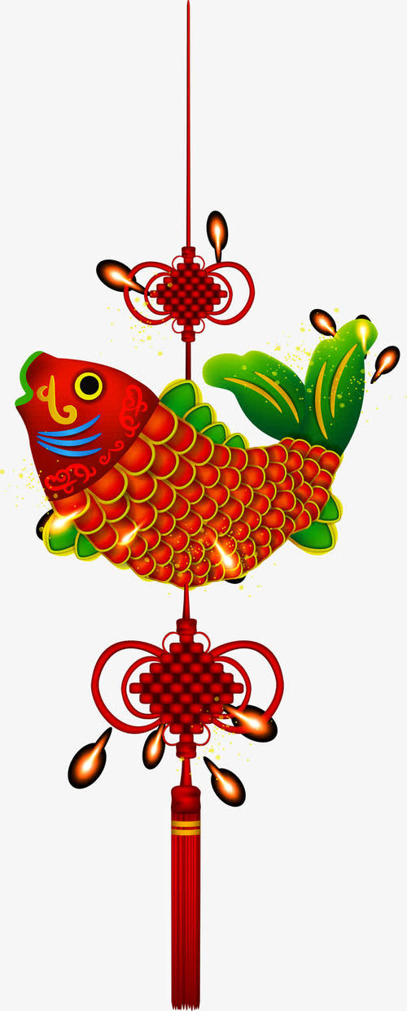
The Chinese knot continued to become a popular art in the Qing Dynasty. Now, Chinese knots are often used as interior decorations, gifts between relatives and friends and personal accessories.
It is possessed of delicate and symmetrical appearance and accords with the conventions of Chinese traditional decorations and aesthetics, which earned the knot as its name.

Slide 5
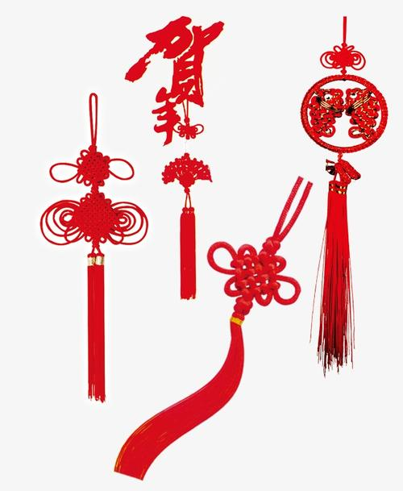
2.The Classification of Chinese Knots
There are ten main kinds of Chinese knots which are named according to the shape, purpose or meaning of the knot.
Double Coin Knot(双钱结）
Good Luck Knot（吉祥结）
Chinese Button Knot（纽扣结）
Sauvastika Knot（万字结）
Oxalis Knot（酢浆草结）
Pan Chang Knot（盘长结）
Round Brocade Knot（团锦结）
Caisson Celling Knot（藻井结）
Cross Knot(十字结）
Ping Knot（平结）.

Slide 6

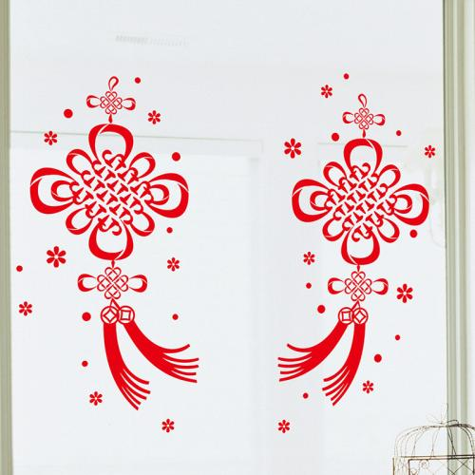
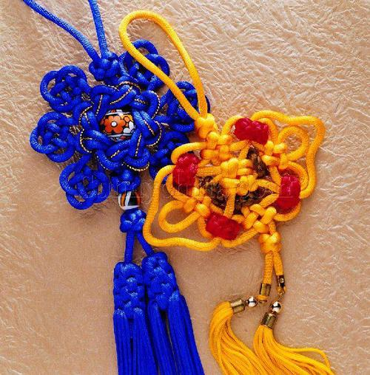
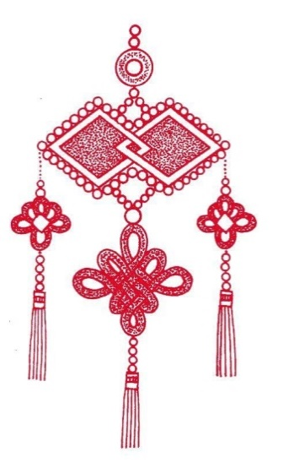
3.The Cultural Connotations of Chinese Knots and Translations
The Chinese knot is a woven fabric of rope and thread. In Chinese， "rope" (绳）and "god" （神）are homophonic, so the Chinese nation has a worship of "rope".
Chinese people love the Chinese knot because it embodies the cultural essence and national characteristics of the Chinese nation.
In addition, Chinese people are descendants of Dragons.

Slide 7
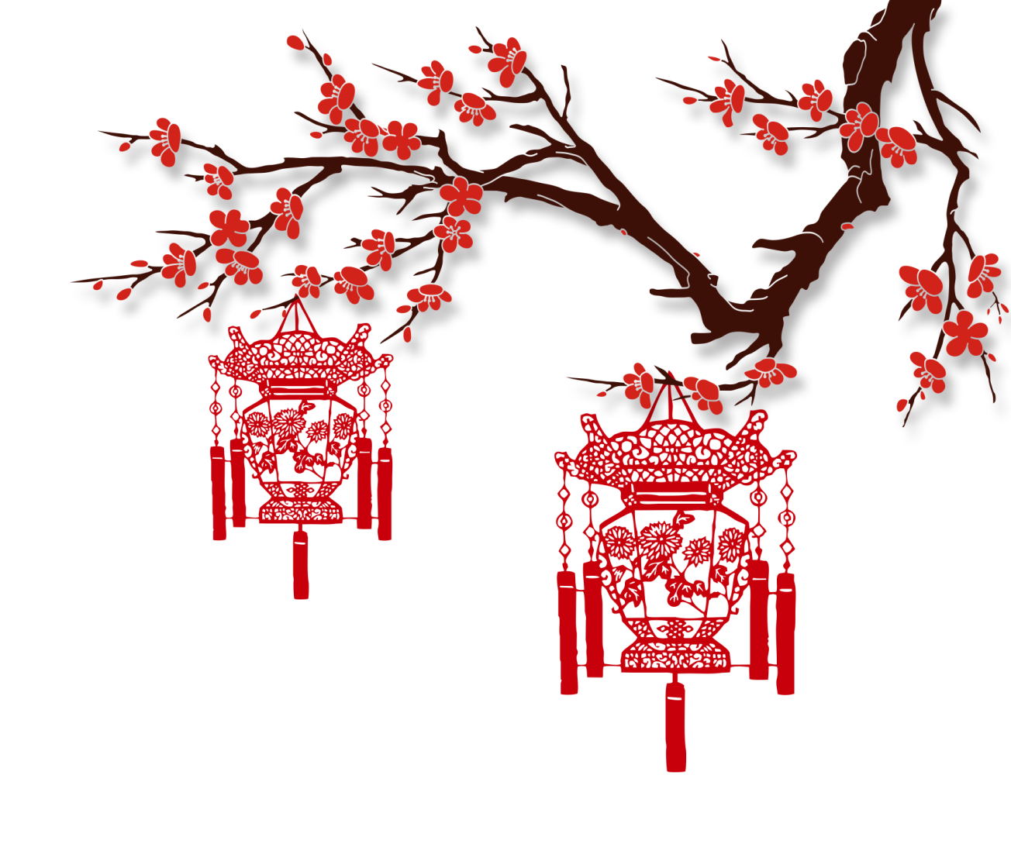
Because the shape of "rope" is like a winding dragon, people also regard "rope" as a symbol of dragon. Chinese people also have their own unique understanding of "knot", which means reunion and happiness.
Many of the Chinese words composed of "结"（knot) that we usually see have beautiful meanings, such as 团结（unity）, 结交 （making friends), and 永结同心（tie the knot),etc. "结"(knot) is also homonymous with "吉"（ausipiciousness), so people even think that "knot" is a symbol of good luck.

Slide 8
Translations
Good Luck Knot（吉祥结）
Round Brocade Knot（团锦结）
Round Brocade Knot（团锦结）
Caisson Celling Knot（藻井结）

Slide 9
Thank you!

