Slide 1
Assassinations

Slide 2
Han Dynasty
Emperor Cheng (51 BC - 7 BC)
  No heir
  Believed to have approved the murder of his sons
  Eventually made nephew crown Prince

Slide 3
Liu Song Dynasty
Liu Shao
  Crown prince
  Staged a coup against his father with the help of his brother
  Blamed fathers death on others
  Short reign before a coup was staged against him

Slide 4
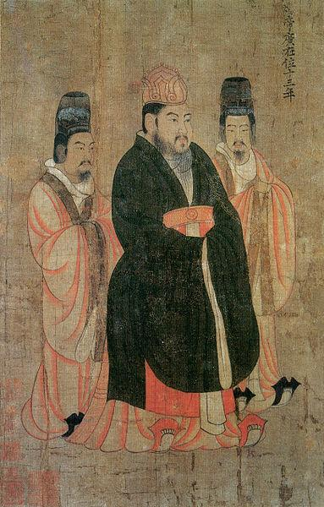
Sui Dynasty
Emperor Yang (569 - 618)
  Believed to have ordered his fathers murder.

Slide 5
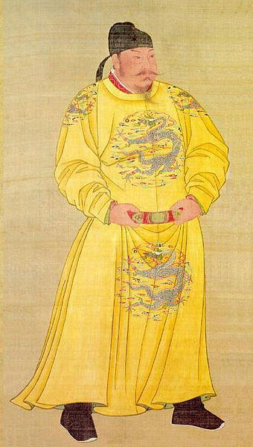
Tang Dynasty
Emperor Taizong of Tang
  Not crown prince
  Believed his brother attempted to assassinate him
  Ambushed and killed two of his brothers
  Emperor Gaozu abdicated

Slide 6
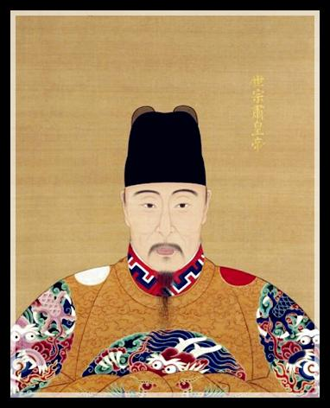
Ming Dynasty
Emperor Jiajing

Slide 7
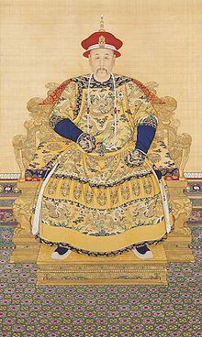
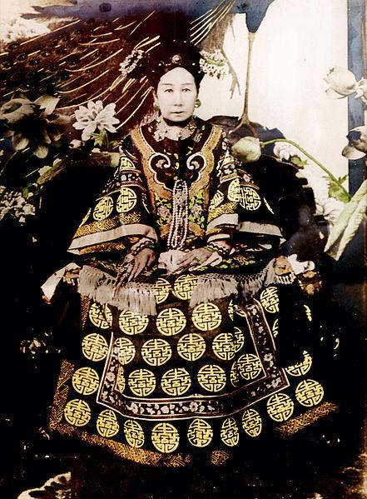
Qing Dynasty
Emperor Yongzheng
  No crown prince = rivalry occurred between sons
  Believe he may have poisoned his father and altered his will.
Empress Dowager Cixi
  Once thought to have poisoned her son.
  Poisoned her grandson with arsenic.

