Slide 1
香文化
单击此处添加副标题内容
曾欣
INCENSE CULTURE
2024.12.12

Slide 2
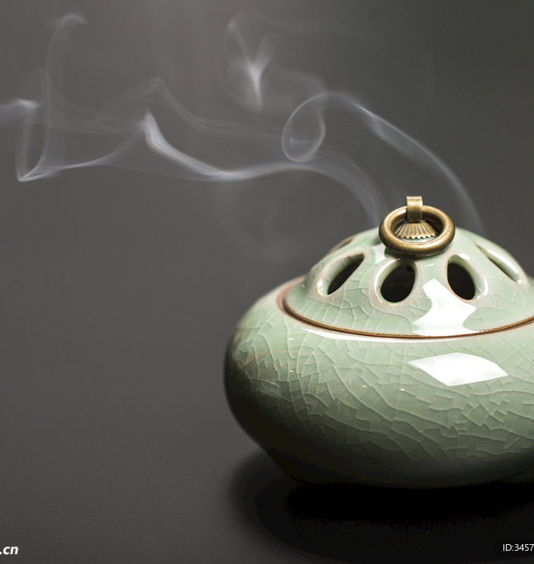
INCENSE CULTURE
What is incense culture?
A tradition deeply rooted in Chinese history, blending spirituality, art, and daily life.
The use of incense spans from religious practices to cultural refinement and personal well-being.
Why is it important?
A symbol of spiritual connection: Incense acts as a bridge between the material and divine.
An embodiment of Chinese artistry: Reflects harmony between nature, craftsmanship, and culture.
A legacy of global influence: Inspiring modern wellness and cultural exchanges worldwide.

Slide 3
Historical Overview
Began with fire worship and natural aromatic materials.
Early use in rituals to connect with the divine.
Incense integrated into Buddhism and Taoism.
Used in temples for purification and offerings.
Silk Road introduced exotic incense materials (e.g., sandalwood, frankincense).
Incense became a luxury in royal courts and elite households.
Birth of Xiangdao ("The Way of Incense").
Incense appreciation flourished among scholars, blending with arts like poetry and tea.
Advanced incense-making techniques developed.
Incense became a daily ritual for families and a symbol of cultural refinement.
Ancient Origins
Han
Tang
Song
Ming & Qing

Slide 4
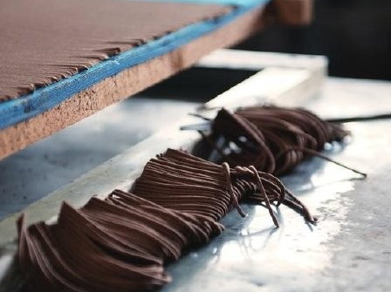
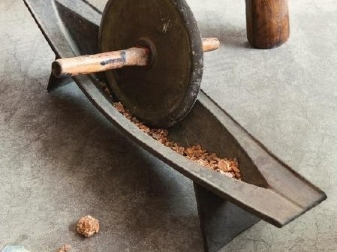
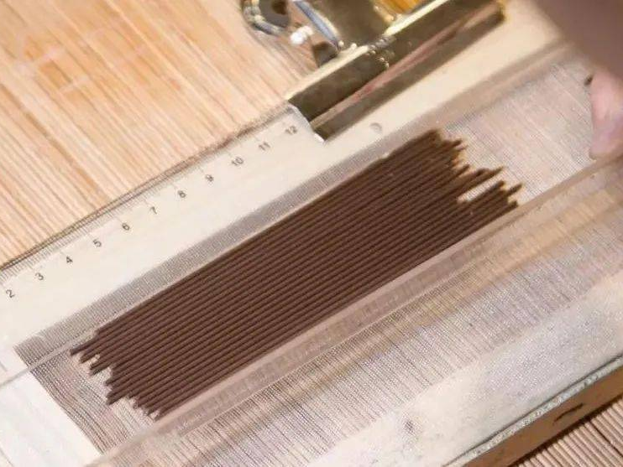
Production and Forms of Incense
Production Process
Ingredient Selection
High-quality natural materials: aloeswood, sandalwood, frankincense, herbs like cinnamon and clove.
Preparation
Ingredients are finely ground into powder.
Shaping
Powder mixed with natural adhesives to form dough, then shaped into various forms.
Drying
Incense is air-dried for days or weeks to cure and enhance its fragrance.

Slide 5
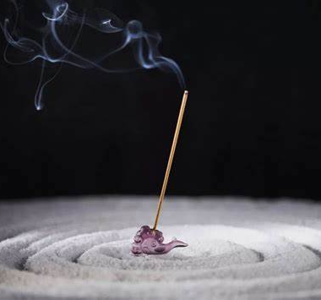
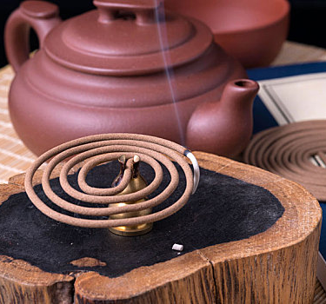
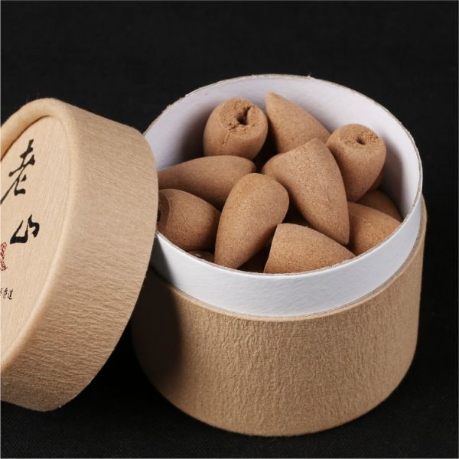
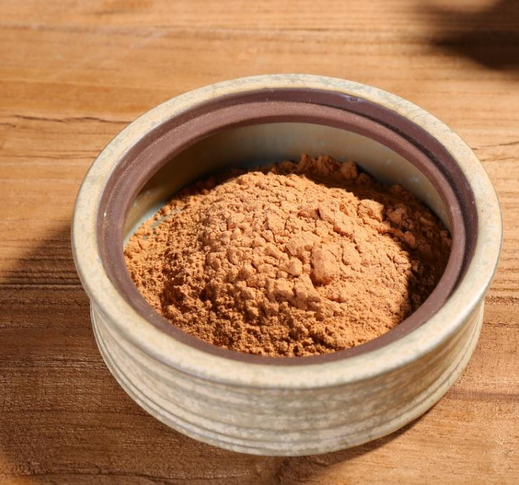
Forms of Incense
Stick Incense
Widely used for daily prayers and offerings.
Coil Incense
Burns for hours, ideal for ceremonies or meditation.
Cone Incense
Compact and aesthetic, creates a beautiful spiral of smoke.
Powder Incense
Often used in traditional incense burners for ceremonies.

Slide 6
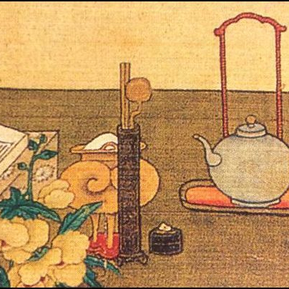
Q: During which Chinese dynasty did incense culture evolve into an art form known as "Xiangdao"?
•A) Han Dynasty
•B) Tang Dynasty
•C) Song Dynasty
D) Ming Dynasty

Slide 7
谢谢观看

