Slide 1
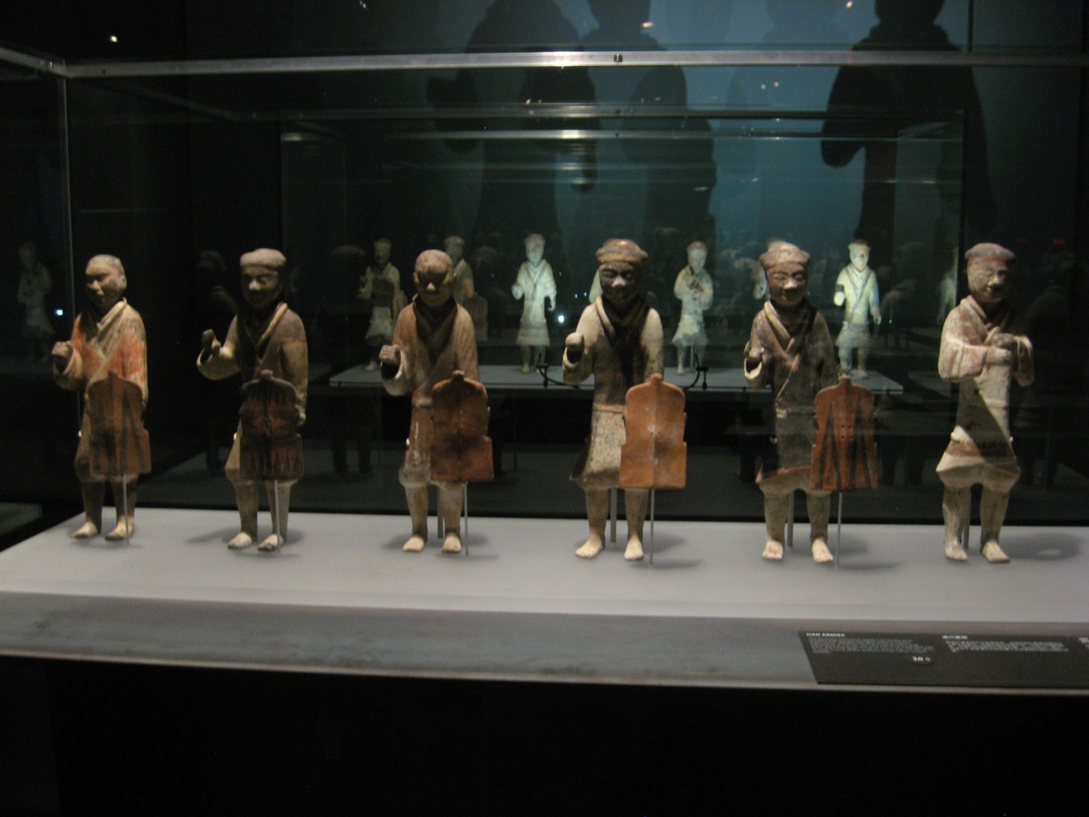
Many smaller figures in different dress and poses

Slide 2
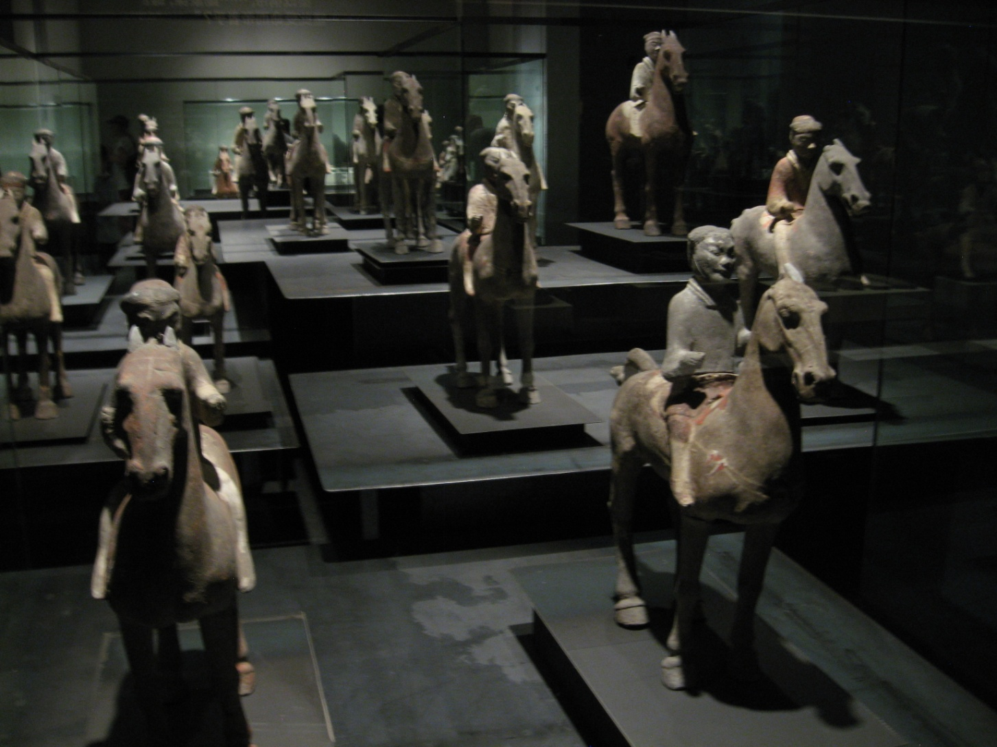
Thousands of mounted warriors

Slide 3
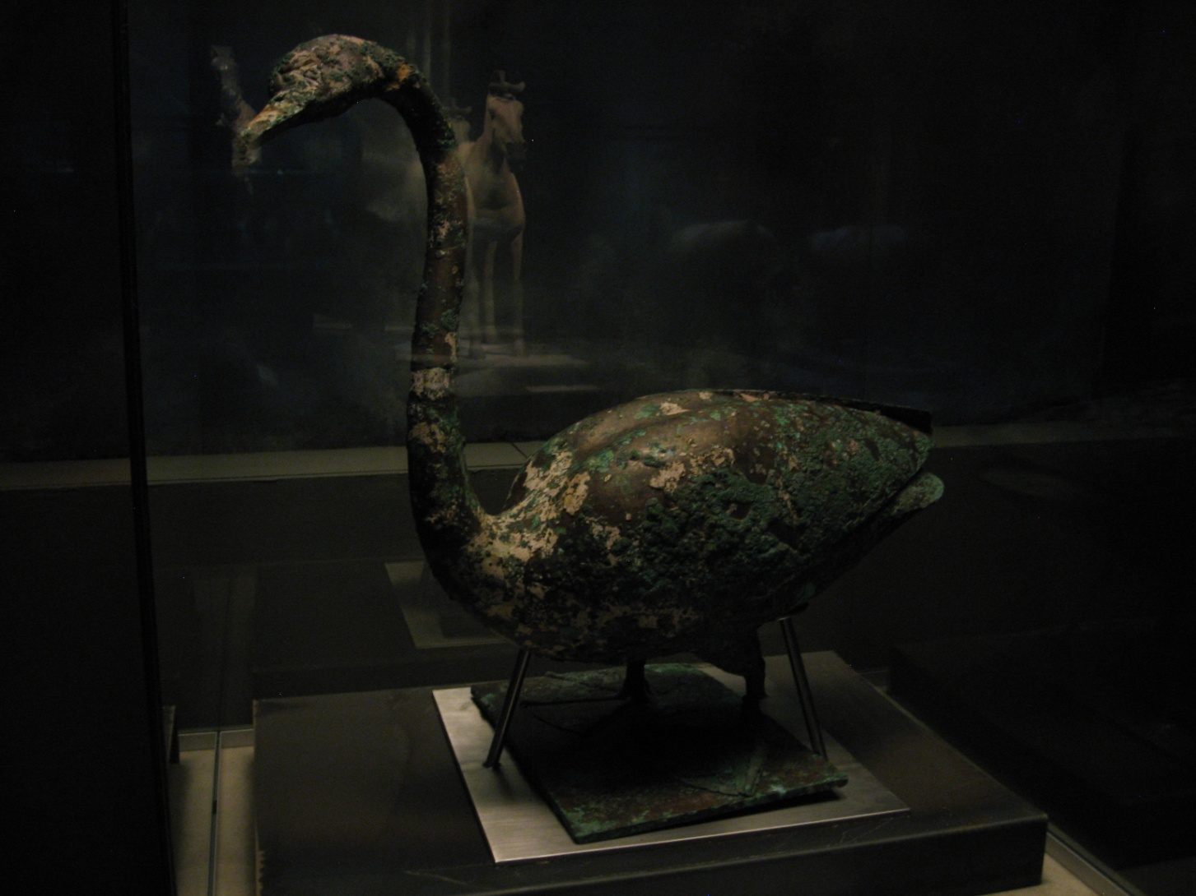
Other figures such as this goose are also found in the tomb complex

Slide 4
Recent digs have revealed that in addition to the clay soldiers, Qin Shi Huangdi's underground realm, presumably a facsimile of the court that surrounded him during his lifetime, is also populated by delightfully realistic waterfowl, crafted from bronze and serenaded by terra cotta musicians. The emperor's clay retinue includes terra cotta officials and even troupes of acrobats, slightly smaller than the soldiers but created with the same methods.
"We find the underground pits are an imitation of the real organization in the Qin dynasty," says Duan Qingbo, head of the excavation team at the Shaanxi Provincial Research Institute for Archaeology. "People thought when the emperor died, he took just a lot of pottery army soldiers with him. Now they realize he took a whole political system with him."

Slide 5
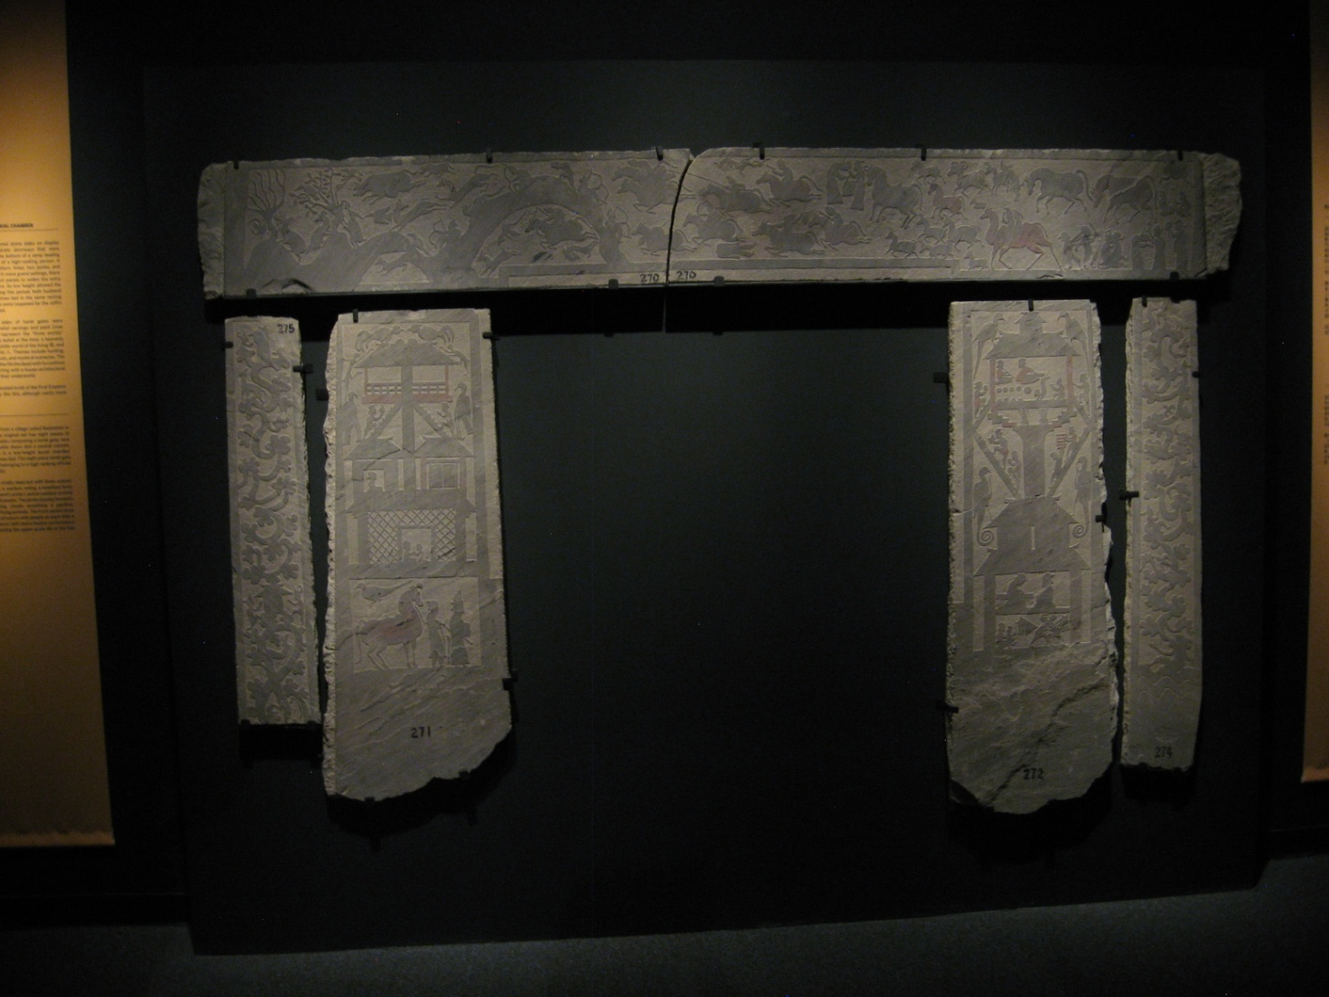
Tomb doorway showing depictions of Earth and heaven

Slide 6
Bibliography
Discovery Times Square
Smithsonianmag.com
Travelchinaguide.com
Terracottawarriors.com

