Slide 1
Footbinding
Mallory Wilsted

Slide 2
Origins
Originated during fifty years between Tang and Song dynasties
  907-959 A.D.
Fashionable for women to walk slowly and sway
Both men and women compressed feet moderately
  Between 750-1100 A.D. footbinding became a female custom and spread to all parts of society
Followed migration pattern
  North to South

Slide 3

The First Bound Feet
Court of the Emperor Li Yu of the Southern Tang Dynasty (961-975 A.D.)
He had a favorite dancer, Yao-niang
Li Yu built her a six foot high golden lotus
Yao-niang was ordered to bind her feet with strips of white silk
  Making them small and graceful
“Golden lotus” poetic euphemism

Slide 4
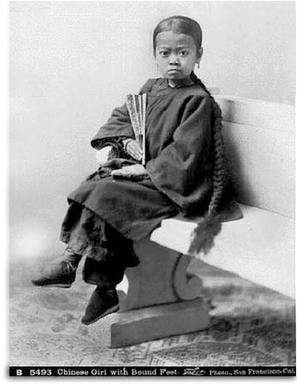
When and Who
3 inches was the ideal
Usually began at age 5 or 6
  Upper-class as early as 3
  Peasantry started as late as 12 or 13
Initial binding performed by mother or grandmother
1/10 girls died from footbinding or its aftereffects

Slide 5
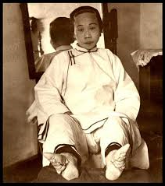
How to Bind a Foot
Women would wash and place alum on the feet, and then cut the toenails.
Bend toes toward plantar with a binding cloth
  10 feet long and 2 inches wide
Girls were forced to walk on them
Washed and rebound after 3 or 4 days
All toes but big one would be pressed against inner surface
When removing bindings, would have to wipe blood and pus

Slide 6
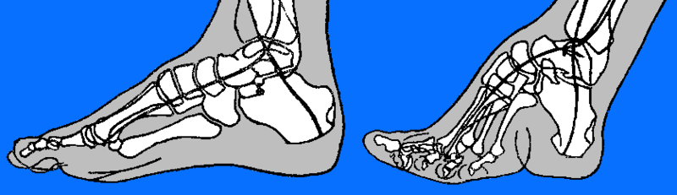
How to Bind a Foot
Remove flesh to make feet slender
Every 2 weeks, change to new shoes
  Each new pair was one- to two-tenths of an inch smaller
Took two years to achieve the 3 inch model
Image by Marco L

Slide 7
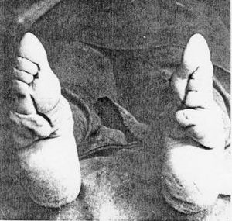
Care of a Bound Foot
Once a week, soak bandaged feet soaked in hot water
Bandages removed, dead skin and calluses rubbed and cut off
Feet perfumed to hide smell
Feet kneaded into desired shape, alum dusted on, and feet quickly rebound

Slide 8
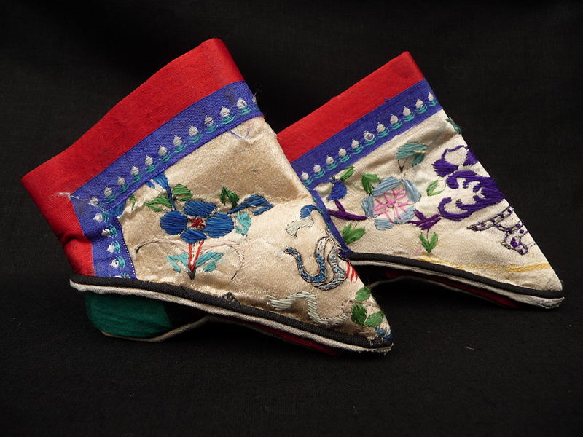
Over the Bandages
Embroidered shoes with one or two inch wooden heels
  Heels helped balance and support the body
Special shoes for special occasions
Ankles were swollen and deformed
  Leggings were fastened above the calf and hung down far enough to show the tiny foot
Photo by Queensland Museum

Slide 9
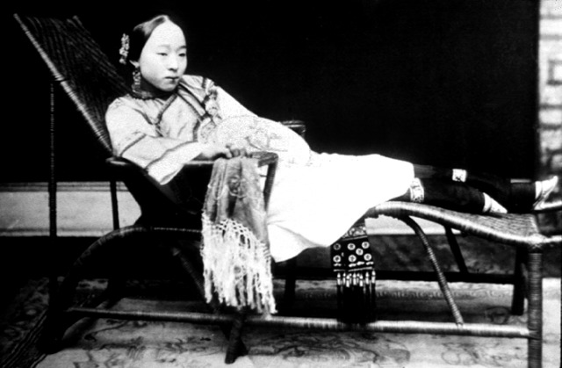
Why Bind Feet?
Aesthetic merit & erotic appeal
Show economic wealth
  “She is useless and expensive, and she is consequently valuable as evidence of {the family’s} pecuniary strength.”
Advantageous marriages
  Family stratifications
    Parents over children
    Males over females

Slide 10
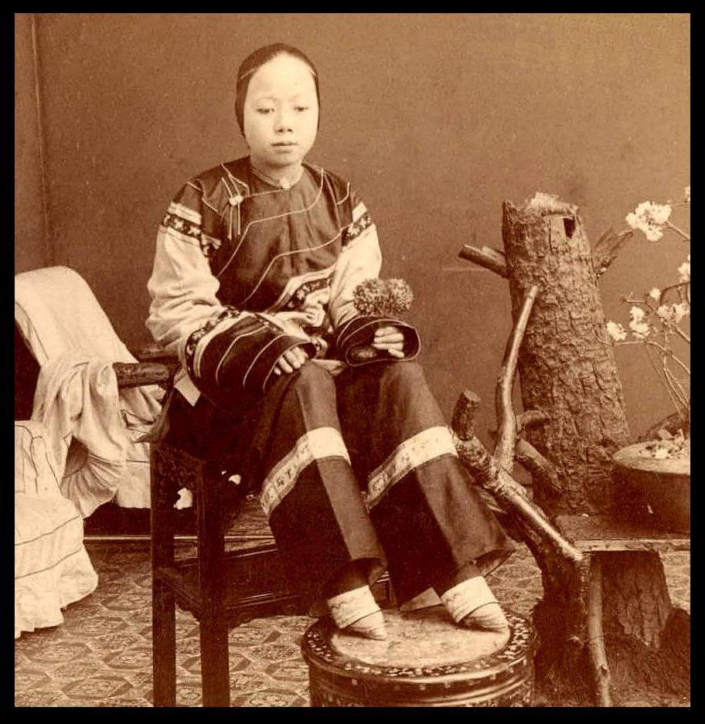
Role in Marriage
Marriage was a way to assure continuity of the patrilineal line
In order to make a daughter marriageable they had to be brought up in strict accordance of correct female behavior
  Three Obediences
  Four Virtues
Women had to follow, no socially acceptable alternative

Slide 11
Three Obediences
Before a woman is married she must obey her father
When married, she must live for her husband
And as a widow she must serve her sons
In Precepts for Women
  2nd Century A.D.
  Nu Chieh

Slide 12
Four Virtues
Woman’s Behavior: chaste and yielding, calm and upright
Woman’s Speech: not talkative, yet agreeable
Woman’s Carriage and Appearance: restrained and exquisite
Woman’s Occupation: handiwork, embroidery.

Slide 13
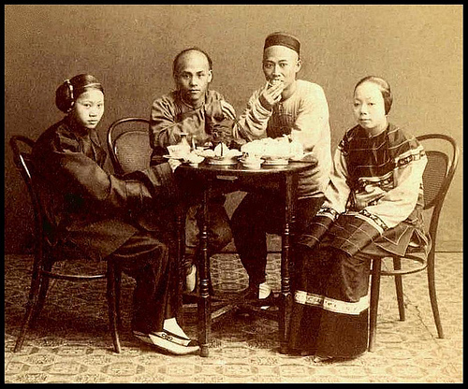
Role in Marriage
Goal of parents was to rear daughter to make best marriage match possible
Advantage of marrying daughter into family of higher status was political
Higher she married, less physical work
Prevented women from becoming disruptive
  Mother-in-law held domestic power
  Wives lived in family compound with husband’s family

Slide 14
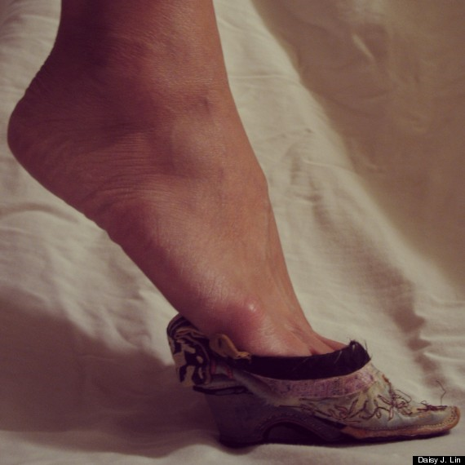
End of Footbinding
Reform did not come from within, came from intrusion of Western imperialism in 19th century
Industrialization creating jobs for women outside of the home
New leaders in 1912 after overthrowing Manchu dynasty passed anti-footbinding decrees

Slide 15
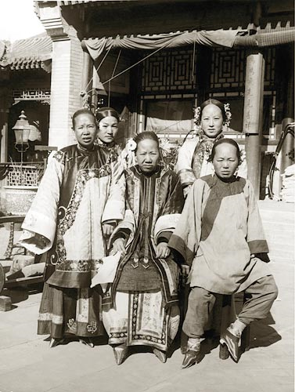
End of Footbinding
1929 survey
  2.3% girls born before 1900 had unbound feet
  95.1% girls born after 1910 had unbound feet
Women who already had bound feet were unlikely to follow laws and unbind their
  Primarily because of the pain and slim chance foot would regaining natural shape

Slide 16
References
Greenhalgh, Susan. “Bound Feet, Hobbled Lives: Women in Old China.” Frontiers: A Journal of Women Studies. Vol. 2, No. 1 (Spring, 1977), pp. 7- 21

