Slide 1



Danmu
汇报人：日语笔译 梁羽彤

Slide 2
01.The Definition of Danmu
02.The Difference from Traditional Online Comments
CONTENTS
03.The Influence of Danmu
04.Conclusion

Slide 3
01.The Definition of Danmu
Danmu, or Danmaku, is a type of comment generated by users on online video platforms, has gained wide popularities in China in recent years.
Danmu originated from the Japanese online video platform Niconico, which is the 34th most-visited website in Japan as of 2021.

Slide 4

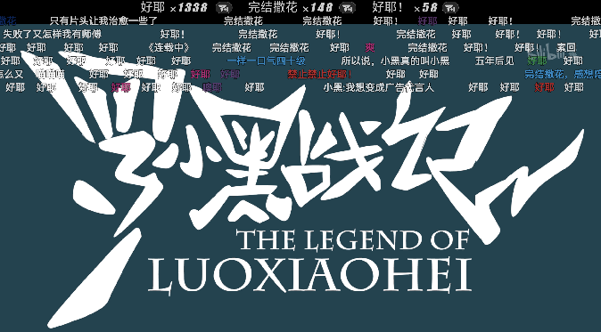
02.The Difference from Traditional Online Comments
1.Traditional online comments placed below the video frame and typically posted by viewers after watching the video.
Danmu comments are displayed as streams of scrolling comments overlaid on the screen and synchronized to the specific playback time at which the users sent the comments, moving horizontally from right to left.

Slide 5
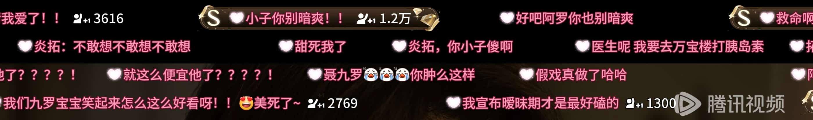
02.The Difference from Traditional Online Comments
2.Danmu comments serve as more than just viewer feedback on video content, they also provide real-time background knowledge extensions that sync with the video, and even some Danmu comments interact among themselves.
Users can type in special symbols with different font colors, and other elements to create graphic-like content, thereby expressing their thoughts more vividly.

Slide 6
03.The Influence of Danmu
1. Danmu culture creats a virtual online community. A virtual community is a cyberspace that focuses on communication and integration, creating content centered around community members and fostering interpersonal relationships.
make online video - watching more like a collective social activity
enable video creators to receive audience feedback faster
promote the diversification of community viewpoints
help promote the video content

Slide 7
03.The Influence of Danmu
2. the bad influence of danmu comments
distinguishing between reliable and unreliable information becomes more difficult
harmful danmu might already cause psychological harm to users before being screened and removed
excessively dense danmu or those with varying colors and fonts can block parts of the video,disrupting the viewing experience
may lead to information overload and increase the cognitive burden during viewing

Slide 8

04.Conclusion
Danmu, as a unique type of online comment created by users and platforms, is playing an increasing important role in Chinese online culture. With its deep adoption by most major online video platforms in China, it will adapt itself as the ever evolving society. It can be utilized as an effective indicator of our online culture, and to serve us in our culture lives.

Slide 9



x
Thanks
图片来源
腾讯视频、bilibili
文本来源
课本、deepseek

