Slide 1
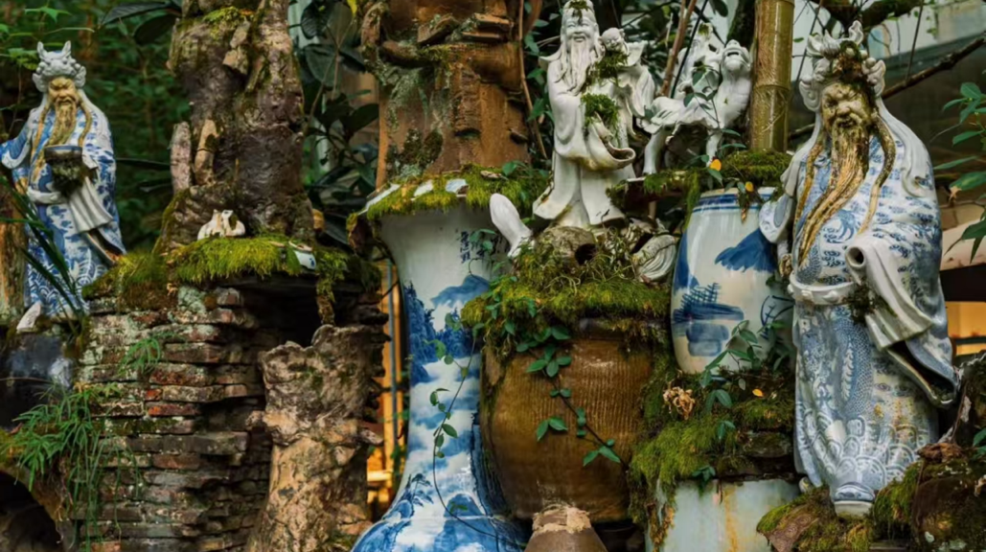
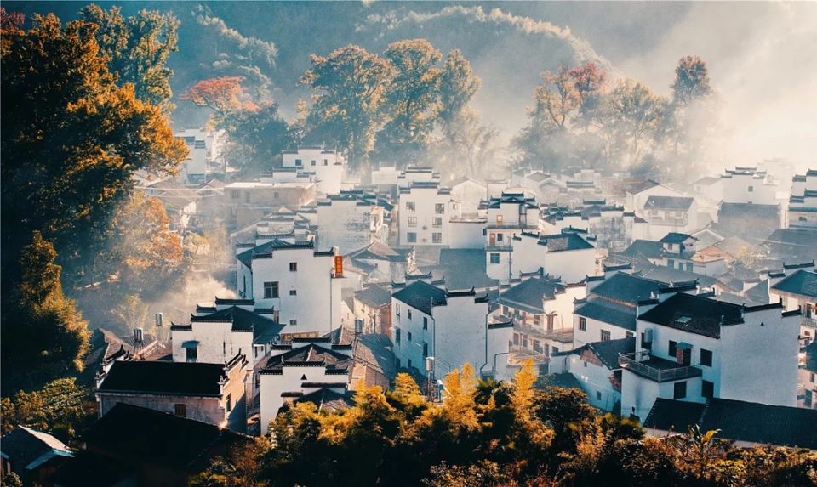
4
Four Famous Porcelains

Slide 2
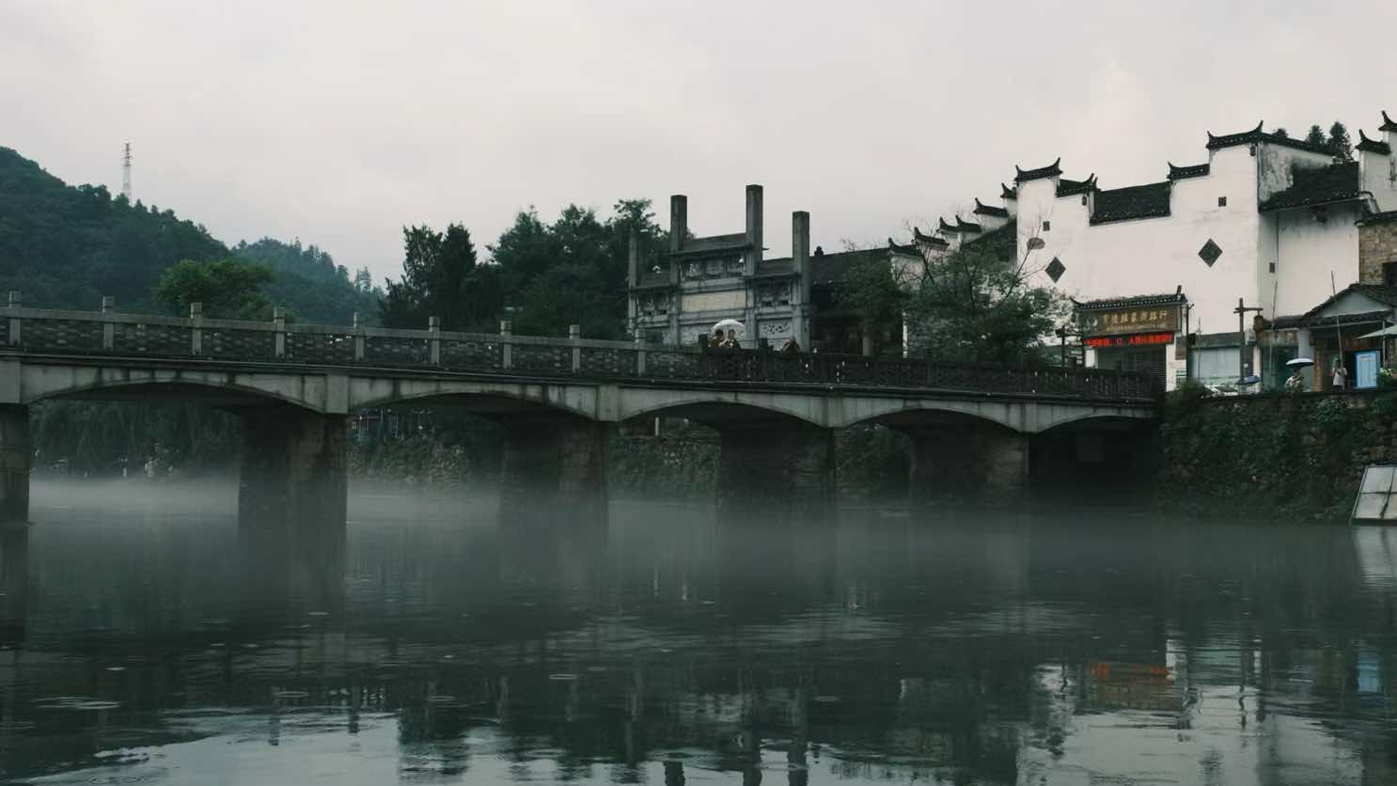
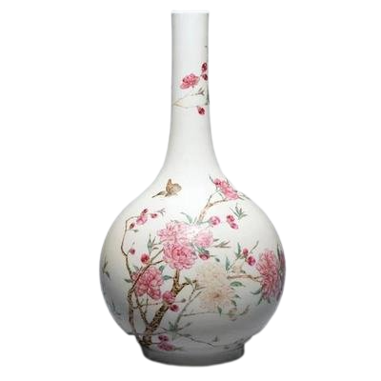
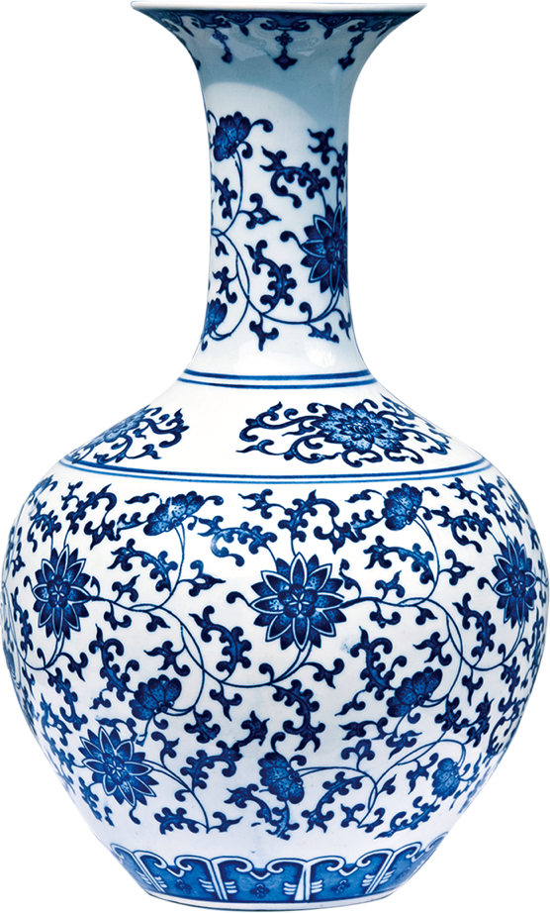
4
Four Famous Porcelains
Blue-and-white porcelain
（青花瓷）
Famille-rose porcelain
（粉彩瓷）
Blue-and-white porcelain is the most representative type of Jingdezhen porcelain, belonging to the category of underglaze-colored（釉下彩） ceramics. Primitive forms of blue-and-white porcelain emerged during the Tang and Song Dynasties, while mature blue-and-white porcelain first appeared in the Yuan Dynasty at the Hutian Kiln in Jingdezhen.
During the Yuan and Ming Dynasties, many derivative varieties were developed and exported worldwide, reaching their peak in the Qing Dynasty. Its thin, translucent body and exotic motifs made it highly valuable in Europe.
Famille-rose porcelain is a new variety created in the late Kangxi period, based on the existing five-color porcelain and influenced by the production techniques of enameling (搪瓷). Emperor Yongzheng had a particular fondness for famille-rose porcelain, which led to the prevalence of “Yongzheng Famille-Rose Porcelain.”

Slide 3
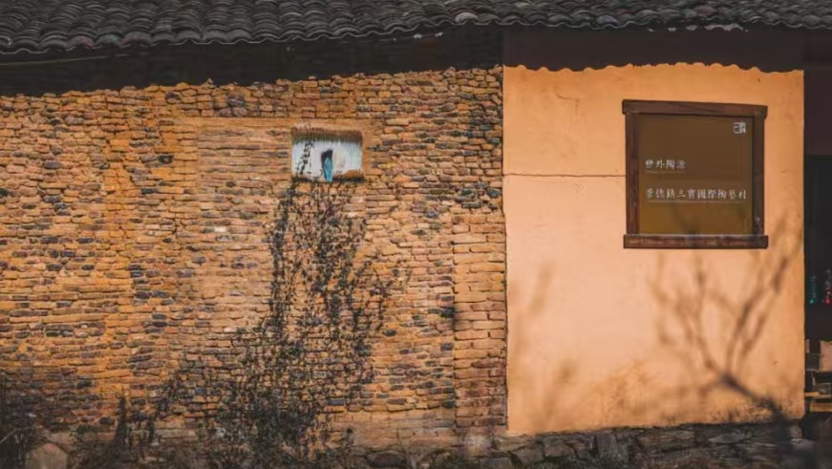
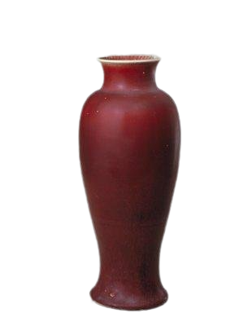
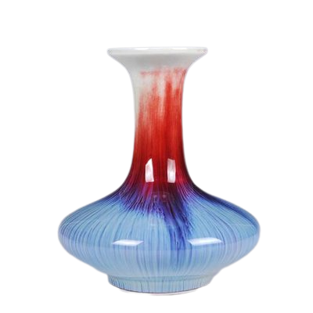
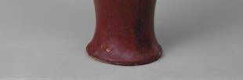
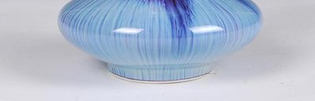
4
Four Famous Porcelains
Color-glazed porcelain
（颜色釉）
Color-glazed porcelain is known as “man-made gems” and is generally divided into the following categories: blue, crimson, black, white, yellow, green, and blue-and-white glaze, with each color further subdivided into specific types.

Slide 4
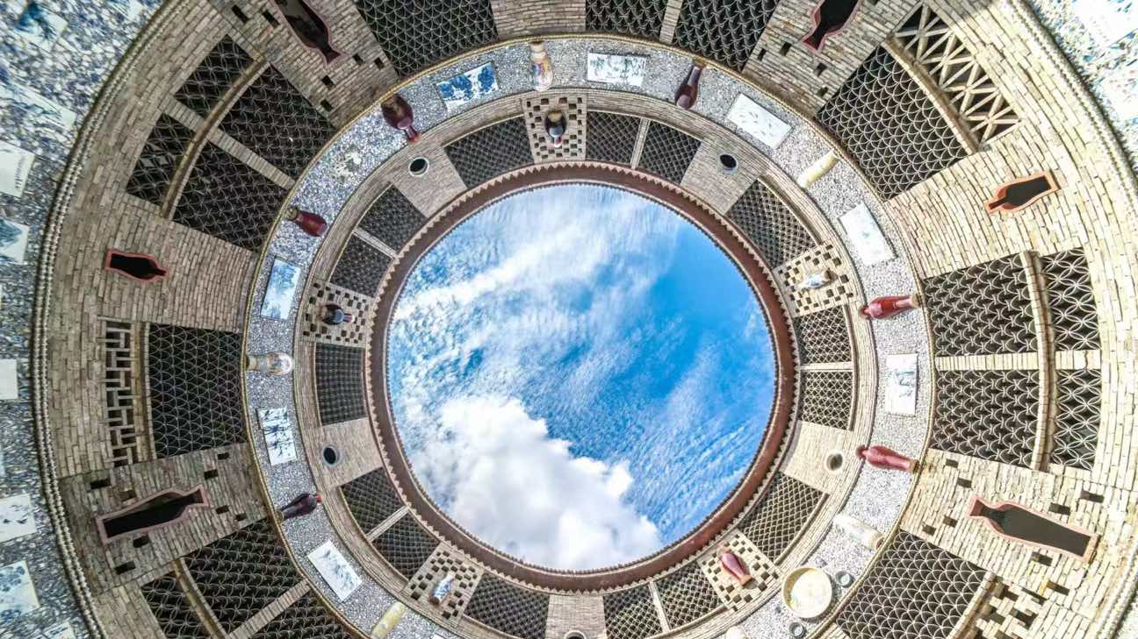
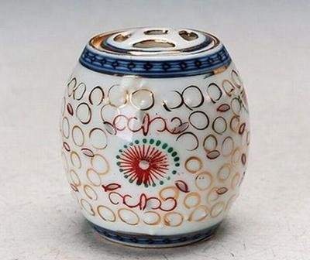
4
Four Famous Porcelains
Linglong porcelain
玲珑瓷
Linglong porcelain developed during the Xuande reign of the Ming Dynasty and is renowned for its reputation as “porcelain inlaid with glass (琉璃镶瓷)”. It is famous for its exquisite carved patterns and translucent beauty. Characterized by perforated decoration（穿孔装饰）, it was later combined with blue-and-white techniques during the Qing Dynasty, resulting in the creation of Blue-and-white Linglong porcelain.

Slide 5
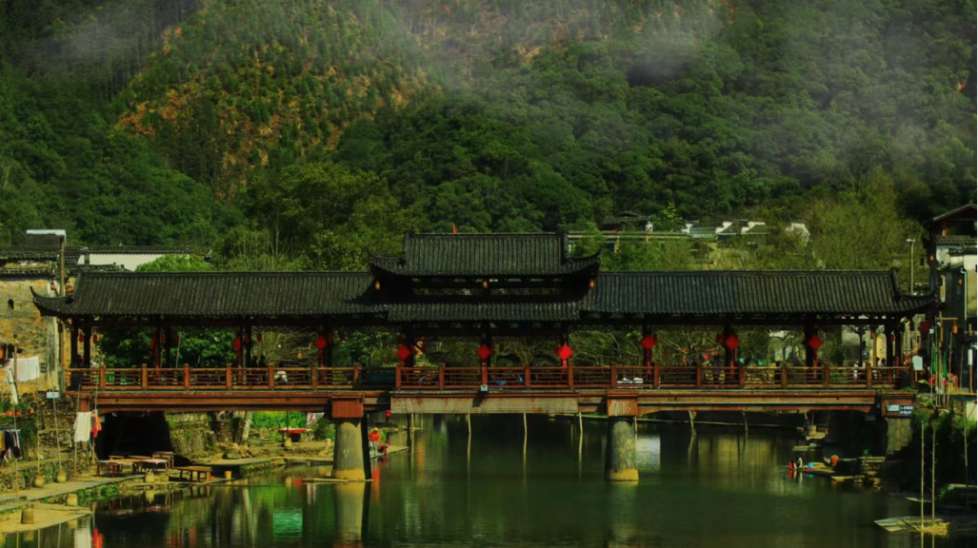
5
Famous Tourist Attarctions

Slide 6
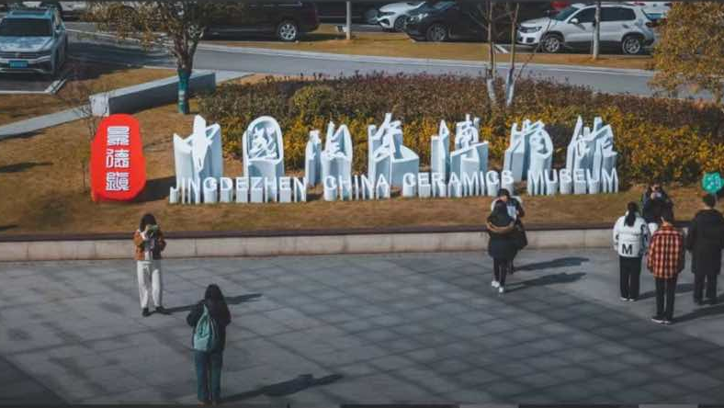
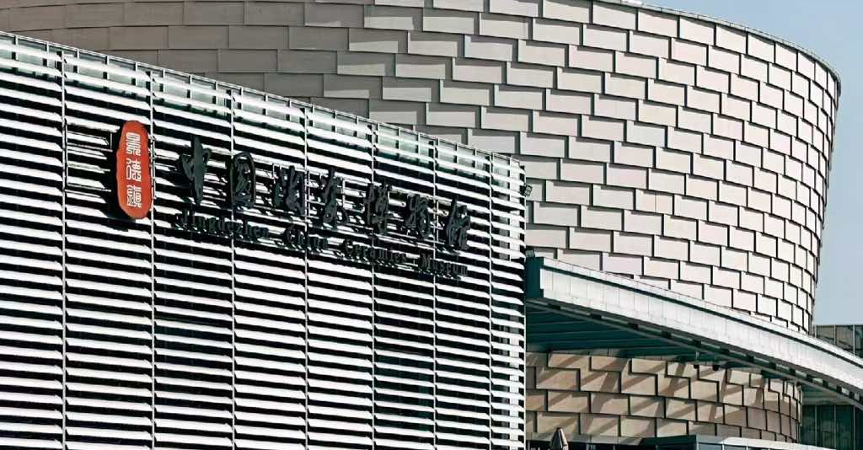
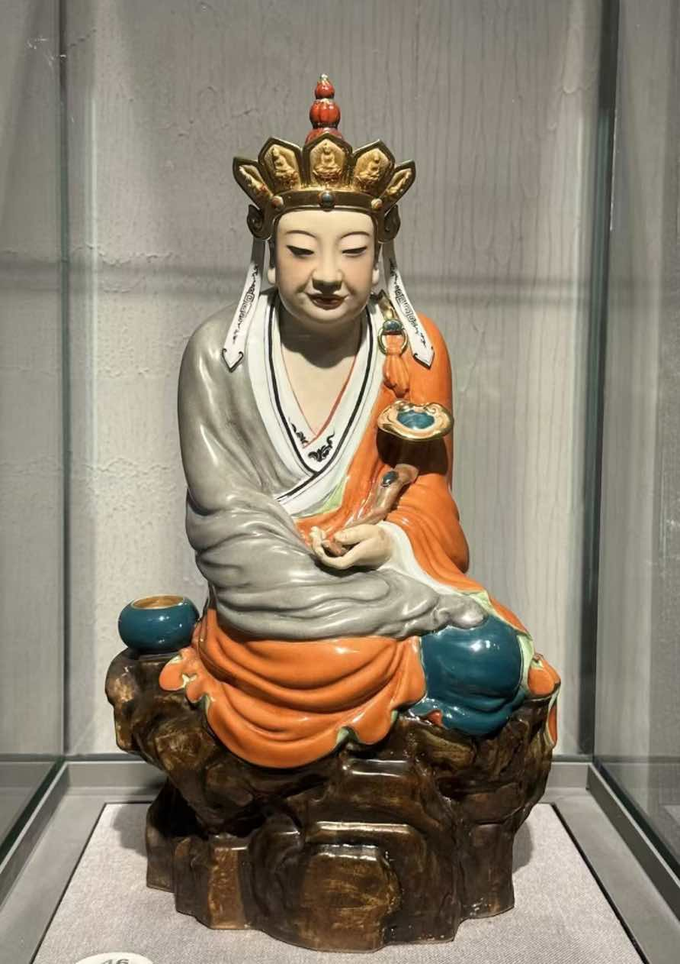
5
Famous Tourist Attractions
1. Jingdezhen China Ceramics Museum
Stepping into the museum feels like traveling through a time tunnel, showcasing ceramic artworks from various historical periods. Among the highlights is the“Spechless Buddha”, which draws numerous visitors.

Slide 7
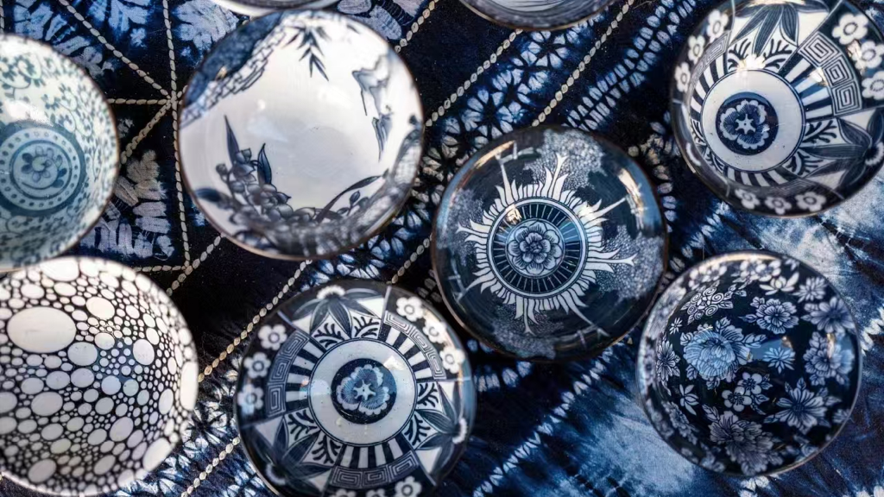
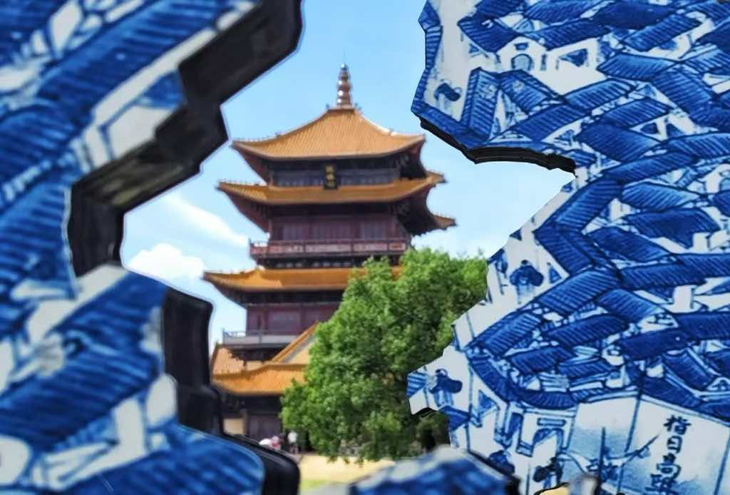
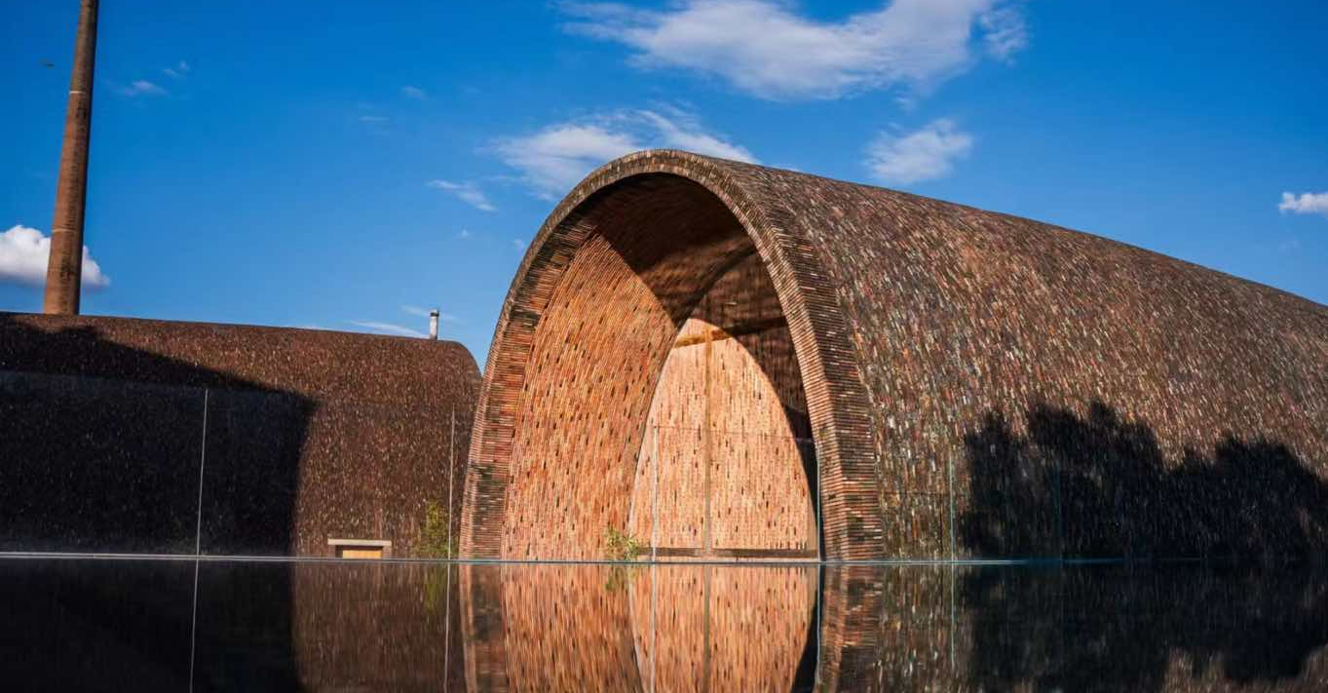
5
Famous Tourist Attractions
2. Imperial Kiln National Archaeological Remains Park
景德镇御窑厂国家考古遗址公园
In the early Ming Dynasty, the Imperial Kiln was established in Jingdezhen, marking the beginning of inscribing the emperor’s reign marks (年号) on imperial porcelain. So here gathered the finest ceramic artisans and craftsmen from Jingdezhen throughout history. Although it produced porcelain only for the emperor, it also contributed to the creation of numerous treasures in Chinese porcelain culture. While many of them were lost overseas, a large number of rare ceramic artifacts are preserved in the Palace Museum and are showcased to visitors from both China and abroad.

Slide 8
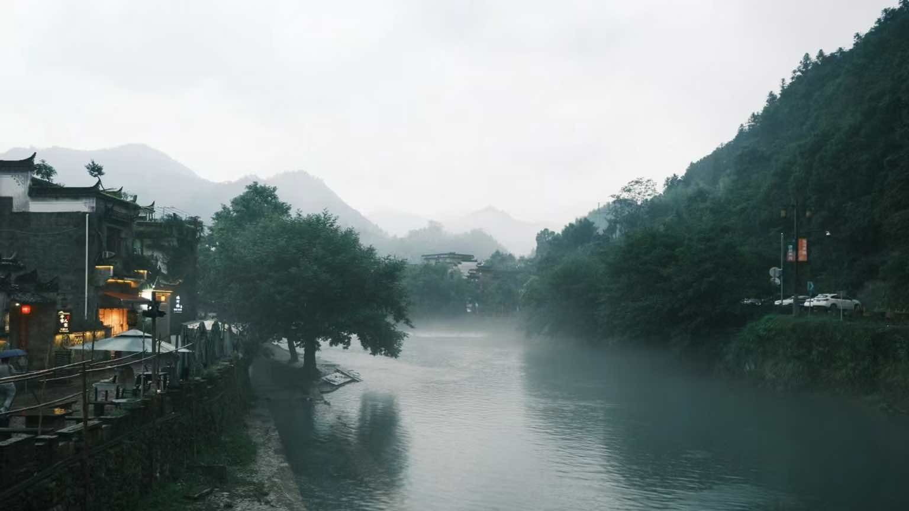
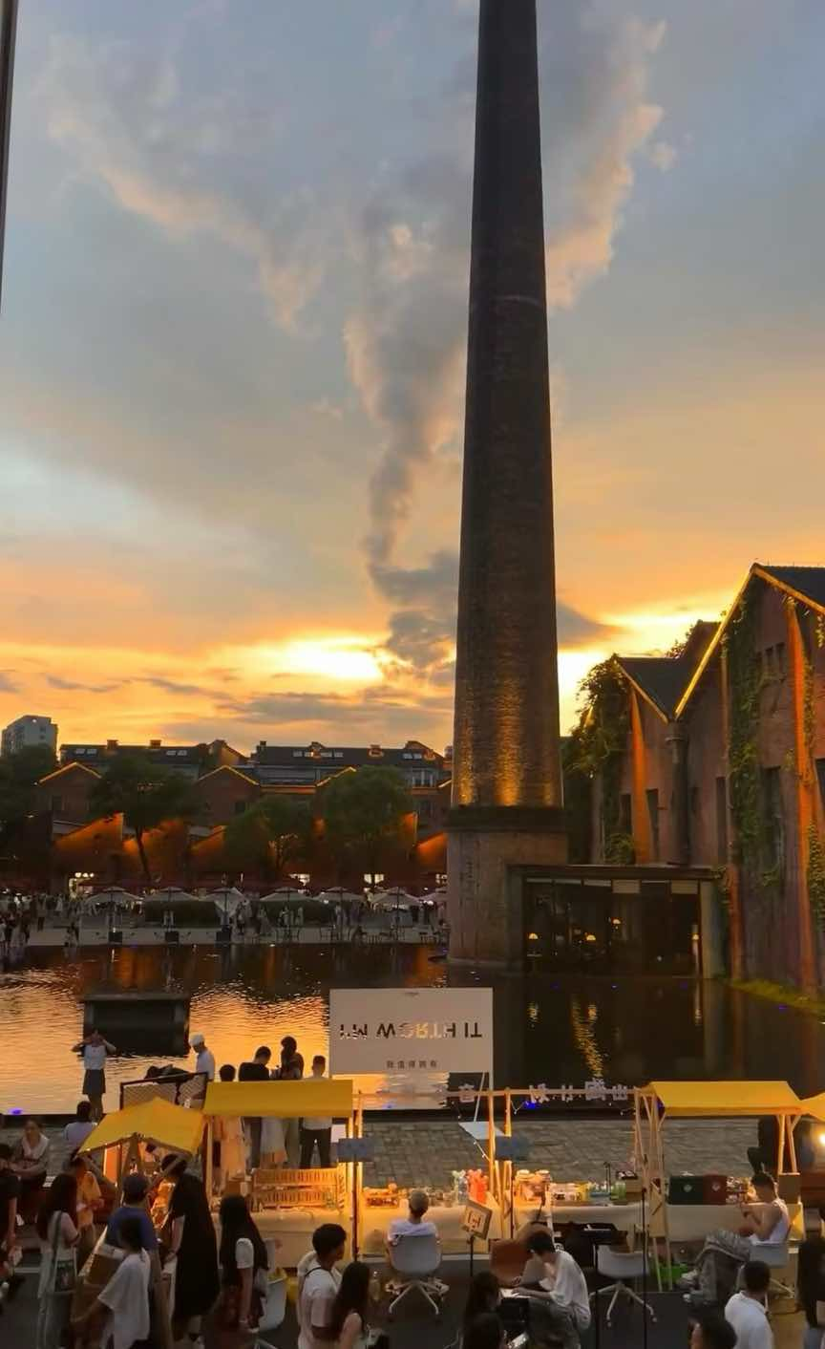
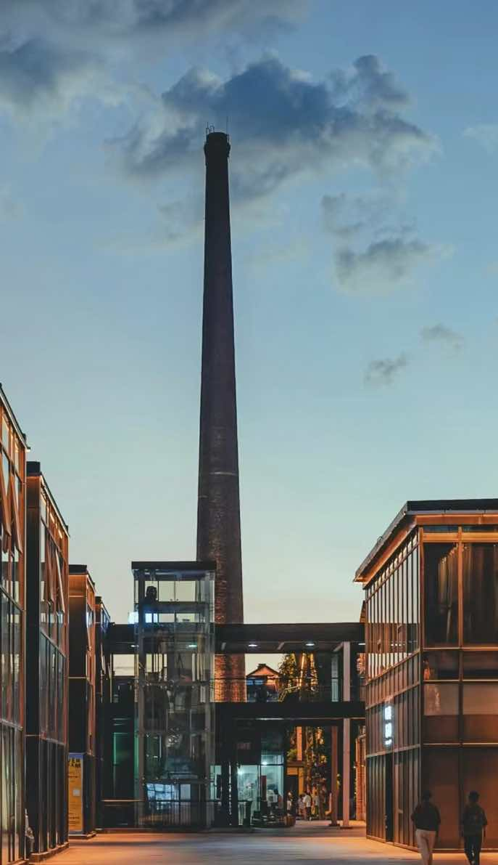
5
Famous Tourist Attractions
3. Taoxichuan Ceramic Art Avenue（陶溪川）
Taoxichuan is a cultural and creative park in Jingdezhen, transformed from an old ceramics factory and integrated with modern art. The park retains 22 old factory buildings, including kilns and chimneys, which have been rebuilt into museums, art galleries and ceramic experience spaces. Additionally, the park also hosts art exhibitions, cultural exchange events, and markets, attracting numerous art enthusiasts and visitors.

Slide 9
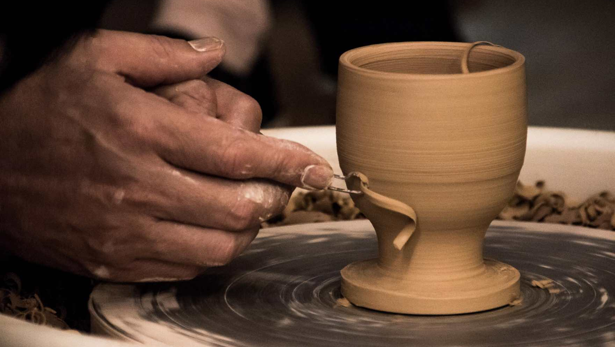
Q1:
What are the four characteristics of Jingdezhen porcelain?

Slide 10
Q2:
What are the four famous porcelain in Jingdezhen?

Slide 11
Q3:
Where did the “Speechless Buddha” meme come from？

Slide 12
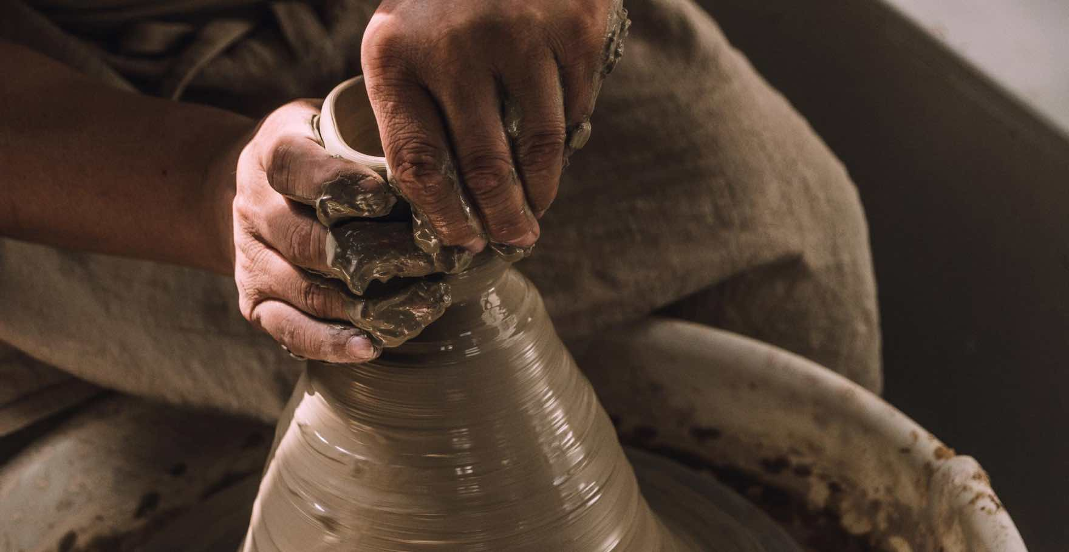
Thanks!

