Slide 1
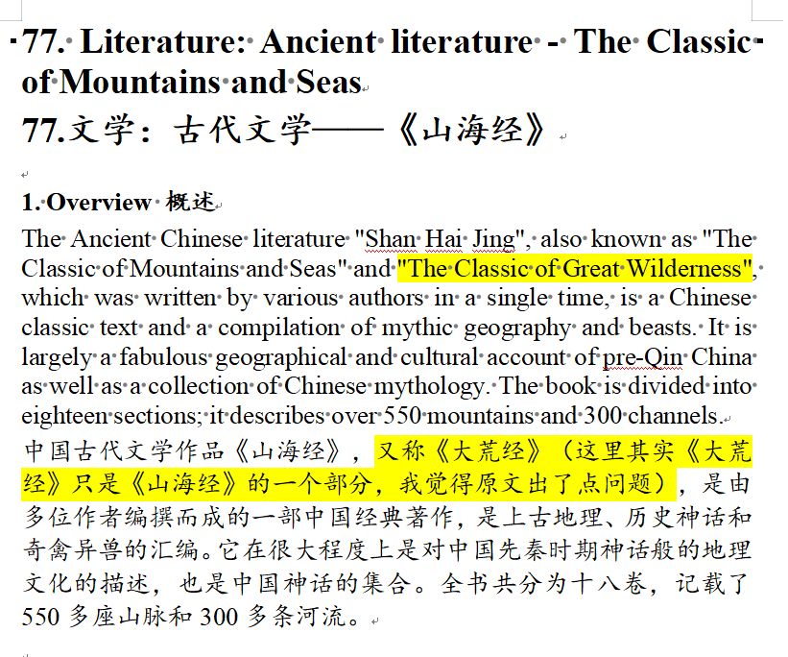
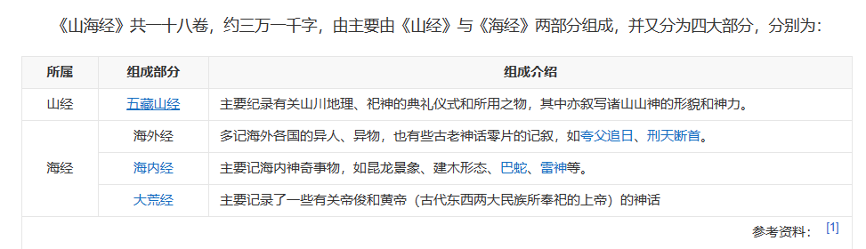

Slide 2
The Bible and The Classic of Mountains and Seas
The same history
from different perspectives?
罗嘉怡
Notes:
模板来自于： 第一PPT https://www.1ppt.com/

Slide 3
References written at the frist
1.引用了部分胡适、刘师培的观点
2.[罗志田]《山海经》与近代中国史学——中国民俗学网 2011-04-12
3.朱大可. 破碎的中国上古神系[J]. 文艺理论研究, 2013, 33 (01): 192-201.
4.朱大可.从《山海经》看上古神话的若干真相[J].文艺争鸣,2011(14):129-132.
5.朱大可其它书作的部分观点
6.一些图片和文字描述来自百度和being

Slide 4
行业PPT模板http://www.1ppt.com/hangye/
1.
伊甸园 与 昆仑山
The Garden of Eden and Kunlun Mountain
2.
亚当夏娃 与 伏羲女娲
Adam and Eve and Fuxi and Nuwa
3.
巴别塔 与 虚见木
The Tower of Babel and Xujianmu
4.
诺亚方舟 与 大禹治水
The Garden of Eden and Kunlun Mountain

Slide 5
伊甸园 与 昆仑山
The Garden of Eden and Kunlun Mountain
Part
1

Slide 6
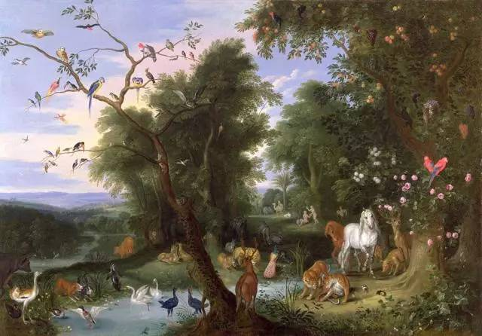
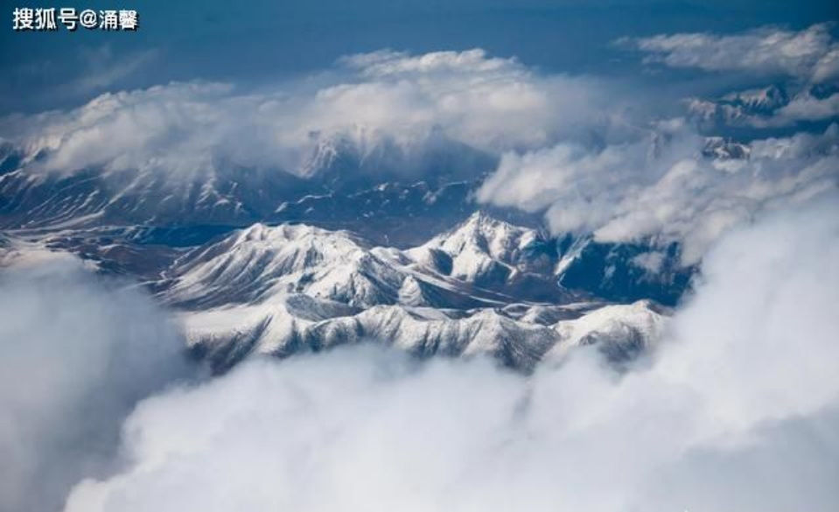
《圣经》中记载伊甸园在东方，有四条河从伊甸之地流出并滋润园里。现在有说法认为是幼发拉底河 、 底格里斯河 、基训河和比逊河 。
《山海经》记载，在西海的南边有座山，是众神生活的地方，位于赤水，黑水，洋水，弱水四水（说法有争议）之间。
The Bible records that the Garden of Eden was in the east, and that four rivers flowed from the land of Eden and nourished the garden. It is now thought to be the Euphrates, Tigris, Gihon, and Bison rivers.
According to The Classic of Mountains and Seas, there is a mountain in the south of the West Sea, where the gods live, located between the four rivers of Chi river, Hei river, Yang river, and Ruo river .

Slide 7
亚当夏娃 与 伏羲女娲
Adam and Eve and Fuxi and Nuwa
Part
2

Slide 8
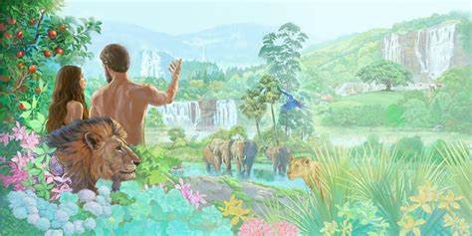
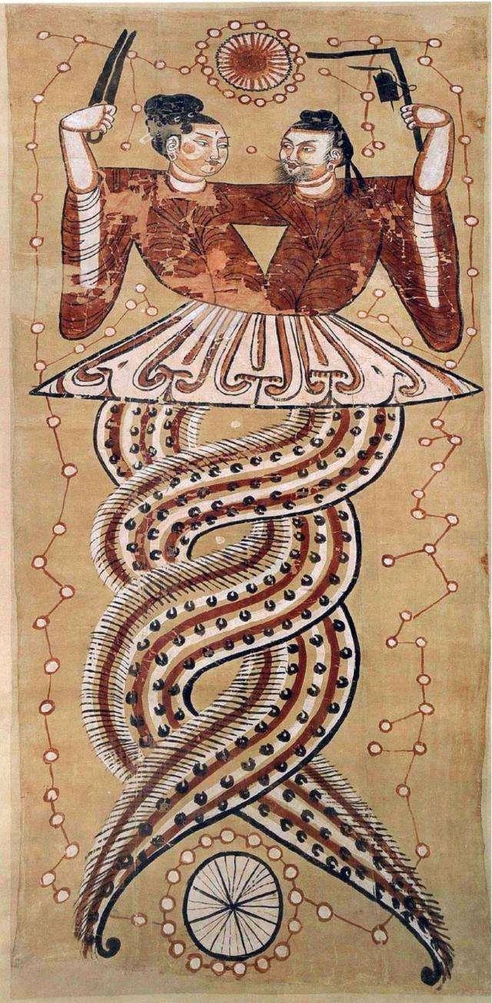
Snake?
Sibling?
couples?
human ancestors?
Like DNA
《圣经》中描述，神按照自己的形象创造出了亚当，又用亚当的肋骨创造出了一个女人——夏娃。他们在蛇的诱惑下偷吃禁果，被逐出伊甸园，成为人类祖先。
《山海经》中则讲述了伏羲和女娲的故事，伏羲的形象是人首蛇身，是创世神，与女娲是兄妹，也是夫妻，而他们创造出了人类。
Coincidence?
Same story?
In the Bible, God created Adam in His own image and created a woman, Eve, out of Adam's rib. They were tempted by the snake to eat the forbidden fruit and were expelled from the Garden of Eden , finally become human ancestors.
The Classic of Mountains and Seas tells the story of Fuxi and Nuwa, and the image of Fuxi is a human head and a snake tail. He is the creator god and Nuwa is his sister. They are also couples, and they created humans.

Slide 9
巴别塔 与 虚见木
The Tower of Babel and Buzhou Mountain
Part
3

Slide 10
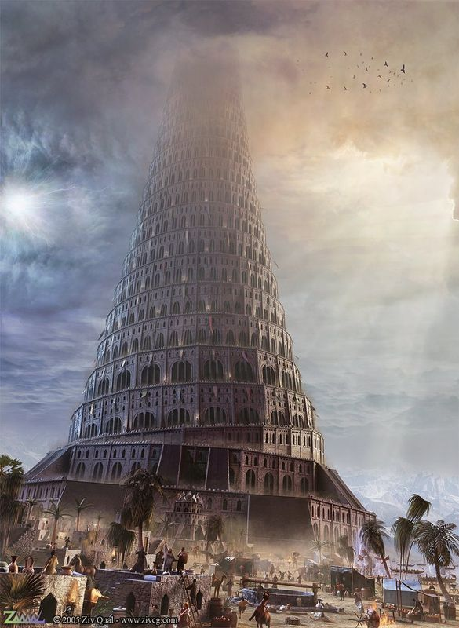
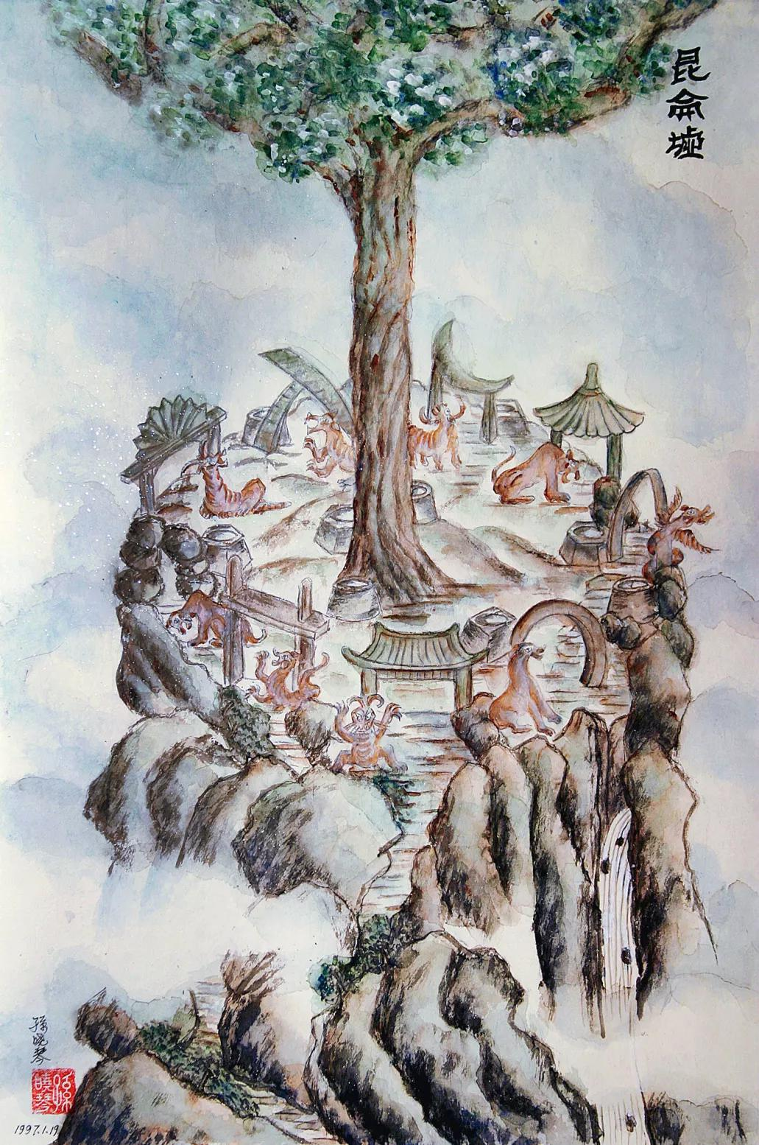
《圣经》记载，当时人类联合起来兴建希望能通往天堂的高塔，与神对话；后来由于人类贪得无厌，上帝迫使人类停止了巴别塔的建造。
而在《山海经》中，人能通过昆仑虚见木抵达天界，与神沟通，但后来因为人类盗取天界宝物，于是这条通天的阶梯就被阻断了。
The Bible records that when mankind united to build a tower that hoped to lead to heaven and talk with God, God forced mankind to stop the construction of the Tower of Babel because of human greed.
In the Classic of Mountains and Seas, people can reach heaven through Kunlun Xujianmu and communicate with God, but later because humans stole the treasures of heaven, this stairway to heaven was blocked.

Slide 11
诺亚方舟 与 大禹治水
The Garden of Eden and Kunlun Mountain
Part
4

Slide 12
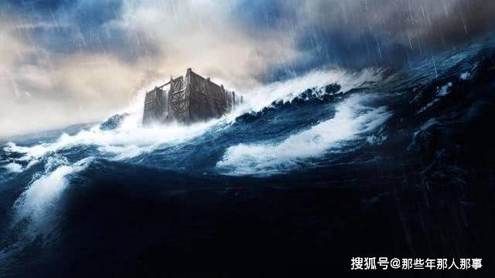
史前大洪水
Prehistoric flood
史前大洪水，一说是指史前时代地球突然被来历不明的海啸包围，强而有力的洪水，使高山在波涛中颤抖，陆地在巨变中呻吟，以雷霆万钧之势，咆哮着冲向陆地，吞没了城市谷地，以及地球上的所有生灵，一说有可能是上一次冰川融化导致的海平面上升。有人认为是人类传讹附会的记忆，也有人认为是千真万确的事实。孰是孰非，千百年来仍无定论。

Slide 13
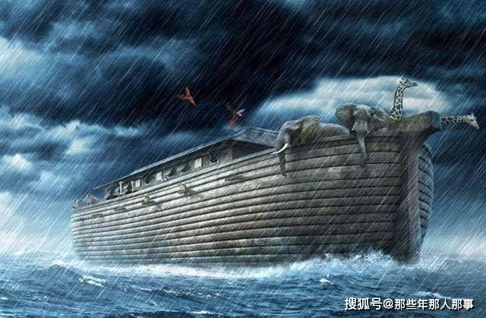
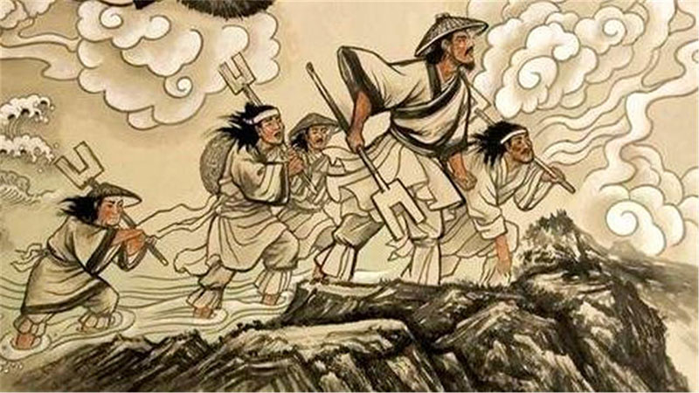
《圣经》中记载，上帝因为看见人世间罪恶遍地，人们都在为了一己私欲而犯罪，整个人间已经无药可救。为此他降下洪水淹没世间一切，只通知了一个诺亚的人，让他打造大船，并把世上每种生物都至少留下一个，以保证生命的延续。
而同样在《山海经》中也有关于大洪水的记录，海内西经中记载当时洪水滔天，滚滚熙攘以咽洪水。这也就是我们后世所说的大禹治水。
Coincidence?
Same story?
According to the Bible, God saw that the world was full of sin and that people were sinning for their own selfish desires, and that there was no cure for the whole world. For this reason, he sent a flood to flood everything in the world, and only informed a man named Noah, asking him to build a large ship, and to leave at least one of every living thing in the world to ensure the continuation of life.
And there is also a record of the great flood in the Classic of Mountains and Seas, when the flood was raging, and a person named Dayu was ordered to deal with it. This is what we later called Dayu to control the water.

Slide 14
洪水记载
40天
天罚
英雄
值得注意的是，不只是信奉圣经的希伯来文明还是我们的华夏文明，甚至包括美索不达米亚平原的苏美尔文明，南美洲的玛雅文明，中国台湾的阿美族文明和泰雅族文明以及北美的印第安文明，甚至古希腊文明，均有关于大洪水的记载。
《圣经》和《山海经》都记载了发生于4000多年前的一场大洪水。《圣经》中表示：“洪水在地泛滥40昼夜，水往上涨，把方舟从地漂起。”《山海经》则讲到伏羲在木头上刻字，记述了洪水持续的时间，一共是40道。
《圣经》和《山海经》都认为洪水是上天的惩罚。
大禹治水与诺亚方舟。

Slide 15
当然，这两本书也不仅仅只讲到这些事情。《山海经》和《圣经》中所涵盖的内容都非常丰富，有所同也有所不同。
Of course, these two books don't just talk about these things. Both the Classic of Mountains and Seas and the Bible cover a wealth of content, with similarities and differences.
做出这个猜想的胡适，朱大可教授等人认为，《山海经》与《圣经》中之所以有这么多类似的地方，是因为它们的故事都有一个母版。而这个母版，就是最初由非洲的那些人及其后代创造出来的。后来随着他们走出非洲，走向全球，其神话也传播到了世界各地。再后来，不同地区的人类对这些母版进行了再加工，这才有了如今这些多姿多彩的神话故事。
Hu Shi, Professor Zhu Dake and others who made this conjecture believe that the reason why there are so many similarities between the Classic of Mountains and Seas and the Bible is that their stories have a master. And this master was originally created by those in Africa and their descendants. Later, as they went out of Africa and into the world, their myths spread around the world. Later, people in different regions reworked these masters, which gave rise to these colorful myths and stories.
summary
然而不可否认的是上古时期的人类确实有着很多相似的记忆，这其中蕴含着我们至今仍无法理解的人类起源之谜。人类的进程也许并没有那么简单。
However, it is undeniable that humans in ancient times did have many similar memories, which contain mysteries of human origins that we still cannot understand.The human process may not be so simple.

Slide 16
Thanks for your listening！

